Slide 1
Health Design Thinking

Slide 2
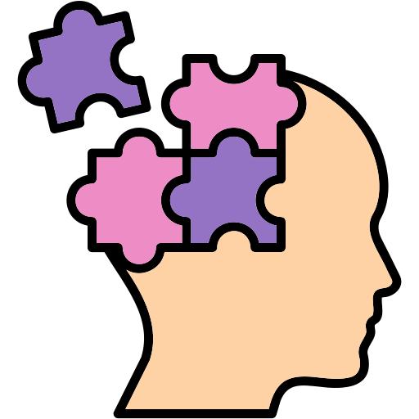
Health design thinking
Health design thinking: approach to generate creative ideas and solutions that enhance human well-being in the context of medicine
Health design thinking is an open mindset rather than a rigid methodology
It aims at improving patient care
Any stakeholder can participate in this process

Slide 3

Principles
Health design thinking is based on two core principles
Human-centered
Creative mindset

Slide 4

Principles: Human-centered
Human-centered means that designing a new «thing» starts with the needs and desires of people rathen than with a business proposition or an artistic idea.
Human-centered means inclusive and collaborative
The final users must be active participants and creators of knowledge, not just passive subjects to be measured and manipulated

Slide 5
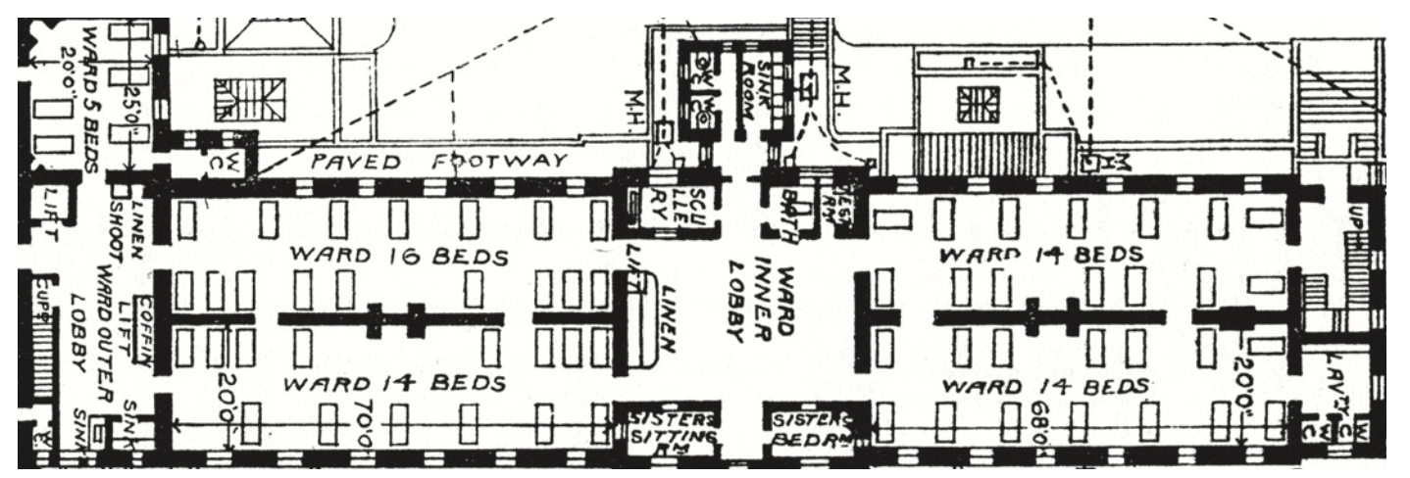
Example: Designing an hospital
The London Hospital (1752) design maximized patient density and visibility at the expense of privacy and comfort
Not human-centered

Slide 6
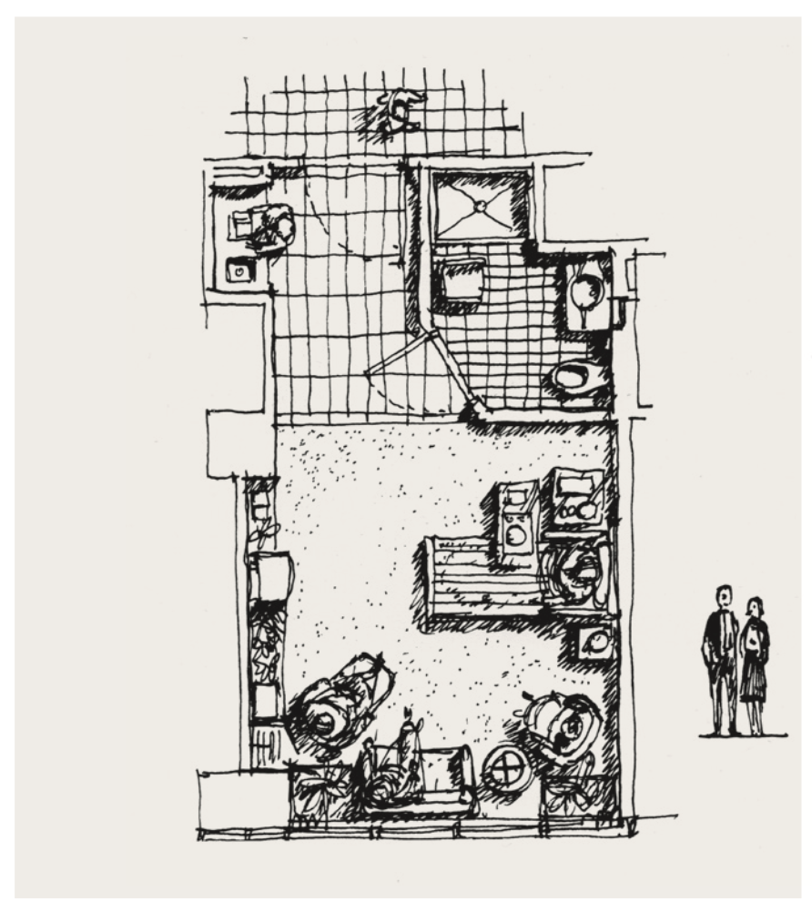
Example: Designing an hospital
This sketch of a patient room, by architect Earl S. Swensson, considered the needs of many users, including the patients, family, members, nurses, and caregivers.
Human-centered

Slide 7
Human-centered approaches/concepts
Human-centered design can be applied leveraging three core approaches/concepts:
Empathy
Codesign
Social determinants

Slide 8

Empathy
Empathy is the ability to share in the experience of another creature and communicate that understanding
The designer must adopt the final user/patient point-of-view and become the user
A good way to do that could be try out a task that the user have to do, e.g.:
Find your way through an hospital without asking questions
Stay overnight in an inpatient bed and get your vitals checked every 4 hours
Test your blood sugar three times a day
…

Slide 9
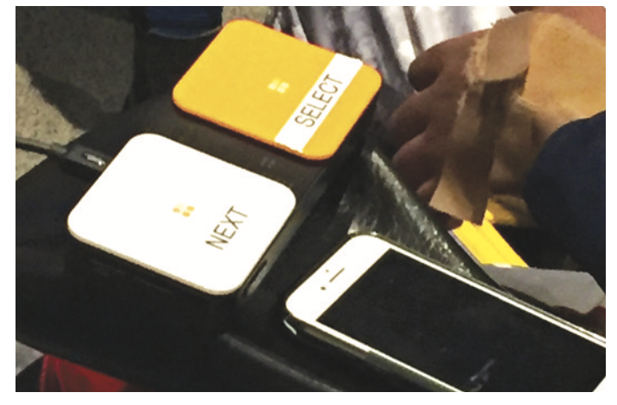
Codesign
Codesign is a collaborative process that actively seeks knowledge and ideas from end-users
It allows to inject user expertise into the design process
Tools for codesign include:
User interviews
Journey maps
Questionnaires
Brainstorming sessions

Slide 10

Social determinants
Society places a tremendous burden on individuals to safeguard their health:
Having an healthy lifestyle is not easy
Health, like wealth, is distributed unevenly and depends on social determinants like food, housing, education…
Many social determinants are connected to design of our environment:
Cars and elevators over sidewalks and stairways promote sedentism
Cigarettes and processed foods contribute to chronic diseases
Rural areas lack clinical facilities

Slide 11

Social determinants: Health Factors mapping
Allergens
Risky behaviours
Pollution
Physical environment
Sleep pattern
Location
Body functions
Diet pattern
Genetics and biology
Individual behaviour
Body structure
Drug use
Genetic
Patient engagement
Social circumstances
Medical care
Access to healthcare
Gender identity
Work
Ethnicity
Quality of healthcare
Education

Slide 12
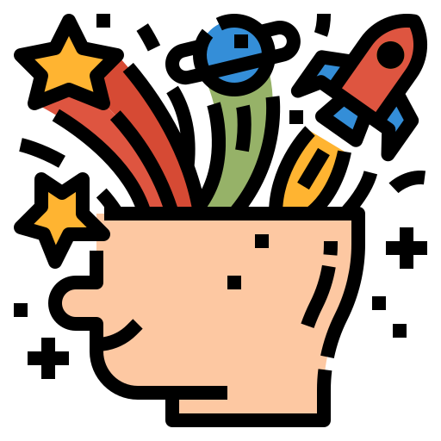
Principles: Creative mindset
Creative mindset means that designing a new «thing» should favor open-ended exploration over a straight path headed toward a given outcome
Few basic concepts guide the process of generating ideas and making them concrete:
Questioning: the act of looking at any problem from a new angle. It is the process of asking questions and reframing assumptions: “How this could be different?”
Visualizing: the ability of perceiving objects, spaces, and patterns.
Prototyping: the act of making ideas concrete in a provisional, speculative way.
Storytelling: the art of recounting a significant action that take place over time.

Slide 13
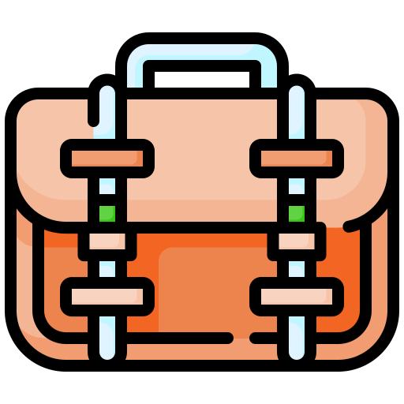
Methods
How to put health design principles in practice? What are the tools in our belt?
Many methods can help us, including:
Design workshop
Brainstorming
Interview
Storyboard
Questionnaires
Persona
Journey map

Slide 14
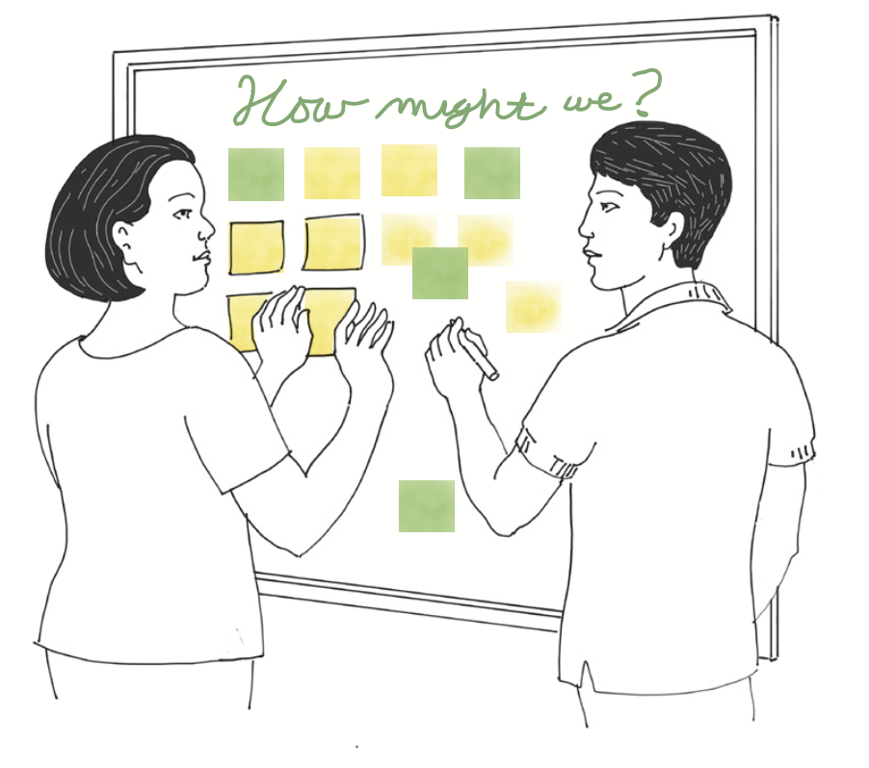
Design workshop
A design workshop is a structured series of activities that primes people and stakeholders to think creatively, share ideas, and make those ideas concrete through project boards and prototypes
Planning a design workshop:
Set the workshop challenge
Create an agenda
Set a time constraint
Decide who to invite (including real users)
Interview stakeholders to gain insights from their expertise
Identify a user whose experience you hope to improve
Develop a prototype
Share what you learnt and what is your solution

Slide 15
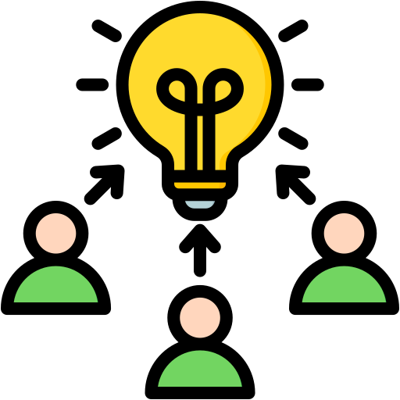
Brainstorming
Brainstorming can be fundamental to think out-of-the-box
Typically, a moderator asks ideas to a group and writes them down on sticky notes or whiteboards
Everything should be written down
It is important that each participant shares some ideas
At the end, ideas are collected, sorted, discarded and combined.

Slide 16
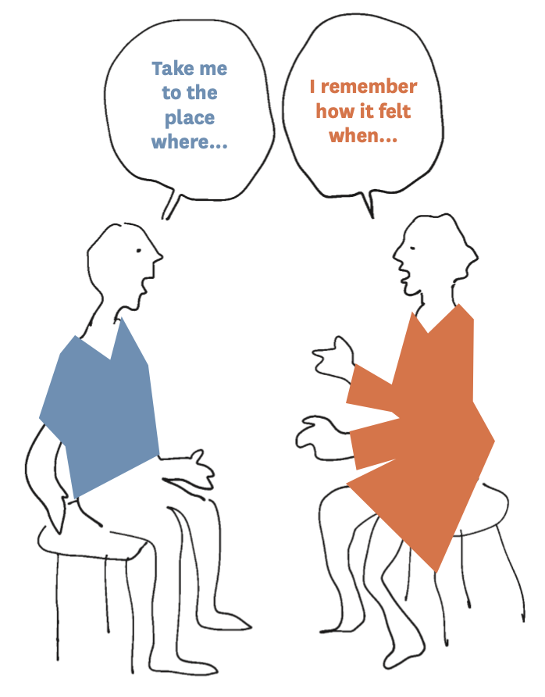
Interviews
Interviewing patients and other users is one of the most powerful tool of health design
Remember: Patients might have very different, divergent perspectives, e.g.: a patient can be super compliant to the therapy, the other not.
In an interview, power imbalance can make participants less forthright, e.g., a patient will not tell a doctor that he/she did not follow the therapy and/or that the proposed designed solution is not good.
Different users might mean very different needs

Slide 17
Interviews: Limits
Users can misunderstand a question and/or the problem
People overemphasize daily annoyance over systemic problems
In health care, people have incomplete pictures of their own situation, e.g., seeing a doctor while in hospital might be hard because of personnel shortage rather than his/her disinterest
Prior experiences might heavily bias answers

Slide 18
Interviews: Asking better questions
Open-ended questions rather than yes-no questions
Once an area of interest is found, ask follow-up questions that probe other details
Uncover unmet needs with a hypothetical questions: “If I had a magic wand that fixes everything, which one would you choose first?”
Saying “I’m curious about…” or “Help me understand why…” rather than just “Why?” is less judgemental and confrontational

Slide 19
Interviews: Conducting a user interview
Find a place that will feel comfortable and familiar
Create a psychological space that is welcoming and safe. To do this frame the interview as a favor to the interviewer and never judge.
As the interviewer, listen more than you talk. Do not rush to fill pauses. Do not complete answers. Give time to answer.
Use a recording device so that you can give full attention to the user
Have people outside your field of expertise review your questions so that the lexicon is clear for everybody

Slide 20

Storyboard
Storyboard consists of a few pictures or sketches with notes that explain the action.
Filmmakers use storyboards to plan the visual flow of a movie. Designers use them to plan the interactive use of a product or service
In a design workshop setting, participants can sketch on sheets of paper that have been pre-printed with four to six boxes.
Usually, the characters of a storyboard have a problem they want to solve or a task they need to complete, such as enrolling patients in a clinical trial or getting to a medical appointment.

Slide 21
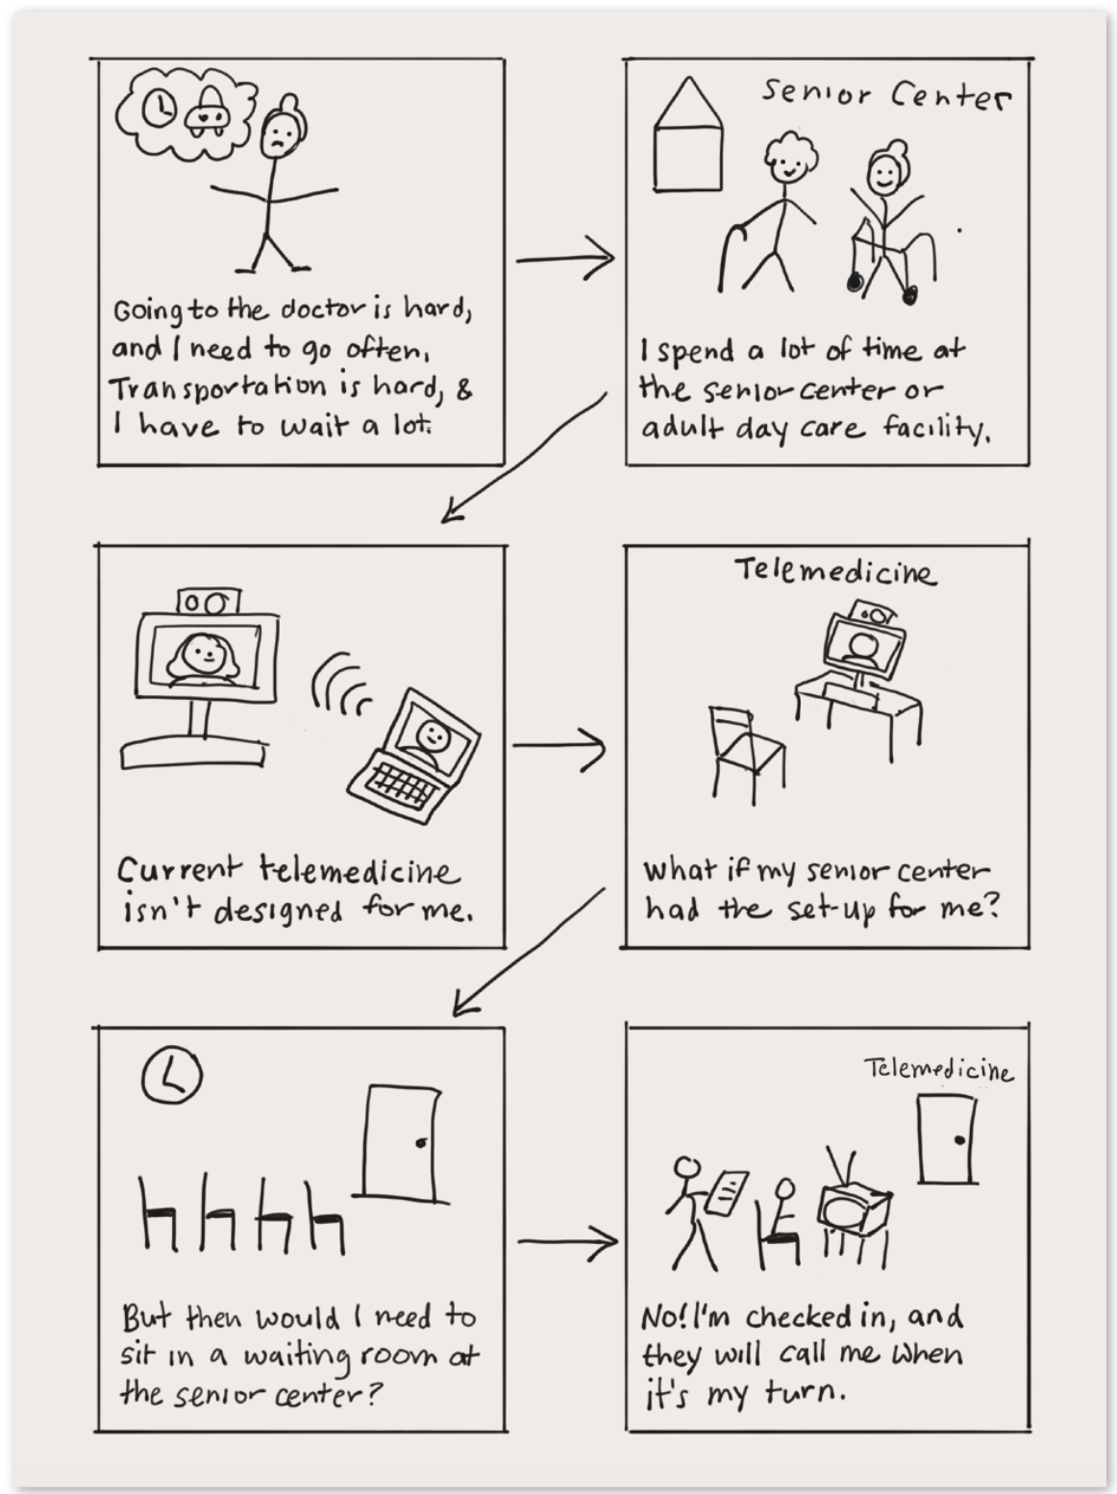
Storyboard: An example

Slide 22
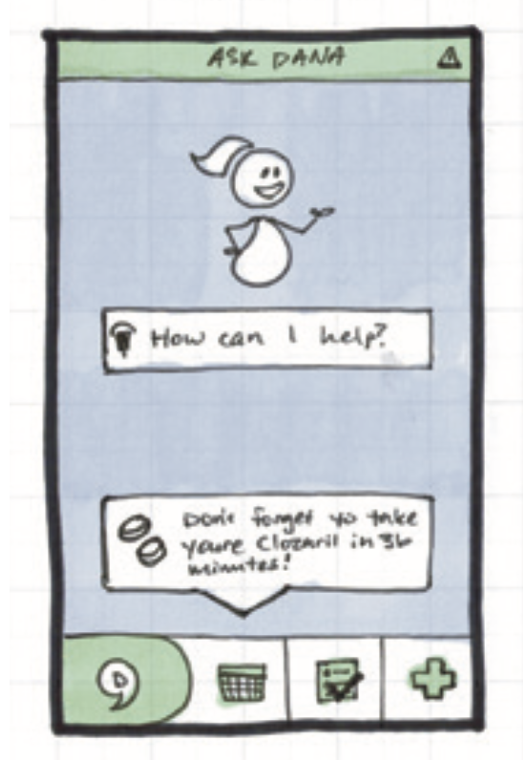
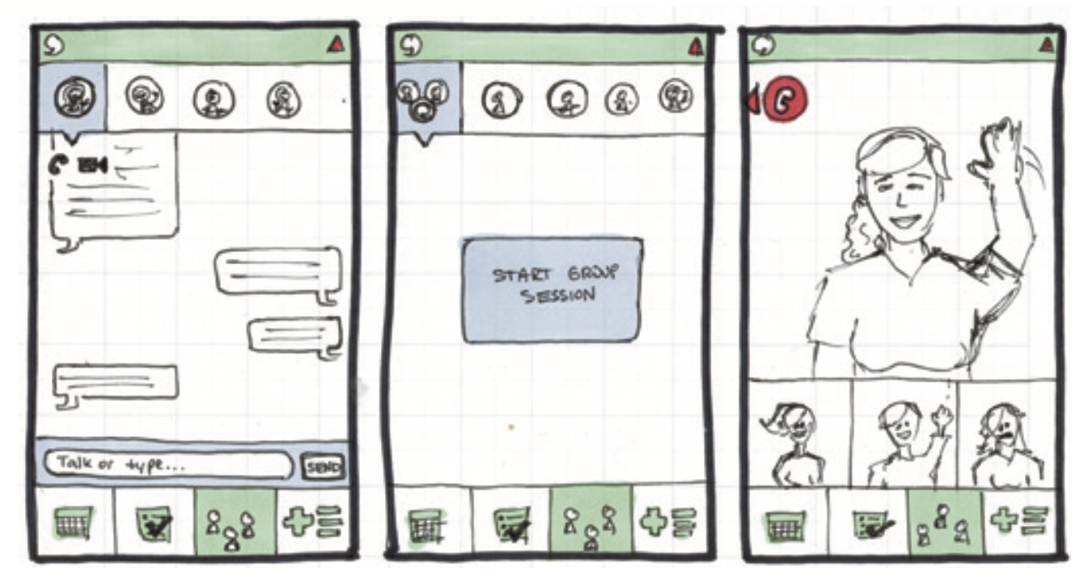
Storyboard for designing apps
Homescreen
Group sessions

Slide 23
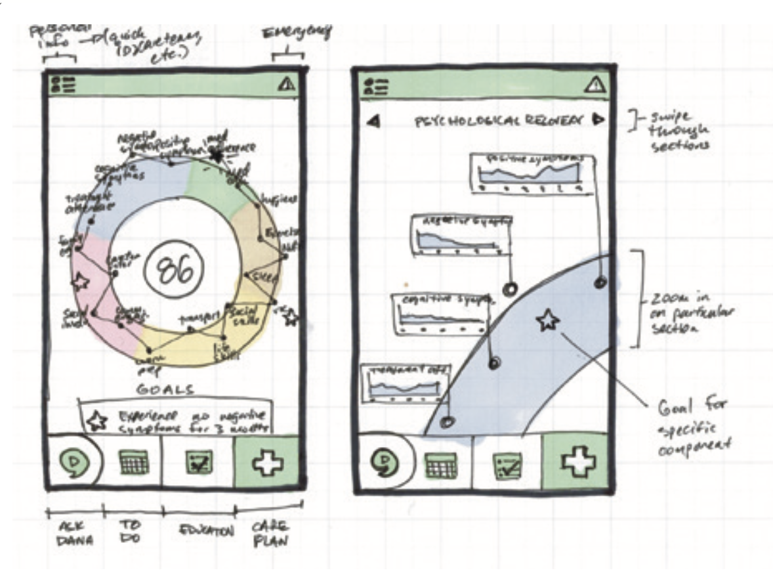
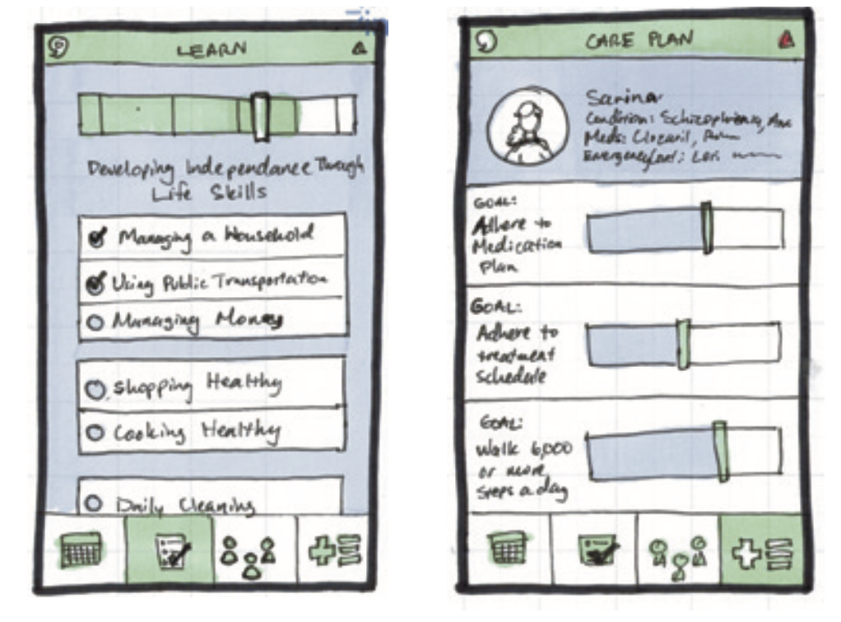
Storyboard for designing apps
Goal tracking
Health metrics

Slide 24
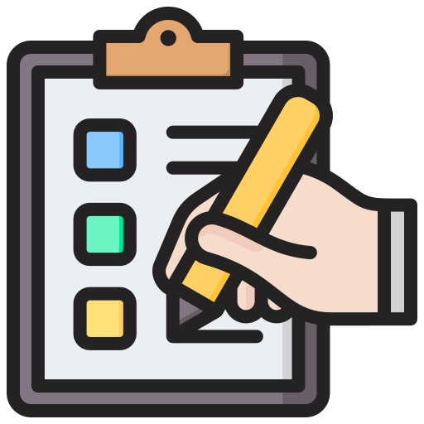
Questionnaire
Questionnaire consists of a series of open and/or closed questions devised for the purposes of a survey or statistical study.
Allow to easily get answers from the intended final users
Pros:
Usually it contains standardized questions
Allow to map answers to standard scores
They are anonymous so people are more confident to tell the truth
Cons:
It is difficult to span the universe of possible questions
Time consuming: people may build fatigue and start putting random answers
They are not very flexible

Slide 25
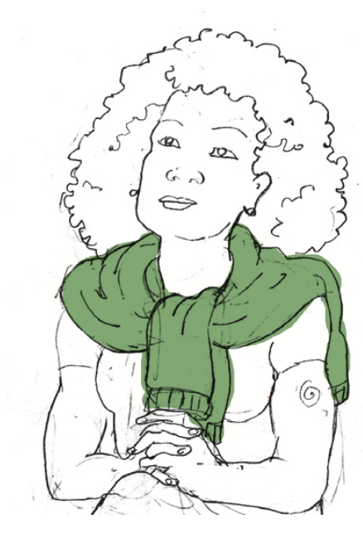
Persona
A persona is a fictional archetypal character who represents potential users.
Each persona has i) a portrait, ii) a background narrative and iii) a name.
The goal is to bring each persona to life with a concise set of narrative details relevant to the design challenge
The designed group of personas must be inclusive. There should be the “average” persona and “extreme/edgy” personas.

Slide 26
Creating a user Persona
Name: pick a name that is easy to remember and use it in conversations: “What should Ashley do here?”
Backstory: name some defining events in the character’s life, e.g., a person that does not speak English.
Scenario: Create a short narrative sketch in which persona confronts a challenge. What situation has brought her to the hospital?
Emotions: How does the persona feel about her situations? Is she angry, or confident?
Motivation: What does the persona want to achieve?
Behaviours: What is the persona doing to achieve her goals?
Ability inhibitors: What actions or situations might be causing anxiety or distress?

Slide 27
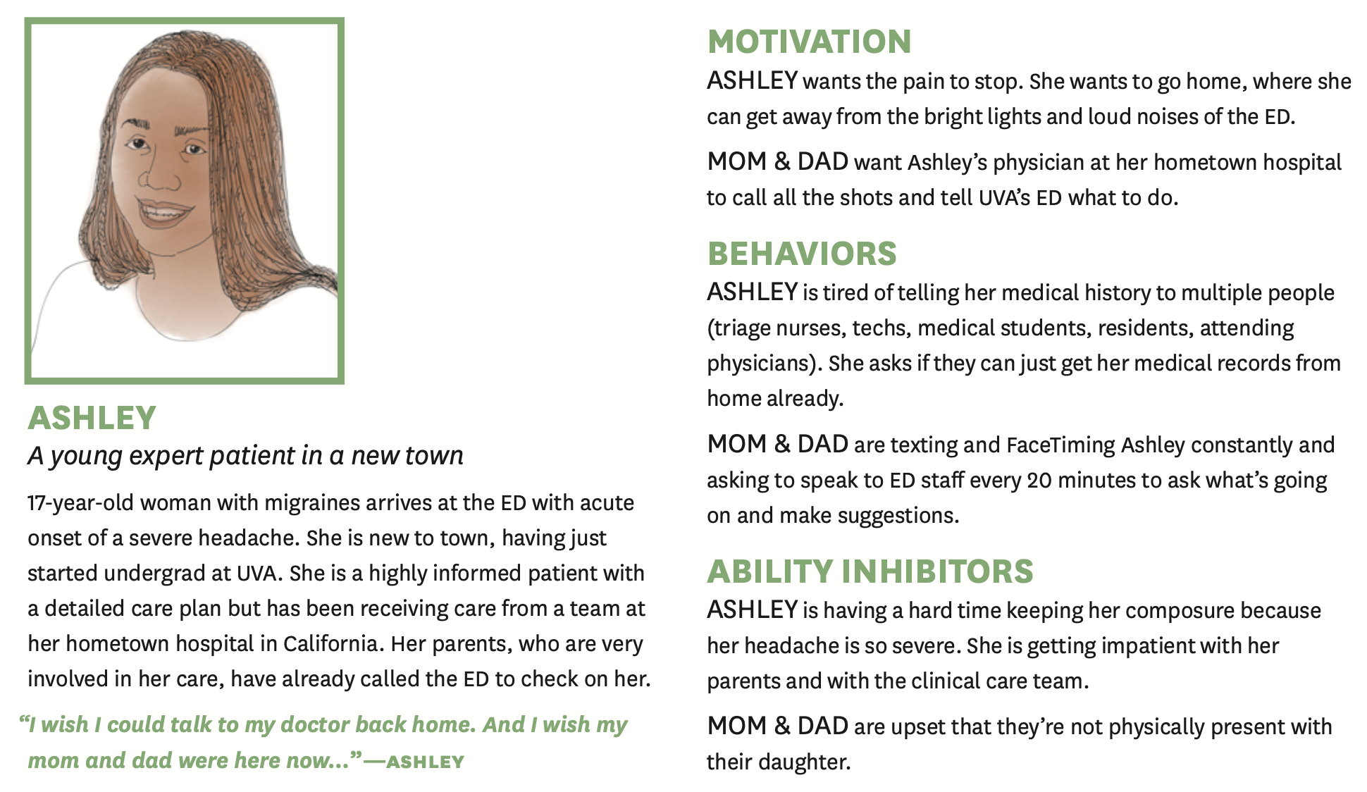
An example: Ashley

Slide 28
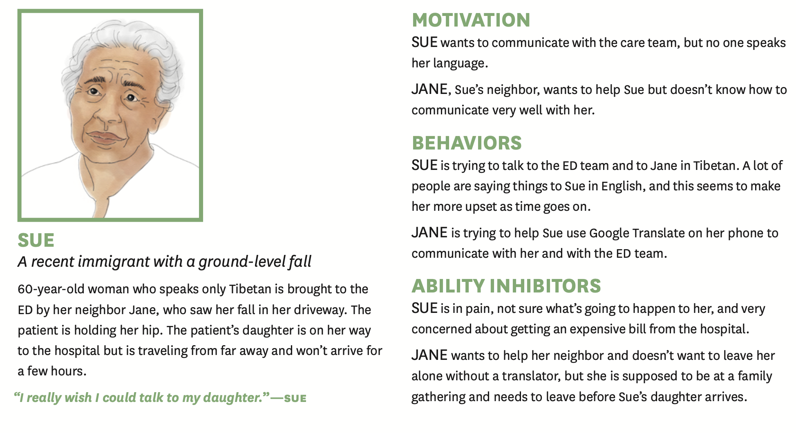
An example: Sue

Slide 29

Journey map
Journey map is a tool that help understand a user’s experience of a product, service, or space over time.
They are dynamical tools
Journey maps can be used to analyze existing health care solutions
They can be also used to design the interaction with hypothetical new tool over time (see next slide)

Slide 30
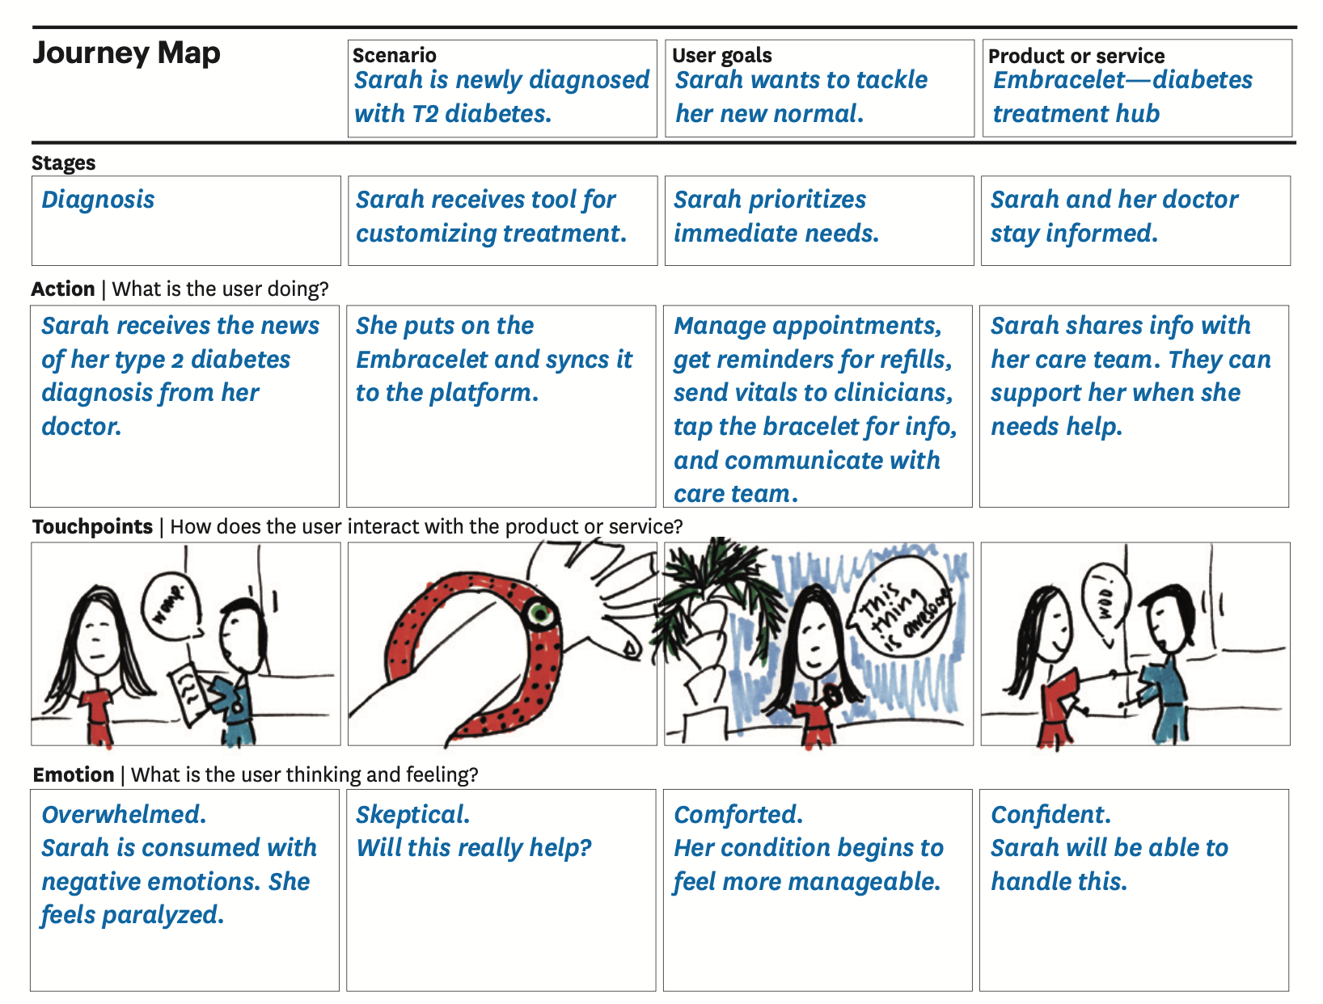
Journey map: An example
This journey map was created during a health design workshop in which participants developed an ideal product concepts for patients newly diagnosed with type 2 diabetes

Slide 31
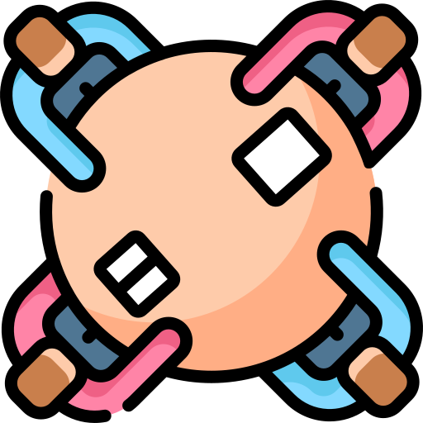
Let’s try
Core problem: Sleep issues
Our idea: We can create a mobile app for that!
What you have to do:
Create a persona
Use that persona as a character of a (simple) journey map where he/she will use your app for the problem at hand
You can do this individually or as a group (with a group this is easier)

Slide 32
References
Ku, Lupton - Human Design Thinking: Creating Products and Services for Better Health – Cooper Hewitt

