Slide 1
Wearable sensors

Slide 2
Agenda
Definition of sensors and wearable sensors
Different types of sensors used in wearable devices based on the sensing technique:
Mechanical sensors
Electrical sensors
Optical sensors
Chemical sensors
Sensor characteristics
Systematic characteristics
Statistical characteristics
Dynamic characteristics
Embedded processing unit
Signal processing
Communication systems
Part 1
Part 2

Slide 3
Agenda
Definition of sensors and wearable sensors
Different types of sensors used in wearable devices based on the sensing technique:
Mechanical sensors
Electrical sensors
Optical sensors
Chemical sensors
Sensor characteristics
Systematic characteristics
Statistical characteristics
Dynamic characteristics
Embedded processing unit
Signal processing
Communication systems
Part 1
Part 2

Slide 4
Detection techniques
The signal from biomarkers can be detected, either directly (e.g., Na⁺ and K⁺ in sweat by ion-selective host), or indirectly from other species generated from the reaction between biomarker and recognition element (e.g., glucose measurement via H₂O₂ generated from the glucose oxidase-catalysed reaction)
Two most popular detection techniques:
Optochemical detection
Electrochemical detection

Slide 5
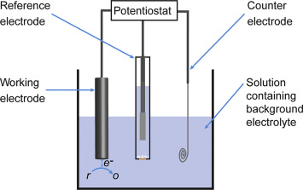
Electrochemical sensors
An electrochemical sensor is composed of a sensing or working electrode, a reference electrode, and, in many cases, a counter electrode.
Electrodes are typically placed in contact with a liquid or solid electrolyte.
Electrochemical sensors work on the principle of measuring an electrical parameter of the sample of interest.
Categories based on the measurement approach:
Potentiometric sensors
Amperometric sensors
Voltammetric sensors

Slide 6
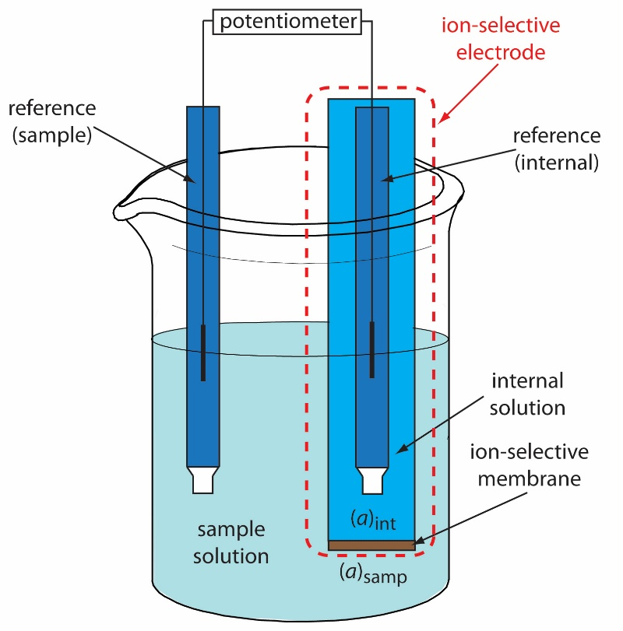
Types of electrochemical sensors (1/3)
Potentiometric sensors:
They measure the difference in potentials (voltage) between the working electrode and a reference electrode.
The working electrode is made of a ion-selective material and its potential depends on the concentration of the target ion which is related to the analyte of interest.

Slide 7
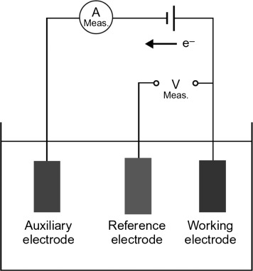
Types of electrochemical sensors (2/3)
Amperometric sensors:
They measure changes in current.
The potential of the working electrode is maintained at a fixed value (relative to a reference electrode) and the current between the working electrode and the counter (or auxiliary) electrode is measured.
The working electrode surface contains specific enzymes catalysing a redox (reduction-oxidation) reaction which generates electron transfer (current).
The working electrode is designed so that the measured current is directly proportional to the concentration of a redox active species of interest in the sample solution.

Slide 8
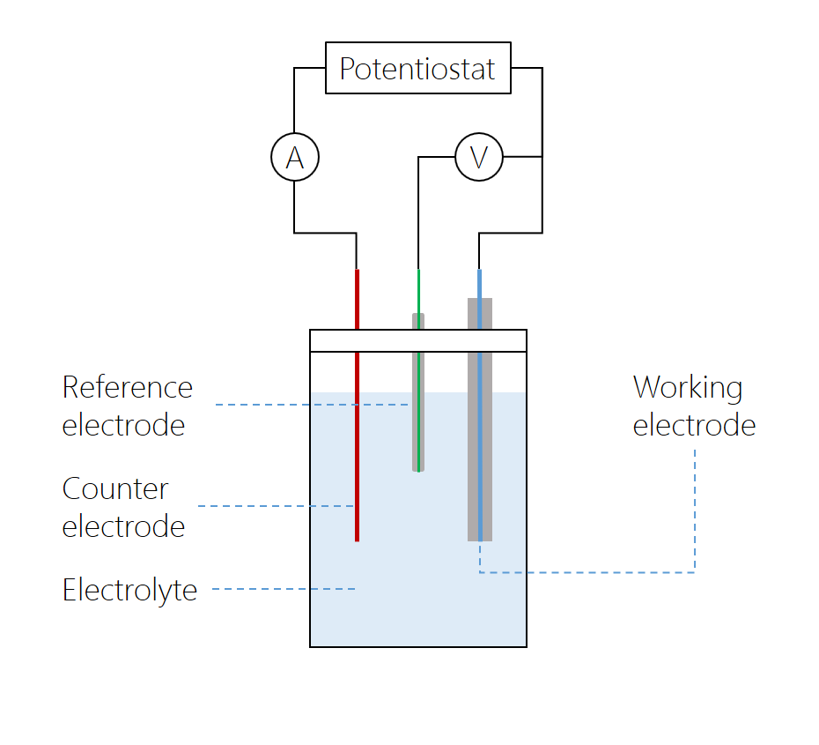
Types of electrochemical sensors (3/3)
Voltammetric sensors:
As the amperometric sensors, they measure changes in current.
Information about the analyte is obtained by measuring the current between the working electrode and the counter electrode as the potential between the working electrode and the reference electrode varies.
The current, generated by a redox reaction, is proportional to the species of interest.

Slide 9
Electrochemical sensors: Pros and cons
Pros:
Since this group of techniques directly deals with electrical signals, the signal transduction and processing are simpler than optical detection methods.
Cons:
They require an electronic hardware (potentiostat) to produce the excitation signal and measure the electrical response → main obstacle for wearable sensor miniaturization.
Ions and many electroactive species in the biofluids might interfere with the analysis → the sensor must be carefully designed to achieve selectivity.

Slide 10
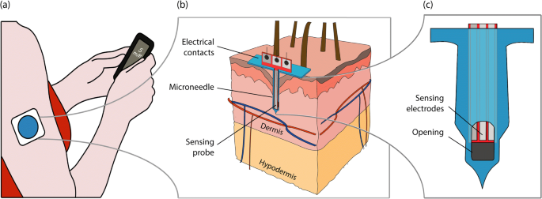
Electrochemical sensors – Example Minimally-invasive electrochemical glucose sensor
Amperometric electrochemical sensor
It exploits glucose oxidase (GOx) to measure glucose concentration in the ISF.
Glucose oxidation:
Oxidation of hydrogen peroxide:
GOx
Glucose + H₂O + O₂
Gluconic acid + H₂O₂
Ribet et al., Biomedical Microdevices, 2018
+500 mV vs IrOx
H₂O₂
O₂ + 2H⁺ + 2e⁻
The reaction takes place at a platinum working electrode used as anode and polarized to a positive potential of +500 mV with respect to an iridium oxide (IrOx) reference electrode.
A counter electrode, also made of platinum, closes the electrical circuit.
The electrons generated by the oxidation hydrogen peroxide generate an electrical current which is proportional to glucose concentration in the ISF.

Slide 11
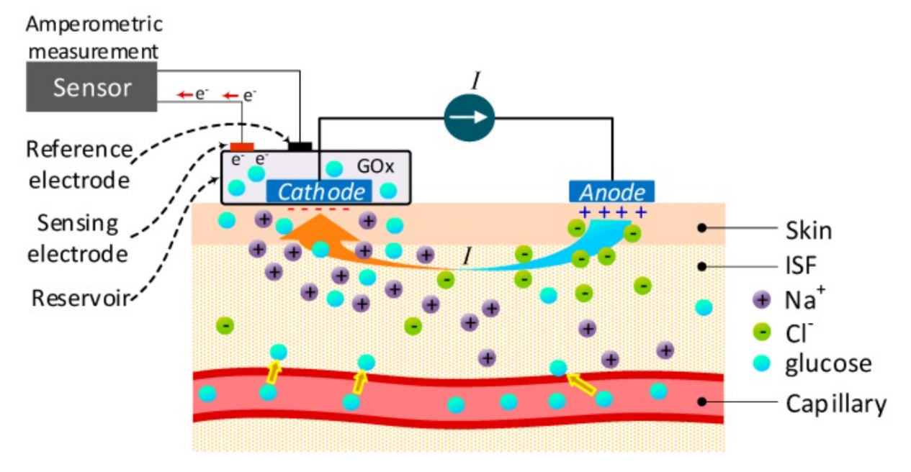
Electrochemical sensors – Example Non-invasive electrochemical glucose sensor
Reverse iontophoresis technique: application of a small controlled current between two electrodes connected to the skin, the anode (positive) and cathode (negative) to promote migration of biochemical species from ISF to sweat.
The current causes a migration of Na⁺ ions in the ISF towards the cathode → convective flow of the ISF that transports the uncharged species, e.g., glucose, towards the iontophoretic cathode.
At the cathode, a standard amperometric glucose sensor measures the glucose concentration by the enzymatic method.
Reverse iontophoresis is very promising for enabling biochemical analyses on skin in a noninvasive way.

Slide 12
Sensor characteristics
To truly understand sensors, and how sensors that measure the same measurand can differ, it is necessary to understand sensor performance characteristics, which are reported in specifications (specs) or datasheet.
Systematic characteristics: those which can be exactly quantified by mathematical or graphical means;
Statistical characteristics: those which cannot be exactly quantified;
Dynamic characteristics: those characterizing the ways in which an element responds to sudden input changes.

Slide 13
Ranges
The minimum-maximum values of the sensor input or output over which the sensor works well (systematic characteristic).
Full-scale range: the difference between the minimum and the maximum values of the input (measurand).
Full-scale output: the difference between the output signals measured at maximum input stimulus and minimum input stimulus.
Operating voltage range: the minimum and maximum voltages that can be used to operate a sensor (for sensors requiring it). Applying an input voltage outside of this range may permanently damage the sensor.

Slide 14

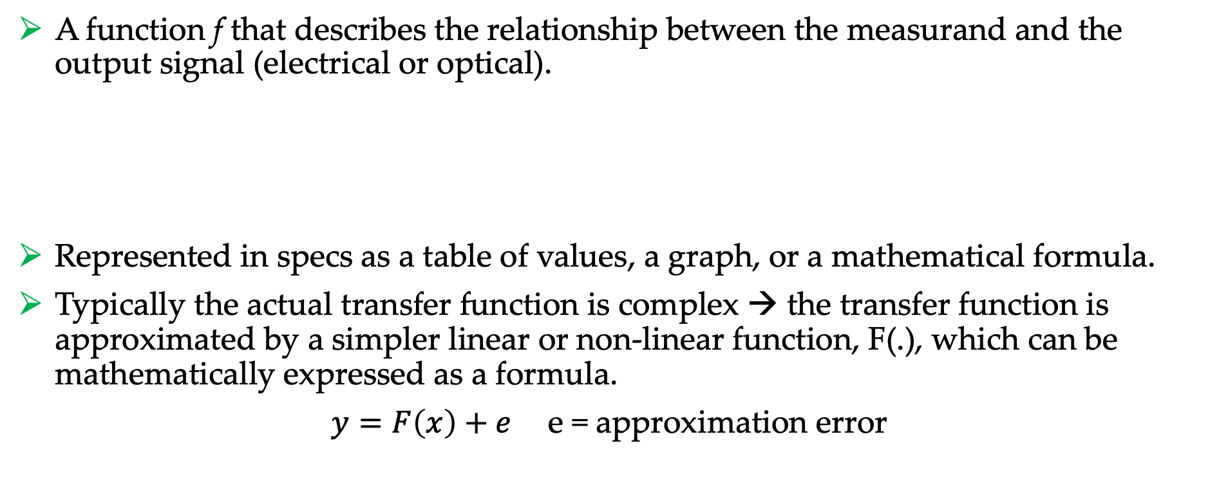
Transfer function
A function f that describes the relationship between the measurand and the output signal (electrical or optical).
Represented in specs as a table of values, a graph, or a mathematical formula.
Typically the actual transfer function is complex → the transfer function is approximated by a simpler linear or non-linear function, F(.), which can be mathematically expressed as a formula.
$y=F\left(x\right)+e$ e = approximation error
$$y=f(x)$$
Output electrical (or optical) signal
Measurand

Slide 15



Inverse transfer function
The embedded processing unit of the sensor device applies the inverse of F(.), F⁻¹(.), to convert the electrical sensor generated by the sensing technique to output measurements in the same domain of the measurand.
Measurand
Glucose concentration
Electrical current
pA
Glucose concentration mg/dl
Amperometric glucose sensor
Approximated inverse transfer function
F⁻¹(y)
$$x$$
$$y$$
$$\hat{x}$$

Slide 16
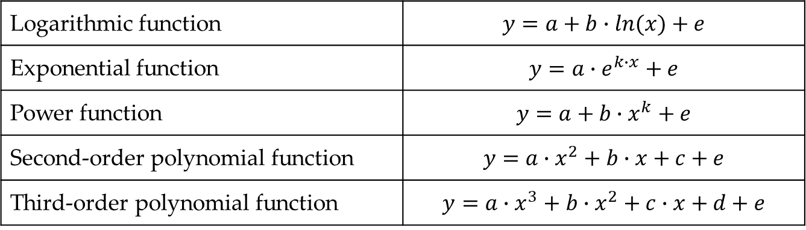

Common transfer function approximations
Linear transfer function approximation:
The offset, b, is the output value of the sensor when no measurand is applied. It is the component of the output signal which does not depend on the measurand.
The slope, a, represents the sensor sensitivity, i.e., the change in the sensor output resulting from a unit change in the input measurand.
Non-linear transfer function approximations:
$$y=a∙x+b+e$$
Logarithmic function | $$y=a+b∙ln(x)+e$$
Exponential function | $$y=a∙e^{k∙x}+e$$
Power function | $$y=a+b∙x^{k}+e$$
Second-order polynomial function | $$y=a∙x^{2}+b∙x+c+e$$
Third-order polynomial function | $$y=a∙x^{3}+b∙x^{2}+c∙x+d+e$$

Slide 17












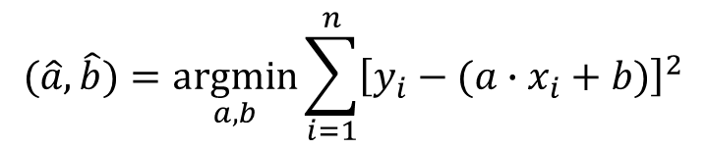
Calibration
The transfer function parameters, e.g., a and b in the linear transfer function, are in general unknown and must be estimated. This process is called calibration.
If a set of known (x,y) paired values are available, estimation of transfer function parameters can be performed by the least square approach.
For linear transfer function:
$$(\hat{a},\hat{b})=\underset{a,b}{argmin}{\sum_{i=1}^{n}{{\left[y_{i}−(a∙x_{i}+b)\right]}^{2}}}$$
Two-point calibration
Multiple-point calibration
$$y$$
$$y=\hat{a}∙x+\hat{b}$$
$$y$$
$$y=\hat{a}∙x+\hat{b}$$
$$y_{2}$$
$$\hat{a}=\frac{y_{2}−y_{1}}{x_{2}−x_{1}}$$
$$y_{1}$$
$$\hat{b}=y_{2}−\frac{y_{2}−y_{1}}{x_{2}−x_{1}}{∙x}_{2}$$
$$x_{1}$$
$$x_{2}$$
$$x$$
$$x$$

Slide 18
Factory calibration
Factory-calibration: the calibration performed during the manufacturing process and performed under controlled laboratory conditions.
The sensor is tested in laboratory by measuring known quantities.
Many (x,y) paired values are obtained across the entire operating range and the shape and the parameters of the transfer function are then determined.

Slide 19
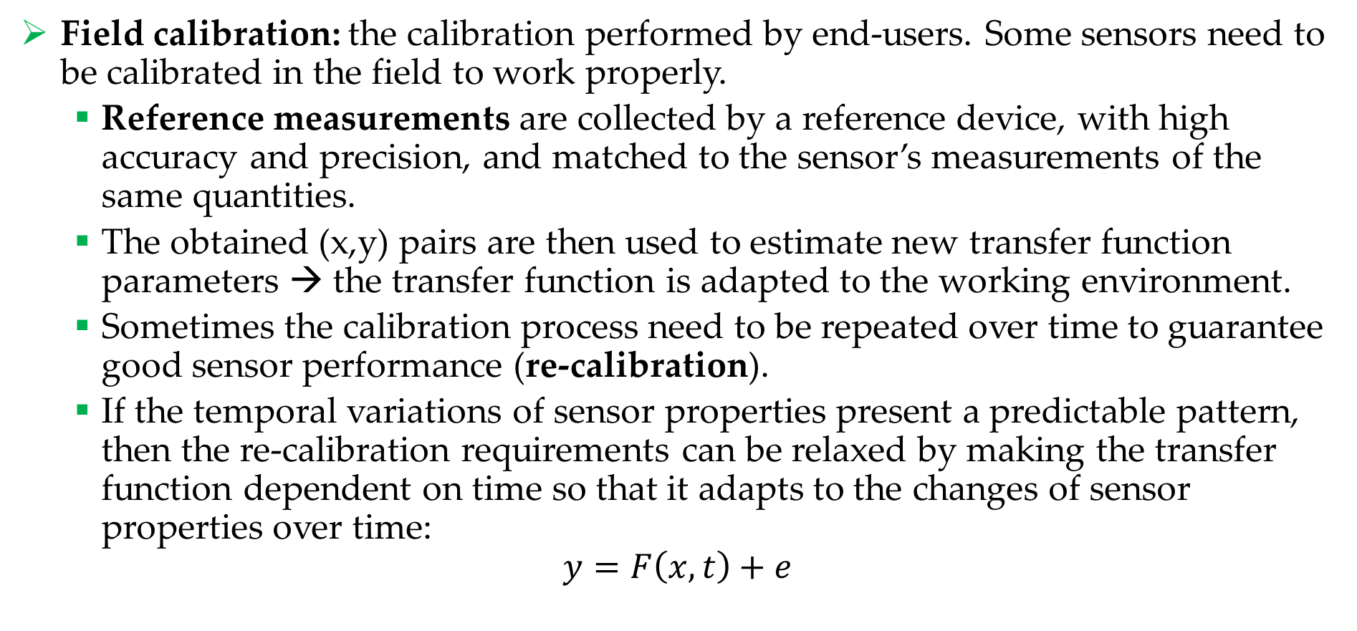
Field calibration
Field calibration: the calibration performed by end-users. Some sensors need to be calibrated in the field to work properly.
Reference measurements are collected by a reference device, with high accuracy and precision, and matched to the sensor’s measurements of the same quantities.
The obtained (x,y) pairs are then used to estimate new transfer function parameters → the transfer function is adapted to the working environment.
Sometimes the calibration process need to be repeated over time to guarantee good sensor performance (re-calibration).
If the temporal variations of sensor properties present a predictable pattern, then the re-calibration requirements can be relaxed by making the transfer function dependent on time so that it adapts to the changes of sensor properties over time:
$$y=F\left(x,t\right)+e$$

Slide 20
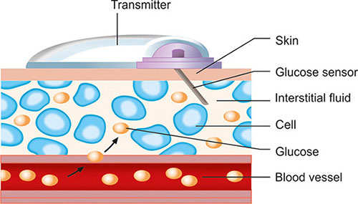
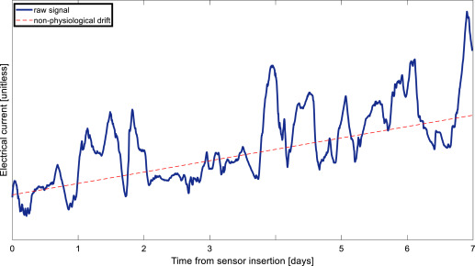
Calibration – Example Minimally-invasive glucose sensor
The current measured by the sensor presents a non-physiologic drift due to the non-stationary conditions of the sensor interaction with the physiological environment.
→ The parameters of the transfer function need to be updated over time.

Slide 21
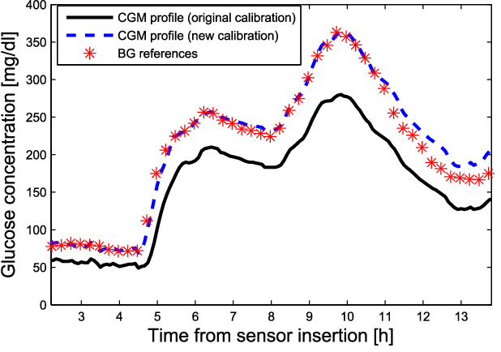
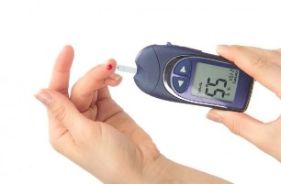
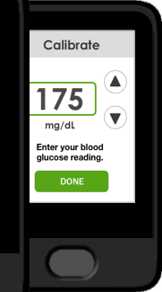
Calibration – Example Minimally-invasive glucose sensor
Past-generation sensors required one calibration every 12 hours using a fingerstick device to collect reference measurements.
The reference measurements are given in input to the sensor processing unit which runs the parameter estimation algorithm.
Modern sensors comes factory-calibrated with a time-dependent transfer functions which automatically compensate the non-physiologic drift.
The systems allows to perform optional re-calibrations with fingerstick in case of perceived sensor inaccuracy.

Slide 22


Sensitivity and non-linearity
Sensitivity: the change in output generated by a unit change in input.
If the sensor response (i.e., the transfer function) is linear, then sensitivity is constant over the range of the sensor and is equal to the slope of the transfer function.
If the sensor response is not linear, sensitivity varies over the sensor range.
Non-linearity: If the sensor response is non-linear, the specs report the level of non-linearity. It is defined as the maximum distance of the non-linear transfer function from the best-fit straight line.
Non-linear transfer function
$$y$$
Best-fit line
Non-linearity
$$x$$

Slide 23
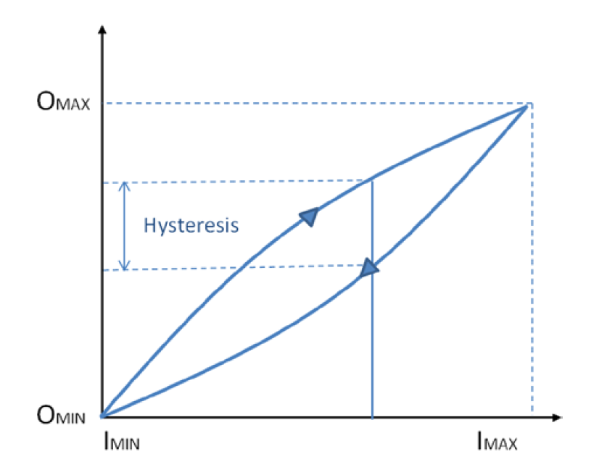
Hysteresis and resolution
Hysteresis: the output of a sensor may be different for a given input, depending on whether the input is increasing or decreasing.
Hysteresis commonly occurs when a sensing technique relies on the stressing of a particular material (as with strain gauges). The material may never return to its original start position after repeated use → unknown offset over time which can affect the transfer function.
Maximum hysteresis reported in the specs.
Resolution or discrimination: the smallest increment of the measurand that causes a detectable change in output.

Slide 24




Modifying input and interfering input
Modifying inputs: factors other than the measurand that can change the sensor sensitivity (e.g., ambient humidity).
Interfering inputs: factors other than the measurand that change the sensor offset (e.g., ambient temperature).
$$y$$
$$y$$
$$x$$
$$x$$

Slide 25
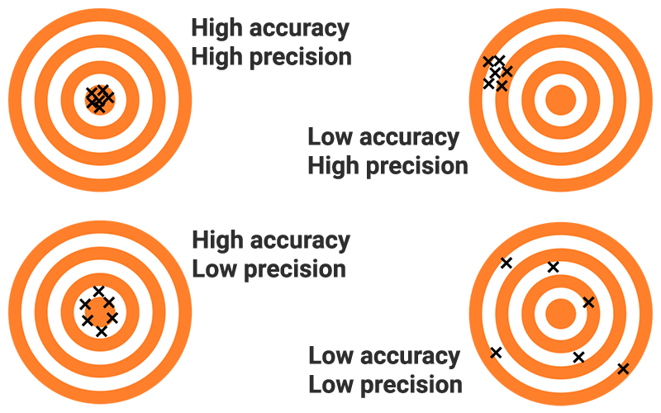
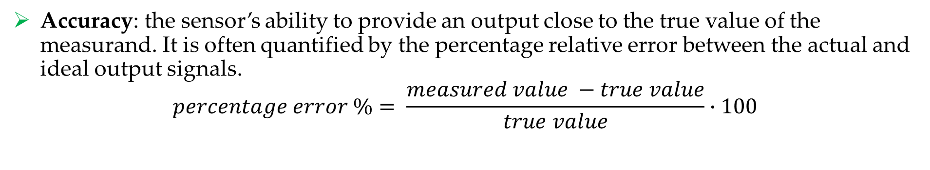
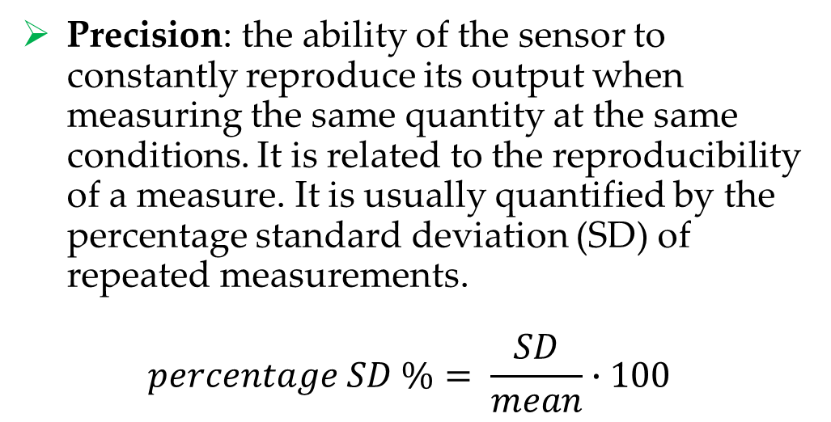
Accuracy and precision
Accuracy: the sensor’s ability to provide an output close to the true value of the measurand. It is often quantified by the percentage relative error between the actual and ideal output signals.
$$percentage error \%= \frac{measured value −true value}{true value}∙100$$
Precision: the ability of the sensor to constantly reproduce its output when measuring the same quantity at the same conditions. It is related to the reproducibility of a measure. It is usually quantified by the percentage standard deviation (SD) of repeated measurements.
$$percentage SD \%= \frac{SD}{mean}∙100$$

Slide 26
Systematic error and random error
Systematic error: reproducible inaccuracies that can be corrected with compensation methods, such as feedback, filtering, and calibration.
Interfering inputs and modifying inputs are sources of systematic errors.
Random error or noise: a signal component that carries no information.
Signal-to-noise ratio (SNR): the ratio of the true signal amplitude to the standard deviation of the noise. High SNR → high signal quality.
Noise can be measured by recording the signal in the absence of the measurand, or by recording a known measurand several times, then subtracting the known true signal from the measured signal.
Sources of noise are: noise of the measurand itself, environmental noise, transmission noise.

Slide 27
Statistical characteristics
They cannot be exactly described by formulas or graphical means.
Repeatability: the ability of a sensor to produce the same output when the same input is applied to it. Lack of repeatability generally occurs due to random fluctuations in environmental inputs or operator error.
Tolerance: It describes the variations in the reported output among a batch of similar elements due to small random manufacturing variations.

Slide 28
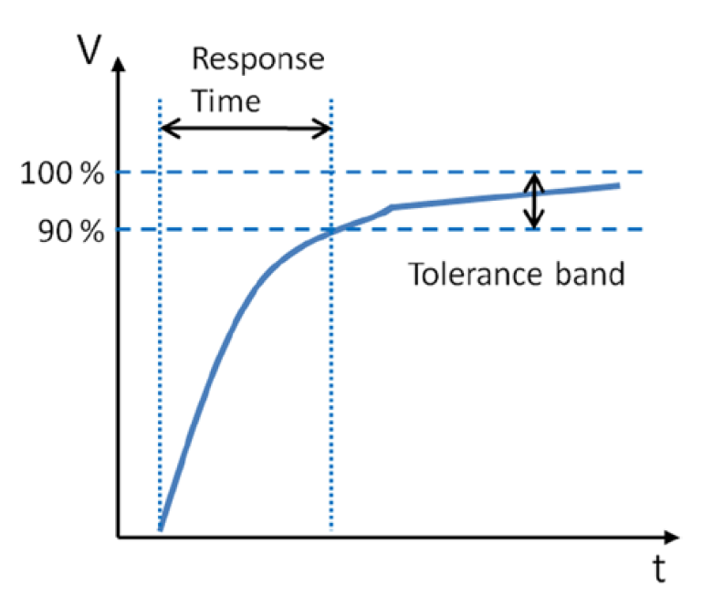
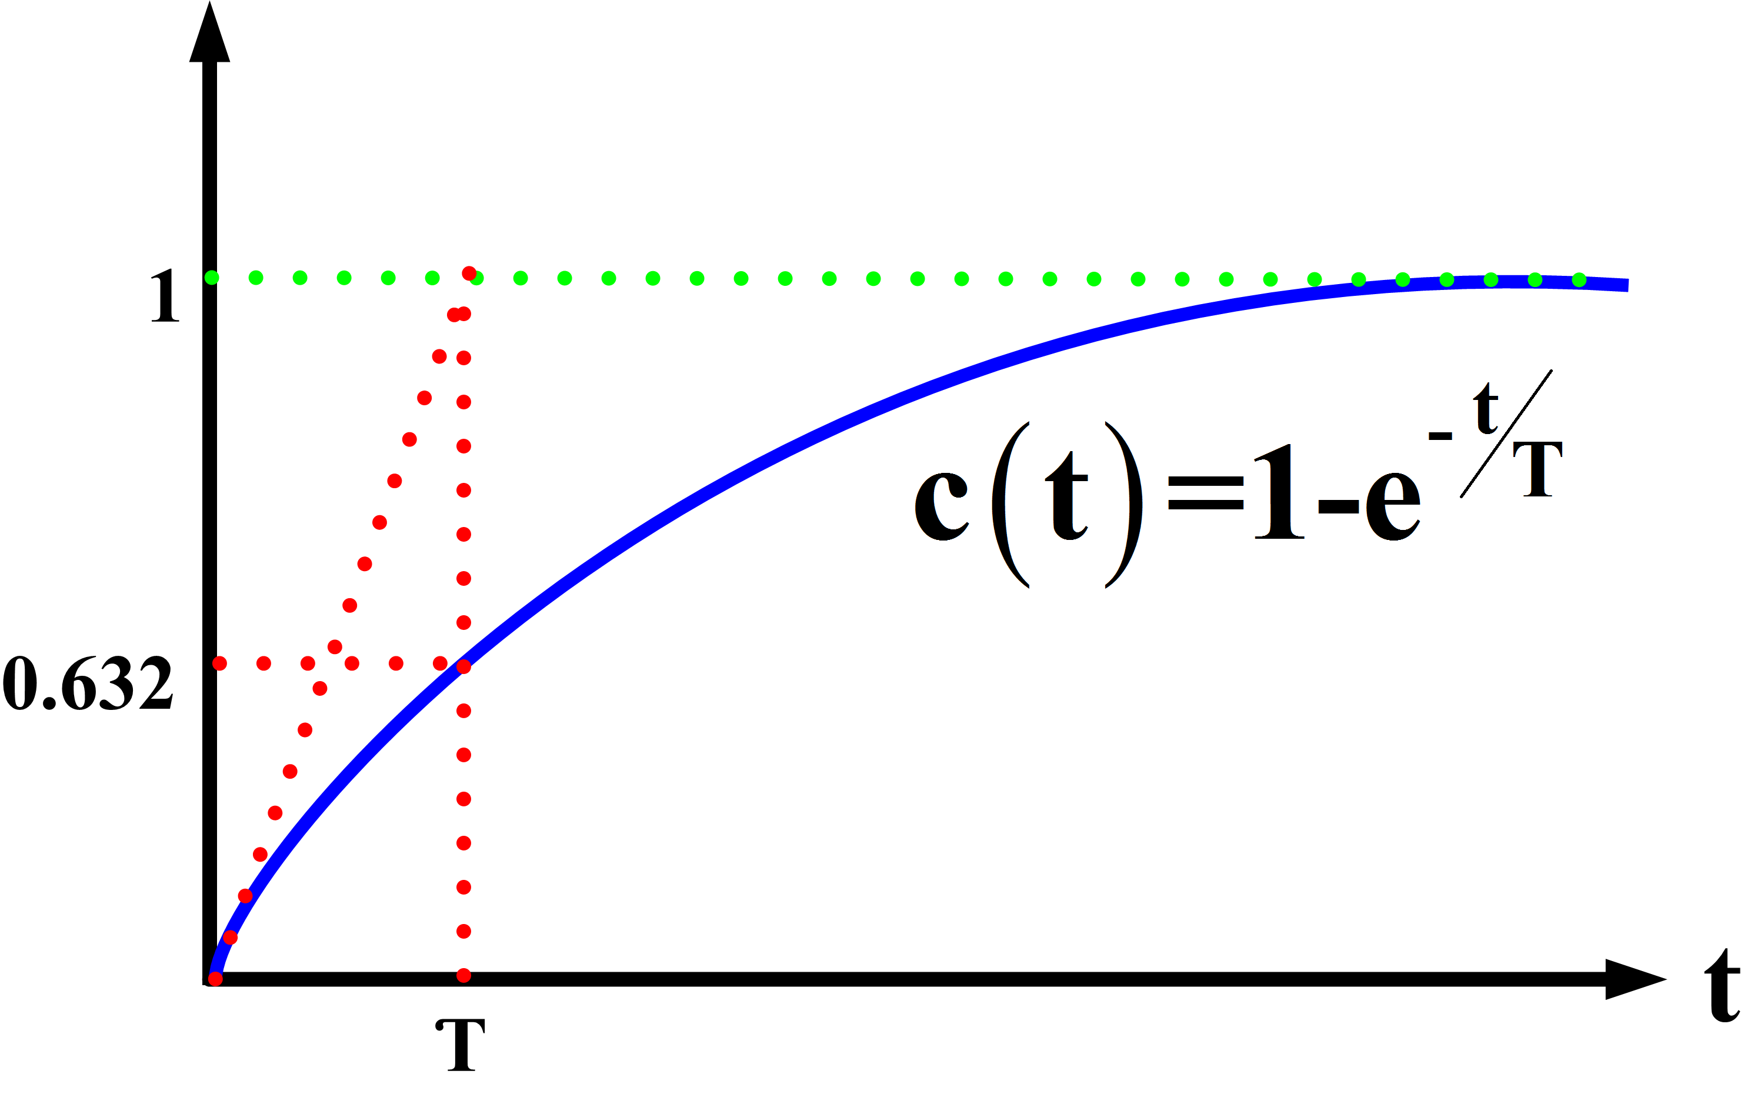
Dynamic characteristics
Time-dependent characteristics of a sensor.
Response time: The period of time taken for the sensor to change its output from its previous state in response to a input change. A tolerance band around the new correct value is considered.
Response time is commonly defined using time constants in first-order systems.
Time constant: the time required by a sensor to reach 63.2 percent of a step change in output under a specified set of conditions. It can be estimated by fitting a single exponential curve to the response curve.

Slide 29
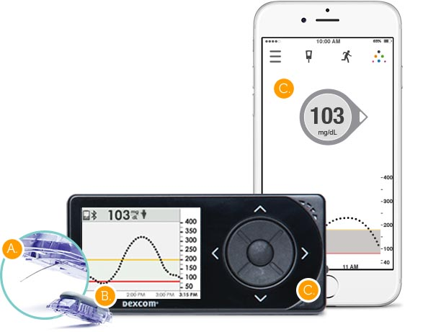
Embedded processing unit
The embedded processing unit is responsible for:
Performing local processing of the measurements
Storing some data in a local memory
Sending the data to another device (e.g., a display device or a gateway device for IoT systems)
Three main operations:
Denoising
Calibration
Fault detection
Sensor
Receiver device / Gateway device (for IoT devices)
Embedded processing unit

Slide 30
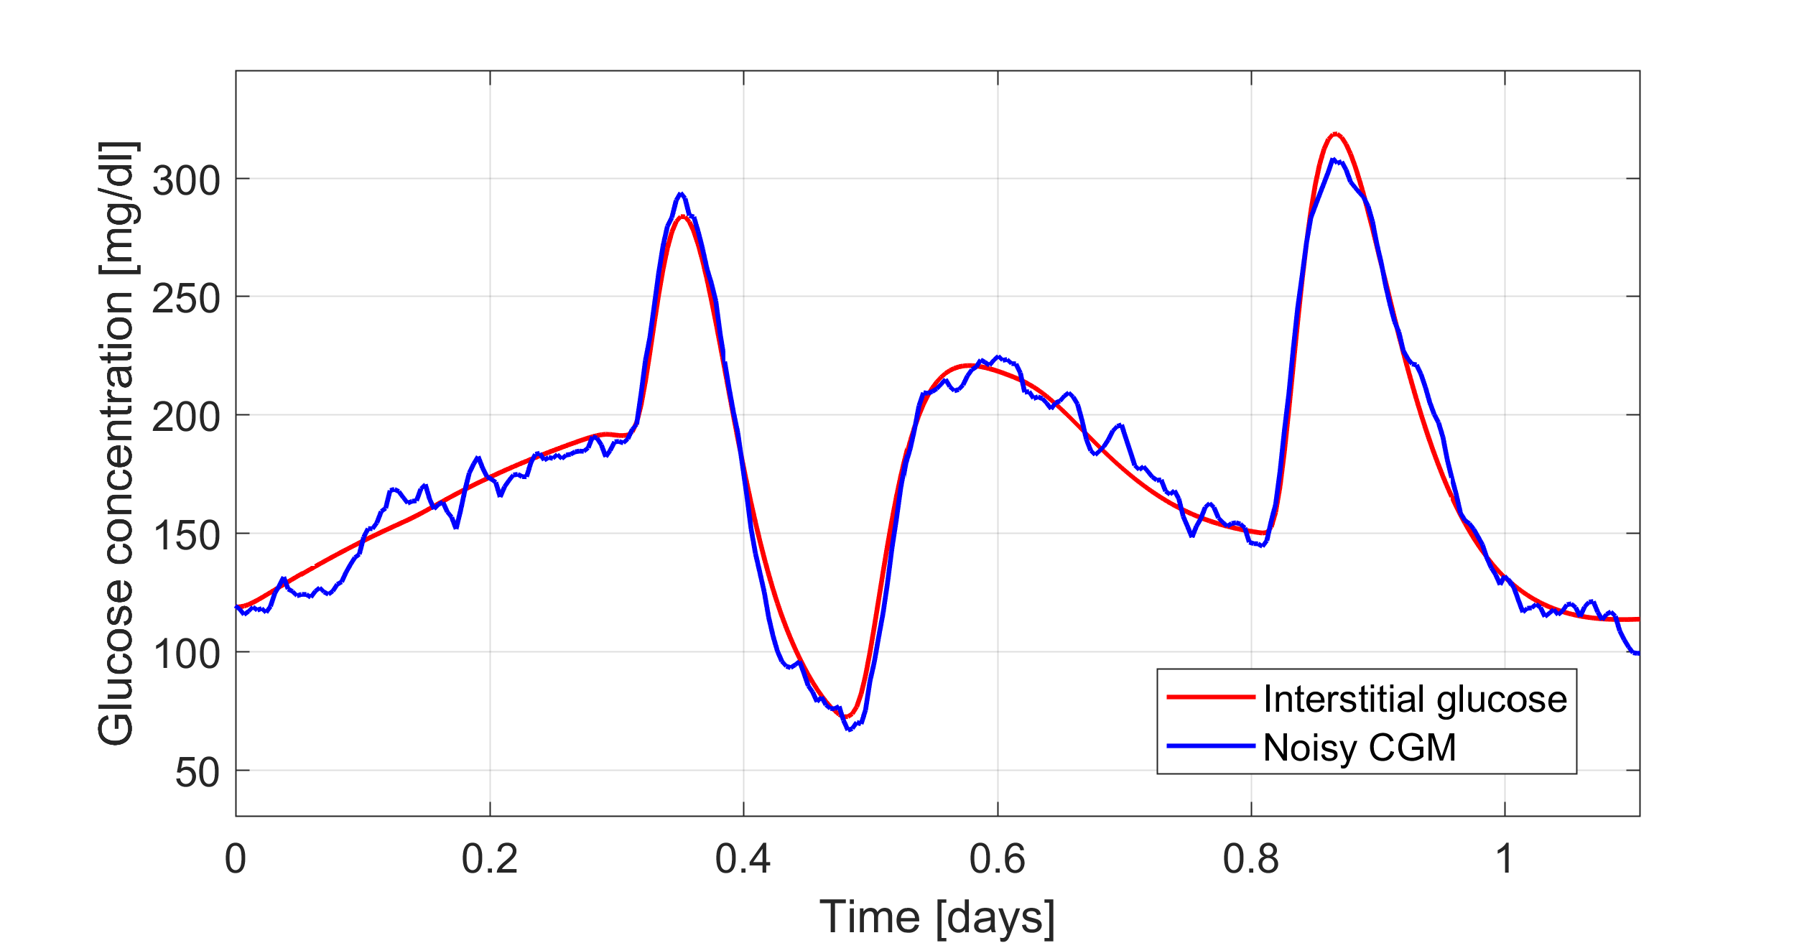
Denoising
Raw signals are often noisy: the signal of interest is corrupted by noise
Example: high-frequency noise on a CGM signal

Slide 31
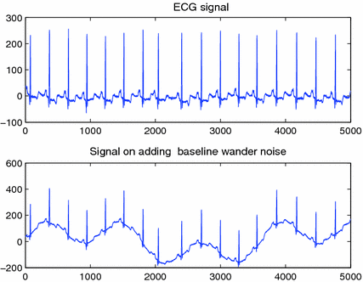
Denoising
Raw signals are often noisy: the signal of interest is corrupted by noise
Example: low-frequency noise (e.g., due to movement) on an ECG signal
Clean ECG signal
ECG signal corrupted by low-freq. noise

Slide 32
Denoising
The noise can be filtered by applying a denoising algorithm exploiting a digital filter.
Noisy signal
Clean signal
Denoising algorithm
(digital filter)
Non-causal filters: the filter output depends on past and future inputs → for offline use only
Causal filters: the filter output depends only on past and present inputs → suitable for online application

Slide 33


Signal transformation and calibration
The embedded processing unit applies the inverse transfer function to convert the raw signal into the signal representing the physical quantity of interest
E.g. electrical current to analyte concentration signal in electro-chemical amperometric sensors
For systems enabling field calibration, the processing unit may also implement the algorithm for performing the calibration (most often this is included in the companion device for computation limitations)
Raw signal
Converted signal
e.g. electrical current [pA]
Inverse transfer function
F⁻¹(y)
e.g. analyte concentration [mg/dl]
$$y$$
$$\hat{x}$$

Slide 34
Fault detection
Detection of temporary sensor errors also called faults or artifacts
Example: pressure-induced signal suppression in a CGM signal
Measured signal
Artifact suppressed
Reconstructed signal
Fault detection algorithm
Signal reconstruction algorithm
(e.g. interpolation)

Slide 35
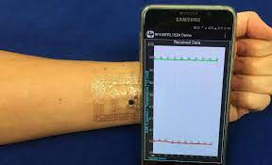
Communication systems
Wearable devices require a data transmission systems that wirelessly communicate between the sensing device and the receiver and/or gateway device (it can be the smartphone).
Bluetooth communication is the primary choice because of its simplicity, low operation cost, compatibility with new smartphone technology, and simple hardware. Drawback: it requires high power consumption.
Near field communication (NFC): a wireless communication technology that operates at a short distance (about 4 cm) and does not need the energy from the battery to transfer the data.
NFC tags can directly communicate with the smartphone equipped with the NFC modules.
Bypassing the need for batteries, NFC enables ultrathin, ultraminiaturized designs for sensors, like a temporary transfer tattoo.

Slide 36








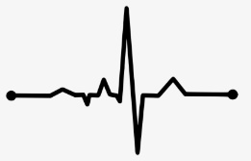
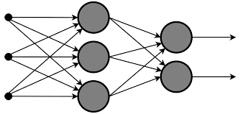
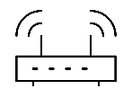

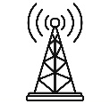

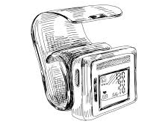


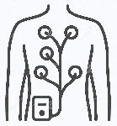
The architecture of wearable IoT systems
Alerts
Decision-support
Event log
Self-management
4. Application layer
Database
Data analyses
Signal processing
Modeling
3. Data storing and processing layer
Gateway device
WiFi,
Router
Internet
2. Network layer
GSM
Activity tracker
Sensors
ECG sensor
1. Sensing layer
Blood pressure sensor
Glucose sensor

