Slide 1
Giacomo Cappon
Exam and Project Discussion Q&A

Slide 2
Outline
The theory exam
Project delivery instructions
Project presentation guidelines

Slide 3
Exam structure
Written test of 90-minute duration:
10 multiple-option questions (only one correct answer)
5 true/false questions
3 open questions
Notes:
The exam is in English, answers to be provided in English (English errors not penalized). Dictionary is not allowed.
At the exam, the students cannot use any course material (slides, books, articles, etc.), nor any electronic device (e.g., smartphone, notebook, etc.). Only the pen and a calculator is allowed.
The theory exam will cover all the theory program except the material marked as
BONUS

Slide 4
Mark of the theory exam
Multiple-option questions:
1 point for each correct answer
-0.33 points for each incorrect answer
0 points for each not given answer
True/false questions:
1 point for each correct answer
-0.33 points for each incorrect answer
0 points for each not given answer
Open questions:
0 to 5 points each
Total score: up to 30 points

Slide 5
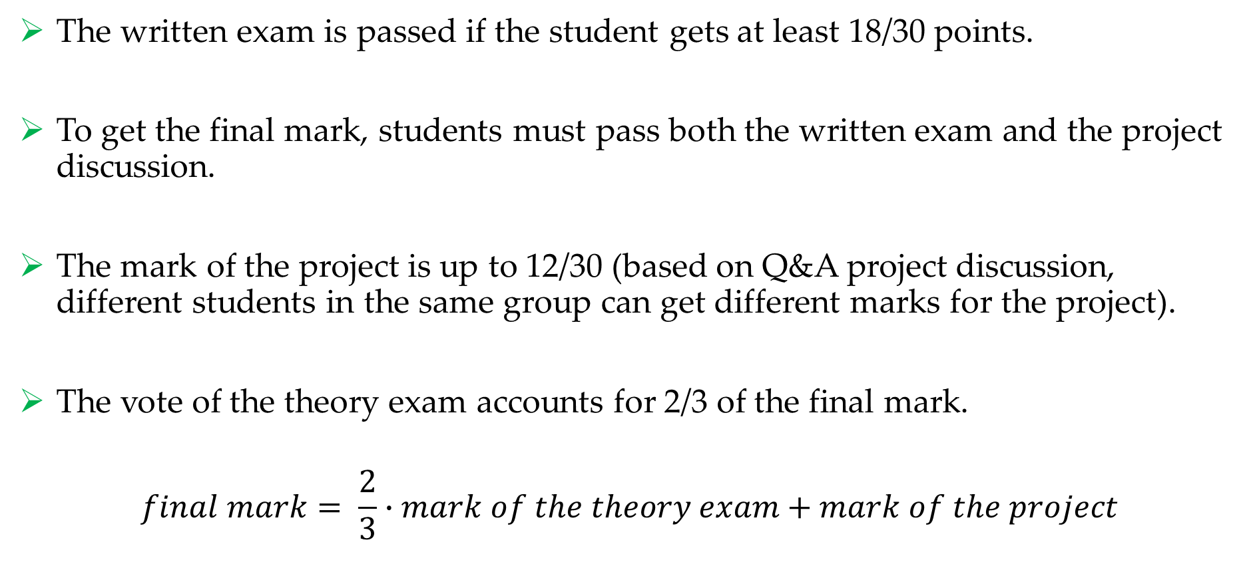
Final mark
The written exam is passed if the student gets at least 18/30 points.
To get the final mark, students must pass both the written exam and the project discussion.
The mark of the project is up to 12/30 (based on Q&A project discussion, different students in the same group can get different marks for the project).
The vote of the theory exam accounts for 2/3 of the final mark.
$$final mark= \frac{2}{3}∙mark of the theory exam+mark of the project$$

Slide 6
Examples of multiple-option questions
Q1. A diffuse-reflective optical sensor:
is made of two separate components, a light emitter and a light detector, and the sensing object is interposed between these two components.
is made of two separate components, a light emitter and a light retroreflector, and the sensing object is interposed between these two components.
is made of a single component integrating both a light emitter and a light detector.
none of the previous options.

Slide 7
Examples of multiple-option questions
Q1. A diffuse-reflective optical sensor:
is made of two separate components, a light emitter and a light detector, and the sensing object is interposed between these two components.
is made of two separate components, a light emitter and a light retroreflector, and the sensing object is interposed between these two components.
is made of a single component integrating both a light emitter and a light detector.
none of the previous options.

Slide 8
Examples of multiple-option questions
Q2. What is the most appropriate use of the following HTTP request?
POST /library HTTP/1.1
Host: www.example.com
{
“Author”: “Stephen Hawking”
“Title”: “A Brief History of Time”
}
Delete the book with author “Stephen Hawking” and title “A Brief History of Time” from the book list at the URL www.example.com/library
Adds to the book list at the URL www.example.com/library a new book with title “A Brief History of Time” and author “Stephen Hawking”
Replace the book list at the URL www.example.com/library with the book list containing the book “A Brief History of Time” by “Stephen Hawking”
None of the previous answers

Slide 9
Examples of multiple-option questions
Q2. What is the most appropriate use of the following HTTP request?
POST /library HTTP/1.1
Host: www.example.com
{
“Author”: “Stephen Hawking”
“Title”: “A Brief History of Time”
}
Delete the book with author “Stephen Hawking” and title “A Brief History of Time” from the book list at the URL www.example.com/library
Adds to the book list at the URL www.example.com/library a new book with title “A Brief History of Time” and author “Stephen Hawking”
Replace the book list at the URL www.example.com/library with the book list containing the book “A Brief History of Time” by “Stephen Hawking”
None of the previous answers

Slide 10
Examples of multiple-option questions
Q3. The Diffie-Hellman protocol can be used to:
Generate a shared secret key, without the need to exchange the key through a communication channel.
Authenticate two communicating parties.
Perform the digital signature of a message.
None of the previous answers.

Slide 11
Examples of multiple-option questions
Q3. The Diffie-Hellman protocol can be used to:
Generate a shared secret key, without the need to exchange the key through a communication channel.
Authenticate two communicating parties.
Perform the digital signature of a message.
None of the previous answers.

Slide 12
Examples of true-false questions
Q4. Amperometric electrochemical sensors measure the current between the working electrode and the counter electrode, while the potential of the working electrode is fixed.
TRUE

Slide 13
Examples of true-false questions
Q5. TCP (Transport Communication Protocol) is an unreliable connectionless protocol of the transport layer.
FALSE

Slide 14
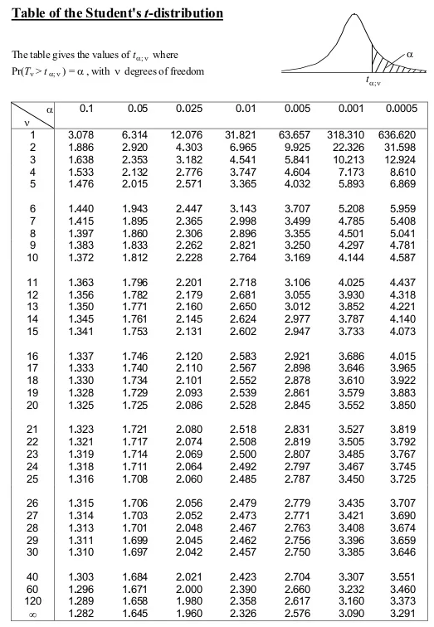
Examples of open questions
Q6. Given the results of 5 SUS questionnaires collected by 5 participants evaluating an app A:
SUS_{A} = 65, 80, 93, 78, 54
Calculate the confidence interval at 90% : 74 ± 14.25
Evaluate if an app B (evaluated by the same 5 participants) with SUS:
SUS_{B} = 90, 90, 87, 95, 91
can be said to be significantly more usable with a level of confidence >= 0.05:
t = 2.30 → NO (if it was >= 0.1, YES)

Slide 15
Examples of open questions
Q7. Provide a brief description of the following HTTP methods: GET, HEAD, POST, PUT, DELETE.
Possible answer:
GET: Method used to request the server to send a page or an object. It only retrieves data.
HEAD: Method used to ask for the response message header, without requesting the actual page content.
POST: Method used to ask to upload data to a server. With POST the client asks to the server to accept the entity enclosed in the request as a new subordinate of the resource identified by the request URL.
PUT: Method used to ask to write a content in the server to the specified URL. If the request URL refers to an already existing resource, the server replaces the existing entity with the new enclosed entity.
DELETE: Method used to ask to delete the content in the server at the specified URL.

Slide 16
Examples of open questions
Q8. List and briefly describe at least 5 of the 7 main principles of the GDPR.
Possible answer:
Lawfulness, fairness and transparency: Personal data shall be processed lawfully, fairly and in a transparent manner in relation to the data subject.
Purpose limitation: Personal data shall be collected for specified, explicit and legitimate purposes and not further processed in a manner that is incompatible with those purposes.
Data minimisation: Personal data shall be adequate, relevant and limited to what is necessary in relation to the purposes for which they are processed.
Accuracy: personal data must be accurate and, where necessary, kept up to date.
Storage limitation: personal data shall be stored in a form which permits identification of data subjects for no longer than is necessary for the purposes for which they are processed.

Slide 17
Outline
The theory exam
Project delivery instructions
Project presentation guidelines

Slide 18
General info
In the following, we reported the instructions on how to deliver your project. In a nutshell, you must prepare and submit a .pdf file containing
the number of your group and the name of each group participant
the link to a public GitHub repository containing a ”valid” version of the code
Since the project must be delivered through GitHub, code delivered via mail will be ignored
“Valid” code must be in the master (or main) branch and must have been committed no later than the 14/07/2024, and no later than the day before the project discussion date.

Slide 19
Example scenario
”I belong to Group 50 composed by me, Martina Vettoretti, and Luca Cossu”
“My code is located in my public repository named bwthw”

Slide 20
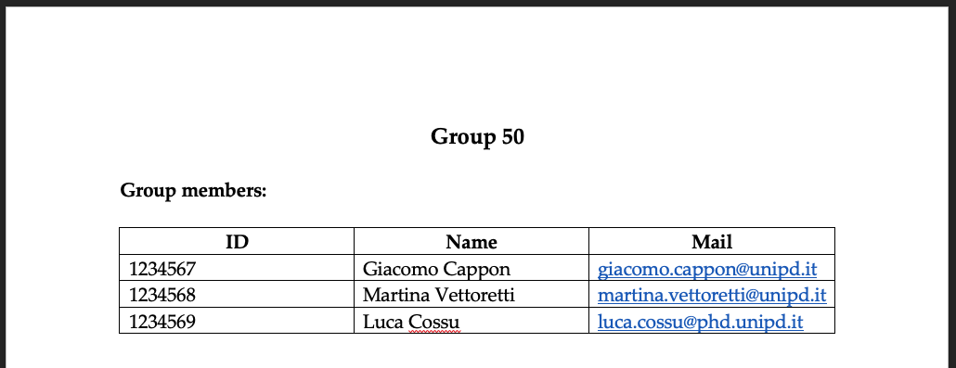
Step 1: Fill the group info
Create a .docx file
Fill the group info at the very top of the file, e.g.:

Slide 21

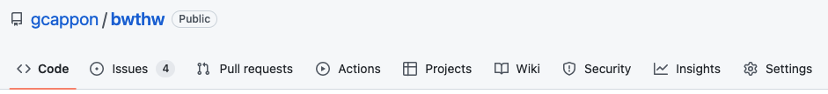
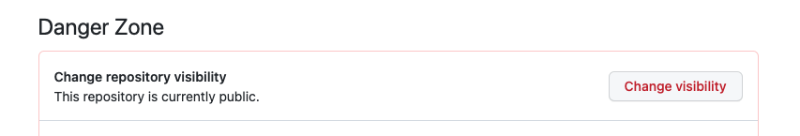
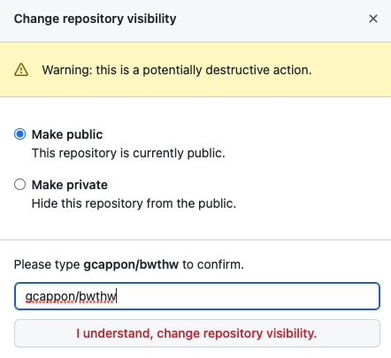
Step 2: Make your repository public
First, make sure your repository is public. This is true if, in GitHub, a “public” label is present near your repo name:
If, instead, the label says “private”, follow these steps to make it public:
Go to “Settings”
Scroll down till the “Danger Zone”
Click on “Change visibility”
Select “Make public”
Type the name of the repo to confirm
Click on the button
Notes:
We focused the laboratories on front-end development

Slide 22
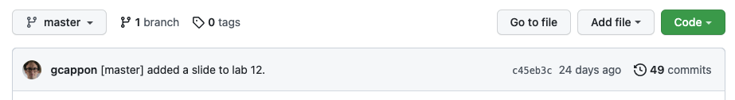
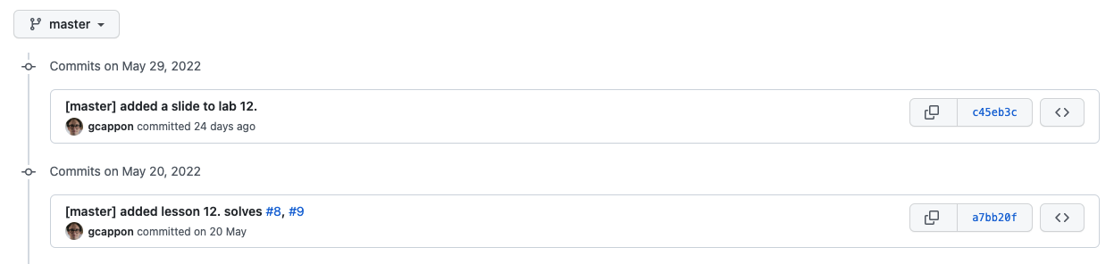
Step 3: Locate the link to a valid code version
From the home page of your GitHub repo, click on the “history” link
Click on the link of the version of the code that you want to submit
Note: be sure that your are in the master (or main) branch!

Slide 23
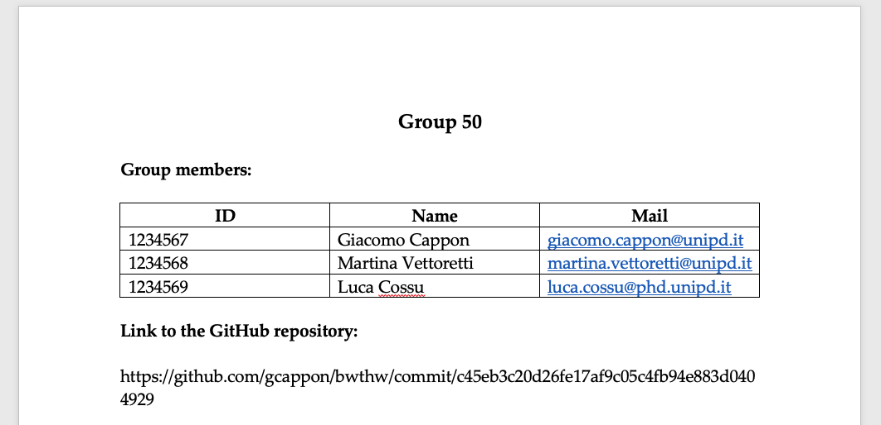
Step 4: Put the link in the .docx file
Copy and paste the link in the url bar of your browser in the .docx file below the group info, e.g.:

Slide 24


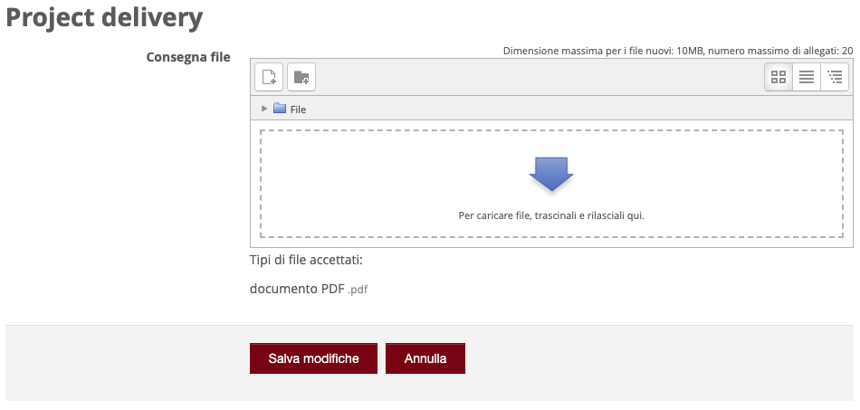
Step 5: Submit the .pdf to moodle
Export your .docx file to .pdf
Then, go to moodle. In the “Project discussion – Project delivery” section locate “Project delivery”:
Click on the delivery button:
Upload the .pdf file
Save and that’s it!

Slide 25
Outline
The theory exam
Project delivery instructions
Project presentation guidelines

Slide 26
Rationale
In the following we reported a brief guide that contains some hints on what to cover during your project discussion. As such, consider this document as a guide rather than something to “fill” with words and images.
You are free to use this PowerPoint template (style, colors, etc…) for preparing the presentation. Of course, you are also free to use your own template if you prefer.
The skeleton proposed here is just a simple guideline. Feel free to change it according to your needs.

Slide 27
Discussion structure – General info
You have 25 minutes max to present your project followed by ~20 min of Q&A. Discussions of more than 25 minutes will be penalized.
The presentation must include a PowerPoint presentation followed by a live demonstration of your app working. Both the presentation and the demo must fit the 25 minutes.
The discussion has to be in English.
The Q&A session will be in English.

Slide 28
Discussion structure – (Possible) skeleton
A possible skeleton for your discussion can be:
Background - What’s the ”story” behind your app? Is it for healthy people? Is it targeting any disease? …
Problem to be solved/Feature to be provided to the public - What’s the target user/use case? What kind of problem your app is trying to solve? What’s missing in the current market (if some)? …
Your solution - High overview of your app (name, catchy motto, …). What do you want to enable with your app? …
Core app functionalities
Screen map of your app
User authentication and management - How do you do it? …
Data collection – How do you do it? …
Data persistence – How do you manage data in your app (DB schema can be used here)? What’s the data flow inside your app? …
Data visualization and presentation – How do you visualize user data in your app? …
Original part - What’s the original part of your app? Have you implemented literature stuff? If yes, briefly describe it. …
Project management flavours - How did you work as a group? …
Special implementation decisions – Did you make implementative decisions that worth some space in the project discussion? …
Closing remarks and future developments – Sum up you discussion briefly. What are the possible evolution of your app in the future? …
Live demo - Show (via emulator or physical device) your app working.

Slide 29
Discussion suggestions
Try to motivate every choice.
Consider to split the discussion among the group participants to demonstrate that you worked as a group.
Consider to allocate around 15 minutes for the PowerPoint presentation and 10 minutes for the live demo.
Prepare the live demo. You only have 10 minutes so you must know what to ”tap”, to show, to do ,….
Be sure that your app is working when you run the demo.

