Slide 1
Giacomo Cappon
Project Delivery Instructions

Slide 2
General info
This file will instruct you on how to deliver your project. In a nutshell, you must prepare and submit a .pdf file containing
the number of your group and the name of each group participant
the link to a public GitHub repository containing a ”valid” version of the code
Since the project must be delivered through GitHub, code delivered via mail will be ignored
“Valid” code must be in the master (or main) branch and must have been committed no later than the 30th of June
Notes:
We focused the laboratories on front-end development

Slide 3
Example scenario
”I belong to Group 50 composed by me, Martina Vettoretti, and Luca Cossu”
“My code is located in my public repository named bwthw”
Notes:
We focused the laboratories on front-end development

Slide 4
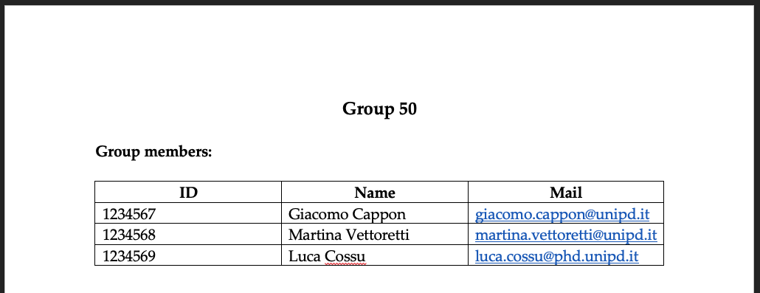
Step 1: Fill the group info
Create a .docx file
Fill the group info at the very top of the file, e.g.:
Notes:
We focused the laboratories on front-end development

Slide 5

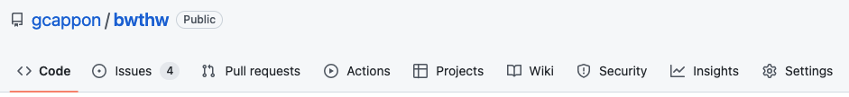
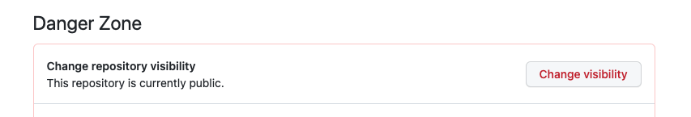
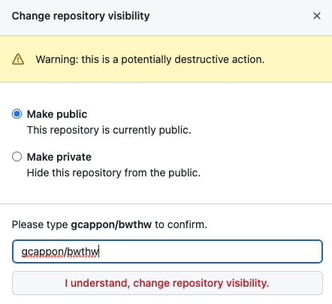
Step 2: Make your repository public
First, make sure your repository is public. This is true if, in GitHub, a “public” label is present near your repo name:
If, instead, the label says “private”, follow these steps to make it public:
Go to “Settings”
Scroll down till the “Danger Zone”
Click on “Change visibility”
Select “Make public”
Type the name of the repo to confirm
Click on the button
Notes:
We focused the laboratories on front-end development

Slide 6
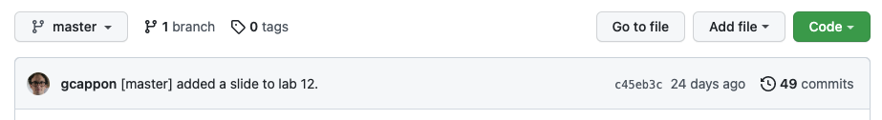
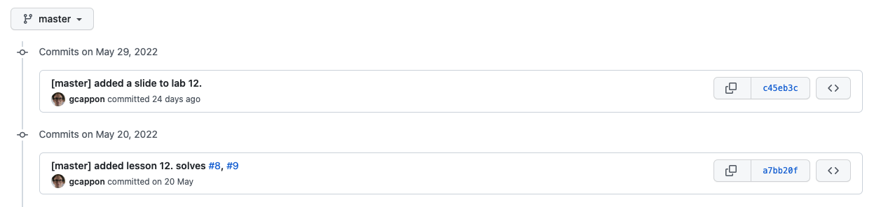
Step 3: Locate the link to a valid code version
From the home page of your GitHub repo, click on the “history” link
Click on the link of the version of the code that you want to submit
Note: be sure that your are in the master (or main) branch!
Notes:
We focused the laboratories on front-end development

Slide 7
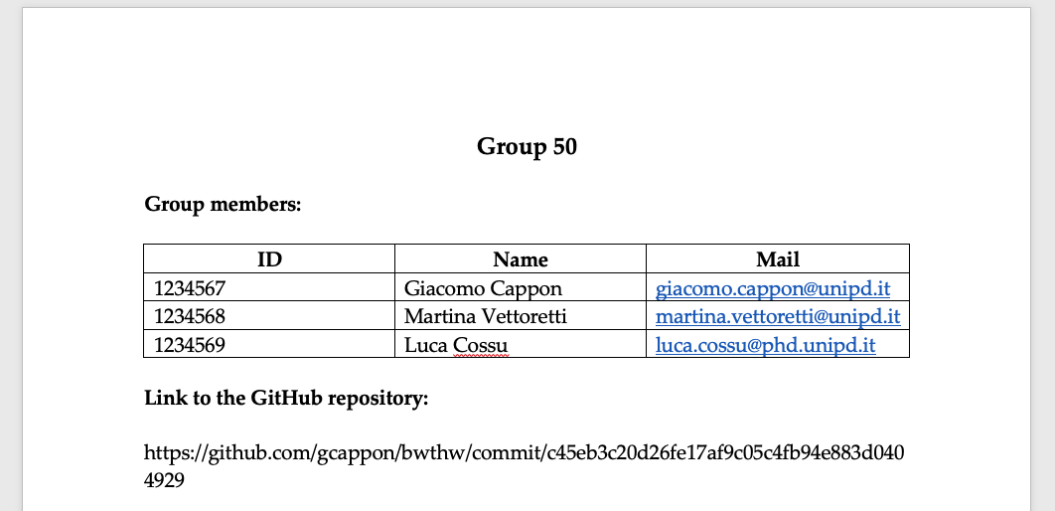
Step 4: Put the link in the .docx file
Copy and paste the link in the url bar of your browser in the .docx file below the group info, e.g.:
Notes:
We focused the laboratories on front-end development

Slide 8


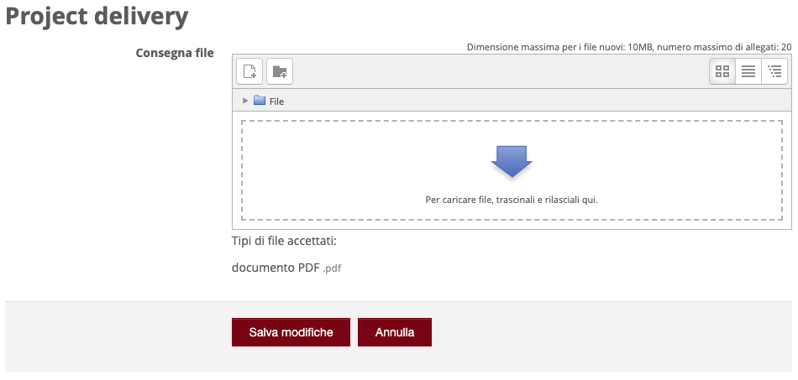
Step 5: Submit the .pdf to moodle
Export your .docx file to .pdf
Then, go to moodle. In the “Project discussion – Project delivery” section locate “Project delivery”:
Click on the delivery button:
Upload the .pdf file
Save and that’s it!
Notes:
We focused the laboratories on front-end development

