Slide 1
Giacomo Cappon
Hello, Flutter!

Slide 2
Outline
Recap
Creating a new project
App dissection
Expanding our first app
Homework & Resources
Final project overview

Slide 3
Outline
Recap
Creating a new project
App dissection
Expanding our first app
Homework & Resources
Final project overview

Slide 4

Flutter
What is Flutter?
Simply a declarative framework for Dart
Why this choice?
State-of-the-art and Google-maintained
Single codebase for iOS and Android (and Mac, Windows, Web)
Relatively easy to learn
Lots of examples
Fastly growing job market
Today we will create and study our first Flutter app

Slide 5

Before starting…
What you’ll see in these labs about Flutter examples
Actual things that you will probably use
Flutter possibilities

Slide 6
Outline
Recap
Creating a new project
App dissection
Expanding our first app
Homework
Resources
Final project overview

Slide 7
Hello, Flutter!
In this lesson, we will run and analyse our first Flutter app
First, setup VS Code to work with Flutter
Start VS Code.
Invoke View > Command Palette….
Type “install”, and select Extensions: Install Extensions.
Type “flutter” in the extensions search field, select Flutter in the list, and click Install. This also installs the required Dart plugin.
Then, create the app
Invoke View > Command Palette.
Type “flutter”, and select the Flutter: New Project.
Select Application
Select the parent directory that will contain the app
Enter a project name, such as ”my_first_app”, and press Enter.
Wait for project creation to complete and the main.dart file to appear.

Slide 8
Hello, Flutter!
Replace all the code of main.dart with
import 'package:flutter/material.dart'; void main() {
runApp(const MyApp());
}//main class MyApp extends StatelessWidget {
const MyApp({Key? key}) : super(key: key);
@override
Widget build(BuildContext context) {
return MaterialApp(
title: 'Welcome to Flutter’,
home: Scaffold(
appBar: AppBar(title: const Text('Welcome to Flutter'),),
body: const Center(child: Text('Hello World'),),),
);
}//build
}//MyApp

Slide 9
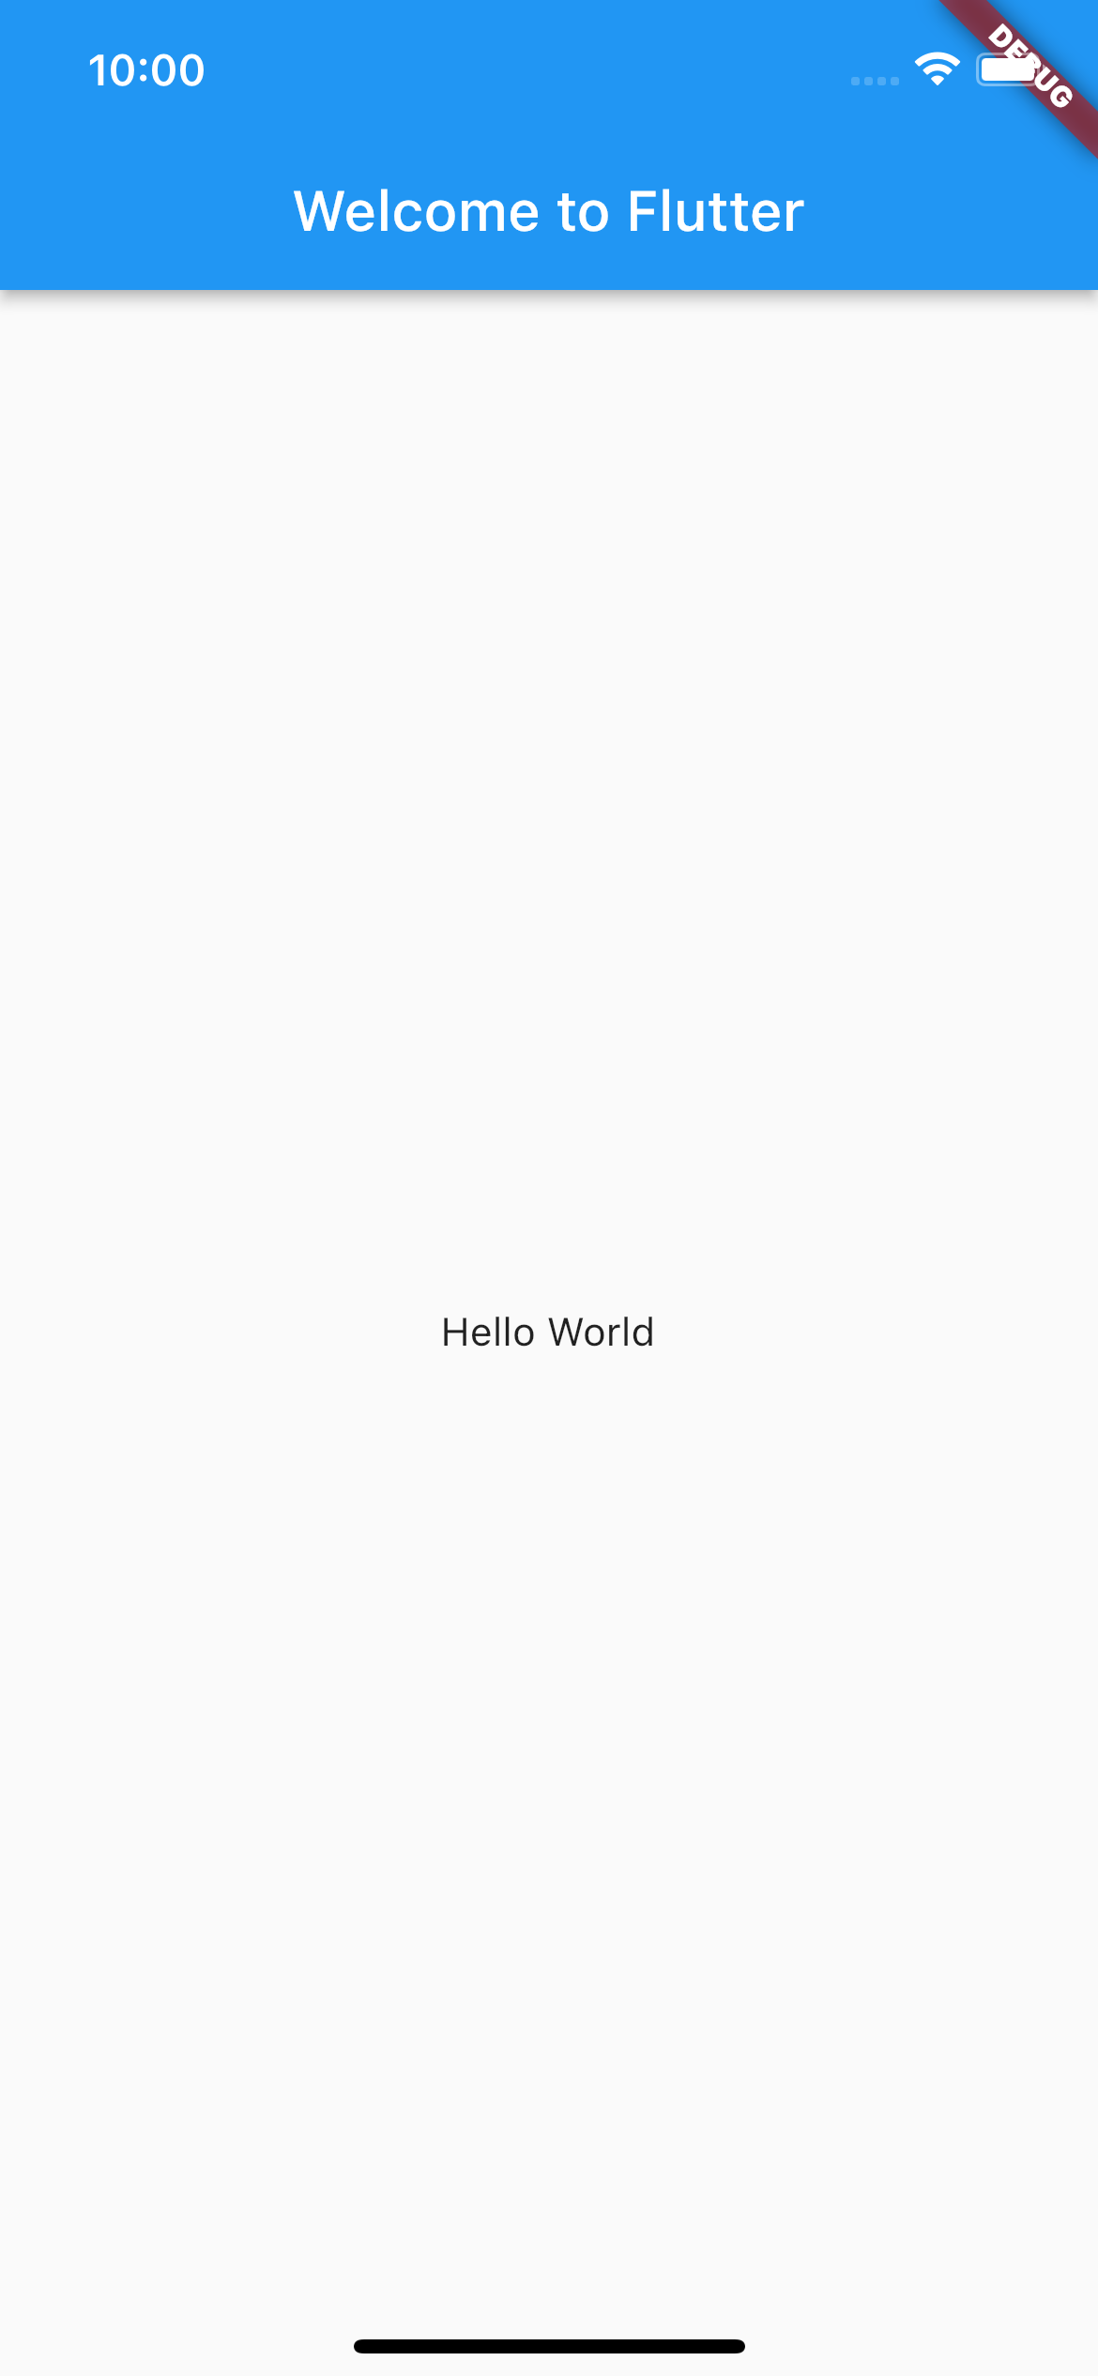
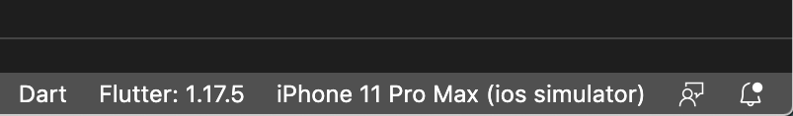
Hello, Flutter!
Finally, run the app!
Locate the VS Code status bar (the blue bar at the bottom of the window):
Select a mobile device from the Device Selector area
Invoke Run > Start Debugging or press F5
Wait for the app to launch — progress is printed in the Debug Console view.
After the app build completes, you’ll see the starter app on your device.

Slide 10
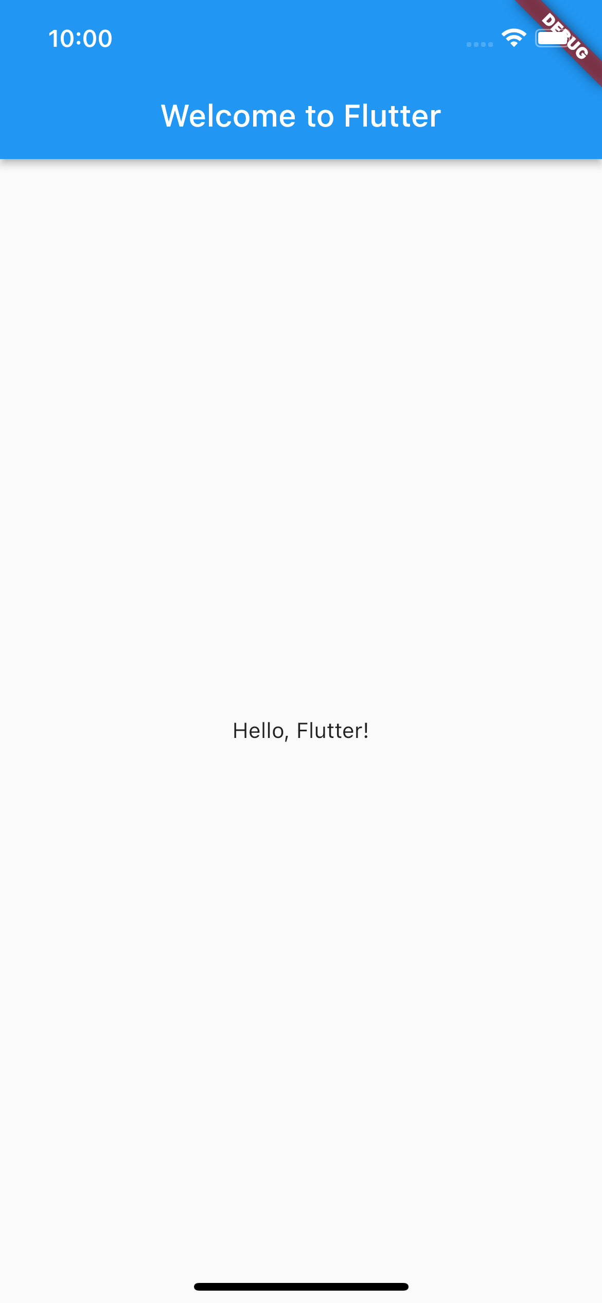
A great feature: Hot reload
Dart offers a fast development cycle with Stateful Hot Reload, the ability to reload the code of a live running app without restarting or losing app state. Make a change to app source, tell your IDE or command-line tool that you want to hot reload, and see the change in your simulator, emulator, or device.
Try that!
Open lib/main.dart.
Change the string
‘Hello World’
with
‘Hello, Flutter!’
Save your changes: invoke Save All, or click Hot Reload
You’ll see the updated string in the running app almost immediately.

Slide 11
Outline
Recap
Creating a new project
App dissection
Expanding our first app
Homework & Resources
Final project overview

Slide 12
Let’s dissect the app
Let’s understand what we have done.

Slide 13
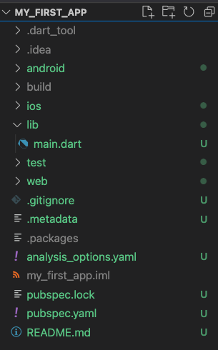
Let’s dissect the app – Project folder
First, what’s inside the project folder?
Important things
lib folder: it contains the app source code
main.dart file: the entry point for the compiler
pubspec.yaml file: it specifies high level app features as well as listing which third party libraries our app needs and uses
README.md file: a markdown file describing the app
(Less) Important things
android/ios/web folders: where native specific code can be defined if needed
test folder: where to put code for running automatic testers
(Even less) Important things
All other folders and files are very use case specific and probably you will never use those in this course. If you are curious…
Notes:
Note the .gitignore file.

Slide 14
Let’s dissect the app – main.dart
Let’s understand the main.dart file.
import 'package:flutter/material.dart'; void main() {
runApp(const MyApp());
}//main class MyApp extends StatelessWidget {
const MyApp({Key? key}) : super(key: key);
@override
Widget build(BuildContext context) {
return MaterialApp(
title: 'Welcome to Flutter’,
home: Scaffold(
appBar: AppBar(title: const Text('Welcome to Flutter'),),
body: const Center(child: Text('Hello World'),),),
);
}//build
}//MyApp
To run an app using the Flutter framework we can use the runApp method which takes a Widget object as an input.
What’s a Widget?

Slide 15
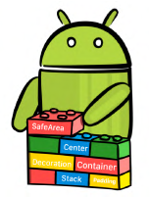

Everything is a Widget
In Flutter, almost everything is (inherits from) a Widget!
A Widget is a building block for your user interface (UI). Using widgets is like combining Legos.
More technically, a Widget is a sort of blueprint for displaying your app state.
Widgets can be thought as a function of UI. Given a state, the build() method (that every custom Widget must override and implement) constructs the widget UI:

Slide 16
Let’s dissect the app – main.dart
In bold the Widgets of our app
import 'package:flutter/material.dart'; void main() {
runApp(const MyApp());
}//main class MyApp extends StatelessWidget {
const MyApp({Key? key}) : super(key: key);
@override
Widget build(BuildContext context) {
return MaterialApp(
title: 'Welcome to Flutter’,
home: Scaffold(
appBar: AppBar(title: const Text('Welcome to Flutter'),),
body: const Center(child: Text('Hello World'),),),
);
}//build
}//MyApp
Key method for building the Widget that must be implemented
But how Widgets are combined together?

Slide 17
The Widget Tree
Widgets are combined together using a tree structure
import 'package:flutter/material.dart'; void main() {
runApp(const MyApp());
}//main class MyApp extends StatelessWidget {
const MyApp({Key? key}) : super(key: key);
@override
Widget build(BuildContext context) {
return MaterialApp(
title: 'Welcome to Flutter’,
home: Scaffold(
appBar: AppBar(title: const Text('Welcome to Flutter'),),
body: const Center(child: Text('Hello World'),),),
);
}//build
}//MyApp
main
MyApp
MaterialApp
Scaffold
AppBar
Center
Text
Text

Slide 18
State and widgets
In bold the Widgets of our app
import 'package:flutter/material.dart'; void main() {
runApp(const MyApp());
}//main class MyApp extends StatelessWidget {
const MyApp({Key? key}) : super(key: key);
@override
Widget build(BuildContext context) {
return MaterialApp(
title: 'Welcome to Flutter’,
home: Scaffold(
appBar: AppBar(title: const Text('Welcome to Flutter'),),
body: const Center(child: Text('Hello World'),),),
);
}//build
}//MyApp
MyApp is not just a Widget, it is a StatelessWidget

Slide 19
Stateless vs. Stateful widgets
StatelessWidgets are Widgets that always build the same way given a particular configuration and ambient state. So, they never re-build while they are displayed to the user (their lifetime).
StatefulWidgets for widgets that can build differently several times over their lifetime.
You can think about StatelessWidget as a sort of constant and StatefulWidget as a variable.

Slide 20
Let’s dissect the app – pubspec.yaml
pubspec.yaml contains high-level instructions for the development environment and information on the app
name: my_first_app
description: A new Flutter project.
publish_to: 'none’
version: 1.0.0+1
environment:
sdk: ">=2.15.1 <3.0.0"
dependencies:
flutter:
sdk: flutter cupertino_icons: ^1.0.2
dev_dependencies:
flutter_test:
sdk: flutter
flutter_lints: ^1.0.0
flutter: uses-material-design: true
my_first_app information (name, description, version, …)
Flutter sdk version to be used
App dependencies: what the app needs in order to work: other packages? Other libraries? Put them here.
App dependencies while developing the app
Information for the Flutter environment such as where to find assets.
Full example in lab_04-hello_flutter/my_first_app/

Slide 21

DevTools
BONUS
DevTools is a suite of performance and debugging tools for Dart and Flutter.

Slide 22
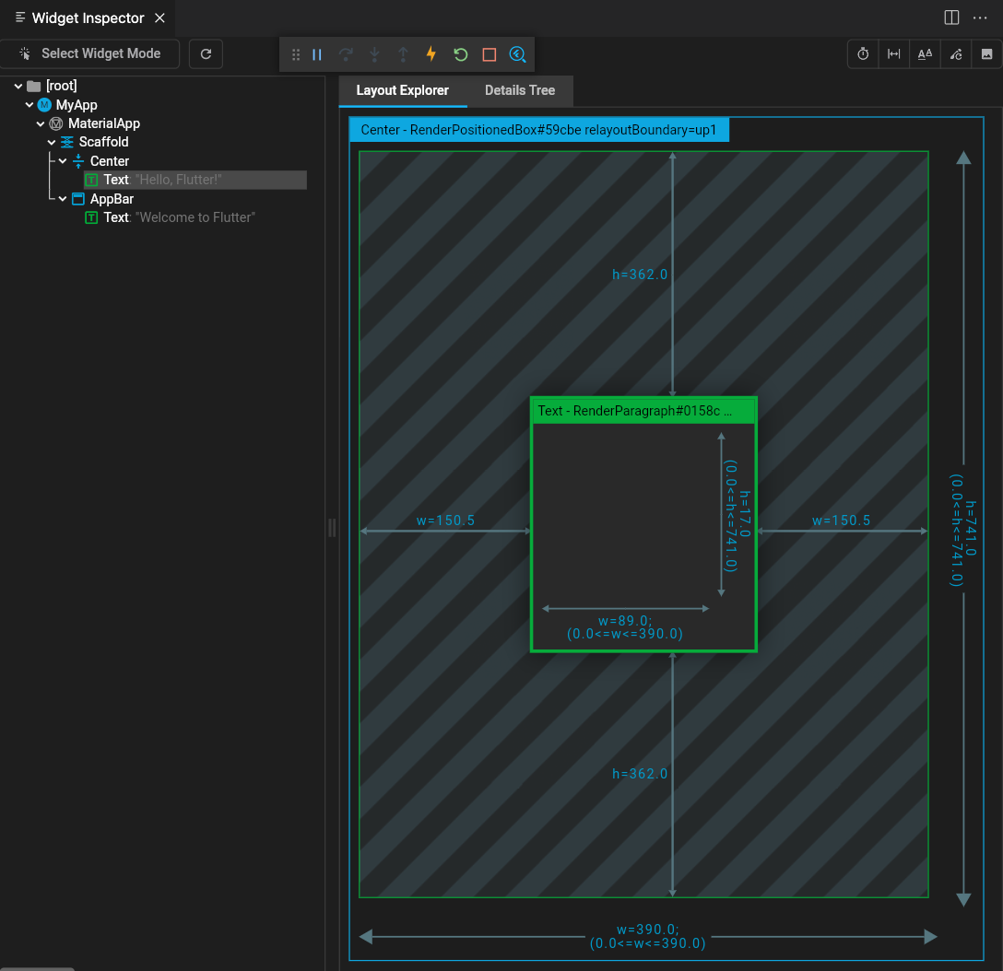
DevTools
BONUS
Simple example: with DevTools you can see the Widget Tree and it’s layout!
main
MyApp
MaterialApp
Scaffold
AppBar
Center
Text
Text

Slide 23
Outline
Recap
Creating a new project
App dissection
Expanding our first app
Homework & Resources
Final project overview

Slide 24
My first app with steroids
Let’s play with my_first_app and let’s expand it
Aim: change my_first_app to this
We will learn how to:
Install an external package and add it as a dependency
Use the external package inside our app
StatefulWidgets 101
How to modify the UI

Slide 25
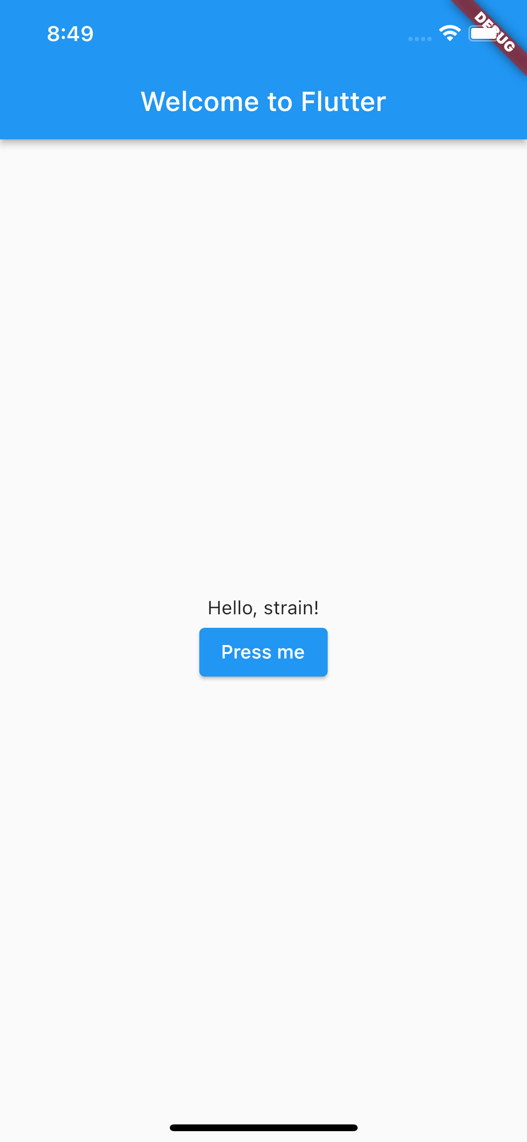
My first app with steroids
Aim: The result will be a very simple app that, each time a button is tapped, a new random ”Hello” message is shown to the user.

Slide 26
My first app with steroids
Roadmap
Understand what to use to generate a random word
Generate a random word and check that everything is working
Display the word in the “Hello” message
Modify the UI to generate a new message each time a button is tapped

Slide 27
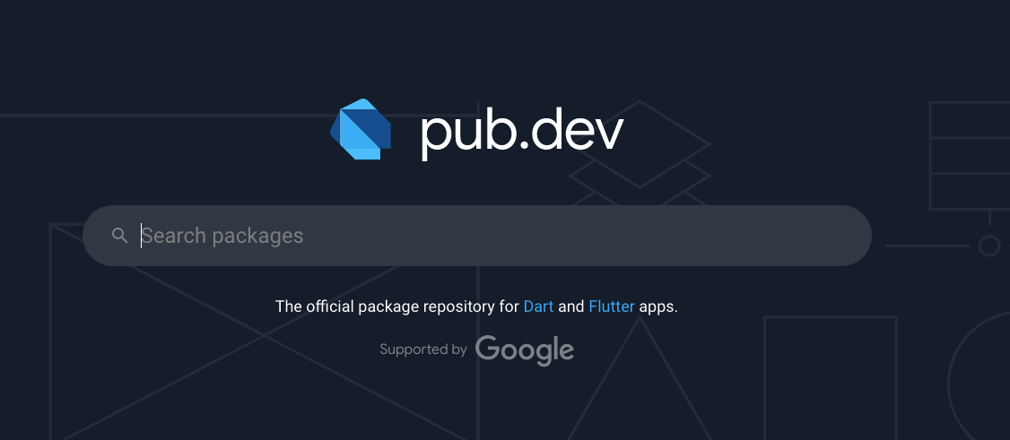
Solving point 1
We do not want to code a random English word generator!
On the Internet we can find a lot of already made code and ready-to-use packages that can fit your needs
A place that we will visit often during this course is pub.dev:

Slide 28
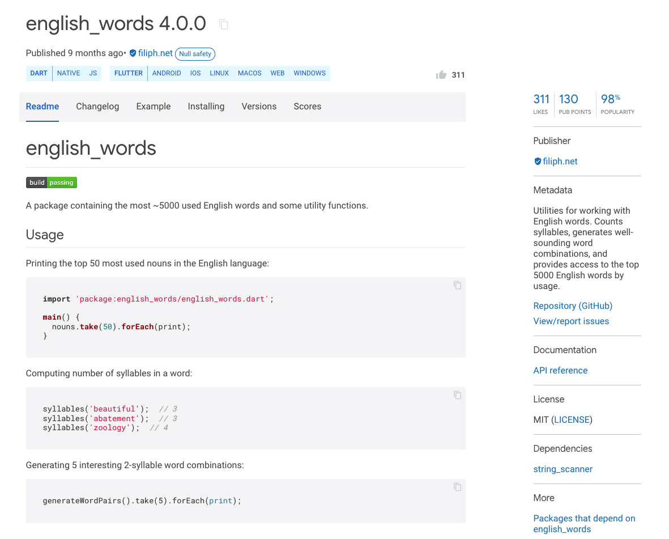
This is the package I was looking for
After some research, it seems like the english_words package can solve our needs
It can generate words and words pairs!
How to use it? Docs!
Code is available too!

Slide 29
Including english_words in the app
Installing the english_words package in our app is very easy.
By definition, it is a dependency right?
So, let’s add it under the dependency list of our app into pubspec.yaml
After adding it, save pubspec.yaml and you will see VSCode running flutter pub get for you.
Done!
...
dependencies:
flutter:
sdk: flutter
cupertino_icons: ^1.0.2
english_words: ^4.0.0
...

Slide 30

My first app with steroids
Roadmap
Understand what to use to generate a random word
Generate a random word and check that everything is working
Display the word in the “Hello” message
Modify the UI to generate a new message each time a button is tapped

Slide 31
Generating a random word
Let’s add some line of code to main.dart to generate a word using the english_words package
Modify the build method by adding
final word = WordPair.random().first;
before the return statement and run the app.
Nothing it’s happening. How to see if we are generating a random word?
We can use the logger and the debug console!

Slide 32
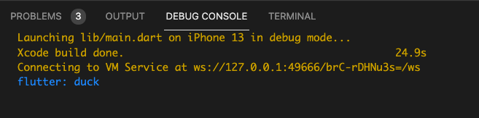
Logging things
Simply try to print the word value as a normal Dart program:
final word = WordPair.random().first;
print(word);
If you run the application now you will see something like this in the Debug Console of VS Code:

Slide 33

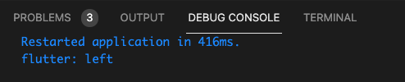
Logging things
Every time you reload/restart the app
…you will see a different word
Restart button
Reload button

Slide 34
My first app with steroids
Roadmap
Understand what to use to generate a random word
Generate a random word and check that everything is working
Display the word in the “Hello” message
Modify the UI to generate a new message each time a button is tapped

Slide 35
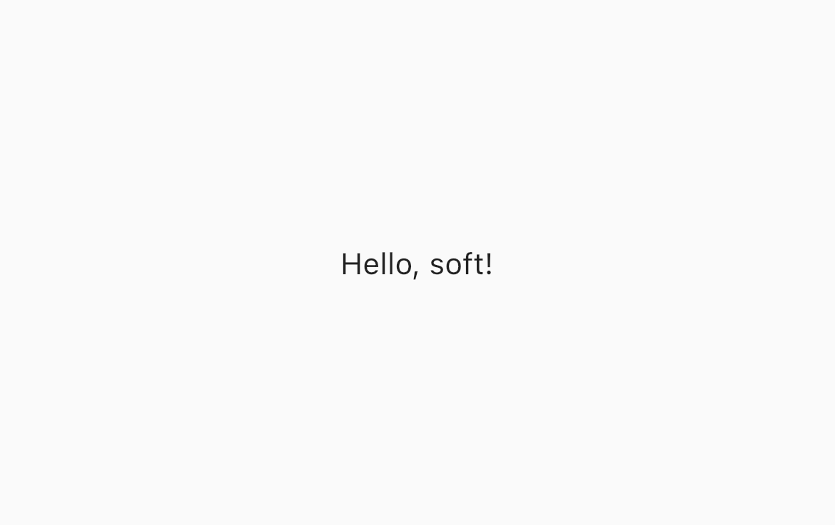
Change the Hello message
You should be able to solve this point by yourself now
Simply, using string interpolation, change
‘Hello, Flutter!’ to ’Hello, $word!’
and save to reload the app and see the changes.

Slide 36
My first app with steroids
Roadmap
Understand what to use to generate a random word
Generate a random word and check that everything is working
Display the word in the “Hello” message
Modify the UI to generate a new message each time a button is tapped

Slide 37
Changing the UI
Let’s start by simply changing the UI
We need to obtain something like
Problems:
How to add a button
How to put it there

Slide 38
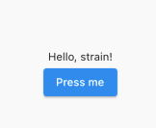
The Column Widget
We can use the Column widget.
It has a list of children (not like Text or Center or Scaffold)
Children are lined up to a column from top to the bottom
Column( children: [ Child#1, Child#2, ], );
Column
Child#1
Child#2

Slide 39
Implement the new UI
Change the build method of MyApp to
Widget build(BuildContext context) {
final word = WordPair.random().first;
print(word);
return MaterialApp(
title: 'Welcome to Flutter’,
home: Scaffold(
appBar: AppBar(title: const Text('Welcome to Flutter'),),
body: Center(
child: Column(
mainAxisAlignment: MainAxisAlignment.center,
children: [
Text('Hello, $word!’),
ElevatedButton(onPressed: (){}, child: const Text('Press me')),
],
),),),
);
}//build

Slide 40

Different UI, different tree
How the widget tree changed?
...
...
Scaffold
Scaffold
AppBar
Center
AppBar
Center
Text
Column
Text
Text
MainAxisAlignment
ElevatedButton
Text
Text

Slide 41
Changing the UI
(New) Problem: How to change the message when we press the button?
In other words: how to change the app state without reloading or restarting everything
We need a StatefulWidget

Slide 42
StatefulWidget
As we mentioned before, stateful widgets maintain state that might change during the lifetime of the widget.
Implementing a stateful widget requires at least two classes:
A StatefulWidget class that creates an instance of…
…a State class.
Note: The StatefulWidget class is, itself, immutable and can be thrown away and regenerated, but the State class persists over the lifetime of the widget.

Slide 43
The boilerplate code of a StatefulWidget
class RandomHello extends StatefulWidget{
const RandomHello({Key? key}) : super(key: key);
@override
_RandomHelloState createState() => _RandomHelloState();
}//RandomHello
class _RandomHelloState extends State<RandomHello>{
@override
Widget build(BuildContext buildContext){
//return some widget
}//build
}//_RandomHelloState
Note: the state is private to the Widget. Not necessary, but it is a good practice to understand what is private and what is not.

Slide 44
Refactoring the UI - RandomHello
Let’s copy some code into the build method new Widget
... class _RandomHelloState extends State<RandomHello>{
@override
Widget build(BuildContext buildContext){
final word = WordPair.random().first;
return Column(
mainAxisAlignment: MainAxisAlignment.center,
children: [
Text('Hello, $word!’),
ElevatedButton(onPressed: (){}, child: const Text('Press me')),
],
);
}//build
}//_RandomHelloState

Slide 45
Refactoring the UI - MyApp
Now let’s refactor the MyApp code
class MyApp extends StatelessWidget {
const MyApp({Key? key}) : super(key: key);
@override
Widget build(BuildContext context) {
return MaterialApp(
title: 'Welcome to Flutter’,
home: Scaffold(
appBar: AppBar(title: const Text('Welcome to Flutter'),),
body: const Center(child: RandomHello(),),
),
);
}//build
}//MyApp

Slide 46
Same UI, different tree
The UI should look like the same as before, but we have a new widget tree
...
...
Scaffold
Scaffold
AppBar
Center
AppBar
Center
Text
Column
Text
RandomHello
MainAxisAlignment
ElevatedButton
Text
Column
Text
MainAxisAlignment
ElevatedButton
Text
Text

Slide 47
void initState(){}
Let’s do some changes to RandomHello to make it more stateful
class _RandomHelloState extends State<RandomHello>{
String? _word;
@override
void initState() {
_word = WordPair.random().first;
super.initState();
}//initState
...
_word will represent the state of the Widget
initState is a special method that is called the first time the Widget is created. It is used (as its name suggest) to initialize the state of the Widget itself.

Slide 48
setState((){})
We are ready to implement the function to provide to onPressed
...
@override
Widget build(BuildContext buildContext){
return Column(
mainAxisAlignment: MainAxisAlignment.center,
children: [
Text('Hello, $_word!’),
ElevatedButton(onPressed: _changeWord, child: const Text('Press me')),
],);
}//build
void _changeRandomWord(){
setState(() {
_word = WordPair.random().first;
});
}//_changeRandomWord
...
setState is a special method that requires a callback function as input. setState notifies the Flutter framework that the state might be changed causing to delete and rebuild the widget itself.

Slide 49
My first app with steroids
Roadmap
Understand what to use to generate a random word
Generate a random word and check that everything is working
Display the word in the “Hello” message
Modify the UI to generate a new message each time a button is tapped
Full example in lab_04-hello_flutter/my_first_app_with_steroids/

Slide 50
Outline
Recap
Creating a new project
App dissection
Expanding our first app
Homework & Resources
Final project overview

Slide 51
Homework
Get familiar with the structure of a Flutter project and how to install new packages using pubspec.yaml
Get familiar with the concept of Widget
To know what to do to create a StatelessWidget and a StatefulWidget
Understanding the Flutter flow

Slide 52
Resources
Introduction to Widgets
https://docs.flutter.dev/development/ui/widgets-intro
Write your first Flutter app, part 1 codelab
https://docs.flutter.dev/get-started/codelab
DevTools
https://docs.flutter.dev/development/tools/devtools/overview ∂

Slide 53
Outline
Recap
Creating a new project
App dissection
Expanding our first app
Homework & Resources
Final project overview

Slide 54
What’s the spirit here
The goal is learning “How do SOMETHING using wearable devices”
What I DO expect from you
To use your imagination to create that SOMETHING
To learn to build something from scratch
To use code built by others
To work together
To use Google and StackOverflow
What I DO NOT expect from you
To create the new Google
To reinvent the wheel (copying others code is fine)
To create extra complicated UI with animations and stuff
To implement sophisticated design pattern (even if it would be a nice thing to do)

Slide 55
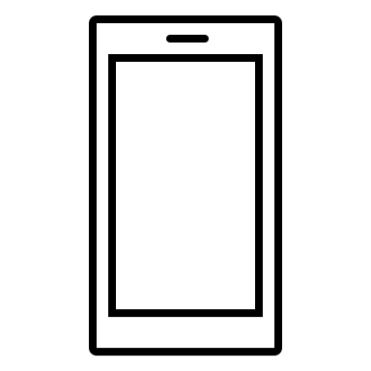
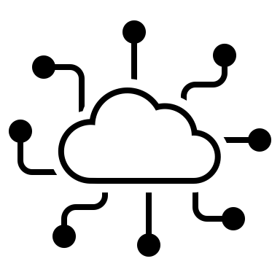

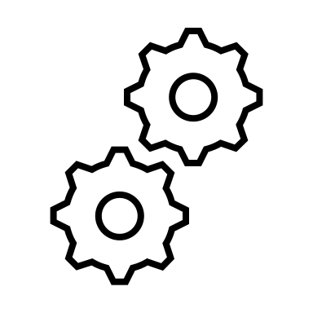
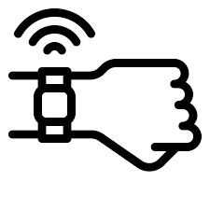
Project structure
The project consists of building an app for iOS or Android that collects user data from a wearable device through Web APIs, stores them, visualizes them, and does some tricks with them.
Core functionalities:
User authentication and management
Data collection
Data persistence
Data visualization and presentation
Additional fuctionalities → It’s up to you! Some examples:
Run some analysis on data and provide suggestions to the user
Implement some literature algorithm
…

Slide 56
Grading
What are the grading criteria
Originality of the additional feature
Quality of teamwork
Compliance to core functionalities
The vote is 32/30 (31/32 = 30L)
How the grade is split?
20 points: core functionalities
8 points: additional app functionalities
4 points: GIT working tree

