Slide 1
Quantitative Usability Evaluation

Slide 2

Usability
Usability has an international standard definition in ISO 9241-11: the extent to which a product can be used by specified users to achieve specified goals with effectiveness, efficiency, and satisfaction in a specified context of use.
Three separate components:
Effectiveness: whether people can actually complete their tasks and achieve their goals
Efficiency: the extent to which they expend resource in achieving their goals
Satisfaction: the level of comfort they experience in achieving those goals
Thus, a system that lets people complete their tasks, but at the expense of considerable expenditure of time and effort and which was felt to be very unsatisfactory by all concerned, could not really be said to be usable.
Seamlessly, a system which people enjoyed using but which didn’t allow them to complete any tasks and on which they spent a lot of unproductive time is not very usable.

Slide 3
Usability
Problem: ISO 9241-11 makes the point that there are no specific guidelines on how to measure effectiveness, efficiency, and satisfaction since they depend on:
Background/Experience of the user
Task that the user must perform
Environment in which the task is performed
There are generally two types of usability tests:
Formative tests
Summative tests

Slide 4

Formative tests
Formative tests: they are the bulk of usability testing, and they have the aim of finding and fixing usability problems
Data from formative tests take the form of problem descriptions and design recommendations
Quantification can be made in terms of frequency and severity of an encountered problem, time to complete a task, completion rate of a task.

Slide 5
Summative tests
Summative tests have the aim of describing the usability of an application using metrics. They are of two types: benchmark and comparative
Benchmark Usability Tests: aim to describe how usable an application is relative to a set of benchmark goals. They provide:
Input on what to fix in an interface
Baseline for the comparison of post-design changes
Comparative Usability Tests: aim to compare usability of two or more applications or different versions of the same application
They allow to identify the best tool for the job from the point-of-view of usability

Slide 6
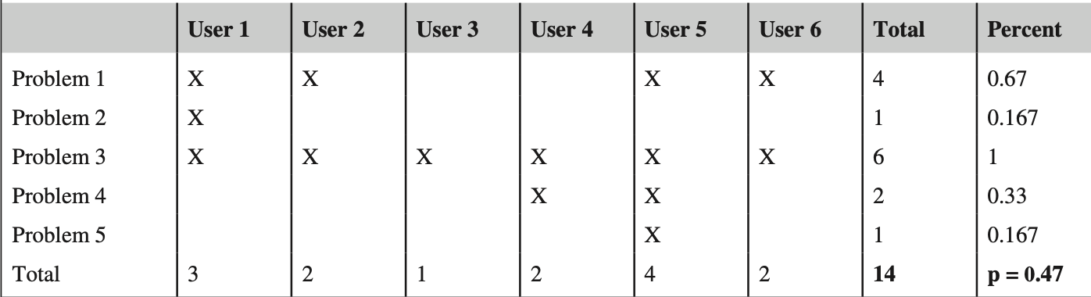
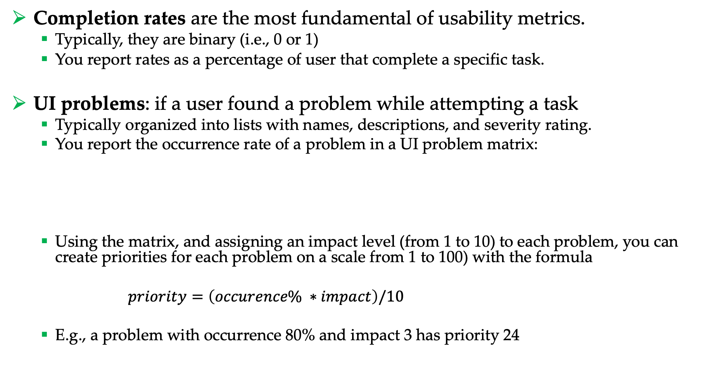
Metrics
Completion rates are the most fundamental of usability metrics.
Typically, they are binary (i.e., 0 or 1)
You report rates as a percentage of user that complete a specific task.
UI problems: if a user found a problem while attempting a task
Typically organized into lists with names, descriptions, and severity rating.
You report the occurrence rate of a problem in a UI problem matrix:
Using the matrix, and assigning an impact level (from 1 to 10) to each problem, you can create priorities for each problem on a scale from 1 to 100) with the formula
$priority=\left(occurence\% ∗impact\right)/10$
E.g., a problem with occurrence 80% and impact 3 has priority 24

Slide 7
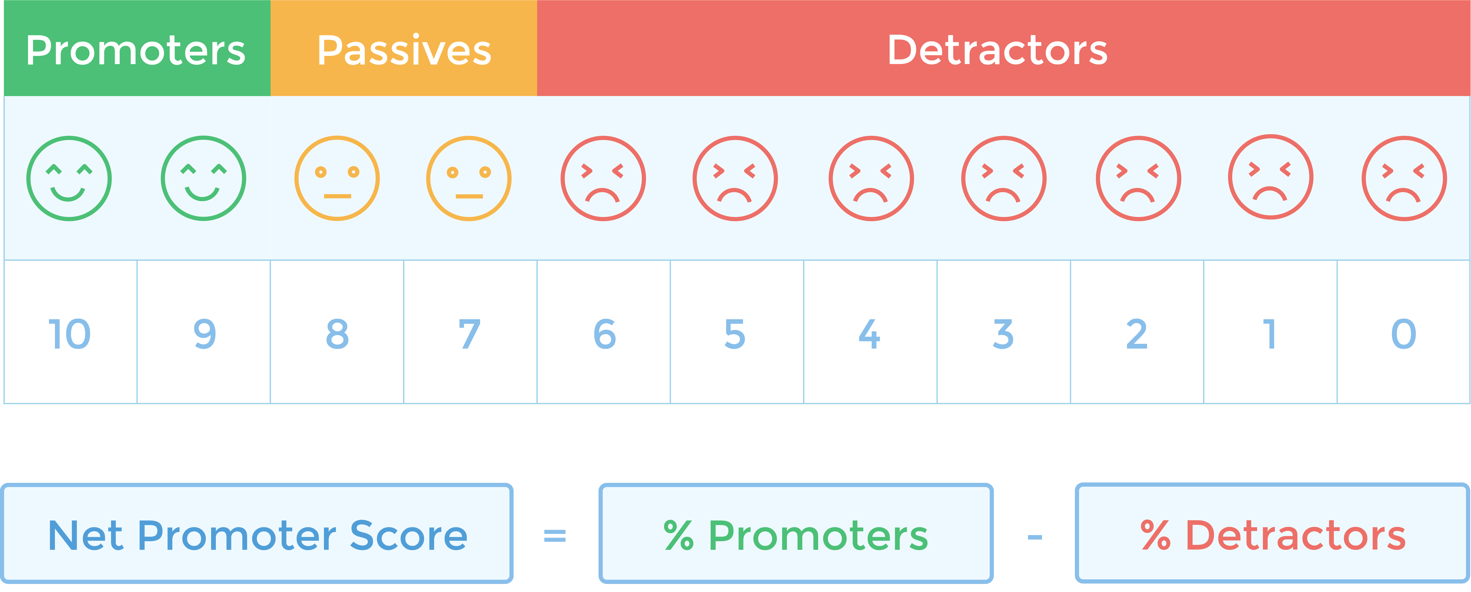
Metrics
Net promoter score (NPS): is a score based on a single question on loyalty: “How likely it is that you will recommend this product to a friend or colleague on a scale from 0 to 10?”
You are a:
Promoter if your response is 9 or 10
Passive if your response is 7 or 8
Detractor if your response is < 7
NPS is computed subtracting the percentage of promoters with the percentage of detractors
The final score goes from -100% to 100%

Slide 8
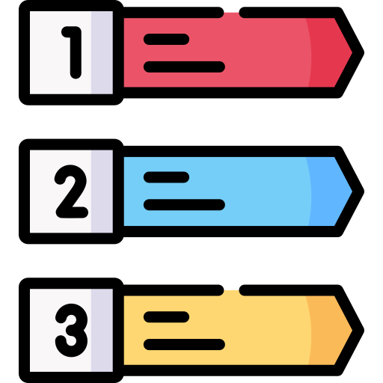
Metrics
Comments and open-ended data: can be very heterogeneous and might include:
Reasons why users are promoters or detractors for an app
User insights from field studies
App complaints to calls to user service
Why a task was difficult
Requirement list: features that a user identify as necessary in your app but it is still not implemented.

Slide 9

Satisfaction ratings
Satisfaction ratings: obtained via standardized usability questionnaries.
Standardized usability questionnaires (SUQ) consists of a collection of question items each associated to an underneath score. At the end, all questions are collected in a single value (i.e., satisfaction rating) that provide a standardized measure.
The advantages of SUQ include:
Objectivity: independent verification of the measurement
Replicability: it is easy to replicate the studies of others
Quantification: results can be quantified via numbers and statistics
Economy: very cheap to reuse
Communication: results are very easy to communicate
Generalization: it is fundamental that the results are generalizable

Slide 10
Assessing the quality of a SUQ
However, we cannot just put together a bunch of questions to create a good SUQ. Indeed, a good SUQ must be reliable, valid, sensitive.
Reliability: consistency of measurement
Can be measured via the Cronbach’s alpha. Can range between 0 (no reliability) and 1 (perfect reliability). Measures that can affect a person’s future (e.g., college entrance test) should have a minimum alpha of 0.9. For other research or evaluations > 0.7 is acceptable.
Validity: am I measuring what I am trying to measure?
Sensitivity: it must be sensitive to experimental manipulations
For example, responses from participants who experience difficulties working with Product A but find Product B easy to use should reflect a statistically significant difference in the overall SEQ outcome

Slide 11
Available SUQ
SUQ can be administered at the end of each task, i.e., post-task:
After-Scenario Questionnaire (ASQ) - Lewis, 1991
Expectation Ratings (ER) – Albert and Dixon, 2003
Usability Magnitude Estimation (UME) – McGee, 2004
Single Ease Question (SEQ) – Sauro, 2010
Subjective Mental Effort Question (SMEQ) – Sauro and Dumas, 2009
…or at the end of the entire study, i.e., post-study:
Questionnaire for User Interaction Satisfaction (QUIS) – Chin et al., 1988
Software Usability Measurement Inventory (SUMI) – Kirakowski and Corbett, 1993
Post-Study System Usability Questionnaire (PSSUQ) – Lewis, 1995
System Usability Scale (SUS) – Brooke, 1996
General recommendation:
Post-test: SEQ or SMEQ
Post-study: SUS

Slide 12
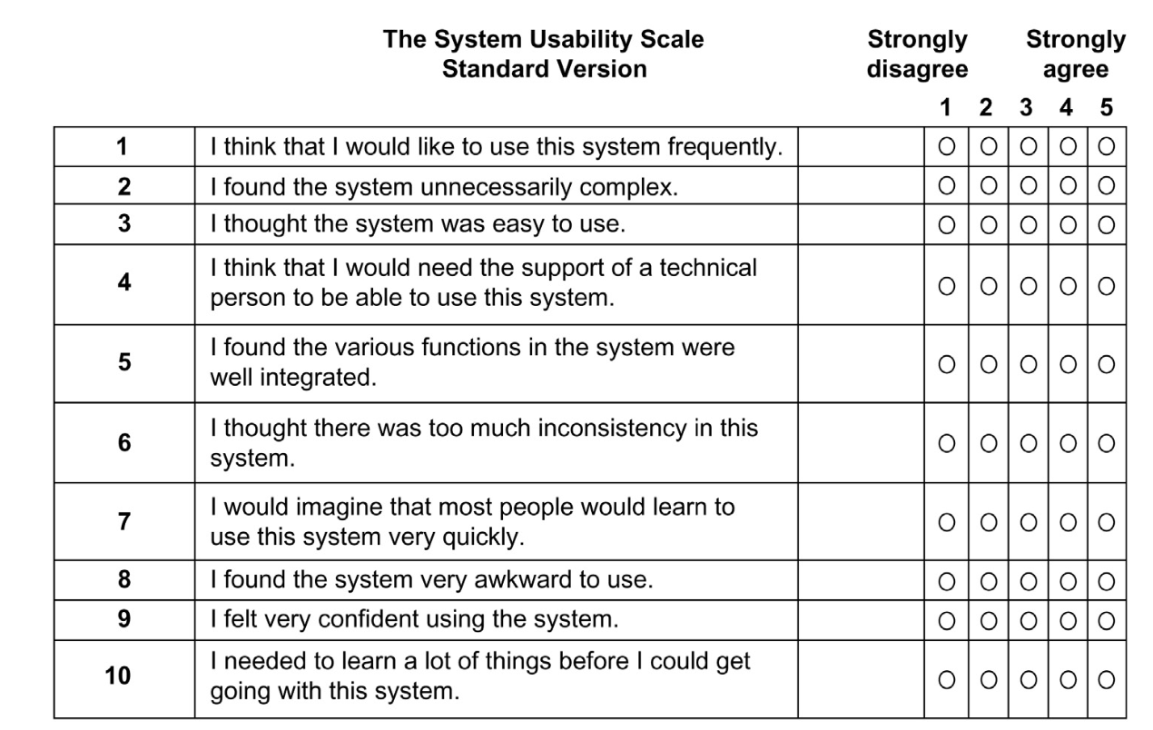
SUS
5 “Positively” worded items
5 ”Negatively” worded items

Slide 13
Evaluation of SUS
The ten SUS items were selected from a pool of 50 potential items, based on the responses of 20 people who used the full set of items to rate two software systems, one of which was relatively easy to use, and the other relatively difficult.
The items selected for the SUS were those that provided the strongest discrimination between the systems.
In the original paper by Brooke (1996), he did not report any measures of reliability or validity, referring to the SUS as a quick and dirty usability scale.
An early assessment of the SUS indicated a reliability of 0.85. More recent estimates using larger samples have consistently found its reliability to be at or just over 0.90.

Slide 14
How SUS score works
Each item's score contribution ranges from 0 to 4.
For items 1, 3, 5, 7, and 9 (the positively worded items) the score contribution is the scale position minus 1.
For items 2, 4, 6, 8, and 10 (the negatively worded items), the contribution is 5 minus the scale position.
You then multiply the sum of the scores by 2.5 to obtain the overall value of SUS.

Slide 15
Example – Overall SUS
For items 1, 3, 5, 7, and 9 (the positively worded items) the score contribution is the scale position minus 1:
(3-1) + (4-1) + (4-1) + (3-1) + (5-1) = 16
For items 2, 4, 6, 8, and 10 (the negatively worded items), the contribution is 5 minus the scale position:
(5-2) + (5-2) + (5-1) + (5-3) + (5-2) = 15
You then multiply the sum of the scores by 2.5 to obtain the overall value of SUS:
(16 + 15) x 2.5 = 77.5

Slide 16
Psychometric evaluation of SUS
According to an investigation of the psychometric properties of the SUS (from 2324 SUS questionnaires), two factors can be identified in the SUS questionnaire:
Items 1, 2, 3, 5, 6, 7, 8, and 9 quantify the “Usable” factor
Items 4 and 10 quantify the “Learnable” factor
To make the Usable and Learnable scores comparable with the Overall SUS score so they also range from 0 to 100, just multiply their summed score contributions by 3.125 for Usable and 12.5 for Learnable.
The two subscale reliabilities were 0.91 for Usable and 0.70 for Learnable.

Slide 17
Where did the 2.5, 3.125 and 12.5 multipliers come from?
The standard SUS raw score contributions can range from 0 to 40 (ten items with five scale steps ranging from 0 to 4). To get the multiplier needed to increase the apparent range of the summed scale to 100, divide 100 by the maximum sum of 40, which equals 2.5:
100/40 = 2.5
Because the Usable subscale has eight items, its range for summed score contributions is 0-32, so its multiplier is:
100/32 = 3.125
Following the same process, the multiplier for the Learnable subscale is:
100/8 = 12.5

Slide 18
Example – Usable factor
We just need to account for items 1, 2, 3, 5, 6, 7, 8, and 9
For items 1, 3, 5, 7, and 9 the score contribution is the scale position minus 1:
(3-1) + (4-1) + (4-1) + (3-1) + (5-1) = 16
For items 2, 6, and 8 the contribution is 5 minus the scale position:
(5-2) + (5-1) + (5-3) = 9
You then multiply the sum of the scores by 3.125 to obtain the Usable SUS score:
(16 + 9) x 3.125 = 78.125

Slide 19
Example – Learnable factor
We just need to account for items 4 and 10
For items 4, and 10 the contribution is 5 minus the scale position:
(5-2) + (5-2) = 6
You then multiply the sum of the scores by 12.5 to obtain the Leanable SUS score:
6 x 12.5 = 75

Slide 20
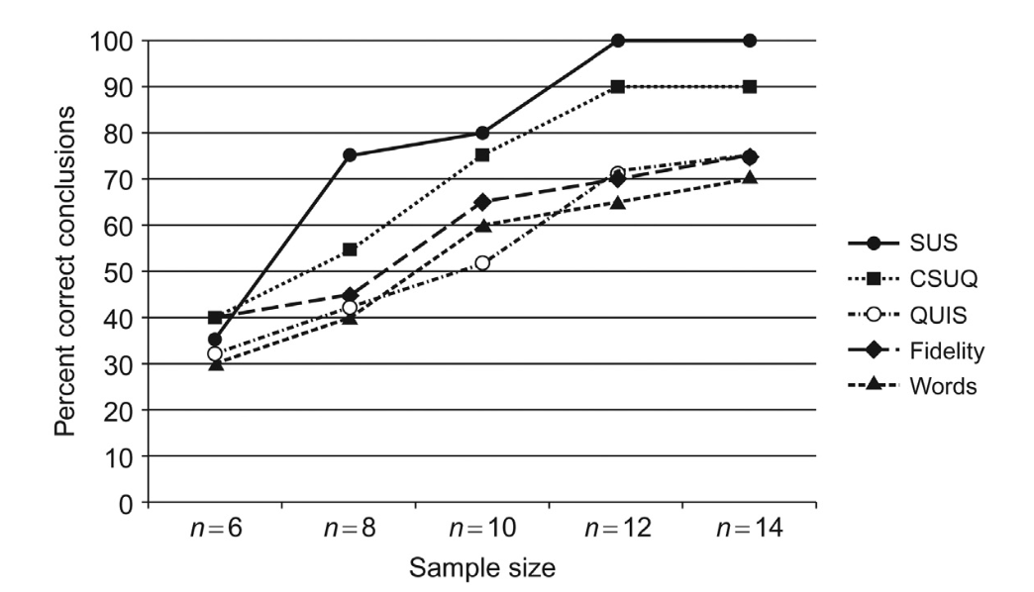
How many people do I need?
To run a usability test using SUS you do not always need a lot of people
According to a study of Tullis and Stetson, 2004 good results can be obtained with 8-12 people.
Remember: your test user pool must be representative of the final user population.
(Extreme) Example: If your app is intended for pregnant women, your pool cannot be made of men

Slide 21
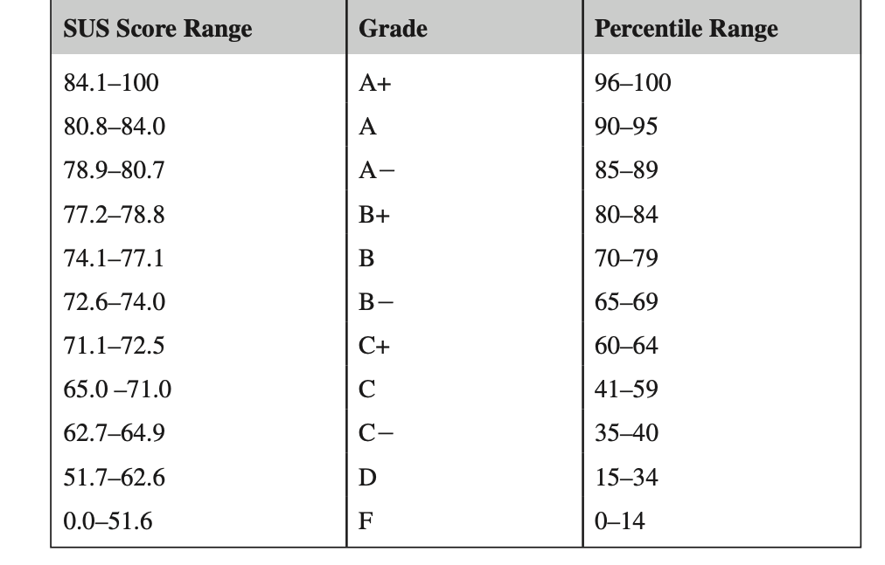
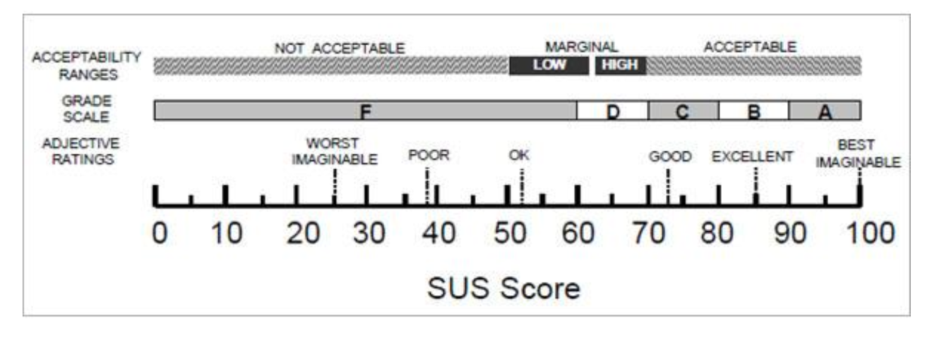
What is a good SUS?
To be “good” SUS must be > 73
Note: It has been showed that a SUS score of 82 (±5), also tend to be "Promoters.” according to NPS

Slide 22
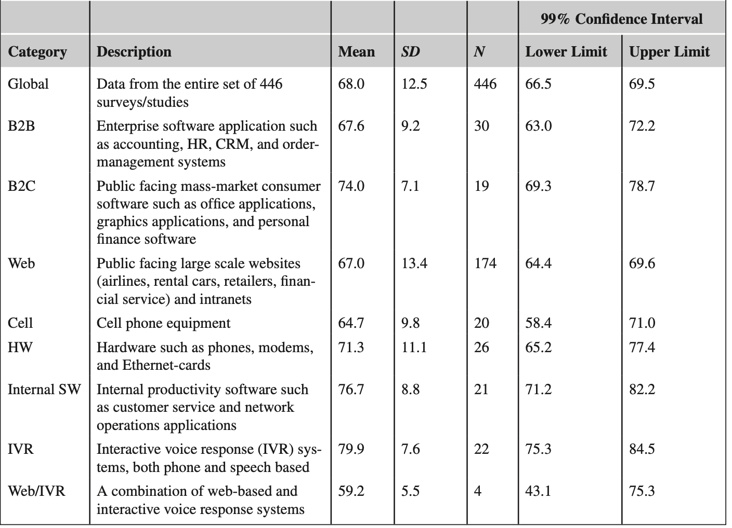
What is a good (interface specific) SUS?
BONUS

Slide 23
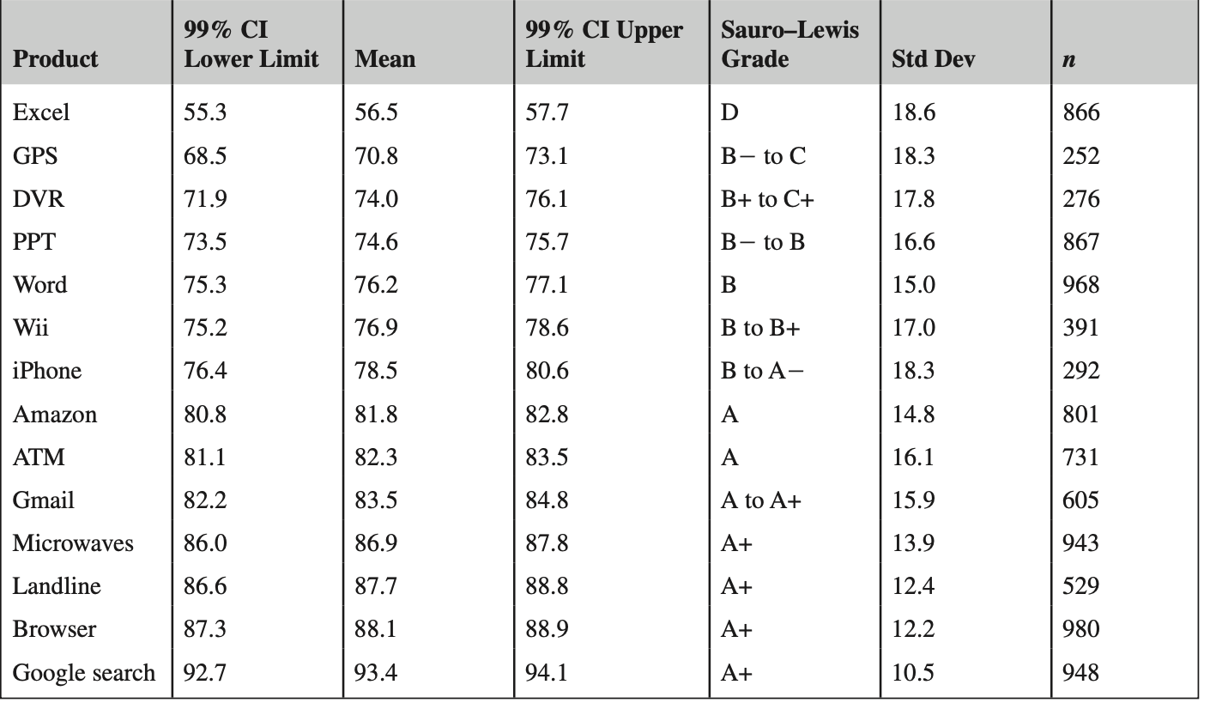
How everyday products are rated using SUS?
BONUS

Slide 24
Final notes on SUS
Extensive analyses of SUS show that:
SUS is reliable. Users respond consistently to the scale items, and SUS has been shown to detect differences at smaller sample sizes than other questionnaires.
SUS is valid. That is, it measures what it purports to measure.
SUS is not diagnostic. That is, it does not tell you what makes a system usable or not.
SUS measures both learnability and usability.
SUS scores have a modest correlation with task performance, but it is not surprising that people’s subjective assessments may not be consistent with whether they were successful using a system.

Slide 25
How precise is our estimate?
In usability testing, like most applied research settings, we almost never have access to the entire user population: we have to rely on taking samples to estimate the unknown population values.
The sample means and sample proportions (called statistics) are estimates of the values we really want.
We need a way to know how good (precise) our estimates are.
To do so, we construct a range of values that we think will have a specified chance of containing the unknown population parameter. These ranges are called confidence intervals (CI).

Slide 26
Confidence interval (CI)
CI quantifies twice the margin of error.
If you hear that 57% of likely voters approve a legislation with a margin of error ±3% then the CI is 6% wide, falling between 54% and 60% (57 − 3% and 57 + 3%).
CI provides both a measure of location and precision.
That is, we can see that the average approval rating is around 57%. We can also see that this estimate is reasonably precise. If we want to know whether the majority of voters approve the legislation we can see that it is very unlikely that fewer than half the voters approve.
CI is made of 3 components:
Confidence level
Variability
Sample size

Slide 27
Components of a CI
Confidence level: the ”coverage” of a confidence interval
A confidence level of 95% (the typical value) means that if you were to sample from the same population 100 times, you’d expect the interval to contain the actual mean or proportion 95 times.
Variability: If there is more variation in a population, each sample taken will fluctuate more and therefore create a wider CI.
The variability of the population is estimated using the standard deviation from the sample.
Sample size: how many samples do you have
Without lowering the confidence level, the sample size is the only thing a researcher can control in affecting the width of a CI.
The CI width and sample size have an inverse square root relationship. This means if you want to cut your margin of error in half, you need to quadruple your sample size. For example, if your margin of error is ±20% at a sample size of 20 you’d need a sample size of approximately 80 to have a margin of error of ±10%.

Slide 28
Computing CI
CI are computed differently according to your population pool and the “nature” of the data
Here we will focus on computing CI for continuous data
As a case of study, we will work on rating scales obtained from SUS

Slide 29
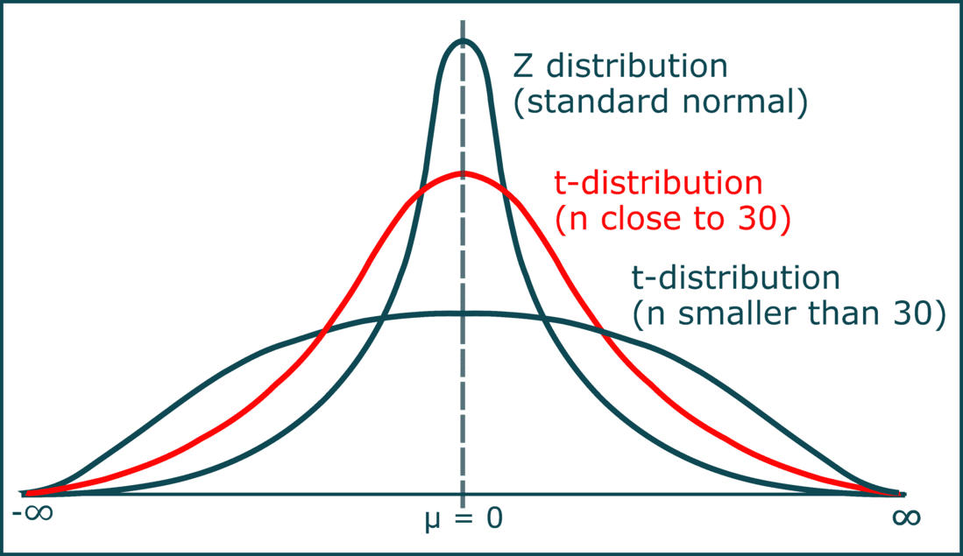
t-distribution
The best approach for constructing a CI around numeric rating scales is to compute the mean and standard deviation of the responses and then use the t-distribution.
The t-distribution is like the standard normal distribution (also called z-distribution) except that it takes the sample size into account
The t-distribution adjusts for how good our estimate is by making the intervals wider as the sample sizes get smaller.
As the sample size increases (especially at or above a sample size of 30), the t-confidence interval converges on the normal z-confidence interval.

Slide 30
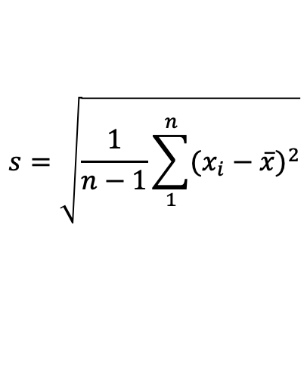


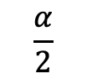

Computing CI with t
The t-confidence interval takes the following form:
Note: usually you set $α$ and n comes from the data
$$\overline{x}±t_{(α,n−1)}\frac{s}{\sqrt{n}}$$
$$s=\sqrt{\frac{1}{n−1}\sum_{1}^{n}{(x_{i}−\overline{x})^{2}}}$$
$\overline{x}$ is the sample mean,
n is the sample size,
s is the sample standard deviation, and
$t_{(α,n−1)}$is the critical value from the t-distribution for n−1 degrees of freedom and the specified confidence level $1−α$
$α$ is called level of significance
$$1−α$$
$$\frac{α}{2}$$
$$\frac{α}{2}$$

Slide 31
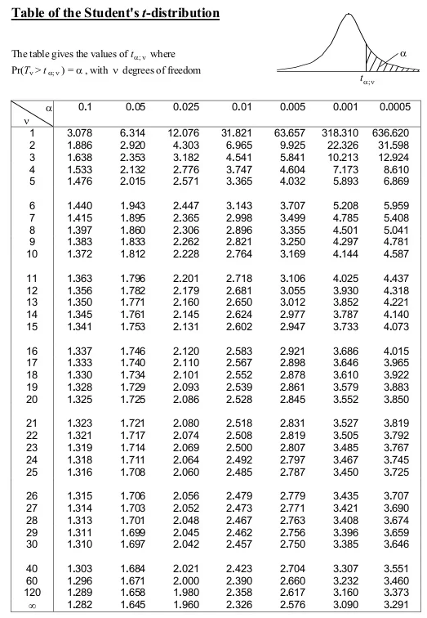
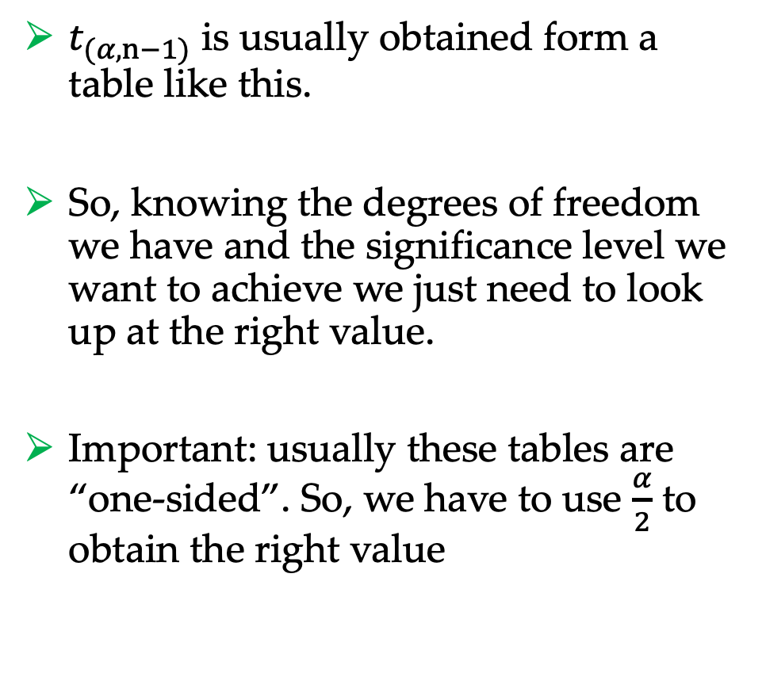
CI
$t_{(α,n−1)}$ is usually obtained form a table like this.
So, knowing the degrees of freedom we have and the significance level we want to achieve we just need to look up at the right value.
Important: usually these tables are “one-sided”. So, we have to use $\frac{α}{2}$ to obtain the right value

Slide 32
Example
For example, let’s use the following scores from the System Usability Scale (SUS), collected when users rated the usability of an app:
90, 80, 87, 95, 91
From this data we want to generate the CI at 95%.
It is easy to compute:
Mean: 88.60
Standard deviation: 5.59
Sample size: 5
The CI at a confidence level of 95% results:
$$\overline{x}±t_{(α,n−1)}\frac{s}{\sqrt{n}}=88.60±t_{(0.95,4)}\frac{5.59}{\sqrt{5}}=88.60±2.776∗2.50=88.60±6.94$$
This reads that we can be 95% confident that the true score is between 81.66 and 95.54

Slide 33

Comparing results
What if we want to compare the usability of two products using SUS?
Just because a sample of users from Product A has a higher average SUS score than a sample from Product B does not mean the average SUS score for all users is higher on Product A than Product B.
Chance plays a role in every sample selection, and we need to account for that when comparing means.
To determine whether SUS scores are statistically significantly different, you first need to identify whether the same users were used in each test (within-subjects design) or whether there was a different set of users tested on each product (between-subjects design).

Slide 34
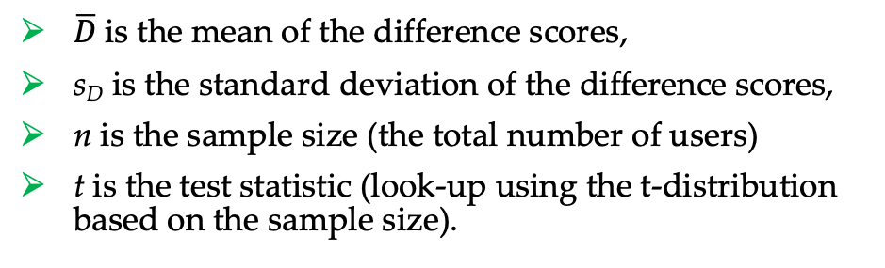

Within-subjects comparison
When the same users are in each test group you have removed a major source of variation between your sets of data.
In such tests you should alternate which product users encounter first to minimize carry-over effects
If all users encounter Product A first, this runs the risk of unfairly biasing users either for or against Product A.
To determine if the different scores are statistically different, we can use the paired t-test:
$$t=\frac{\overline{D}}{\frac{s_{D}}{\sqrt{n}}}$$
$\overline{D}$is the mean of the difference scores,
s_{D} is the standard deviation of the difference scores,
n is the sample size (the total number of users)
t is the test statistic (look-up using the t-distribution based on the sample size).

Slide 35
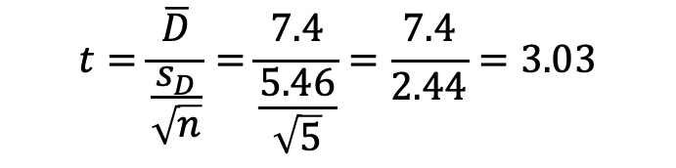
Example
For example, let’s use the following SUS scores collected from 5 users rating app A and app B:
SUS of app A = 92, 77, 73, 98, 95
SUS of app B = 83, 79, 63, 90, 84
It is easy to compute
Differences = 9, -2, 10, 8, 11
Mean of SUS A = 87
Mean of SUS B = 79.6
Mean of differences = 7.4
It follows:
This means that the usability of the two apps are: statistically different if we consider a level of significance greater than ~ 0.05
$$t=\frac{\overline{D}}{\frac{s_{D}}{\sqrt{n}}}=\frac{7.4}{\frac{5.46}{\sqrt{5}}}=\frac{7.4}{2.44}=3.03$$

Slide 36
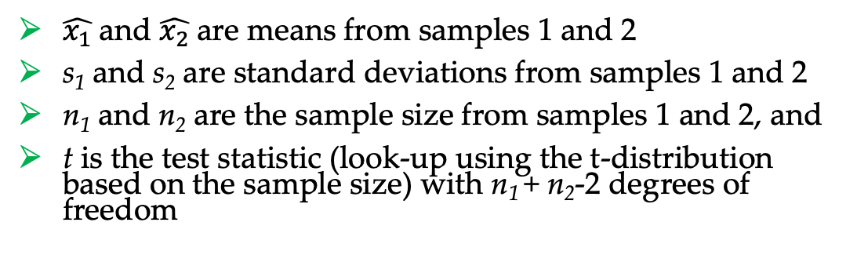
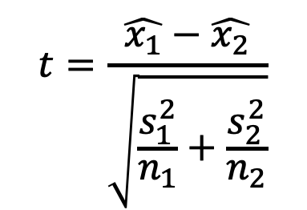
Within-subjects comparison
When a different set of users is tested on each product there is variation both between users and between designs.
Any difference between the means must be tested to see whether it is greater than the variation between the different users.
To determine whether there is a significant difference between means of independent samples of users, we use the two-sample t-test (also called t-test on independent means). It uses the following formula:
$$t=\frac{\hat{x_{1}}−\hat{x_{2}}}{\sqrt{\frac{s_{1}^{2}}{n_{1}}+\frac{s_{2}^{2}}{n_{2}}}}$$
$\hat{x_{1}}$and $\hat{x_{2}}$are means from samples 1 and 2
s₁ and s₂ are standard deviations from samples 1 and 2
n₁ and n₂ are the sample size from samples 1 and 2, and
t is the test statistic (look-up using the t-distribution based on the sample size) with n₁ + n₂-2 degrees of freedom

Slide 37
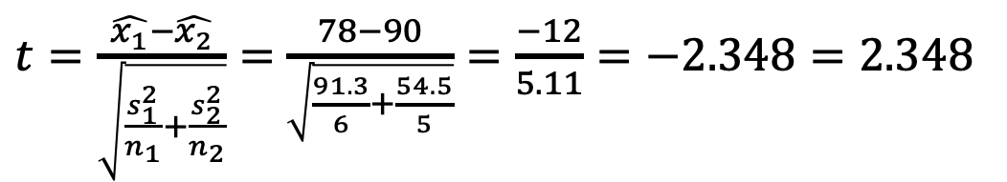
Example
For example, let’s use the following SUS scores collected from A users rating app A and other 5 users rating app B:
SUS of app A = 79, 76, 60, 86, 77, 90
SUS of app B = 92, 85, 80, 98, 95
It is easy to compute:
Mean of SUS A = 78
Mean of SUS B = 90
Degree of freedom = 9
It follows:
The usability of app B is statistically better if we consider a level of significance (p-value) greater than ~ 0.05
$t=\frac{\hat{x_{1}}−\hat{x_{2}}}{\sqrt{\frac{s_{1}^{2}}{n_{1}}+\frac{s_{2}^{2}}{n_{2}}}}=$ $\frac{78−90}{\sqrt{\frac{91.3}{6}+\frac{54.5}{5}}}=\frac{−12}{5.11}=−2.348=2.348$

Slide 38
References
Sauro, Lewis – Quantifying the User Experience: Practical Statistics for User Research, 2nd edition – Elsevier
Brooke et al., SUS: A Retrospective, Journal of Usability Studies, vol. 8, no. 2, 2013, pp. 29-40.

