Slide 1
Giacomo Cappon
Symposium

Slide 2
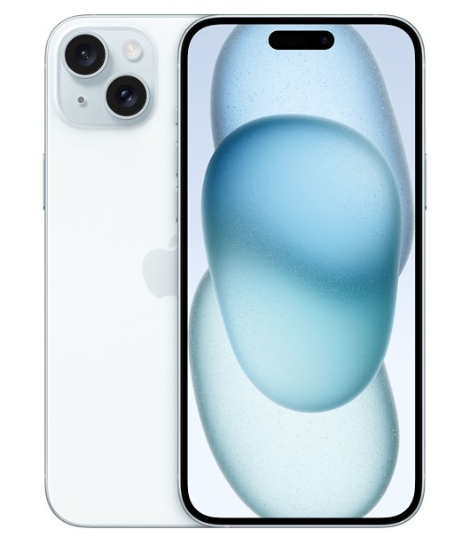
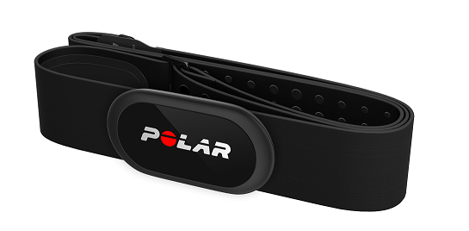
The devices
Polar H10 Heart Rate Monitor
Bluetooth and ANT+ communication
Sampling rate of 1 Hz
iPhone 15
Hosts a custom app that communicates with Polar H10
Collects and export data

Slide 3
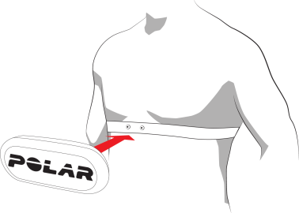
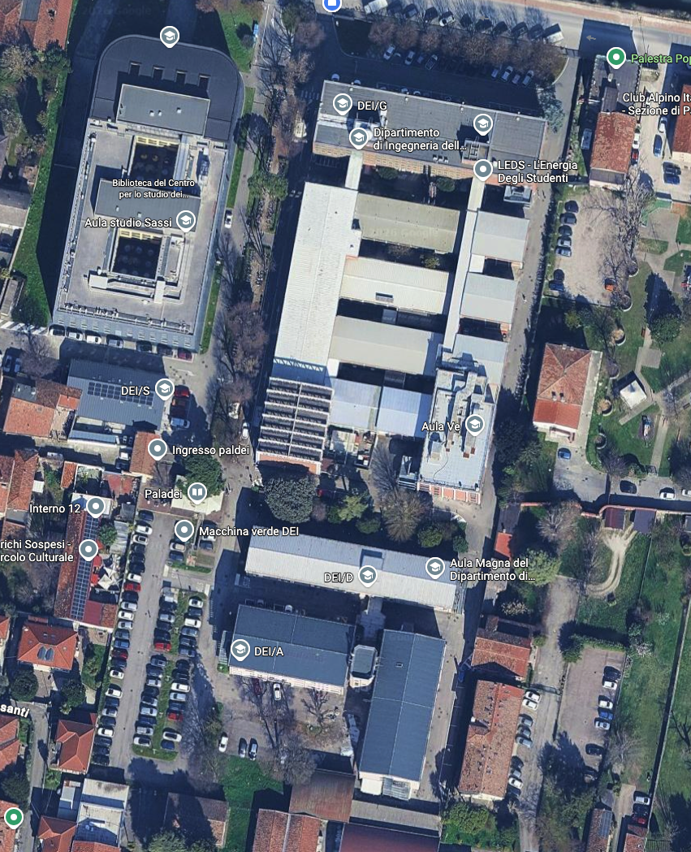
The “protocol”
3 volunteers wearing 1 x Polar H10 + 1x iPhone (need their Age and BW)
Measure heart rate at rest
2 laps of the DEI “highway” running (or walking as fast as possible)
At the end, export data
Start/Stop

Slide 4
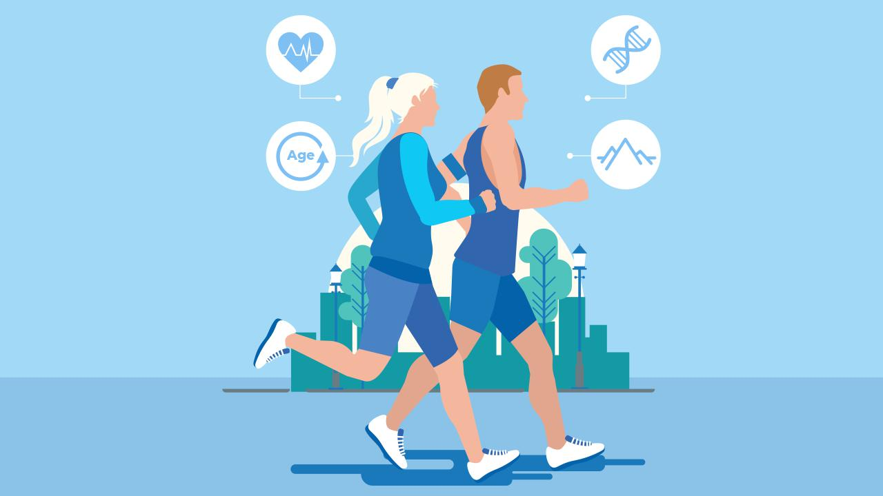
The aim
Quantify and rank the activity “load” experienced by each participant

Slide 5
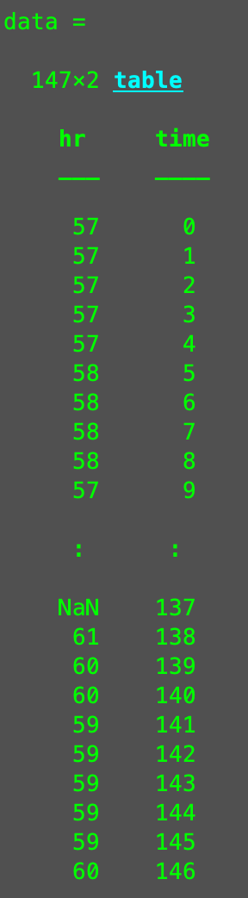
How data will look like
3 .csv files containing
time from start (s)
heart rate at given time (bpm)

