Slide 1
HTTP

Slide 2
Outline
HyperText Transfer Protocol (HTTP)
Web applications

Slide 3
The HyperText Transfer Protocol (HTTP)
HyperText Transfer Protocol (HTTP): the main web communication protocol for exchanging information between servers and clients.
Simple request-response protocol, proper of the application layer, running over TCP.
It specifies what messages clients may send to servers and what responses they get back in return.
Most of Web currently use HTTP/1.1 and HTTP/2.0, which share the same syntax.
1991
1996
1997
2015
2020
HTTP/0.9
HTTP/1.0
HTTP/2.0
HTTP/3.0
HTTP/1.1

Slide 4
Request structure (HTTP/1.1)
Each request consists of one or more lines of ASCII text
Case-sensitive name of the method (type of the request)
First line:
Name of the resource in the server
METHOD resource protocol
Name of the protocol version
(e.g. HTTP/1.1)
Request headers:
Additional information related to the request.
In HTTP/1.1 there must be at least one header containing the DNS name of the server.
Host: servername
Other optional headers
Empty line
Request body (payload):
Optional message body

Slide 5
HTTP methods
HTTP methods indicate the desired action to be performed for a given resource
Method | Desired action
GET | Retrieves a resource
HEAD | Retrieves a resource header
POST | Submits an entity to the specified resource (causes a change of server state)
PUT | Replaces all current representations of the target resource with the request payload.
DELETE | Deletes a resource
TRACE | Echoes the incoming request
CONNECT | Establishes a tunnel to the server identified by the target resource
OPTIONS | Describes the communication option for a resource
PATCH | Applies partial modifications to a resource

Slide 6
Examples of request headers
Host: the server’s DNS name
User-Agent: it allows the client to inform the server about the user agent making the request, e.g., the browser implementation
Accept: it allows to tell the server what the client is willing to accept
If-Modified-Since: time and date of last page modification, it allows the client to check the validity of cached pages (the client stores recently requested contents in a cache memory, similarly to what the server does).
Authorization: needed for pages that are protected. The client might need to demonstrate it has the right to see the requested page.
Cache-Control: it specify directives that must be obeyed by all caching mechanisms along the request/response chain (e.g., no-cache).
Content-Type: the type of the content in the request body.
…

Slide 7
Response structure (HTTP/1.1)
A response message is sent by a server to a client as a reply to its former request message.
Three-digit integer code representing the result of the server's attempt to understand and satisfy the request.
Status line:
Optional. If the status code indicated a problem, the reason phrase might displayed the further information about the nature of the problem.
Protocol status_code reason_phrase
Response headers:
Status code | Description
1xx | Informational: the request was received and is being processed,
2xx | Successful: the request was successfully received, understood, and accepted.
3xx | Redirecting: further action needs to be taken in order to complete the request.
4xx | Client error: the request contains bad syntax or cannot be fulfilled.
5xx | Server error: The server failed to fulfill an apparently valid request.
Optional headers
Empty line
Request body (payload):
Optional message body

Slide 8
Examples of response headers
Date: date and time the message was sent
Content-Language: the natural language used in the page
Content-Type: the type of the returned content (e.g., HTML, image, plain text, …)
Content-Length: the content length in bytes
Last-Modified: time and date the page was last changed
Expires: Time and date when the page stops being valid
ETag: tag for the content of the page (used for caching)
Location: redirect the recipient to a location other than the requested URL for completion of the request or identification of a new resource
…

Slide 9
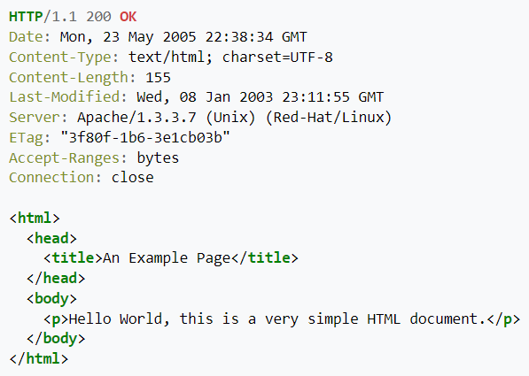
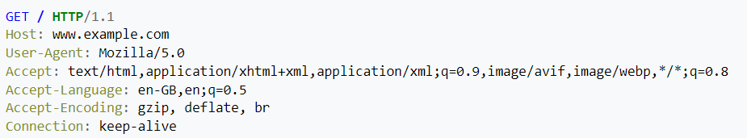
GET
GET: Retrieves a resource.
GET / HTTP/1.1
Host: www.example.com
Accept-Language: en
Response example:
Request example:

Slide 10
Conditional GET and Partial GET
The GET can become conditional if the request message includes an If-Modified-Since, If-Unmodified-Since, If-Match, If-None-Match, or If-Range header field.
The content is transferred only under the circumstances described by the conditional header field(s).
The conditional GET reduces unnecessary network usage by allowing cached entities to be refreshed without requiring the transfer of data already held by the client.
The GET can become partial if the request message includes a Range header field.
Only part of the entity is transferred.
The partial GET method reduces unnecessary network usage by allowing partially-retrieved entities to be completed without transferring data already held by the client.

Slide 11
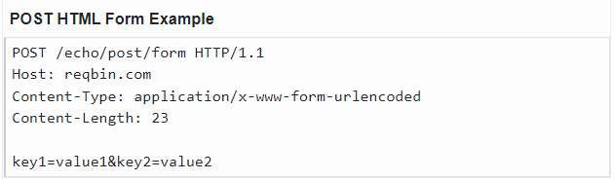
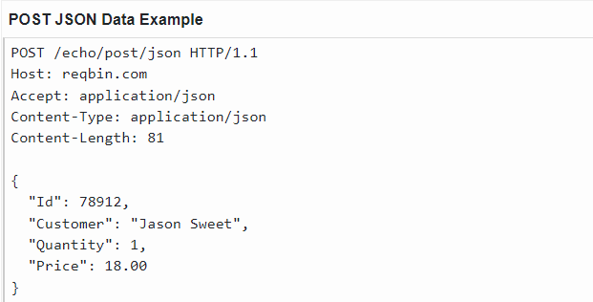
POST
POST: Submits an entity to the specified resource. Can be used for creating a resource.
If the request is accepted, then the server does something with the data that depends on the URL, and send a response page indicating the result.
POST is commonly used when forms are submitted, or when uploading files to servers, e.g., to extend a database appending some new data.

Slide 12
Other important methods
PUT: Replaces all current representations of the target resource with the request payload. Can be used for updating/modifying a resource.
DELETE: Deletes a resource.
PATCH: Applies partial modifications to a resource.
HEAD: it just asks for the message header, without the actual content. It can be used to collect information for indexing purposes, or to test a resource for validity.

Slide 13
POST vs PUT vs PATCH
Difference between POST and PUT?
POST: the client asks to the server to accept the entity enclosed in the request as a new subordinate of the resource identified by the request URL.
PUT: the client asks to the server to store the enclosed entity under the request URL. → If the request URL refers to an already existing resource, the server replaces the existing entity with the new enclosed entity. If the URL does not point to an existing resource, the server can create the resource with that URL.
Difference between PUT and PATCH?
PUT supplies a modified version of the resource to be allocated at the request URL.
PATCH supplies a set of instructions to modify the resource at the requested URL.

Slide 14
Other (less) important methods
BONUS
TRACE: it asks the server to send back the request. Useful when requests are not processed correctly to check what the server received.
CONNECT: it lets a user make a connection to a Web server through an intermediate device, such as a Web cache.
OPTIONS: it queries the server for a resource and obtain the methods and headers that can be used with that resource.

Slide 15
Properties of the HTTP methods
Safe methods: A request method is safe if a request with that method has no intended effect on the server.
GET, HEAD, OPTIONS, and TRACE are safe, since they only read data from the server.
POST, PUT, DELETE, PATCH, CONNECT are not safe, since they may modify the server state.
Idempotent methods: A request method is idempotent if multiple identical requests with that method have the same intended effect as a single such request.
PUT and DELETE, and safe methods are idempotent.
POST, PATCH and CONNECT are not necessarily idempotent. Sending an identical POST request multiple times may further modify the state of the server.
Cacheable methods: A request method is cacheable if responses to requests with that method may be stored by the client in the cache for future reuse.
Only GET, HEAD, and POST are cacheable.

Slide 16
Summary of properties of the HTTP methods
METHOD | REQUEST HAS BODY | RESPONSE HAS BODY | IS SAFE | IS IDEMPOTENT | IS CACHEABLE
GET | Optional | Yes | Yes | Yes | Yes
HEAD | Optional | No | Yes | Yes | Yes
POST | Yes | Yes | No | No | Yes
PUT | Yes | Yes | No | Yes | No
DELETE | Optional | Yes | No | Yes | No
TRACE | No | Yes | Yes | Yes | No
CONNECT | Optional | Yes | No | No | No
OPTIONS | Optional | Yes | Yes | Yes | No
PATCH | Yes | Yes | No | No | No

Slide 17
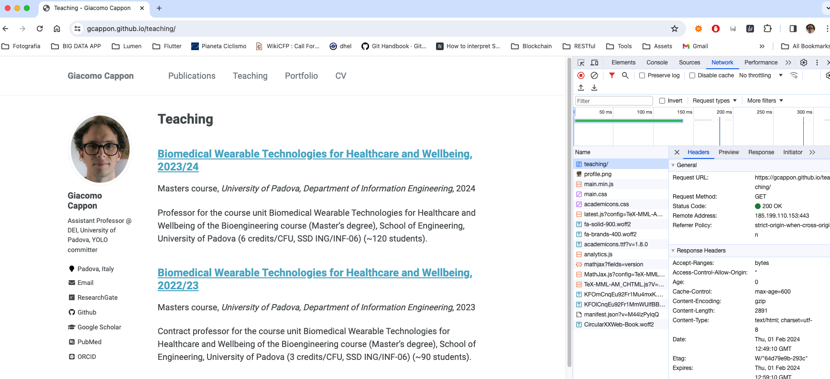
Example: inspecting the HTTP requests in Chrome
Request headers
Requested page and contents
Response headers

Slide 18
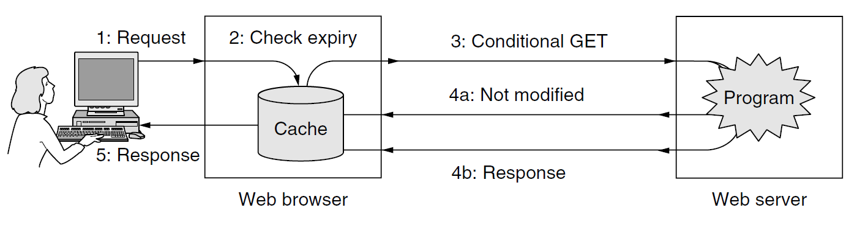
Caching
People often return to Web pages that they have viewed before, and related Web pages often have the same embedded resources.
Caching: save on the client pages that are fetched for possible subsequent use.
HTTP headers can be used to let the client know when a page can be safely re-used. → reduced network traffic
Page validation: The cache is consulted, and if it has a copy of a page for the requested URL that is known to be fresh (i.e., still valid), there is no need to fetch it new from the server. The validity time is obtained by the Expires header of the original GET request.
Conditional GET: The client checks the time a cached page was last updated from the Last-Modified header. It can send it to the server using the If-Modified-Since header to ask for the page only if it has been changed in the meantime.

Slide 19
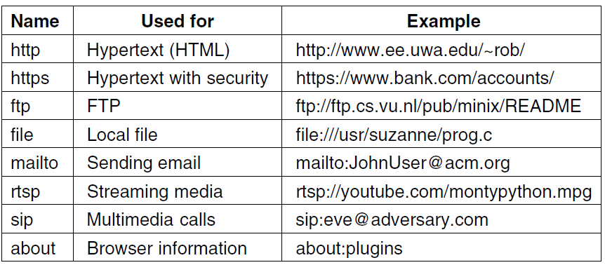
Web communication protocols
HTTP is not the only Web communication protocol.
Different protocols have been defined for different purposes.

Slide 20
Outline
HyperText Transfer Protocol (HTTP)
Web applications

Slide 21
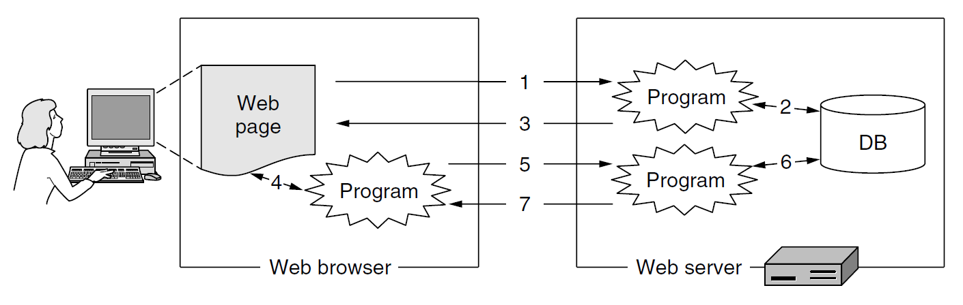
Web application
Web application: a Web page or a collection of Web pages, delivered over HTTP, which use server-side or client-side processing, i.e., programs, to provide an "application-like" experience within a Web browser.
Web applications access data that are stored in databases in the server and use Web protocols (e.g., HTTP) to exchange data with the client. They use the Web browser to display a user interface by which the user can use the app (making queries, inserting data, view retrieved data, etc.).
Advantage of Web applications: The users do not need to install separate application programs, and data can be accessed from different computers and backed up by the service operator.
Examples of Web apps: Gmail, Google Docs, Trello, online banking apps, online retail sales apps, …
To act as applications, Web pages can no longer be static, but they need to generate dynamic content.

Slide 22
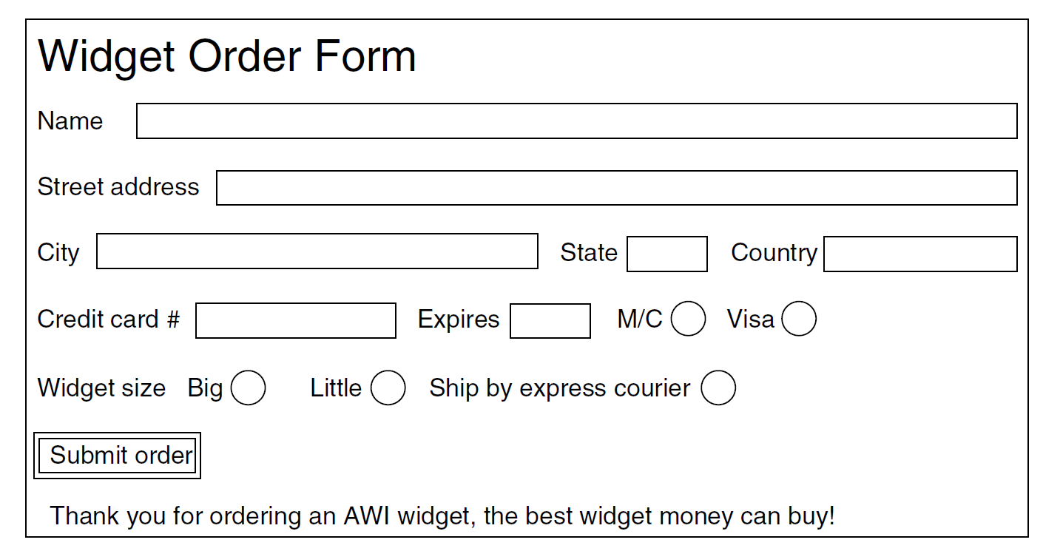
Server-side dynamic Web page generation
A simple situation in which server-side processing is needed is a Web form.
When the user compiles the form and click ‘Submit order’, the client sends a POST request to a specific URL pointing to a program in the Web server.
The POST request will include the input data of the form, properly formatted, in the request body.
The server receives the data and passes them to the program.
The program process the data and generates an HTML page, whose content depends on the inserted data.
The server returns the HTML page to the client’s browser, in the body of the POST response.
How can the server invoke the program?
Using specific APIs (Application Programming Interfaces)

Slide 23
Client-side dynamic Web page generation
Client-side processing is necessary to have applications with a more responsive interface that quickly responds to user commands and interact with the user.
It is necessary to have scripts embedded in HTML pages that are executed on the client machine.
The most popular language for client-side scripting is JavaScript.
When the browser interprets the HTML page, it also interprets the JavaScript code contained in the page.
All the work is done locally, inside the browser. There is no contact with the server.
<html>
<head>
<script language="javascript" type="text/javascript">
function response(test form) {
var person = test form.name.value;
var years = eval(test form.age.value) + 1;
document.open();
document.writeln("<html> <body>");
document.writeln("Hello " + person + ".<br>");
document.writeln("Prediction: next year you will be " + years + ".");
document.writeln("</body> </html>");
document.close(); }
</script>
</head>
<body>
<form>
Please enter your name: <input type="text" name="name">
<p>Please enter your age: <input type="text" name="age"><p>
<input type="button" value="submit" onclick="response(this.form)">
</form>
</body>
</html>

Slide 24
Example of a Web application architecture
Client
Server
Web browser
HTTP
Server-side language interpreter
HTML interpreter
Database
Client-side language interpreter
Plugs-in
Back-end program # 1
Back-end programs # 2
…
…
Common client-side languages: Javascript, Java
Common server-side languages: Javascript, Python, PHP

Slide 25
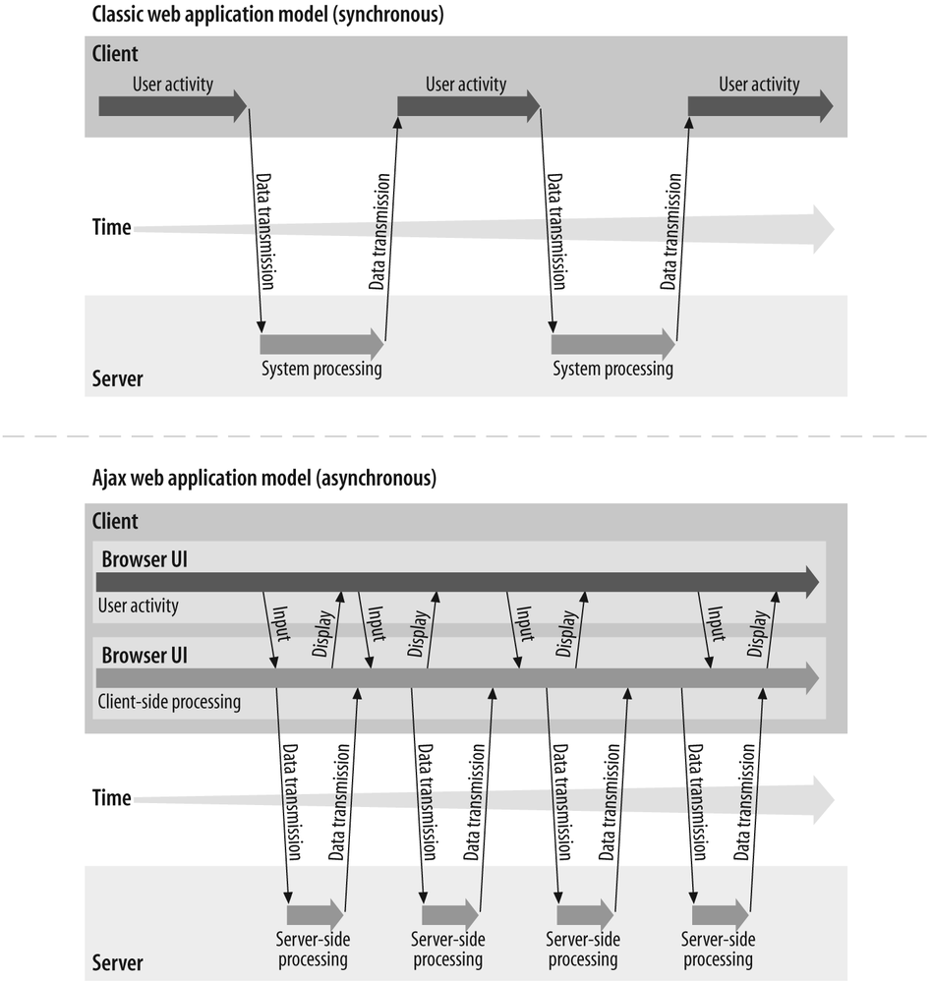
Limitation of classic Web application model (synchronous)
Every update of the Web page requiring server-side processing, requires the re-load of the entire Web page (by HTTP request/response), even if only a small part of the page has to be updated.

Slide 26
Asynchronous JavaScript and XML (AJAX)
This limitation is overcome by Asynchronous JavaScript and XML (AJAX), a set of techniques for Web application development that decouples the server-client interchange of data from the interchange of Web pages.
Asynchronous applications: applications that can send and retrieve data from a server asynchronously (i.e., in the background) without interfering with the display of the existing page.
AJAX allows Web applications to change content dynamically without the need to reload the entire page.
The data are exchanged with the server in a structured data format such as XML or JSON.
Advantages of AJAX:
It increases the responsiveness of Web applications
It decreases network traffic

Slide 27
Structured data formats
Asynchronous Web applications need to exchange data with the server.
HTML is not suitable for representing data because it mixes content with formatting. It is indeed concerned about the presentation of the content.
It is difficult to automatically retrieve data within an HTML file
Two popular structured data formats that facilitate the automatic structured data processing:
Extensible Markup Language (XML)
JavaScript Object Notation (JSON)

Slide 28
Extensible Markup Language (XML)
Example of XML code that define a book list
A language for specifying structured content.
Introduced in 1998.
It defines a set of rules for encoding documents in a format that is both human-readable and machine-readable.
Unlike HTML, there are no defined tags for XML. Each user can define their own tags.
Extension .xml
<?xml version="1.0" ?>
<book list>
<book>
<title> Human Behavior and the Principle of Least Effort </title>
<author> George Zipf </author>
<year> 1949 </year>
</book>
<book>
<title> The Mathematical Theory of Communication </title>
<author> Claude E. Shannon </author>
<author> Warren Weaver </author>
<year> 1949 </year>
</book>
<book>
<title> Nineteen Eighty-Four </title>
<author> George Orwell </author>
<year> 1949 </year>
</book>
</book list>

Slide 29
JavaScript Object Notation (JSON)
A format that uses human-readable text to store and transmit data objects consisting of attribute–value pairs and arrays.
Introduced in 2001.
JSON is language-independent. It was derived from JavaScript, but many modern programming languages include code to generate and parse JSON-format data.
Extension .json
JSON data types: number, string, Boolean, null (empty value)
JSON data structures
Object
Array

Slide 30
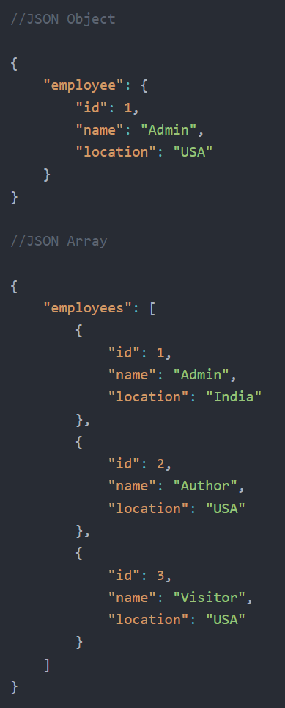
JSON data structures
JSON object: a collection of name–value pairs where the names (also called keys) are strings. The order of pairs is not relevant. The object is surrounded by curly braces.
JSON array: an ordered list of zero or more elements, each of which may be of any type. Arrays use square bracket notation with comma-separated elements.
Objects can contain array and arrays can contain objects.

Slide 31

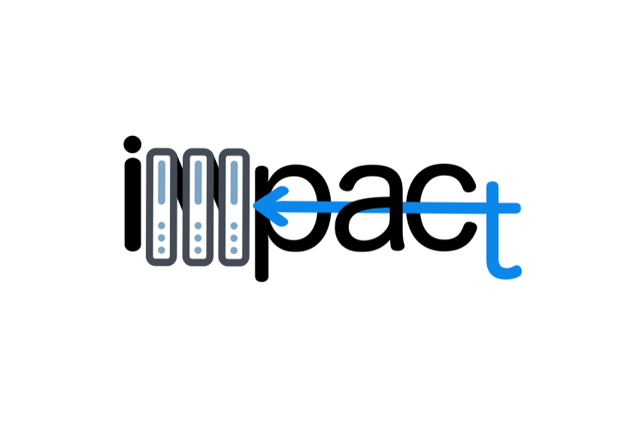

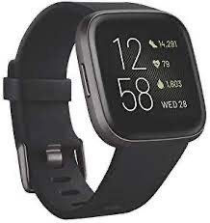
Why JSON are important here? What we need?
The Fitbit data you will need to develop your project (stored in the IMPACT server are stored in a JSON format
We need to learn how to make and ”debug” our requests!
[
{
"time": "03:10:19",
"value": 58,
"confidence": 1
},
{
"time": "03:10:24",
"value": 54,
"confidence": 3
},
{
"time": "03:10:29",
"value": 52,
"confidence": 3
}, ...
]
https://impact.dei.unipd.it/bwthw/
Your app

Slide 32

POSTMAN
We saw that using a browser we are actually visualizing the response of an HTTP request using the GET method.
What if we need to make an authenticated request? What if we need to make a POST request?
POSTMAN can help us here: https://www.postman.com
We will use it during the theory lessons to try what we learn

Slide 33
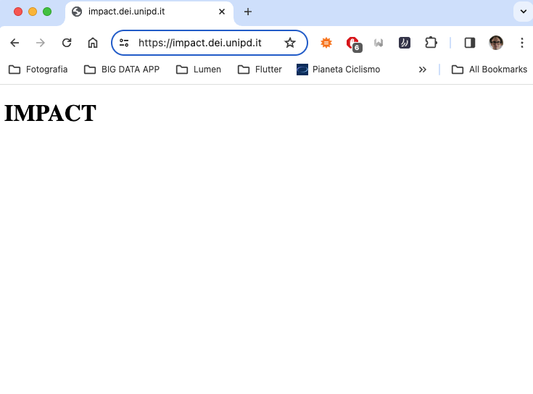
Hello IMPACT
At https://impact.dei.unipd.it/ you will obtain the following
Let’s replicate it in POSTMAN

Slide 34
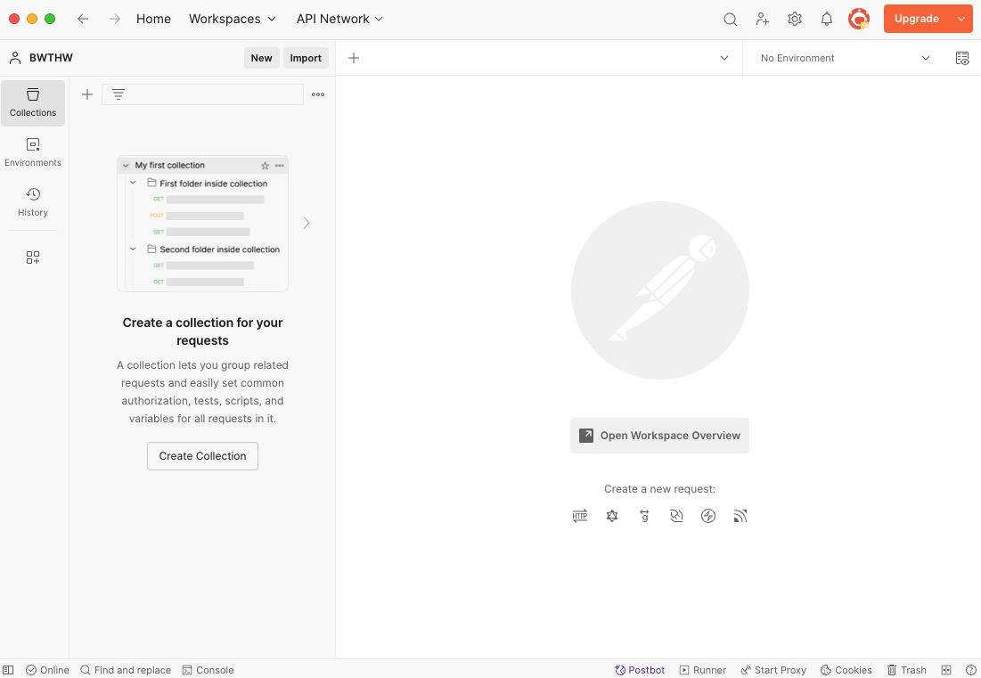
Hello IMPACT
This is the POSTMAN interface
Many things can be done (e.g., automatic debugging, writing custom scripts, etc…
We will limit to create and organize a collection of HTTP requests

Slide 35
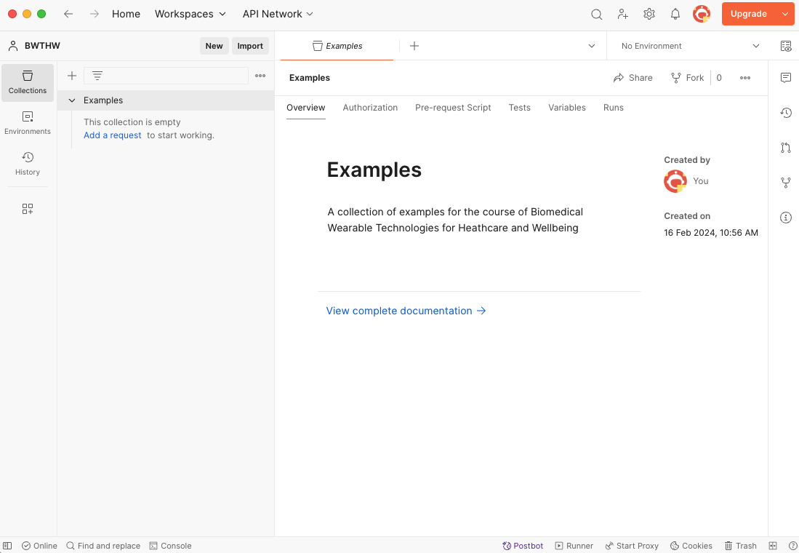
Hello IMPACT
Go to the ”Collections” tab
Press the “+” button
Create a “Blank collection”
Call it “Examples”: here we will collect all the theory lessons examples

Slide 36
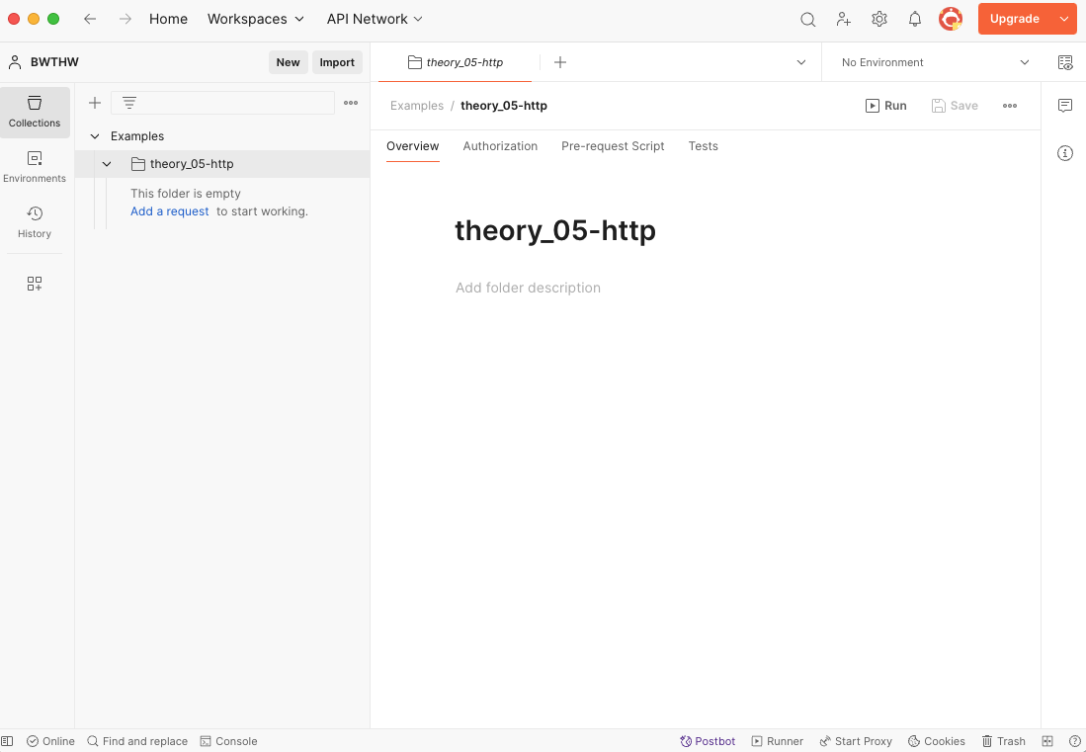
Hello IMPACT
Right click the “Examples” collection
Select “Add folder”
Call it as you want, e.g.: “theory_05-http”

Slide 37
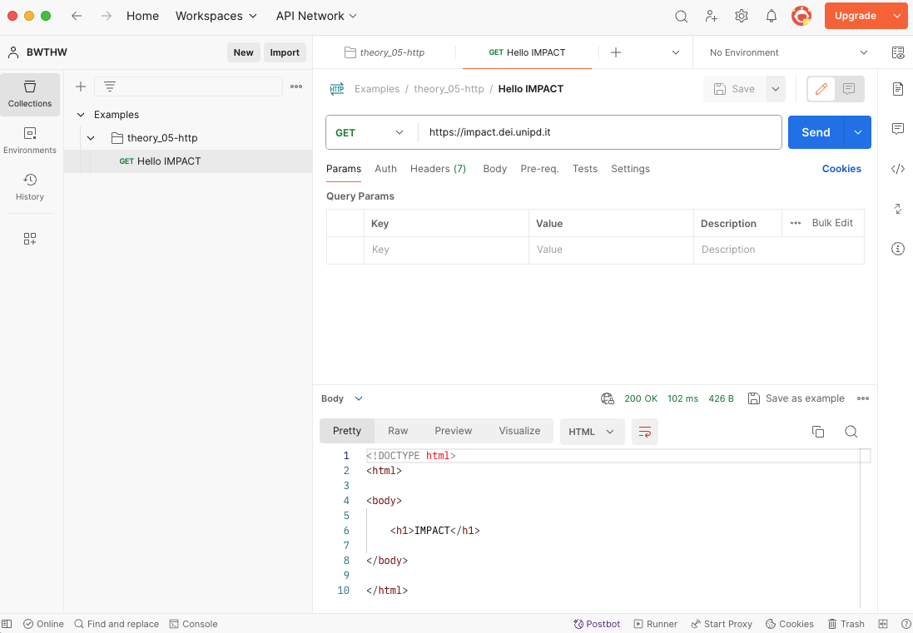
Hello IMPACT
Right click the folder and choose “Add request”
Call it as you want, e.g., “Hello IMPACT”
Choose the GET method
And write the IMPACT home URL, i.e., https://impact.dei.unipd.it/
Click “Send” and inspect the response

Slide 38
References
Tanenbaum, Wetherall – Computer Networks – Fifth Edition
Chapter 7 – The application layer
POSTMAN: https://www.postman.com

