Slide 1
Fundamentals of computer networks

Slide 2



Computer networks
Data collected by wearable IoT sensors are shared among different devices running over a computer network, typically the Internet.
Computer network: a collection of autonomous computers (hosts) interconnected by a single technology.
Two computers are said to be interconnected if they are able to exchange information.
Purpose of computer networks: to share resources (e.g. data and applications).

Slide 3
Types of computer networks by their extention
Personal Area Network (PAN): it lets devices communicate over the range of a person (e.g., short-range Bluetooth networks).
Local Area Network (LAN): a privately owned network that operates within and nearby a single building (e.g., the network of a company).
Metropolitan Area Network (MAN): it covers a city (e.g. cable television networks available in many cities with poor over-the-air television reception).
Wide Area Network (WAN): it spans a large geographical area, often a country or continent (e.g., a network of a company that has offices in different cities)
Internetworks (internet): a collection of interconnected networks, in which devices of different networks can exchange messages regardless of their underling network hardware
Gateway: a machine that makes a connection between two or more networks and provides the necessary translation, both in terms of hardware and software
The worldwide Internet (with capital I) is the most popular example of internet
WAN
MAN
LAN
PAN
internet
N1
N2
Gateway

Slide 4
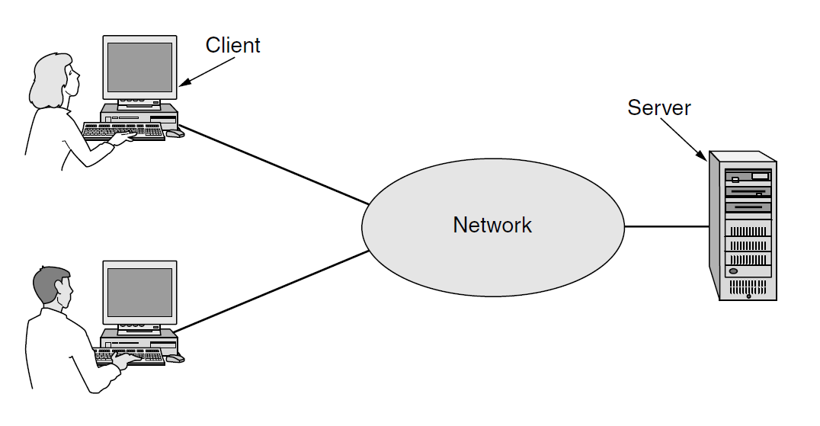
Client-server model
Client-server model: a network structure that partitions tasks between the providers of a resource or service, called servers, and service requesters, called clients.
The server is often designed to operate as a centralized system that serves many clients. The computing power, memory and storage requirements of a server must be scaled appropriately to the expected workload.

Slide 5
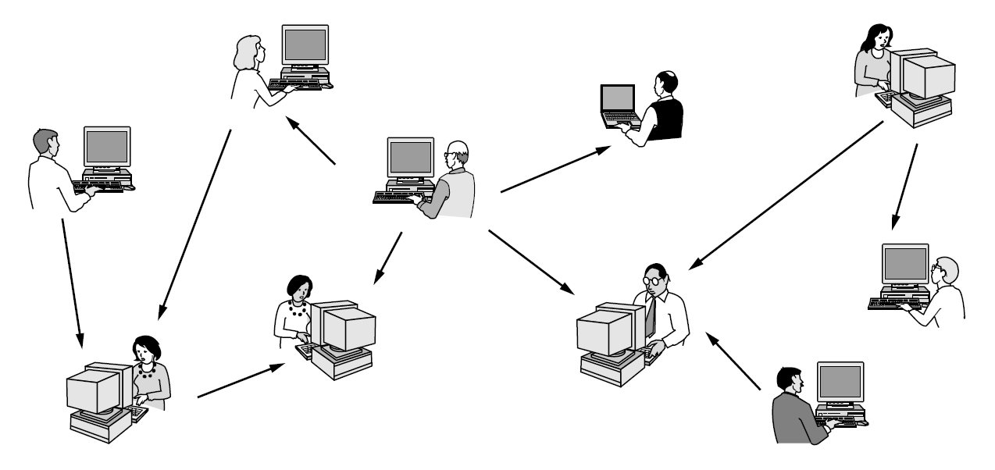
Peer-to-peer model
Peer-to-peer model: a network structure that partitions tasks or workloads between peers. Peers are equally privileged, equipotent participants in the application.
Every hosts can communicate with one or more other hosts.
No fixed division into clients and servers (they are all peers).

Slide 6
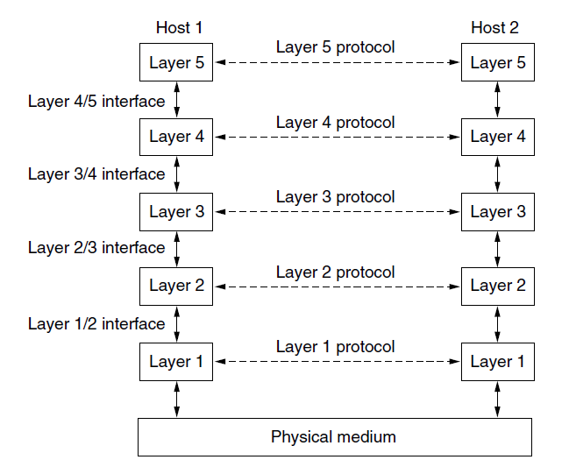
Network software: protocol hierarchies
To reduce their design complexity, most networks are organized as a stack of layers or levels, each one built upon the one below it.
The purpose of each layer is to offer certain services to the higher layers while shielding those layers from the details of how the offered services are actually implemented.

Slide 7
Network software: protocol hierarchies
Two entities of the same layer on different machines are called peers.
When two peers of layer n communicate, the rules and conventions used in this conversation constitute the layer n protocol.
Protocol: agreement between the communicating parties on how communication is to proceed.
Layers and protocols form the network architecture.

Slide 8
Network software: protocol hierarchies
Virtual communication
Physical communication
In reality, no data are directly transferred from layer n on one machine to layer n on another machine.
Each layer passes data to the layer immediately below it, until the lowest layer is reached.
Layer 1 passes data to the physical medium through which actual communication occurs.
An interface between each pair of adjacent layers defines which primitive operations and services the lower layer makes available to the upper one.

Slide 9
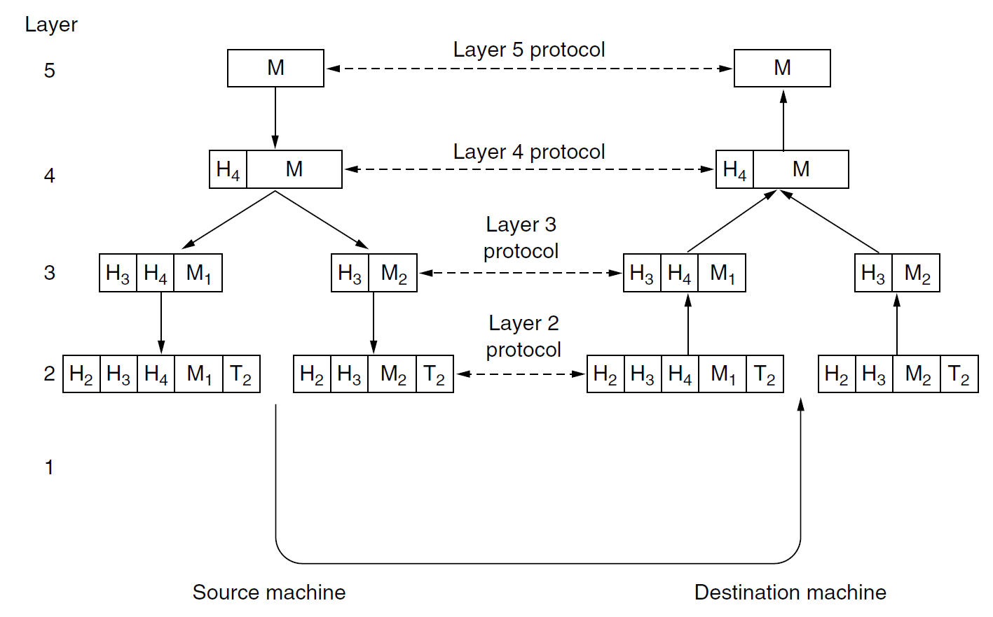
Example of network architecture
A message M is produced by an application running on layer 5 and given to layer 4 for transmission.
Layer 4 puts a header (e.g. address) in front of M to identify it and then pass it to layer 3.
Layer 3 breaks M into smaller packets (M1 and M2) and add headers to each packet which are passed to layer 2.
Layer 2 adds a header and a trailer to each packet and then pass them to layer 1 for physical transmission to the destination machine.
None of the headers for layers below n are passed up to layer n.

Slide 10
Services and primitives
Service: a set of primitives (operations) that a layer provides to the layer above.
What operations the layer is prepared to perform on behalf of its users
No information about how these operations are implemented.
It relates to an interface between two layers, with the lower layer being the service provider and the upper layer being the service user.
Examples of primitives for a simple connection-oriented service
Primitive | Meaning
LISTEN | Block waiting for an incoming connection
CONNECT | Establish a connection with a waiting peer
ACCEPT | Accept an incoming connection from a peer
RECEIVE | Block waiting for an incoming message
SEND | Send a message to the peer
DISCONNECT | Terminate a connection

Slide 11
Connection-oriented vs connectionless services
Two types of service:
Connection-oriented service: the service user first establishes a connection with the receiver, then it uses the connection to send data, and finally it releases the connection (like in a telephone communication).
In most cases the order of data bits is preserved → bits arrive in the same order they were sent.
Connectionless service: each message carries the full destination address and each one is sent independently on the subsequent messages (like in postal system).
Normally, when two messages are sent to the same destination, the first one sent will be the first one to arrive. However, it is possible that the first one sent can be delayed so that the second one arrives first.
The messages in a connectionless service are also called datagram.

Slide 12
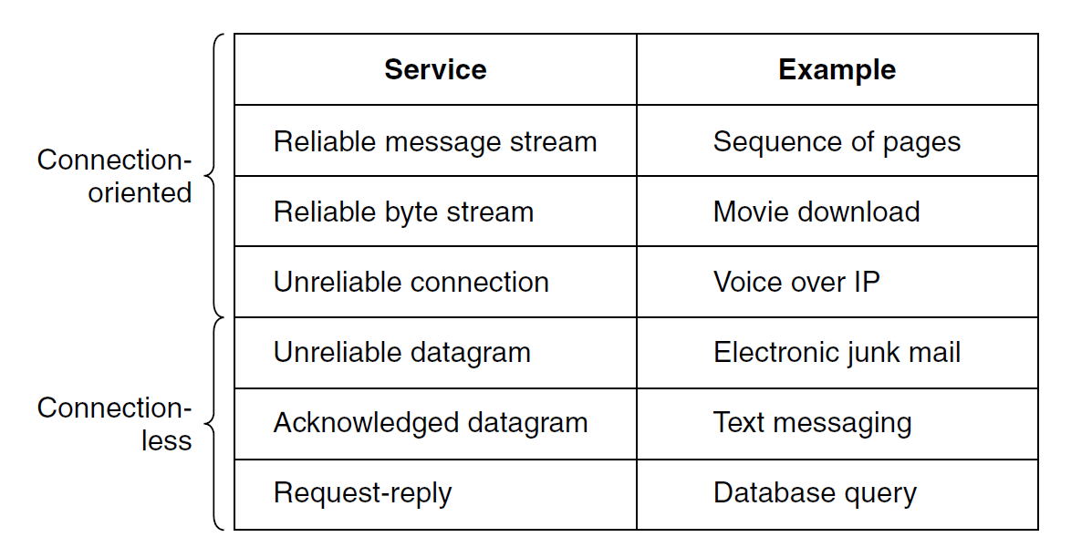
Reliable vs. unrealiable services
A reliable service never looses data: the receiver acknowledges the receipt of each message so the sender is sure that it arrived.
The acknowledgement process introduces overhead and delays, sometimes undesirable.
E.g. in a telephone communication it is less disruptive to hear a bit of noise on the line from time to time than to experience a delay waiting for acknowledgements.
An unreliable service does not return an acknowledgement to the sender

Slide 13
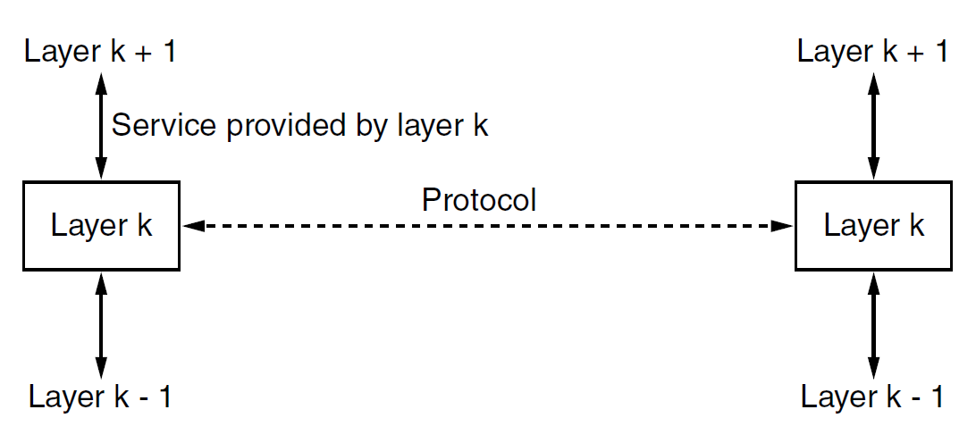
Protocol vs. service
Protocol: The set of rules governing the format and meaning of the packets, or messages that are exchanged by the peer entities within a layer.
Service: the set of primitives (operations) that a layer provides to the layer above it. They are related to the interfaces between layers.
The protocol of layer k defines the implementation details of services which layer k provides to users of layer k+1; such details are not visible to users of layer k+1.

Slide 14
The TCP/IP reference model
Application layer
Worldwide Internet: the global system of interconnected computer networks that uses the Internet protocol suite (TCP/IP) to communicate between networks and devices.
The reference model used by the worldwide Internet is called TCP/IP reference model and it was introduced by Cerf and Kahn in 1974.
Transport layer
Network layer
Link layer
Physical layer

Slide 15
The TCP/IP reference model
Application layer
It includes the protocols used by applications running on different hosts to communicate
Example: A Web browser can send requests to a Web server using the HTTP protocol, which is a protocol of the application layer
Transport layer
Network layer
Link layer
Physical layer

Slide 16
The TCP/IP reference model
It creates and maintain conversations between applications on two hosts
Two transport protocols have been defined:
Transmission control protocol (TCP): a reliable connection-oriented protocol that allows a byte stream delivery without errors.
User Datagram Protocol (UDP): an unreliable, connectionless protocol for applications in which prompt delivery is more important than accurate delivery (e.g., speech or video).
Application layer
Transport layer
Network layer
Link layer
Physical layer
TCP/UDP header
Data
SEGMENT

Slide 17
The TCP/IP reference model
Application layer
Finds the correct routing path, handles congestions and quality of service.
Packets are sent independently to the destination by a certain path.
This layer works with two protocols:
Internet protocol (IP): it defines the IP addresses, i.e,. that label (e.g., 192.0.2.1) that uniquely identifies a host connected to a computer network using the IP protocol.
Internet Control Message Protocol (ICMP): it sends error and control messages.
Transport layer
Network layer
Link layer
Physical layer
IP header
TCP/UDC header
Data
PACKET

Slide 18
The TCP/IP reference model
Source and destination MAC address (local address in a LAN)
Application layer
Error checking information
Transport layer
FRAME
Link header
IP header
TCP/UDC header
Data
Link trailer
Network layer
It moves packets between the network layer and the physical layer.
Not really a layer at all, but rather an interface between hosts and physical transmission links.
Link layer
Physical layer

Slide 19
The TCP/IP reference model
Application layer
Transport layer
Network layer
00010101110110101001100110101111010101
Link layer
It physically receives and transmit raw bits over a communication channel.
A standardized interface to the transmission medium (electrical, optical, or wireless communication).
Physical layer

Slide 20
World Wide Web
An architectural framework for accessing linked content spread out over millions of machines all over the Internet.
How the Web was born:
1989, Geneva, CERN: the physicist Tim Berners-Lee proposed to develop a web of linked documents to help large research teams
1991, San Antonio, Texas: First prototype of Web presented at the Hypertext ’91 conference
1993, Champaign, Illinois: First graphical browser (Mosaic) developed by Marc Andreessen (University of Illinois).
1994, Mountain View, California: Marc Andreessen found the company Netscape Communications Corp., whose goal was to develop Web software.
1994: CERN and M.I.T. Foundation of the World Wide Web Consortium (W3C), an organization devoted to further developing the Web, standardizing protocols, and encouraging interoperability between sites.
1994 - today: The Web has grown exponentially…

Slide 21
Architectural overview
The Web is a vast, worldwide collection of contents in the form of Web pages, accessed and shared through the Internet according to a client-server architecture model.
Pages can contain text, images, videos, programs that produce a graphical interface with which users can interact, etc.
Each page may contain links to other pages. A piece of text, icon, image, etc. associated with another page is called a hyperlink.
A page can be static or dynamic.
Static page: a document that is the same every time it is displayed.
Dynamic page: a page that contains a program generating dynamic content or that is generated on demand by a program.
A Web site is a collection of Web pages.

Slide 22
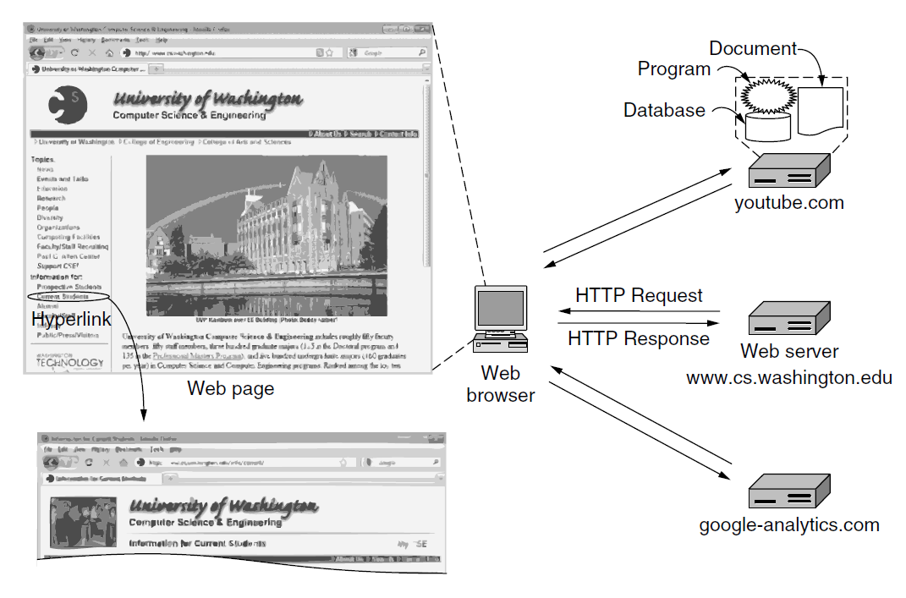
Architectural overview
Browser: program running on the client to view Web pages
The browser requests the page to the server, receives it, interprets the content, and displays the page, properly formatted, on the screen.
The request-response application protocol for fetching pages is a simple text-based protocol that runs over TCP, called HyperText Transfer Protocol (HTTP).

Slide 23
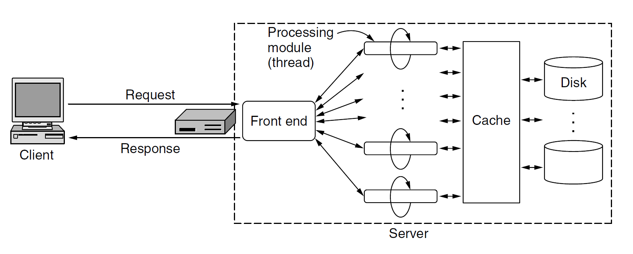
The server structure
Web servers are designed with a multithreaded design to manage multiple requests at a time.
A front-end module that accepts all incoming requests and k parallel processing modules.
The cache stores the most-recently read files.

Slide 24
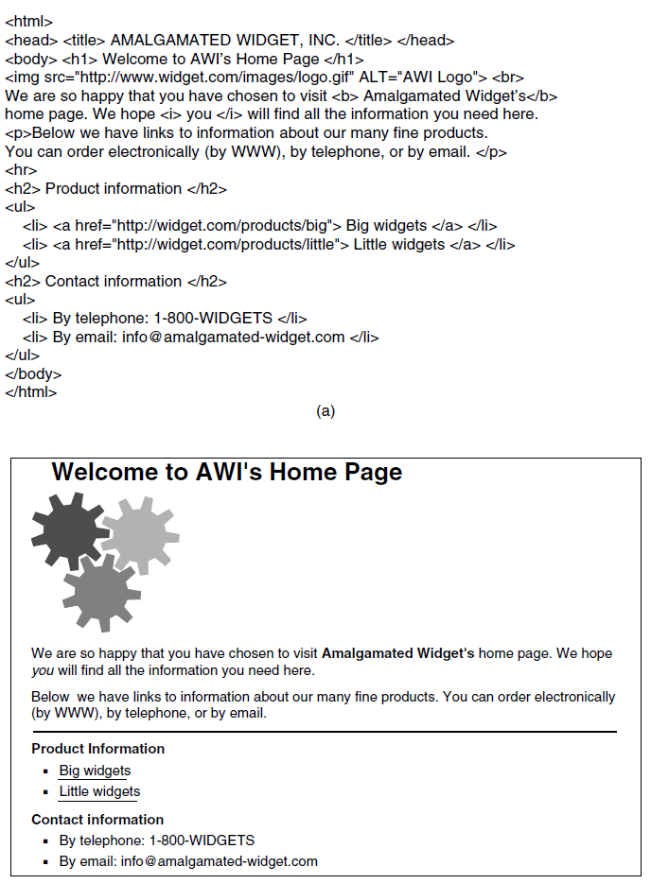
HyperText Markup Language (HTML)
Web pages are written in a HTML (HyperText Markup Language). HTML is a markup language: language for describing how documents are to be formatted.
A browser is basically an HTML interpreter
HTML pages can contain text and rich content elements (e.g., MPEG, JPEG, mp3).
When a server returns a page, it also returns some information about the type of contents in the page (MIME type).
If the page content is different from text/html, the browser resorts to a plug-in, i.e., a third-party code module that is installed as an extension to the browser, to interpret that content (e.g., plug-in for PDF).

Slide 25
The client side
How can the browser retrieve a page?
Each page is assigned an identifier called Uniform Resourse Locator (URL)
The URL includes three components:
the communication protocol to access to the page
the name of the server where the page is located
the path identifying the page file on the server
Remember: The IP address is that label (e.g. 192.0.2.1) which uniquely identifies a host connected to a computer network using the IP protocol.
http://www.dei.unipd.it/index.html
http | www.dei.unipd.it | index.html
Protocol | Name of the server | Path of the page
But in order to send the request the browser needs to know the IP address of the server.
This information is stored in a name server…

Slide 26
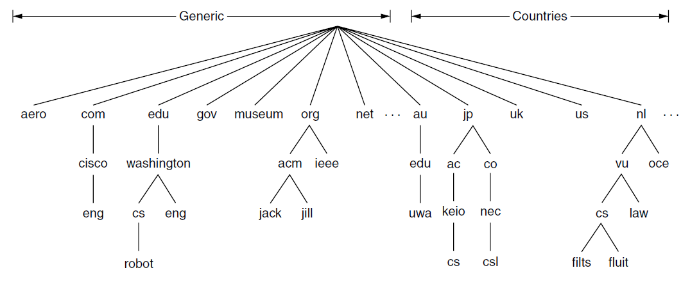
Domain Name Space (DNS)
The Domain Name Space (DNS) is a hierarchical, domain-based naming scheme and a distributed database system used for mapping server names with their IP address.
The DNS is managed by an organization called ICANN (Internet Corporation for Assigned Names and Numbers).
There are top-level domains, each divided into subdomains according to a hieararchical structure.

Slide 27
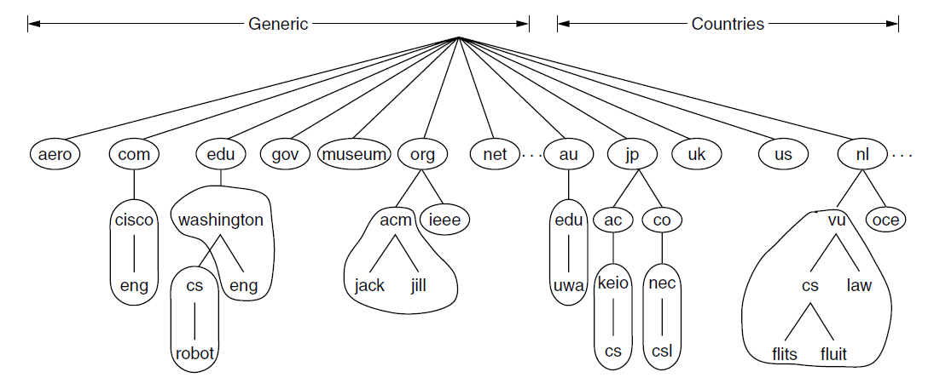
The DNS database
The DNS database stores information about each registered domain, including the IP address.
The DNS database is not stored in a single server. It is divided into non-overlapping zones and each zone is associated to multiple servers.
The process of looking up a domain name in the DNS database and finding its resource records (e.g., IP address) is called name resolution and it is performed by a program called resolver.

Slide 28
Browsing - the client side
When the user click on a hyperlink linking the URL:
http://www.dei.unipd.it/index.html
The browser determines the linked URL (by seeing what was selected).
The browser asks to the DNS resolver the IP address of the server www.dei.unipd.it
The resolver replies with 147.162.2.199.
The browser makes a TCP connection to 147.162.2.199 on port 80 (port for HTTP).
It sends over an HTTP request asking for the page /index.html.
The server www.dei.unipd.it sends the page /index.html as an HTTP response.
If the page includes URLs that are needed for display, the browser fetches the other URLs using the same process.
The browser displays the page.
The TCP connection with www.dei.unipd.it is closed if there are no other requests for the same server for a short period.

Slide 29
Browsing – The server side
When the client sends a connection request to a server, the server:
Accepts a TCP connection from a client (a browser).
Resolves the name of the Web page requested (some incoming paths may contain build-in shortcuts that need to be parsed, e.g., empty file names to be expanded to a default file name).
Performs access control on the Web page → checking access restrictions for the requested page.
Fetches the requested page from disk or run a program to build it.
Returns the response to the client.
Makes an entry in the server log for administrative purposes.
To increase performance, a single TCP connection may be used by a client and server for multiple page fetches.

Slide 30
References
Tanenbaum, Wetherall – Computer Networks – Fifth Edition
Chapter 1 – Introduction
Chapter 7 – The application layer

