Slide 1
Introduction

Slide 2
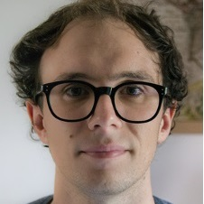
Who am I
Giacomo Cappon
Assistant Professor, Department of Information Engineering, University of Padova
PhD in Information Engineering, curriculum Bioengineering
Main research interests: signal processing; decision support systems; wearable sensors; digital health; ai for medicine
Contacts
email: giacomo.cappon@unipd.it
personal website: https://gcappon.github.io
public repos: https://github.com/gcappon

Slide 3
What is the course about?
Biomedical wearable technologies…
E-health or digital health: The use of modern Information and Communication Technologies (ICT) to efficiently deliver all kinds of healthcare services
Examples: EHR, telemedicine systems
Wearables: electronic devices worn close to and/or on the surface of the skin, which detect, analyze and transmit biomedical data, such as heart rate, activity, blood pressure, temperature, etc.
Internet-of-thing (IoT) wearables: Wearables that connect and exchange data with other devices (wearable or not) and systems over the Internet or other communication networks
E-health
Wearables
IoT wearables

Slide 4
What is the course about?
… for healthcare and wellbeing
Our society is facing some important global health challenges
Lifestyle-related illnesses driven by sedentary life, consumption of processed and fast foods, alcohol drinking and smoking
Need to change the paradigm of healthcare, from a mostly reactive system to a proactive system
Population ageing rises the demand of health services and the healthcare expenditure.
Need to decentralizing the healthcare
Covid-19 pandemic called for urgent delivery of healthcare at home
Biomedical wearable technologies are fundamental to make healthcare scalable and accessible outside the hospital setting and deliver personalized and preventive health services

Slide 5
Theory program
The theoretical part of the course will cover the following:
Wearable sensor technologies
Health design thinking
Elements of UI/UX Design
Evaluation of app usability
Fundamentals of network architectures and the HTTP communication protocol
The representational state transfer (REST) paradigm
Application programming interfaces (APIs)
Elements of network security
Authentication protocols
Regulation for health data management

Slide 6
Lab program
The laboratorial part of the course will cover the following:
The Git version control system
Dart programming language and the Flutter framework
Building mobile/web applications in Flutter
User Interface design
Navigation
State management
Basic data persistence
Networking
Integrating AI models in mobile applications
Workshop…

Slide 7
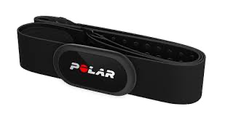
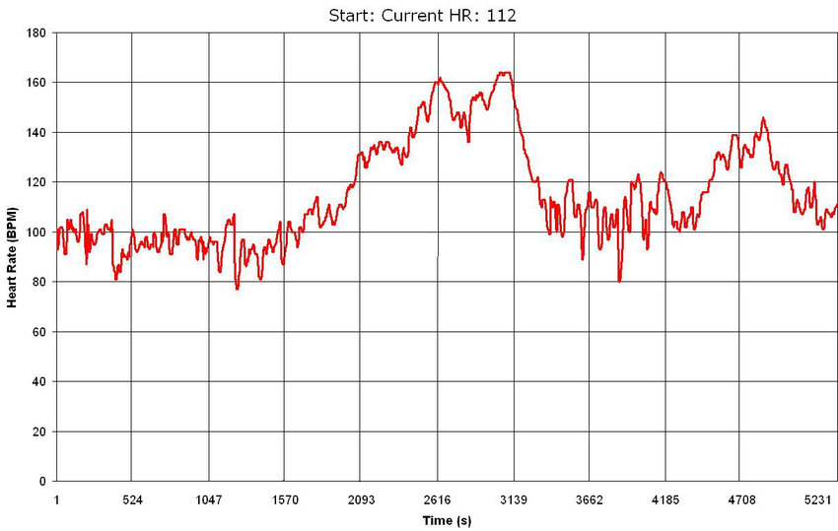
Lab program - The workshop
2-hours workshop where we will set up a fake clinical trial aimed at evaluating the cardiovascular tone in a cohort of healthy subjects using an experimental algorithm
The fastest 5 students to submit the right answer will get a +1 to the final evaluation.
1. Trial setup
2. Data collection using a wearable and an app
Together
3. Data preparation
4. Data analysis
Individually
5. Trial outcome

Slide 8


Prerequisites & End of class goals
Prerequisites
Basic:
Propension for programming, Python
Preferable:
Object-oriented programming
End of class goals
Knowing how wearable devices communicates to the end-user
Designing digital solutions to enhance healthcare and well-being
Developing a fully functioning mobile application

Slide 9
The exam
Written test: Theory exam
4 open questions
Duration: 90 min
Max vote: 20/30
Project: Development of an application that integrates and elaborates data from a smartwatch. To be done in groups of 3 students.
Duration of the discussion: 45 min (25 min presentation + 20 min Q&A)
Max vote: 12/30
Final mark: sum of the votes of the written test and the project.
Dates of the written test
First attempt: 18 Jun 2026, 14:00 (Room Me+Ne)
Second round: 07 Jul 2026, 14:00 (Room De)
Third round: 28 Aug 2026, 14:00 (Room De)
Fourth round: 01 Feb 2027, 14:00 (Room Ee)

Slide 10
Project: What’s the spirit here
The goal is learning “How to do SOMETHING ORIGINAL using wearable devices”
What I DO expect from you
To use your imagination to create that SOMETHING
To learn to build something from scratch
To use code built by others
To work together
To use Google and StackOverflow
What I DO NOT expect from you
To create the new Google
To reinvent the wheel (copying others code is fine)
To create extra complicated UI with animations and stuff

Slide 11
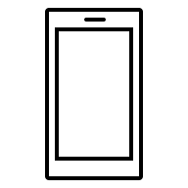
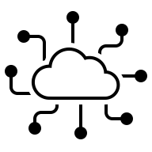

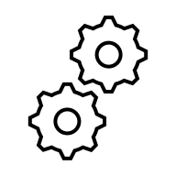
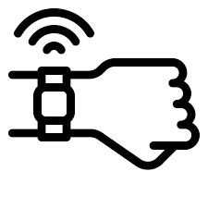
Project structure
The project consists of building an app for iOS or Android that collects user data from a wearable device through Web APIs, visualizes them, and does some tricks with them.
Core functionalities:
Correct app flow
User authentication and management
Data collection
Data visualization and presentation
Additional fuctionalities → It’s up to you! Some examples:
Run some analysis on data and provide suggestions to the user
Implement some literature algorithm
…

Slide 12
Grading
What are the grading criteria
Compliance to core functionalities
Originality of the additional feature
Quality of teamwork
How much these criteria matter?
Core functionalities: 40%
Additional app functionalities: 50%
Quality of teamwork: 10%

Slide 13

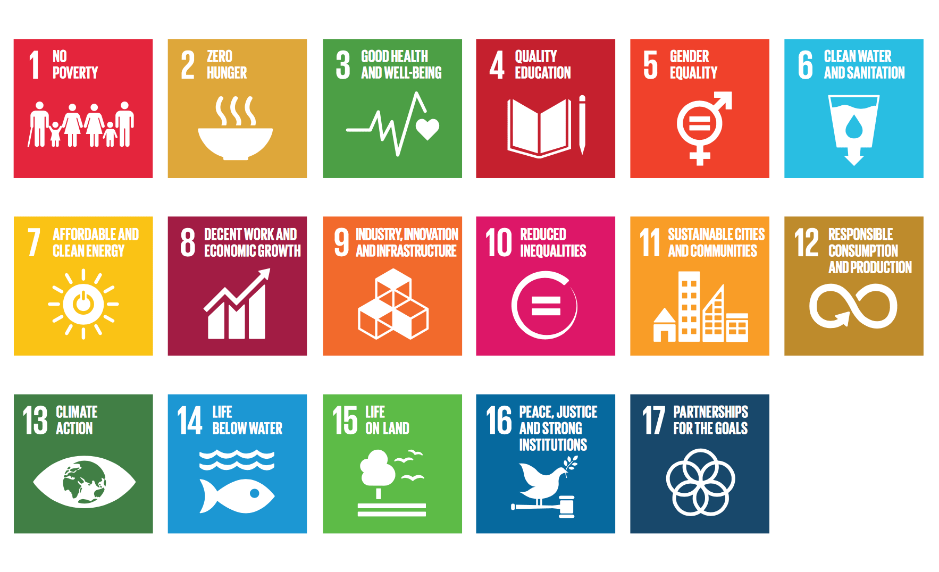
Choose your target
Your app must represent a solution for the current SDGs (Sustainable Development Goals) targets
SDG are 17 topics representing the current big challenges humanity must face and solve

Slide 14
Choose your target
These are the target you can choose from (see the elearning page for more details):
SDG 2: Target 2.2 (By 2030, end all forms of malnutrition, including achieving, by 2025, the internationally agreed targets on stunting and wasting in children under 5 years of age, and address the nutritional needs of adolescent girls, pregnant and lactating women and older persons)
SDG 2: Target 2.3 (By 2030, double the agricultural productivity and incomes of small-scale food producers, in particular women, indigenous peoples, family farmers, pastoralists and fishers, including through secure and equal access to land, other productive resources and inputs, knowledge, financial services, markets and opportunities for value addition and non-farm employment)
SDG 3: Target 3.4 (By 2030, reduce by one third premature mortality from non-communicable diseases through prevention and treatment and promote mental health and well-being)
SDG 3: Target 3.5 (Strengthen the prevention and treatment of substance abuse, including narcotic drug abuse and harmful use of alcohol)
SDG 4: Target 4.7 (By 2030, ensure that all learners acquire the knowledge and skills needed to promote sustainable development, including, among others, through education for sustainable development and sustainable lifestyles, human rights, gender equality, promotion of a culture of peace and non-violence, global citizenship and appreciation of cultural diversity and of culture’s contribution to sustainable development)
SDG 8: Target 8.9 (By 2030, devise and implement policies to promote sustainable tourism that creates jobs and promotes local culture and products)

Slide 15
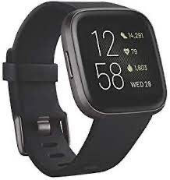
Data source
Data that you will use are collected by me using a Fitbit Versa 2
Data are available starting from 09/02 and will be collected up to 30/11
The following data “types” are included(see mor details in the Appendix):
Calories
Distance
Exercise sessions
Heart rate
Resting heart rate (Estimated)
Sleep
Steps
Your project must use at least 1 type of data

Slide 16
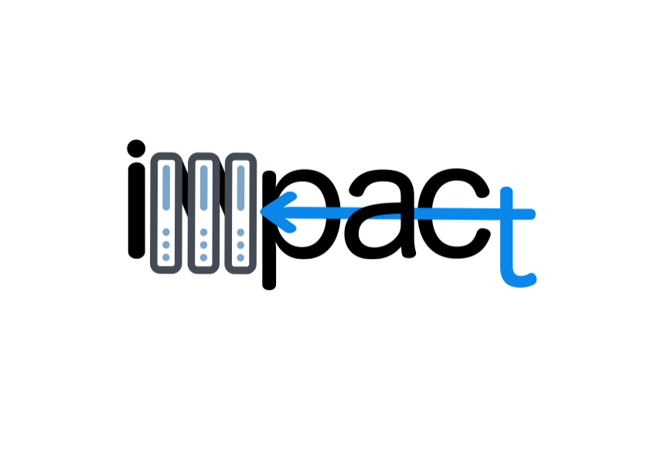

How to get data - The IMPACT backend
HTTP requests/responses
https://impact.dei.unipd.it/bwthw/
Your app
You will be provided with credentials (different for each group) and learn how to get data during the lab lessons

Slide 17
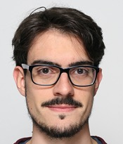
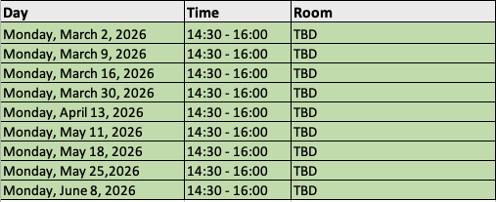
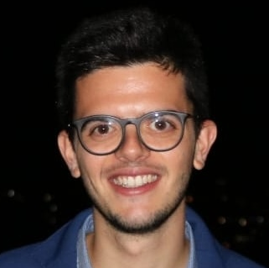
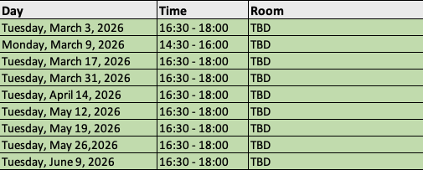
Optional tutoring activities
Need help? They are here to cover your back with answers and optional tutoring activities
Calendar of the optional tutoring activities
Luca Cossu
luca.cossu@phd.unipd.it
Alberto Gastaldello
alberto.gastaldello.2@phd.unipd.it
OR

Slide 18



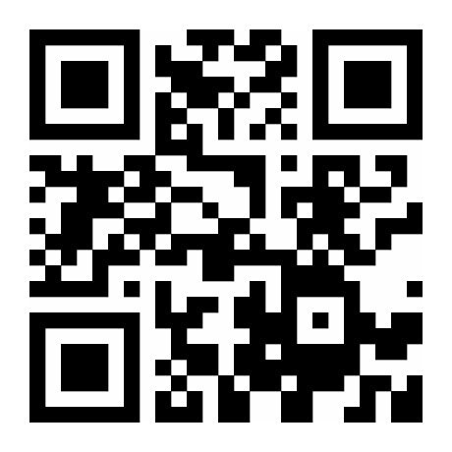
Discord server
Join the Discord server to get in touch and ask questions
Link: https://discord.gg/j76A3D27bm

Slide 19
Wearables

Slide 20

Wearable devices

Slide 21
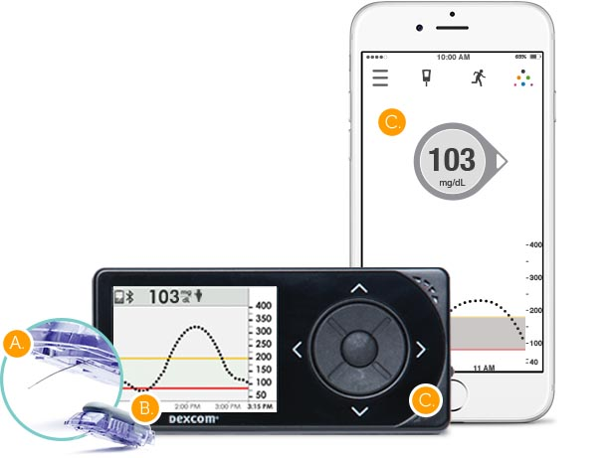
Wearable devices
A wearable device is a device that can be used for sensing physiological parameters or signals which generally include two components:
A sensor that measures the physical quantity of interest (measurand)
An embedded processing unit that does some initial processing of the measurements and either stores them in a memory or sends them to another device
Sensor
Receiver device / Gateway device (for IoT devices)
Embedded processing unit

Slide 22
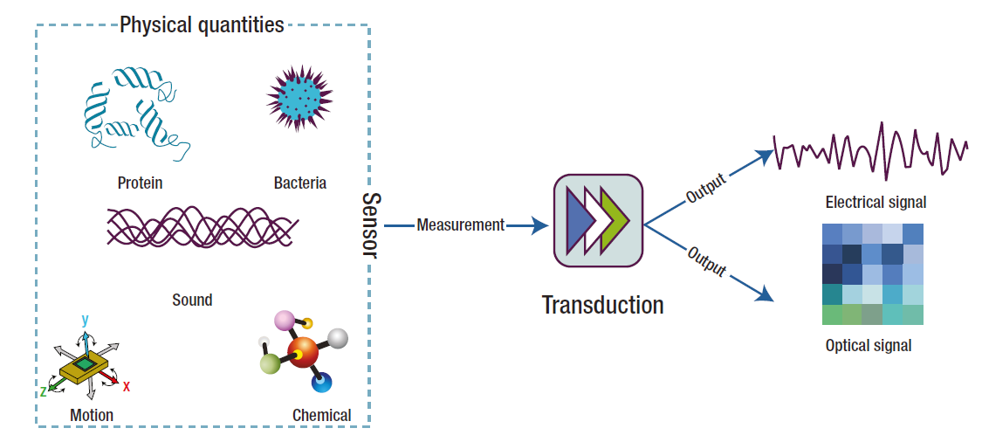
Definitions of sensor
“A sensor generally refers to a device that converts a physical measure into a signal that is read by an observer or by an instrument” (Chen et al., 2012)
Measurand

Slide 23
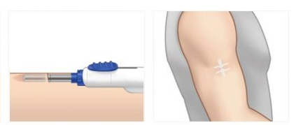
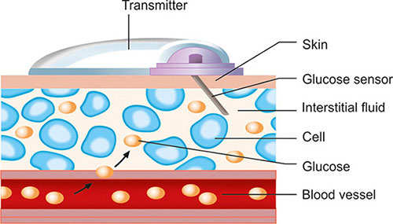
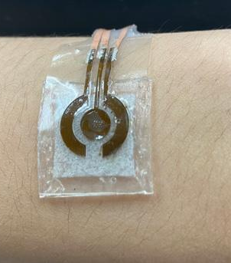
Classification of sensors based on their interaction with the measurand
Contact sensor: sensors requiring physical contact with the measurand.
Their deployment obviously perturbs the state of the subject to some degree.
Comfort and biocompatibility are important considerations
Response time determined by the speed at which the measurand is transported to the measurement site.
Poor contact can result in signal noise and the introduction of signal artifacts.
Invasive: sensors inserted into human body
Minimally-invasive: patch-type devices on the skin that monitor interstitial fluids
Non-invasive: sensors that simply have contact with the skin without effect

Slide 24
Classification of sensors based on their interaction with the measurand
Non-contact sensors: do not require direct contact with the measurand.
Minimum perturbation of the subject
Generally used in ambient sensing applications
Example: infrared thermometer
Sample based sensors: require an invasive collection of a sample of the person to be monitored by a human or automated sampling system.
The collected samples are analyzed using sensors or laboratory-based analytical instrumentation
Common approach in healthcare (e.g. monitoring cholesterol)

Slide 25
Classification of sensors based on their sensing technique
Mechanical sensors
Electrical sensors
Optical sensors
Chemical sensors

Slide 26
Mechanical sensors
Mechanical sensors detect some form of mechanical deformation of a material, in response to the measurand (input), and translate it to an electrical, optical, magnetic or thermal signal (output).
Electromechanical sensors:
Types of electromechanical sensing techniques:
Piezoresistive sensors
Capacitive sensors
Iontronic sensors
Piezoelectric sensors
Measurand
Mechanical deformation
Electrical signal

Slide 27
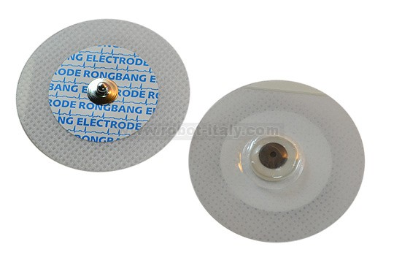
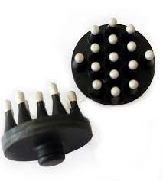
Electrical sensors
Electrical sensors: on-skin electrodes that measure a change in electrical resistance or the electrical charge of the skin.
Good electrical contact with skin is required.
Wet electrodes: solid conductive pad interfaced to the skin via an electrolyte gel that minimizes the impedance of skin by hydrating it and forming a conformal electrical contact with its textured surface.
Dry electrodes: direct contact with the skin, sensible to movement artifacts.
Skin electrodes allow to collect high-fidelity measurements of a broad range of physiologically relevant biopotentials:
electrocardiogram (ECG)
electroencephalogram (EEG)
electromyogram (EMG)
electrooculogram (EOG)
electroretinogram (ERG)
galvanic skin response (GSR), also known as skin impedance or electrodermal activity (EDA)

Slide 28
Optical sensors
Electro-optical sensors detect light and convert it to an electrical signal
Photoconductive devices convert a change of incident light into a change of resistance.
Photovoltaics (solar cells) convert an amount of incident light into an output voltage.
Photodiodes and phototransistor convert an amount of incident light into an output current.
Operating principle of wearable optical sensors: a light source introduces light into the body and based on how much the light is absorbed or reflected, measurements related to the body tissue are derived.
The wavelength of light sources can range from UV to deep infrared, depending on needed penetration depth and the absorption peak for the relevant sensing application.
Commonly used for monitoring of heart rate and blood oxygenation.

Slide 29
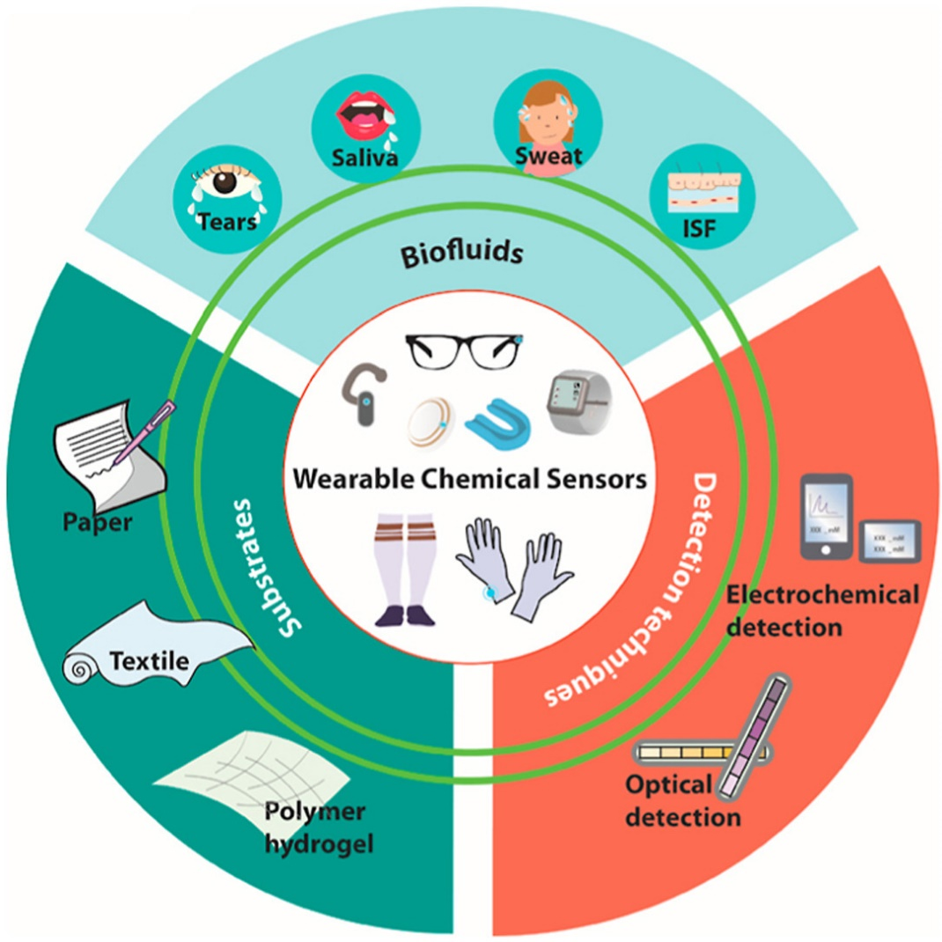
Chemical sensors
They quantify chemical markers, or analytes, in biological fluids and convert this information in an optical (optochemical sensor) or electrical signal (electrochemical sensor).
Require direct chemical interaction with the biomarker (contact sensors).
Wearable chemical sensors use non-invasive or minimally-invasive techniques to measure analytes in alternative biofluids instead of invasive blood sampling.
Biofluids secreted by the body (saliva, sweat, tears)
Interstitial fluid reached through minimally-invasive sensors or by reverse iontophoresis

Slide 30
Sensor characteristics
To truly understand sensors, and how sensors that measure the same measurand can differ, it is necessary to understand sensor performance characteristics, which are reported in specifications (specs) or datasheet.
Systematic characteristics: those which can be exactly quantified by mathematical or graphical means;
Statistical characteristics: those which cannot be exactly quantified;
Dynamic characteristics: those characterizing the ways in which an element responds to sudden input changes.

Slide 31

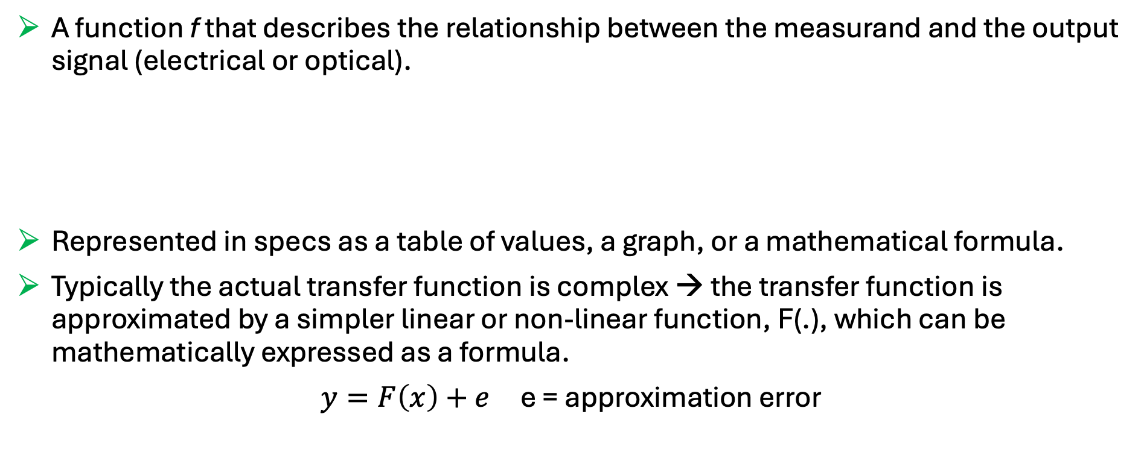
Transfer function
A function f that describes the relationship between the measurand and the output signal (electrical or optical).
Represented in specs as a table of values, a graph, or a mathematical formula.
Typically the actual transfer function is complex → the transfer function is approximated by a simpler linear or non-linear function, F(.), which can be mathematically expressed as a formula.
$y=F\left(x\right)+e$ e = approximation error
$$y=f(x)$$
Output electrical (or optical) signal
Measurand

Slide 32



Inverse transfer function
The embedded processing unit of the sensor device applies the inverse of F(.), F⁻¹(.), to convert the electrical signal generated by the sensing technique to output measurements in the same domain of the measurand.
Measurand
(e.g., glucose concentration)
Measurement (e.g., current in pA)
Glucose concentration mg/dl
Sensor
Approximated inverse transfer function
F⁻¹(y)
$$x$$
$$y$$
$$\hat{x}$$

Slide 33
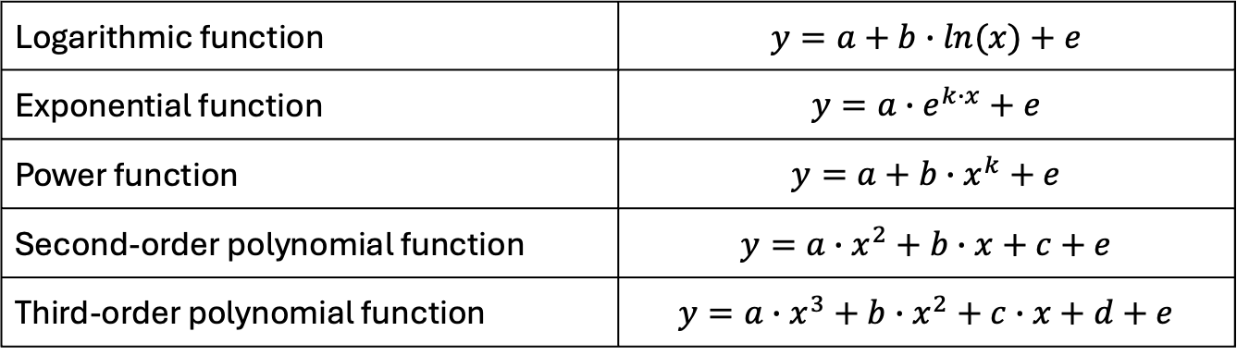

Common transfer function approximations
Linear transfer function approximation:
The offset, b, is the output value of the sensor when no measurand is applied. It is the component of the output signal which does not depend on the measurand.
The slope, a, represents the sensor sensitivity, i.e., the change in the sensor output resulting from a unit change in the input measurand.
Non-linear transfer function approximations:
$$y=a∙x+b+e$$
Logarithmic function | $$y=a+b∙ln(x)+e$$
Exponential function | $$y=a∙e^{k∙x}+e$$
Power function | $$y=a+b∙x^{k}+e$$
Second-order polynomial function | $$y=a∙x^{2}+b∙x+c+e$$
Third-order polynomial function | $$y=a∙x^{3}+b∙x^{2}+c∙x+d+e$$

Slide 34











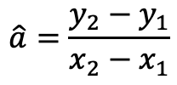
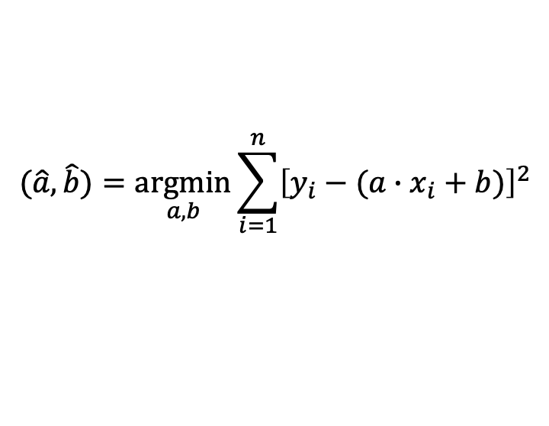
Calibration
The transfer function parameters, e.g., a and b in the linear transfer function, are in general unknown and must be estimated. This process is called calibration.
If a set of known (x,y) paired values are available, estimation of transfer function parameters can be performed by the least square approach.
For linear transfer function:
$$(\hat{a},\hat{b})=\underset{a,b}{argmin}{\sum_{i=1}^{n}{{\left[y_{i}−(a∙x_{i}+b)\right]}^{2}}}$$
Two-point calibration
Multiple-point calibration
$$y$$
$$y=\hat{a}∙x+\hat{b}$$
$$y$$
$$y=\hat{a}∙x+\hat{b}$$
$$y_{2}$$
$$\hat{a}=\frac{y_{2}−y_{1}}{x_{2}−x_{1}}$$
$$y_{1}$$
$$\hat{b}=y_{2}−\frac{y_{2}−y_{1}}{x_{2}−x_{1}}{∙x}_{2}$$
$$x_{1}$$
$$x_{2}$$
$$x$$
$$x$$

Slide 35
Embedded processing unit
The embedded processing unit is responsible for:
Performing local processing of the measurements
Storing some data in a local memory
Sending the data to another device (e.g., a display device or a gateway device for IoT systems)
Three main operations:
Denoising
Calibration
Fault detection
Sensor
Receiver device / Gateway device (for IoT devices)
Embedded processing unit

Slide 36
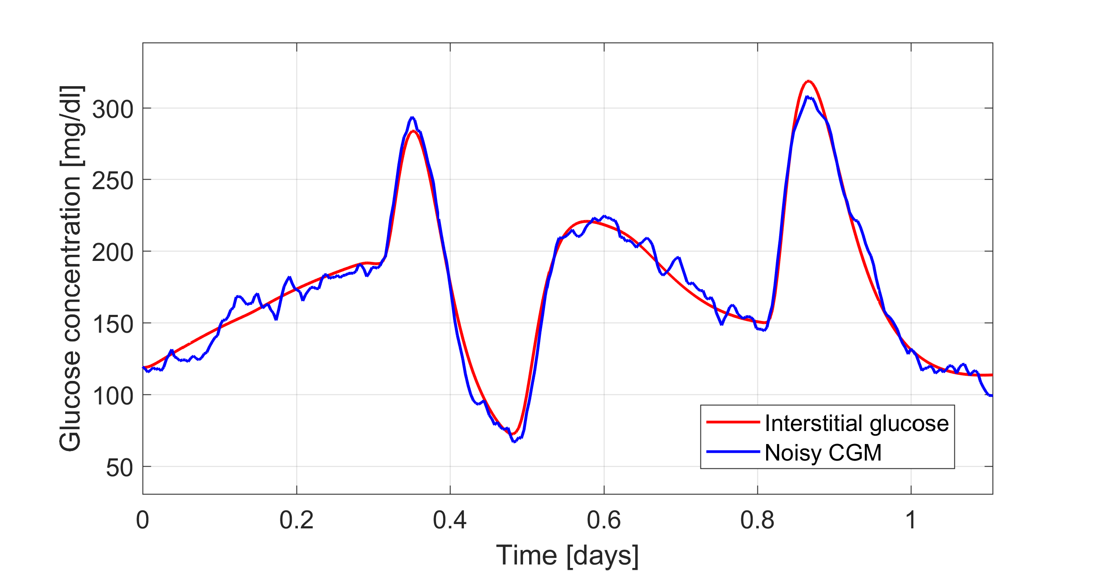
Denoising
Raw signals are often noisy: the signal of interest is corrupted by noise
Example: high-frequency noise on a CGM signal

Slide 37
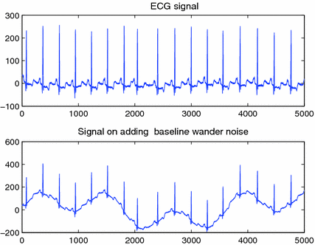
Denoising
Raw signals are often noisy: the signal of interest is corrupted by noise
Example: low-frequency noise (e.g., due to movement) on an ECG signal
Clean ECG signal
ECG signal corrupted by low-freq. noise

Slide 38
Denoising
The noise can be filtered by applying a denoising algorithm exploiting a digital filter.
Noisy signal
Clean signal
Denoising algorithm
(digital filter)
Non-causal filters: the filter output depends on past and future inputs → for offline use only
Causal filters: the filter output depends only on past and present inputs → suitable for online application

Slide 39
Fault detection
Detection of temporary sensor errors also called faults or artifacts
Example: pressure-induced signal suppression in a CGM signal
Measured signal
Artifact suppressed
Reconstructed signal
Fault detection algorithm
Signal reconstruction algorithm
(e.g. interpolation)

Slide 40
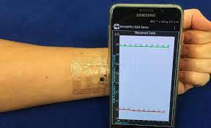
Communication systems
BONUS
Wearable devices require a data transmission systems that wirelessly communicate between the sensing device and the receiver and/or gateway device (it can be the smartphone).
Bluetooth communication is the primary choice because of its simplicity, low operation cost, compatibility with new smartphone technology, and simple hardware. Drawback: it requires high power consumption.
Near field communication (NFC): a wireless communication technology that operates at a short distance (about 4 cm) and does not need the energy from the battery to transfer the data.
NFC tags can directly communicate with the smartphone equipped with the NFC modules.
Bypassing the need for batteries, NFC enables ultrathin, ultraminiaturized designs for sensors, like a temporary transfer tattoo.

Slide 41


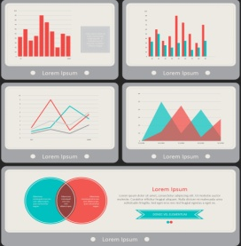
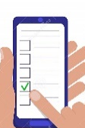
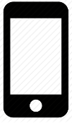

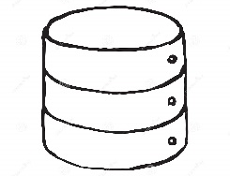

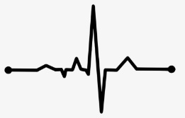
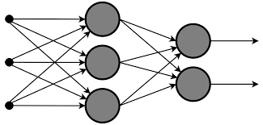
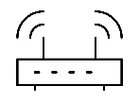
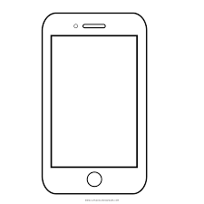
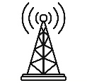
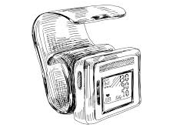
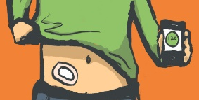
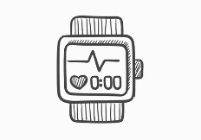
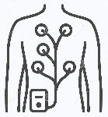
The architecture of wearable IoT systems
Alerts
Decision-support
Event log
Self-management
4. Application layer
Database
Data analyses
Signal processing
Modeling
3. Data storing and processing layer
Gateway device
WiFi,
Router
Internet
2. Network layer
GSM
Activity tracker
Sensors
ECG sensor
1. Sensing layer
Blood pressure sensor
Glucose sensor

Slide 42
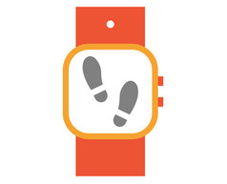

1. Sensing layer
This layer includes sensors, which are responsible for:
Collecting the data either directly from the body through contact sensors or from peripheral sensors providing indirect information of body and behaviours
Preparing the data for on-board analysis, closed-loop feedback or remote transmission for more comprehensive analysis and storing
Contact sensors
ECG sensor
Glucose sensor
Peripheral sensors
Step counter
Microphone and camera
Key components of IoT wearable sensors:
Miniaturized sensor hardware
Embedded processor with storage capabilities, power management and communication circuits
Typically, limited computing power and storage capabilities.

Slide 43
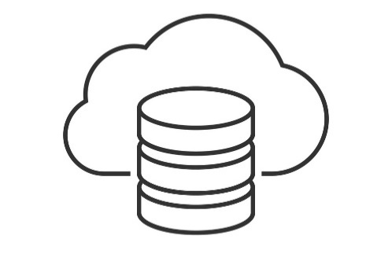
2. Network layer
Fore more comprehensive data analysis and storage, the sensor layer need to transmit the data to cloud computing servers (remotely-located computing machines).
This transmission can be mediated by a companion device that serves as a gateway, i.e., it enables the information to flow from sensors to the cloud server.
Example of gateway devices: smartphones, tablets and PCs.
The communication must be secured through:
Authentication protocols for writing, modifying and accessing the data
Security and privacy protocols for preserving the data
Sensor
Gateway device
Cloud server
Bluetooth
WiFi
GSM

Slide 44
3. Data storing and processing layer
Layer responsible for data storing and complex processing
Key components:
Database for structured data storing
Data organized based on a specific data model (relational, hierarchical, object-oriented,…)
Algorithms for data processing
Statistical analysis
Feature extraction (e.g., heart rate, calories expenditure, …)
Signal processing (e.g., filtering, artifact removal, …)
Data mining (e.g., cluster analysis, anomaly detection, sequential pattern extraction, …)
Data modeling (knowledge-based, data-driven or hybrid approaches)
Artificial intelligence (knowledge representation, machine learning, natural language processing, machine perception, automated planning, …)

Slide 45
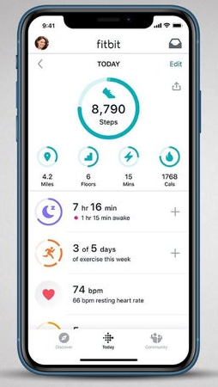
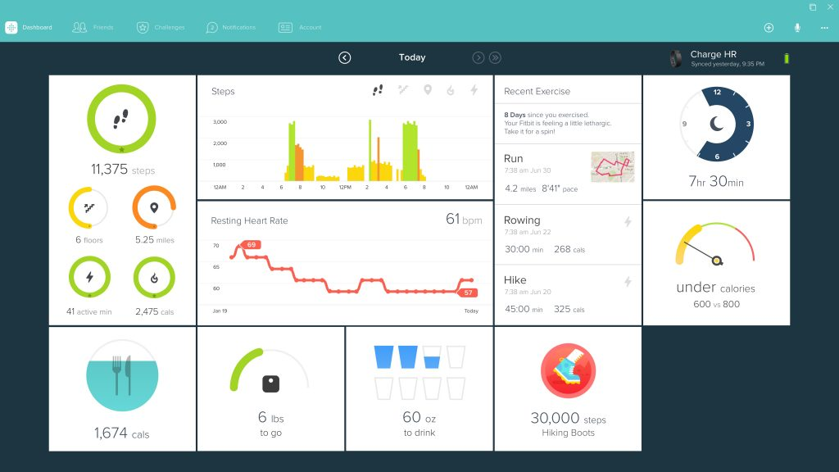
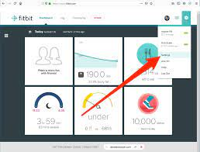
4. Application layer
Layer responsible for visualizing raw or processed data to end-users and for providing decision support to them through a software application
Possible end-users: patients, physicians, caregivers, analysts, data managers, administrators, etc.
Possible types of applications:
Mobile app
Desktop app
Web app
App installed in a mobile device (e.g. smartphone, smartwatch, tablet, etc.)
App installed in a computer. It can work offline.
App that runs on the browser.
Installation not required. Internet access required.

Slide 46
Appendix: Data source characteristics

Slide 47
Focus on data – Calories
Calories: a list with 1 data point exactly every minute
Fields meaning:
time: timestamp (hh:mm:ss format) of the calory entry
value: the calories spent during the last 1 minute (rest + active)
[
{
"time": "00:00:00",
"value": "1.29"
},
{
"time": "00:01:00",
"value": "1.29"
},
{
"time": "00:02:00",
"value": "1.29"
},
{
"time": "00:03:00",
"value": "1.55"
},
{
"time": "00:04:00",
"value": "1.29"
},
{
"time": "00:05:00",
"value": "1.29"
},
{
"time": "00:06:00",
"value": "1.29"
},
...
]

Slide 48
Focus on data – Distance
Distance: a list with 1 data point every minute or more depending on user’s movement
Fields meaning:
time: timestamp (hh:mm:ss format) of the distance entry
value: the distance travelled between the last timestamp and now (in cm)
[
{
"time": "00:03:00",
"value": "0"
},
{
"time": "00:50:00",
"value": "0"
},
{
"time": "01:28:00",
"value": "0"
},
{
"time": "01:32:00",
"value": "1440"
},
{
"time": "01:33:00",
"value": "3110"
},
{
"time": "01:34:00",
"value": "0"
},
{
"time": "01:53:00",
"value": "0"
},
{
"time": "03:09:00",
"value": "0"
},
...
]

Slide 49
Focus on data – Steps
Steps: a list with 1 data point every minute or more depending on user’s movement
Fields meaning:
time: timestamp (hh:mm:ss format) of the step entry
value: the number of steps done between the last timestamp and now
Note: there can be days without data
[
{
"time": "00:07:00",
"value": "0"
},
{
"time": "00:10:00",
"value": "0"
},
{
"time": "01:57:00",
"value": "0"
},
{
"time": "02:29:00",
"value": "0"
},
{
"time": "02:40:00",
"value": "0"
},
{
"time": "02:57:00",
"value": "11"
},
{
"time": "02:58:00",
"value": "18"
},
{
"time": "02:59:00",
"value": "0"
}, ...
]

Slide 50
Heart rate
Heart rate: a list with 1 data point every 5 seconds.
Fields meaning:
time: timestamp (hh:mm:ss format) of the heart rate entry
value: the heart rate at the current time (in bpm)
confidence: a number from 0 to 3 defining how much the reading is reliable (this problably depends on user movement, etc. You can ignore it)
Note: there can be missing values
[
{
"time": "03:10:19",
"value": 58,
"confidence": 1
},
{
"time": "03:10:24",
"value": 54,
"confidence": 3
},
{
"time": "03:10:29",
"value": 52,
"confidence": 3
},
{
"time": "03:10:44",
"value": 52,
"confidence": 3
},
{
"time": "03:10:54",
"value": 53,
"confidence": 3
},
{
"time": "03:11:09",
"value": 54,
"confidence": 3
},
{
"time": "03:11:19",
"value": 53,
"confidence": 3
}, ...
]

Slide 51
Resting heart rate
Resting heart rate: an entry per day.
Fields meaning:
time: timestamp (hh:mm:ss format) of the resting heart rate entry (always 00:00:00)
value: the estimated resting heart rate at the current time (in bpm)
error: the estimate error (in %) (Can be ignored)
Note: there can be days without data
{
"time": "00:00:00",
"value": 51.35,
"error": 17.86
}

Slide 52
Exercise
[
{
"activityName": "Corsa",
"averageHeartRate": 143,
"calories": 727,
"distance": 8.474117,
"distanceUnit": "Kilometer",
"duration": 3.548E+6,
"activeDuration": 3.214E+6,
"steps": 8604,
"logType": "tracker",
"heartRateZones": [
{
"name": "Fuori zona",
"min": 30,
"max": 110,
"minutes": 3,
"caloriesOut": 30.146219999999971
},
{
"name": "Grassi bruciati",
"min": 110,
"max": 137,
"minutes": 8,
"caloriesOut": 97.13782
},
{
"name": "Attivita aerobica",
"min": 137,
"max": 170,
"minutes": 48,
"caloriesOut": 659.73843
},
{
"name": "Picco",
"min": 170,
"max": 220,
"minutes": 0,
"caloriesOut": 0
}
],
"speed": 9.4981754822650917,
"vo2Max": {
"vo2Max": 48.77853
},
"elevationGain": 28.042,
"time": "11:22:43"
},
Exercise: a list with 1 entry for each recorded exercise session
Fields meaning:
activityName: the type of entry (“Corsa”: Run, “Bici”: bike, “Camminata”: Walk)
averageHeartRate: the average heart rate during the session
calories: the active calories spent during the session
distance: the distance covered during the session
distanceUnit: the unit of the “distance” field
duration: the total duration of the session (in ms)
activeDuration: the total active duration of the session (in ms)
steps: the total number of steps done during the session (if “Corsa” or ”Camminata”)
logType: how this record was logged (“tracker” or “auto_detected”)
heartRateZones: a list that summarizes the number of minutes and calories spent in specific heart rate ranges (from min to max)
speed: the average speed (in km/h)
vo2max: the estimated running VO2Max (only for “Corsa” activities)
elevationGain: the elevation gained during the session
time: the starting time of the session (format hh:mm:ss)
Note: different activity types can have (slightly) different fields
Note: there can be days without data
{
"activityName": "Bici",
"averageHeartRate": 150,
"calories": 3893,
"distance": 140.143695,
"distanceUnit": "Kilometer",
"duration": 2.0901E+7,
"activeDuration": 1.756E+7,
"logType": "tracker",
"heartRateZones": [
{
"name": "Fuori zona",
"min": 30,
"max": 110,
"minutes": 28,
"caloriesOut": 214.83527999999842
},
{
"name": "Grassi bruciati",
"min": 110,
"max": 136,
"minutes": 64,
"caloriesOut": 664.55027999999993
},
{
"name": "Attivita aerobica",
"min": 136,
"max": 170,
"minutes": 232,
"caloriesOut": 3167.1500100000012
},
{
"name": "Picco",
"min": 170,
"max": 220,
"minutes": 24,
"caloriesOut": 377.76059999999995
}
],
"speed": 28.734978587699313,
"elevationGain": 663.55,
"time": "11:03:54"
},...
]

Slide 53
Sleep
Sleep: a list with 1 entry for each sleep session
Fields meaning:
dateOfSleep: day associated to the sleep entry (MM-DD format)
startTime: the starting timestamp of the sleep (MM-DD hh:mm:ss format)
endTime: the ending timestamp of the sleep (MM-DD hh:mm:ss format)
duration: the duration of the sleep session (in ms)
minutesToFallAsleep: the number of minutes spent to fall asleep
minutesAsleep: the number of minutes asleep during the sleep entry
minutesAwake: the number of minutes awake during the sleep entry
minutesAfterWakeup: the number of minutes the user spent in bed after waking up
efficiency: the estimated sleep efficiency (from 0 to 100)
logType: how the entry was logged (always “auto_detected”)
mainSleep: a boolean indicating if the entry corresponds to the main sleep session
levels: a summary of the sleeping stages (deep/wake/light/rem/restless) during the sleep session
data: the stage profile of the sleep session. Each entry contains the starting timestamp, the level, and how much it lasted.
Note: there can be days without data
[
{
"dateOfSleep": "02-14",
"startTime": "02-13 22:44:00",
"endTime": "02-14 06:36:30",
"duration": 2.832E+7,
"minutesToFallAsleep": 0,
"minutesAsleep": 429,
"minutesAwake": 43,
"minutesAfterWakeup": 3,
"timeInBed": 472,
"efficiency": 96,
"logType": "auto_detected", ”mainSleep": true,
"levels": {
"summary": {
"deep": {
"count": 5,
"minutes": 106,
"thirtyDayAvgMinutes": 86
},
"wake": {
"count": 34,
"minutes": 43,
"thirtyDayAvgMinutes": 46
},
"light": {
"count": 28,
"minutes": 235,
"thirtyDayAvgMinutes": 281
},
"rem": {
"count": 11,
"minutes": 88,
"thirtyDayAvgMinutes": 101
}
},
"data": [
{
"dateTime": "02-13 22:44:00",
"level": "wake",
"seconds": 30
},
{
"dateTime": "02-13 22:44:30",
"level": "light",
"seconds": 150
},
{
"dateTime": "02-13 22:47:00",
"level": "deep",
"seconds": 1860
}, ... },
...
]

