Slide 1
Giacomo Cappon
Terminal primer

Slide 2
Intro
Terminal is the software that allows to send UNIX Shell commands to the operating system through the command line.
This very brief primer lists some useful UNIX Shell commands that you will need to use during this course in order to work with GIT.
UNIX (Mac and Linux) users have Terminal already installed.
Windows users must install and use git-bash instead of Terminal since the latter is not available for Windows (to install it, follow step 4b in the “Setup the development environment” guide you can find in the moodle page of the course).
In the following, and during the course, I will always refer to both Terminal and git-bash as “Terminal”

Slide 3
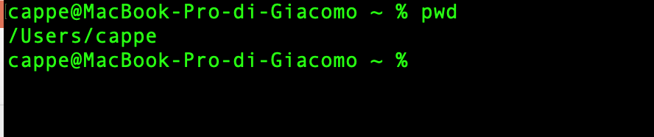
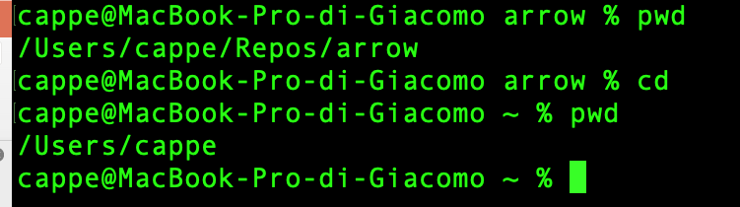
UNIX Shell - Directories
When you open the Terminal, it should start in your home directory. This is your individual space on the system for your files. You can find out the name of your current working directory using the pwd (parent working directory) command: pwd
No matter where in the directory structure you are, you can always get back to your home directory by using the cd (change directory) command without any arguments: cd

Slide 4
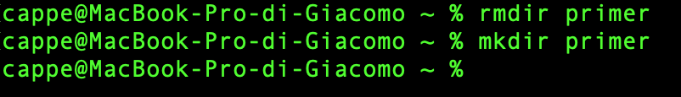
UNIX Shell - Directories
To create a folder you can use the mkdir (make directory) command followed by the name of the directory you want to create: mkdir primer
You can remove an empty subdirectory with the rmdir (remove directory) command (but don't do this right now): rmdir primer (Note: if you do remove "primer", please create it again since all examples will refer to it.)

Slide 5
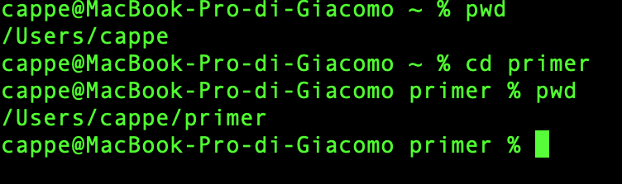
UNIX Shell - Directories
To move into a directory you can use the cd command this time followed by the name of the directory you want to move into: cd primer

Slide 6
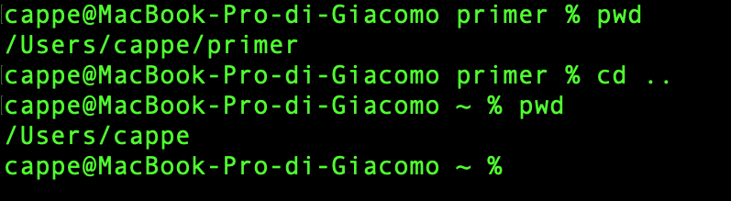
UNIX Shell - Directories
To move into a directory you can use the cd command followed by the name of the directory you want to move into, e.g.: cd primer
To move back into the parent folder use “..” as directory name: cd ..

Slide 7
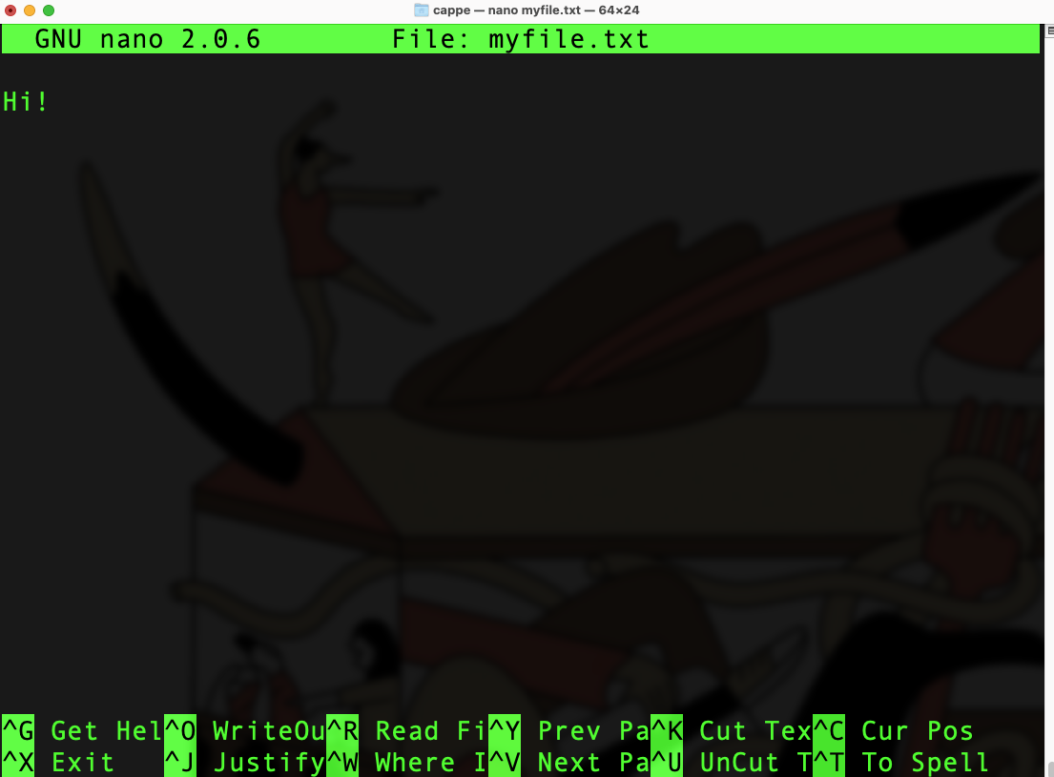
UNIX Shell - Files
To create a file (for example a .txt file) you can use the nano text editor, e.g.: nano myfile.txt
A blank window will open where you can write and edit the myfile.txt file.
To exit, use “CTRL+X” on your keyboard. You will be asked to save the changes you made to the file:
Use “Y” on your keyboard to save and exit
Use “N” on your keyboard to exit without saving
If you choose “Y”, the editor will ask you to choose a file name. Choose it and press enter to exit.

Slide 8
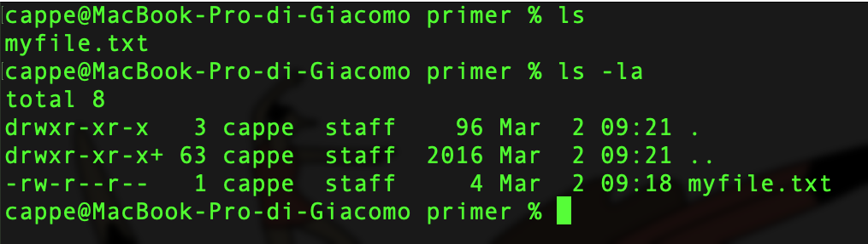
UNIX Shell - Files
To list the content of a directory, use the ls (list) command: ls
If you want to also see all the details of each files and also the hidden folders, use the –la option: ls –la
Note: I won’t cover what are those details since this is not necessary for the course. If you want to know more about it, you can find some useful resources at the end of the document.

Slide 9
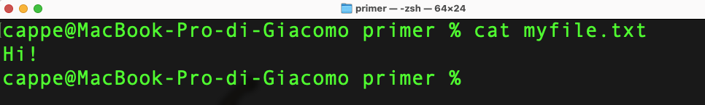
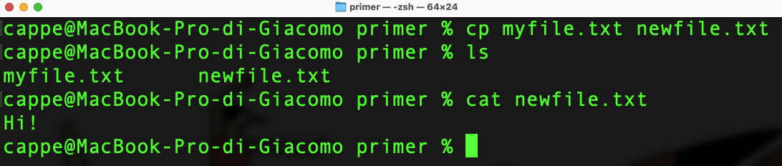
UNIX Shell - Files
To show the content of a file use the cat command followed by the name of the file you want to show, e.g.: cat myfile.txt
To copy a file into another use the cp (copy) command followed by the name of the source file and the name of the destination file, e.g.: cp myfile.txt newfile.txt

Slide 10
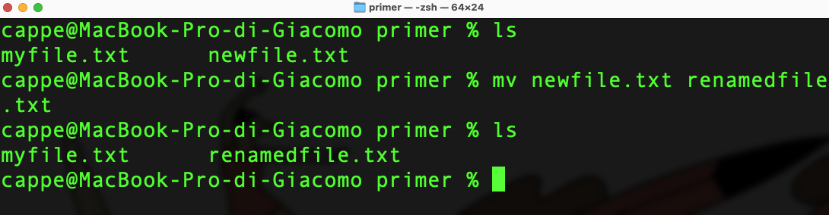
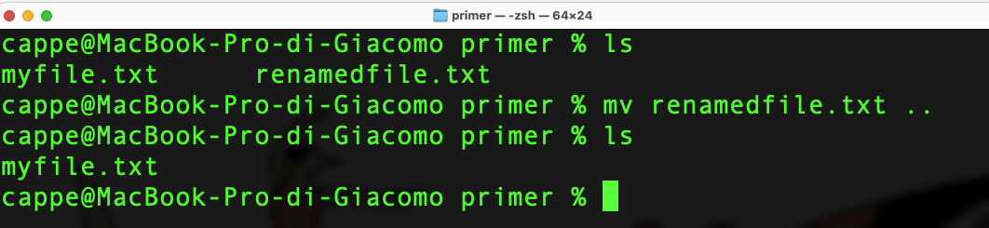
UNIX Shell - Files
To rename a file use the mv (move) command followed by the name of the file you want to rename and the new file name, e.g.: mv newfile.txt renamedfile.txt
To move a file into another directory, use the mv command followed by the name of the file you want to move and the name of the destination directory, e.g. (this moves the file into the parent directory): mv renamedfile.txt ..

Slide 11
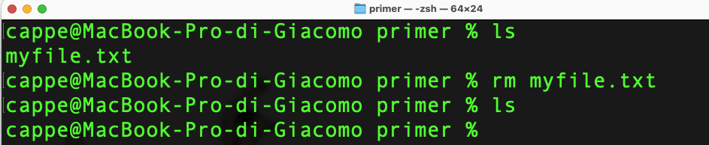
UNIX Shell - Files
To remove a file use the rm (remove) command followed by the name of the file you want to remove, e.g.: rm myfile.txt

Slide 12
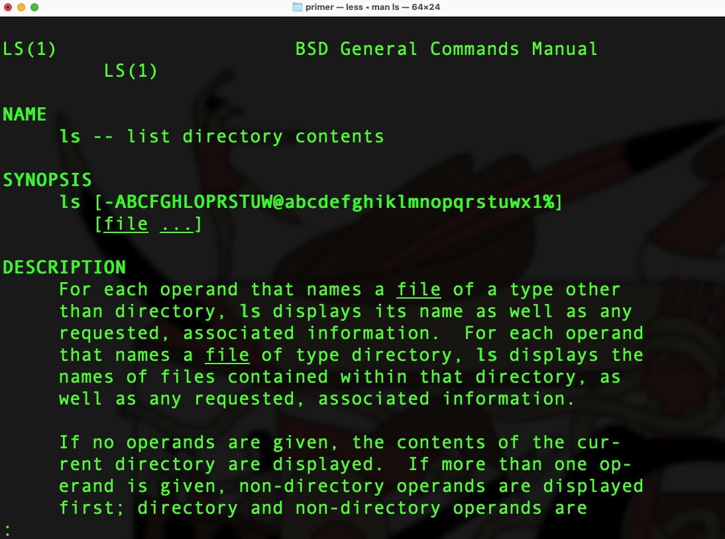
UNIX Shell - Help
To show the online help for a specific command use the man (manual) command, e.g. (this will show the online help for the ls command): man ls
To exit press “q” on the keyboard

Slide 13
UNIX Shell - Summary
nano myfile.txt | text edit file "myfile.txt"
ls | list files in current directory
ls -la | long format listing with also hidden things
cat myfile.txt | view contents of text file "myfile.txt"
more myfile.txt | paged viewing of text file "myfile.txt"
less myfile.txt | scroll through text file "myfile"
cp srcfile destfile | copy file "srcfile" to new file "destfile"
mv oldname newname | rename (or move) file "oldname" to "newname"
rm myfile.txt | remove file "myfile.txt"
mkdir dirname | make new directory called ”dirname"
cd dirname | move into ”dirname"
rmdir dirname | remove (empty) directory ”dirname"
pwd | display current working directory
man command | display man page for "command"

Slide 14
Useful resources
UNIX Shell Crash Course by swcarpentry
https://www.youtube.com/watch?v=8c1BL5b47kg&ab_channel=Geek%27sLesson
UNIX Shell docs by swcarpentry
https://swcarpentry.github.io/shell-novice/

