Slide 1
Informational meeting on hardware description languages (HDL)
SPEAKERS:
  Giuliano Cardinali
  Emanuel Conti
ORGANIZED BY:
  https://www.pidrsm.sm
  https://www.facebook.com/professionistiperinnovazionedigitale

Slide 2
PART ONE
LOGIC
NETWORKS

Slide 3
HISTORICAL NOTES
Binary system: Leibniz (1705).
Boolean algebra: Boole (1847).
Boolean algebra applied to electrical circuits: thanks to Peirce (1886), to the work of several nineteenth-century philosophers and mathematicians, and following the technological developments of the early twentieth century, the first digital logic circuits were built in 1924 by Walther Bothe.
Claude Shannon, the father of Information Theory, showed in 1938 that Boole's two-valued logic and Peirce's work were applicable to electrical circuits (relays) and electronic circuits (vacuum tubes), contributing strongly to the creation of digital circuits described by means of "Logic Network Theory".

Slide 4
Logic Networks
Logic networks process information. They are the foundation of many electronic devices and the heart of modern digital computers.
Boolean algebra is used to describe their structure and behavior.
The values handled are normally symbols representing true and false (by convention 1 and 0). The variables take the values above and are therefore called binary.

Slide 5
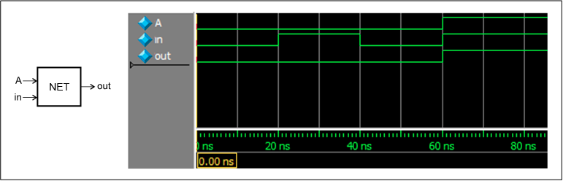
SIGNALS IN THE CONTEXT OF LOGIC NETWORKS
In electronic digital circuits it is useful to regard binary variables as signals: voltages or currents that evolve over time.
When represented ideally, they show discontinuities in the transitions between the two values.

Slide 6
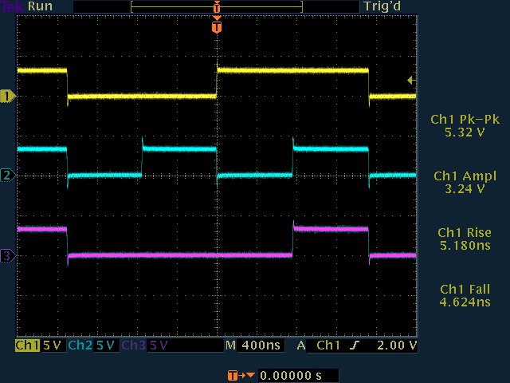
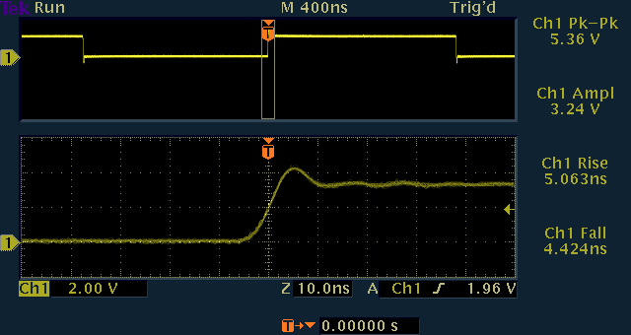
REAL SIGNALS AND LOGIC NETWORKS
In the real world, the function that
represents the evolution of values
over time is continuous.
Signals can be degraded by
physical factors or phenomena,
either internal or external to
the logic network itself, which may
compromise their integrity.

Slide 7
SIGNAL INTEGRITY: THEY CAN DEGRADE DUE TO…
Attenuation due to (thermal) energy dissipation in devices and electrical connections.
Overshoot/Undershoot, i.e. signals may take values that "exceed" the absolute permissible limits because of second-order effects due to the reactive components distributed in the circuit (parasitic inductances and capacitances).
In the distributed-parameter regime, propagation delays for unavoidable physical reasons (non-negligible propagation times along lines).
Reflections between the two ends of a transmission line due to impedance mismatches between the signal source, the load and the line itself.
Electrical noise of various kinds: intrinsic thermal noise such as the Johnson effect, or induced noise (from inductive/capacitive coupling or external electromagnetic fields).

Slide 8
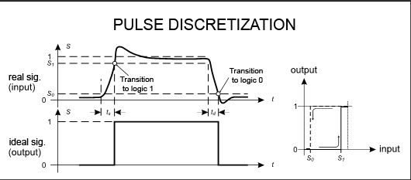
SIGNAL INTERPRETATION IN LOGIC NETWORKS
To mitigate errors in interpreting
signals as binary variables, two thresholds
(conventional levels) S0 and S1 are
usually defined. When the input signal
exceeds threshold S1
the output takes the value 1. For the output
to return to 0, the input must fall
below threshold S0. The hysteresis defined by the thresholds and by the output state yields an output free of uncertainty (spikes) in the presence of small amounts of noise or disturbance.
The discretization performed by the thresholds on disturbed or degraded signals still produces jitter (time fluctuations at value changes). The thresholds also cause a pulse to be slightly distorted in duration and delayed in time. In practice, discretizing a signal never produces ideal outputs like the one in the figure.

Slide 9
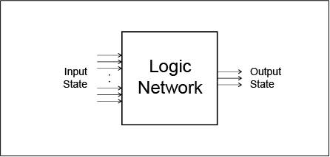
Logic networks as blackboxes
Logic networks can be regarded as "black
boxes" that may have an input state and
an output state.
Grouping several related signals (binary
variables) can be seen as a "vector"
representing a so-called "state"; a state may in turn represent several values at once and thus correspond to familiar "objects", such as numbers or characters. A single binary variable can itself be considered a state.
Observable states are used to study them and therefore, when possible, to describe how they work. They may also have internal, unobservable states that are nevertheless necessary for their operation.

Slide 10
LOGIC DESIGN (1)
Logic design aims at building digital devices that process input signals and produce output signals. The process of defining the structure of a logic network starting from its specifications is called "Synthesis". The opposite operation is called "Analysis".
There are several methodologies for Synthesis, from "manual" methods to automatic procedures. Nowadays manual synthesis is performed very rarely.
To design a logic network, the verbal specifications must be translated into formal specifications, using ideal signal diagrams, truth tables and Boolean equations for so-called "combinational networks". For so-called "sequential" networks, flow tables, state diagrams or so-called ASM charts will generally be needed.

Slide 11
LOGIC DESIGN (2)
The specifications will determine a possible architecture for the system to be designed.
With the specifications in hand, the technologies to adopt can be chosen based on the architecture and on purely technical or commercial requirements.
Technologies can influence the type of development tools needed; in
turn, depending on availability and cost, they may redefine technologies and architecture.

Slide 12
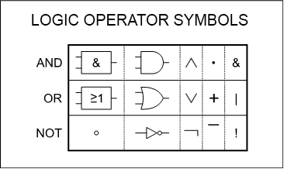
Logic networks: FUNDAMENTAL OPERATORS (1)
Using the three fundamental operators
(negation, intersection and union) to
"combine" binary variables, any desired
expression can be composed.
In the context of logic networks,
expressions always represent predicates. Predicates, in turn, can be defined as expressions whose result is only true or false. The only exception is the "simulation" or analysis scenario, where logic is extended to three values (three-valued logic), so that a predicate may fail to provide a certain answer given undefined inputs.

Slide 13
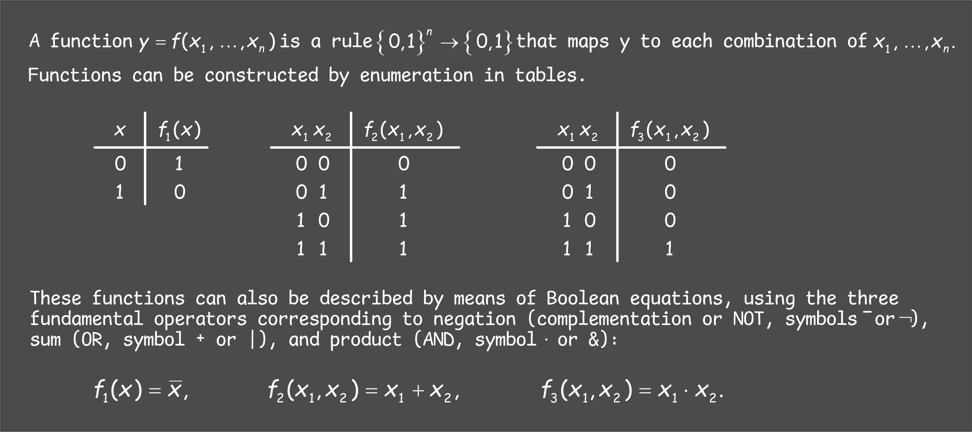
Logic networks: FUNDAMENTAL OPERATORS (2)

Slide 14
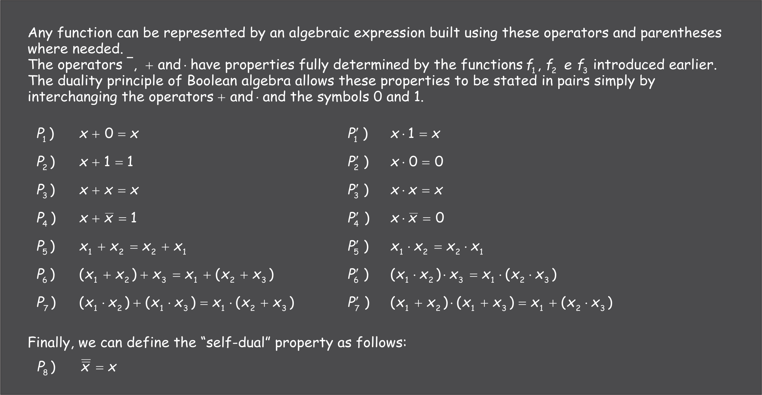
ALGEBRAIC PROPERTIES (1)

Slide 15
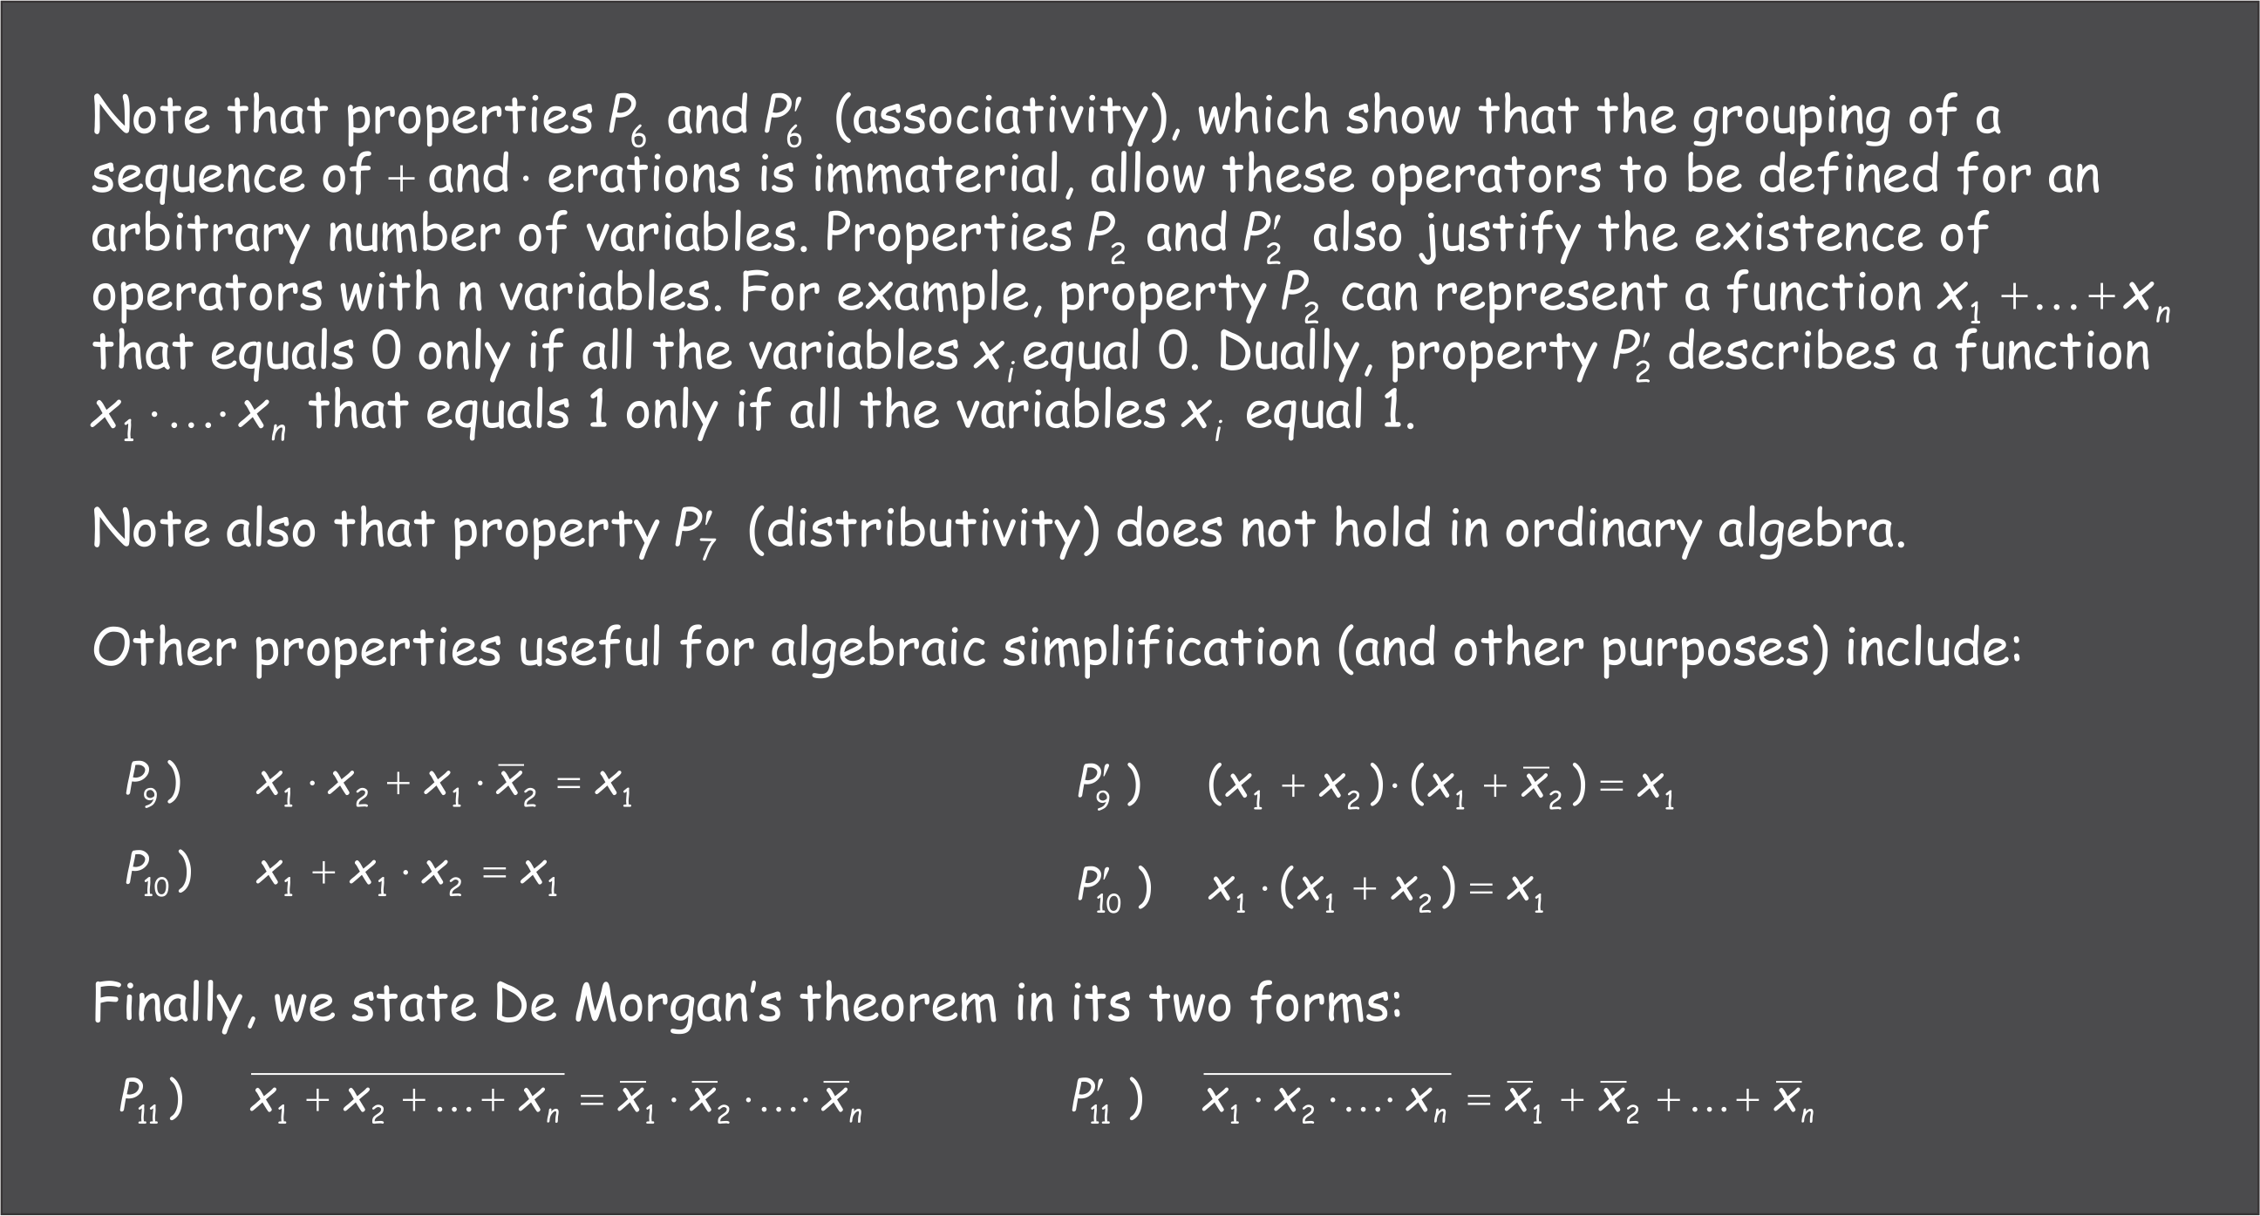
ALGEBRAIC PROPERTIES (2)

Slide 16

ENUMERATION OF FUNCTIONS (1)
There are $2^{{(2}^{n})}$ possible functions that can be obtained from the combination
of n binary variables. For n=2 they are the following:

Slide 17
ENUMERATION OF FUNCTIONS (2)
There are $2^{{(2}^{n})}$ possible functions that can be obtained from the combination
of n binary variables. For n=2 they are the following:
AND
OR
NOT

Slide 18
ENUMERATION OF FUNCTIONS (3)
There are $2^{{(2}^{n})}$ possible functions that can be obtained from the combination
of n binary variables. For n=2 they are the following:
NOR
NAND

Slide 19
ENUMERATION OF FUNCTIONS (4)
There are $2^{{(2}^{n})}$ possible functions that can be obtained from the combination
of n binary variables. For n=2 they are the following:
XOR
XNOR (EQ)

Slide 20
ENUMERATION OF FUNCTIONS (5)
There are $2^{{(2}^{n})}$ possible functions that can be obtained from the combination
of n binary variables. For n=2 they are the following:
IMPLICATION

Slide 21
ENUMERATION OF FUNCTIONS (6)
There are $2^{{(2}^{n})}$ possible functions that can be obtained from the combination
of n binary variables. For n=2 they are the following:
CONTRADICTION
TAUTOLOGY

Slide 22
STRUCTURE OF LOGIC NETWORKS
Combinational Networks
Comparable to "pure" functions, the output state depends solely on the values of the input state (one-to-one or onto function).
Sequential Networks
The outputs depend on the "history" of the input states up to the instant of observation considered. They are defined in terms of combinational networks equipped with feedback on themselves or with the addition of memory elements.

Slide 23
MANUAL SYNTHESIS OF COMBINATIONAL NETWORKS (1)
With the formal definitions of the network's operation given in truth tables or as expressions, transformations can be applied to produce structures suitable for practical implementation: that is, this process involves their rearrangement, for example to adapt them to the technology to be used.
Reorganizing the specifications also entails seeking the lowest cost in terms of network size, consistent with the required performance. Here the network is
minimized while always keeping the desired performance in mind.

Slide 24
MANUAL SYNTHESIS OF COMBINATIONAL NETWORKS (2)
Manually designing a logic network involves direct algebraic manipulation of the equations, "graphical" techniques on suitably rearranged truth tables, such as Veitch-Karnaugh maps, or a mix of these and other techniques.
A relatively complex logic network may consist of several subnetworks that can be handled separately.
The "logic minimizer" Espresso (or other similar tools) can be considered an aid to manual design.

Slide 25
SYNTHESIS AND MINIMIZATION OF COMBINATIONAL NETWORKS
Definition of the network with truth tables or Boolean equations (or equivalent)
Optional minimization:
  Manual minimization of combinational networks
    With Boolean algebra (algebraic manipulation, tedious and error-prone).
    With Veitch-Karnaugh maps (limited to six variables).
    With Reed-Müller maps (using the XOR operator).
  Automatic minimization (by computer)
    With the Quine-McCluskey tabular method (prohibitive with a large number of variables).
    With the Espresso heuristic minimizer or similar tools.

Slide 26
From equations to circuits
Expressions are manipulated in order to exploit predefined logic blocks, such as AND, OR and NOT gates, gates with intrinsic functional completeness such as NAND, NOR and XOR, or more complex functions such as DECODER, MUX, DEMUX, HALF-ADDER, FULL-ADDER, and others. These functions are embedded in low-density chips (SSI) and known as "discrete logic".

Slide 27
CATEGORIES OF COMBINATIONAL LOGIC
Combinational logic network in canonical (or normal) form
It has two forms:
  - Disjunctive normal form (sum of products, or SOP)
  - Conjunctive normal form (product of sums, or POS)
  NB: "product" means conjunction (AND) and "sum" means disjunction (OR)
A network in canonical form is characterized by two levels of logic (NOTs are not counted): this means that an input signal passes through two operators before reaching the output.
Multilevel combinational logic network
This is a network in which at least one input signal passes through more than two operators before reaching the output. It is generally a more compact form than the previous one, but usually exhibits longer propagation times. With this category of networks it is also possible to build circuits based on a single type of operator, provided it is functionally complete (that is, the operator includes the negation of at least one variable); examples of such operators are NAND, NOR and XOR.

Slide 28

COMBINATIONAL LOGIC NETWORKS (CANONICAL forms)
$$f(a,b,c)$$
These are networks made up of two levels of logic.
They define the function by joining the
intersections of several signals or
their negations (sums of products or sums
of minterms) or by intersecting the
unions of several signals or their
negations (products of sums or products
of maxterms).
The Products P_{n} (minterms) identify the input combinations (the terms T_{n}) for which the function equals 1. The Sums S_{n} (maxterms) identify the terms for which the function equals 0.

Slide 29
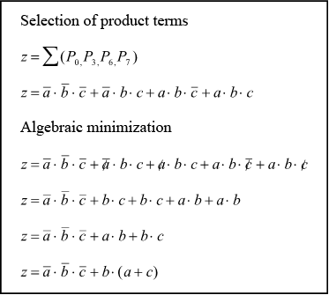
DESIGN EXAMPLE
The function z described by the table at the side can be written as a Boolean expression using one of the two canonical forms. In this example the SOP (Sum of Products) form was used.
From the tabular description of 'z', the terms where the function equals 1 (the minterms only) are selected; in the predicate z = f( a, b, c ) the terms for the products P₀, P₃, P₆ and P₇ are listed, taking care to negate the arguments (a, b or c) that are zero for a given product P_{n}.
By applying the algebraic properties seen earlier, a reduced or alternative form of the original expression can be obtained (note that the last version of function z in the box at the bottom right is not in canonical form, i.e. we will see later that it represents logic with more than two levels).

Slide 30
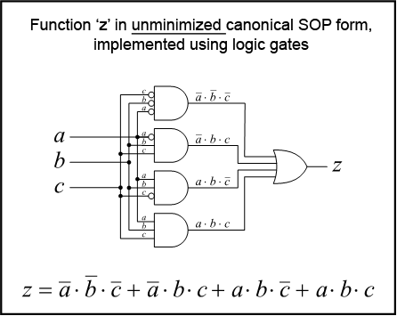
Implementation with logic gates
A non-minimized canonical SOP version of function z can be built using only logic gates corresponding to the negation, intersection and union operators.
Note that some terms going into the AND gates, all of which have three inputs, pass through a negation operator (shown as an empty circle).
Canonical forms are ideal for building reliable logic circuits and naturally fit the structures of the simplest programmable logic devices, allowing direct technology mapping.

Slide 31
MINIMIZATION WITH THE GRAPHICAL method (1)
Besides the algebraic manipulation seen earlier, an alternative way to minimize a function is to use Veitch-Karnaugh maps, mainly known as Karnaugh maps or K-Maps. They exploit properties P₉ or P’₉ seen earlier, highlighting the so-called logical adjacency of two or more minterms (SOP) or of two or more maxterms (POS).
For SOP forms, K-Maps are used to group all the minterms that can geometrically form squares or rectangles whose sides have a height or width equal to a power of two cells. For POS forms the maxterms are grouped in the same way. Grouping terms into regular areas with the characteristics above is called a "cover". The larger a cover, the fewer variables are involved and therefore the "smaller" the operator required.

Slide 32
MINIMIZATION WITH THE GRAPHICAL METHOD (2)
In some cases the tables representing the functions may be not completely specified. That is, for some terms the result is a don't-care and can be considered either zero or one depending on convenience. In the example at the side, term T₇ is considered a minterm (one) because it allows two overlapping covers larger than a single cell. That is, only two variables are involved for those covers instead of three, yielding a "smaller" function and therefore a simpler circuit.
K-Maps are useful for minimizing functions of up to six variables. Beyond six variables logical adjacency is hard to perceive, so using them is no longer convenient.

Slide 33
Minimization with ESPRESSO software (1)
The Espresso logic minimizer can be considered an aid to manual synthesis. It
has also been used as a minimizer inside CAE software. It originated at the University of California, Berkeley as an aid to minimizing combinational networks with many input variables.
Espresso is a heuristic minimizer that bases the minimization process on a few empirical rules in addition to the properties of Boolean algebra. The result may be sub-optimal, yet it can quickly produce excellent-quality results even for networks with a large number of input variables.
The Espresso logic minimizer is widely available online and can be found both as source code and as a build for various platforms (https://github.com/Gigantua/Espresso).

Slide 34
Minimization with ESPRESSO software (2)
Minimization of function z.
File z_sp.pla File
z_ps.pla
.i 3
.o 1
.p 4
.ilb a b c
.ob z
000 1
011 1
110 1
111 -
.e
.i 3
.o 1
.p 5
.type r
.ilb a b c
.ob z
001 0
010 0
100 0
101 0
111 -
.e

Slide 35
Minimization with ESPRESSO software (3)
Minimization of function z defined on the
minterms. Minimizer output for z_sp.pla
.i 3
.o 1
.p 4
.ilb a b c
.ob z
000 1
011 1
110 1
111 -
.e
C:\Espresso>espresso z_sp.pla
.i 3
.o 1
.ilb a b c
.ob z
.p 3
000 1
11- 1
-11 1
.e
C:\Espresso>espresso –o eqntott z_sp.pla
z = (!a & !b & !c) | (a & b) | (b & c);
C:\Espresso>

Slide 36
Minimization with ESPRESSO software (4)
Minimization of function z defined on the
maxterms. Minimizer output for z_ps.pla
.i 3
.o 1
.p 5
.type r
.phase 0
.ilb a b c
.ob z
001 0
010 0
100 0
101 0
111 -
.e
C:\Espresso>espresso z_ps.pla
.i 3
.o 1
.ilb a b c
.ob z
#.phase 0
.p 3
010 1
10- 1
-01 1
.e
C:\Espresso>espresso –o eqntott z_ps.pla
z = (!a & b & !c) | (a & !b) | (!b & c);
C:\Espresso>
This comment reminds us that inputs and functions must be
complemented to
determine the
resulting maxterms manually

Slide 37
why ESPRESSO?
# 7seg.pla
.i 4
.o 7
.p 16
.ilb i3 i2 i1 i0
.ob a b c d e f g
0000 1111110
0001 0110000
0010 1101101
0011 1111001
0100 0110011
0101 1011011
0110 1011111
0111 1110000
1000 1111111
1001 1110011
1010 1110111
1011 0011111
1100 1001110
1101 0111101
1110 1001111
1111 1000111
.e
C:>espresso 7seg.pla
.i 4
.o 7
.ilb i3 i2 i1 i0
.ob a b c d e f g
.p 14
1011 0001100
100- 1000000
001- 0001001
-000 0001010
0-11 1110000
0100 0110011
-00- 0110000
1101 0111101
0101 1011011
-0-0 1100100
11-0 1001110
111- 1000111
10-- 0010011
0110 1011111
.e
C:>espresso -o eqntott 7seg.pla
a = (i3 & !i2 & !i1) | (!i3 & i1 & i0) | (!i3 & i2 &! i1 & i0) | (!i2 & !i0)
| (i3 & i2 & !i0 ) | (i3 & i2 & i1) | (!i3 & i2 & i1 & !i0);
b = (!i3 & i1 & i0) | (!i3 & i2 & !i1 & !i0) | (!i2 & !i1)
| (i3 & i2 & !i1 & i0) | (!i2 & !i0);
c = (!i3 & i1 & i0) | (!i3 & i2 & !i1 & !i0) | (!i2 & !i1)
| (i3 & i2 & !i1 & i0) | (!i3 & i2 & !i1 & i0) | (i3 &! i2)
| (!i3 & i2 & i1 & !i0);
d = (i3 & !i2 &i1 & i0) | (!i3 & !i2 & i1) | (!i2 & !i1 & !i0)
| (i3 & i2 & !i1 & i0) | (!i3 & i2 & !i1 & i0 ) | (i3&i2&!i0)
| (!i3 & i2 & i1 & !i0);
e = (i3 & !i2 & i1 & i0) | (i3 & i2 & !i1 & i0) | (!i2 & !i0)
| (i3 & i2 & !i0) | (i3 & i2 & i1) | (!i3 & i2 & i1 & !i0);
f = (!i2 & !i1 & !i0) | (!i3 & i2 & !i1 & !i0) | (!i3 & i2 & !i1 & i0)
| (i3 & i2 & !i0) | (i3 & i2 & i1) | (i3 & !i2) | (!i3 & i2 & i1 & !i0);
g = (!i3 & !i2 & i1) | (!i3 & i2 & !i1 & !i0) | (i3 & i2 & !i1 & i0)
| (!i3 & i2 & !i1 & i0) | (i3 & i2 & i1) | (i3 & !i2)
| (!i3 & i2 & i1 & !i0);

Slide 38
ASICs (1)
ASIC is the acronym of Application Specific Integrated Circuit.
In the field of digital logic, these are devices designed specifically to optimize, in terms of speed and efficiency, a specific computation or processing task.
These devices are historically developed by semiconductor companies on commission from the customer, or by the customer itself with very significant support from the manufacturer.
Designing an ASIC is usually a long and expensive process.

Slide 39
ASICs (2)
ASICs minimize the cost of the final product and are therefore justified only by very large production volumes.
When the ASIC implements functions generic enough to be used in several products or by several customers, we speak of an ASSP (Application Specific Standard Product/Part). Because they are used in several designs, ASSPs help reduce the "non-recurring engineering costs" (NRE cost) in the development cycle.
The impossibility of resorting every time to completely custom solutions (ASICs) or to specific standard functions (ASSPs) led semiconductor companies to develop the so-called Programmable Logic.

Slide 40
PROGRAMMABLE LOGIC (PLD)
Programmable Logic Devices (PLDs) are devices whose internal architecture is predefined by the manufacturer.
Compared with ASICs, PLDs have the advantage of greatly reduced development costs and times, and of not requiring large minimum quantities of parts to be ordered from the manufacturer.
PLD technology has evolved in step with the manufacturing of other types of chips, following their evolution in terms of integration density as well.
In the early days of the technology, PLDs existed with SSI (Small Scale Integration) levels of integration, which implemented fairly limited functionality. Ever higher densities were then adopted, such as MSI (Medium Scale Integration), LSI (Large Scale Integration) and then VLSI (Very Large Scale Integration). The latter is used in modern programmable logic. The largest modern user-programmable PLDs can easily host over 100 million simple logic functions (called gates).

Slide 41
TAXONOMY OF PROGRAMMABLE LOGIC (1)
Programmable logic can be divided into:
"Field" programmable logic (FPDs, Field Programmable Devices), i.e. programmable on the production line only the first time, or programmable/updatable when already mounted on the printed circuit board (PCB).
Logic pre-programmed by the manufacturer (Factory Programmable Devices). In general these are "Gate Arrays", i.e. devices with many logic functions that lack only the interconnections (the metallizations). They are logic to consider when the required production volumes are significant but not large enough to justify the development cost of a true ASIC. During prototyping the customer uses an FPD, then asks the manufacturer for equivalent devices pre-programmed to their specification.

Slide 42
FIELD PROGRAMMABLE LOGIC (1)
SPLD: Simple Programmable Logic Devices
  This group includes devices that can be programmed only once (OTP, One Time Programmable): PROMs (Programmable Read Only Memory), PLAs (Programmable Logic Array) and PALs (Programmable Array Logic). More modern, reprogrammable versions of PALs also exist: the best known are GAL and PALCE.
CPLD
  That is, Complex Programmable Logic Devices. These are devices that host several interconnected macro-blocks implementing the disjunctive normal form (SP canonical form), similar to erasable PALs.

Slide 43

FIELD PROGRAMMABLE LOGIC (2)
FPGA: Field Programmable Gate Array
  As the name itself suggests, these are programmable Gate Arrays. There are three types:
  Antifuse: the connections between metallizations are made using a tiny segment of amorphous (non-crystalline) silicon that normally exhibits a very high resistance ($>{10}^{6} \text{Ω}$). As soon as appropriate voltages and currents are applied, the amorphous silicon converts into conductive polycrystalline silicon.
  Static RAM: once a configuration is loaded, the RAM bits drive transistors that act as switches connecting the metallizations and configure the LUTs (LookUp Tables).
  FLASH/EPROM: like the static RAM versions, the non-volatile memory bits are used to enable the connections between the metallizations and to configure the LUTs.

Slide 44
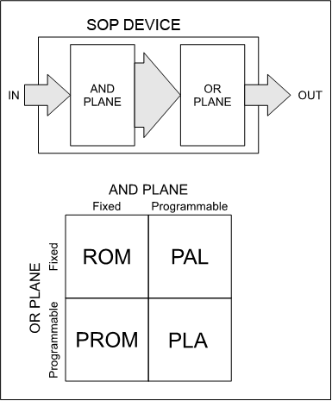
CLASSIC DEVICES IMPLEMENTING THE
SOP CANONICAL FORMS (SSI)
ROM: Read Only Memory
  They have an output pattern predetermined by the manufacturer.
PROM: Programmable Read Only Memory
  Only the OR plane is programmable.
PAL: Programmable Array Logic
  The AND plane is programmable and the OR plane is predetermined by the manufacturer. They implement only SP forms (sums of products or sums of minterms).
PLA: Programmable Logic Array
  Both planes (AND and OR) are programmable.

Slide 45
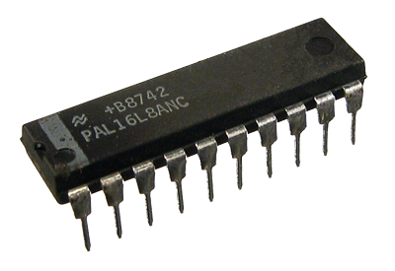
EXAMPLE WITH PAL16L8 (SSI)
PALs (Programmable Array Logic) are by now obsolete programmable logic devices that were invented by John Birkner and introduced by MMI back in 1978.
The PAL16L8 is a device for combinational (or asynchronous sequential) logic. Historically built in bipolar technology (with BJT transistors), it was a hugely successful device, used by the early minicomputer makers (DEC, Data General, etc.) to optimize their systems.

Slide 47

Programming OTP SPLDs
In devices such as PALs, PLAs and PROMs, programming is done by blowing tiny fuses.
Specifically for PAL devices, there are fuses in series with
each signal and its complement on the path
that reaches the AND gate.
Initially all the fuses are intact.
When a fuse is blown as a result of program-
ming, the signal can no longer reach
the AND gate. The input is therefore connect-
ed to 1 through a so-called pull-up resistor.
In practice, this means the AND output will depend only on the inputs whose fuses have remained intact. In the example, note that only $a$ and $\overline{b}$ can make up
the term $y$.

Slide 52
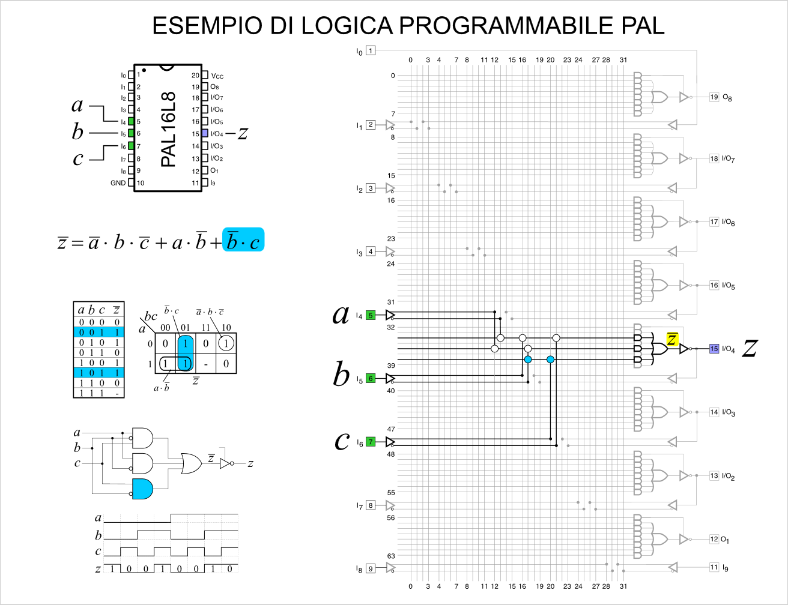

Slide 53
MULTILEVEL COMBINATIONAL LOGIC NETWORKS
They can use simple logic gates or
canonical forms connected in cascade. The time the outputs take to settle when the inputs change
can be longer and show less consistency.
Multilevel networks are typical of modern programmable devices (CPLDs and FPGAs); they connect
macrocells/LUTs (Look Up Tables, predefined logic blocks) to one another to build even very complex logic structures.

Slide 54
HAZARDS
On the side you can see a multilevel network that produces the output out for the inputs a, b and c. Since the network is built with a single type of component, obtaining function out requires cascading more gates than in a canonical-form network, which in effect gives a multilevel network. Since the
components exhibit no propagation delays, the behavior of this network is ideal. That is, there are no "uncertainties" in how the signals evolve over time.

Slide 55
STATIC HAZARDS
When the propagation times of the gates or of the physical paths (electrical connections) are not negligible, the circuit producing out can show uncertainty before settling on a nominal value. In the figure at the side you can see some very short pulses called hazards (glitches). These are transients that disturb the signal for a very short period. They must be taken into account at design time, since they can cause malfunctions in logic networks. Static hazards are not exclusive to multilevel networks. Canonical forms with non-ideal components or "slow" paths can also show uncertainty.
In the practical example at the side, the NOR gates of two SN74LS02 devices were used (for the inverters too), which exhibit a typical delay of 10 ns: note that the propagation delays are not really negligible compared with the speed of the applied signals (edges every 100 ns).

Slide 56
DYNAMIC HAZARDS
The circuit at the side exhibits a second type of hazard that produces an output which initially moves to the expected value (from 0 to 1) but does not remain stable: it is immediately followed by a pulse with the opposite value (zero), and only then finally settles on the desired value (one).
This circuit behavior is called a "dynamic hazard". Dynamic hazards appear when, following a change in one or more input signals, the output signal makes a transition to the opposite value, but instead of settling abruptly it may oscillate one or more times.
The presence of dynamic hazards causes considerable problems in the design and implementation of so-called "asynchronous sequential networks" with more than two states. This kind of network will not be covered in this presentation, although we will see an example of a very simple two-state asynchronous sequential network later on.

Slide 57
MEMORY ELEMENTS
Certain circuit configurations constitute memory elements. These elements are the heart of sequential networks.
Commonly used memory elements can be sensitive to "levels" (top box) or to "edges" (bottom box).
"Edge"-sensitive memory elements are often used with a signal of specific cadence that sets the pace of processing (clock). They are mainly of three types, D, T and JK, and their operation is described by the so-called "excitation tables".
They always have an internal feedback of one or more
levels. They can be studied as combinational networks once the feedback loops are broken and treated as ordinary inputs.
The combinational networks seen earlier "feed" the input variables of these memory elements in order to build larger and more complex sequential network systems.

Slide 58

TERNARY or three-valued logic (3VL)
Three-valued logic is an extension of the binary propositional
logic we have seen so far.
It is useful in the analysis and simulation of binary digital circuits
with feedback, that is, with the network's outputs fed back to its
inputs.
The values represented are three: 0, 1 and X.
A function in three-valued logic $z=f\left(x_{1},…,x_{n}\right)$ is a rule
${\left\{0,1,X\right\}}^{n}→\left\{0,1,X\right\}$ that maps $z$ for every combination of $x_{1},…,x_{n}$.
It appears as the representation of "undefined" in simulators.

Slide 59
NOT, OR AND AND IN THREE-VALUED LOGIC

Slide 60
S-R LATCH SIMULATION WITH THREE-VALUED LOGIC
Three-valued logic is useful for studying the behavior of asynchronous logic networks. As an example, let us look at the study of a Set-Reset latch built with NOR gates.

Slide 61

S-R LATCH SIMULATION WITH THREE-VALUED LOGIC
Initially (instant $t_{0}$) the output state of the NOR gates is unknown because inputs at 0 (zero) allow X (undefined) values as outputs. In practice, the state of the S-R Latch cannot be determined with certainty. It can be stated, however, that outputs $Q$ and $\overline{Q}$ are the negation of each other under stable conditions.

Slide 62
S-R LATCH SIMULATION WITH THREE-VALUED LOGIC
As soon as the Set input is driven to 1 (instant $t_{1}$), the gate connected to it "reacts", getting ready to produce a 0 regardless of whether the second input sees X.

Slide 63

S-R LATCH SIMULATION WITH THREE-VALUED LOGIC
At instant $t_{2}$, the NOR gate connected to output $\overline{Q}$ stably generates the value zero. However, the output change triggers the other NOR gate which, seeing the 00 configuration at its input, gets ready to generate the value 1 for output $Q$.

Slide 64
S-R LATCH SIMULATION WITH THREE-VALUED LOGIC
Output $\overline{Q}$ confirms the value 0 (instant $t_{3}$), reinforced by the 11 configuration at the input of the NOR gate concerned.

Slide 65
S-R LATCH SIMULATION WITH THREE-VALUED LOGIC
When the Set command is de-asserted (set back to zero at instant $t_{4}$), the latch, as expected, keeps the previously imposed value.

Slide 66

S-R LATCH SIMULATION WITH THREE-VALUED LOGIC
At instant $t_{5}$ the Res (Reset) input of the latch is driven to 1. The gate connected to output $Q$ immediately triggers an output change given by the 10 configuration present on its inputs.

Slide 67
S-R LATCH SIMULATION WITH THREE-VALUED LOGIC
At instant $t_{6}$ the latch output $Q$ immediately goes to zero. This event triggers the next change to 1 of the output relating to $\overline{Q}$.

Slide 68
S-R LATCH SIMULATION WITH THREE-VALUED LOGIC
As expected, shortly afterwards output $\overline{Q}$ settles at 1 at instant $t_{7}$.

Slide 69
S-R LATCH SIMULATION WITH THREE-VALUED LOGIC
When the Res command is removed, the 01 configuration at the input of the NOR gate of output $Q$ confirms the value zero. The latch will now remember the state until the next Set.

Slide 70
S-R LATCH SIMULATION WITH THREE-VALUED LOGIC

Slide 71

SEQUENTIAL LOGIC NETWORKS (1)
The S-R Latch simulation seen earlier suggests the existence of logic networks able to "remember" the processing phase, normally also known as internal state.
Still observing the previous experiment, we can deduce that feeding the output signals back to the input may be the key to giving a logic network the ability to have memory.
With a simple manipulation we can see that the NOR-based S-R Latch seen earlier can also be defined as a combinational network in SP canonical form that reads its own output (we consider only output $Q).$
Note that the form in the middle of the drawing below suggests that, depending on which of the two outputs ($Q$) is to be used as feedback, one can choose either of the two canonical forms (SP if the OR is chosen or PS if the AND is chosen).

Slide 72

SEQUENTIAL LOGIC NETWORKS (2)
The last form on the right shows that output $Q$ is fed back to the input.
By setting the relation $Q^{′}=Q$, the loop can be opened to obtain a pure combinational network from which the Boolean expression $Q=Q^{′}∙\overline{R}+S$ is derived.

Slide 73

ASYNCHRONOUS SEQUENTIAL NETWORK MODEL
In the SP canonical form of the S-R Latch, we can say that
output $Q$ also represents the state (or rather, it is the state
variable) of the sequential network.
The category of sequential networks that feed the state
variable directly back to the input is called
"asynchronous".
Changes in the outputs immediately affect the
inputs; if the state variable consists of several
expressions (i.e. it is a vector of several related binary
variables), this category of logic networks becomes
complicated to manage.
Because of the hazards (especially dynamic ones) mentioned earlier, the state variable may be encoded incorrectly, resulting in errors or instability of the system. Techniques for
mitigating these problems are well beyond the scope of this presentation.

Slide 74

SYNCHRONOUS SEQUENTIAL NETWORKS (1)
To try to solve the problem and the typical critical issues of asynchronous sequential networks, one can try placing a "pulse-controlled register" on the loops. A pulse-controlled register can consist of an array of D-type Latches (already seen earlier) with their enable inputs $C_{p}$ tied together. By applying a pulse to the latches' enable inputs, the register can be asked to "track", continuously storing it, the internal state of the sequential network. When the pulse is absent the register presents the last stored configuration. In this way the output state is not continuously fed back to the inputs. In effect the processing is "synchronized" with the cadence of the pulses.
This synchronous model is nevertheless not free of problems: one must make sure that time $t_{e}$ is long enough to guarantee settling of the combinational network; at the same time the pulse $t_{p}$ must be long enough for the register to store the state, yet short enough not to create an asynchronous loop (a continuous connection).
The configuration described here, which uses so-called "Transparent Latches", is difficult to manage in terms of network reliability.

Slide 75

SYNCHRONOUS SEQUENTIAL NETWORKS (2)
To arrive at a reliable synchronous network model, the state registers must be built using Flip-Flops. With this type of register there is no longer a need to control the width of the cadence pulse (also called "Clock"). The register built with Flip-Flops stores information based on the "changes" of signal $C_{p}$ and not on its level. For a rising edge, i.e. from 0 to 1, we speak of a "positive edge" (posedge). For the transition from 1 to 0 we speak of a "negative edge" (negedge). A Flip-Flop reacts to only one of the two edges, depending on its nature.
The Flip-Flops for this type of application are called Master-Slave, since they consist of two latches in cascade working on opposite levels of the value of $C_{p}$. If the first latch stores at level 0, continuously "tracking" the input, the second latch presents the stored value at the output. As soon as signal $C_{p}$ goes from 0 to 1, the first latch stops tracking, holding the last value, while the second latch "tracks" the stable value of the first. A small "triangle" at the register's input $C_{p}$ denotes sensitivity to the positive edge. If a small empty circle is also present, the register is sensitive to the negative edge.

Slide 76
SYNCHRONOUS SEQUENTIAL NETWORKS (3)
They use a cadence (clock) for processing.
They need a register (a set of flip-flops) to store the internal state.
They use a combinational network to compute the next state.
They may have a combinational network to produce the output state.
They are called Moore Machines if the output depends only on the internal state; those whose output state depends on both the internal state and the input state are called Mealy Machines.

Slide 77
SYNCHRONOUS SEQUENTIAL EXAMPLE (1)

Slide 78
SYNCHRONOUS SEQUENTIAL EXAMPLE (2)

Slide 79
INCREASING CIRCUIT COMPLEXITY
To reduce size, power consumption and cost, and to allow more complex and faster logic structures, the semiconductor industry has introduced ever more complex components and new hardware technologies, together with the related software development systems.
  The so-called "simple programmable logic" (SPLD) such as PROM, PAL, PLA, GAL and PALCE replaced parts of networks made with discrete components (logic gates and small SSI functions).
  Introduction of the first rudimentary HDL software tools to manage the programming of SPLDs, with PALASM and later ABEL, ISP and CUPL.
  Appearance on the market of the first "complex programmable logic" devices (CPLD).
  Appearance of the first programmable Gate Array device (FPGA), namely the XC2064 from Xilinx Inc., introduced in 1985. The tool to program this device was called XACT (Xilinx Advanced CAD Technology), whose syntax was based on ABEL (Advanced Boolean Expression Language) from Data I/O Corporation.

Slide 80
CPLD
CPLDs can be considered an evolution of PALs and consist of several PAL structures put together, known as "macrocells".
The macrocells are connected through a programmable interconnect, also called GIM (global interconnection matrix). By reconfiguring the GIM, the most diverse logic circuits can be built by interconnecting the macrocells.
CPLDs communicate with the outside world through digital I/Os. In the example at the side you can see that these are divided into groups closely and efficiently connected to their own macrocell. Nevertheless, a macrocell can reach the I/Os of other macrocells through the programmable interconnect matrix (GIM), albeit less efficiently.
CPLDs are complex enough to require CAE tools for their programming.

Slide 81
FPGA
FPGAs are, to all intents and purposes, programmable Gate Arrays. They are the user-programmable devices that come closest to ASICs. FPGAs are organized into logic blocks (CLB, Configurable Logic Block), somewhat like CPLDs, but these are simpler, more numerous and can be interconnected with one another through programmable interconnects (PI). The latter connect the I/Os, which are normally divided into banks.
In general, CLBs consist of a relatively small number of elements. A typical CLB consists of a 4-5 input LUT (Look Up Table), a Full-Adder and a D-type flip-flop. A multiplexer at the input of the Flip-Flop is often present as well. There is no standard scheme for LUTs, which always differ depending on the manufacturer.
Modern FPGAs also have many predefined macroblocks (Hard Blocks) dedicated to complex functions, specifically optimized in terms of speed and chip area. There are devices with memory blocks, parallel multipliers, entire DSP functions, processors and much more. FPGAs also implement support for clock generation (PLL) and programmable delays. Some are so rich in resources that they can implement entire systems inside them (SoC, System on Chip).
Programming a modern FPGA can only be tackled with sophisticated software tools that provide for the most efficient mapping of the cells and a careful routing of signals between the cells and to the I/Os.

Slide 82
MANAGING CIRCUIT COMPLEXITY
Synthesis of a complexity that cannot be tackled manually or with primitive HDLs, in the context of modern FPGAs or complex PLDs.
Simulation as the primary support for designing logic networks, to verify operation well before implementation.
Need to synthesize the logic network, or parts of it, automatically.
Appearance of the first sophisticated Electronic Design Automation (EDA) tools.

Slide 83
PART TWO
HARDWARE
DESCRIPTION
LANGUAGES

Slide 84
automated design
HDLs (Hardware Description Languages) are languages for modeling, simulating and, optionally, formally verifying hardware.
If properly written, a model defined in an HDL can allow automatic synthesis.
The main languages in use are Verilog (and SystemVerilog), VHDL and, more rarely, SystemC.
They allow the model to be described at different levels of abstraction (behavioral, structural RTL, gate level or switch/transistor level).
They allow the description of test vectors to stimulate the models, to be run on dedicated simulators. They can support stochastic functions (queues and random probability distributions) to support performance verification.
They optionally allow formal verification of the model (SystemVerilog).

Slide 85
EDA – Electronic Design Automation (1)
A set of tools, specifically for digital systems, for designing ASICs or for
development on CPLDs and FPGAs.
EDA areas for the development of digital systems:
  Design Entry: definition of the logic network design (schematics and HDL languages).
  Verification of the logic network (pre-synthesis) by running the HDL code on a simulator.
  Synthesis of the logic network from the HDL code, generating netlists (structures of components/functions and nodes as interconnections) specific to the target hardware architecture.
  Simulation of the logic network at structural level (pre-layout): the technology blocks are considered ideal components.

Slide 86
EDA – Electronic Design Automation (2)
EDA areas for the development of digital systems (continued)
  Place & Route, i.e. mapping the network onto the various predefined blocks of the chosen technology and routing the signals.
  Calculation of the time the signals need to cross the interconnects and logic blocks (propagation times). Generation of a further netlist provided with elements that generate delays equivalent to the propagation times calculated above (back-annotation). The purpose of
  back-annotation is to have accurate post-synthesis simulations that also take into account the physical operating conditions (such as the estimated ambient temperature and the supply voltage(s)).
  Programming of the device (with a bitstream) or generation of the layouts (masks) for production.

Slide 87
PART TWO
The VERILOG LANGUAGE®

Slide 88
A BRIEF HISTORY OF THE VERILOG LANGUAGE
Verilog HDL was invented by Phil Moorby and Prabhu Goel around 1984 as a proprietary hardware modeling language of Gateway Design Automation Inc.
It was stabilized as a specification in 1990 and made open by Cadence Design Systems in 1991, again by Cadence, which organized the Open Verilog International (OVI) consortium.
It was subsequently submitted to the IEEE and became the IEEE 1364-1995 standard, commonly referred to as Verilog-95.
To cover some shortcomings found in Verilog-95, a number of extensions were resubmitted to the IEEE and became the IEEE 1364-2001 standard, known as Verilog-2001.
Verilog-2005 (IEEE Standard 1364-2005) was published with minor corrections and changes.
Also in 2005, SystemVerilog was published, a superset of Verilog-2005, with many new features and capabilities to facilitate design verification.
Starting in 2009, the SystemVerilog and Verilog standards were merged into SystemVerilog 2009 (IEEE Standard 1800-2009).

Slide 89
VERILOG AND COMPUTER LANGUAGES
Differences from computer programming languages.
  Purpose: Verilog is used to describe a circuit or an entire digital system; a computer programming language is used to produce executable code.
  Constructs: Verilog describes the properties of wires, registers, logic gates, etc., whereas a programming language describes variables, functions and flow-control structures.
  Execution: Verilog describes but does not directly execute: it can be used to generate configurations or masks for physical circuits; a computer language describes code that, once compiled, is executed on a CPU.

Slide 90
Introduction to the VERILOG language
A Verilog project consists of at least one text file; .v is usually used as the extension (.sv for SystemVerilog).
Verilog is "case sensitive": var_X and var_x are two different objects.
The main construct in Verilog is the module (lexical element 'module').
A .v file can contain one or more modules and other commands, such as the so-called directives and tasks (which start with $).
Some files may have the .tf extension (test fixtures): they are Verilog files (like .v files) that contain the stimulus and verification vectors (to be used with the simulator).

Slide 91
LEVELS OF ABSTRACTION
Verilog supports abstract behavioral modeling, so it can be used to model the functionality of a logic network at a high level of abstraction. This is useful for verifying the analysis and system-partitioning phase (proof of concept).
Verilog supports the RTL (Register Transfer Level), which is used for the detailed design of digital circuits. If the code is written appropriately, synthesis tools transform RTL descriptions down to the level of gates/logic blocks/switches.
Verilog supports gate-level and switch-level descriptions, used for the verification of digital designs, including very low-level logic simulation, static and dynamic timing analysis, testability analysis and fault classification.
The test vectors, which stimulate the network and contain the expected results to compare with the network's output, are also written in Verilog, usually in non-synthesizable form.
At the highest level, Verilog contains stochastic functions (queues and random probability distributions) to support test fixtures for performance modeling.

Slide 92
HDL-BASED ASIC DEVELOPMENT FLOW (1)
Analysis and partitioning of the problem.
Writing or editing the code blocks (modules) in behavioral or RTL style and the related test vectors.
Simulation (pre-synthesis) of the code: if the results are unexpected, go back to step 2.
Synthesis into blocks specific to the chosen technology.

Slide 93
HDL-BASED ASIC DEVELOPMENT FLOW (2)
Simulation (post-synthesis) of the code: in case of error, go back to step 2.
Place & route. Mapping of "resources" and interconnections.
Post-place & route simulation is to be considered an optional step and not very useful except in special circumstances. Instead of simulation, the technique based on so-called "constraints" applied to the critical signal paths is used.
Programming of the device or circuit implementation.

Slide 94
INTRO TUTORIAL (1)
Modules:
They are blocks of code that implement functionality.
They communicate with the outside through ports (input/output), which can be likened to electrical connections (wires).
They contain code constructs that describe their internal structure.
They are delimited by the keywords module and endmodule.
module name( [port list] );
// Module contents
endmodule

Slide 95
INTRO TUTORIAL (2)
Modules:
They may have no port list.
The keywords input and output are used to define the respective input and output ports.
Inside the module are the constructs that define the behavior. In this box we see a construct that represents a "continuous" combinational assignment.
module name;
// Module contents
endmodule
module fn_Z( input a, input b, input c, output z );
// Module contents
endmodule
module device_under_test( input a, input b, input c, output z );
assign z = ~a & ~b & ~c | a & b | b & c;
endmodule

Slide 96
INTRO TUTORIAL (3)
Modules:
To verify the correctness of what we have written so far, we will use an open-source tool called Icarus Verilog (iverilog). Icarus Verilog is an implementation of the IEEE-1364 Verilog hardware description
language.
Icarus Verilog is a compiler and
simulator that reads a Verilog
source file and produces an output
file. The latter, on some
platforms, can also be a pure executable. If compiling the module produces no errors, we are looking at code that is at least syntactically correct.
$ iverilog assign.v
$ ll
drwxr-xr-x 2 user user 4096 Apr 23 12:43 ./
drwxr-x--- 29 user user 4096 Apr 23 11:56 ../
-rwxr-xr-x 1 user user 2367 Apr 23 12:43 a.out*
-rw-r--r-- 1 user user 109 Apr 23 12:32 assign.v
$ ./a.out
$ _

Slide 97
INTRO TUTORIAL (4/1)
Modules:
Digital systems are structured hierarchically: that is, they consist of blocks interconnected with one another having more or less complex functions. Some blocks contain blocks that in turn may contain other blocks, and so on. Through modules, Verilog can model the hierarchical structure of such systems.
Modules, however, cannot be defined inside other modules. Although this seems to contradict the previous point, it should be remembered that – like programming languages – Verilog also distinguishes between declarations and definitions.
module tf;
fn_z device_under_test(…);
endmodule
module fn_z(…);
// Module contents
endmodule

Slide 98
INTRO TUTORIAL (4/2)
Modules:
Modules can also contain "instances" (i.e. declarations) of other modules, but they cannot directly or indirectly contain instances of themselves.
A module can also declare multiple instances of other modules.
At the top of the hierarchy there will be a single module that contains all of them (directly or indirectly), identified as the "top" module (tf in the example alongside).
module tf;
fn_z device_under_test(…);
endmodule
module fn_z(…);
// Module contents
endmodule

Slide 99
INTRO TUTORIAL (5/1)
// File assign_sim.v
`timescale 10ns/100ps
module tf;
reg a, b, c;
wire z;
initial begin
$monitor( a, b, c,, z );
$dumpvars( 0, tf );
a = 0; b = 0; c = 0; #10
a = 0; b = 0; c = 1; #10
a = 0; b = 1; c = 0; #10
a = 0; b = 1; c = 1; #10
a = 1; b = 0; c = 0; #10
a = 1; b = 0; c = 1; #10
a = 1; b = 1; c = 0; #10
a = 1; b = 1; c = 1; #10
$finish;
end
fn_z device_under_test( a, b, c, z );
endmodule
module fn_z( input a, b, c, output z );
assign z = ~a & ~b & ~c | a & b | b & c;
endmodule
Modules:
Some modules (test benches) can contain the stimuli for the simulation (test fixtures). The stimuli are usually grouped in suitable constructs.

Slide 100
INTRO TUTORIAL (5/2)
// File assign_sim.v
`timescale 10ns/100ps
module tf;
reg a, b, c;
wire z;
initial begin
$monitor( a, b, c,, z );
$dumpvars( 0, tf );
a = 0; b = 0; c = 0; #10
a = 0; b = 0; c = 1; #10
a = 0; b = 1; c = 0; #10
a = 0; b = 1; c = 1; #10
a = 1; b = 0; c = 0; #10
a = 1; b = 0; c = 1; #10
a = 1; b = 1; c = 0; #10
a = 1; b = 1; c = 1; #10
$finish;
end
fn_z device_under_test( a, b, c, z );
endmodule
module fn_z( input a, b, c, output z );
assign z = ~a & ~b & ~c | a & b | b & c;
endmodule
Modules:
Some modules (test benches) can contain the stimuli for the simulation (test fixtures). The stimuli are usually grouped in suitable constructs.
In our example, the keyword initial is used to define a time sequence for applying the stimuli. During simulation, whatever is controlled by initial is executed only once. To incorporate more than one command inside initial, we must resort to another construct that represents the so-called block.

Slide 101
INTRO TUTORIAL (5/3)
// File assign_sim.v
`timescale 10ns/100ps
module tf;
reg a, b, c;
wire z;
initial begin
$monitor( a, b, c,, z );
$dumpvars( 0, tf );
a = 0; b = 0; c = 0; #10
a = 0; b = 0; c = 1; #10
a = 0; b = 1; c = 0; #10
a = 0; b = 1; c = 1; #10
a = 1; b = 0; c = 0; #10
a = 1; b = 0; c = 1; #10
a = 1; b = 1; c = 0; #10
a = 1; b = 1; c = 1; #10
$finish;
end
fn_z device_under_test( a, b, c, z );
endmodule
module fn_z( input a, b, c, output z );
assign z = ~a & ~b & ~c | a & b | b & c;
endmodule
Modules:
Some modules (test benches) can contain the stimuli for the simulation (test fixtures). The stimuli are usually grouped in suitable constructs.
In our example, the keyword initial is used to define a time sequence for applying the stimuli. During simulation, whatever is controlled by initial is executed only once. To incorporate more than one command inside initial, we must resort to another construct that represents the so-called block.
The block is syntactically defined by the pair of keywords begin…end. Inside a block, which is always controlled by another construct (in this case initial), the statements are considered to be a single unit. In the case of initial the commands of the block (excluding the directives that start with $) are executed sequentially. initial blocks are not synthesizable. For the moment the details of the simulation constructs will be ignored.

Slide 102
INTRO TUTORIAL (6/1)
// File assign_sim.v
`timescale 10ns/100ps
module tf;
reg a, b, c;
wire z;
initial begin
$monitor( a, b, c,, z );
$dumpvars( 0, tf );
a = 0; b = 0; c = 0; #10
a = 0; b = 0; c = 1; #10
a = 0; b = 1; c = 0; #10
a = 0; b = 1; c = 1; #10
a = 1; b = 0; c = 0; #10
a = 1; b = 0; c = 1; #10
a = 1; b = 1; c = 0; #10
a = 1; b = 1; c = 1; #10
$finish;
end
fn_z device_under_test( a, b, c, z );
endmodule
module fn_z( input a, b, c, output z );
assign z = ~a & ~b & ~c | a & b | b & c;
endmodule
Modules:
Inside the simulation modules there are the instances of the modules to be simulated (they generally form a hierarchy). In the example alongside, we see that module fn_z defines an instance (device_under_test) that receives the stimuli generated by the hosting module tf.

Slide 103
INTRO TUTORIAL (6/2)
// File assign_sim.v
`timescale 10ns/100ps
module tf;
reg a, b, c;
wire z;
initial begin
$monitor( a, b, c,, z );
$dumpvars( 0, tf );
a = 0; b = 0; c = 0; #10
a = 0; b = 0; c = 1; #10
a = 0; b = 1; c = 0; #10
a = 0; b = 1; c = 1; #10
a = 1; b = 0; c = 0; #10
a = 1; b = 0; c = 1; #10
a = 1; b = 1; c = 0; #10
a = 1; b = 1; c = 1; #10
$finish;
end
fn_z device_under_test( a, b, c, z );
endmodule
module fn_z( input a, b, c, output z );
assign z = ~a & ~b & ~c | a & b | b & c;
endmodule
Modules:
Inside the simulation modules there are the instances of the modules to be simulated (they generally form a hierarchy). In the example alongside, we see that module fn_z defines an instance (device_under_test) that receives the stimuli generated by the hosting module tf.
There are other fundamental elements that we have already met. Besides reg we see the keyword wire highlighted at the side. Both elements allow interconnection between modules.
wires can be likened to real electrical connections. They can be read or assigned. No value is stored inside them. They must be driven by an assign statement or by a module port.
regs represent the memory elements (registers) seen earlier. They keep their value until a new one is given to them. Contrary to their name, regs do not necessarily correspond to physical registers. They can be synthesized as Flip-Flops, latches or combinational circuits.

Slide 104
INTRO TUTORIAL (7/1)
// File assign_sim.v
`timescale 10ns/100ps
module tf;
reg a, b, c;
wire z;
initial begin
$monitor( a, b, c,, z );
$dumpvars( 0, tf );
a = 0; b = 0; c = 0; #10
a = 0; b = 0; c = 1; #10
a = 0; b = 1; c = 0; #10
a = 0; b = 1; c = 1; #10
a = 1; b = 0; c = 0; #10
a = 1; b = 0; c = 1; #10
a = 1; b = 1; c = 0; #10
a = 1; b = 1; c = 1; #10
$finish;
end
fn_z device_under_test( a, b, c, z );
endmodule
module fn_z( input a, b, c, output z );
assign z = ~a & ~b & ~c | a & b | b & c;
endmodule
Modules:
The actual stimuli consist of sequences of values assigned to the registers.

Slide 105
INTRO TUTORIAL (7/2)
// File assign_sim.v
`timescale 10ns/100ps
module tf;
reg a, b, c;
wire z;
initial begin
$monitor( a, b, c,, z );
$dumpvars( 0, tf );
a = 0; b = 0; c = 0; #10
a = 0; b = 0; c = 1; #10
a = 0; b = 1; c = 0; #10
a = 0; b = 1; c = 1; #10
a = 1; b = 0; c = 0; #10
a = 1; b = 0; c = 1; #10
a = 1; b = 1; c = 0; #10
a = 1; b = 1; c = 1; #10
$finish;
end
fn_z device_under_test( a, b, c, z );
endmodule
module fn_z( input a, b, c, output z );
assign z = ~a & ~b & ~c | a & b | b & c;
endmodule
Modules:
The actual stimuli consist of sequences of values assigned to the registers.
Verilog "test benches" should include a `timescale directive. The first value defines the default time unit and the second the simulation resolution. In this example, the default time unit is 10 ns and the simulation resolution is 100 ps.

Slide 106
INTRO TUTORIAL (7/3)
// File assign_sim.v
`timescale 10ns/100ps
module tf;
reg a, b, c;;
wire z;
initial begin
$monitor( a, b, c,, z );
$dumpvars( 0, tf );
a = 0; b = 0; c = 0; #10
a = 0; b = 0; c = 1; #10
a = 0; b = 1; c = 0; #10
a = 0; b = 1; c = 1; #10
a = 1; b = 0; c = 0; #10
a = 1; b = 0; c = 1; #10
a = 1; b = 1; c = 0; #10
a = 1; b = 1; c = 1; #10
$finish;
end
fn_z device_under_test( a, b, c, z );
endmodule
module fn_z( input a, b, c, output z );
assign z = ~a & ~b & ~c | a & b | b & c;
endmodule
Modules:
The actual stimuli consist of sequences of values assigned to the registers.
Verilog "test benches" should include a `timescale directive. The first value defines the default time unit and the second the simulation resolution. In this example, the default time unit is 10 ns and the simulation resolution is 100 ps.
After each assignment to registers a, b, and c, the # operator is present. In our case, # suspends processing for a period of time computed by multiplying the time unit defined by the timescale directive by the value that follows the operator itself. A delay of #10 results in a step of 100 ns.

Slide 107
INTRO TUTORIAL (8/1)
Verilog has nets and variables of scalar and vector type.
  A declaration without specifying a so-called "range" is
  one bit wide and is a scalar.
// File assign_sim_b.v
`timescale 10ns/100ps
module tf;
reg [2:0] in;
wire out;
initial begin
$monitor( in,, in[2], in[1], in[0],, out );
$dumpvars( 0, tf );
in = 3'b000; #10
in = 3'b001; #10
in = 3'b010; #10
in = 3'b011; #10
in = 3'b100; #10
in = 3'b101; #10
in = 3'b110; #10
in = 3'b111; #10
$finish;
end
fn_z device_under_test( in[2], in[1], in[0], out );
endmodule
module fn_z( input a, b, c, output z );
assign z = ~a & ~b & ~c | a & b | b & c;
endmodule

Slide 108
INTRO TUTORIAL (8/2)
Verilog has nets and variables of scalar and vector type.
  A declaration without specifying a so-called "range" is
  one bit wide and is a scalar.
  If a declaration specifies a range, we get a multi-bit entity also known as a "vector". The syntax for defining a range (and therefore a vector) is the following:
  [MSB bit index : LSB bit index]
// File assign_sim_b.v
`timescale 10ns/100ps
module tf;
reg [2:0] in;
wire out;
initial begin
$monitor( in,, in[2], in[1], in[0],, out );
$dumpvars( 0, tf );
in = 3'b000; #10
in = 3'b001; #10
in = 3'b010; #10
in = 3'b011; #10
in = 3'b100; #10
in = 3'b101; #10
in = 3'b110; #10
in = 3'b111; #10
$finish;
end
fn_z device_under_test( in[2], in[1], in[0], out );
endmodule
module fn_z( input a, b, c, output z );
assign z = ~a & ~b & ~c | a & b | b & c;
endmodule

Slide 109
INTRO TUTORIAL (8/3)
Verilog has nets and variables of scalar and vector type.
  A declaration without specifying a so-called "range" is
  one bit wide and is a scalar.
  If a declaration specifies a range, we get a multi-bit entity also known as a "vector". The syntax for defining a range (and therefore a vector) is the following:
  [MSB bit index : LSB bit index]
In Verilog the following syntax is used to specify values:
  [width]’[radix][literal]
  width: declares the width of the value in bits;
  literal: represents the actual value
  radix: specifies the nature of the value expressed by literal and can be: d (decimal), h (hexadecimal), o (octal), b (binary).
// File assign_sim_b.v
`timescale 10ns/100ps
module tf;
reg [2:0] in;
wire out;
initial begin
$monitor( in,, in[2], in[1], in[0],, out );
$dumpvars( 0, tf );
in = 3'b000; #10
in = 3'b001; #10
in = 3'b010; #10
in = 3'b011; #10
in = 3'b100; #10
in = 3'b101; #10
in = 3'b110; #10
in = 3'b111; #10
$finish;
end
fn_z device_under_test( in[2], in[1], in[0], out );
endmodule
module fn_z( input a, b, c, output z );
assign z = ~a & ~b & ~c | a & b | b & c;
endmodule

Slide 110
INTRO TUTORIAL (9/1)
Vector indexing To
select one or more bits belonging to a vector, the [] operator is used, with the following syntax:
[msb-index:lsb-index] or [bit-index]
// File assign_sim_b.v
`timescale 10ns/100ps
module tf;
reg [2:0] in;
wire out;
initial begin
$monitor( in,, in[2], in[1], in[0],, out );
$dumpvars( 0, tf );
in = 3'b000; #10
in = 3'b001; #10
in = 3'b010; #10
in = 3'b011; #10
in = 3'b100; #10
in = 3'b101; #10
in = 3'b110; #10
in = 3'b111; #10
$finish;
end
fn_z device_under_test( in[2], in[1], in[0], out );
endmodule
module fn_z( input a, b, c, output z );
assign z = ~a & ~b & ~c | a & b | b & c;
endmodule

Slide 111
INTRO TUTORIAL (9/2)
Vector indexing To
select one or more bits belonging to a vector, the [] operator is used, with the following syntax:
[msb-index:lsb-index] or [bit-index]
The module can have parameters that describe the interface through which it communicates
externally. The parameters are associated with the names needed to use them inside the module.
// File assign_sim_b.v
`timescale 10ns/100ps
module tf;
reg [2:0] in;
wire out;
initial begin
$monitor( in,, in[2], in[1], in[0],, out );
$dumpvars( 0, tf );
in = 3'b000; #10
in = 3'b001; #10
in = 3'b010; #10
in = 3'b011; #10
in = 3'b100; #10
in = 3'b101; #10
in = 3'b110; #10
in = 3'b111; #10
$finish;
end
fn_z device_under_test( in[2], in[1], in[0], out );
endmodule
module fn_z( input a, b, c, output z );
assign z = ~a & ~b & ~c | a & b | b & c;
endmodule

Slide 112
INTRO TUTORIAL (9/3)
Vector indexing To
select one or more bits belonging to a vector, the [] operator is used, with the following syntax:
[msb-index:lsb-index] or [bit-index]
The module can have parameters that describe the interface through which it communicates
externally. The parameters are associated with the names needed to use them inside the module.
The direction of the signals must be declared for all the module's parameters.
// File assign_sim_b.v
`timescale 10ns/100ps
module tf;
reg [2:0] in;
wire out;
initial begin
$monitor( in,, in[2], in[1], in[0],, out );
$dumpvars( 0, tf );
in = 3'b000; #10
in = 3'b001; #10
in = 3'b010; #10
in = 3'b011; #10
in = 3'b100; #10
in = 3'b101; #10
in = 3'b110; #10
in = 3'b111; #10
$finish;
end
fn_z device_under_test( in[2], in[1], in[0], out );
endmodule
module fn_z( input a, b, c, output z );
assign z = ~a & ~b & ~c | a & b | b & c;
endmodule

Slide 113
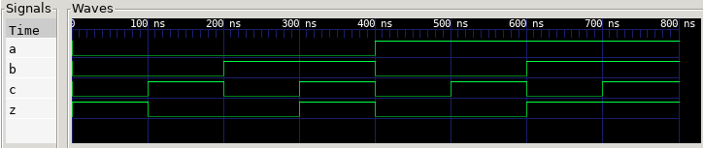
INTRO TUTORIAL (10)
Modules:
With the stimuli supplied in module tf to the device_under_test instance of type fn_z, Icarus Verilog is run again.
Running the command vvp (the simulator’s
run-time engine) and passing it assign_sim.out
as a parameter, the file dump.vcd is produced
and the simulation result is written to standard
output. You can see that the last column
matches what is expected from the truth table
of function z.
Finally, passing the dump.vcd
file to the gtkwave software
lets us display a diagram with
signals a, b, c and z evolving
over time.
$ iverilog assign_sim.v -o assign_sim.out
$ vvp assign_sim.out
VCD info: dumpfile dump.vcd opened for output.
000 1
001 0
010 0
011 1
100 0
101 0
110 1
111 1
$ gtkwave dump.vcd &
$ _

Slide 114
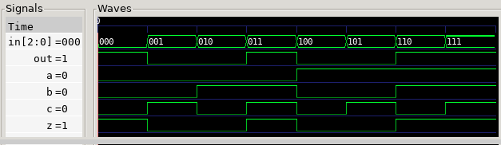
INTRO TUTORIAL (11)
As we have seen, data types are used to characterize the memory elements (reg) and the "nets", which in Verilog, remember, can be likened to wires. Several wires or regs can be grouped in an orderly way to represent a single data type.
Groups of wires can be regarded as so-called "Buses", as they are classically represented in the context of digital systems.
Memory elements can be likened to variables in programming languages; a single Flip-Flop (reg) is an example of a variable that stores one bit. A group of regs
represents a typical n-bit register.
// File assign_sim_b.v
`timescale 10ns/100ps
module tf;
reg [2:0] in;
wire out;
initial begin
$monitor( in,, in[2], in[1], in[0],, out );
$dumpvars( 0, tf );
in = 3'b000; #10
in = 3'b001; #10
in = 3'b010; #10
in = 3'b011; #10
in = 3'b100; #10
in = 3'b101; #10
in = 3'b110; #10
in = 3'b111; #10
$finish;
end
fn_z device_under_test( in[2], in[1], in[0], out );
endmodule
module fn_z( input a, b, c, output z );
assign z = ~a & ~b & ~c | a & b | b & c;
endmodule

Slide 115
INTRO TUTORIAL (12)
Operators
Verilog has several operators: alongside we see a summary table where we can also find the logical (bitwise) operators used so far. Below it, the precedence table.

Slide 116
INTRO TUTORIAL (13/1)
Always Block
Verilog allows more complex logic than
the simple assign thanks to the use of always
blocks. Combinational logic can be
written using always @(*). The value inside
the parentheses is called the
"sensitivity list". Using * tells the tool to compute this "sensitivity
list" automatically.
module fn_z( input a, b, c, output /*reg*/ z );
reg z; // required with always
// assign z = ~a & ~b & ~c | a & b | b & c;
// always @(a,b,c)
always @(*)
begin
z = ~a & ~b & ~c | a & b | b & c;
end
endmodule

Slide 117
INTRO TUTORIAL (13/2)
Always Block
Verilog allows more complex logic than
the simple assign thanks to the use of always
blocks. Combinational logic can be
written using always @(*). The value inside
the parentheses is called the
"sensitivity list". Using * tells the tool to compute this "sensitivity
list" automatically.
If a signal is driven inside an always block, it must be defined as reg. Conversely, as we have seen, if a continuous assignment (assign) is used, it can be defined as wire which always represents a connection, whereas a reg is equivalent to a wire if it is used inside an always @(*) construct.
module fn_z( input a, b, c, output /*reg*/ z );
reg z; // required with always
// assign z = ~a & ~b & ~c | a & b | b & c;
// always @(a,b,c)
always @(*)
begin
z = ~a & ~b & ~c | a & b | b & c;
end
endmodule

Slide 118
INTRO TUTORIAL (14)
The always block
A reg represents a register if it is used inside an
always block with synchronous sequential logic,
which is generated by specifying the list of signals
in the "sensitivity list" of the always block.
module counter( input Clk, input G );
reg [2:0] S = 3’d0; // WARNING: not synthesizable
always @( posedge Clk ) begin
case( S )
3'b000: S <= !G ? 3'b001 : 3'b001;
3'b001: S <= !G ? 3'b010 : 3'b011;
3'b010: S <= !G ? 3'b011 : 3'b110;
3'b011: S <= !G ? 3'b100 : 3'b010;
3'b100: S <= !G ? 3'b101 : 3'b000;
3'b101: S <= !G ? 3'b110 : 3'b100;
3'b110: S <= !G ? 3'b111 : 3'b111;
3'b111: S <= !G ? 3'b000 : 3'b101;
endcase
end
endmodule

Slide 119

INTRO TUTORIAL (14/2)
The always block
A reg represents a register if it is used inside an
always block with synchronous sequential logic,
which is generated by specifying the list of signals
in the "sensitivity list" of the always block.
Moreover, with the keywords posedge and negedge you
can specify on which edge (signal change) the
block is activated: posedge 0$→$1, negedge 1$→$0.
module counter( input Clk, input G );
reg [2:0] S = 3’d0; // WARNING: not synthesizable
always @( posedge Clk ) begin
case( S )
3'b000: S <= !G ? 3'b001 : 3'b001;
3'b001: S <= !G ? 3'b010 : 3'b011;
3'b010: S <= !G ? 3'b011 : 3'b110;
3'b011: S <= !G ? 3'b100 : 3'b010;
3'b100: S <= !G ? 3'b101 : 3'b000;
3'b101: S <= !G ? 3'b110 : 3'b100;
3'b110: S <= !G ? 3'b111 : 3'b111;
3'b111: S <= !G ? 3'b000 : 3'b101;
endcase
end
endmodule

Slide 120

INTRO TUTORIAL (14/3)
The always block
A reg represents a register if it is used inside an
always block with synchronous sequential logic,
which is generated by specifying the list of signals
in the "sensitivity list" of the always block.
Moreover, with the keywords posedge and negedge you
can specify on which edge (signal change) the
block is activated: posedge 0$→$1, negedge 1$→$0.
Inside the always block there is a
case statement that serves to synthesize the
next-state function, taken from the Gray/Binary counter example seen earlier. As is known, the function that computes the next state is a combinational structure, and note that in this case no equations were used to define it. always blocks can make the code more readable and easier to understand.
module counter( input Clk, input G );
reg [2:0] S = 3’d0; // WARNING: not synthesizable
always @( posedge Clk ) begin
case( S )
3'b000: S <= !G ? 3'b001 : 3'b001;
3'b001: S <= !G ? 3'b010 : 3'b011;
3'b010: S <= !G ? 3'b011 : 3'b110;
3'b011: S <= !G ? 3'b100 : 3'b010;
3'b100: S <= !G ? 3'b101 : 3'b000;
3'b101: S <= !G ? 3'b110 : 3'b100;
3'b110: S <= !G ? 3'b111 : 3'b111;
3'b111: S <= !G ? 3'b000 : 3'b101;
endcase
end
endmodule

Slide 121

INTRO TUTORIAL (14/4)
The always block
A reg represents a register if it is used inside an
always block with synchronous sequential logic,
which is generated by specifying the list of signals
in the "sensitivity list" of the always block.
Moreover, with the keywords posedge and negedge you
can specify on which edge (signal change) the
block is activated: posedge 0$→$1, negedge 1$→$0.
Inside the always block there is a
case statement that serves to synthesize the
next-state function, taken from the Gray/Binary counter example seen earlier. As is known, the function that computes the next state is a combinational structure, and note that in this case no equations were used to define it. always blocks can make the code more readable and easier to understand.
Verilog has two assignment operators: blocking (=) and non-blocking (<=). The blocking operator (=) is used for combinational logic and the non-blocking one for synchronous sequential logic.
module counter( input Clk, input G );
reg [2:0] S = 3’d0; // WARNING: not synthesizable
always @( posedge Clk ) begin
case( S )
3'b000: S <= !G ? 3'b001 : 3'b001;
3'b001: S <= !G ? 3'b010 : 3'b011;
3'b010: S <= !G ? 3'b011 : 3'b110;
3'b011: S <= !G ? 3'b100 : 3'b010;
3'b100: S <= !G ? 3'b101 : 3'b000;
3'b101: S <= !G ? 3'b110 : 3'b100;
3'b110: S <= !G ? 3'b111 : 3'b111;
3'b111: S <= !G ? 3'b000 : 3'b101;
endcase
end
endmodule

Slide 122
INTRO TUTORIAL (15/1)
"Test Bench" modules
In addition to the actual counter module, an additional module (clock) is needed that generates the cadence (clk_gen). As written, this module is not synthesizable, but that is not a problem since it only serves to generate one of the two test vectors (Cp) for counter_1.
`timescale 10ns/100ps
module tf;
reg Mode; // 0=Bin 1=Gray
wire Cp;
initial begin
$dumpvars( 0, tf );
Mode = 0; #102
Mode = 1; #108
$finish;
end
clock clk_gen( .Out( Cp ) );
counter counter_1( .Clk( Cp ), .G( Mode ) );
endmodule
module clock( output reg Out );
// WARNING: module not synthesizable
initial
Out = 1;
always
begin
#5
Out = ~Out;
end
endmodule

Slide 123
INTRO TUTORIAL (15/2)
"Test Bench" modules
In addition to the actual counter module, an additional module (clock) is needed that generates the cadence (clk_gen). As written, this module is not synthesizable, but that is not a problem since it only serves to generate one of the two test vectors (Cp) for counter_1.
The two modules declared inside tf, namely clk_gen and counter_1, are interconnected through the net Cp (wire).
`timescale 10ns/100ps
module tf;
reg Mode; // 0=Bin 1=Gray
wire Cp;
initial begin
$dumpvars( 0, tf );
Mode = 0; #102
Mode = 1; #108
$finish;
end
clock clk_gen( .Out( Cp ) );
counter counter_1( .Clk( Cp ), .G( Mode ) );
endmodule
module clock( output reg Out );
// WARNING: module not synthesizable
initial
Out = 1;
always
begin
#5
Out = ~Out;
end
endmodule

Slide 124
INTRO TUTORIAL (15/3)
"Test Bench" modules
In addition to the actual counter module, an additional module (clock) is needed that generates the cadence (clk_gen). As written, this module is not synthesizable, but that is not a problem since it only serves to generate one of the two test vectors (Cp) for counter_1.
The two modules declared inside tf, namely clk_gen and counter_1, are interconnected through the net Cp (wire).
In the example there are two constructs that
start with $. The first ($dumpvars) instructs the simulator to consider the future observation of all the nets of the main module (the top moduletf).
The second construct is $finish. This "system task" tells the simulator to stop and terminate.
`timescale 10ns/100ps
module tf;
reg Mode; // 0=Bin 1=Gray
wire Cp;
initial begin
$dumpvars( 0, tf );
Mode = 0; #102
Mode = 1; #108
$finish;
end
clock clk_gen( .Out( Cp ) );
counter counter_1( .Clk( Cp ), .G( Mode ) );
endmodule
module clock( output reg Out );
// WARNING: module not synthesizable
initial
Out = 1;
always
begin
#5
Out = ~Out;
end
endmodule

Slide 125
INTRO TUTORIAL (16/1)
To make the counter synthesizable, a mechanism must be added to clear the state from outside. For this purpose an input (net Rst) can be added to the module's list of inputs/outputs.
module counter( input Clk, input Rst, input G );
reg [2:0] S;
always @( posedge Clk or posedge Rst )
begin
if ( Rst )
begin
S <= 3'b000;
end
else
begin
case ( S )
3'b000: S <= !G ? 3'b001 : 3'b001;
3'b001: S <= !G ? 3'b010 : 3'b011;
3'b010: S <= !G ? 3'b011 : 3'b110;
3'b011: S <= !G ? 3'b100 : 3'b010;
3'b100: S <= !G ? 3'b101 : 3'b000;
3'b101: S <= !G ? 3'b110 : 3'b100;
3'b110: S <= !G ? 3'b111 : 3'b111;
3'b111: S <= !G ? 3'b000 : 3'b101;
endcase
end
end
endmodule

Slide 126
INTRO TUTORIAL (16/2)
To make the counter synthesizable, a mechanism must be added to clear the state from outside. For this purpose an input (net Rst) can be added to the module's list of inputs/outputs.
The net Rst is therefore also added to the sensitivity list of the always statement, and every change of it (posedge) will therefore be taken into account.
module counter( input Clk, input Rst, input G );
reg [2:0] S;
always @( posedge Clk or posedge Rst )
begin
if ( Rst )
begin
S <= 3'b000;
end
else
begin
case ( S )
3'b000: S <= !G ? 3'b001 : 3'b001;
3'b001: S <= !G ? 3'b010 : 3'b011;
3'b010: S <= !G ? 3'b011 : 3'b110;
3'b011: S <= !G ? 3'b100 : 3'b010;
3'b100: S <= !G ? 3'b101 : 3'b000;
3'b101: S <= !G ? 3'b110 : 3'b100;
3'b110: S <= !G ? 3'b111 : 3'b111;
3'b111: S <= !G ? 3'b000 : 3'b101;
endcase
end
end
endmodule

Slide 127
INTRO TUTORIAL (16/3)
To make the counter synthesizable, a mechanism must be added to clear the state from outside. For this purpose an input (net Rst) can be added to the module's list of inputs/outputs.
The net Rst is therefore also added to the sensitivity list of the always statement, and every change of it (posedge) will therefore be taken into account.
If, when the always block is triggered, the value of Rst is equal to 1, we are facing a request to clear the register that holds the state.
module counter( input Clk, input Rst, input G );
reg [2:0] S;
always @( posedge Clk or posedge Rst )
begin
if ( Rst )
begin
S <= 3'b000;
end
else
begin
case ( S )
3'b000: S <= !G ? 3'b001 : 3'b001;
3'b001: S <= !G ? 3'b010 : 3'b011;
3'b010: S <= !G ? 3'b011 : 3'b110;
3'b011: S <= !G ? 3'b100 : 3'b010;
3'b100: S <= !G ? 3'b101 : 3'b000;
3'b101: S <= !G ? 3'b110 : 3'b100;
3'b110: S <= !G ? 3'b111 : 3'b111;
3'b111: S <= !G ? 3'b000 : 3'b101;
endcase
end
end
endmodule

Slide 128
INTRO TUTORIAL (16/4)
To make the counter synthesizable, a mechanism must be added to clear the state from outside. For this purpose an input (net Rst) can be added to the module's list of inputs/outputs.
The net Rst is therefore also added to the sensitivity list of the always statement, and every change of it (posedge) will therefore be taken into account.
If, when the always block is triggered, the value of Rst is equal to 1, we are facing a request to clear the register that holds the state.
If it was not Rst that triggered the always block, then it was certainly the Clk input. The register will therefore be updated with the rule seen earlier, contained in the case statement.
module counter( input Clk, input Rst, input G );
reg [2:0] S;
always @( posedge Clk or posedge Rst )
begin
if ( Rst )
begin
S <= 3'b000;
end
else
begin
case ( S )
3'b000: S <= !G ? 3'b001 : 3'b001;
3'b001: S <= !G ? 3'b010 : 3'b011;
3'b010: S <= !G ? 3'b011 : 3'b110;
3'b011: S <= !G ? 3'b100 : 3'b010;
3'b100: S <= !G ? 3'b101 : 3'b000;
3'b101: S <= !G ? 3'b110 : 3'b100;
3'b110: S <= !G ? 3'b111 : 3'b111;
3'b111: S <= !G ? 3'b000 : 3'b101;
endcase
end
end
endmodule

Slide 129
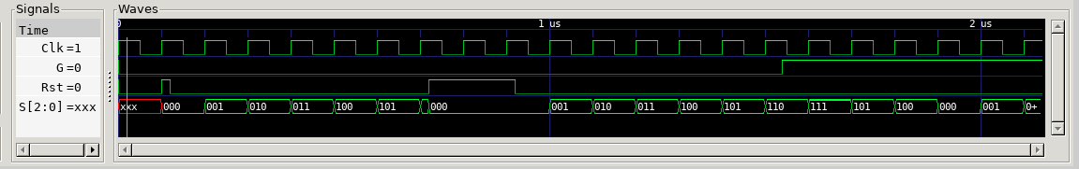
INTRO TUTORIAL (17)
`timescale 10ns/100ps
module tf;
reg Mode;
wire Cp;
reg Reset;
initial begin
$dumpvars( 0, tf );
Mode = 0; #154
Mode = 1; #60
$finish;
end
initial begin
Reset = 0; #10
Reset = 1; #2
Reset = 0; #60
Reset = 1; #20
Reset = 0;
end
clock Clk( .Out( Cp ) );
counter counter_1 (
.Clk( Cp ),
.Rst( Reset ),
.G( Mode )
);
endmodule
Once the test fixtures have been updated to support the new Reset input, the simulation can be run to verify that the counter works correctly. As can be seen in the diagrams below, the Rst pulse initially clears the register, which started with an undefined value (xxx). When Rst is released, the subsequent clock pulses (Clk) advance the count. An Rst level of 1 held long enough to exceed the period of several clock cycles shows that the Rst input has priority, like an asynchronous reset applied directly to the registers.
Lastly, you can see that a change from zero to one of the G input modifies the counting criterion, switching from Binary to Gray code.

Slide 130
Q&A
Speakers:
  Emanuel Conti (e.conti@embedded.sm)
  Giuliano Cardinali (giulicard@gmail.com)

Slide 131
BIBLIOGRAPHY
Reti logiche e
calcolatori F. Luccio, L. Pagli –
ISBN: 978-8833954870
FPGAs: Instant Access
Clive Maxfield - ISBN: 978-0750689748
Bebop to the Boolean Boogie: An Unconventional Guide to Electronics
Clive Maxfield - ISBN: 978-1856175074
Logic Circuit Design: Selected Topics and Methods, Second Ed.
Shimon P. Vingron - ISBN: 978-3031406720
The Verilog® Hardware Description Language, 5th Ed.
Donald E. Thomas, Philip R. Moorby - ISBN: 978-1402070896
Digital design : with an introduction to the verilog hdl
M. Morris Mano, Michael D. Ciletti.—5th ed. - ISBN-13: 978-0132774208
Digital Design Principles and Practices
John F. Wakerly - ISBN: 978-0134460093

