Slide 1
Sequences and Time-Series July 24, 2020
Applied Data Science
MMCi Term 4
Matthew Engelhard
Notes:
NEED INFO ABOUT ROC, CONFUSION MATRIX, ETC HERE

Slide 2
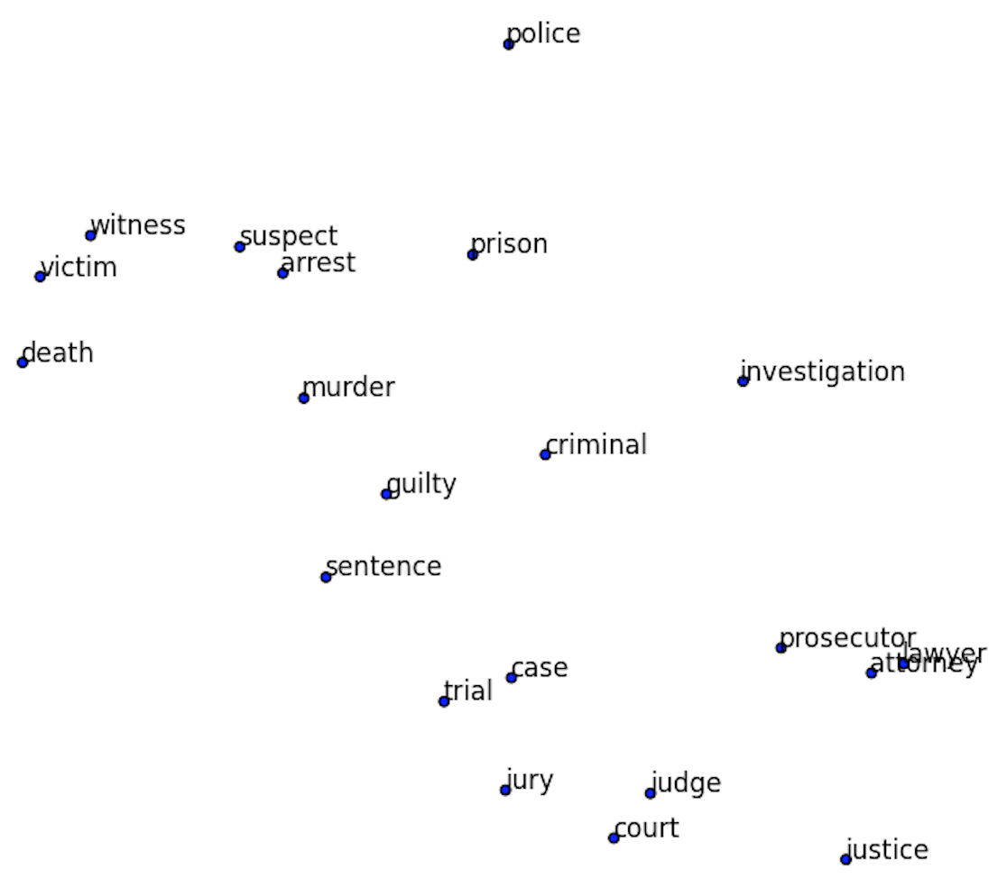
Recall: Word embeddings allow us to quantify word meaning
If we zoom in on a small region of our word map, it’s all related words.
Note the similarity of all the words as a whole, but also of the individual neighbors.
“Lawyer” and “attorney” are nearly identical in space!

Slide 3
Applying Word Embeddings to a Sentence
Look up words individually to obtain their vectors
Construct a sequence of vectors
This is a sentence
x_{i}
Notes:
esta es una frase

Slide 4
Sequences of measurements: same structure
Day 1 Day 2 Day 3 Day 4
Temp
BP
HR
RR
SpO2
Glucose
x_{i}

Slide 5

Task 1: Predict a label associated with the sentence
This movie is awful
y_{i}
x_{i}
Notes:
esta es una frase

Slide 6
Task 1: Predict a label associated with the report
Intracranial mass effect noted
y_{i}
x_{i}
Notes:
esta es una frase

Slide 7
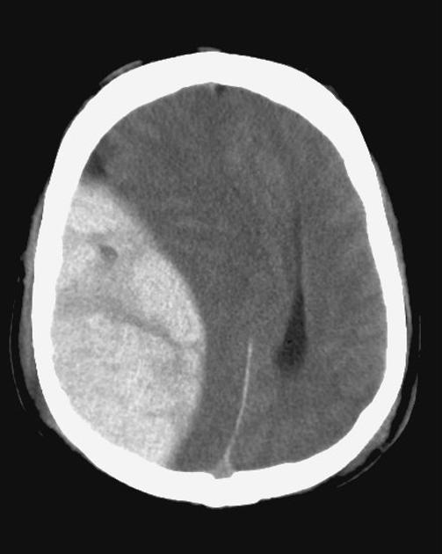
Classification of radiology reports using neural attention models, IJCNN 2017
Mass effect from extradural hemorrhage
https://radiopaedia.org
Notes:
How does all this affect medicine?
There are five parts to this course. We’ll be talking about the basics of neural networks; CNNs; natural language processing; time-series modeling; and reinforcement learning.
Imaging is already there – we’re getting ML-based diagnostics – plain images, dermoscopy, ultrasound, fundoscopic images, radiology, pathology, etc.
NLP is right on the cusp – so far the ‘NLP’ that’s out there hasn’t been very smart – very context aware – but NLP systems are right at human-performance, and it’s going to start making a huge impact very soon. Can only hope that NLP starts reducing some of the documentation burden placed on physicians.
RL is also very close, though evaluation here is more difficult.

Slide 8

Task 1: Predict a label associated with the note
Child demonstrates protodeclarative point
y_{i}
x_{i}
Notes:
esta es una frase

Slide 9

Task 1: Predict label assoc. with all measurements
$t_{1}$ $t_{2}$ $t_{3}$ $t_{4}$
0 (survival)
y_{i}
Temp
BP
HR
RR
SpO2
Glucose
x_{i}
Notes:
This is what we do in diagnosis prediction, for instance

Slide 10
Task 2: Predict a label associated with each word
This movie is awful
adj. noun verb adj.
y_{i1}
y_{i2}
y_{i3}
y_{i4}
Notes:
esta es una frase

Slide 11
Task 2: Predict a label (?) associated with each word
This movie is awful
esta pelicula es horrible
y_{i1}
y_{i2}
y_{i3}
y_{i4}
Notes:
esta es una frase

Slide 12
Multi-Class Logistic Regression (many classes)
z(pelicula)
softmax
p(pelicula)
p(horrible)
p(es)
v(this)
p(esta)
z(esta)

Slide 13
Task 2: Predict a label associated with each word
My SSN is 111-22-3333
not PHI not PHI not PHI PHI
y_{i1}
y_{i2}
y_{i3}
y_{i4}
Notes:
esta es una frase

Slide 14
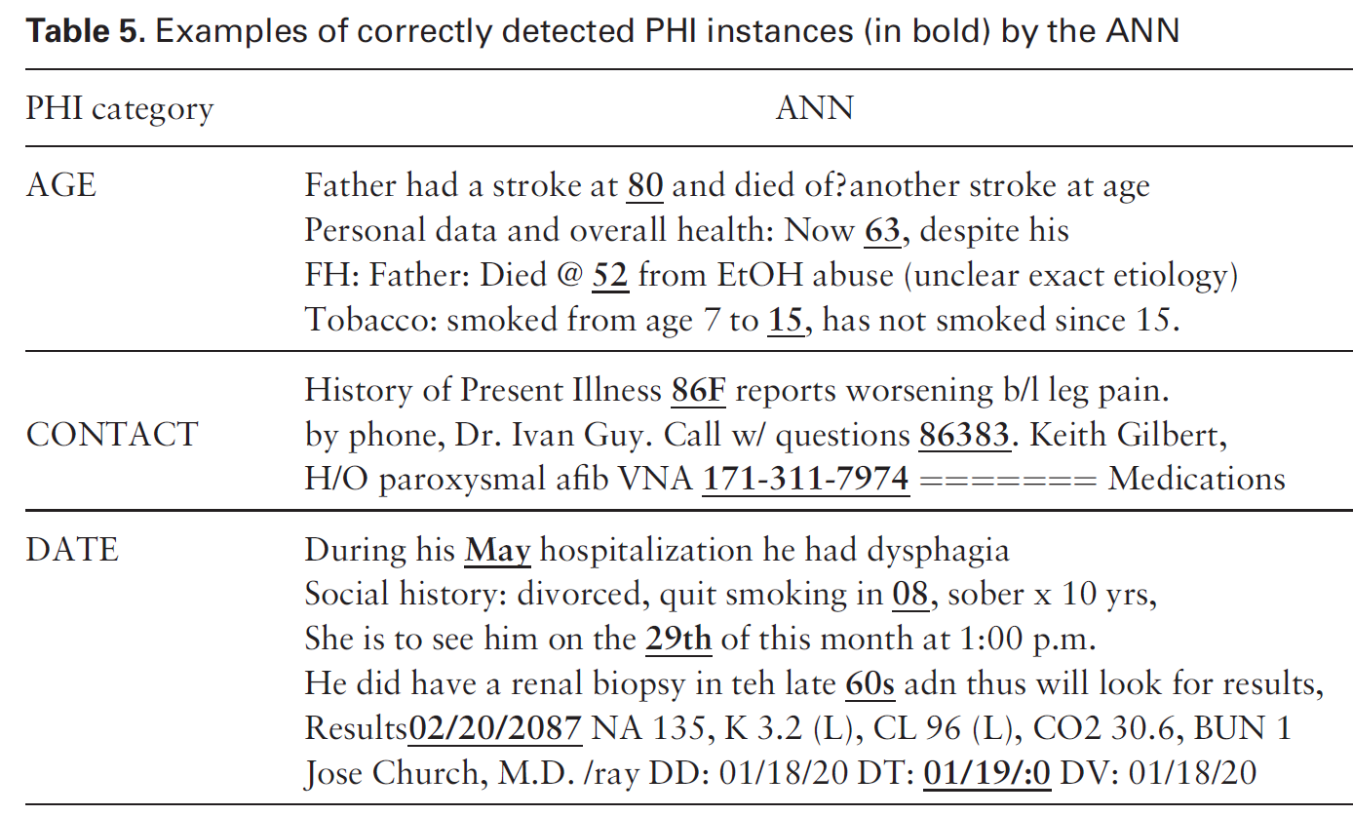
Deidentification of Patient Notes
A bidirectional RNN is used to identify PHI (18 HIPAA fields)
i2b2: 889 discharge summaries, >28k PHI tokens
MIMIC: 1635 discharge summaries, >60k PHI tokens
State of the art sensitivity and F1 metric on both datasets
De-identification of patient notes with recurrent neural networks
Dernoncourt F, Lee JY, Uzuner O, Szolovits P
JAMIA 24(3), 2017, 596–606
Notes:
Deidentification is a big challenge
Ideally want 100% sensitive removal of PHI, but there’s a huge amount to identify and human rates are pretty low when done at scale
Expert systems out there – manually curated rule-set – that does this
The idea – we want to use an RNN approach – very similar to the one David described – to do this
Use two datasets, including one generated specifically for this task based on discharge summaries coming from MIMIC
Point out that they say ANN instead of RNN

Slide 15

Task 2: Predict label assoc. with each time point
$t_{1}$ $t_{2}$ $t_{3}$ $t_{4}$
Temp
BP
HR
RR
SpO2
Glucose
not hypoxemic not hypoxemic hypoxemic not hypoxemic
y_{i1}
y_{i2}
y_{i3}
y_{i4}
Notes:
This is what we do in diagnosis prediction, for instance

Slide 16
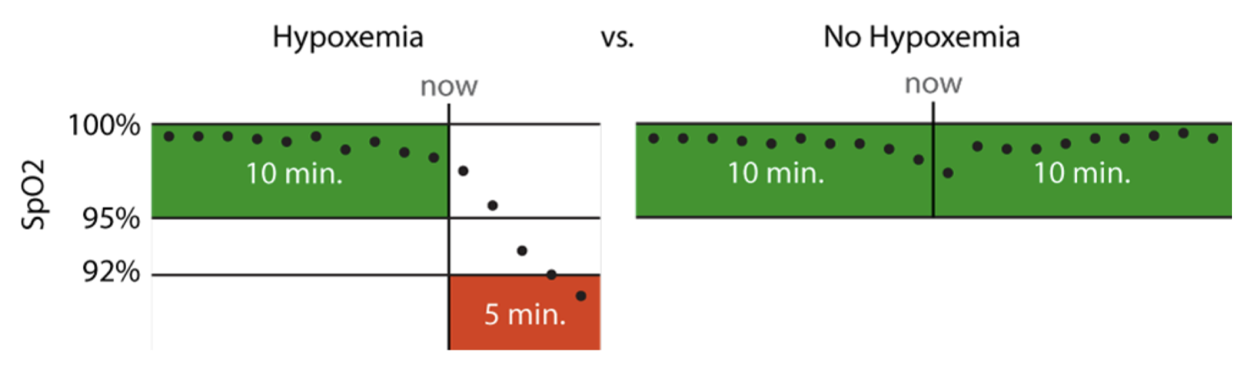
Hypoxemia Prediction during Surgery
Real-time Prediction Task:
hypoxemia (yes/no) in the next 5 minutes
based on data from the Anesthesia Information Management System
static features + real-time features collected up to that time point
Notes:
5 min window: long enough to allow an anaesthesiologist to intervene, but short enough to represent near-term risks that would benefit from immediate attention
This is actually what’s used for the anesthesiologist comparison
Model training was less strict

Slide 17
Problem 1: Sequences Vary in Length
Sentences/text have different # words
Time-series have different # measurement times
Solution 1: aggregate over words/time points

Slide 18
VSWEM allows us to convert a variable-length sentence to a fixed-length feature vector
This is a sentence
max
MAX
Notes:
We will come back to this idea in the time-series models

Slide 19
Similarly, we can aggregate measurements in a time-series
$t_{1}$ $t_{2}$ $t_{3}$ $t_{4}$
Temp
BP
HR
RR
SpO2
Glucose
x_{i3}
not hypoxemic not hypoxemic hypoxemic not hypoxemic
y_{i1}
y_{i2}
y_{i3}
y_{i4}
Notes:
This is what we do in diagnosis prediction, for instance

Slide 20
Similarly, we can aggregate measurements in a time-series
$t_{1}$ $t_{2}$ $t_{3}$ $t_{4}$
Temp
BP
HR
RR
SpO2
Glucose
Max
Min
Avg
Slope
SD
Skew
etc
x_{i3}
not hypoxemic not hypoxemic hypoxemic not hypoxemic
y_{i1}
y_{i2}
y_{i3}
y_{i4}
Notes:
This is what we do in diagnosis prediction, for instance

Slide 21
Problem 2: Interpret Words or Measurements in Context
A sentence is more than the average (or max) of its words
A time-series is more than the average / min / max / SD of individual measurements
Deep learning: we learn what’s important about the sequence rather than choosing features or summary stats

Slide 22
Recurrent Neural Networks

Slide 23
Predict a label associated with each word
This movie is awful
LogReg
LogReg
LogReg
LogReg
esta pelicula es horrible
y_{i1}
y_{i2}
y_{i3}
y_{i4}
Notes:
esta es una frase

Slide 24
Predict a label associated with each word
This movie is awful
MLP
MLP
MLP
MLP
esta pelicula es horrible
y_{i1}
y_{i2}
y_{i3}
y_{i4}
Notes:
esta es una frase

Slide 25
Transfer relevant information about earlier words
This movie is awful
h_{i1}
h_{i2}
h_{i3}
MLP
MLP
MLP
MLP
esta pelicula es horrible
y_{i1}
y_{i2}
y_{i3}
y_{i4}
Notes:
esta es una frase

Slide 26
Transfer relevant information about earlier values
$t_{1}$ $t_{2}$ $t_{3}$ $t_{4}$
$x_{i1}$ $x_{i2}$ $x_{i3}$ $x_{i4}$
h_{i1}
h_{i2}
h_{i3}
MLP
MLP
MLP
MLP
not hypoxemic not hypoxemic hypoxemic not hypoxemic
y_{i1}
y_{i2}
y_{i3}
y_{i4}
Notes:
esta es una frase

Slide 27
Transfer relevant information about earlier values
$t_{1}$ $t_{2}$ $t_{3}$ $t_{4}$
$x_{i1}$ $x_{i2}$ $x_{i3}$ $x_{i4}$
h_{i1}
h_{i2}
h_{i3}
MLP
MLP
MLP
MLP
not hypoxemic not hypoxemic hypoxemic not hypoxemic
y_{i1}
y_{i2}
y_{i3}
y_{i4}
Notes:
esta es una frase

Slide 28
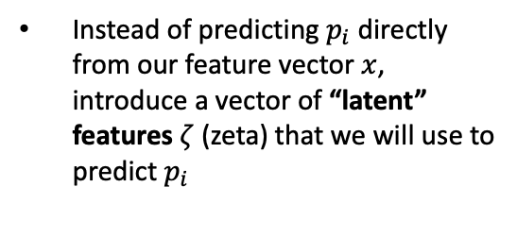


Instead of predicting $p_{i}$ directly from our feature vector $x$, introduce a vector of “latent” features $ζ$ (zeta) that we will use to predict $p_{i}$
Back to Lecture 1…
$p_{i}$ (probability of hypoxemia)
$$\text{ζ}\text{i}$$
x_{i}
Think of 𝜁 as a learned representation that is useful for predicting p
Since they are neither an input nor an output, the features ζ are said to be a “hidden” layer

Slide 29



$p_{i2}$ = probability of hypoxemia ($y_{i2}$)
$\text{ζ}\text{i}$₂
x_{i2}
$$x_{i2}$$
Since they are neither an input nor an output, the features ζ are said to be a “hidden” layer

Slide 30



$p_{i2}$ = probability of hypoxemia ($y_{i2}$)
$$\text{ζ}\text{i}\text{2}$$
$$\text{h}\text{i}\text{2}$$
x_{i2}
$$\text{h}\text{i}\text{1}$$
$$x_{i2}$$

Slide 31
$p_{i2}$ = probability of hypoxemia ($y_{i2}$)
$$\text{ζ}\text{i}\text{2}$$
$$\text{h}\text{i}\text{2}$$
x_{i2}
$$\text{h}\text{i}\text{1}$$
$$x_{i2}$$
current word / measurements

Slide 32
$p_{i2}$ = probability of hypoxemia ($y_{i2}$)
$$\text{ζ}\text{i}\text{2}$$
$$\text{h}\text{i}\text{2}$$
used to make prediction
x_{i2}
$$\text{h}\text{i}\text{1}$$
$$x_{i2}$$

Slide 33
$p_{i2}$ = probability of hypoxemia ($y_{i2}$)
$$\text{ζ}\text{i}\text{2}$$
$$\text{h}\text{i}\text{2}$$
x_{i2}
$$\text{h}\text{i}\text{1}$$
$$x_{i2}$$
learned representation of previous words / history

Slide 34
$p_{i2}$ = probability of hypoxemia ($y_{i2}$)
updated representation of previous words / history
$$\text{ζ}\text{i}\text{2}$$
$$\text{h}\text{i}\text{2}$$
x_{i2}
$$\text{h}\text{i}\text{1}$$
$$x_{i2}$$

Slide 35
We learn what’s important about previous values
$t_{1}$ $t_{2}$ $t_{3}$ $t_{4}$
$x_{i1}$ $x_{i2}$ $x_{i3}$ $x_{i4}$
h_{i1}
h_{i2}
h_{i3}
MLP
MLP
MLP
MLP
not hypoxemic not hypoxemic hypoxemic not hypoxemic
y_{i1}
y_{i2}
y_{i3}
y_{i4}
Notes:
esta es una frase

Slide 36
Recurrent MLP (NN): these are all the same / have same weights
$t_{1}$ $t_{2}$ $t_{3}$ $t_{4}$
$x_{i1}$ $x_{i2}$ $x_{i3}$ $x_{i4}$
h_{i1}
h_{i2}
h_{i3}
MLP
MLP
MLP
MLP
not hypoxemic not hypoxemic hypoxemic not hypoxemic
y_{i1}
y_{i2}
y_{i3}
y_{i4}
Notes:
esta es una frase

Slide 37
Task 1: Predict a label associated with the sequence
$t_{1}$ $t_{2}$ $t_{3}$ $t_{4}$
$x_{i1}$ $x_{i2}$ $x_{i3}$ $x_{i4}$
h_{i1}
h_{i2}
h_{i3}
MLP
MLP
MLP
MLP
0 (survival)
y_{i}
Notes:
esta es una frase

Slide 38
Hypoxemia Prediction: Use learned representation of previous measurements
Real-time Prediction Task:
hypoxemia (yes/no) in the next 5 minutes
based on data from the Anesthesia Information Management System
static features + real-time features collected up to that time point
Notes:
5 min window: long enough to allow an anaesthesiologist to intervene, but short enough to represent near-term risks that would benefit from immediate attention
This is actually what’s used for the anesthesiologist comparison
Model training was less strict

Slide 39
Common RNN Variants
Gated Recurrent Unit (GRU)
Long Short Term Memory (LSTM)
Bidirectional RNNs
Look at previous words and upcoming words
Usually not appropriate for time-series
Notes:
What does recurrent mean? (describe)

Slide 40
Deidentification of Patient Notes
A bidirectional RNN is used to identify PHI (18 HIPAA fields)
i2b2: 889 discharge summaries, >28k PHI tokens
MIMIC: 1635 discharge summaries, >60k PHI tokens
State of the art sensitivity and F1 metric on both datasets
De-identification of patient notes with recurrent neural networks
Dernoncourt F, Lee JY, Uzuner O, Szolovits P
JAMIA 24(3), 2017, 596–606
Notes:
Deidentification is a big challenge
Ideally want 100% sensitive removal of PHI, but there’s a huge amount to identify and human rates are pretty low when done at scale
Expert systems out there – manually curated rule-set – that does this
The idea – we want to use an RNN approach – very similar to the one David described – to do this
Use two datasets, including one generated specifically for this task based on discharge summaries coming from MIMIC
Point out that they say ANN instead of RNN

Slide 41
Note: we can also generate text this way.
This movie is awful
h_{i1}
h_{i2}
h_{i3}
MLP
MLP
MLP
MLP
esta pelicula es horrible
y_{i1}
y_{i2}
y_{i3}
y_{i4}
Notes:
esta es una frase

Slide 42
Note: we can also generate text this way.
[Start] this movie is
h_{i1}
h_{i2}
h_{i3}
MLP
MLP
MLP
MLP
this movie is horrible
y_{i1}
y_{i2}
y_{i3}
y_{i4}
Notes:
esta es una frase

Slide 43
Working with irregularly spaced measurements

Slide 44
Still Another Problem…
All of this supposes we have a nice grid of complete measurements
For text, we do have this.
But in real-world time-series data – and particularly in healthcare – we usually have incomplete sets of measurements at irregular intervals
How do we use an RNN?

Slide 45
Measurements on the Wards…
time
blood pressure
chest xray
culture
glucose
CMP
CBC
This is a major difficulty!
Notes:
Also true for diagnosis codes, etc

Slide 46
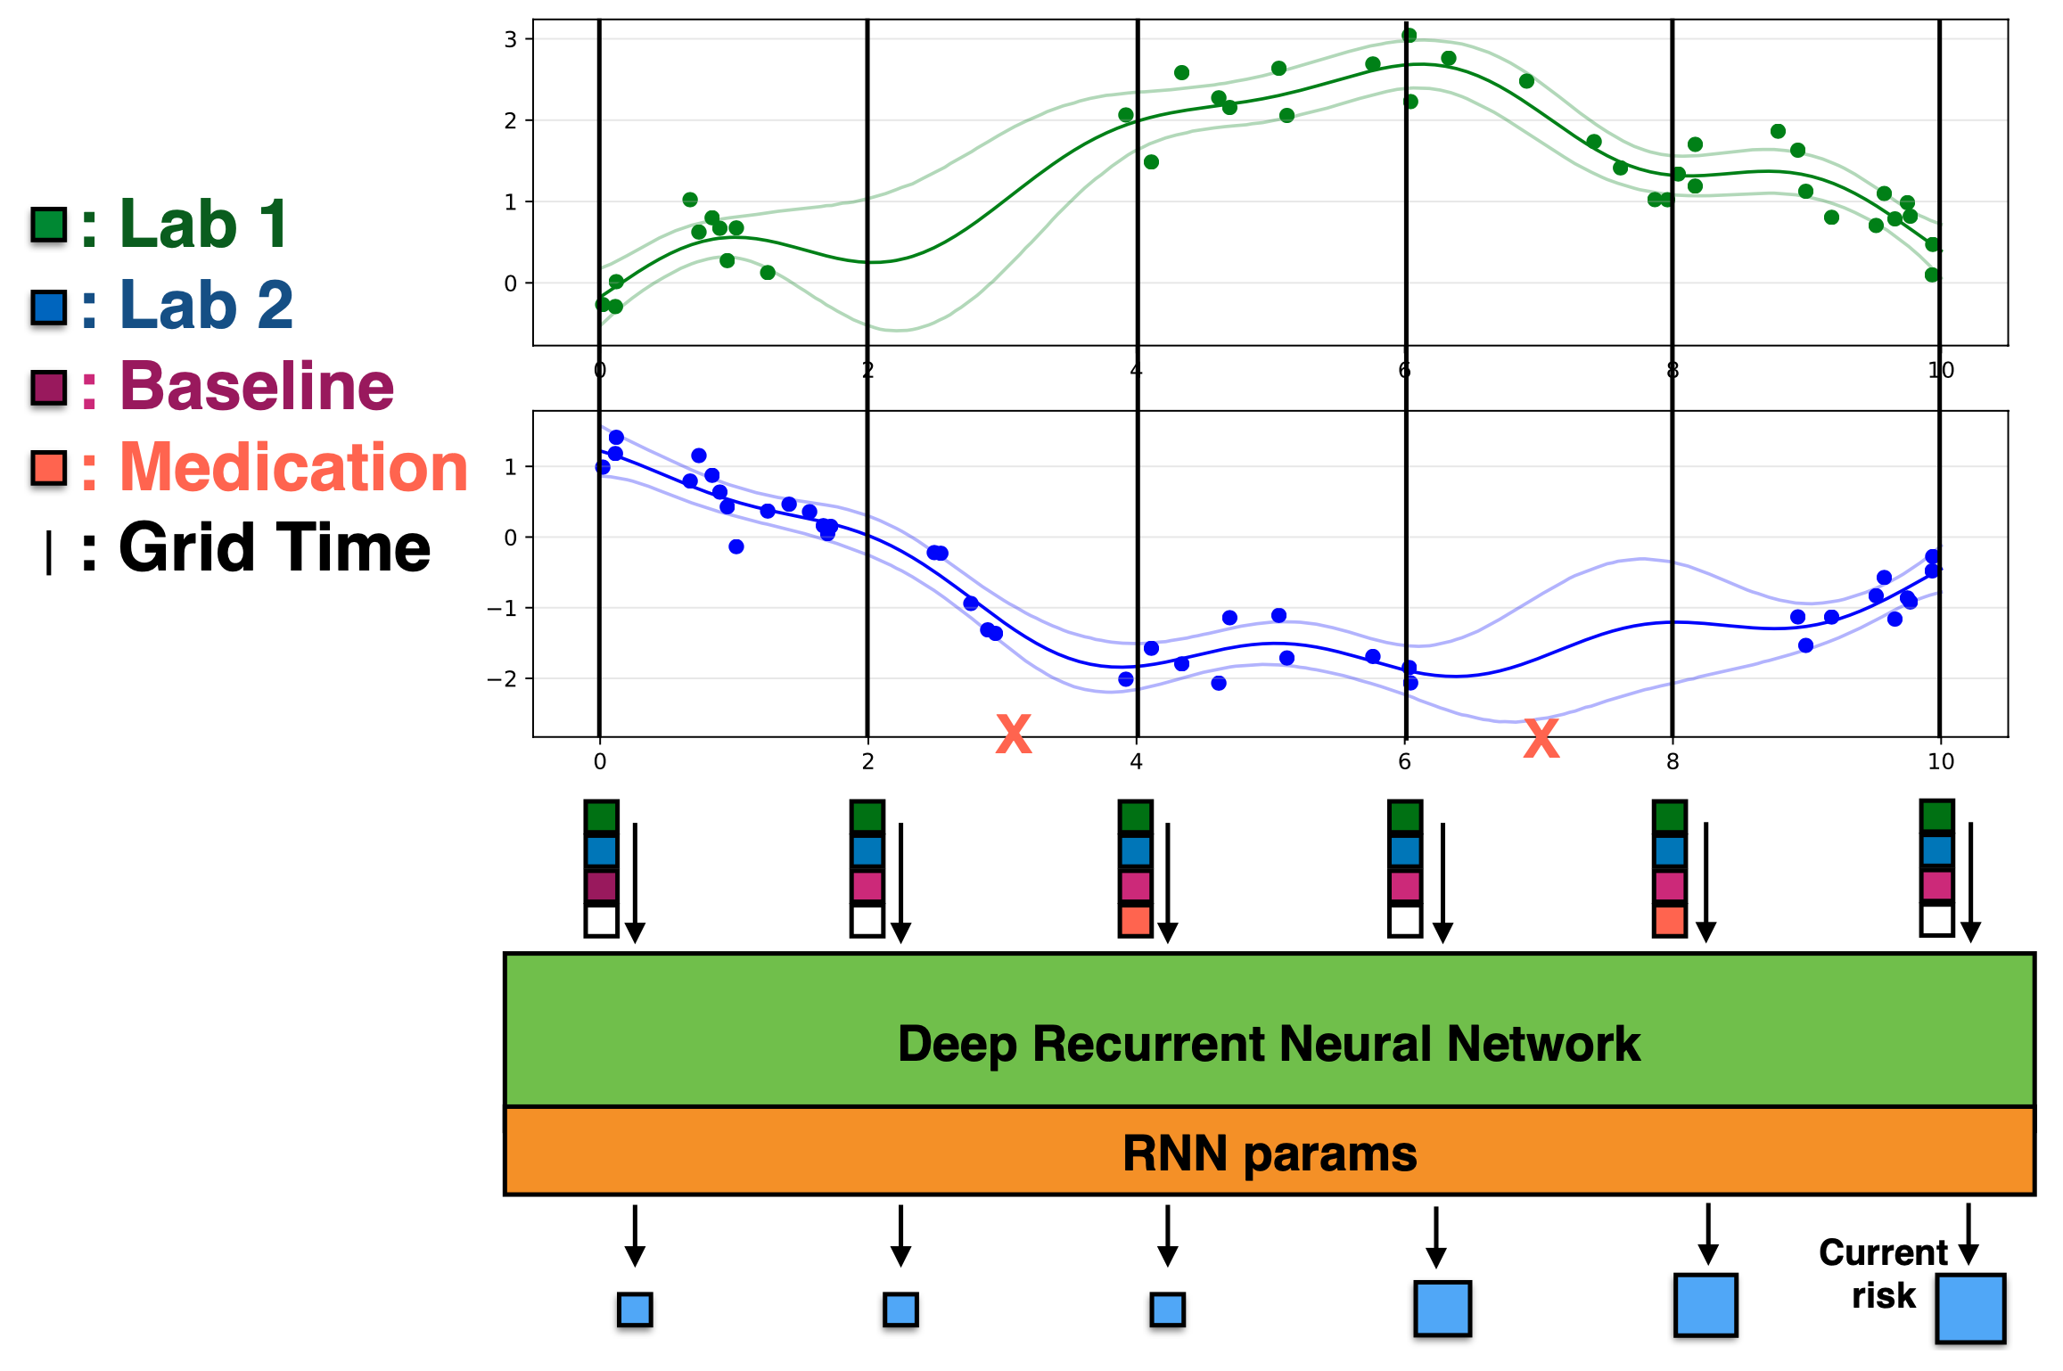
DIHI Sepsis Watch
<- Use GP regression to predict measurements at regular intervals
<- Predict sepsis risk using an RNN

Slide 47
Simplest Method…
time
blood pressure
chest xray
culture
glucose
CMP
CBC
aggregate in hour 1
aggregate in hour 2
aggregate in hour 2
aggregate in hour 4…

Slide 48
In the EHR, measurements are highly “sparse”
Many more missing measurements than non-missing
Consider diagnosis codes, procedure codes, uncommon labs, etc
We want to learn from these measurements, but most patients don’t have them

Slide 49
Conclusions
Often, aggregating measurements/features is sufficient
RNNs allow us to learn a representation of earlier measurements (or words) that helps us make predictions. But, in can be time and memory intensive to train.
The RNN is just that: a recurrent / repeating MLP block
Sparse data (most values are missing) is common in health applications and remains very challenging

