Slide 1
The Model Training and Development Process
Matthew Engelhard

Slide 2
Today
Essentials of Sound Model Development and Evaluation
Why out-of-sample evaluation (i.e., a held-out test set) is critical
How do we divide up the data?
How is each portion is used?
What can go wrong?
Common Variations in Practice
Hyperparameter tuning
Cross-validation

Slide 3
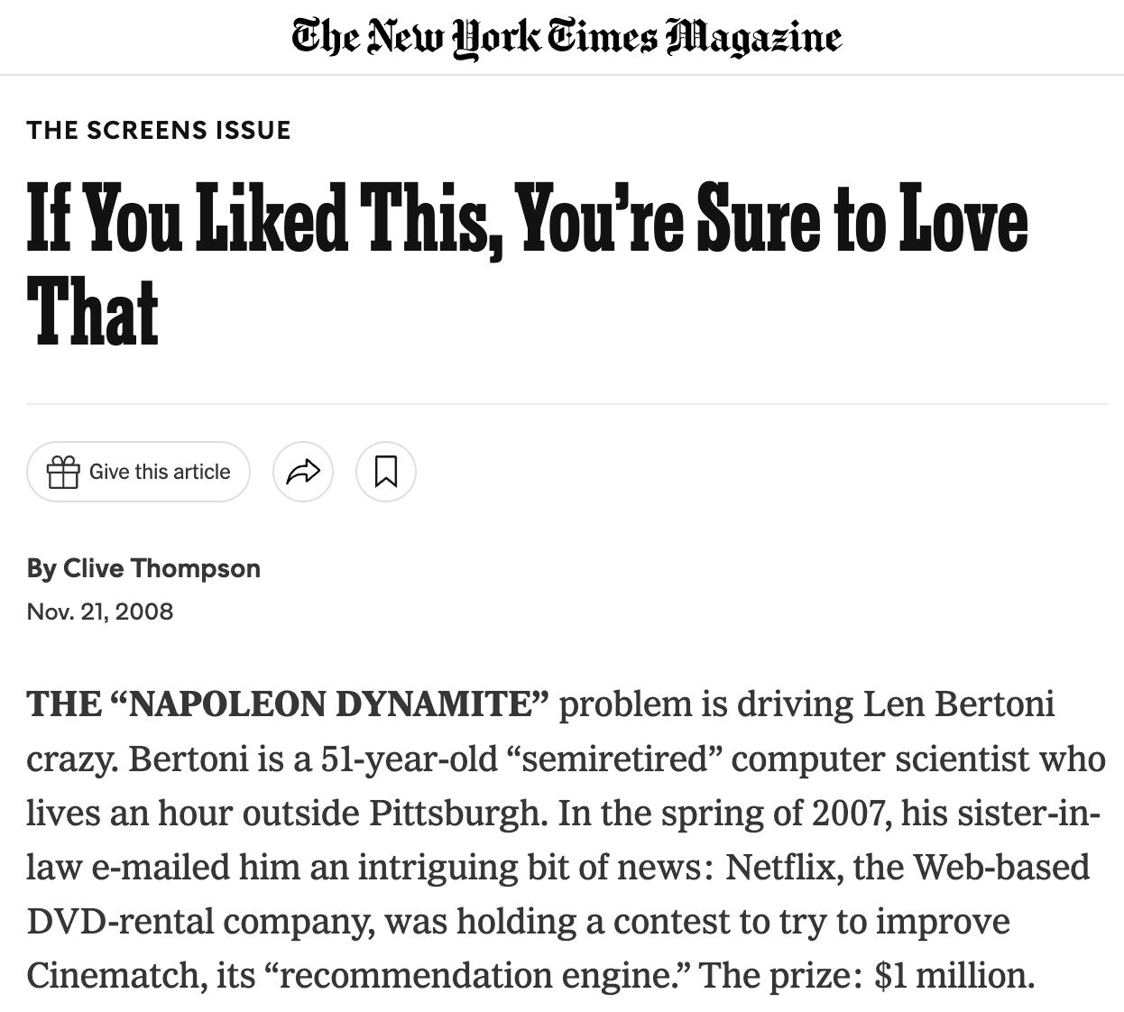

The Napoleon Dynamite Problem (NDP)

Slide 4
Claim: I’ve solved the NDP.
Randy took headshots of each member of the MMCi class of 2021
Catherine asked them whether they liked Napoleon Dynamite
I then studied the data
I can predict whether someone likes Napoleon Dynamite from a picture of their face with 100% accuracy, and I can prove it. Show me a picture of anyone in the class and I will predict whether they like Napoleon Dynamite.
Aren’t you impressed?
Notes:
Why not?
Now, go around the room (class of 2022) and predict whether someone likes Napoleon Dynamite
How many do I have to get right before you start believing me?

Slide 5
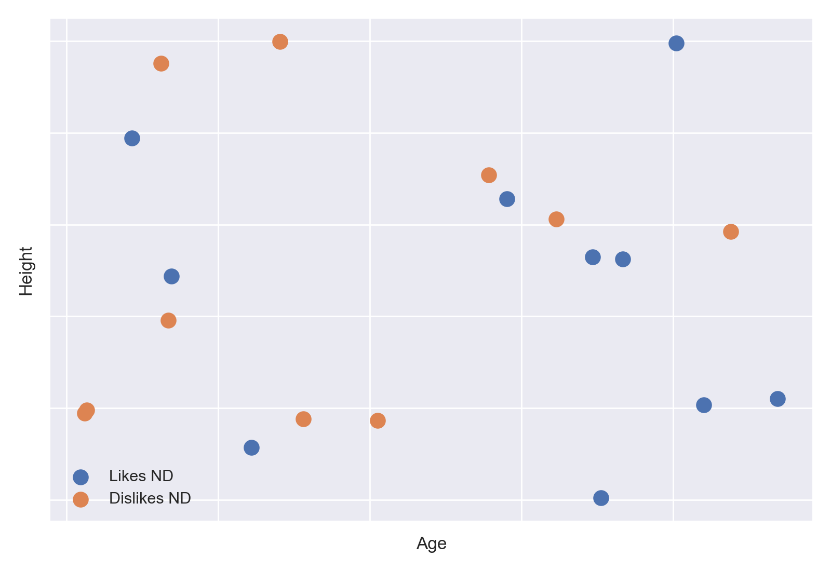
You got me. I memorized the dataset.
And I can do it again with this dataset.
I can predict whether people like Napoleon Dynamite from their age and height.

Slide 6
You got me. I memorized the dataset.
And I can do it again with this dataset.
Question: Can logistic regression memorize this dataset (i.e., make perfect predictions)?

Slide 7
You got me. I memorized the dataset.
And I can do it again with this dataset.
Question: Can logistic regression memorize this dataset (i.e., make perfect predictions)?
Answer: No. There is no line that perfectly separates the blue and orange points.

Slide 8
You got me. I memorized the dataset.
And I can do it again with this dataset.
Question: Can a neural network memorize this dataset (i.e., make perfect predictions)?

Slide 9

You got me. I memorized the dataset.
And I can do it again with this dataset.
Question: Can a neural network memorize this dataset (i.e., make perfect predictions)?
Answer: Yes… like so -->

Slide 10
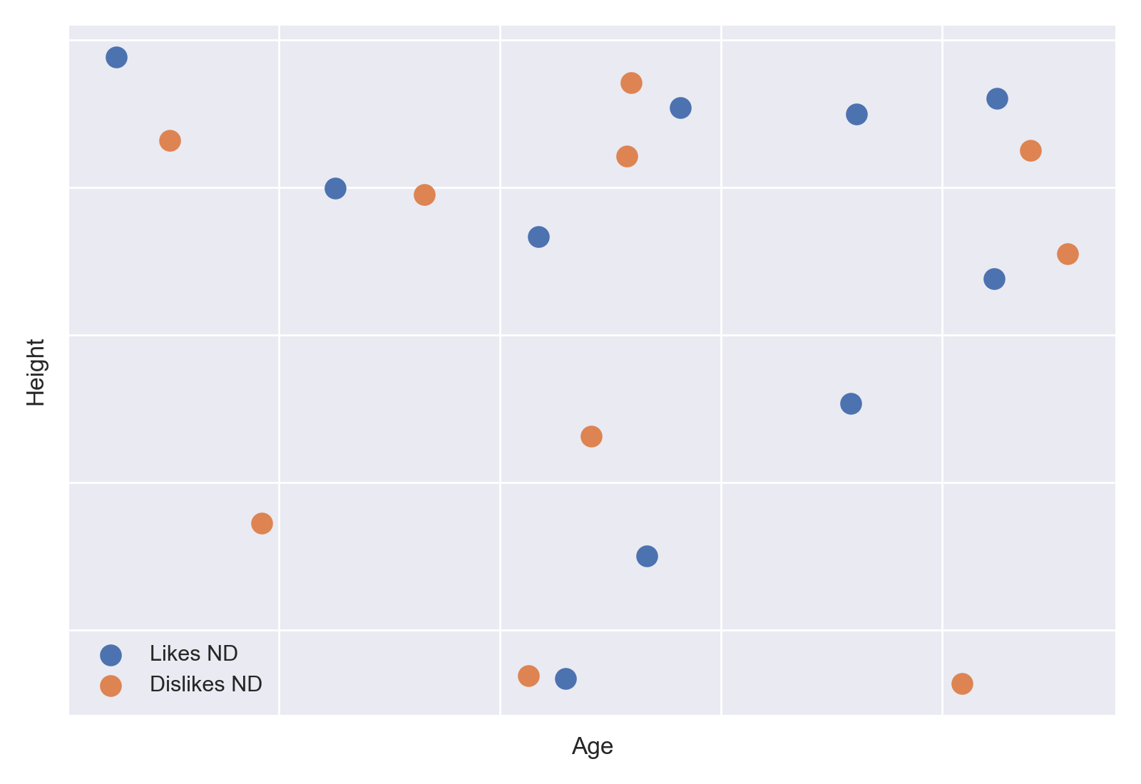
You got me. I memorized the dataset.
And I can do it again with this dataset.
Question: Can a neural network memorize this dataset (i.e., make perfect predictions)?
Answer: Yes… like so -->

Slide 11

You got me. I memorized the dataset.
And I can do it again with this dataset.
Question: Can a neural network memorize this dataset (i.e., make perfect predictions)?
Answer: Yes… like so -->

Slide 12
You got me. I memorized the dataset.
And I can do it again with this dataset.
Question: Can a neural network memorize this dataset (i.e., make perfect predictions)?
Answer: Yes… like so -->
What is this called?

Slide 13
You got me. I memorized the dataset.
If this were the true relationship between age, height, and Napoleon Dynamite, then this boundary would still work when we gather data from a new sample of participants.

Slide 14
You got me. I memorized the dataset.
If this were the true relationship between age, height, and Napoleon Dynamite, then this boundary would still work when we gather data from a new sample of participants.
But it doesn’t.
In this case, there’s no relationship – it’s just random noise. But the NN can still make perfect predictions on the training data.

Slide 15
Key Takeaways
We must evaluate our models using data they haven’t seen before.
The test set should not be used to train
The test set should not be used in any other way prior to the evaluation
For complex models – say, an MLP with many layers, or logistic regression with a large number of predictors:
Performance on the training set can dramatically overestimate performance on the test set
So, evaluating on a held-out test set is critical
For simple models – say, logistic regression with only a few predictors:
Performance on the training set should be close to performance on the test set
Nevertheless, evaluating on a held-out test set is good practice

Slide 16


















How do we divide up the data? (easy version)
$$x_{1}$$
$$y_{1}$$
$$x_{1}$$
$$y_{1}$$
$$x_{2}$$
$$y_{2}$$
$$x_{2}$$
$$y_{2}$$
$$x_{3}$$
$$y_{3}$$
$$x_{3}$$
$$y_{3}$$
$$x_{4}$$
$$y_{4}$$
$$x_{4}$$
$$y_{4}$$
$$x_{N−1}$$
$$y_{N−1}$$
$$x_{N}$$
$$y_{N}$$
Development Set:
-> used to build the model
Test Set:
-> used to estimate real-world
performance

Slide 17
Suppose we receive a new dataset
Read the data (Excel, SQL)
Assign to the development set or test set: shuffle, then split
Divide predictors (x) from outcomes (y) and unwanted columns (often identifiers)
Preprocessing
Normalize numeric variables
Cell code categorical variables
Remember, we don’t want to use any information from the test set prior to training. This can be a bit tricky to implement.
MORTALITY PREDICTION WORKSHEET
COVARIATES |  |  |  | OUTCOME
patient | age | female | temp | mortality
0 | 30.5 | 0 | 105.0 | 1
1 | 74.0 | 1 | 96.7 | 0
2 | 27.4 | 0 | 96.1 | 0
3 | 0.1 | 1 | 98.5 | 0
4 | 0.7 | 1 | 96.5 | 0
5 | 49.9 | 1 | 97.1 | 0
6 | 72.9 | 1 | 100.1 | 1
7 | 29.1 | 1 | 99.6 | 0
8 | 83.5 | 1 | 100.6 | 1
9 | 82.3 | 1 | 95.2 | 1
10 | 23.7 | 0 | 99.4 | 1
11 | 12.9 | 0 | 96.6 | 0
12 | 53.9 | 1 | 100.3 | 0
13 | 18.8 | 0 | 98.6 | 0
14 | 51.8 | 0 | 98.5 | 0
15 | 3.3 | 0 | 94.6 | 0
16 | 69.7 | 0 | 99.1 | 0
17 | 60.4 | 1 | 104.2 | 1
18 | 73.6 | 1 | 99.1 | 1
19 | 53.3 | 1 | 99.1 | 0

Slide 18
Variations on random assignment
Why is it a good idea to assign the data at random (i.e., shuffle first)?
Are there any exceptions or alternatives?
Our evaluation should match the claims we wish to make about performance
We might want to make a specific claim, such as:
A model trained on years 2000-2010 generalizes to years 2010-2020
A model trained at DUHS generalizes to the UNC Health System
We might have repeated measures data
Multiple (x, y) pairs from the same patient <-- this is a very common source of errors
We typically handle this by assigning repeated measures (i.e., all data for a given patient) to the same fold (i.e., development set, test set)

Slide 19
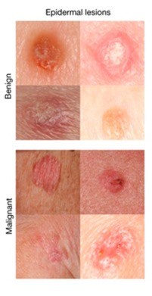
Claims about performance must match your evaluation.
What’s wrong here?
Dataset: pictures of skin lesions along with label (benign/malignant)
2,000 images of 600 lesions from 400 participants
Goal: predict whether lesions are benign or malignant
Evaluation Strategy: Divide the data (image/label pairs) at random between a development set (80%) and a test set (20%)

Slide 20
Claims about performance must match your evaluation.
What’s wrong here?
Dataset: wearables data from 20 patients with arrhythmia and 20 controls
10 sessions during arrhythmia for each patient with arrhythmia
10 sessions at random times for each control
Goal: predict arrythmia
Evaluation Strategy: Divide the data (image/label pairs) at random between a development set (70%) and a test set (30%)

Slide 21
What goes wrong?
Subtle mistakes like the previous examples are very common.
Obvious mistakes like evaluating on the training data are also very common.
Data Leakage: the use of information in the model training process which would not be expected to be available at prediction time
Think about whether the information you are using would be available at the time of prediction.

Slide 22
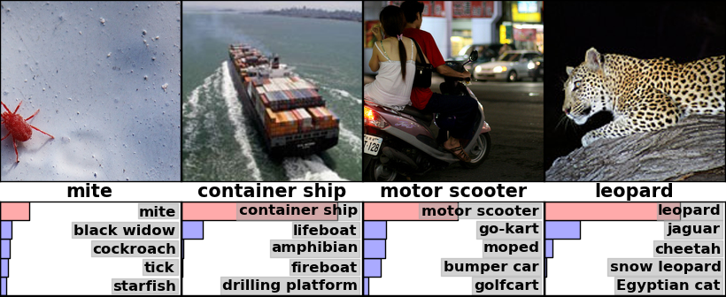
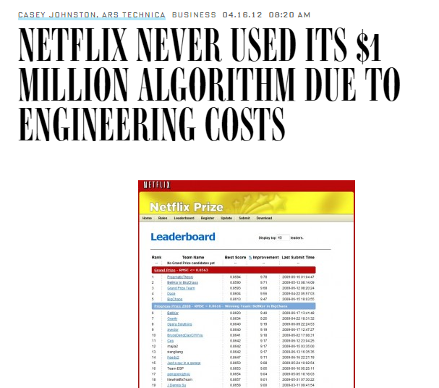

Defenses against improper evaluation
Publicly available data and code:
Facilitates reproducibility
Challenge format:
Test and development sets are fixed by the organizers. Often, test sets aren’t even available; entrants submit their model rather than presenting their results.
In healthcare:
There are some good publicly available datasets (MIMIC, All of Us, etc.), but we’re still way behind the curve.

Slide 23
There’s more to model development than training…
What if I want to choose which kind of model is best (e.g., logistic regression, MLP)?
-> this is model selection
What if I want to refine or modify my model or the training process in some way (e.g., adjust the number of hidden layers)?
-> this is hyperparameter tuning
Definition: a hyperparameter is a value or setting that is fixed before training that influences the training process

Slide 24

Parameters versus Hyperparameters
Parameters
Lengths of the seams
Hyperparameters
Which seams to adjust
What ruler to use
How fast / careless versus careful

Slide 25

Parameters versus Hyperparameters
Parameters
Lengths of the seams
Model coefficients (i.e., numeric values in the equation)
Hyperparameters
Which seams to adjust
What ruler to use
How fast / careless versus careful
Model architecture (i.e., the form of the equation)
Training algorithm
Regularization (*more next time)

Slide 26
How do we tune hyperparameters?
Proposal 1: Figure out which hyperparameters perform best on the training set
Proposal 2: Figure out which hyperparameters perform best on the test set
Are either of these a good idea? Why or why not?

Slide 27
How do we tune hyperparameters?
Proposal 1: Figure out which hyperparameters perform best on the training set
Proposal 2: Figure out which hyperparameters perform best on the test set
Are either of these a good idea? Why or why not?
-> Hyperparameters require their own tuning set.

Slide 28




































How do we divide up the data?
Refine Model
$$x_{1}$$
$$y_{1}$$
$$x_{1}$$
$$y_{1}$$
$$x_{2}$$
$$y_{2}$$
$$x_{2}$$
$$y_{2}$$
$$x_{3}$$
$$y_{3}$$
$$x_{3}$$
$$y_{3}$$
$$x_{4}$$
$$y_{4}$$
$$x_{4}$$
$$y_{4}$$
$$x_{1}$$
$$y_{1}$$
$$x_{N−1}$$
$$x_{2}$$
$$y_{2}$$
$$x_{N−1}$$
$$y_{N−1}$$
$$x_{N}$$
$$y_{N}$$
$$x_{3}$$
$$y_{3}$$
$$x_{N}$$
$$y_{N}$$
Training Set
$$x_{4}$$
$$y_{4}$$
Test
$$x_{N−1}$$
$$y_{N−1}$$
$$x_{N}$$
$$y_{N}$$
$({b_{0},b}_{1},…b_{M})$
Validation
Estimate Performance on Validation Set
Final Performance Evaluation

Slide 29
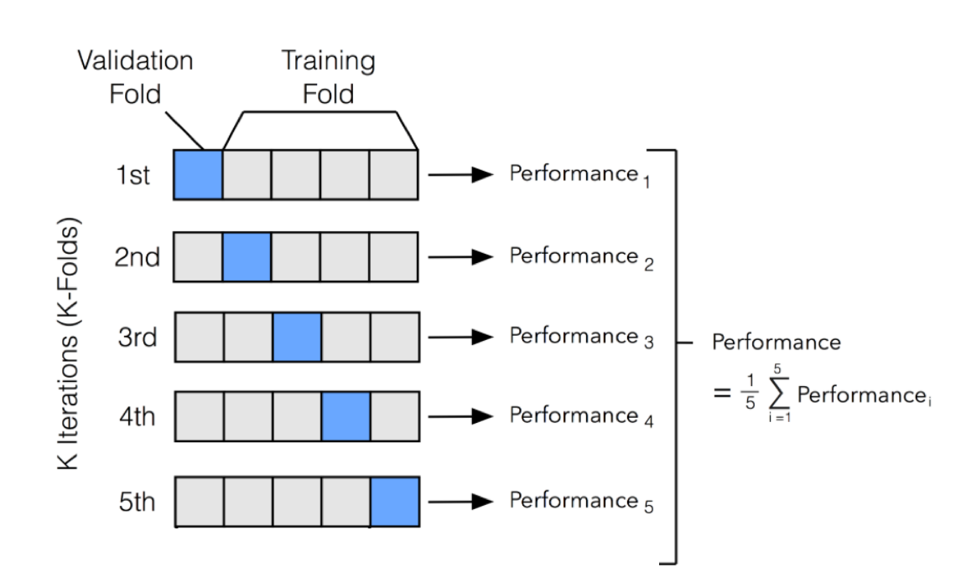
What if we don’t have enough data for this?
Very common in medicine
We use cross validation
http://ethen8181.github.io/machine-learning/model_selection/model_selection.html

Slide 30
Summary

