Slide 1
Logistic Regression
Matthew Engelhard
Notes:
Preliminaries – Intro
Plan for the weekend (lecture structure, computational assignment)
We’ll cover the quiz during the discussion section
Any questions about the course to start?

Slide 2

features $x$ -> prediction $y$: a predictive model
y, associated value or label
x, data/features for a subject or patient
End goal: predict y from x
Notes:
Suppose we have a vector of measurements (x)
Associated with those measurements is an outcome – or a label – or another measurement (y)
We’d like to make a prediction about (y) that is based on (x)
Maybe (y) is a home price. X is a bunch of information about that home, e.g. square footage, number of bedrooms, how old, neighborhood, school district. Let’s say we’d like to make an informed guess about the home price based on all that information. What we need is a predictive model.
Might call them covariates, might call them predictors. In this class, we will most often call them ‘features’

Slide 3
Simple models often work well for clinical data!
Age
WBC Count
Respiratory Rate
Creatinine
Mean BP
Hematocrit
Pulse Rate
Temperature
Survival
y, associated value or label
x, data/features for a subject or patient
End goal: predict odds of hospital mortality
(APACHE III)
Notes:
Remember, we want to use the simplest model we possibly can
For now I’m asking you to take my word for it, but simple models tend to work quite well for data like this – distinct clinical variables as we have here
So let’s use the simplest model we can think of

Slide 4
Can we use a linear model?
z_{i}
b₁
b_{M}
$$zi=b_{1}x_{i1}+b_{2}x_{i2}+…+b_{M}x_{iM}$$
x_{i1}
x_{iM}
Notes:
The equation that links the features to the prediction is a linear equation
We get to multiply each feature by a parameter – these are the b values, which will be learned during training – and then we add everything up
In this course, we will use a graph structure like the one you see above to represent this and other equations
Remember that each of these boxes on the bottom is a single numeric value
When we see an arrow going from one box to another, it means that we take the value in the first box – the one where the arrow starts – multiply it by a parameter of the model, which is associated with the edge – here we see that parameter b_1 is associated with that leftmost edge – and we add it to the other box, in this case z_i, where the arrow terminates
So here, the value z_i is obtained by taking the x values, multiplying them by their respective parameters (the values on the edges), and adding up the result
A good question to ask yourself at this point: how many parameters are in this model?
Now, what’s the problem with this model?
Note that this model, exactly as written, is linear regression
But, linear regression is good for numeric values; in our case, we have an event that may or may not occur. And what we really want to do is to predict the probability of event occurrence
As you know, probabilities range from 0 to 1
But there’s nothing stopping z_i from being well outside that range
As a result, what we’ll need is a ”link” function – a function that will ensure that the output of our model is a valid probability rather than an unbounded numeric value

Slide 5
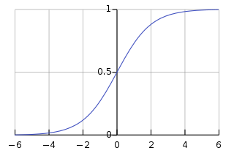

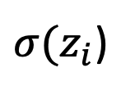
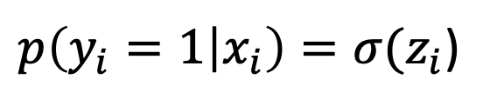

The logistic function converts $z_{i}$ to a probability
$$zi=b_{1}x_{i1}+b_{2}x_{i2}+…+b_{M}x_{iM}+…+b_{0}$$
$p\left(y_{i}=1 | x_{i}\right)=σ(z_{i}$)
Extra Constant
(i.e. intercept)
(i.e. bias)
$σ(z_{i}$)
Notes:
For logistic regression, we use the logistic function – often called the sigmoid function, because it is ‘S’ shaped – to perform that conversion to a valid probability.
One miscellaneous thing to note at this point is that, in addition to the predictors and corresponding coefficients, we do typically include one additional model parameter, called the bias or intercept, that is added to z_i
This parameter is related to the baseline event rate. If the event is unlikely, the bias will be negative, and if the event is likely, it will be positive
When we apply this function, denoted by sigma, to z_i, we can see that the output always ranges between 0 and 1 –here we’re looking at the y axis -- no matter how big z_i gets – here we’re looking at the x axis
This equation – z_i is linear in the predictors, and converted to a probability by the logistic function – fully describes the logistic regression model

Slide 6
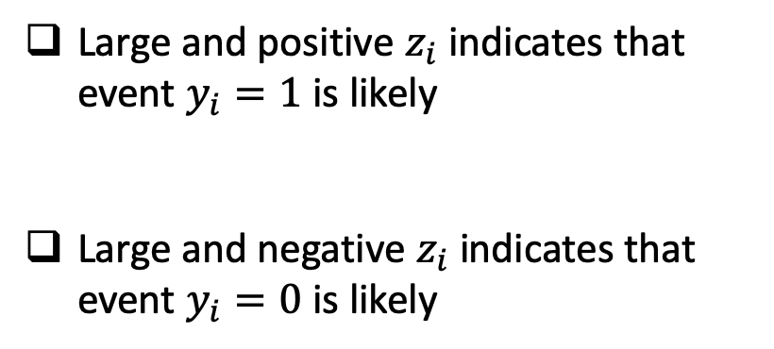
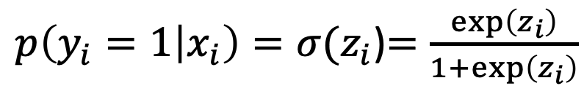
The logistic function converts $z_{i}$ to a probability
$$zi=b_{1}x_{i1}+b_{2}x_{i2}+…+b_{M}x_{iM}+…+b_{0}$$
$p\left(y_{i}=1 | x_{i}\right)=σ(z_{i}$)$=\frac{\exp\left(z_{i}\right)}{1+\exp\left(z_{i}\right)}$
Large and positive $z_{i}$ indicates that event $y_{i}=1$ is likely
Large and negative $z_{i}$ indicates that event $y_{i}=0$ is likely
Notes:
Inverse of the log link function is log(p / 1-p) – this is the log of the ratio between the probability the event will occur and the probability that it won’t. This allows us to interpret the output of our linear model as the “log-odds”.

Slide 7


Logistic Regression: a linear model with a logistic “link” function that converts the prediction to a probability
$$σ\left(z_{i}\right)=p\left(y_{i}=1 | x_{i}\right)$$
$$σ$$
z_{i}
b₁
b_{M}
$$p\left(y_{i}=1 | x_{i}\right)=σ(b_{1}x_{i1}+b_{2}x_{i2}+…+b_{M}x_{iM})$$
x_{i1}
x_{iM}
Notes:
By combining these two, we get logistic regression
Note that the arrows going to z are hidden – it just gets messy. But all arrows will be going in the same direction for any graph we’ll consider in this course

Slide 8


Logistic Regression: a linear model with a logistic “link” function that converts the prediction to a probability
$$p_{i}$$
$$σ$$
z_{i}
b₁
b_{M}
$$p_{i}=σ(b_{1}x_{i1}+b_{2}x_{i2}+…+b_{M}x_{iM})$$
x_{i1}
x_{iM}

Slide 9
Logistic Regression
$$p_{i}$$
$$σ$$
Linear
Model
z_{i}
b₁
b_{M}
$$p_{i}=σ(b_{1}x_{i1}+b_{2}x_{i2}+…+b_{M}x_{iM})$$
x_{i1}
x_{iM}

Slide 10
Logistic Regression
Convert to a
Probability
$$p_{i}$$
$$σ$$
z_{i}
b₁
b_{M}
$$p_{i}=σ(b_{1}x_{i1}+b_{2}x_{i2}+…+b_{M}x_{iM})$$
x_{i1}
x_{iM}
Notes:
Before we go through an example – what questions do you have?

Slide 11
ICU Mortality Prediction
A clinical example

Slide 12
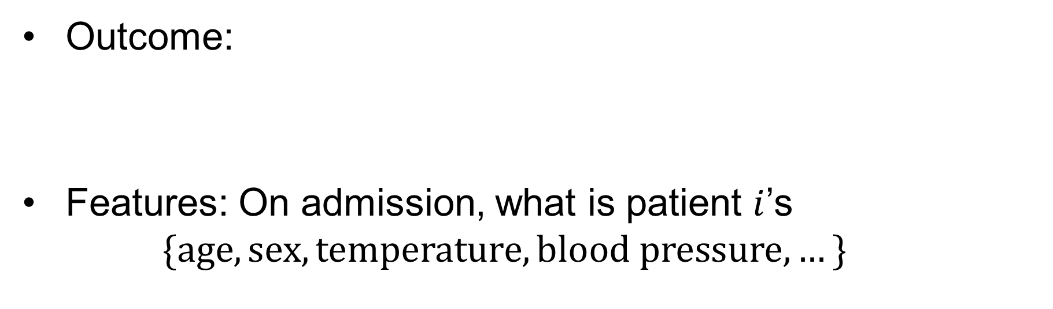
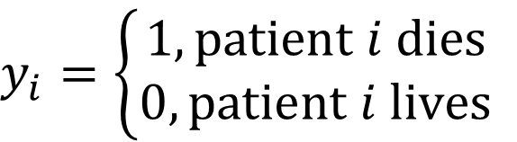
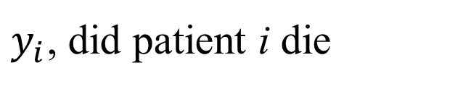
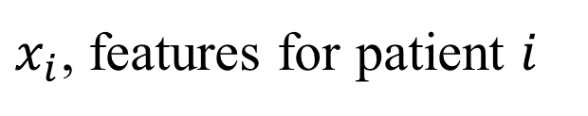
Example: ICU Mortality Prediction
Outcome:
Features: On admission, what is patient $i$’s
$$\{age, sex, temperature,blood pressure,…\}$$
$$y_{i}=\left\{\begin{aligned}1, patient i dies \\ 0, patient i lives\end{aligned}\right.$$
$y_{i}$, did patient i die
$x_{i}$, features for patient $i$

Slide 13
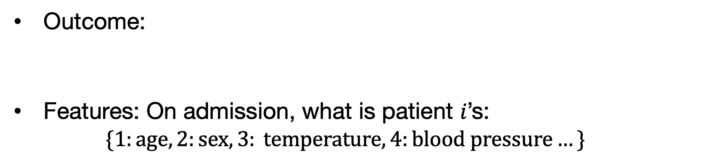
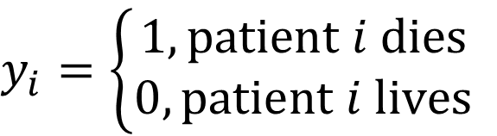
Example: ICU Mortality Prediction
Outcome:
Features: On admission, what is patient 𝑖’s:
$$\{1:age, 2:sex, 3: temperature, 4:blood pressure…\}$$
$$y_{i}=\left\{\begin{aligned}1, patient i dies \\ 0, patient i lives\end{aligned}\right.$$
$$zi=b_{1}x_{i1}+b_{2}x_{i2}+…+b_{M}x_{iM}+b_{0}$$
Age
Blood Pressure
If increased age increases odds of mortality, $b_{1}$ should be positive

Slide 14
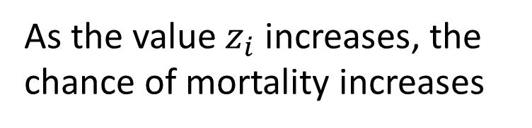
Impact on the Sigmoid Function
$$zi=b_{1}x_{i1}+b_{2}x_{i2}+…+b_{M}x_{iM}+b_{0}$$
$p\left(y_{i}=1 | x_{i}\right)=σ(z_{i}$)
Age
Chance of Rain
As the value $z_{i}$ increases, the chance of mortality increases
Notes:
“squashes” values between zero and 1… cannot have probability outside of this range

Slide 15
The logistic function just converts the patient’s log-odds (of mortality) to the corresponding probability.
An example:
Suppose the patient’s predicted log odds = 2
Convert log odds to odds by exponentiating: e^2 = 7.4
The odds are always relative to 1; in other words, they are 7.4x more likely to die than not
Convert odds to probability = 7.4 / (1 + 7.4) = 0.88
Notes:
The important thing: linear model predicting log odds

Slide 16
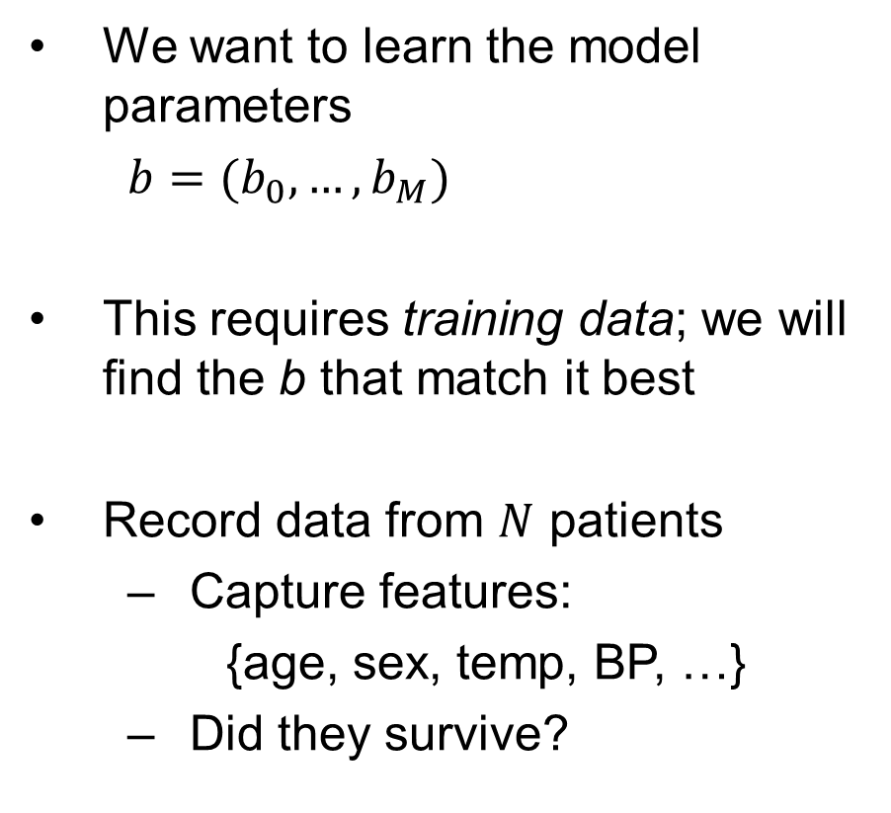
Building the Training Set
We want to learn the model parameters
$b=(b_{0},…,b_{M})$
This requires training data; we will find the b that match it best
Record data from $N$ patients
Capture features:
{age, sex, temp, BP, …}
Did they survive?
x₁
y₁
x₂
y₂
x₃
y₃
x₄
y₄
…
…
x_{N-1}
y_{N-1}
x_{N}
y_{N}

Slide 17
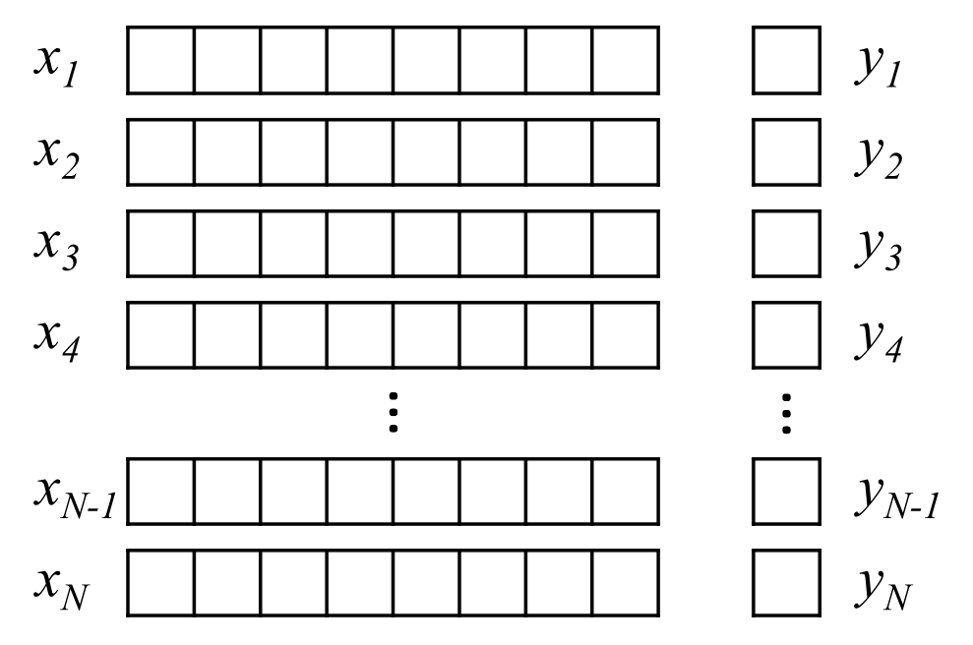
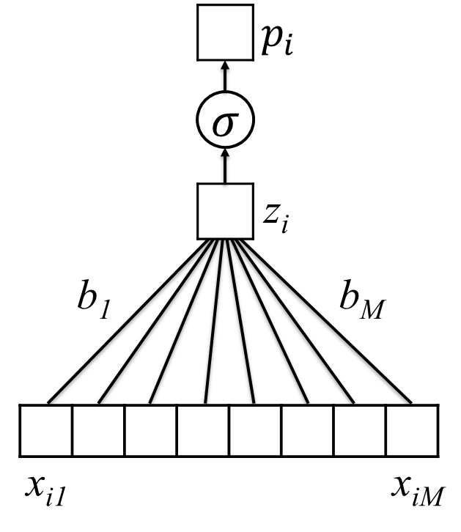
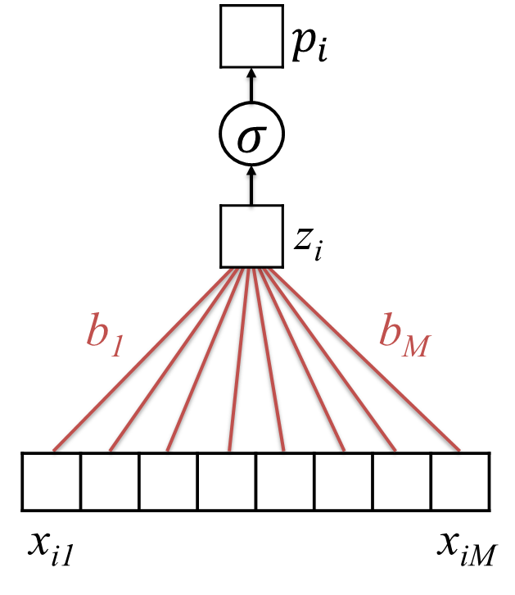

Learning Model Parameters
Training Set
$$p_{i}=σ(b_{0}+b_{1}x_{i1}+b_{2}x_{i2}+…+b_{M}x_{iM})$$
$b=(b_{0},…b_{M})$
Untrained Logistic Regression
Model (or “Network”)
Trained Model (with learned parameters)

Slide 18












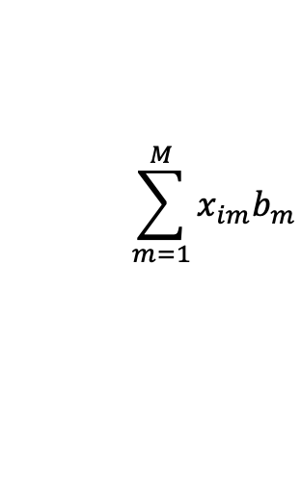



Simplifying our Notation…
$$zi=b_{1}x_{i1}+b_{2}x_{i2}+…+b_{M}x_{iM}$$
$$x_{i1}$$
$$x_{i2}$$
$$…$$
$$…$$
$$x_{iM}$$
$$x_{i}$$
$$\sum_{m=1}^{M}{x_{im}b_{m}}$$
$$×$$
$$×$$
$$…$$
$$…$$
$$×$$
$$b$$
$$b_{1}$$
$$b_{2}$$
$$…$$
$$…$$
$$b_{M}$$

Slide 19

Simplifying our Notation…
$$zi=b_{1}x_{i1}+b_{2}x_{i2}+…+b_{M}x_{iM}$$
$$x_{i1}$$
$$x_{i2}$$
$$…$$
$$…$$
$$x_{iM}$$
$$x_{i}$$
$$\sum_{m=1}^{M}{x_{im}b_{m}}$$
$$×$$
$$×$$
$$…$$
$$…$$
$$×$$
$$b$$
$$b_{1}$$
$$b_{2}$$
$$…$$
$$…$$
$$b_{M}$$
Compact Notation: $x_{i}⊙b$ (inner or dot product)

Slide 20

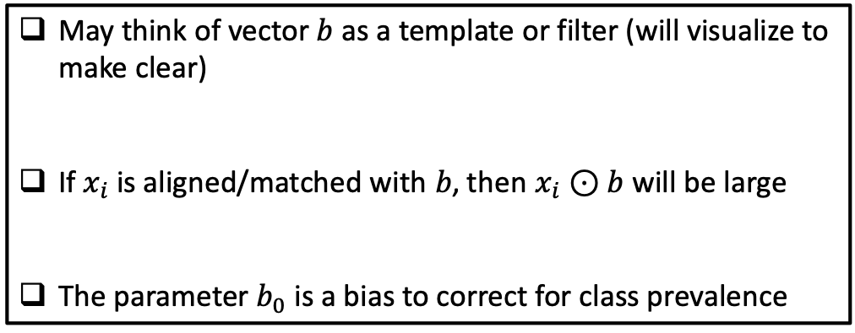

Interpretation of Logistic Regression
$$z_{i}=b_{0}+b_{1}x_{i1}+b_{2}x_{i2}+b_{M}x_{iM}$$
$=b_{0}+x_{i}⊙b$
$p\left(y_{i}=1 | x_{i}\right)=σ(z_{i}$)
May think of vector $b$ as a template or filter (will visualize to make clear)
If $x_{i}$ is aligned/matched with $b$, then $x_{i}⊙b$ will be large
The parameter $b_{0}$ is a bias to correct for class prevalence

Slide 21
Recognizing Handwritten Digits
A visual example

Slide 22
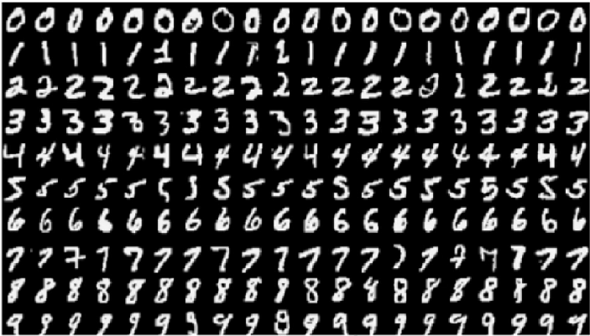
The MNIST Dataset
The Modified National Institute of Standards and Technology (MNIST) contains pictures of handwritten digits (0,1,2,…)
Want to be able to tell what digit each image is (e.g., optical character recognition)

Slide 23
Images are Encoded as Numbers

Slide 24
Vectorization
We will start talking about deep learning without using the structure of the image
Later, in block 2, we will consider how to take advantage of this structure
To convert an image into an unstructured set of numbers, we vectorize (or flatten) it
vectorization

Slide 25
Start With The Binary Case
Zeros
Ones

Slide 26
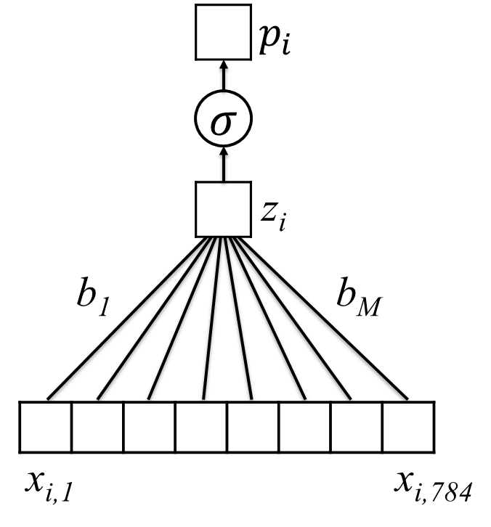
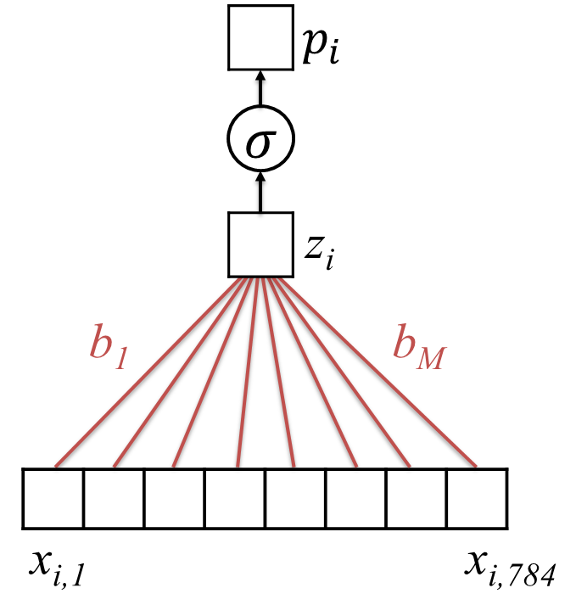

Learning on MNIST
Vectorize
Training set:
28 x 28 images
$$p_{i}=σ(b_{0}+b_{1}x_{i1}+b_{2}x_{i2}+…+b_{M}x_{iM})$$
$b=(b_{0},…b_{M})$
Untrained Logistic Regression
Model (or “Network”)
Trained Model (with learned parameters)

Slide 27

Zooming in on 0/1
$$σ\left( \right)$$
$$⊙$$

Slide 28

Zooming in on 0/1
Negative Sections
$$σ\left( \right)=0.006$$

Slide 29

Zooming in on 0/1
Positive Section
$$σ\left( \right)=.991$$

Slide 30

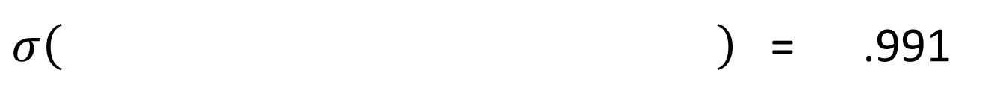
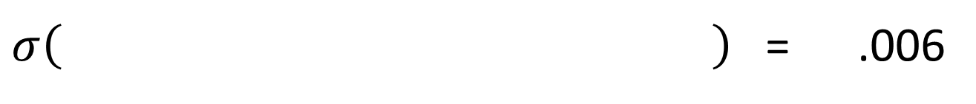

Learned Weights for 0/1
We think that this is a “zero” (.6% chance it is a “one”)
$σ\left( \right)$ = .006
$$⊙$$
We think that this is a “one” (99.1% chance it is a “one”)
$σ\left( \right)$ = .991
$$⊙$$

Slide 31
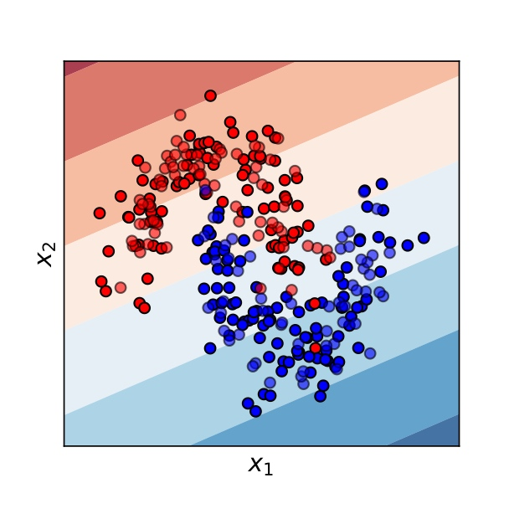
Logistic Regression is a “Linear” Classifier
A “generalized linear model”
Can only split data by linear trends

Slide 32
Summary
Logistic regression is commonly used in machine learning to predict events and/or binary labels. It is simple but often quite effective.
Logistic regression consists of a linear model coupled with a logistic “link” function that converts predictions to valid probabilities.
We may view its parameters as a filter; when the features and filter are similar (dissimilar), the predicted probability is high (low).
For many problems, however, we will not want to limit ourselves to a linear decision surface. In the next lecture, we will extend logistic regression to address this limitation.

