Slide 1
The Multilayer Perceptron
(in other words, a standard neural network)
Matthew Engelhard
Notes:
Preliminaries – Intro
Plan for the weekend (lecture structure, computational assignment)
We’ll cover the quiz during the discussion section
Any questions about the course to start?

Slide 2
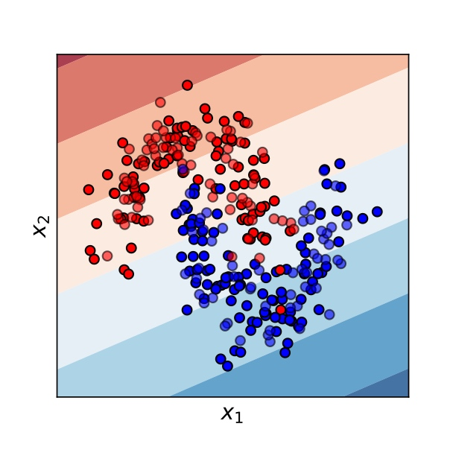
We need more flexible, non-linear classifiers
Logistic Regression Decision Surface
There are many ways to achieve this…
One of them is to “extend” logistic regression to form a multilayer perceptron (MLP) – in other words, a neural network.

Slide 3
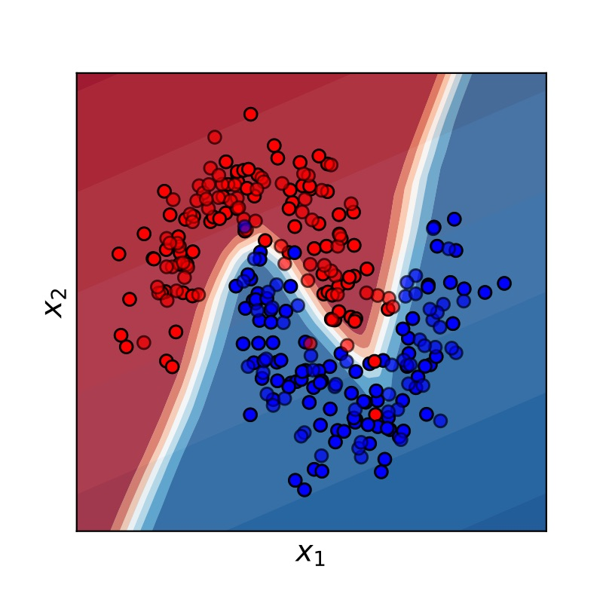
We need more flexible, non-linear classifiers
MLP Decision Surface
There are many ways to achieve this…
One of them is to “extend” logistic regression to form a multilayer perceptron (MLP) – in other words, a neural network.

Slide 4


How can we modify logistic regression to learn complex, nonlinear relationships?
$$p_{i}$$
$$σ$$
z_{i}
b₁
b_{M}
x_{i1}
x_{iM}
Notes:
Recall our logistic regression model
In this model we have features for patient x_i; there are M of them ranging from x_i1 to x_iM
We’re going to multiply each of those features by a corresponding model coefficient
We also add a bias term, which we have omitted here to simplify the presentation
We then add up all of those terms, which gives us z_i, which we call the log odds
We then convert the log odds to the corresponding probability using the logistic, or sigmoid function, denoted by sigma
But remember, from our earlier lecture, that when we do this – when we multiply all the x_i values by the corresponding b’s – the output tells us how much x_i looks like b
Thinking of each as a vector, when we take the dot product, we’re asking: to what extent does x_i point in the direction of b?
When we take the part of x_i that’s aligned with b – in mathematical terms, we’re projecting x_i on b – the part of x_i that’s left could point in the same direction of b, or in the opposite direction as b, and with varying magnitude. But since we only care about how much x_i points in the b direction, our decision surface is the hyperplane perpendicular to b
For those of you with less math background, what matters is this: logistic regression by its nature always gives us a linear decision surface
And as we’ve discussed, in many cases this just isn’t good enough

Slide 5

How can we modify logistic regression to learn complex, nonlinear relationships?
$$p_{i}=σ(b_{0}+b⊙x)$$
b₁
b_{M}
x_{i1}
x_{iM}
Notes:
So, we’re looking for a way to extend logistic regression – using the same kinds of principles we’ve discussed – to give us a more flexible, nonlinear decision surface. We want to make correct predictions for as many patients as possible.
And as we move forward, I’m going to introduce another simplification to our diagrams to make them easier to present.
Instead of showing that sigmoid each time, we’re going to remove it, so that when you see nodes connected as above, remember that there are in fact two steps: first, the linear part, and second, the sigmoid. But we’re going to leave off the sigmoid in our diagrams so we can fit more on the page.

Slide 6
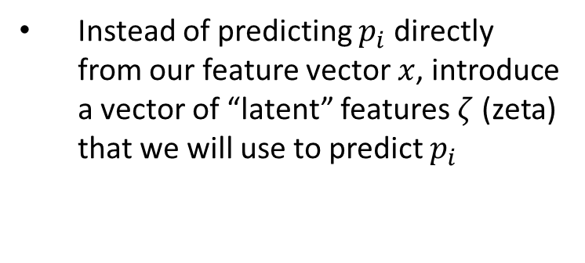

Instead of predicting $p_{i}$ directly from our feature vector $x$, introduce a vector of “latent” features $ζ$ (zeta) that we will use to predict $p_{i}$
$$p_{i}=σ(b_{0}+b⊙\text{ζ})$$
b₁
b_{M}
ζ_{i1}
ζ_{iM}

Slide 7
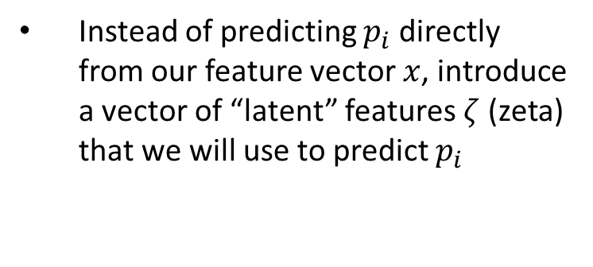


Instead of predicting $p_{i}$ directly from our feature vector $x$, introduce a vector of “latent” features $ζ$ (zeta) that we will use to predict $p_{i}$
$$p_{i}=σ(b_{0}+b⊙\text{ζ})$$
b₁
b_{M}
ζ_{i1}
$$\text{ζ}\text{iM}=σ(β_{M0}+β_{M}⊙x)$$
Individual elements of 𝜁 will themselves be the output of a logistic-regression-like model based on 𝑥
x_{i1}
x_{iM}

Slide 8

Instead of predicting $p_{i}$ directly from our feature vector $x$, introduce a vector of “latent” features $ζ$ (zeta) that we will use to predict $p_{i}$
$$p_{i}=σ(b_{0}+b⊙\text{ζ})$$
b₁
b_{M}
ζ_{i1}
$$\text{ζ}\text{iM}$$
Individual elements of 𝜁 will themselves be the output of a logistic-regression-like model based on 𝑥
x_{i1}
x_{iM}
Since this is true for all elements of 𝜁, x and 𝜁 are said to be “fully connected”

Slide 9
Instead of predicting $p_{i}$ directly from our feature vector $x$, introduce a vector of “latent” features $ζ$ (zeta) that we will use to predict $p_{i}$
$$p_{i}=σ(b_{0}+b⊙\text{ζ})$$
b₁
b_{M}
ζ_{i1}
$$\text{ζ}\text{iM}$$
Individual elements of 𝜁 will themselves be the output of a logistic-regression-like model based on 𝑥
x_{i1}
x_{iM}
Since this is true for all elements of 𝜁, x and 𝜁 are said to be “fully connected”
Simplified notation for fully connected layers

Slide 10
Instead of predicting $p_{i}$ directly from our feature vector $x$, introduce a vector of “latent” features $ζ$ (zeta) that we will use to predict $p_{i}$
$$p_{i}=σ(b_{0}+b⊙\text{ζ})$$
b₁
b_{M}
ζ_{i1}
$$\text{ζ}\text{iM}$$
Individual elements of 𝜁 will themselves be the output of a logistic-regression-like model based on 𝑥
x_{i1}
x_{iM}
Since they are neither an input nor an output, the features ζ are said to be a “hidden” layer
Since this is true for all elements of 𝜁, x and 𝜁 are said to be “fully connected”

Slide 11
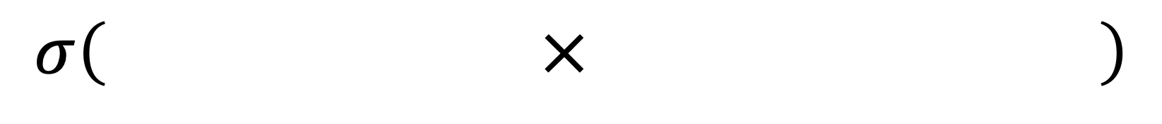
Why Limit Ourselves to Only One Filter?
$$σ\left( × \right)$$

Slide 12
Return to MNIST: Many ways of writing “4”

Slide 13
Return to MNIST: Many ways of writing “4”
Single Filter (e.g. Logistic Regression/ “Shallow Learning”) only uses one filter, looks for the average shape

Slide 14
Return to MNIST: Many ways of writing “4”
Multiple filters can look for subtypes indicative of different ways of writing “4”

Slide 15
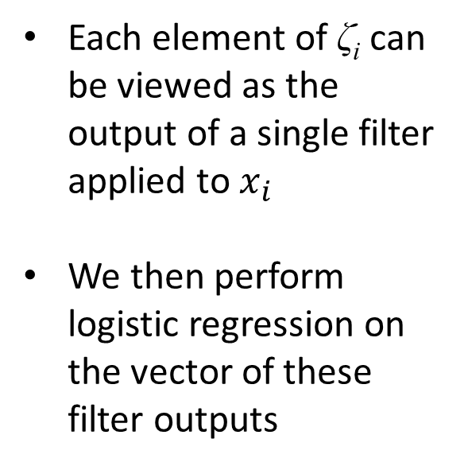
$$p_{i}=σ(b_{0}+b⊙\text{ζ})$$
Each element of $\text{ζ}\text{i}$ can be viewed as the output of a single filter applied to $x_{i}$
We then perform logistic regression on the vector of these filter outputs
b₁
b_{M}
ζ_{i1}
$$\text{ζ}\text{iM}$$
x_{i1}
x_{iM}

Slide 16
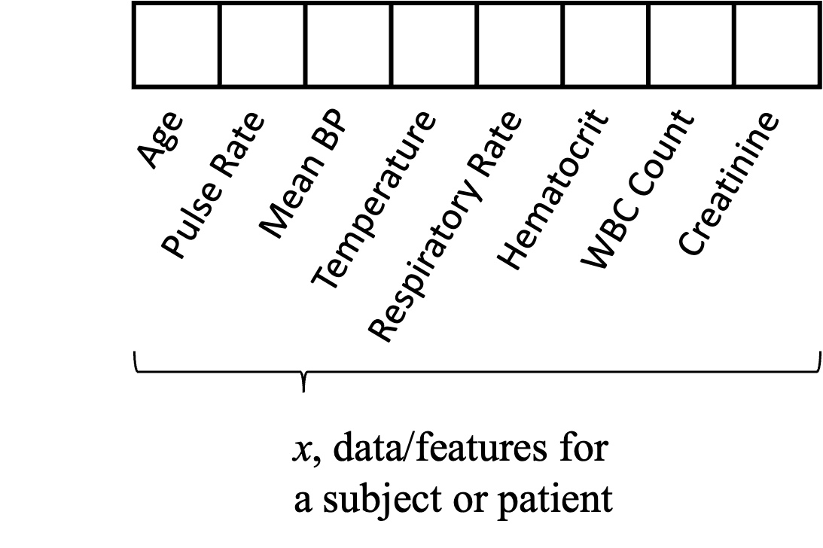
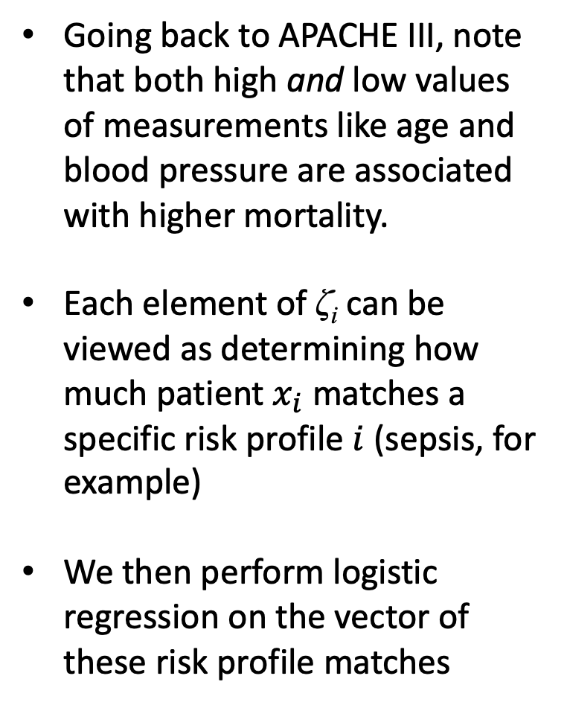
$$p_{i}=σ(b_{0}+b⊙\text{ζ})$$
Going back to APACHE III, note that both high and low values of measurements like age and blood pressure are associated with higher mortality.
Each element of $\text{ζ}\text{i}$ can be viewed as determining how much patient $x_{i}$ matches a specific risk profile $i$ (sepsis, for example)
We then perform logistic regression on the vector of these risk profile matches
b₁
b_{M}
ζ_{i1}
$$\text{ζ}\text{iM}$$
x_{i1}
x_{iM}
Notes:
The directional association depends on the value of the predictor, and other values – it is not the case that higher temperature always means higher mortality, for instance.
Risk profile 1: tachycardia & low BP (consistent with something like sepsis)
Risk profile 2: hypertensive emergency (high BP)

Slide 17
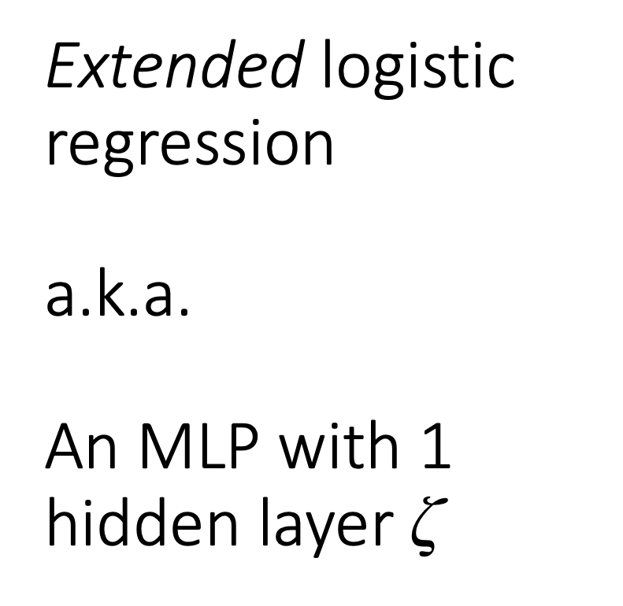
Extended logistic regression a.k.a. An MLP with 1 hidden layer $\text{ζ}$
$$p_{i}=σ(b_{0}+b⊙\text{ζ})$$
b₁
b_{M}
ζ_{i1}
$$\text{ζ}\text{iM}$$
x_{i1}
x_{iM}

Slide 18
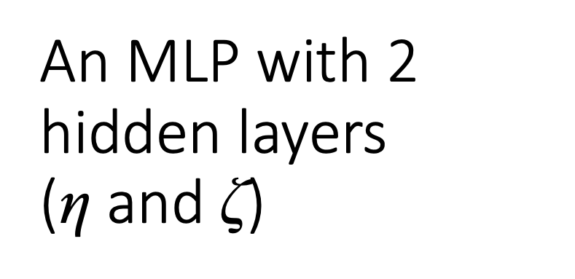
An MLP with 2 hidden layers (η and $\text{ζ}$)
$$p_{i}=σ(b_{0}+b⊙\text{ζ})$$
b₁
b_{M}
ζ_{i1}
$$\text{ζ}\text{iM}$$
η_{i1}
η_{iM}
By adding layers, we build a hierarchy of increasingly complex features
x_{i1}
x_{iM}

Slide 19
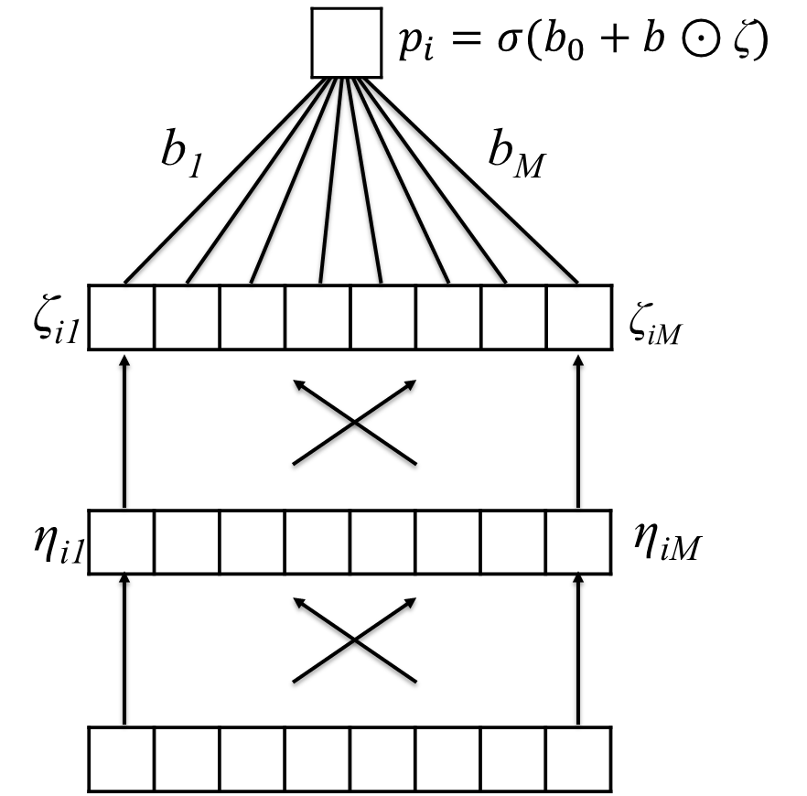
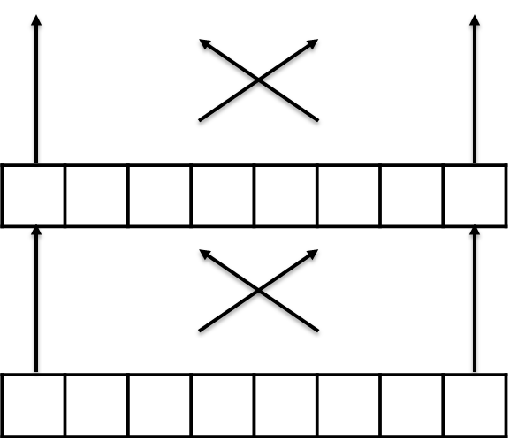
A deep MLP with many hidden layers “deep learning”
Notes:
Note that width is variable
Deep learning comes from many layers
Note that we get a large number of parameters by doing this
In each layer, each latent feature is connected to each latent feature in the next layer. If we suppose there are M units in one layer and L in the next, there are M x L connections between them. This gets large very quickly!
In this way, we are extracting a hierarchy of features that get more abstract and complex in each successive layer, as we move from the original, input features to the outcome

Slide 20
Learn Highly Non-Linear Decision Surfaces
Notes:
This model allows us to achieve our goal. If we have enough data, it can learn an arbitrarily complex decision surface

Slide 21
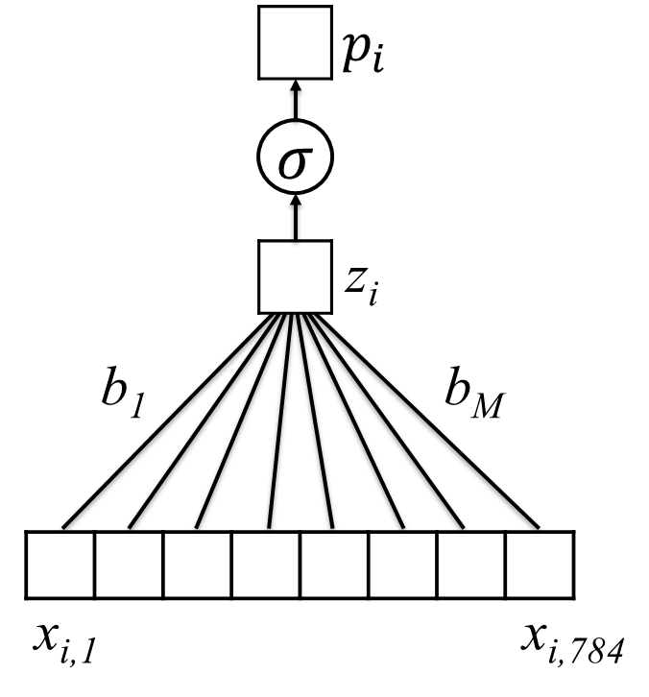
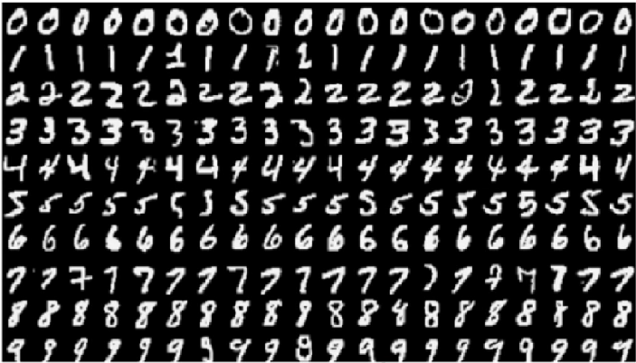
Does this work with MNIST?
~91% Accurate

Slide 22
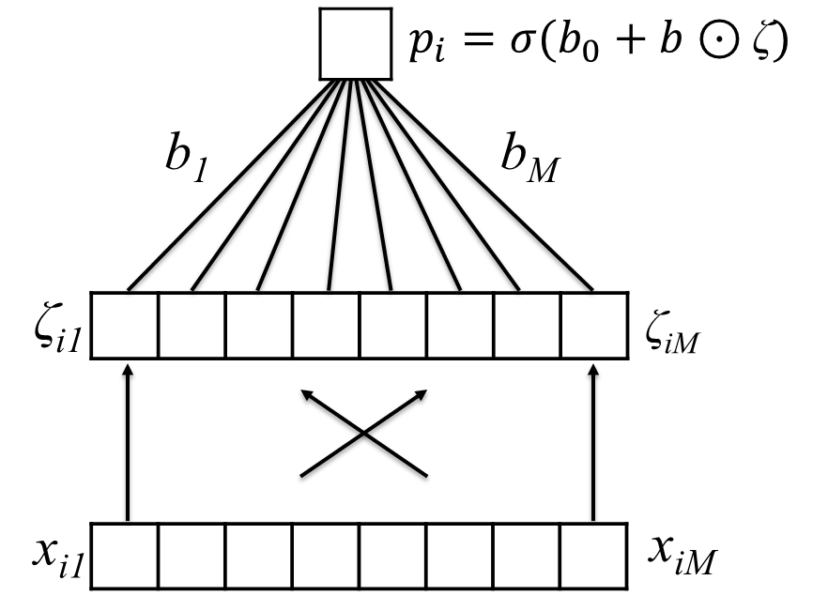
Does this work with MNIST?
~91% Accurate
~96% Accurate

Slide 23
Summary
The multilayer perceptron (MLP), also called an artificial neural network (ANN), may be viewed as stacked (layers of) logistic regression models. Logistic regression is applied to latent features, which themselves are the result of earlier logistic regression models.
We therefore say that the MLP learns a hierarchy of features. Each successive level is more complex and/or abstract than the last.
MLPs can learn highly complex – in fact arbitrarily complex – decision surfaces. However, a large amount of data may be required.

