Slide 1
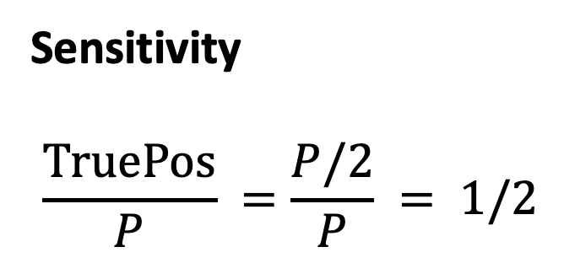
Assignment 2, Question 1
What sensitivity, specificity, PPV, and NPV would you expect for a ‘random’ (i.e. coin-flip) classifier?
- Suppose there are P positive cases and N negative cases in our test set.
 | Prediction Positive | Prediction Negative
Condition Positive | P/2 TruePos | P/2 FalseNeg
Condition Negative | N/2 FalsePos | N/2 TrueNeg
Sensitivity
$$\frac{TruePos}{P} =\frac{P/2}{P} = 1/2$$

Slide 2
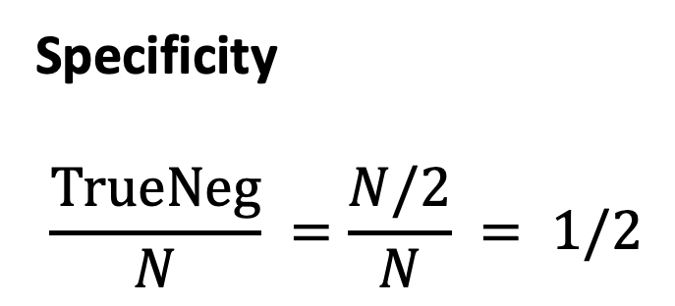
Assignment 2, Question 1
What sensitivity, specificity, PPV, and NPV would you expect for a ‘random’ (i.e. coin-flip) classifier?
- Suppose there are P positive cases and N negative cases in our test set.
 | Prediction Positive | Prediction Negative
Condition Positive | P/2 TruePos | P/2 FalseNeg
Condition Negative | N/2 FalsePos | N/2 TrueNeg
Specificity
$$\frac{TrueNeg}{N} =\frac{N/2}{N} = 1/2$$

Slide 3
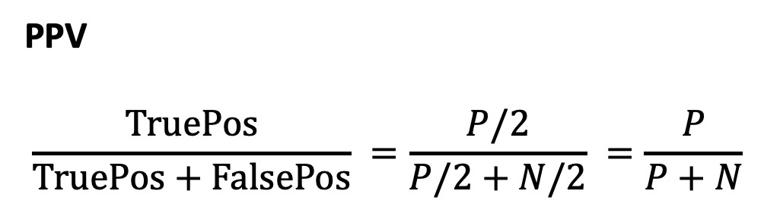
Assignment 2, Question 1
What sensitivity, specificity, PPV, and NPV would you expect for a ‘random’ (i.e. coin-flip) classifier?
- Suppose there are P positive cases and N negative cases in our test set.
 | Prediction Positive | Prediction Negative
Condition Positive | P/2 TruePos | P/2 FalseNeg
Condition Negative | N/2 FalsePos | N/2 TrueNeg
PPV
$$\frac{TruePos}{TruePos+FalsePos} =\frac{P/2}{P/2+N/2} =\frac{P}{P+N}$$

Slide 4
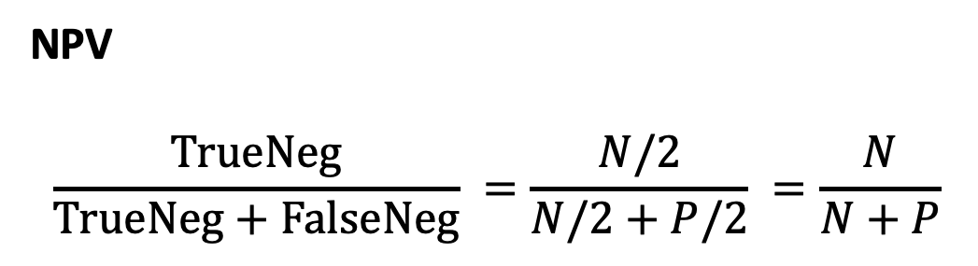
Assignment 2, Question 1
What sensitivity, specificity, PPV, and NPV would you expect for a ‘random’ (i.e. coin-flip) classifier?
- Suppose there are P positive cases and N negative cases in our test set.
 | Prediction Positive | Prediction Negative
Condition Positive | P/2 TruePos | P/2 FalseNeg
Condition Negative | N/2 FalsePos | N/2 TrueNeg
NPV
$$\frac{TrueNeg}{TrueNeg+FalseNeg} =\frac{N/2}{N/2+P/2} =\frac{N}{N+P}$$

Slide 5
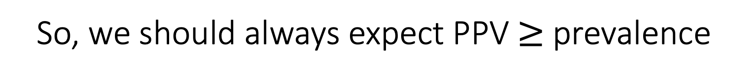
So, we should always expect PPV $≥$ prevalence
Notes:
ROC Curve
Sensitivity
Specificity
AUC
PR Curve
Sensitivity
PPV
Avg Precision / AUPR

