Slide 1
Model Performance: Accuracy and Cross-Entropy Loss

Slide 2
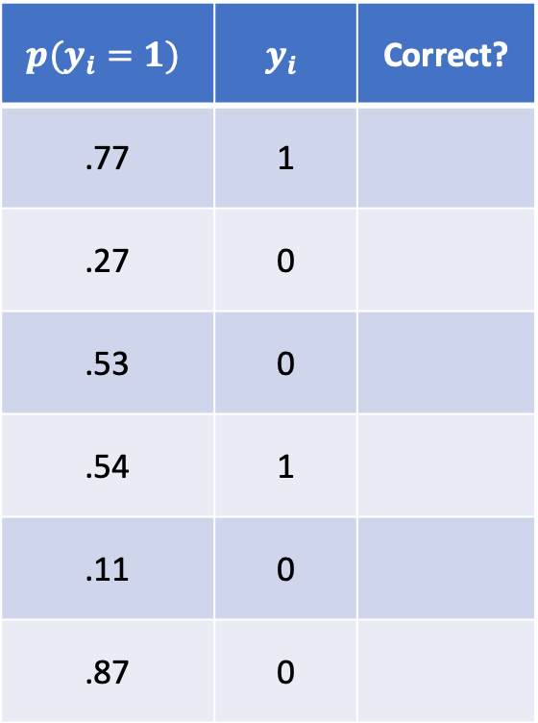
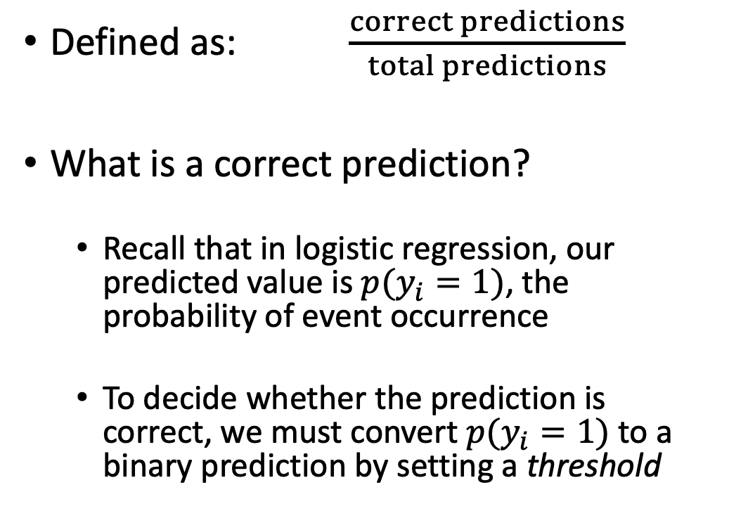
Accuracy
$$p(y_{i}=1)$$ | $$y_{i}$$ | Correct?
.77 | 1
.27 | 0
.53 | 0
.54 | 1
.11 | 0
.87 | 0
Defined as: $\frac{correct predictions}{total predictions}$
What is a correct prediction?
Recall that in logistic regression, our predicted value is $p(y_{i}=1)$, the probability of event occurrence
To decide whether the prediction is correct, we must convert $p(y_{i}=1)$ to a binary prediction by setting a threshold

Slide 3
Accuracy
Easy to understand, but not useful in learning
Rarely used as a performance metric; we will discuss performance metrics in subsequent lectures

Slide 4
Cross-Entropy Loss
A loss is a measure of model performance that we use during training
The lower the loss, the better the performance. During training, we look for parameters that minimize the loss.
Sometimes, including in logistic regression, we can be sure that we’ve found the best possible parameters – those that give us the lowest loss possible
Other times we cannot be sure, so we lower the loss as much as we can

Slide 5


Cross-Entropy Loss
Suppose we have a fair coin:
$p\left(y_{i}=1\right)=.5$ (heads)
$p\left(y_{i}=0\right)=.5$ (tails)

Slide 6

Cross-Entropy Loss
What is the probability that we observe the following?
.5 x .5 x .5

Slide 7


Cross-Entropy Loss
What if the coin is not balanced?
$p\left(y_{i}=1\right)=.3$ (heads)
$p\left(y_{i}=0\right)=.7$ (tails)

Slide 8


Cross-Entropy Loss
What is the probability that we observe the following?
.7 x .3 x .7

Slide 9

Cross-Entropy Loss
Suppose we don’t know $p(y_{i}=1)$. We might try to infer it – i.e. learn it – by choosing a value that maximizes the probability of our observations. We may need many observations to be confident.
? x ? x ?

Slide 10

Cross-Entropy Loss
What if it’s a different coin every time…
.5 x .3 x .6

Slide 11
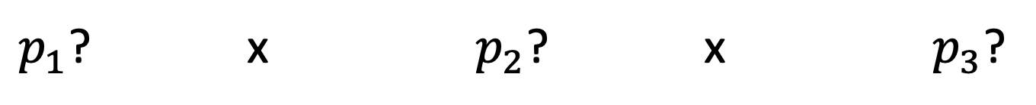
Cross-Entropy Loss
…or not a coin
$y_{1}=1$ $y_{2}=0$ $y_{3}=0$
(dies) (survives) (survives)
$p_{1}$? x $p_{2}$? x $p_{3}$?

Slide 12

Cross-Entropy Loss
We’d like to predict $p_{i}$ values that maximize the probability of our observations (the $y_{i}$). This is what the cross-entropy loss measures.
$y_{1}=1$ $y_{2}=0$ $y_{3}=0$
(dies) (survives) (survives)
$p_{1}$? x $p_{2}$? x $p_{3}$?

Slide 13
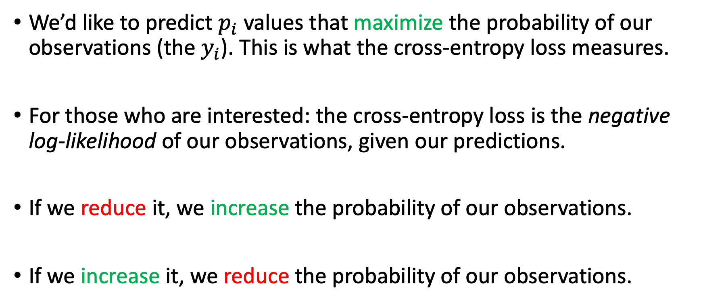
Cross-Entropy Loss
We’d like to predict $p_{i}$ values that maximize the probability of our observations (the $y_{i}$). This is what the cross-entropy loss measures.
For those who are interested: the cross-entropy loss is the negative log-likelihood of our observations, given our predictions.
If we reduce it, we increase the probability of our observations.
If we increase it, we reduce the probability of our observations.

Slide 14
Minimizing Loss
As we change a parameter – in this case, the intercept, or bias of a linear regression model – the loss changes.
Data Loss

Slide 15
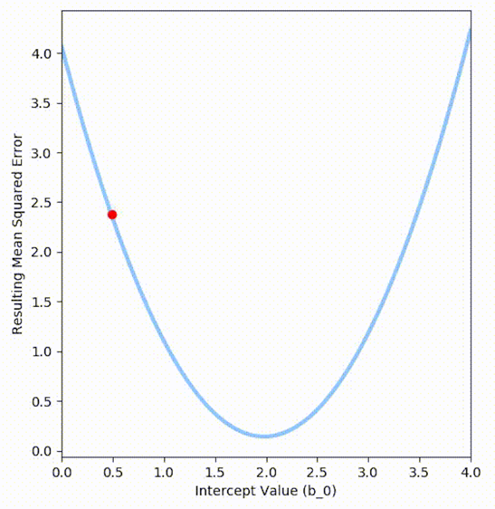
Minimizing Loss
How do we reduce the loss? Follow the slope.

