Slide 1
Activity: MLP Structure
ML for Health, Week 3

Slide 2
Part I
For each of the following, determine (a) how many logistic regression models and (b) how many parameters are contained in the model.
Logistic regression with 3 input features
An MLP with 3 input features and 1 hidden layer with 6 hidden units
An MLP with 3 input features and 2 hidden layers, each with 6 hidden units
(challenge) An MLP with 3 input features and 3 hidden layers with 6, 2, and 6 hidden units, respectively
It may be helpful to draw or create graphs for these models. For this activity, bias/intercept parameters may be ignored.

Slide 3






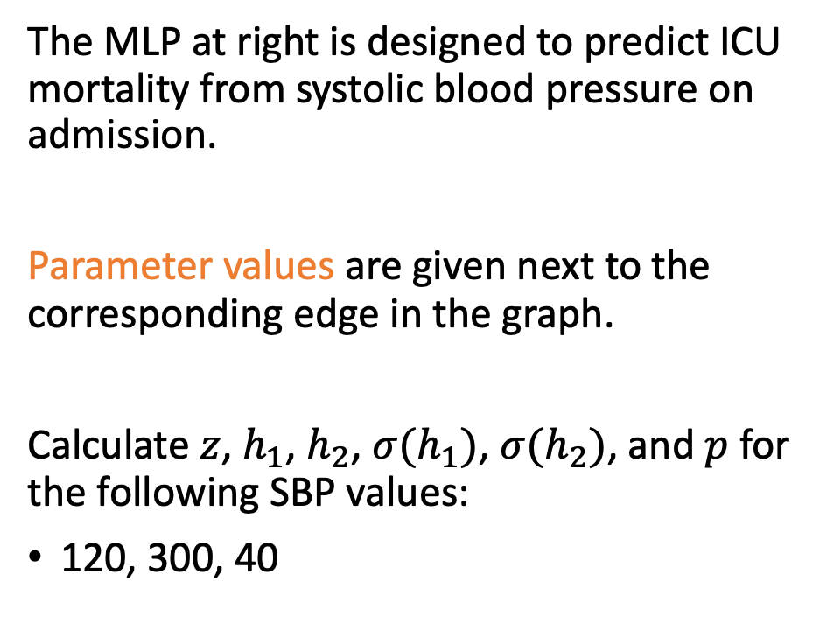


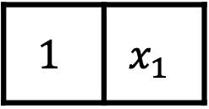

Part II
$$p$$
$$σ$$
The MLP at right is designed to predict ICU mortality from systolic blood pressure on admission.
Parameter values are given next to the corresponding edge in the graph.
Calculate $z$, $h_{1}$, $h_{2}$, $σ(h_{1})$, $σ(h_{2})$, and $p$ for the following SBP values:
120, 300, 40
$$z$$
1 1
$$σ(h_{1})$$
$$σ(h_{2})$$
$$σ$$
$$σ$$
$$h_{1}$$
$$h_{2}$$
5 -9 -0.075 0.043
$$1$$ | $$x_{1}$$
Intercept
SBP

