Slide 1
Understanding Model Predictions
Matthew Engelhard

Slide 2
Interpretable versus Explainable
An interpretable model:
It is easy to for us to understand why the model makes the predictions that it makes.
An explainable model:
One or more techniques can be used to provide a human-friendly explanation for each model prediction.
Notes:
Bike versus car?
Bike:
Why did it turn left? I can see the handles
Why did it move forward? I can see the chain
Why did it stall? The chain fell off
Car:
Why did it turn left? It’s because I turned the wheel left… but I can’t really see how turning the wheel left makes the wheel go left
Why did it move forward? It’s because you pushed the pedal.
Why did it stall? You let the clutch out too quickly.

Slide 3


Interpretable Explainable

Slide 4
We can interpret a count-based NLP model
Suppose you use logistic regression with count-based features, and your model predicts that that an SMS you receive is urgent.
Q: Is it hard to figure out why it made that prediction?
Notes:
Cautions:
not causal
Many predictors can be highly correlated
When we use many predictors, coefficients can be somewhat arbitrary as a result
Don’t assign too much meaning here

Slide 5

We can interpret a count-based NLP model
Suppose you use logistic regression with count-based features, and your model predicts that that an SMS you receive is urgent.
Q: Is it hard to figure out why it made that prediction?
A: No. You can look at the coefficients to see which words increased and decreased the predicted probability.
LOG ODDS
𝜎
y
shaking
clinic
morning
mom
sickness
breastfeed
passed
where
$$β1 β8$$
y, associated label:
(0 = not urgent, 1 = urgent)
x₁ | x₂ | x₃ | x₄ | x₅ | x₆ | x₇ | x₈
Notes:
Cautions:
not causal
Many predictors can be highly correlated
When we use many predictors, coefficients can be somewhat arbitrary as a result
Don’t assign too much meaning here

Slide 6
We can explain a deep learning NLP model
Suppose you apply a deep neural network to a sequence of word vectors, and your model predicts that that the SMS you receive is urgent.
Q: Is it hard to figure out why it made that prediction?

Slide 7
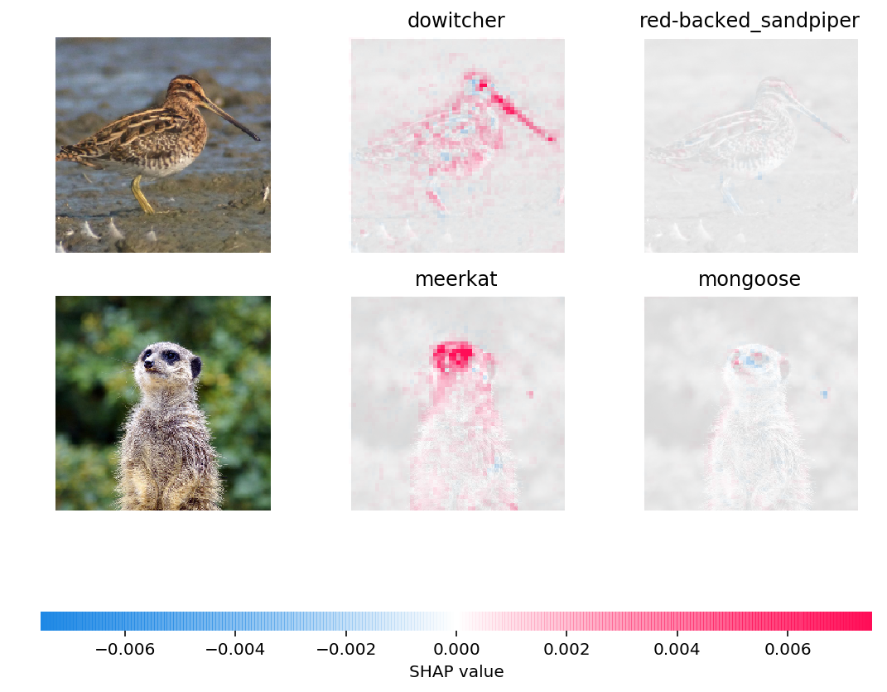
We can explain a deep learning NLP model
Suppose you apply a deep neural network to a sequence of word vectors, and your model predicts that that the SMS you receive is urgent.
Q: Is it hard to figure out why it made that prediction?
A: It is harder, but it can be done.
Similar to the image-based example at left
Identify passages within the text documented that would change predictions most if they were removed.
Caveats:
This is for a single example; hard to summarize across all examples
Can be very computationally expensive

Slide 8
Similarities and differences
Requires computation
Is fundamentally example-specific; can then aggregate across a dataset
Multiple competing approaches, though SHAP values are common
Give the example of the autism spans

Slide 9
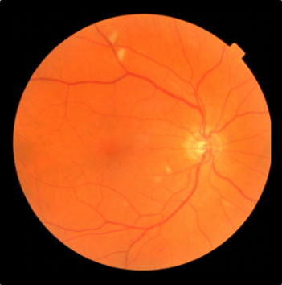
Machine Learning: A Black Box?
Retinopathy? Yes/No
Notes:
Want to highlight the issue of interpretability
How can we trust a ”black box” diagnostic if we don’t know what’s happening inside?

Slide 10

Prostate-specific antigen measurement: A Black Box?
PSA Level
Notes:
At the same time, I might question whether we fully understand even more traditional diagnostics.
For instance, I might know that PSA is an enzyme found in the prostate, but I have only a very rudimentary understanding of how PSA levels are detected, or how reliable a PSA measurement might be
gamma-seminoprotein or kallikrein-3 (KLK3), is a glycoprotein enzyme encoded in humans by the KLK3 gene

Slide 11
Two competing perspectives
Interpretability will be central to FDA regulation of clinical decision support.
We can only use tools if we fully understand how they work
We just need to make sure our tools are valid and reliable
Notes:
At the end of the day there are two competing perspectives.
Those that think we must fully understand how these tools work to trust them
And those who think that we just need to know that they DO work.
But that means rigorously and repeatedly validating them, in a variety of settings – health systems, patient populations, other conditions

Slide 12
Conclusions
Text data are central to clinical medicine, so the potential for NLP impact is high (but not yet realized)
Simple, count-based NLP models are surprisingly effective in most clinical applications.
Complex, deep learning NLP models have exceeded human performance. In these models, words are converted to vectors of semantic attributes, and increasingly complex, heirarchical semantic features are then extracted.
Similar to image processing, we can take advantage of complex NLP models by repurposing them for a specific clinical task via fine-tuning of parameters.
It is easy for us to interpret simple, count-based models. However, it is also possible to explain the predictions of deep learning models. Interpretability and explainability are likely to be important going forward, particularly from a regulatory perspective.

