Slide 1
Model Learning
MMCi Block 2
Matthew Engelhard

Slide 2
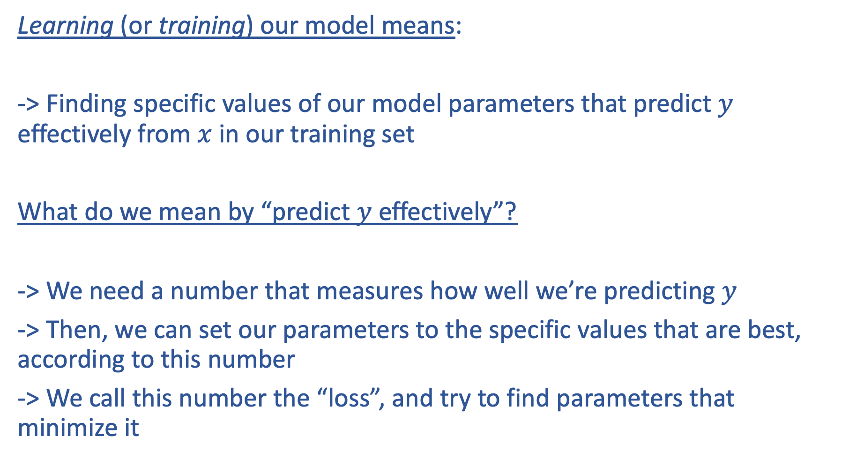
Learning (or training) our model means:
-> Finding specific values of our model parameters that predict $y$ effectively from $x$ in our training set
What do we mean by “predict $y$ effectively”?
-> We need a number that measures how well we’re predicting $y$
-> Then, we can set our parameters to the specific values that are best, according to this number
-> We call this number the “loss”, and try to find parameters that minimize it

Slide 3
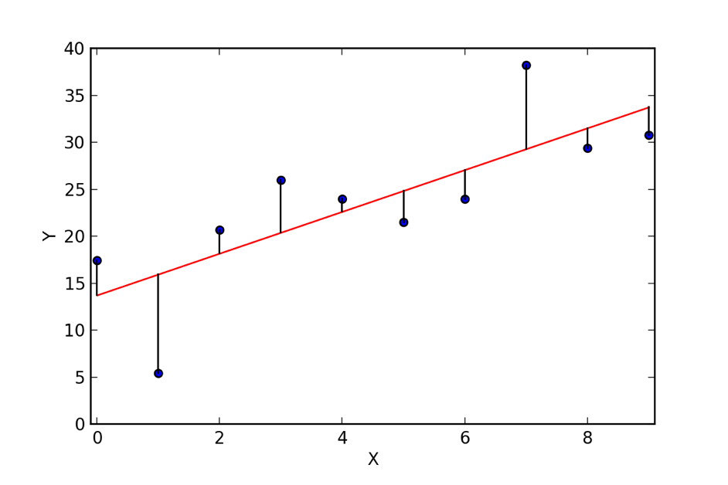
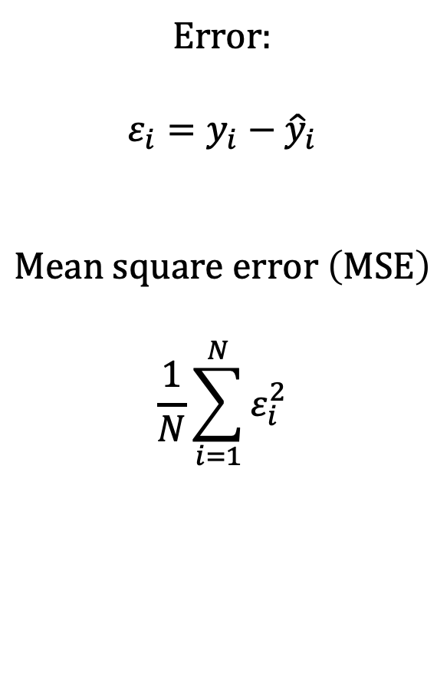
In linear regression, the loss is the mean squared error.
𝜀₈
Error:
$$ε_{i}=y_{i}−{\hat{y}}_{i}$$
$$Mean square error \left(MSE\right)$$
$$\frac{1}{N}\sum_{i=1}^{N}{ε_{i}^{2}}$$
𝜀₁₀
𝜀₉
𝜀₇
𝜀₄
𝜀₅
𝜀₆
𝜀₃
𝜀₁
𝜀₂
Notes:
Root mean square error, normalized mean square error, etc, but these are the essentials
Other ways to measure distance between the prediction and the truth that might be appropriate for specific applications
Note that Normalized MSE is 1-R^2

Slide 4
We have two parameters: the slope, and the intercept. As we change the intercept, we can see that the MSE changes.
Notes:
Root mean square error, normalized mean square error, etc, but these are the essentials
Other ways to measure distance between the prediction and the truth that might be appropriate for specific applications
Note that Normalized MSE is 1-R^2

Slide 5
We’re looking for the intercept that minimizes the MSE.
Notes:
Root mean square error, normalized mean square error, etc, but these are the essentials
Other ways to measure distance between the prediction and the truth that might be appropriate for specific applications
Note that Normalized MSE is 1-R^2

Slide 6
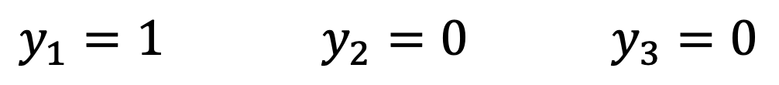
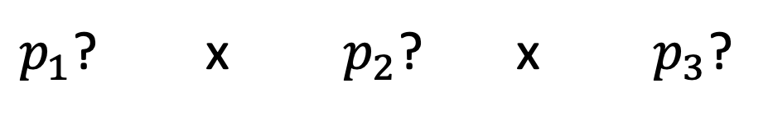
What loss makes sense for logistic regression?
Our model predicts the probability of death for each patient.
If we change the parameters, we change the predicted probabilities for each patient.
$y_{1}=1$ $y_{2}=0$ $y_{3}=0$
(dies) (survives) (survives)
$p_{1}$? x $p_{2}$? x $p_{3}$?
Notes:
Root mean square error, normalized mean square error, etc, but these are the essentials
Other ways to measure distance between the prediction and the truth that might be appropriate for specific applications
Note that Normalized MSE is 1-R^2

Slide 7
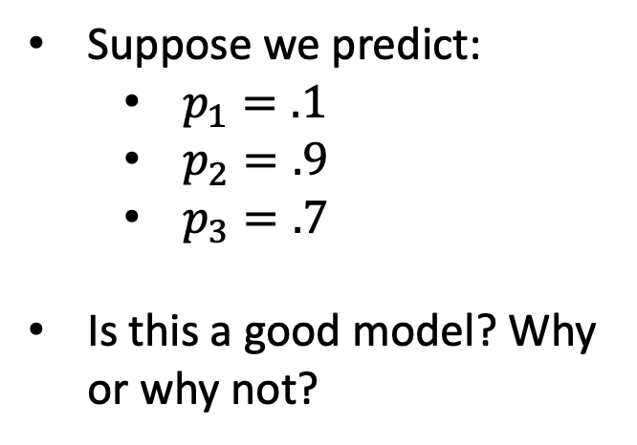
What loss makes sense for logistic regression?
Suppose we predict:
$p_{1}=.1$
$p_{2}=.9$
$p_{3}=.7$
Is this a good model? Why or why not?
$y_{1}=1$ $y_{2}=0$ $y_{3}=0$
(dies) (survives) (survives)
$p_{1}$? x $p_{2}$? x $p_{3}$?
Notes:
Root mean square error, normalized mean square error, etc, but these are the essentials
Other ways to measure distance between the prediction and the truth that might be appropriate for specific applications
Note that Normalized MSE is 1-R^2

Slide 8
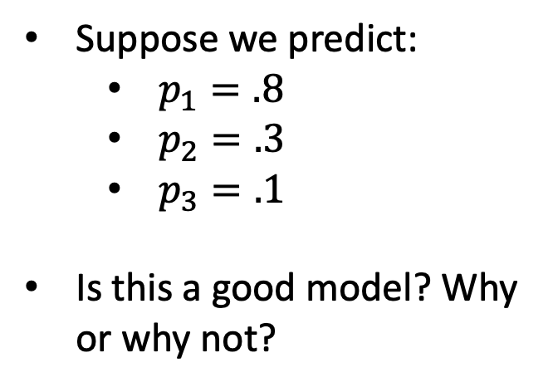
What loss makes sense for logistic regression?
Suppose we predict:
$p_{1}=.8$
$p_{2}=.3$
$p_{3}=.1$
Is this a good model? Why or why not?
$y_{1}=1$ $y_{2}=0$ $y_{3}=0$
(dies) (survives) (survives)
$p_{1}$? x $p_{2}$? x $p_{3}$?
Notes:
Root mean square error, normalized mean square error, etc, but these are the essentials
Other ways to measure distance between the prediction and the truth that might be appropriate for specific applications
Note that Normalized MSE is 1-R^2

Slide 9
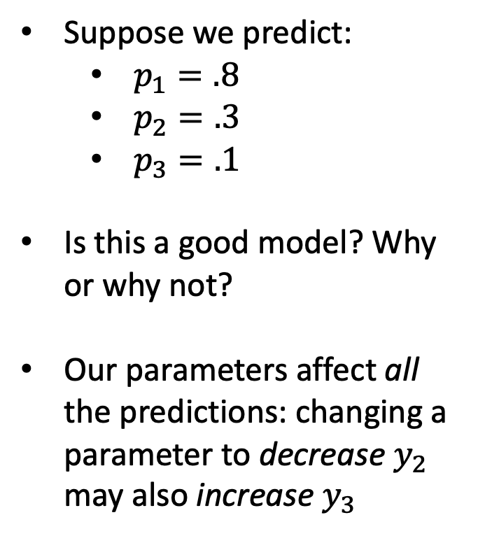
What loss makes sense for logistic regression?
Suppose we predict:
$p_{1}=.8$
$p_{2}=.3$
$p_{3}=.1$
Is this a good model? Why or why not?
Our parameters affect all the predictions: changing a parameter to decrease $y_{2}$ may also increase $y_{3}$
$y_{1}=1$ $y_{2}=0$ $y_{3}=0$
(dies) (survives) (survives)
$p_{1}$? x $p_{2}$? x $p_{3}$?
Notes:
Root mean square error, normalized mean square error, etc, but these are the essentials
Other ways to measure distance between the prediction and the truth that might be appropriate for specific applications
Note that Normalized MSE is 1-R^2

Slide 10
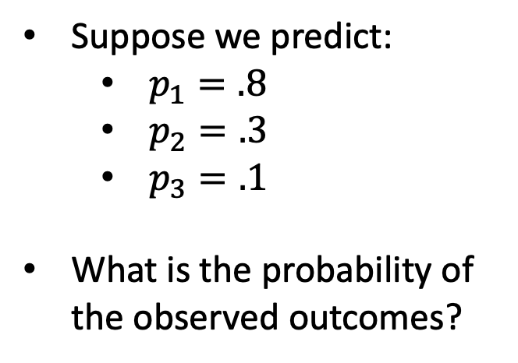
What loss makes sense for logistic regression?
Suppose we predict:
$p_{1}=.8$
$p_{2}=.3$
$p_{3}=.1$
What is the probability of the observed outcomes?
$y_{1}=1$ $y_{2}=0$ $y_{3}=0$
(dies) (survives) (survives)
$p_{1}$? x $p_{2}$? x $p_{3}$?
Notes:
Root mean square error, normalized mean square error, etc, but these are the essentials
Other ways to measure distance between the prediction and the truth that might be appropriate for specific applications
Note that Normalized MSE is 1-R^2

Slide 11
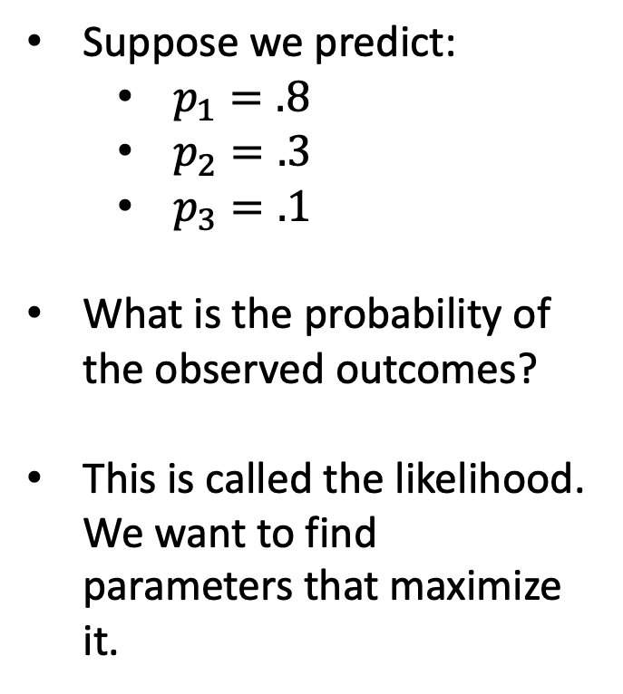
What loss makes sense for logistic regression?
Suppose we predict:
$p_{1}=.8$
$p_{2}=.3$
$p_{3}=.1$
What is the probability of the observed outcomes?
This is called the likelihood. We want to find parameters that maximize it.
$y_{1}=1$ $y_{2}=0$ $y_{3}=0$
(dies) (survives) (survives)
$p_{1}$? x $p_{2}$? x $p_{3}$?
Notes:
Root mean square error, normalized mean square error, etc, but these are the essentials
Other ways to measure distance between the prediction and the truth that might be appropriate for specific applications
Note that Normalized MSE is 1-R^2

Slide 12
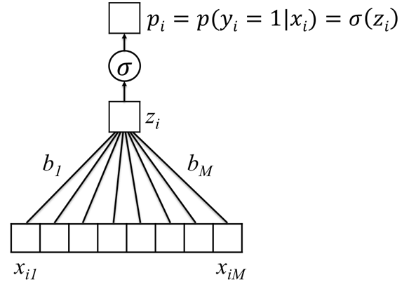
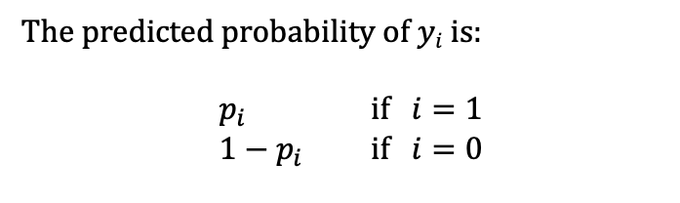
Logistic Regression Likelihood
Probability of all the events $y1,…,yN$given our current model parameters
The predicted probability of $yi$ is:
$p_{i}$ if $i=1$
$1−p_{i}$ if $i=0$
Notes:
This is called the likelihood.

Slide 13
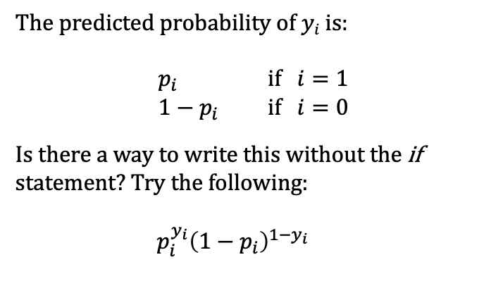
Logistic Regression Likelihood
Probability of all the events $y1,…,yN$given our current model parameters
The predicted probability of $yi$ is:
$p_{i}$ if $i=1$
$1−p_{i}$ if $i=0$
Is there a way to write this without the if statement? Try the following:
$p_{i}^{y_{i}}{\left(1−p_{i}\right)}^{1−y_{i}}$
Notes:
This is called the likelihood.

Slide 14
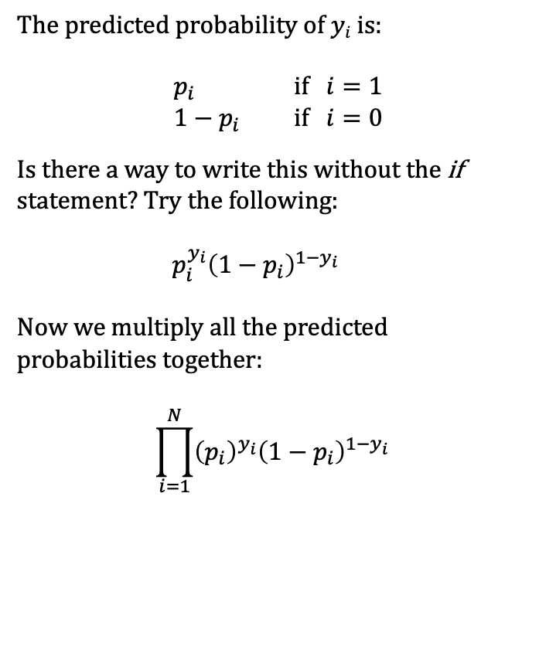
Logistic Regression Likelihood
Probability of all the events $y1,…,yN$given our current model parameters
The predicted probability of $yi$ is:
$p_{i}$ if $i=1$
$1−p_{i}$ if $i=0$
Is there a way to write this without the if statement? Try the following:
$p_{i}^{y_{i}}{\left(1−p_{i}\right)}^{1−y_{i}}$
Now we multiply all the predicted probabilities together:
$$\prod_{i=1}^{N}{{\left(p_{i}\right)}^{y_{i}}{\left(1−p_{i}\right)}^{1−y_{i}}}$$
Notes:
This is called the likelihood.

Slide 15
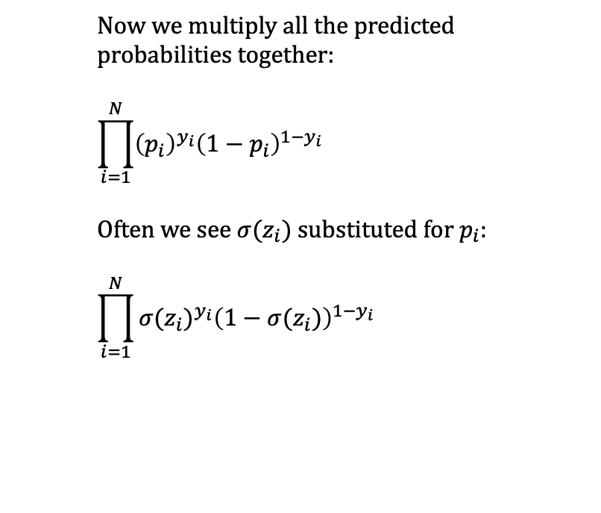
Logistic Regression Likelihood
Probability of all the events $y1,…,yN$given our current model parameters
Now we multiply all the predicted probabilities together:
$$\prod_{i=1}^{N}{{\left(p_{i}\right)}^{y_{i}}{\left(1−p_{i}\right)}^{1−y_{i}}}$$
Often we see $σ(z_{i})$substituted for $p_{i}$:
$$\prod_{i=1}^{N}{{σ(z_{i})}^{y_{i}}{\left(1−σ(z_{i})\right)}^{1−y_{i}}}$$
Notes:
This is called the likelihood.

Slide 16
Remember that for linear regression, we want to minimize the mean squared error.
𝜀₈
Error:
$$ε_{i}=y_{i}−{\hat{y}}_{i}$$
$$Mean square error \left(MSE\right)$$
$$\frac{1}{N}\sum_{i=1}^{N}{ε_{i}^{2}}$$
𝜀₁₀
𝜀₉
𝜀₇
𝜀₄
𝜀₅
𝜀₆
𝜀₃
𝜀₁
𝜀₂
Notes:
Root mean square error, normalized mean square error, etc, but these are the essentials
Other ways to measure distance between the prediction and the truth that might be appropriate for specific applications
Note that Normalized MSE is 1-R^2

Slide 17
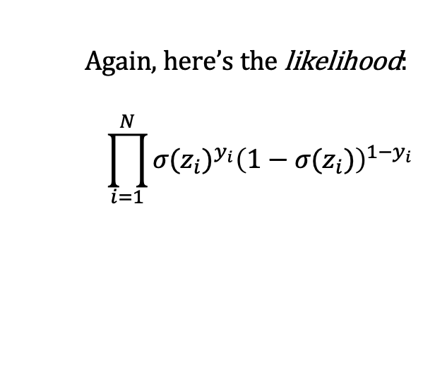
Two Final Modifications
Again, here’s the likelihood:
$$\prod_{i=1}^{N}{{σ(z_{i})}^{y_{i}}{\left(1−σ(z_{i})\right)}^{1−y_{i}}}$$
Notes:
This is called the likelihood.

Slide 18
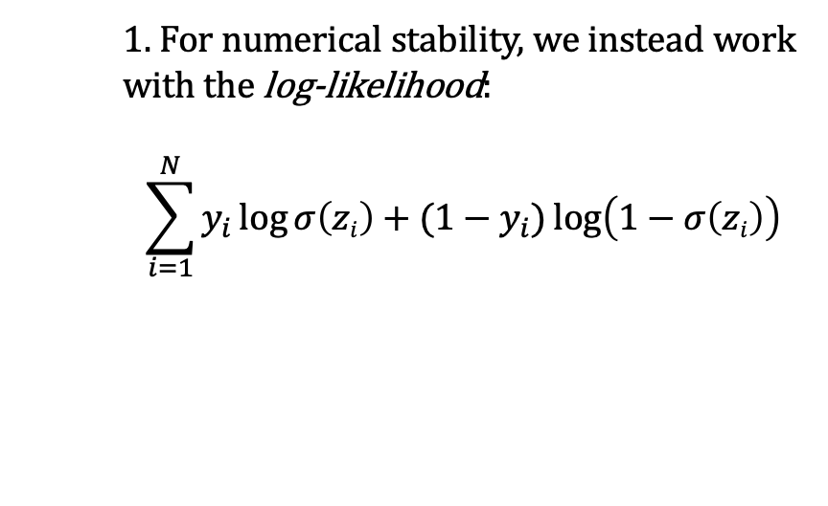
Two Final Modifications
Again, here’s the likelihood:
$$\prod_{i=1}^{N}{{σ(z_{i})}^{y_{i}}{\left(1−σ(z_{i})\right)}^{1−y_{i}}}$$
1. For numerical stability, we instead work with the log-likelihood:
$$\sum_{i=1}^{N}{y_{i}\log{σ\left(zi\right)}+(1−y_{i})\log\left(1−σ\left(zi\right)\right)}$$
Notes:
This is called the likelihood.

Slide 19
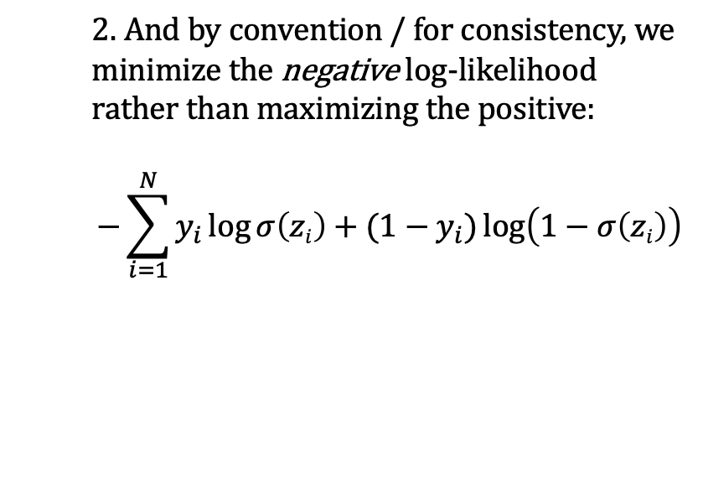
Two Final Modifications
Again, here’s the likelihood:
$$\prod_{i=1}^{N}{{σ(z_{i})}^{y_{i}}{\left(1−σ(z_{i})\right)}^{1−y_{i}}}$$
1. For numerical stability, we instead work with the log-likelihood:
$$\sum_{i=1}^{N}{y_{i}\log{σ\left(zi\right)}+(1−y_{i})\log\left(1−σ\left(zi\right)\right)}$$
2. And by convention / for consistency, we minimize the negative log-likelihood rather than maximizing the positive:
$$−\sum_{i=1}^{N}{y_{i}\log{σ\left(zi\right)}+(1−y_{i})\log\left(1−σ\left(zi\right)\right)}$$
Notes:
This is called the likelihood.

Slide 20
Cross-Entropy Loss
Again, here’s the likelihood:
$$\prod_{i=1}^{N}{{σ(z_{i})}^{y_{i}}{\left(1−σ(z_{i})\right)}^{1−y_{i}}}$$
1. For numerical stability, we instead work with the log-likelihood:
$$\sum_{i=1}^{N}{y_{i}\log{σ\left(zi\right)}+(1−y_{i})\log\left(1−σ\left(zi\right)\right)}$$
2. And by convention / for consistency, we minimize the negative log-likelihood rather than maximizing the positive:
$$−\sum_{i=1}^{N}{y_{i}\log{σ\left(zi\right)}+(1−y_{i})\log\left(1−σ\left(zi\right)\right)}$$
This is called the cross-entropy loss.
We are looking for parameters that make it as small as possible.
It is used for all the prediction tasks we consider in this course.
Notes:
This is called the likelihood.

Slide 21
How do we minimize the loss?
The cross-entropy loss just tells us what quantity we should be minimizing
In some cases (e.g. linear regression), we can solve for the minimum directly
But, we’d like to have an approach that works even for very complex models

Slide 22
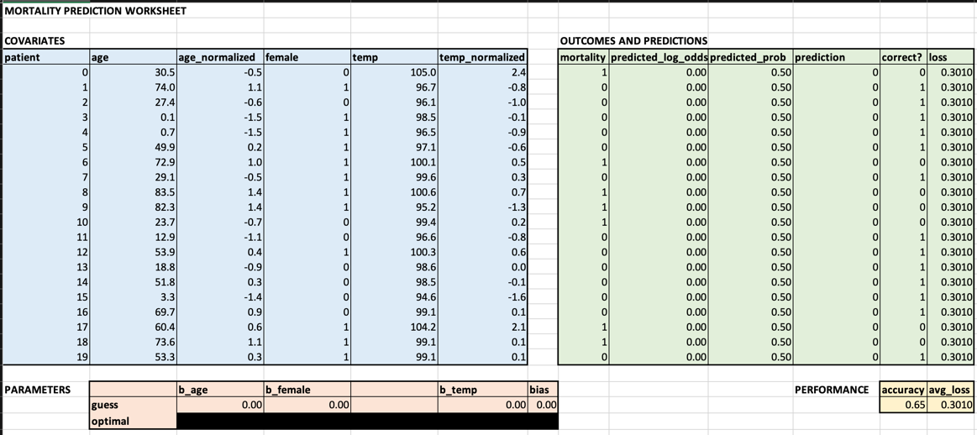
Strategy: determine how small changes in parameters affect the loss

