Slide 1
Beyond Supervised Learning August 8, 2020
Applied Data Science
MMCi Term 4
Matthew Engelhard
Notes:
NEED INFO ABOUT ROC, CONFUSION MATRIX, ETC HERE

Slide 2
Supervised Learning
y, associated value or label
x, data/features for a subject or patient
The learning process: find the equation that best predicts y based on x
Notes:
So how do we make these predictions?
Well, first we need a model.
A model is a mathematical equation or program that x’s as input and returns a prediction about y as output.
And the equation has two parts.
There’s the form of the equation – for example a line, a polynomial, etc – and the specific instantiation of that equation or program
The model has parameters – for example, the slope of the line
And we want to figure out which parameters are best matched to our data.
This is called “training” the model.
Ultimately we want to predict y without learning it. But first we need a dataset – this is pairs of x and y – so we can learn the relationship between the two and encode it in our model parameters

Slide 3
Supervised Learning: Classification
y, categorical label
x, data/features for a subject or patient
The learning process: find the equation that best predicts y based on x
Notes:
So how do we make these predictions?
Well, first we need a model.
A model is a mathematical equation or program that x’s as input and returns a prediction about y as output.
And the equation has two parts.
There’s the form of the equation – for example a line, a polynomial, etc – and the specific instantiation of that equation or program
The model has parameters – for example, the slope of the line
And we want to figure out which parameters are best matched to our data.
This is called “training” the model.
Ultimately we want to predict y without learning it. But first we need a dataset – this is pairs of x and y – so we can learn the relationship between the two and encode it in our model parameters

Slide 4
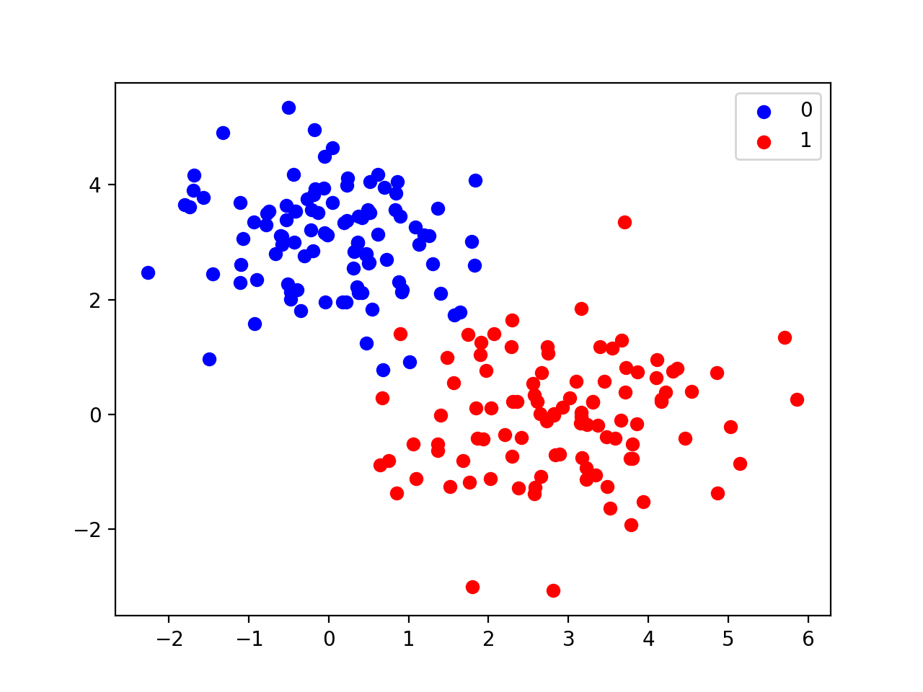
Supervised Learning: Classification
Goal:
Learn a decision boundary that separates 0s from 1s

Slide 5
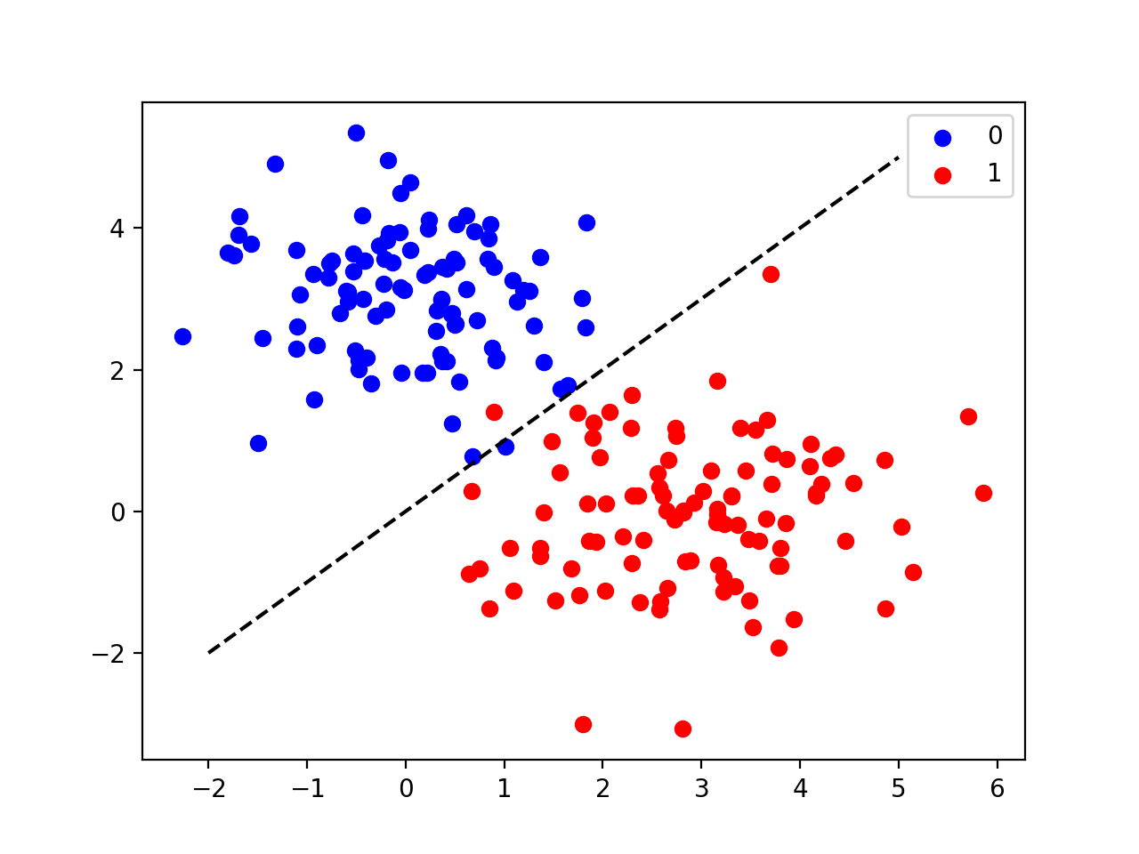
Supervised Learning: Classification
Goal:
Learn a decision boundary that separates 0s from 1s
Notes:
Go back to examples of this

Slide 6
Supervised Learning: Regression
y, numeric
value
x, data/features for a subject or patient
The learning process: find the equation that best predicts y based on x
Notes:
So how do we make these predictions?
Well, first we need a model.
A model is a mathematical equation or program that x’s as input and returns a prediction about y as output.
And the equation has two parts.
There’s the form of the equation – for example a line, a polynomial, etc – and the specific instantiation of that equation or program
The model has parameters – for example, the slope of the line
And we want to figure out which parameters are best matched to our data.
This is called “training” the model.
Ultimately we want to predict y without learning it. But first we need a dataset – this is pairs of x and y – so we can learn the relationship between the two and encode it in our model parameters

Slide 7
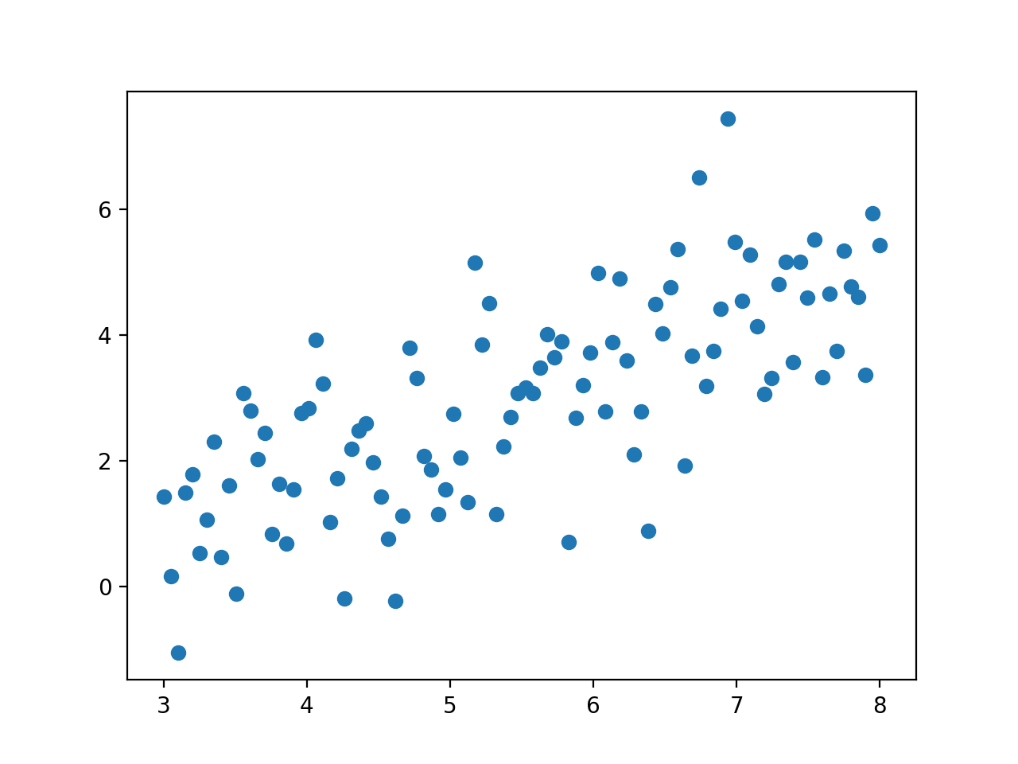
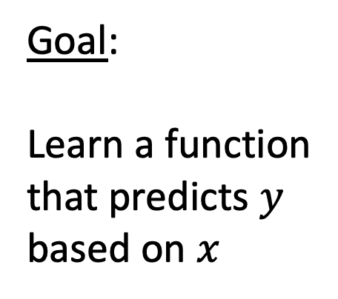
Supervised Learning: Regression
Goal:
Learn a function that predicts $y$ based on $x$

Slide 8
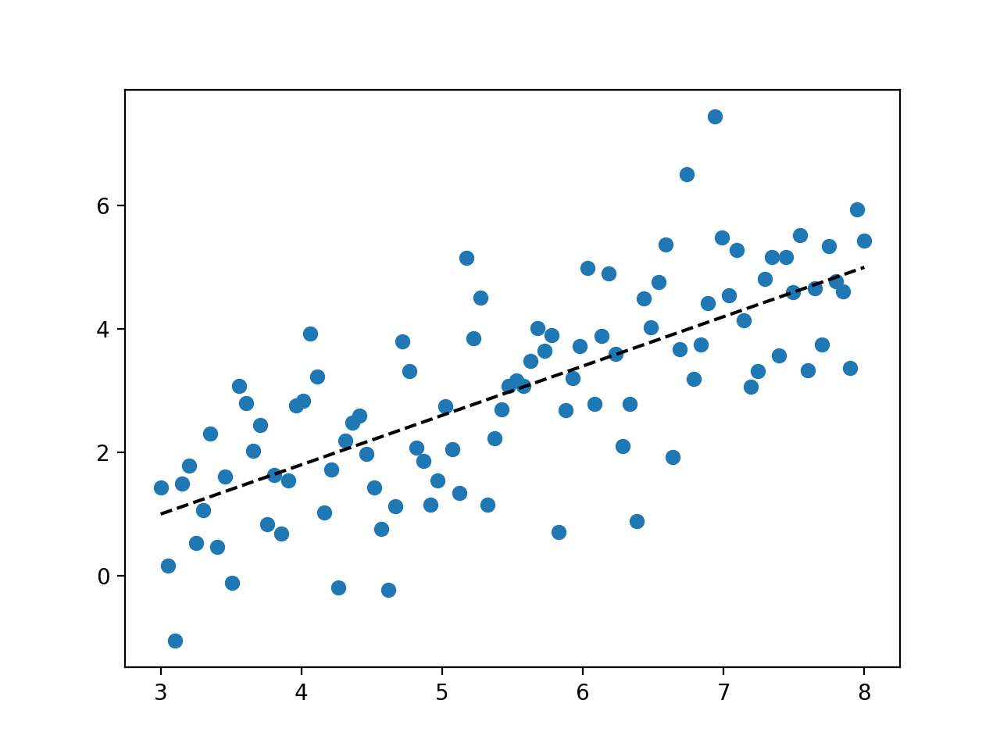
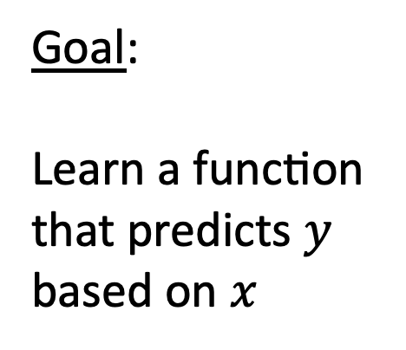
Supervised Learning: Regression
Goal:
Learn a function that predicts $y$ based on $x$
Notes:
And this is linear regression, but remember, we can learn highly complex, non-linear curves and decision boundaries
Healthcare examples:
predict someone’s AGE based on a picture of their skin
predict severity of depression, on a linear scale, based on someone’s tweets
predict the precise location of objects within images

Slide 9
Unsupervised Learning
x, data/features for a subject or patient
The learning process: - find structure or patterns in the data
- describe the data or create new, similar data
Notes:
So how do we make these predictions?
Well, first we need a model.
A model is a mathematical equation or program that x’s as input and returns a prediction about y as output.
And the equation has two parts.
There’s the form of the equation – for example a line, a polynomial, etc – and the specific instantiation of that equation or program
The model has parameters – for example, the slope of the line
And we want to figure out which parameters are best matched to our data.
This is called “training” the model.
Ultimately we want to predict y without learning it. But first we need a dataset – this is pairs of x and y – so we can learn the relationship between the two and encode it in our model parameters

Slide 10
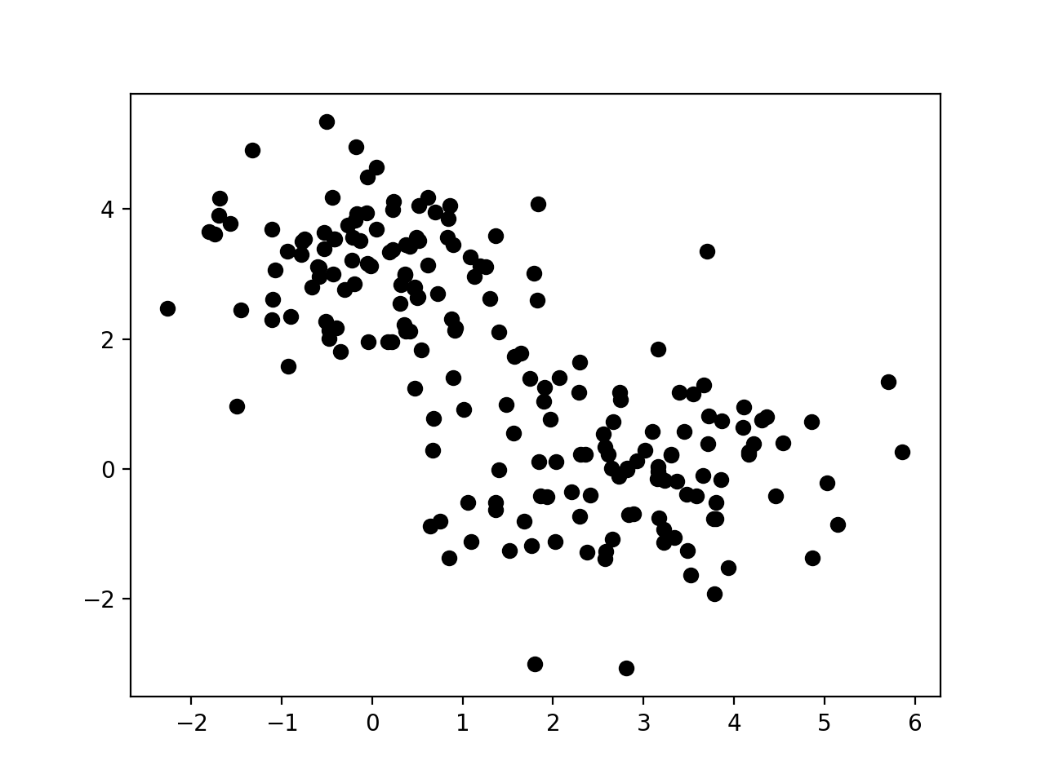
Unsupervised Learning
Notes:
- Simplest thing: might model the density of these points. Describes their distribution. Allows us to create a new dataset that looks similar to this one.

Slide 11
Unsupervised Learning: Dimensionality Reduction
x, data/features for a subject or patient
Goal:
Describe a large number of features in terms of a smaller number of features
z, lower-dimensional representation (or embedding) of x

Slide 12
Dimensionality Reduction Example: Autoencoder
Goal:
Describe a large number of features in terms of a smaller number of features
Train to minimize reconstruction loss
x, data/features for a subject or patient

Slide 13
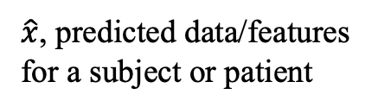
Dimensionality Reduction Example: Autoencoder
Goal:
Describe a large number of features in terms of a smaller number of features
Train to minimize reconstruction loss
x, data/features for a subject or patient
$\hat{x}$, predicted data/features for a subject or patient

Slide 14
Dimensionality Reduction Example: Autoencoder
Goal:
Describe a large number of features in terms of a smaller number of features
Train to minimize reconstruction loss
z, latent code
x, data/features for a subject or patient
$\hat{x}$, predicted data/features for a subject or patient

Slide 15
Unsupervised Learning: Clustering
Goal:
Assign points to distinct groups with shared characteristics

Slide 16
Unsupervised Learning: Clustering
Goal:
Assign points to distinct groups with shared characteristics
Notes:
Example of this: subtypes of ADHD
Executive functioning impairment clusters

Slide 17
Example of K-Means Clustering
Goal:
Assign points to distinct groups with shared characteristics
sensitive to initialization
minimize 𝞢distance² from points to centers
Notes:
Healthcare example: identifying disease subtypes
Or subtypes of executive dysfunction
Or patient subgroups that might be useful for deciding on treatment

Slide 18
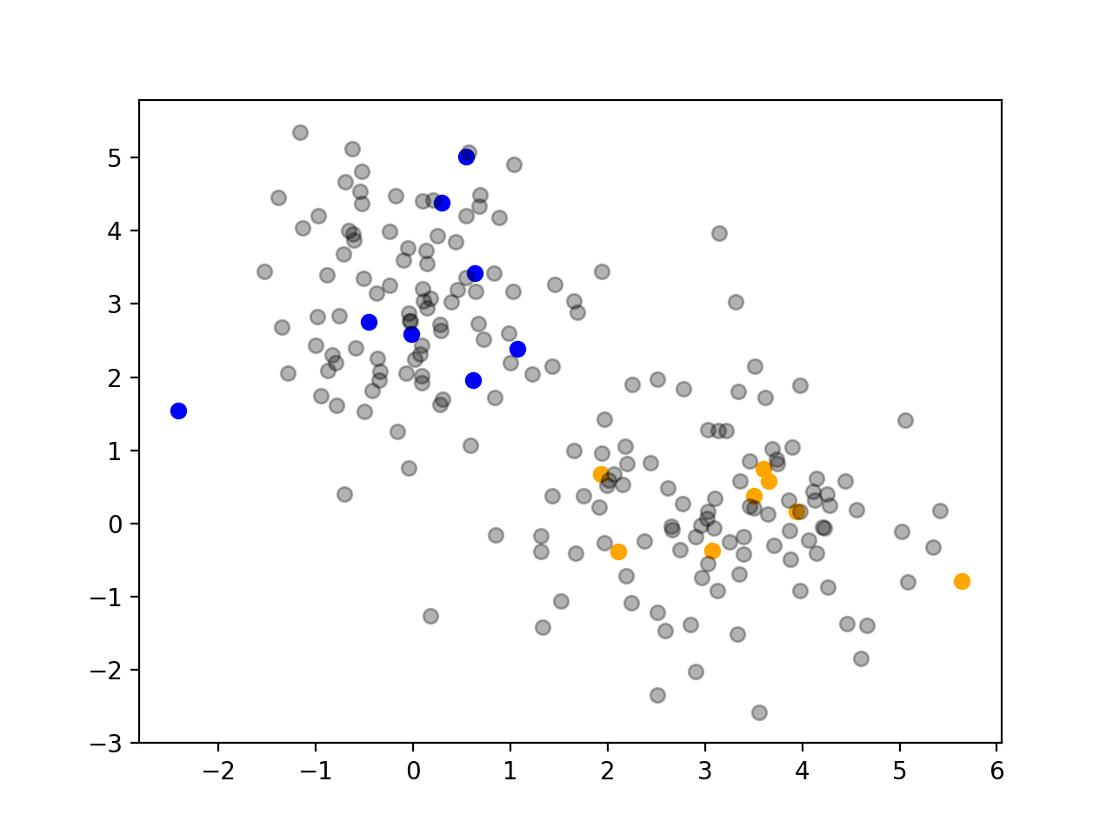
Semi-Supervised Learning
Some points are labeled, some are not
Try to use the unlabeled data to help us reason about the labeled data
Notes:
Highly medically relevant, because the cost of labels is high

Slide 19
Active Learning
Some points are labeled, some are not
We can get additional labels, but at a cost
Request labels we believe will improve our classifier the most

Slide 20
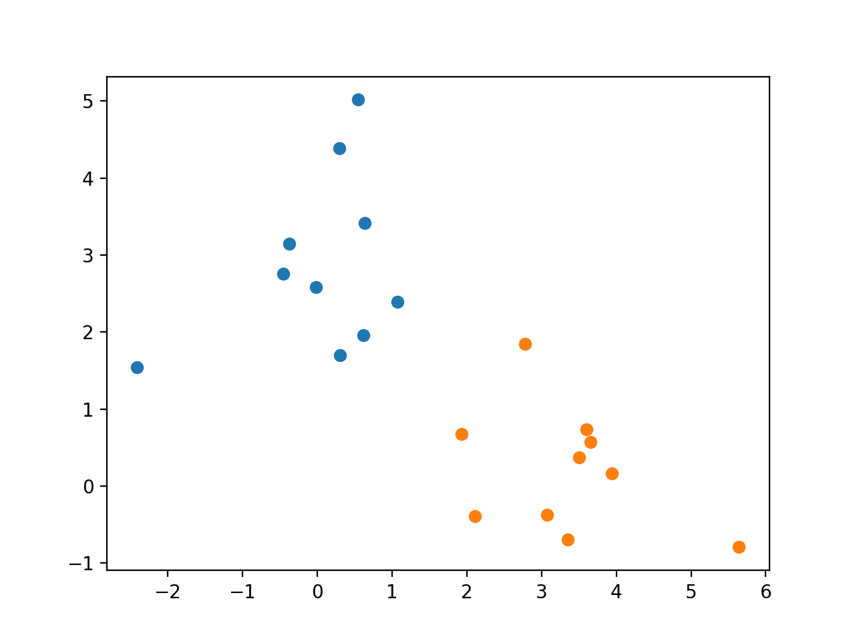
Online Learning
Data arrives one point at a time, or in batches
Continually improve our classifier without having to retrain from scratch with each arrival
Uses a learning rate, much like RL

Slide 21
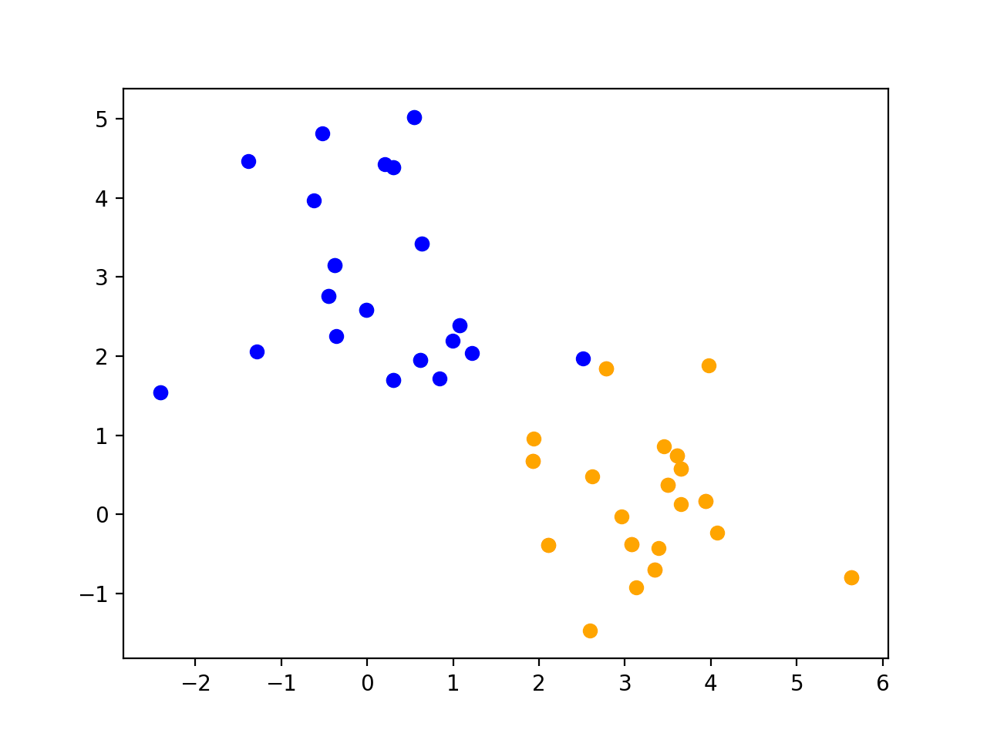
Online Learning
Data arrives one point at a time, or in batches
Continually improve our classifier without having to retrain from scratch with each arrival
Uses a learning rate, much like RL

Slide 22
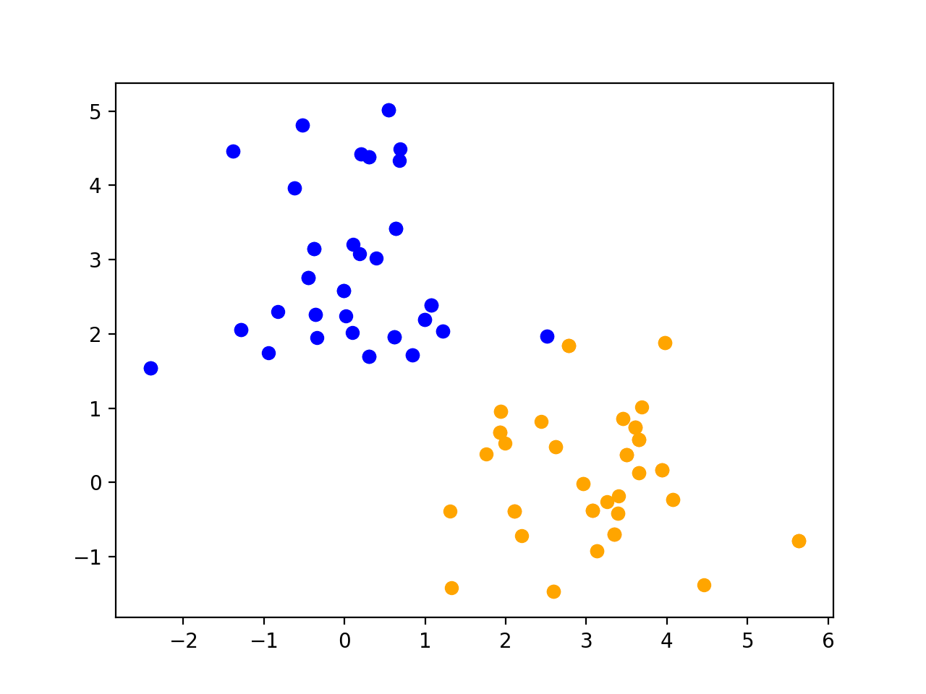
Online Learning
Data arrives one point at a time, or in batches
Continually improve our classifier without having to retrain from scratch with each arrival
Uses a learning rate, much like RL

Slide 23
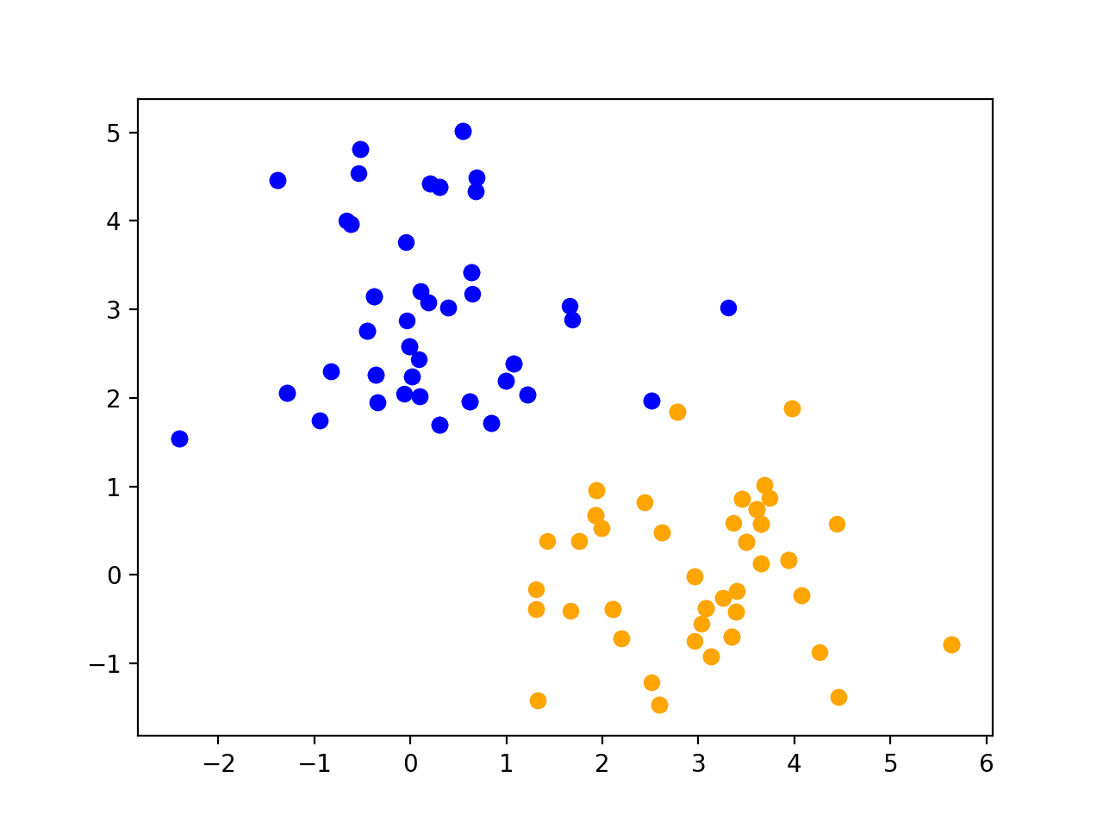
Online Learning
Data arrives one point at a time, or in batches
Continually improve our classifier without having to retrain from scratch with each arrival
Uses a learning rate, much like RL

Slide 24
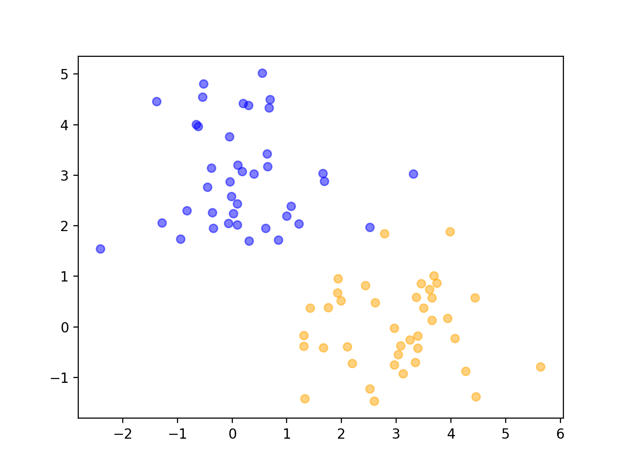
Lifelong Learning
Similar to lifelong learning; also uses a learning rate
Data characteristics change over time
Continually refine our classifier to adjust to these changing characteristics

Slide 25
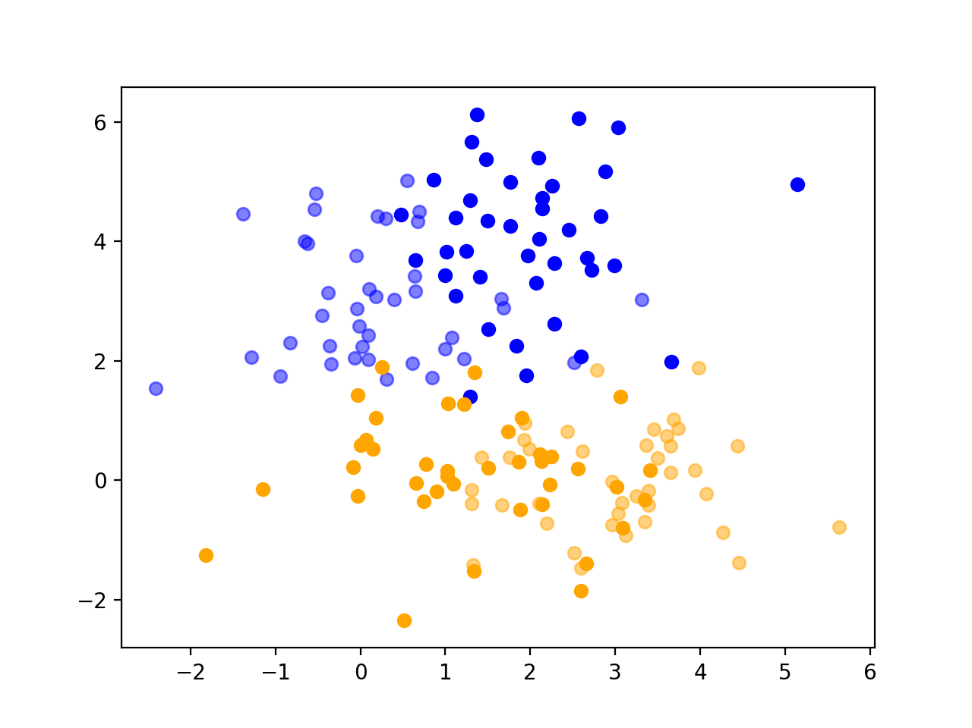
Lifelong Learning
Similar to lifelong learning; also uses a learning rate
Data characteristics change over time
Continually refine our classifier to adjust to these changing characteristics

Slide 26
We have covered a lot!

Slide 27
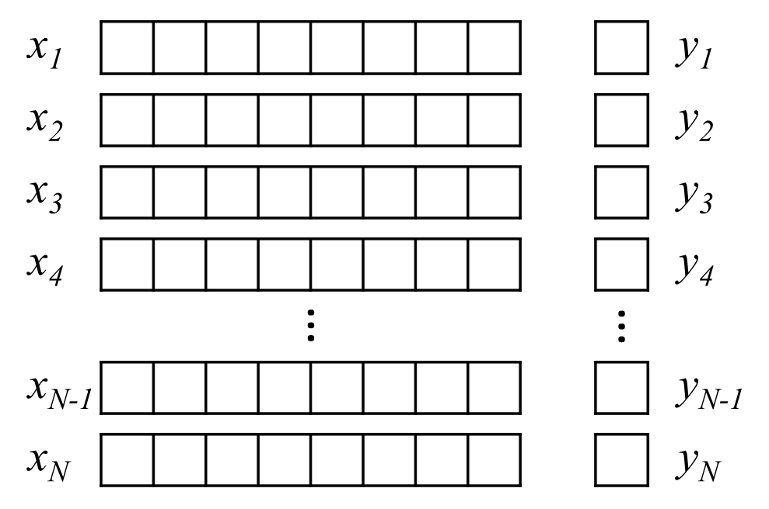
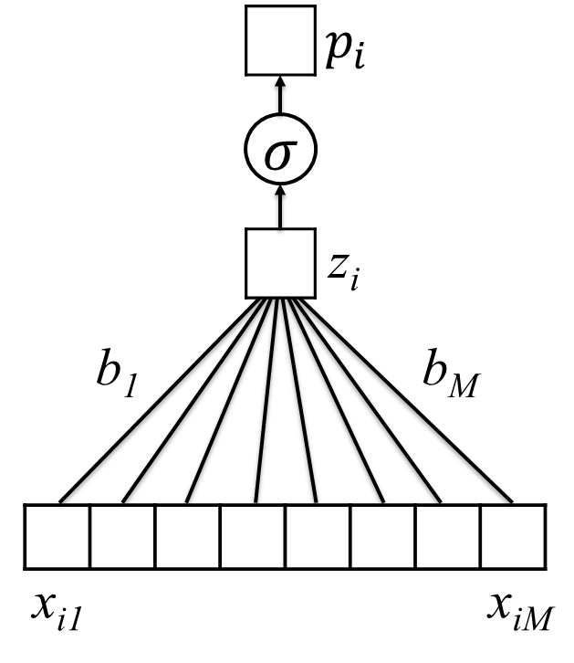
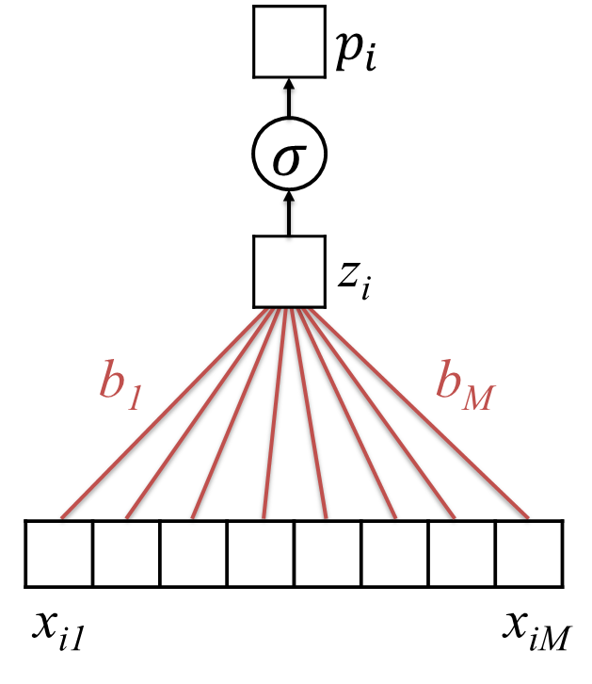
Learning Model Parameters
Training Set
$$p_{i}=σ(b_{0}+b_{1}x_{i1}+b_{2}x_{i2}+…+b_{M}x_{iM})$$
$b=(b_{0},…b_{M})$
Untrained Logistic Regression
Model (or “Network”)
Trained Model (with learned parameters)

Slide 28
Split Data into Separate Groups
Train, Validation, Test
$$x_{1}$$
$$y_{1}$$
$$x_{1}$$
$$y_{1}$$
$$x_{2}$$
$$y_{2}$$
$$x_{2}$$
$$y_{2}$$
$$x_{3}$$
$$y_{3}$$
$$x_{3}$$
$$y_{3}$$
$$x_{4}$$
$$y_{4}$$
$$x_{4}$$
$$y_{4}$$
$$x_{5}$$
$$y_{5}$$
$$x_{5}$$
$$y_{5}$$
$$x_{6}$$
$$y_{6}$$
Random Assignment
$$x_{6}$$
$$y_{6}$$
$$x_{7}$$
$$y_{7}$$
$$x_{7}$$
$$y_{7}$$
$$x_{N−1}$$
$$y_{N−1}$$
$$x_{N−1}$$
$$y_{N−1}$$
$$x_{N}$$
$$y_{N}$$
$$x_{N}$$
$$y_{N}$$
All Available Data

Slide 29
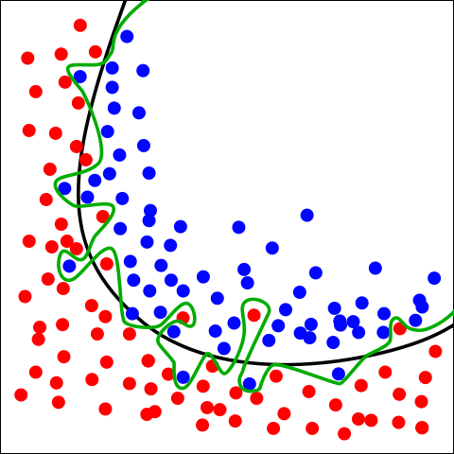
But some models can be too flexible.
Green boundary:
This is overfitting
Black boundary:
Balance between fit and model complexity
-> The black boundary is likely to perform better on new data
By Chabacano - Own work, CC BY-SA 4.0, https://commons.wikimedia.org/w/index.php?curid=3610704
Notes:
Willingness to embrace complex models → need this better approach to overfitting.

Slide 30

An Example…
-1 | 5 | -5
3 | -5 | 9
-1 | 5
filter
image
$$x_{i}^{R}⊙b$$

Slide 31
Saliency maps for example images
Saliency maps show gradients for each pixel with respect to the CNN’s loss function. Darker pixels represent those with more influence.
Q: How much does this visualization help us understand the model?
Notes:
Note here – much more to say about this

Slide 32
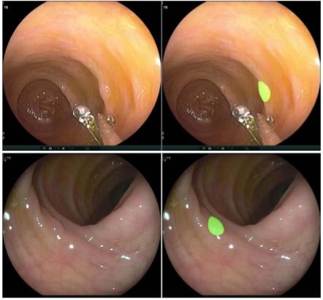
Precisely Identify Boundaries
Notes:
- All pixels not highlighted are classified as NOT polyp

Slide 33
Logistic Regression for Text Classification
shaking
what
clinic
how
helps
was
nearest
many
with
said
months
the
morning
mom
should
sickness
and
I
is
how
out
breastfeed
passed
where
$$p_{3}$$
$$σ$$
z₃
b₁
b_{M}
x₃
1 | 0 | 0 | 0 | 0 | 1 | 0 | 0 | 0 | 1 | 0 | 0 | 0 | 1 | 0 | 0 | 0 | 2 | 0 | 0 | 1 | 0 | 1 | 0
I passed out and Mom said I was shaking

Slide 34
We now have a distributed representation of word meaning based on context
z(man)
0
0
1
0
0
0
0
0
softmax
p(man)
p(woman)
swims
p(child)
p(banana)
p(crocodile)
$$W$$
$$B$$
v(swims)
p(concept)
z(concept)

Slide 35
Task 2: Predict a label associated with each word
My SSN is 111-22-3333
not PHI not PHI not PHI PHI
y_{i1}
y_{i2}
y_{i3}
y_{i4}
Notes:
esta es una frase

Slide 36
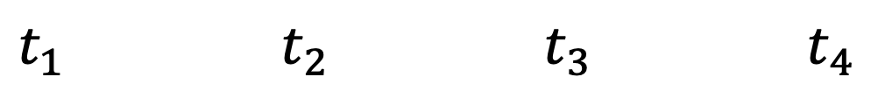
Task 2: Predict label assoc. with each time point
$t_{1}$ $t_{2}$ $t_{3}$ $t_{4}$
Temp
BP
HR
RR
SpO2
Glucose
not hypoxemic not hypoxemic hypoxemic not hypoxemic
y_{i1}
y_{i2}
y_{i3}
y_{i4}
Notes:
This is what we do in diagnosis prediction, for instance

Slide 37
Similarly, we can aggregate measurements in a time-series
$t_{1}$ $t_{2}$ $t_{3}$ $t_{4}$
Temp
BP
HR
RR
SpO2
Glucose
x_{i3}
not hypoxemic not hypoxemic hypoxemic not hypoxemic
y_{i1}
y_{i2}
y_{i3}
y_{i4}
Notes:
This is what we do in diagnosis prediction, for instance

Slide 38
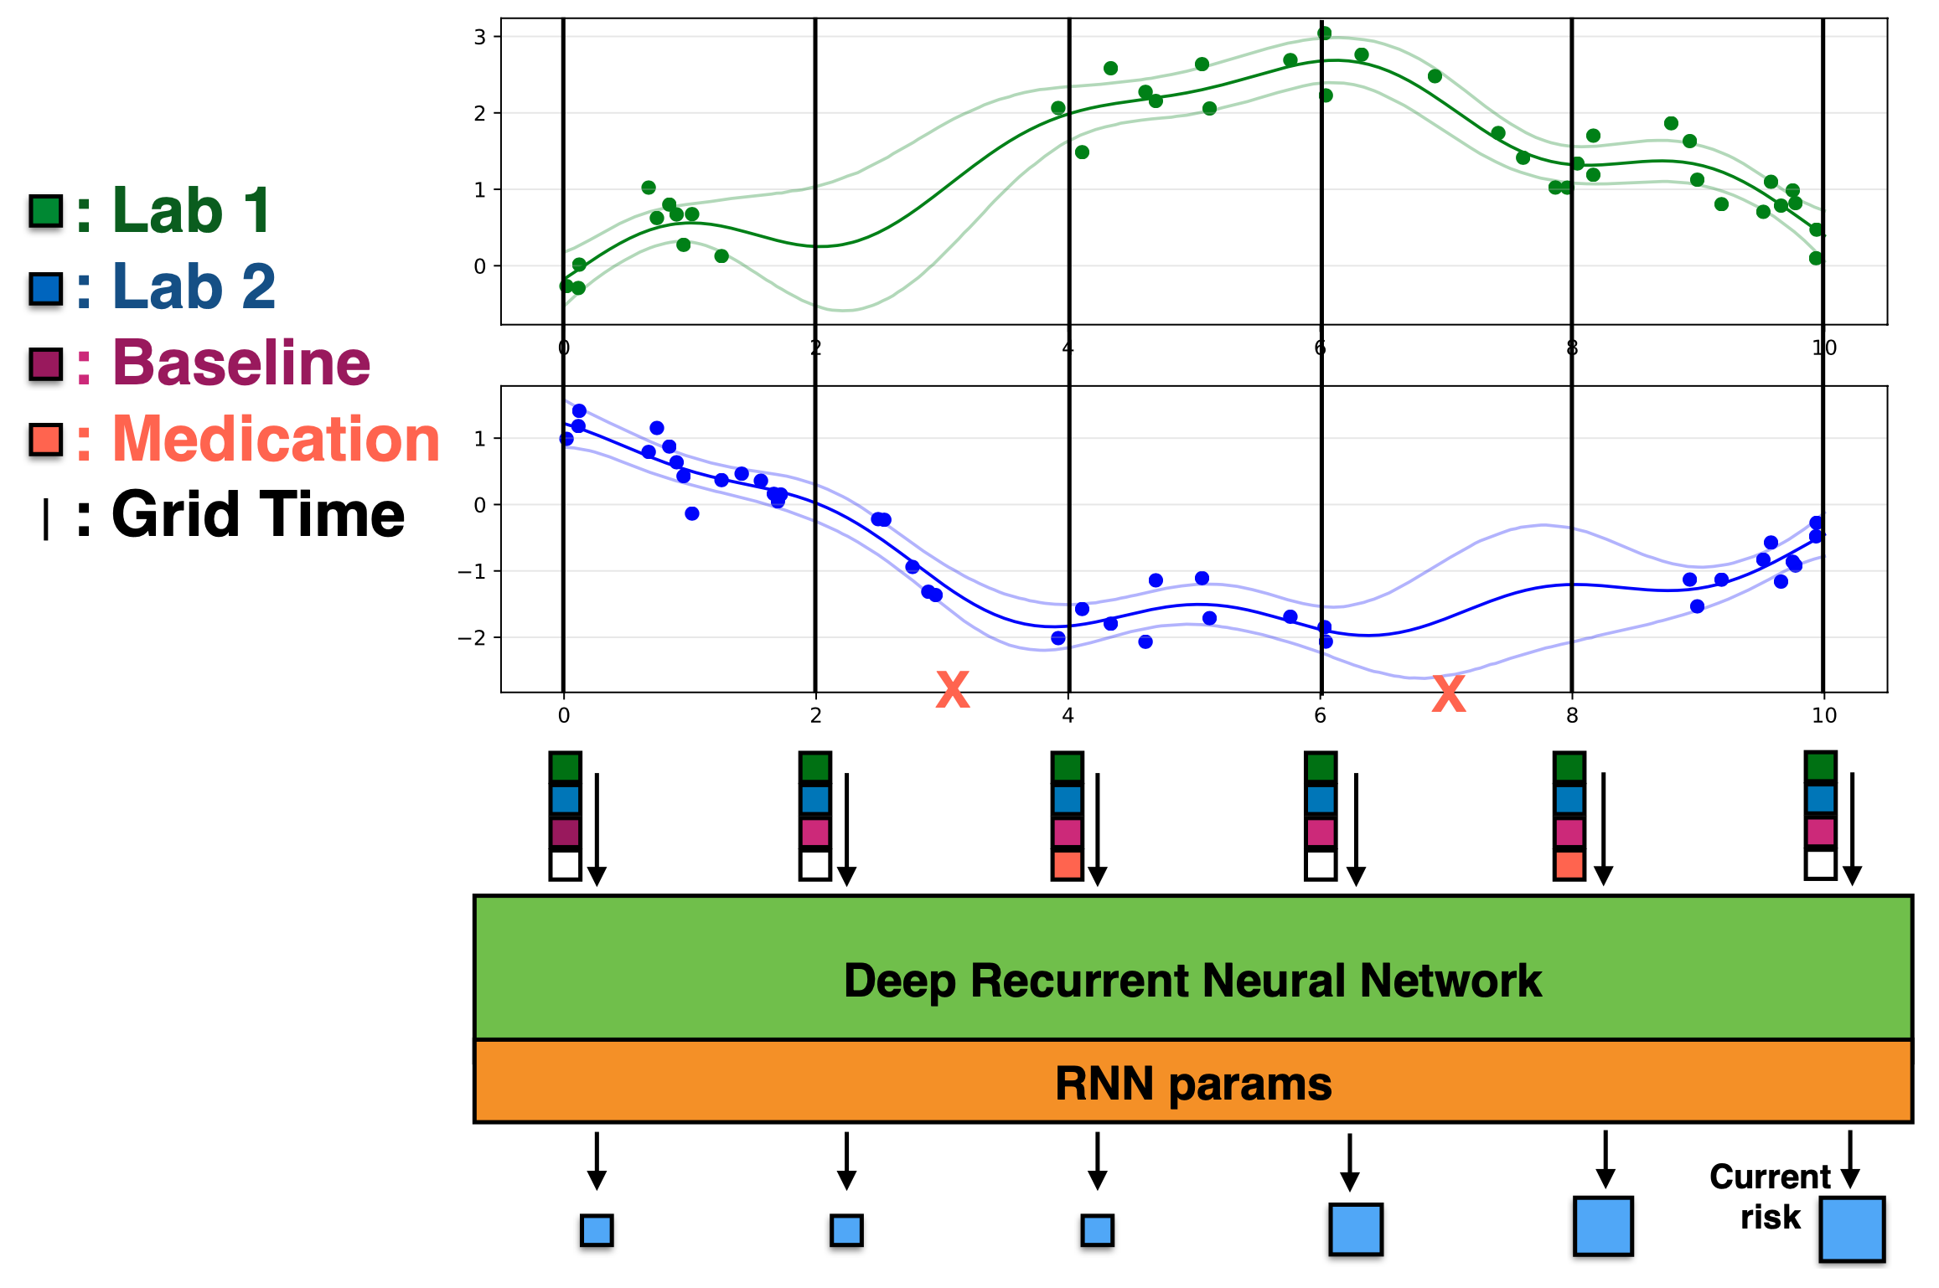
DIHI Sepsis Watch
<- Use GP regression to predict measurements at regular intervals
<- Predict sepsis risk using an RNN

Slide 39
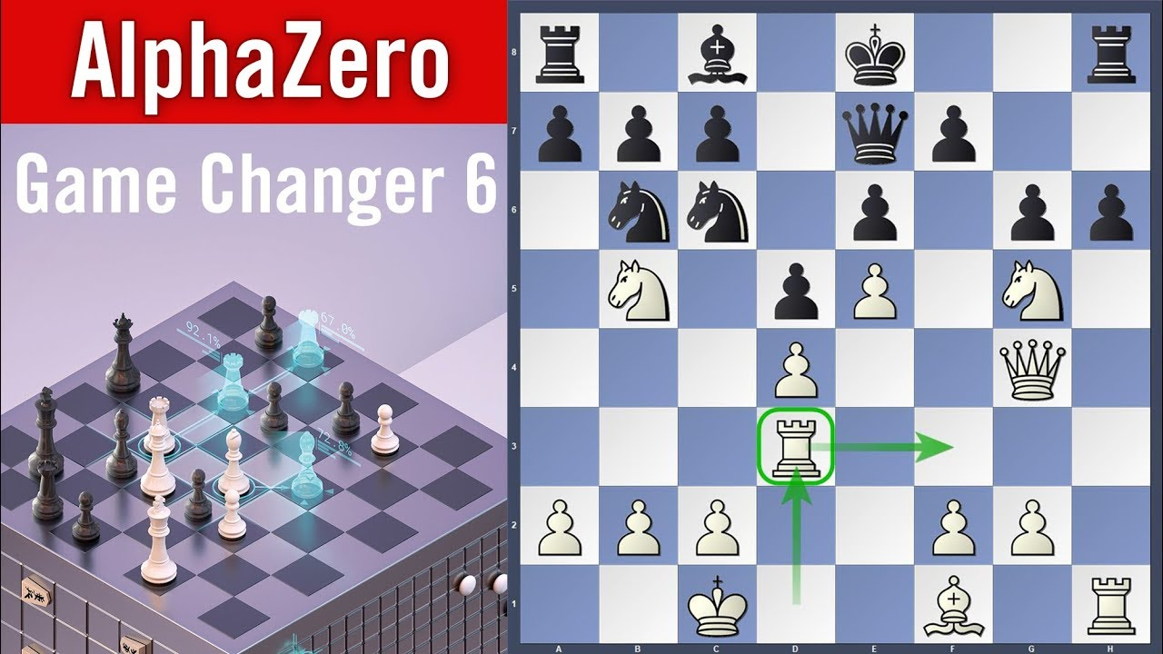
Sequential Decision-Making
Make a series of decisions
based on a set of features (state)
to maximize reward over time
Notes:
examples: robot navigating
Computer program playing video game
Doctor deciding on treatment(s)
Two things to note:
- this is happening on an ongoing basis
- Reward must be quantified numerically

Slide 40
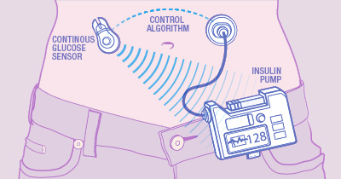
Sequential Medical Decision-Making
Make a series of decisions
based on a set of features (state)
to maximize reward over time
Notes:
examples: robot navigating
Computer program playing video game
Doctor deciding on treatment(s)
Two things to note:
- this is happening on an ongoing basis
- Reward must be quantified numerically

Slide 41
Thank you!
Be in touch: m.engelhard@duke.edu

