Slide 1
Word Embeddings and A Very Simple Word Embedding Based Model July 10, 2020
Applied Data Science
MMCi Term 4
Matthew Engelhard
Notes:
NEED INFO ABOUT ROC, CONFUSION MATRIX, ETC HERE

Slide 2
Motivating Word Embeddings

Slide 3
Problem: our model counts words, but has no understanding of their meaning
gleeful
merry
euphoric
joyful
ecstatic
happy
satisfied
content
Goal: predict sentiment (positive/negative)
Notes:
ACUTE PHYSIOLOGY AND CHRONIC HEALTH EVALUATION
Predictive models are nothing new in medicine – APACHE, for instance – this is to predict mortality in ICU setting – has been around since the 70s.
In an ICU setting, we might want a model that takes a bunch of measurements about a patient -- their age (demographics), vitals, lab values, and some information about chronic health conditions and predicts their risk of dying (or likelihood of surviving…)

Slide 4
Problem: our model counts words, but has no understanding of their meaning
miserable
upset
sorrowful
melancholy
down
sad
depressed
unhappy
Goal: predict sentiment (positive/negative)
Notes:
ACUTE PHYSIOLOGY AND CHRONIC HEALTH EVALUATION
Predictive models are nothing new in medicine – APACHE, for instance – this is to predict mortality in ICU setting – has been around since the 70s.
In an ICU setting, we might want a model that takes a bunch of measurements about a patient -- their age (demographics), vitals, lab values, and some information about chronic health conditions and predicts their risk of dying (or likelihood of surviving…)

Slide 5


To effectively predict sentiment, it would be helpful to understand which words have similar meaning
I am sad
I am miserable
I am sorrowful
I am upset
I am down
training set
I am content
I am joyful
I am merry
I am satisfied
I am euphoric
I am depressed
?
?
?
?
I am unhappy
test set
I am happy
I am gleeful
Notes:
ACUTE PHYSIOLOGY AND CHRONIC HEALTH EVALUATION
Predictive models are nothing new in medicine – APACHE, for instance – this is to predict mortality in ICU setting – has been around since the 70s.
In an ICU setting, we might want a model that takes a bunch of measurements about a patient -- their age (demographics), vitals, lab values, and some information about chronic health conditions and predicts their risk of dying (or likelihood of surviving…)

Slide 6


logistic regression: positive / negative sentiment
$$p_{i}$$
probability that sentiment is positive
positive
zero
negative
gleeful
sad
miserable
sorrowful
upset
down
content
joyful
merry
satisfied
euphoric
gleeful
ecstatic
depressed
unhappy
i
am
melancholy
Satisfied
happy
$$σ$$
z_{i}
b₁
b_{M}
x_{i}
I passed out and Mom said I was shaking

Slide 7
We’d like a numeric representation of words that encodes their meaning
miserable
upset
joyful
melancholy
happy
content
euphoric
sad
unhappy
satisfied
merry
ecstatic
sorrowful
depressed
down
gleeful
<- sadder
happier ->
Numeric value indicating whether the word is happy or sad
Notes:
ACUTE PHYSIOLOGY AND CHRONIC HEALTH EVALUATION
Predictive models are nothing new in medicine – APACHE, for instance – this is to predict mortality in ICU setting – has been around since the 70s.
In an ICU setting, we might want a model that takes a bunch of measurements about a patient -- their age (demographics), vitals, lab values, and some information about chronic health conditions and predicts their risk of dying (or likelihood of surviving…)

Slide 8
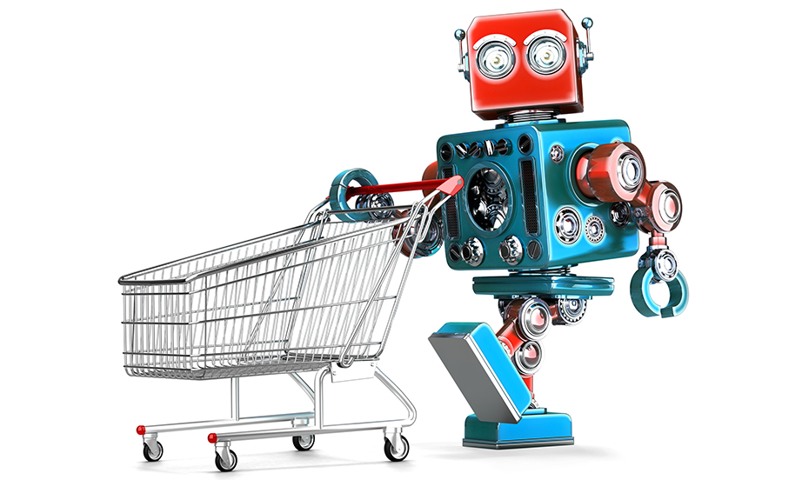
Training a robot to buy groceries
Example from Anand Chowdhury, MMCi 2019

Slide 9
Grocery List
granulated sugar
vanilla extract
dark brown sugar
carrots
table salt
eggs

Slide 10

Characteristics/Dimensions
Dimension | 1 | 10
State | Liquid | Solid
Sweetness | Bland | Sweet
Color | Light | Dark
Size | Small | Large
Carrotness | Not really
“Carrot Vegetables” icon by CHARIE Tristan from the Noun Project.

Slide 11
Five dimensions

Slide 12
Make Sense of Items not Seen Before
Item | State | Sweetness | Color | Size | Carrotness
??? | 0 | 8 | 7 | 6 | 0
??? | 0 | 0 | 10 | 6 | 0
??? | 8 | 9 | 8 | 3 | 0
??? | 0 | 5 | 3 | 4 | 10

Slide 13
Make Sense of Items not Seen Before
Item | State | Sweetness | Color | Size | Carrotness
Soda / Sweet Tea | 0 | 8 | 7 | 6 | 0
Black Coffee | 0 | 0 | 10 | 6 | 0
Chocolate | 8 | 9 | 8 | 3 | 0
Carrot Juice | 0 | 5 | 3 | 4 | 10

Slide 14
Recipe
Dark Brown Sugar – Granulated Sugar + Carrots
 | Item | State | Sweetness | Color | Size | Carrotness
 | Dark Brown Sugar | 10 | 8 | 8 | 1 | 1
- | Granulated Sugar | 10 | 10 | 1 | 1 | 1
+ | Carrots | 10 | 6 | 4 | 6 | 10
= | ??? | 10 | 4 | 11 | 6 | 10

Slide 15
Word Embeddings: Assign Each Word in our Vocabulary to a Numeric Vector (of characteristics)
Dimension | 1 | 10
Gender | Male | Female
Class | Commoner | Royalty
Plural | One | Many

Slide 16
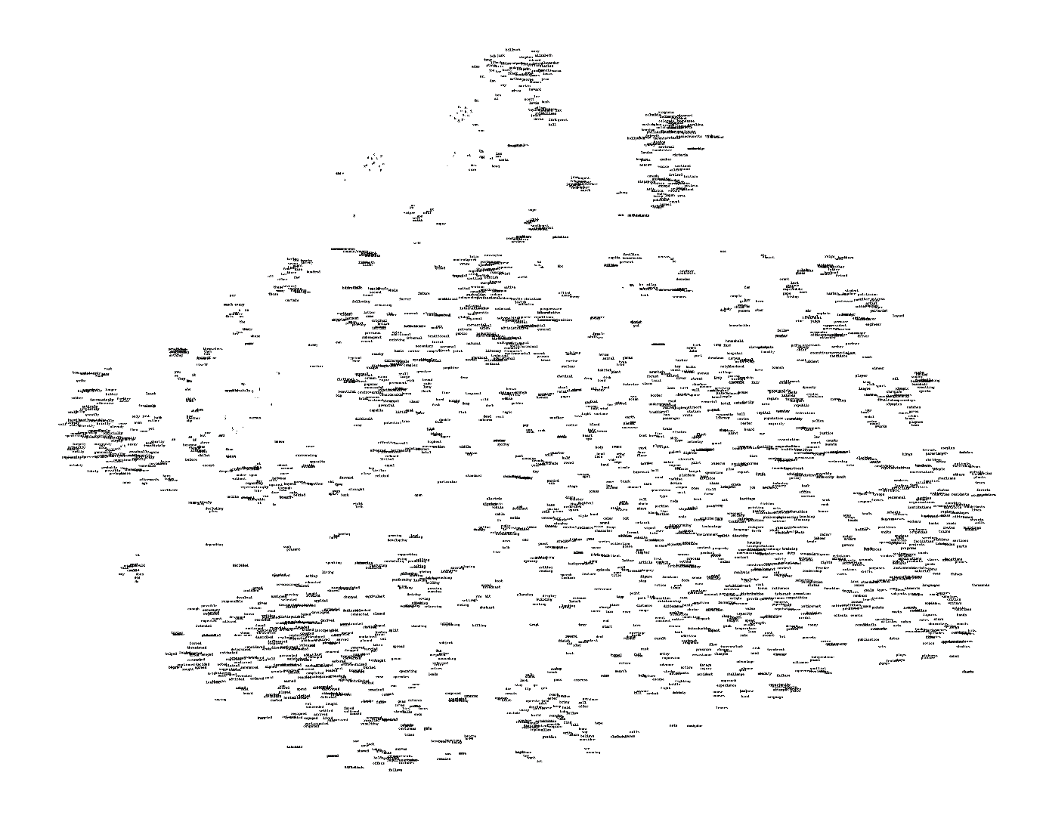
Visualizing Word Embeddings
Here we show the learned numeric representations (limited here to 2 dimensions) of many different vocabulary words
Too many words here to see! Let’s zoom in on a smaller section.

Slide 17
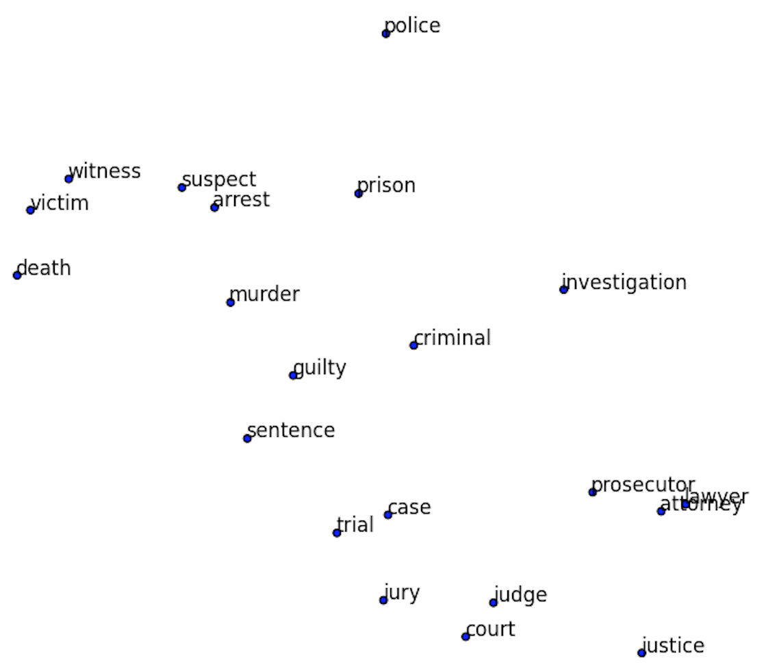
Visualizing Word Embeddings
If we zoom in on a small region of our word map, it’s all related words.
Note the similarity of all the words as a whole, but also of the individual neighbors.
“Lawyer” and “attorney” are right next to each other – they have almost identical characteristics!

Slide 18
Word Recipes
The relationship between words can be maintained, we can do mathematical operations on these word vectors.
Add the same vector distance between man and woman will convert uncle to aunt and king to queen.
Plural relationships are also maintained.

Slide 19
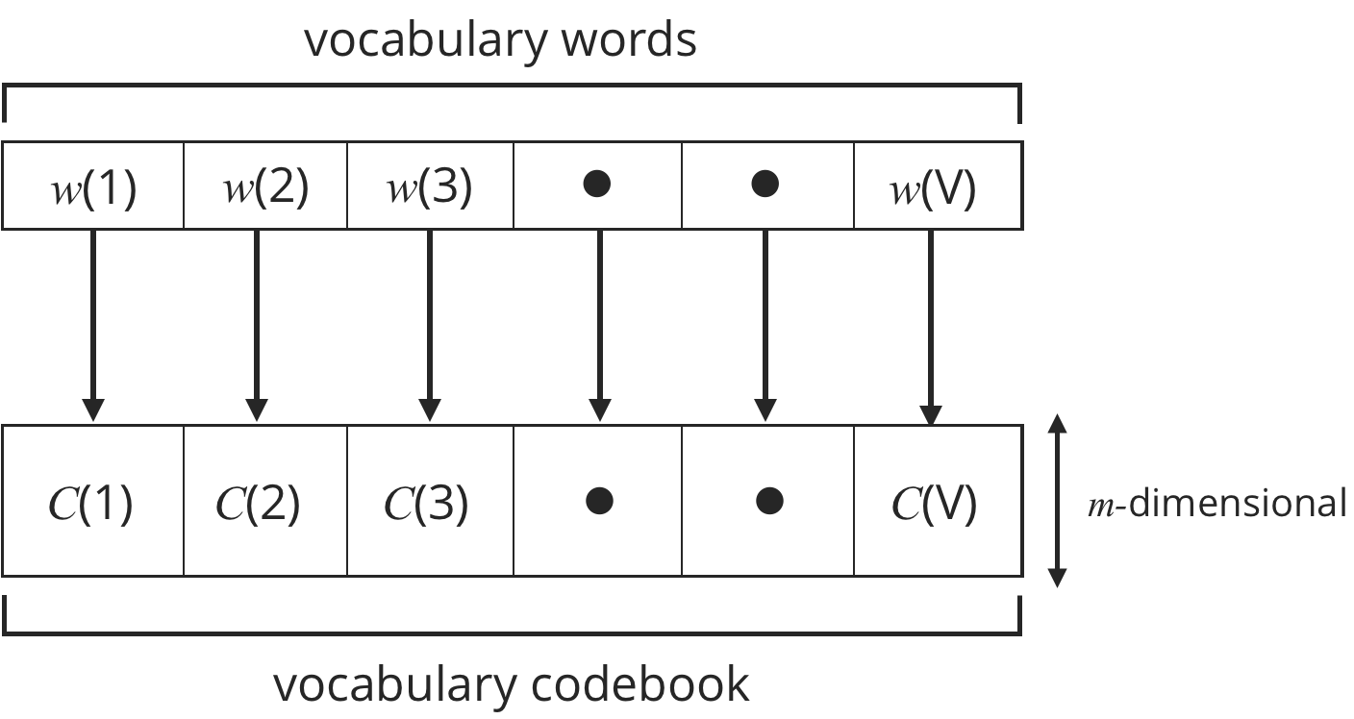
Word to Vector (Word2Vec)
Assigns words to numeric vectors
Many characteristics/dimensions (~300) to capture complexity of meaning
Do this by creating a lookup table for each word in our vocabulary (i.e. all the words we know). In code, the lookup table is implemented as a dictionary.

Slide 20
Word to Vector (Word2Vec)
Enter the word into the dictionary
Receive the vector, or “embedding”, for that word

Slide 21
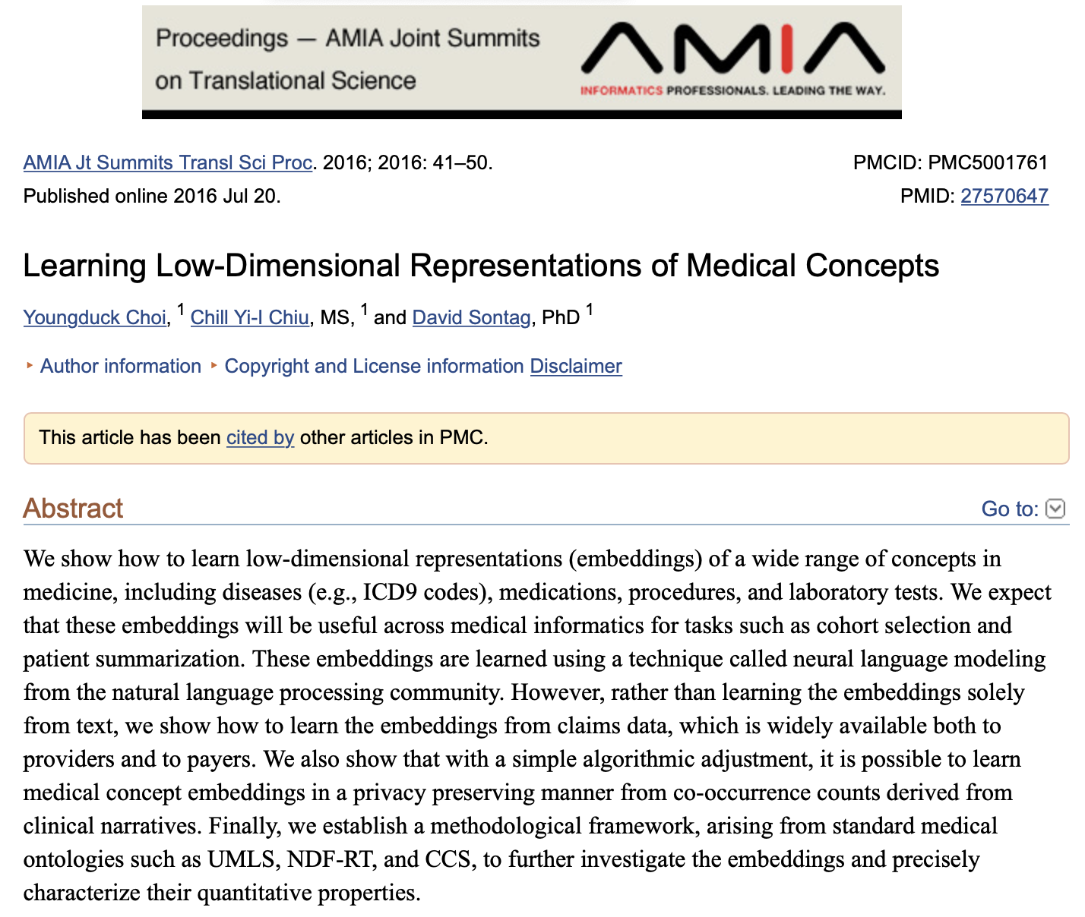
Note: we can also do this with categorical variables!
Locations (city/state)
Dx and procedure codes
Medical concepts
What attributes could be used to encode the meaning of medical concepts?

Slide 22
What happens when we apply this to a sentence?
Look up words individually to obtain their vectors
Construct a sequence of vectors
This is a sentence
x_{i}

Slide 23
So how do we learn spatial locations for each word?
KEY IDEA: words are defined by the context in which they appear
A man strolls down the street
A woman strolls down the street
A child strolls down the street
A crocodile strolls down the street
A banana strolls down the street
A concept strolls down the street

Slide 24
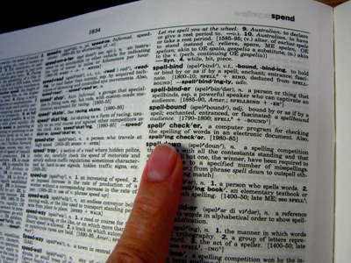
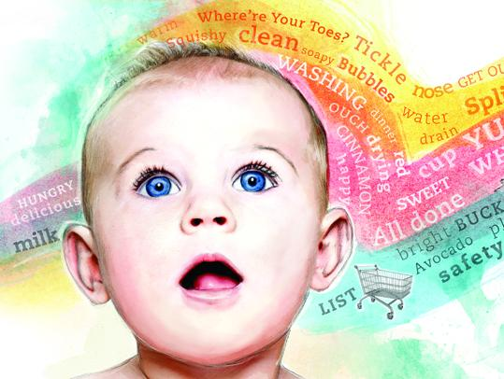
KEY IDEA: words are defined by the context in which they appear
-> if words are always exchangeable, they must have very similar meaning
https://www.parenting.com/activities/baby/teach-baby-to-talk/
learn word meaning like an adult:
explicit definitions
learn word meaning like an child:
implicit definitions from context

Slide 25
Learning Word Embeddings

Slide 26
So how do we learn spatial locations for each word?
We want: a vector for each word that allows us to predict its context
(i.e. what other words are likely/unlikely to be around it)
p(man)
p(woman)
elements of the vector corresponding to “strolls”
Logistic regression
p(child)
probabilities for all words in our vocabulary
p(banana)
p(crocodile)
v(strolls)
p(concept)

Slide 27
Predict Context Words from Input Words
We define a context word as one that appears inside a fixed-length window around the input word in our training corpus.
(e.g. Wikipedia)
A man strolls down the street.
input context
{input word, context word}
{strolls, man}
{strolls, woman}
{swims, crocodile}
{swims, fish}
{flies, bird}
{flies, plane}

Slide 28
So how do we learn spatial locations for each word?
We want: a vector for each word that allows us to predict its context
(i.e. what other words are likely/unlikely to be around it)
p(man)
p(woman)
close to 1
elements of the vector corresponding to “strolls”
Logistic regression
p(child)
p(banana)
p(crocodile)
v(strolls)
p(concept)
close to 0

Slide 29
So how do we learn spatial locations for each word?
We want: a vector for each word that allows us to predict its context
(i.e. what other words are likely/unlikely to be around it)
p(man)
p(woman)
elements of the vector corresponding to “swims”
Logistic regression
p(child)
p(banana)
p(crocodile)
v(swims)
p(concept)

Slide 30
So how do we learn spatial locations for each word?
We want: a vector for each word that allows us to predict its context
(i.e. what other words are likely/unlikely to be around it)
p(man)
p(woman)
elements of the vector corresponding to “swims”
Logistic regression
p(child)
p(banana)
p(crocodile)
closer to 1
v(swims)
p(concept)

Slide 31
So how do we learn spatial locations for each word?
We want: a vector for each word that allows us to predict its context
(i.e. what other words are likely/unlikely to be around it)
p(man)
p(woman)
These vectors are what we want to learn
Logistic regression
p(child)
p(banana)
We could build this model if we had the vectors; less clear how to get them
closer to 1
p(crocodile)
v(swims)
p(concept)

Slide 32



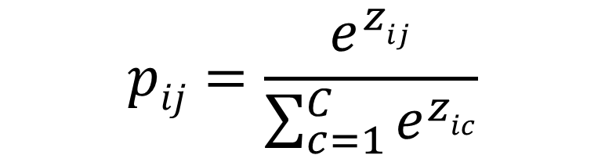


Recall: Multi-Class Logistic Regression
$$p_{i1}$$
$$p_{iC}$$
$$pij=\frac{e^{zij}}{\sum_{c=1}^{C}{e^{zic}}}$$
$$pi = softmax(zi)$$
$$z_{i1}$$
$$z_{iC}$$
x_{i1}
x_{iM}

Slide 33
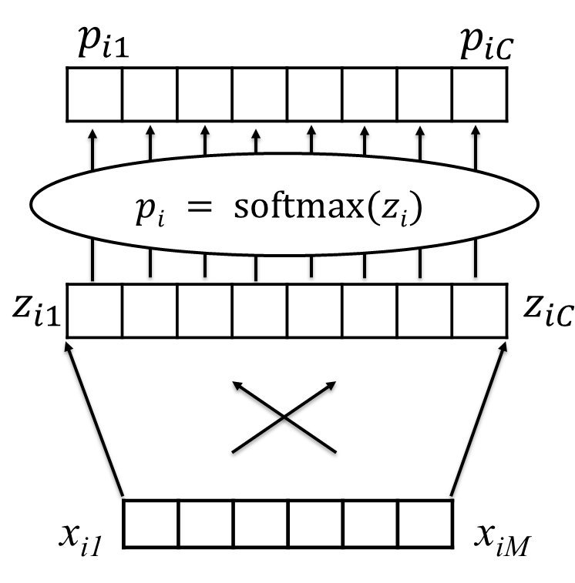
Recall: Multi-Class Logistic Regression

Slide 34
Recall: Multi-Class Logistic Regression
z(man)
softmax
p(man)
p(woman)
p(child)
p(banana)
p(crocodile)
v(strolls)
p(concept)
z(concept)

Slide 35
We want: word vectors that allow us to predict their likely context
But again, how do we learn these vectors?
Let’s take a step back: we’ll focus on understanding how we can predict context words based on input words
z(man)
softmax
p(man)
p(woman)
p(child)
p(banana)
p(crocodile)
v(strolls)
p(concept)
z(concept)

Slide 36
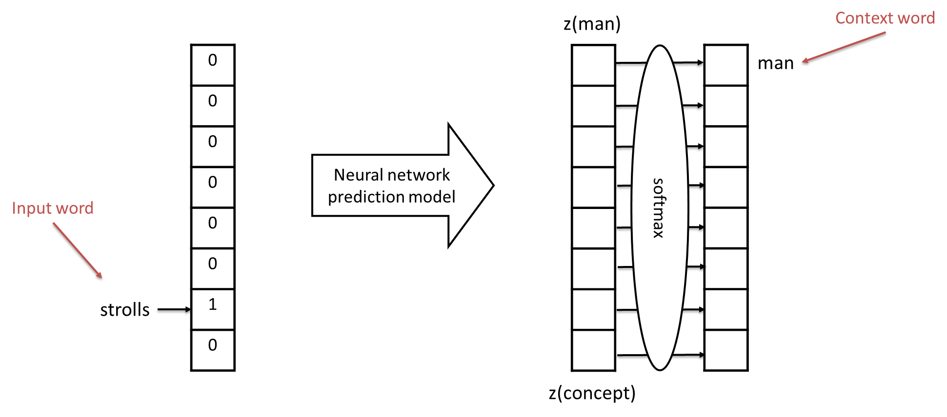
Predicting context words based on input words
Input words and context words are one-hot encoded
(similar to bag of words representation)

Slide 37
Predicting context words based on input words
Training Data:
HUGE number of pairs of the following form:
{input word, context word}
e.g. from Wikipedia
Examples:
{strolls, man}
{strolls, woman}
{swims, crocodile}
{swims, fish}
{flies, bird}
{flies, plane}

Slide 38
Predicting context words based on input words
Training Data:
HUGE number of pairs of the following form:
{input word, context word}
e.g. from Wikipedia
Examples:
{strolls, man}
{strolls, woman}
{swims, crocodile}
{swims, fish}
{flies, bird}
{flies, plane}
These vectors are huge!
They’re the size of our vocabulary

Slide 39
What’s the simplest model we can possibly use?
First idea:
Directly connect our input to the log-odds layer
These vectors are huge!
They’re the size of our vocabulary

Slide 40
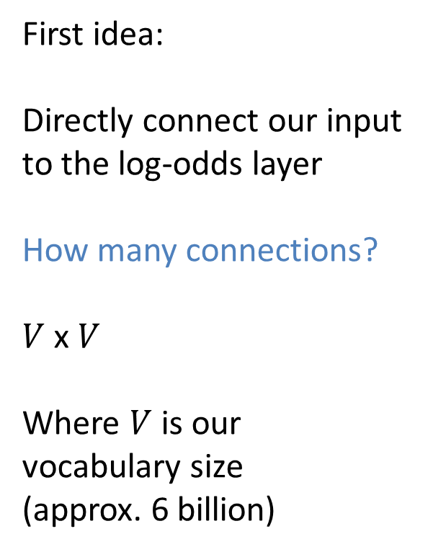
What’s the simplest model we can possibly use?
First idea:
Directly connect our input to the log-odds layer
How many connections?
$V$ x $V$
Where $V$ is our vocabulary size
(approx. 6 billion)
These vectors are huge!
They’re the size of our vocabulary

Slide 41
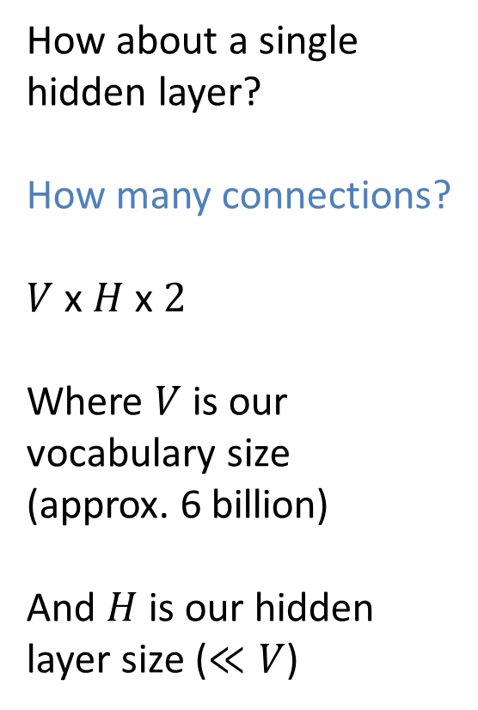
What’s the next simplest?
How about a single hidden layer?
How many connections?
$V$ x $H$ x $2$
Where $V$ is our vocabulary size
(approx. 6 billion)
And $H$ is our hidden layer size ($≪V$)
These vectors are huge!
They’re the size of our vocabulary

Slide 42
OK, let’s try it: use a single hidden layer
z(man)
0
0
0
0
0
0
1
0
softmax
1
0
0
0
0
0
0
0
man
strolls
z(concept)

Slide 43
Use mini-batches of training examples; minimize cross-entropy loss
z(man)
0
0
1
0
0
0
0
0
softmax
0
0
0
0
0
1
0
0
swims
crocodile
z(concept)

Slide 44


Learn our parameters: Weight Matrices $W$ and $B$
z(man)
0
0
1
0
0
0
0
0
softmax
0
0
0
0
0
1
0
0
swims
crocodile
$$W$$
$$B$$
z(concept)

Slide 45


Isn’t this the vector we were looking for?
z(man)
0
0
1
0
0
0
0
0
softmax
p(man)
p(woman)
swims
p(child)
p(banana)
it’s compact
It allows us to predict context words for a given input word
p(crocodile)
$$W$$
$$B$$
p(concept)
v(swims) ??
z(concept)

Slide 46


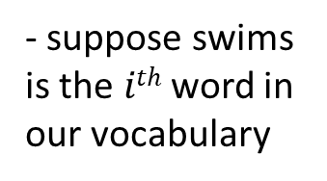
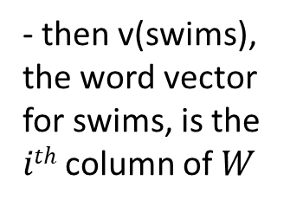
Let’s take a closer look at $W$
$$e_{i}$$
z(man)
0
0
1
0
0
0
0
0
$$We_{i}=W^{i}$$
softmax
p(man)
p(woman)
swims
p(child)
- suppose swims is the $ith$ word in our vocabulary
p(banana)
p(crocodile)
$$W$$
$$B$$
- then v(swims), the word vector for swims, is the $ith$ column of $W$
v(swims)
p(concept)
z(concept)

Slide 47


Let’s take a closer look at $W$
$V$, the size of the vocabulary
$H$, the size of the hidden layer

Slide 48
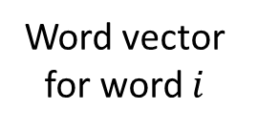

Let’s take a closer look at $W$
$V$, the size of the vocabulary
$$i$$
Word vector for word $i$
$H$, the size of the hidden layer

Slide 49
We now have a distributed representation of word meaning based on context
z(man)
0
0
1
0
0
0
0
0
softmax
p(man)
p(woman)
swims
p(child)
p(banana)
p(crocodile)
$$W$$
$$B$$
v(swims)
p(concept)
z(concept)

Slide 50
Important Takeaways:
We are learning a vector representation for each word based on the contexts in which it appears
training data: large number of pairs of nearby words from a large corpus
These vectors give us much more flexibility when modeling: makes text sequences like other sequences

Slide 51
A Very Simple Word Embedding-Based Model

Slide 52
VSWEM Step 1: Convert sentence to vectors
Look up words individually to obtain their vectors
Construct a sequence of vectors
This is a sentence

Slide 53
VSWEM Step 1: Convert sentence to vectors
Sentence length
This is a sentence
Embedding length

Slide 54
VSWEM Step 2: Take the MAX over the sentence for each embedding dimension
This is a sentence
MAX

Slide 55
VSWEM Step 2: Take the MAX over the sentence for each embedding dimension
This is a sentence
MAX

Slide 56
VSWEM Step 2: Take the MAX over the sentence for each embedding dimension
This is a sentence
MAX

Slide 57
VSWEM Step 2: Take the MAX over the sentence for each embedding dimension
This is a sentence
MAX

Slide 58
VSWEM Step 2: Take the MAX over the sentence for each embedding dimension
This is a sentence
MAX

Slide 59
VSWEM Step 2: Take the MAX over the sentence for each embedding dimension
This is a sentence
MAX

Slide 60
VSWEM Step 2: Take the MAX over the sentence for each embedding dimension
This is a sentence
max
MAX

Slide 61
VSWEM Step 3: Take the AVERAGE over the sentence for each embedding dimension
This is a sentence
AVG

Slide 62
VSWEM Step 3: Take the AVERAGE over the sentence for each embedding dimension
This is a sentence
AVG

Slide 63
VSWEM Step 3: Take the AVERAGE over the sentence for each embedding dimension
This is a sentence
AVG

Slide 64
VSWEM Step 3: Take the AVERAGE over the sentence for each embedding dimension
This is a sentence
AVG

Slide 65
VSWEM Step 3: Take the AVERAGE over the sentence for each embedding dimension
This is a sentence
AVG

Slide 66
VSWEM Step 3: Take the AVERAGE over the sentence for each embedding dimension
This is a sentence
AVG

Slide 67
VSWEM Step 3: Take the AVERAGE over the sentence for each embedding dimension
This is a sentence
avg
AVG

Slide 68
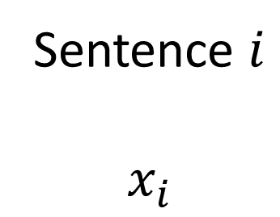
VSWEM Step 4: Concatenate MAX and AVG
max
This is a sentence
Sentence $i$
$$x_{i}$$
Question:
What information are we losing when we do this?
avg
Notes:
Losing: information about distinct words!
Different from bag of words, where we have no info about relationships between words.

Slide 69
A sequence of word vectors…
This is a sentence

Slide 70
…now looks just like a sequence of measurements
Day 1 Day 2 Day 3 Day 4
Temp
BP
HR
RR
SpO2
Glucose

Slide 71
In this case, too, we can get a single numeric vector for our predictive models by taking a max and average (or any other summary statistics we’d like)
Day 1 Day 2 Day 3 Day 4
Temp
BP
HR
RR
SpO2
Glucose

Slide 72
But when we do this, we lose information about measurement order (or word order).
Next time, we’ll talk about ways to overcome this limitation
Day 1 Day 2 Day 3 Day 4
Temp
BP
HR
RR
SpO2
Glucose

