Slide 1
The Multilayer Perceptron
(in other words, a standard neural network)
Matthew Engelhard
Notes:
Hi Everybody
In this lecture, we’re going to pick up right where we left off –
we’ll build on our understanding of logistic regression
And see how we can extend logistic regression to overcome its major limitation,
namely that it can only learn linear decision boundaries
The model we’ll end up with – in which we perform multiple rounds of logistic regression in sequence –
turns out to be the multilayer perceptron, also called a neural network or artificial neural network
The more logistic regressions we stack up, the deeper our models become, hence the term “deep learning”

Slide 2



Today: How can we modify logistic regression to learn complex, nonlinear relationships?
$$p$$
$$σ$$
z
b₀
b₅
$$1$$ | $$x_{1}$$ | $$x_{2}$$ | $$x_{3}$$ | $$x_{4}$$ | $$x_{5}$$
Notes:
RECALL OUR LOGISTIC REGRESSION MODEL – DESCRIBE IT
WE PREFER SIMPLE MODELS WHEN THEY CAN GET THE JOB DONE
BUT THIS THING… HAS A BIG LIMITATION.
Recall our logistic regression model
In this model we have features for patient x_i; there are M of them ranging from x_i1 to x_iM
We’re going to multiply each of those features by a corresponding model coefficient
We also add a bias term, which we have omitted here to simplify the presentation
We then add up all of those terms, which gives us z_i, which we call the log odds
We then convert the log odds to the corresponding probability using the logistic, or sigmoid function, denoted by sigma
But remember, from our earlier lecture, that when we do this – when we multiply all the x_i values by the corresponding b’s – the output tells us how much x_i looks like b
Thinking of each as a vector, the dot product tells us to what extent x_i points in the direction of b

Slide 3
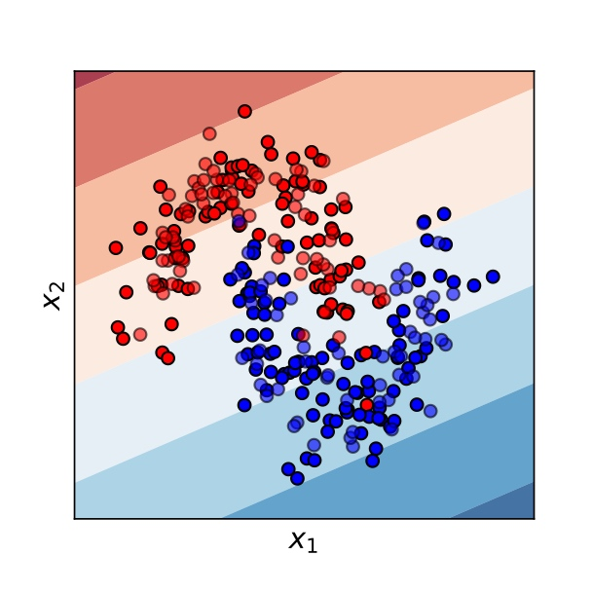
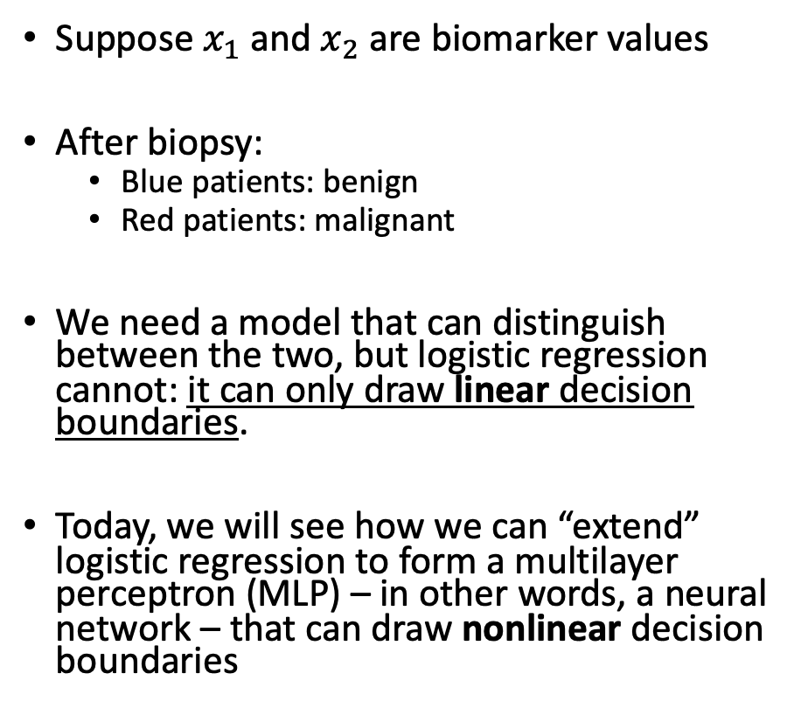
We need more flexible, non-linear classifiers
Suppose $x_{1}$and $x_{2}$ are biomarker values
After biopsy:
Blue patients: benign
Red patients: malignant
We need a model that can distinguish between the two, but logistic regression cannot: it can only draw linear decision boundaries.
Today, we will see how we can “extend” logistic regression to form a multilayer perceptron (MLP) – in other words, a neural network – that can draw nonlinear decision boundaries
Logistic Regression Decision Boundary
Notes:
And since our model only cares about how much x_i points in the b direction, our decision boundary is the hyperplane perpendicular to b
The image on this slide allows us to visualize the decision boundary.
In places where the background is red, the logistic regression model predicts that with >50% probability, a point in that location will be red
In places where the background is blue, the logistic regression model predicts that with >50% probability, a point in that location will be blue
The darker the shade, the more confident the model is in its predictions
Assuming we use a threshold of 50%, or .5, the model will predict that in regions with blue background, points will be blue; and that in regions with red background, points will be red.
And no matter what threshold we choose, the boundary between predicting red and predicting blue will be a line.
But clearly, this boundary is far from perfect: we have blue points on red background and vice versa; there are many examples for which logistic regression will perform poorly..
Now, I hope some of the explanations I’ve given here are helpful, but what really matters is this: logistic regression by its nature always gives us a linear decision boundary. But in practice, this often isn’t good enough.

Slide 4
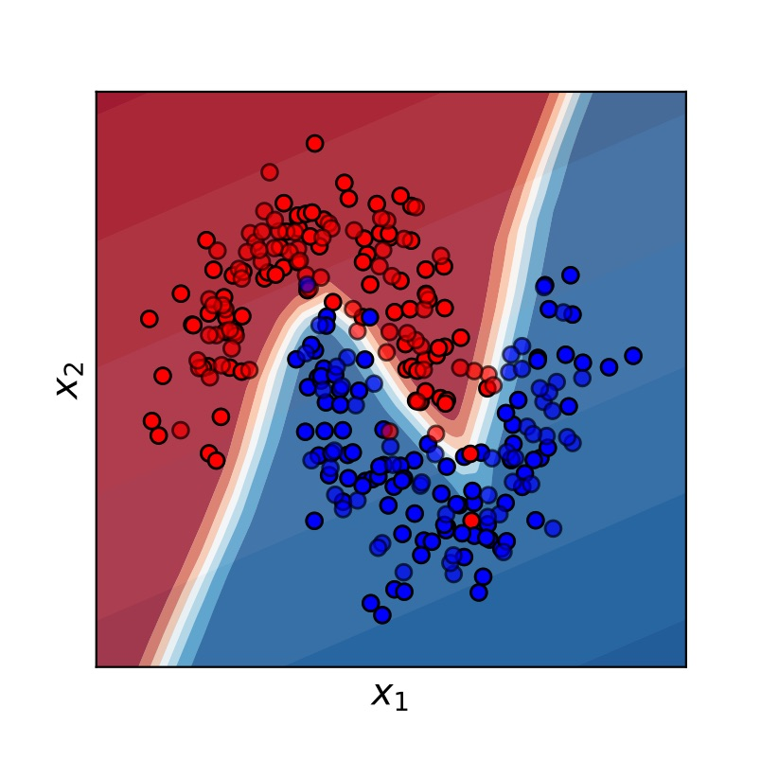
We need more flexible, non-linear classifiers
MLP (i.e. neural network)
decision boundary
Suppose $x_{1}$and $x_{2}$ are biomarker values
After biopsy:
Blue patients: benign
Red patients: malignant
We need a model that can distinguish between the two, but logistic regression cannot: it can only draw linear decision boundaries.
Today, we will see how we can “extend” logistic regression to form a multilayer perceptron (MLP) – in other words, a neural network – that can draw nonlinear decision boundaries
Notes:
What we’d like to have, in contrast, is a more flexible decision boundary. This is exactly what we’ll get by extending logistic regression to the multilayer perceptron, or MLP. In contrast to the previous figure, we see here that when we train an MLP to classify these points, it is highly effective – it learns a non-linear decision boundary that separates the red and blue groups quite well

Slide 5
Let’s break logistic regression.

Slide 6
Breaking logistic regression: simple example 1
Suppose there’s a new disease. We’re trying to develop a predictive model to determine who it will affect.
For whatever reason, it turns out the disease affects only two groups of people:
Females under 60
Males over 60
Can logistic regression learn to predict this?

Slide 7

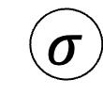
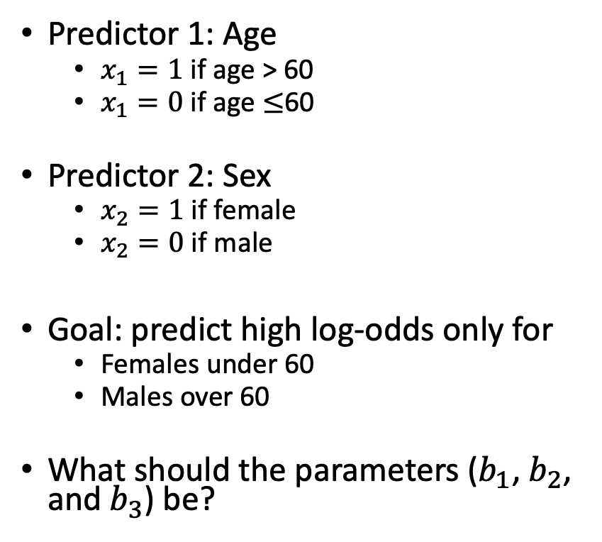

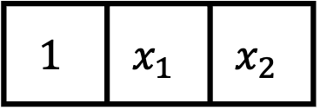
Breaking logistic regression: simple example 1
Predictor 1: Age
$x_{1}=1$if age > 60
$x_{1}=0$if age $≤$60
Predictor 2: Sex
$x_{2}=1$if female
$x_{2}=0$if male
Goal: predict high log-odds only for
Females under 60
Males over 60
What should the parameters ($b_{1}$, $b_{2}$, and $b_{3}$) be?
$$p\left(y=1 | x\right)$$
$$σ$$
$$z$$
b₀
b₁
b₂
$$1$$ | $$x_{1}$$ | $$x_{2}$$
Intercept
Age >60
Sex

Slide 8
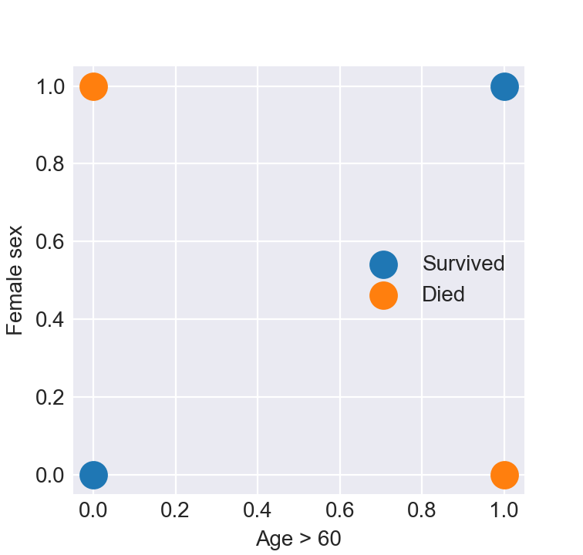
Breaking logistic regression: simple example 1
Can we solve this with a linear decision boundary?
In other words, can we draw a line separating those who lived from those who died?
Example of a Logistic Regression
Decision Boundary

Slide 9
Breaking logistic regression: simple example 2
In the ED, we’re trying to develop a model that predicts mortality from systolic blood pressure upon arrival.
It turns out, you’re at high risk of dying if you:
You have very high blood pressure, OR
You have very low blood pressure
Can logistic regression learn to predict this?

Slide 10
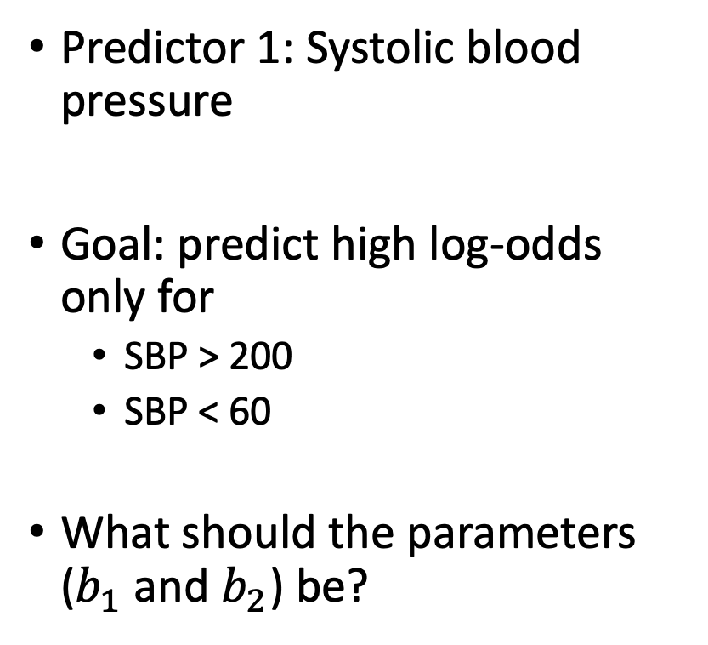
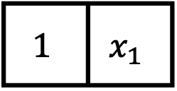
Breaking logistic regression: simple example 2
Predictor 1: Systolic blood pressure
Goal: predict high log-odds only for
SBP > 200
SBP < 60
What should the parameters ($b_{1}$ and $b_{2}$) be?
$$p\left(y=1 | x\right)$$
$$σ$$
$$z$$
b₀
b₁
$$1$$ | $$x_{1}$$
Intercept
SBP

Slide 11
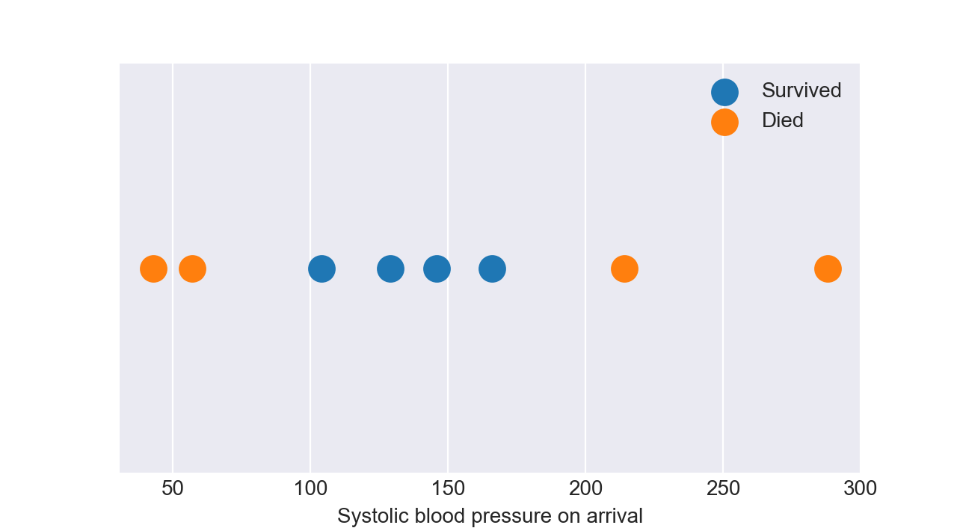
Breaking logistic regression: simple example 2
Can we solve this with a linear decision boundary?
In other words, can we draw a line separating those who lived from those who died?
Example of a Logistic Regression
Decision Boundary

Slide 12
In general, there can be:
Nonlinear affects (e.g. high and low blood pressure both increase risk; middle/normal blood pressure is OK)
Interactions: males over 60 are at risk, and females under 60 are at risk, but being male (or female) does not on its own increase risk
We need models that can figure this stuff out… but how?

Slide 13
How can we modify logistic regression to learn complex, nonlinear relationships?
$$p$$
$$σ$$
z
b₀
b₅
$$1$$ | $$x_{1}$$ | $$x_{2}$$ | $$x_{3}$$ | $$x_{4}$$ | $$x_{5}$$
Notes:
So, let’s get to it.
Returning to our logistic regression model, we’re going to make yet another simplification to our diagram

Slide 14

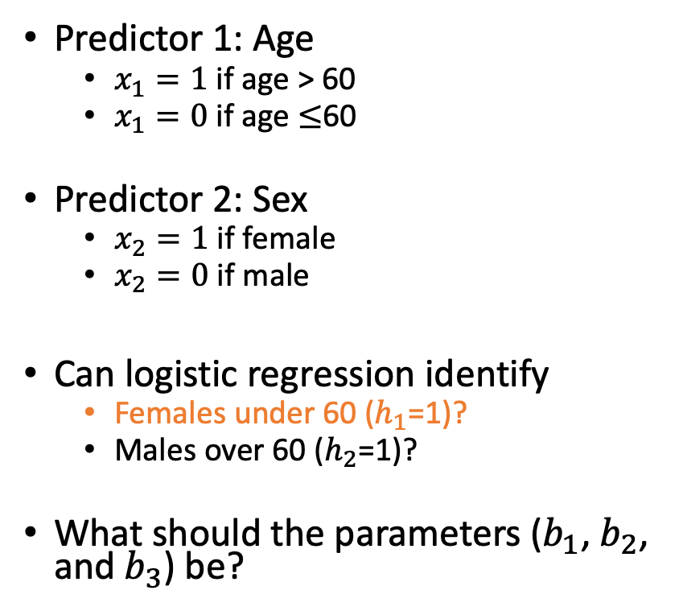

Let’s break the problem into simpler pieces.
Predictor 1: Age
$x_{1}=1$if age > 60
$x_{1}=0$if age $≤$60
Predictor 2: Sex
$x_{2}=1$if female
$x_{2}=0$if male
Can logistic regression identify
Females under 60 ($h_{1}$=1)?
Males over 60 ($h_{2}$=1)?
What should the parameters ($b_{1}$, $b_{2}$, and $b_{3}$) be?
$$p\left(h_{1}=1 | x\right)$$
$$σ$$
$$z_{1}$$
b₀
b₁
b₂
$$1$$ | $$x_{1}$$ | $$x_{2}$$
Intercept
Age >60
Sex

Slide 15

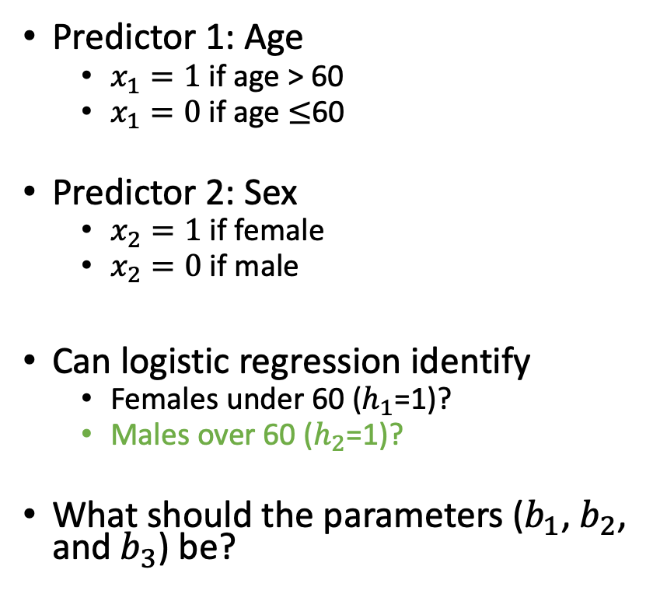

Let’s break the problem into simpler pieces.
Predictor 1: Age
$x_{1}=1$if age > 60
$x_{1}=0$if age $≤$60
Predictor 2: Sex
$x_{2}=1$if female
$x_{2}=0$if male
Can logistic regression identify
Females under 60 ($h_{1}$=1)?
Males over 60 ($h_{2}$=1)?
What should the parameters ($b_{1}$, $b_{2}$, and $b_{3}$) be?
$$p\left(h_{2}=1 | x\right)$$
$$σ$$
$$z_{2}$$
b₀
b₁
b₂
$$1$$ | $$x_{1}$$ | $$x_{2}$$
Intercept
Age >60
Sex

Slide 16






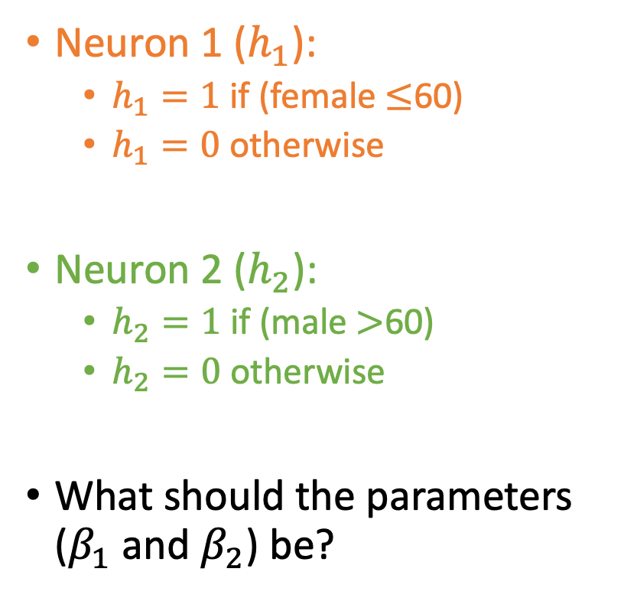



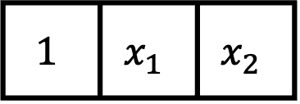


Now, use these predictions to make predictions
$$p\left(y=1 | x\right)$$
$$σ$$
$$ζ_{1}$$
Neuron 1 ($h_{1}$):
$h_{1}=1$ if (female $≤$60)
$h_{1}=0$ otherwise
Neuron 2 ($h_{2}$):
$h_{2}=1$ if (male $>$60)
$h_{2}=0$ otherwise
What should the parameters ($β_{1}$ and $β_{2}$) be?
$$β_{1}$$
$$β_{2}$$
$$p\left(h_{1}=1 | x\right)$$
$$p\left(h_{2}=1 | x\right)$$
$$σ$$
$$σ$$
$$z_{1}$$
$$z_{2}$$
$$1$$ | $$x_{1}$$ | $$x_{2}$$
Intercept
Age >60
Sex

Slide 17
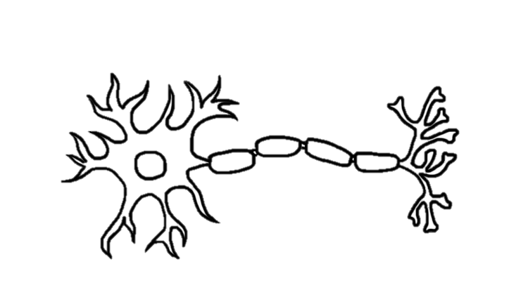
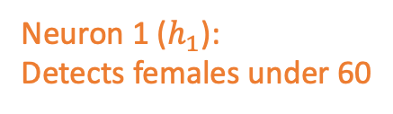
This is a neural network, or MLP.
Each logistic regression is like a neuron
Neuron 1 ($h_{1}$):
Detects females under 60

Slide 18
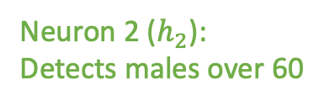
This is a neural network, or MLP.
Each logistic regression is like a neuron
Different neurons detect different features
Feature 1: female under 60
Feature 2: male over 60
Neuron 1 ($h_{1}$):
Detects females under 60
Neuron 2 ($h_{2}$):
Detects males over 60

Slide 19
This is a neural network, or MLP.
Each logistic regression is like a neuron
Different neurons detect different features
Feature 1: female under 60
Feature 2: male over 60
Predictions are made based on detected features rather than the original predictors
Neuron 3:
Predicts the outcome
Neuron 1 ($h_{1}$):
Detects females under 60
Neuron 2 ($h_{2}$):
Detects males over 60

Slide 20
Neural networks provide unlimited flexibility.
MLP (i.e. neural network)
decision boundary
Become more flexible by:
Adding more layers of feature detectors
Adding more feature detectors per layer
Notes:
What we’d like to have, in contrast, is a more flexible decision boundary. This is exactly what we’ll get by extending logistic regression to the multilayer perceptron, or MLP. In contrast to the previous figure, we see here that when we train an MLP to classify these points, it is highly effective – it learns a non-linear decision boundary that separates the red and blue groups quite well

Slide 21
To show multiple layers of neurons, we need to simplify our logistic regression graph.
$$p$$
$$σ$$
z
b₀
b₅
$$1$$ | $$x_{1}$$ | $$x_{2}$$ | $$x_{3}$$ | $$x_{4}$$ | $$x_{5}$$
Notes:
So, let’s get to it.
Returning to our logistic regression model, we’re going to make yet another simplification to our diagram

Slide 22

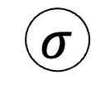
To show multiple layers of neurons, we need to simplify our logistic regression graph.
$$p$$
$$p$$
$$σ$$
$$σ$$
z
simplify
z
b₀
b₅
b
$$1$$ | $$x_{1}$$ | $$x_{2}$$ | $$x_{3}$$ | $$x_{4}$$ | $$x_{5}$$
x
Notes:
Instead of showing that sigmoid each time, we’re going to remove it, so that when you see nodes connected as above, remember that there are in fact two steps: first, the linear part, and second, the sigmoid. But we’re going to leave off the sigmoid in our diagrams – we’re doing this only because it allows us to fit more complicated graphs on the page without making things too small.

Slide 23

To show multiple layers of neurons, we need to simplify our logistic regression graph.
$$p$$
$$σ$$
z
simplify
$$p$$
b₀
b₅
$$1$$ | $$x_{1}$$ | $$x_{2}$$ | $$x_{3}$$ | $$x_{4}$$ | $$x_{5}$$
Notes:
Instead of showing that sigmoid each time, we’re going to remove it, so that when you see nodes connected as above, remember that there are in fact two steps: first, the linear part, and second, the sigmoid. But we’re going to leave off the sigmoid in our diagrams – we’re doing this only because it allows us to fit more complicated graphs on the page without making things too small.

Slide 24





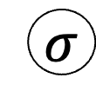

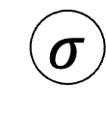
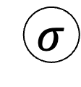
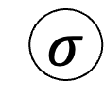




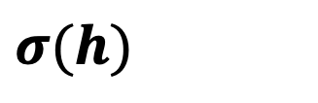
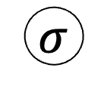

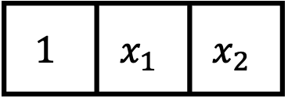

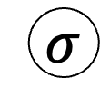
$$p\left(y=1 | x\right)$$
$$p\left(y=1 | x\right)$$
$$σ$$
$$σ$$
$$ζ_{1}$$
$$z$$
$$β_{1}$$
$$β_{2}$$
$$p\left(h_{1}=1 | x\right)$$
$$p\left(h_{2}=1 | x\right)$$
$$σ(h)$$
$$σ$$
$$σ$$
$$σ$$
$$σ$$
$$z_{1}$$
$$z_{2}$$
$$h$$
$$1$$ | $$x_{1}$$ | $$x_{2}$$
$$x$$
Intercept
Age >60
Sex
Intercept
Age >60
Sex

Slide 25

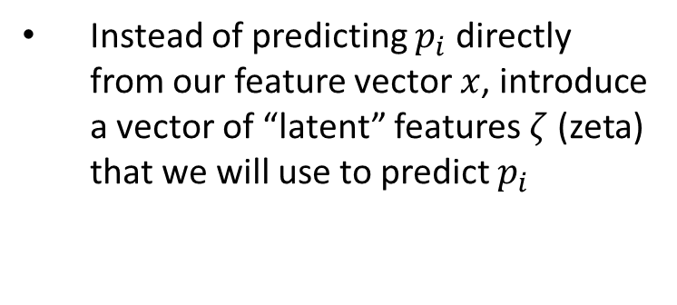
Instead of predicting $p_{i}$ directly from our feature vector $x$, introduce a vector of “latent” features $ζ$ (zeta) that we will use to predict $p_{i}$
$$p_{i}=σ(b_{0}+b⊙\text{ζ})$$
b₁
b_{M}
ζ_{i1}
ζ_{iM}
Notes:
Now again, we have our standard logistic regression model.
But this time, we’re going to suppose that we have a set of latent features zeta – these are features derived, in some way we haven’t determined yet, from the original features x. We don’t know how they’re derived – we can suppose that some other equation is used to produce zeta from x.
Now regardless of where those zeta are coming from, we’re going to use zeta, rather than x, to make our predictions. We’re going to perform logistic regression on zeta, and we’ll worry about where zeta comes from later.
So, fine – we know how to do this – it’s the same process we’ve considered before – based on examples of pairs of zeta and y, we’ll find the values of b that allow us to make good predictions for y

Slide 26


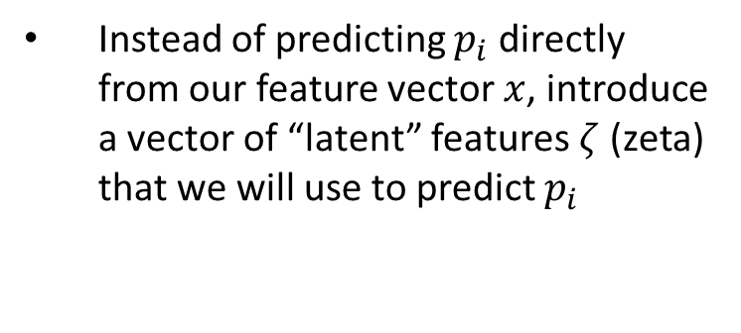
Instead of predicting $p_{i}$ directly from our feature vector $x$, introduce a vector of “latent” features $ζ$ (zeta) that we will use to predict $p_{i}$
$$p_{i}=σ(b_{0}+b⊙\text{ζ})$$
b₁
b_{M}
ζ_{i1}
$$\text{ζ}\text{iM}=σ(β_{M0}+β_{M}⊙x)$$
Individual elements of 𝜁 will themselves be the output of a logistic-regression-like model based on 𝑥
x_{i1}
x_{iM}
Notes:
But the question then becomes: where are we getting zeta?
This is where the idea of the “stacked” logistic regression comes in:
Each element of zeta will be the output of its own logistic regression model in which x are the features, and that element of zeta is the predicted value
As an equation, we can see above that zeta_iM is obtained by taking the dot product of x and a new parameter vector beta_M, adding a bias, and applying the logistic function – again, this is the logistic model we’ve been studying.
Now, since there are M values of zeta_i, each with its own logistic model, it’ll actually require M logistic regression models to connect x_i to zeta_i!

Slide 27

Instead of predicting $p_{i}$ directly from our feature vector $x$, introduce a vector of “latent” features $ζ$ (zeta) that we will use to predict $p_{i}$
$$p_{i}=σ(b_{0}+b⊙\text{ζ})$$
b₁
b_{M}
ζ_{i1}
$$\text{ζ}\text{iM}$$
Individual elements of 𝜁 will themselves be the output of a logistic-regression-like model based on 𝑥
x_{i1}
x_{iM}
Since this is true for all elements of 𝜁, x and 𝜁 are said to be “fully connected”
Notes:
We have one logistic regression model for zeta_i1, another for zeta_i2, and so on -- these models have parameter vectors beta_1, beta_2, etc.
If we put all those parameter vectors together, we get a matrix with that contains M^2 elements corresponding to the M^2 pairs of elements in x_i and zeta_i.
Since we have a parameter for each of these pairs – in other words, there is an arrow connecting each element of x_i to each element of zeta_i – we say that x_i and zeta_i are “fully-connected”

Slide 28
Instead of predicting $p_{i}$ directly from our feature vector $x$, introduce a vector of “latent” features $ζ$ (zeta) that we will use to predict $p_{i}$
$$p_{i}=σ(b_{0}+b⊙\text{ζ})$$
b₁
b_{M}
ζ_{i1}
$$\text{ζ}\text{iM}$$
Individual elements of 𝜁 will themselves be the output of a logistic-regression-like model based on 𝑥
x_{i1}
x_{iM}
Since this is true for all elements of 𝜁, x and 𝜁 are said to be “fully connected”
Simplified notation for fully connected layers
Notes:
And the notational conveniences keep on coming – we’ll use this notation to spare us from looking at all those arrows.
In this course, when you see these crossed arrows, it means that the two layers are fully connected.

Slide 29
Instead of predicting $p_{i}$ directly from our feature vector $x$, introduce a vector of “latent” features $ζ$ (zeta) that we will use to predict $p_{i}$
$$p_{i}=σ(b_{0}+b⊙\text{ζ})$$
b₁
b_{M}
ζ_{i1}
$$\text{ζ}\text{iM}$$
Individual elements of 𝜁 will themselves be the output of a logistic-regression-like model based on 𝑥
x_{i1}
x_{iM}
Since they are neither an input nor an output, the features ζ are said to be a “hidden” layer
Since this is true for all elements of 𝜁, x and 𝜁 are said to be “fully connected”
Notes:
Now in this diagram, the values of zeta_i are entirely internal to our model
These values are not directly observed, and therefore we call them “latent”, or “hidden”, features or variables.
Most often, you’ll hear people referring to these latent features as a “hidden” layer.

Slide 30
One last example: computer vision

Slide 31
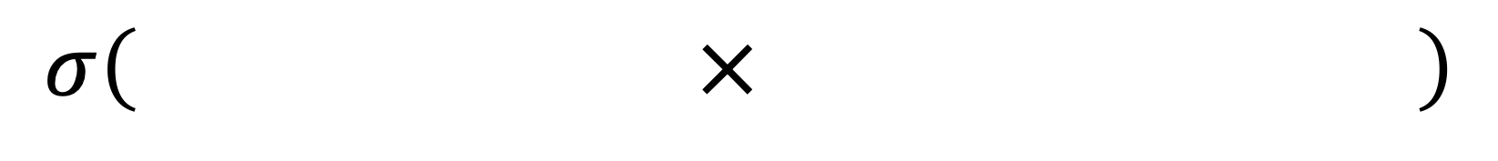
Why Limit Ourselves to Only One Filter?
$$σ\left( × \right)$$
Notes:
Now that we’ve covered the “what” – we’re going to be extending the logistic regression in this way –
Let’s think a little more about why.
And to help us do that, let’s return to our MNIST example from before.
Again, our vector of logistic regression parameters can be viewed as a filter that registers a “hit” – in other words, produces a positive value – when it encounters features that are similar to the filter itself.
When identifying handwritten digits, the model will learn that to identify zeros, it needs a filter that looks like a zero.

Slide 32
Return to MNIST: Many ways of writing “4”
Notes:
But, if we go back to the dataset and look closely, we’ll notice that there are MANY ways to write each digit.
There’s no such thing as a filter that looks like a four, because there are several quit distinct ways of writing a four, and a filter that looks like one won’t look much like the others.

Slide 33
Return to MNIST: Many ways of writing “4”
Single Filter (e.g. Logistic Regression/ “Shallow Learning”) only uses one filter, looks for the average shape
Notes:
But logistic regression gets only one filter per digit
As a result, the filter it’ll end up learning will look like the average of all the different ways of writing a four.
This filter will weakly match all the styles, but it won’t strongly match any of them

Slide 34
Return to MNIST: Many ways of writing “4”
Multiple filters can look for subtypes indicative of different ways of writing “4”
Notes:
Instead, we’d much prefer to have multiple filters, each corresponding to a different way of writing a four – there may be many
Then, we can predict four whenever any of these filters gives us a strong match instead of when the average filter gives us a weak match.
In practice, this is extremely helpful to help us distinguish 9’s from 4’s effectively, for example.

Slide 35
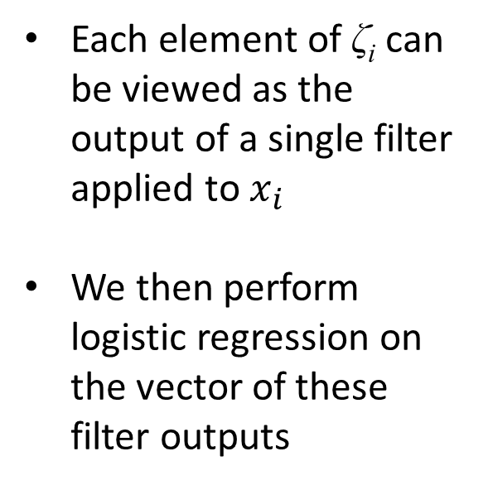
$$p_{i}=σ(b_{0}+b⊙\text{ζ})$$
Each element of $\text{ζ}\text{i}$ can be viewed as the output of a single filter applied to $x_{i}$
We then perform logistic regression on the vector of these filter outputs
b₁
b_{M}
ζ_{i1}
$$\text{ζ}\text{iM}$$
x_{i1}
x_{iM}
Notes:
So, why introduce these zeta_i?
Let’s suppose we’re training a model to distinguish between 4’s and 9’s.
Instead of a single filter, we now have M filters corresponding to the M values of zeta_i.
Each of them has the ability to learn a distinct way of writing a 4, or even a smaller shape representing a small part of a 4
The second layer of the model – the layer connecting zeta_i to p_i – can then learn that when specific zeta_i values are large – indicating that their filter strongly matches x – then the image is highly likely to be a four.
We get M distinct sub-models, each of them specializing in identifying one very specific shape within the image. The final prediction about p_i, then, is based on the weighing all the reports from all of these different specialists.

Slide 36
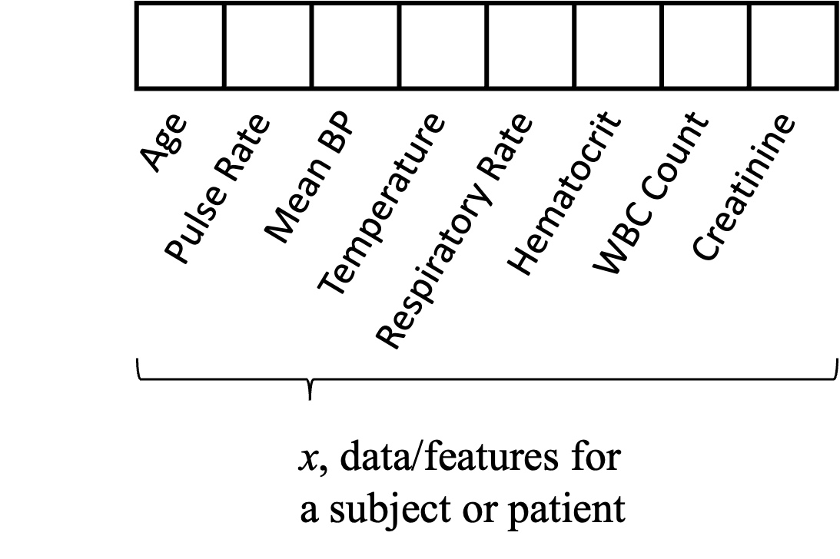
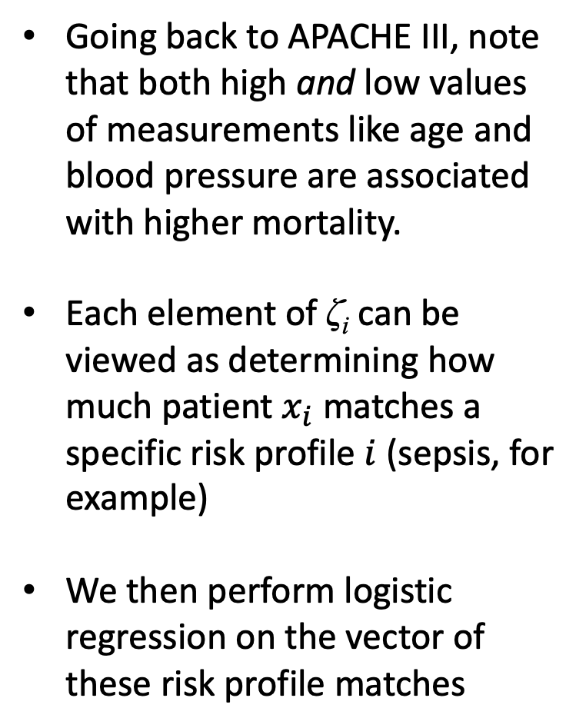
$$p_{i}=σ(b_{0}+b⊙\text{ζ})$$
Going back to APACHE III, note that both high and low values of measurements like age and blood pressure are associated with higher mortality.
Each element of $\text{ζ}\text{i}$ can be viewed as determining how much patient $x_{i}$ matches a specific risk profile $i$ (sepsis, for example)
We then perform logistic regression on the vector of these risk profile matches
b₁
b_{M}
ζ_{i1}
$$\text{ζ}\text{iM}$$
x_{i1}
x_{iM}
Notes:
Going back to our ICU example, we noted before that both high blood pressure and low blood pressure are likely to be associated with higher risk of mortality.
But in logistic regression, it can’t be both: either higher blood pressure increases risk, or it decreases it.
When we extend our logistic regression model to an MLP, however, we have much greater flexibility.
Each element of zeta_i can look for a specific pattern in the predictors – we can think of these patterns as different risk profiles that may be present.
The parameters beta_1 corresponding to zeta_1 might match x values consistent with something like sepsis – say, tachycardia and low BP
Zeta_i1, then, reports to subsequent layers the extent to which this sepsis risk profile is present in patient i
The parameters beta_2 corresponding to zeta_2 might match x values consistent with a hypertensive emergency, which includes a very high blood pressure
Zeta_i2 will then report the extent to which a hypertensive emergency is present in patient i
Again, we call these zeta_i values “latent features”, or a “hidden layer”. But we can think of each of them as reporting on the presence or absence of a specific pattern within the predictors x.
Each of the risk profiles is associated, to varying degrees, with mortality.
If zeta_i1 is reporting on sepsis and sepsis is strongly associated with mortality, then b_1 – which connects zeta_i1 to p_i – will be large and positive.

Slide 37
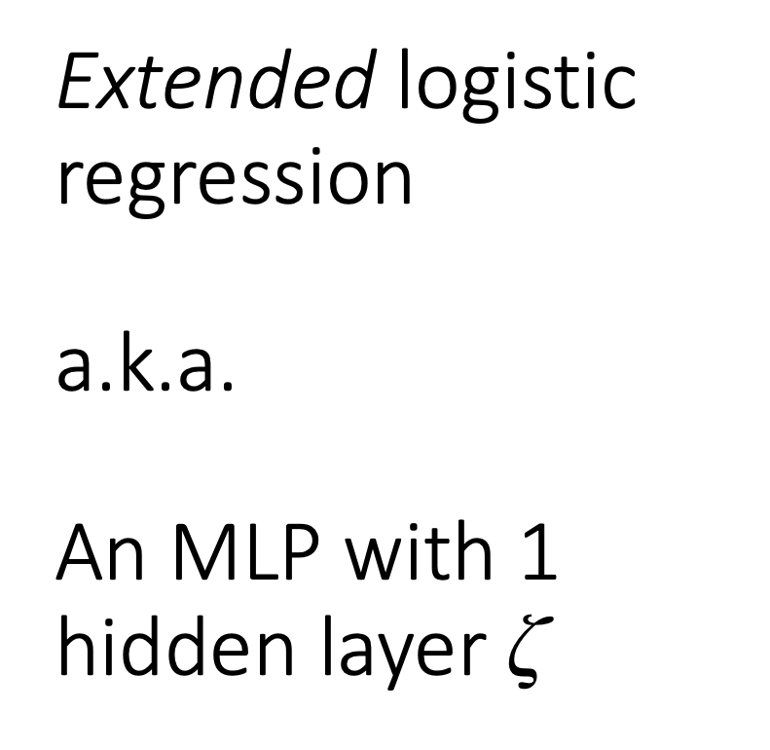
Extended logistic regression a.k.a. An MLP with 1 hidden layer $\text{ζ}$
$$p_{i}=σ(b_{0}+b⊙\text{ζ})$$
b₁
b_{M}
ζ_{i1}
$$\text{ζ}\text{iM}$$
x_{i1}
x_{iM}
Notes:
So again, the idea here is to stack many logistic regression models
Each model is looking for a specific pattern in its features
And those features could be the original features x – here, zeta connects to these features
Or they could be latent features
Here, p_i is connected directly to the latent features – the hidden layer – zeta.

Slide 38
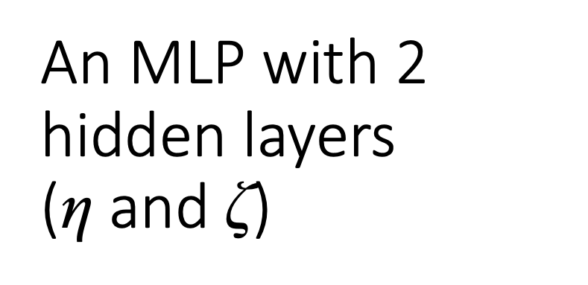
An MLP with 2 hidden layers (η and $\text{ζ}$)
$$p_{i}=σ(b_{0}+b⊙\text{ζ})$$
b₁
b_{M}
ζ_{i1}
$$\text{ζ}\text{iM}$$
η_{i1}
η_{iM}
By adding layers, we build a hierarchy of increasingly complex features
x_{i1}
x_{iM}
Notes:
And we are not limited to a single layer – we can go as deep as we like
As we add more layers, we build a hierarchy of features
As we move through the hierarchy, from the original features x to latent features increasingly removed from x, the patterns those features recognize become more and more abstract
In the image processing case, features in later layers will be identifying increasingly complex shapes
In the ICU case, they might be identifying increasingly complex physiologic profiles or states

Slide 39
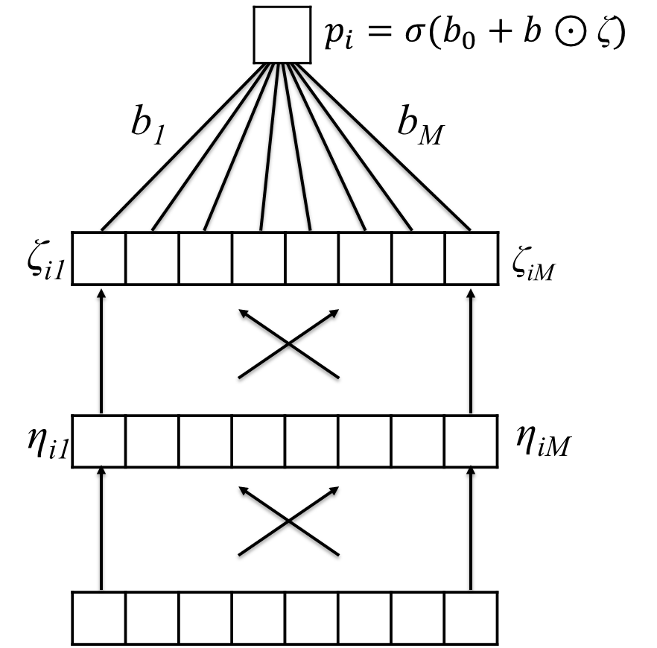
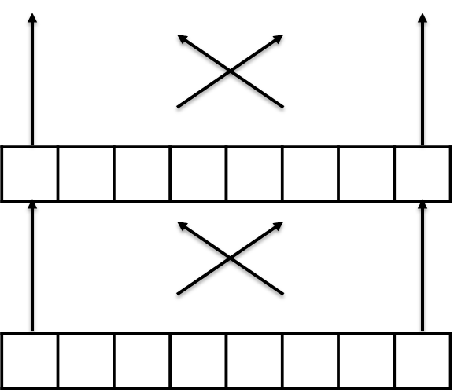
A deep MLP with many hidden layers “deep learning”
Notes:
The name “deep learning” comes from the idea that models are deep – they have many layers
These models can be very powerful
But it does come at a cost – each fully connected layer contains approximately M1 x M2 parameters, where M1 and M2 are the widths of the layers in question, which need not be the same.
These numbers can get large very quickly!

Slide 40
Learn Highly Non-Linear Decision Surfaces
Notes:
For our example problem, shown here, an MLP with one fairly narrow hidden layer is sufficient to give us excellent prediction performance
But the decision boundaries we’ll need to classify images effectively, for instance, are much more complicated than this, and will require very deep models.

Slide 41
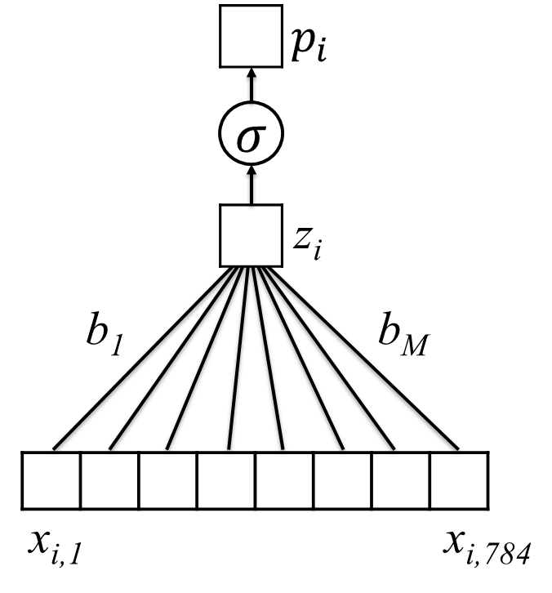
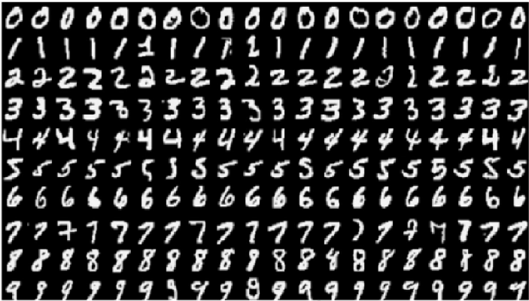
Does this work with MNIST?
~91% Accurate
Notes:
Going back to our MNIST example, how much does extending logistic regression to an MLP help us when classifying digits?
As mentioned previously, logistic regression can get us to about 91% accuracy, which is quite good

Slide 42
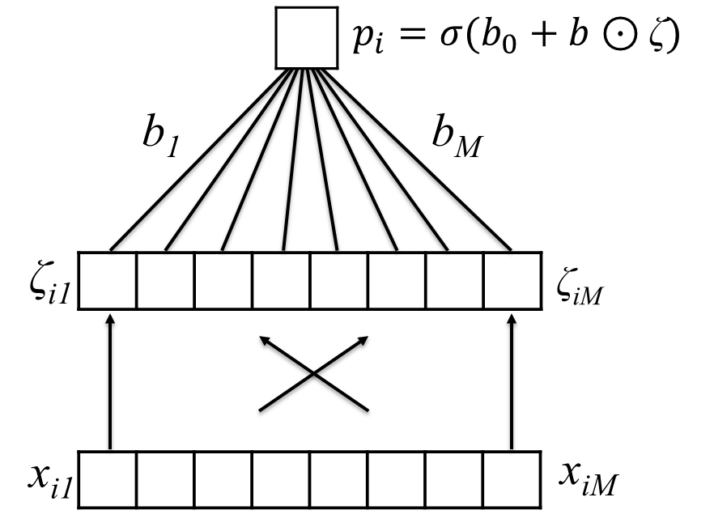
Does this work with MNIST?
~91% Accurate
~96% Accurate
Notes:
But by introducing a single hidden layer – using an MLP with one hidden layer – we immediately jump up to 96% accuracy.
And if you don’t think this is a big difference, think about an ATM that sometimes gave you only $400 dollars instead of the $900 you really deposited – it can happen 9% of the time or 4% of the time – you get to choose.

Slide 43
Summary
The multilayer perceptron (MLP), also called an artificial neural network (ANN), may be viewed as stacked (layers of) logistic regression models. Logistic regression is applied to latent features, which themselves are the result of earlier logistic regression models.
We therefore say that the MLP learns a hierarchy of features. Each successive level is more complex and/or abstract than the last.
MLPs can learn highly complex – in fact arbitrarily complex – decision surfaces. However, a large amount of data may be required.
Notes:
Thanks & see you next time.

