Slide 1
Performance Measures
Matthew Engelhard

Slide 2
Goals
Understand and calculate common performance measures for binary classification
Contextualize performance against that of a no information classifier
Recognize that good performance depends on existing alternatives
Match clinical scenarios to performance measures important in that scenario

Slide 3
Back to cancer prediction. Suppose our features are highly informative. What might our model’s predictions look like?
?
Notes:
What would we hope for so that the model would be useful?
Start with the benign cases. Would we hope that the predicted probabilities would be high, low, or somewhere in between?

Slide 4
Back to cancer prediction. Suppose our features are highly informative. What might our model’s predictions look like?
?
Notes:
Now, what about the malignant cases.
Would we hope that the predicted probabilities would be high, low, or somewhere in between?

Slide 5
Back to cancer prediction. Suppose our features are highly informative. What might our model’s predictions look like?
Notes:
Now, what about the malignant cases.
Would we hope that the predicted probabilities would be high, low, or somewhere in between?

Slide 6
below threshold: predict negative
above threshold: predict cancer positive
(NEGATIVES)
(POSITIVES)
Notes:
Metrics:
Sensitivity (recall, tpr)
Specificity (1-fpr)
Positive predictive value (precision)
Negative predictive value
Dependence on prevalence
Sensitivity: no (we draw more samples, but the TP/P ratio remains the same)
Specificity: no (we draw more samples, but the TN/N ratio remains the same)
PPV: yes (we draw more positive samples, and the TP/(TP+FP) ratio increases)
NPV: yes (we draw more positive samples, and the TN/(TN+FN) ratio decreases)

Slide 7
below threshold: predict negative
above threshold: predict cancer positive
TRUE NEGATIVES
FALSE POSITIVES
(NEGATIVES)
FALSE NEGATIVES
TRUE POSITIVES
(POSITIVES)
Notes:
Metrics:
Sensitivity (recall, tpr)
Specificity (1-fpr)
Positive predictive value (precision)
Negative predictive value
Dependence on prevalence
Sensitivity: no (we draw more samples, but the TP/P ratio remains the same)
Specificity: no (we draw more samples, but the TN/N ratio remains the same)
PPV: yes (we draw more positive samples, and the TP/(TP+FP) ratio increases)
NPV: yes (we draw more positive samples, and the TN/(TN+FN) ratio decreases)

Slide 8
Receiver Operating Characteristic Curve
Illustrates the tradeoff between the true positive rate (i.e., sensitivity) and the false positive rate (i.e., 1– specificity) as we vary the threshold.
The area under this curve (AUC) provides a single summarizing this tradeoff.
Note that to get the sensitivity versus specificity curve, we simply rotate the ROC curve clockwise by 90 degrees. The areas under the two curves are the same.
Notes:
Describe all elements of the curve.
Start at a threshold of zero (top right)
Move to a threshold of one (bottom left)
What is the range of the AUC?
Max = 1
Min = we’ll come back to that.

Slide 9
So, what’s a good AUC value? (i.e., good performance)?
We’ll start to answer this question by taking a look at bad performance.
Notes:
They’ll give you a rule of thumb. AUC=.7 – something like that.
TESTS for each of these.
Delong
Two-sample proportion test.

Slide 10
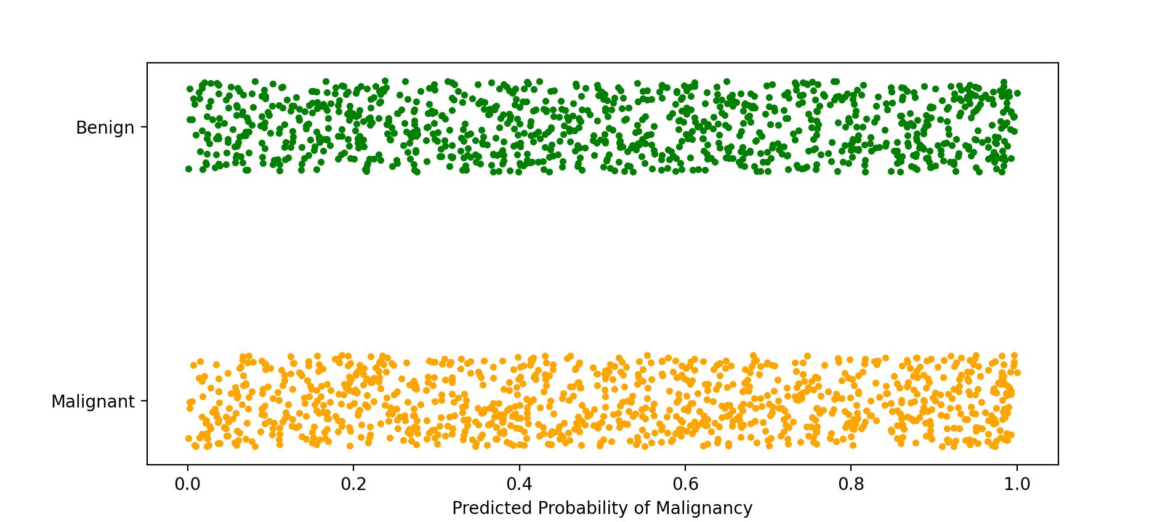
Suppose our features contain no information about the label. What might our model’s predictions look like?
?
Notes:
In other words, they’re all uncorrelated with the label.

Slide 11
Suppose our features contain no information about the label. What might our model’s predictions look like?
Similar distributions between positive and negative cases.
The predicted value tells you nothing about which one it’s more likely to be.
Notes:
Again, we have a raincloud plot as before
The smoothed histogram would be a flat line in this case, so I’ve omitted it.

Slide 12
We’ll try placing a threshold just like before
below threshold: predict negative
above threshold: predict cancer positive
What is the:
Sensitivity?
Specificity?
Positive predictive value?

Slide 13
We’ll try placing a threshold just like before
below threshold: predict negative
above threshold: predict cancer positive
What is the:
Sensitivity?
Specificity?
Positive predictive value?

Slide 14
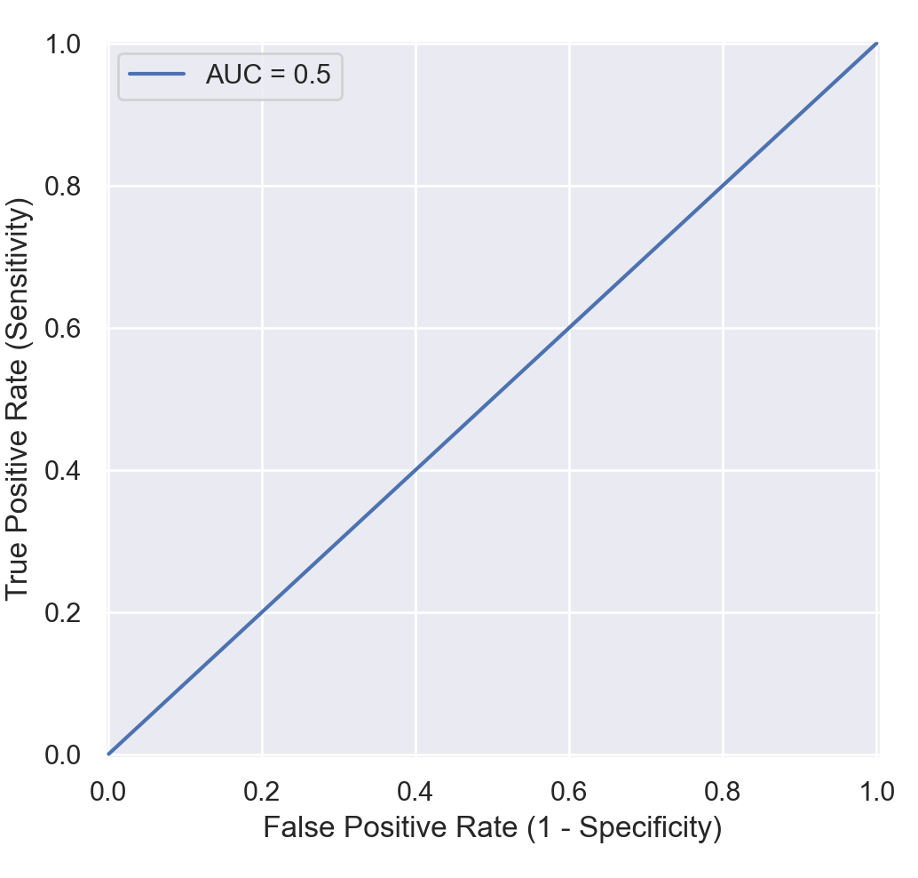
Our no information predictive model:
Place threshold at .3
Sensitivity = .7
False positive rate = .7
Specificity = 1-.7
Place threshold at p
Sensitivity = 1-p
False positive rate = 1-p
Specificity = p

Slide 15
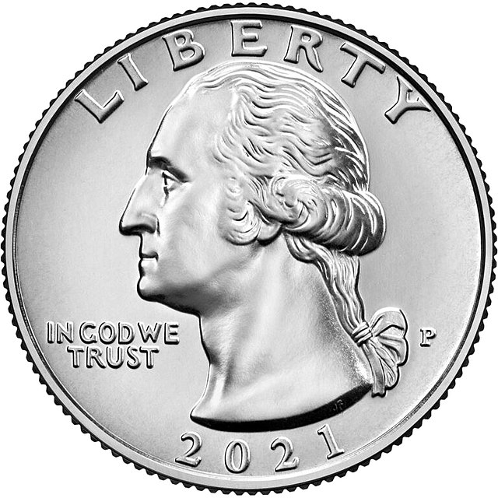
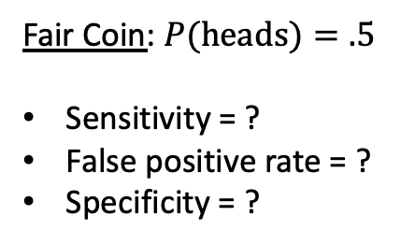
Let’s think about it a different way.
Suppose we have no predictors – again, no information – so we decide we’ll just flip a coin instead of building a model.
If the coin comes up heads, we’ll predict positive.
If the coin comes up tails, we’ll predict negative.
Fair Coin: $P(heads)=.5$
Sensitivity = ?
False positive rate = ?
Specificity = ?

Slide 16
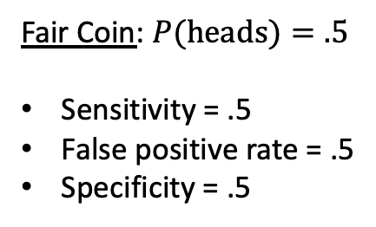
Let’s think about it a different way.
Suppose we have no predictors – again, no information – so we decide we’ll just flip a coin instead of building a model.
If the coin comes up heads, we’ll predict positive.
If the coin comes up tails, we’ll predict negative.
Fair Coin: $P(heads)=.5$
Sensitivity = .5
False positive rate = .5
Specificity = .5

Slide 17
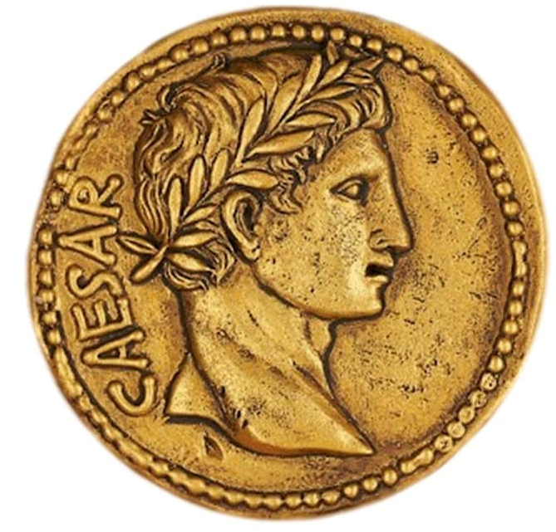

Let’s think about it a different way.
Suppose we have no predictors – again, no information – so we decide we’ll just flip a coin instead of building a model.
If the coin comes up heads, we’ll predict positive.
If the coin comes up tails, we’ll predict negative.
Fair Coin: $P(heads)=.5$
Sensitivity = .5
False positive rate = .5
Specificity = .5
Biased Coin: $P(heads)=p$
Sensitivity = ?
False positive rate = ?
Specificity = ?

Slide 18

Let’s think about it a different way.
Suppose we have no predictors – again, no information – so we decide we’ll just flip a coin instead of building a model.
If the coin comes up heads, we’ll predict positive.
If the coin comes up tails, we’ll predict negative.
Fair Coin: $P(heads)=.5$
Sensitivity = .5
False positive rate = .5
Specificity = .5
Biased Coin: $P(heads)=p$
Sensitivity = 1-p
False positive rate = 1-p
Specificity = p

Slide 19
Again, we arrive at the following no information curve
We may choose any p between 0 and 1 to get:
Sensitivity = p
False positive rate = p
Specificity = 1-p
What’s the area under this curve (AUC)? --> 0.5

Slide 20
So, what’s a good AUC value? (i.e., good performance)?
It depends.
Are predictions better than random?
Are predictions than the previous best performing model?
Are predictions better than expert performance?
Does performance exceed our (informed) expectations?
Is the model clinically useful?
Notes:
They’ll give you a rule of thumb. AUC=.7 – something like that.
EXAMPLES for each of these
TESTS for each of these.
Delong
Two-sample proportion test.

Slide 21
OK, we’ve quantified performance across all thresholds. But how do we use the model?
Sometimes the predicted probability really is what we care about.
Example: probability of heart attack
If so, we need to make sure our model is calibrated
More often, we need to pick a threshold so we can decide whether to:
Alert a provider
Get a biopsy
Refer the patient
etc
What threshold should we pick? What’s the right tradeoff?
Notes:
Describe all elements of the curve.
Start at a threshold of zero (top right)
Move to a threshold of one (bottom left)
What is the range of the AUC?
Max = 1
Min = we’ll come back to that.

Slide 22
Healthcare Scenarios Which performance measure is most important?
A computer vision model that detects carcinoma

Slide 23
Operating Point: high sensitivity

Slide 24
Healthcare Scenarios
A computer vision model that detects carcinoma
An algorithm that detects atrial fibrillation in Apple Watch users

Slide 25
Operating Point: high specificity

Slide 26
Healthcare Scenarios
A computer vision model that detects carcinoma
An algorithm that detects atrial fibrillation in Apple Watch users
An EHR-based model that monitors autism risk

Slide 27
Operating Point: balanced

Slide 28
Healthcare Scenarios
A computer vision model that detects carcinoma
An algorithm that detects atrial fibrillation in Apple Watch users
An EHR-based model that monitors autism risk
Sometimes specificity and sensitivity are difficult to interpret, particularly for rare conditions or events.
The most clinically relevant measure is often the positive predictive value (or negative predictive value).

Slide 29
The Precision-Recall Curve (i.e., PPV-Sensitivity Curve)
Often has greater direct clinical relevance than the ROC curve
The no information classifier always achieves PPV equal to the base rate, or prevalence (why?)
PPV as well as the area under this curve (average precision) must be interpreted relative to prevalence

Slide 30
Operating Point: high sensitivity

Slide 31
Operating Point: high specificity

Slide 32
Operating Point: balanced

Slide 33
Summary
It is critical to understand performance measures in order to critically evaluate models and put them to clinical/healthcare use.
To contextualize performance, we often compare models to a no information model whose predictions are random.
However, good performance depends on existing alternative approaches, both tech- and non-tech-based, and the clinical scenario.
Which measure is most important also depends on the clinical scenario.

Slide 34
Confusion Matrix for Multi-Class Problems
If time allows.

Slide 35
Multi-class problems: “Confusion Matrix”
Predicted Label
True Label

Slide 36
Multi-class problems: Binary for Label 1
Predicted Label
True Label

Slide 37
Multi-class problems: Binary for Label 2
Predicted Label
True Label

Slide 38
There are many more, of course, but classification metrics go a long way.
Regression
Mean squared error (MSE)
Mean absolute error (MAE)
R²
Survival Analysis (i.e. failure time)
Concordance index
MSE, MAE
Brier Score
AUC_{t}

