Slide 1
Learning Word Embeddings
MMCi Block 5
Matthew Engelhard
Notes:
NEED INFO ABOUT ROC, CONFUSION MATRIX, ETC HERE

Slide 2
From sentence to sequence of vectors.
Look up words individually to obtain their vectors
But where do the vectors come from?
This is a sentence
x_{i}

Slide 3
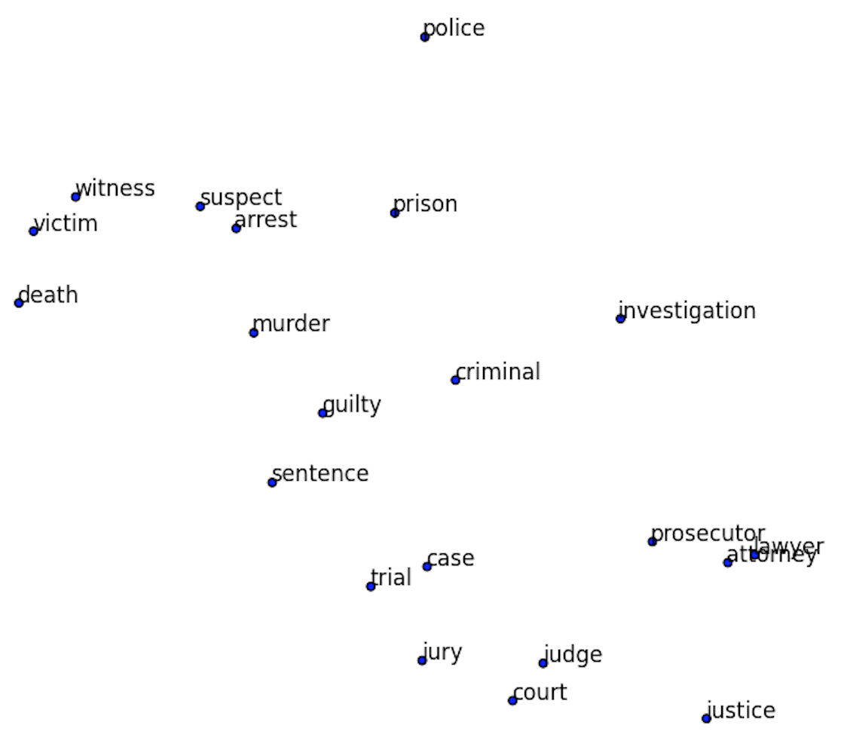
Visualizing Word Embeddings
If the meaning is similar, the vectors (i.e. locations) should be similar!

Slide 4
How are word embeddings learned?
KEY IDEA: words are defined by the context in which they appear
A man strolls down the street
A woman strolls down the street
A child strolls down the street
A crocodile strolls down the street
A banana strolls down the street
A concept strolls down the street

Slide 5
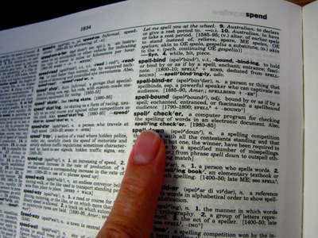
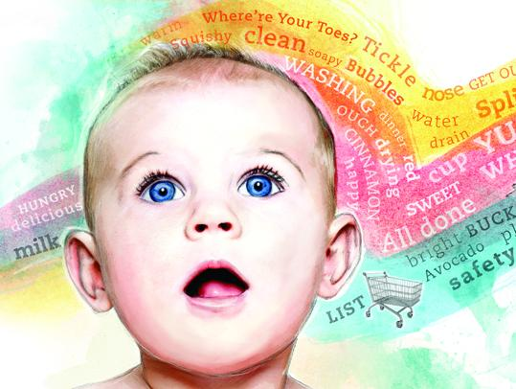
KEY IDEA: words are defined by the context in which they appear
-> if words are always exchangeable, they must have very similar meaning
https://www.parenting.com/activities/baby/teach-baby-to-talk/
learn word meaning like an adult:
explicit definitions
learn word meaning like an child:
implicit definitions from context

Slide 6
So how do we learn spatial locations for each word?
We want: a vector for each word that allows us to predict its context
(i.e. what other words are likely/unlikely to be around it)
p(man)
p(woman)
elements of the vector corresponding to “strolls”
Logistic regression
p(child)
probabilities for all words in our vocabulary
p(banana)
p(crocodile)
v(strolls)
p(concept)

Slide 7
Predict Context Words from Input Words
We define a context word as one that appears inside a fixed-length window around the input word in our training corpus.
(e.g. Wikipedia)
A man strolls down the street.
input context
{input word, context word}
{strolls, man}
{strolls, woman}
{swims, crocodile}
{swims, fish}
{flies, bird}
{flies, plane}

Slide 8
So how do we learn spatial locations for each word?
We want: a vector for each word that allows us to predict its context
(i.e. what other words are likely/unlikely to be around it)
p(man)
p(woman)
close to 1
elements of the vector corresponding to “strolls”
Logistic regression
p(child)
p(banana)
p(crocodile)
v(strolls)
p(concept)
close to 0

Slide 9
So how do we learn spatial locations for each word?
We want: a vector for each word that allows us to predict its context
(i.e. what other words are likely/unlikely to be around it)
p(man)
p(woman)
elements of the vector corresponding to “swims”
Logistic regression
p(child)
p(banana)
p(crocodile)
v(swims)
p(concept)

Slide 10
So how do we learn spatial locations for each word?
We want: a vector for each word that allows us to predict its context
(i.e. what other words are likely/unlikely to be around it)
p(man)
p(woman)
elements of the vector corresponding to “swims”
Logistic regression
p(child)
p(banana)
p(crocodile)
closer to 1
v(swims)
p(concept)

Slide 11
So how do we learn spatial locations for each word?
We want: a vector for each word that allows us to predict its context
(i.e. what other words are likely/unlikely to be around it)
p(man)
p(woman)
These vectors are what we want to learn
Logistic regression
p(child)
p(banana)
We could build this model if we had the vectors; less clear how to get them
closer to 1
p(crocodile)
v(swims)
p(concept)

Slide 12



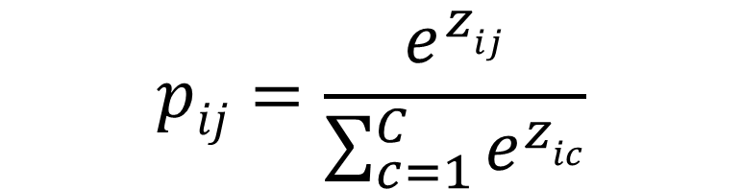

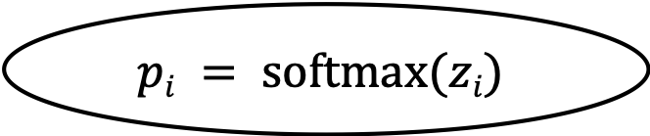
Recall: Multi-Class Logistic Regression
$$p_{i1}$$
$$p_{iC}$$
$$pij=\frac{e^{zij}}{\sum_{c=1}^{C}{e^{zic}}}$$
$$pi = softmax(zi)$$
$$z_{i1}$$
$$z_{iC}$$
x_{i1}
x_{iM}

Slide 13
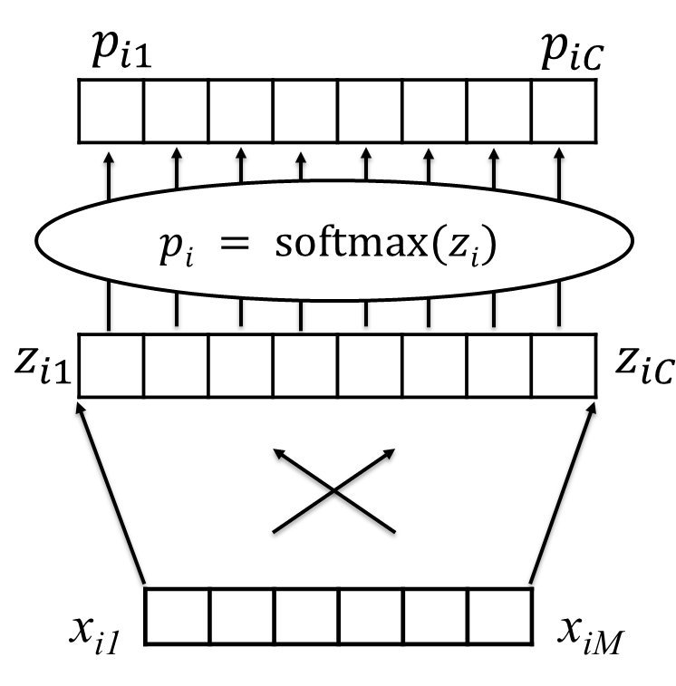
Recall: Multi-Class Logistic Regression

Slide 14
Recall: Multi-Class Logistic Regression
z(man)
softmax
p(man)
p(woman)
p(child)
p(banana)
p(crocodile)
v(strolls)
p(concept)
z(concept)

Slide 15
We want: word vectors that allow us to predict their likely context
But again, how do we learn these vectors?
Let’s take a step back: we’ll focus on understanding how we can predict context words based on input words
z(man)
softmax
p(man)
p(woman)
p(child)
p(banana)
p(crocodile)
v(strolls)
p(concept)
z(concept)

Slide 16
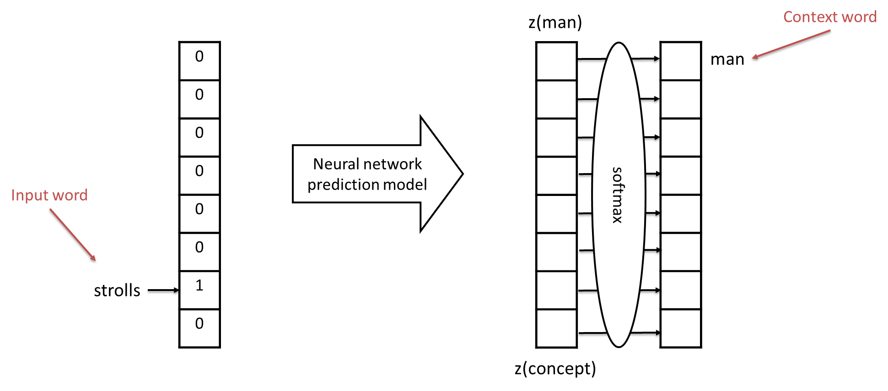
Predicting context words based on input words
Input words and context words are one-hot encoded
(similar to bag of words representation)

Slide 17
Predicting context words based on input words
Training Data:
HUGE number of pairs of the following form:
{input word, context word}
e.g. from Wikipedia
Examples:
{strolls, man}
{strolls, woman}
{swims, crocodile}
{swims, fish}
{flies, bird}
{flies, plane}

Slide 18
Predicting context words based on input words
Training Data:
HUGE number of pairs of the following form:
{input word, context word}
e.g. from Wikipedia
Examples:
{strolls, man}
{strolls, woman}
{swims, crocodile}
{swims, fish}
{flies, bird}
{flies, plane}
These vectors are huge!
They’re the size of our vocabulary

Slide 19
What’s the simplest model we can possibly use?
First idea:
Directly connect our input to the log-odds layer
These vectors are huge!
They’re the size of our vocabulary

Slide 20
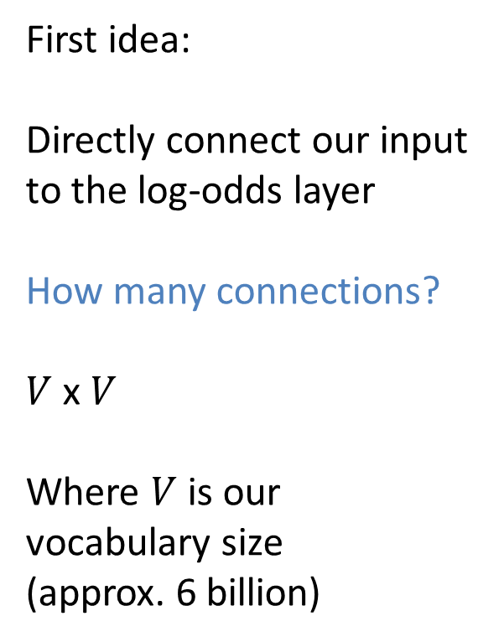
What’s the simplest model we can possibly use?
First idea:
Directly connect our input to the log-odds layer
How many connections?
$V$ x $V$
Where $V$ is our vocabulary size
(approx. 6 billion)
These vectors are huge!
They’re the size of our vocabulary

Slide 21
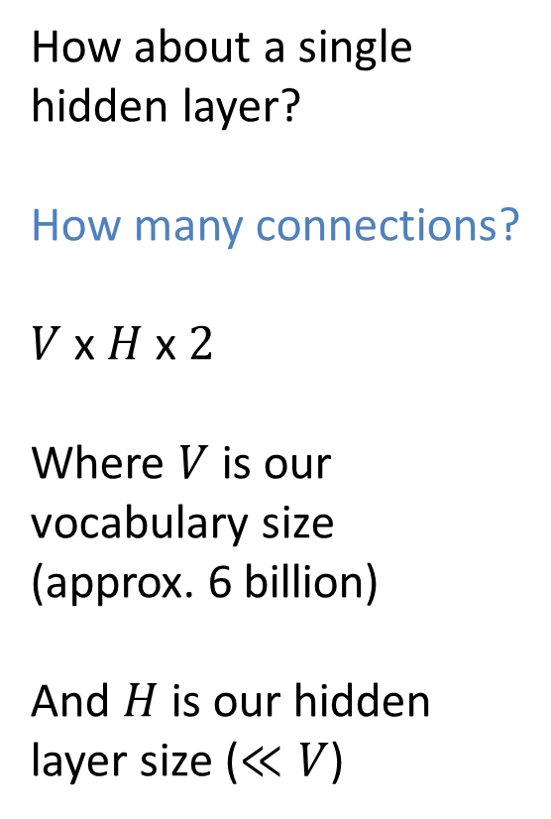
What’s the next simplest?
How about a single hidden layer?
How many connections?
$V$ x $H$ x $2$
Where $V$ is our vocabulary size
(approx. 6 billion)
And $H$ is our hidden layer size ($≪V$)
These vectors are huge!
They’re the size of our vocabulary

Slide 22
OK, let’s try it: use a single hidden layer
z(man)
0
0
0
0
0
0
1
0
softmax
1
0
0
0
0
0
0
0
man
strolls
z(concept)

Slide 23
Use mini-batches of training examples; minimize cross-entropy loss
z(man)
0
0
1
0
0
0
0
0
softmax
0
0
0
0
0
1
0
0
swims
crocodile
z(concept)

Slide 24


Learn our parameters: Weight Matrices $W$ and $B$
z(man)
0
0
1
0
0
0
0
0
softmax
0
0
0
0
0
1
0
0
swims
crocodile
$$W$$
$$B$$
z(concept)

Slide 25


Isn’t this the vector we were looking for?
z(man)
0
0
1
0
0
0
0
0
softmax
p(man)
p(woman)
swims
p(child)
p(banana)
it’s compact
It allows us to predict context words for a given input word
p(crocodile)
$$W$$
$$B$$
p(concept)
v(swims) ??
z(concept)

Slide 26


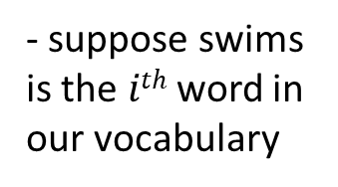
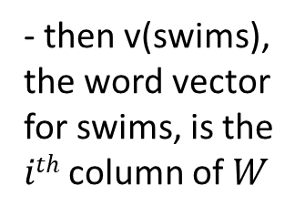
Let’s take a closer look at $W$
$$e_{i}$$
z(man)
0
0
1
0
0
0
0
0
$$We_{i}=W^{i}$$
softmax
p(man)
p(woman)
swims
p(child)
- suppose swims is the $ith$ word in our vocabulary
p(banana)
p(crocodile)
$$W$$
$$B$$
- then v(swims), the word vector for swims, is the $ith$ column of $W$
v(swims)
p(concept)
z(concept)

Slide 27


Let’s take a closer look at $W$
$V$, the size of the vocabulary
$H$, the size of the hidden layer

Slide 28
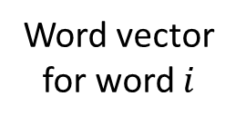

Let’s take a closer look at $W$
$V$, the size of the vocabulary
$$i$$
Word vector for word $i$
$H$, the size of the hidden layer

Slide 29
We now have a distributed representation of word meaning based on context
z(man)
0
0
1
0
0
0
0
0
softmax
p(man)
p(woman)
swims
p(child)
p(banana)
p(crocodile)
$$W$$
$$B$$
v(swims)
p(concept)
z(concept)

Slide 30
Important Takeaways:
We are learning a vector representation for each word based on the contexts in which it appears
training data: large number of pairs of nearby words from a large corpus
These vectors give us much more flexibility when modeling: makes text sequences like other sequences

