Slide 1
Course Retrospective
Matthew Engelhard
Notes:
NEED INFO ABOUT ROC, CONFUSION MATRIX, ETC HERE

Slide 2
We have covered a lot!

Slide 3
What is machine learning and what problems can it solve?
Logistic regression, MLP, computer vision, NLP

Slide 4
Logistic Regression: still going strong; use the simplest model that works well
$$p_{i}$$
$$σ$$
z_{i}
b₁
b_{M}
$$p_{i}=σ(b_{1}x_{i1}+b_{2}x_{i2}+…+b_{M}x_{iM})$$
x_{i1}
x_{iM}
Notes:
As one final simplification, we’ll use p_i to denote the probability that y_i is 1 given x_i – p_i is the probability of y_i predicted by our model
And if we placed a threshold on the probability p_i – as we did before in our prostate cancer example – we’d get a predicted value of y_i, which we’ve said is called y_i hat
More on this later.

Slide 5

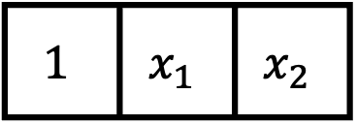



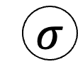
$$p\left(y=1 | x\right)$$
MLP for clinical and EHR variables: what are the advantages?
$$σ$$
$$z$$
Hidden Layer 2
$$h_{2}$$
Hidden Layer 1
$$h_{1}$$
$$1$$ | $$x_{1}$$ | $$x_{2}$$
Intercept
Age >60
Sex
Notes:
Give other terms for hidden layer
Latent features
Latent variables
Hidden units are the individual values

Slide 6
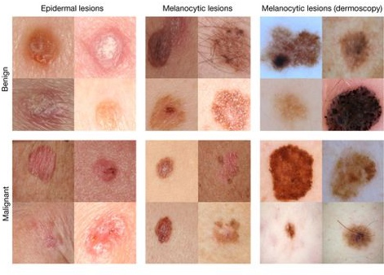
Overview of medical image processing: how it works, what it can do
Dermatologist-level classification of skin cancer
Nature volume 542, pages 115–118 (02 February 2017)

Slide 7

Bag of words & deep NLP how do we feed text into a predictive model?
PE
label
vector of high-
semantic features
NLP
Encoder
clinic
nearest
where
the
is
grid of semantic attributes

Slide 8
Multi-Modal Prediction Models
Train independently
Concatenate
Consider adding one more fully-connected, “interaction” layer
Train together
Fine-tune the whole model
CNN
Encoder
outcome
logistic
regression
image
NLP
Encoder
concatenated, multi-modal features
document
Notes:
As a slightly more advanced version of this, you may want to use a neural network with a single hidden layer to make predictions from your concatenated feature vector rather than a generalized linear model.
This allows you to take advantage of interactions between modalities that may be present
Finally, as a second optional step, you can fine-tune your entire model – including each modality specific encoder – together using a machine learning library like pytorch or tensorflow
This last step will be challenging from a data management and computational perspective, and it will not always improve performance, which is why I say it is optional.

Slide 9
Concepts needed to participate in model development and critically evaluate ML models
Performance measures; model learning; model development process; mitigating overfitting; understanding model predictions

Slide 10
Performance Measures for Binary Classification
ROC Curve and AUC
PR Curve and AP
Trade-offs between sensitivity, specificity, PPV, NPV
Choose clinically relevant measures
Notes:
Describe all elements of the curve.
Start at a threshold of zero (top right)
Move to a threshold of one (bottom left)
What is the range of the AUC?
Max = 1
Min = we’ll come back to that.

Slide 11




































The Model Development Process
Refine Model
$$x_{1}$$
$$y_{1}$$
$$x_{1}$$
$$y_{1}$$
$$x_{2}$$
$$y_{2}$$
$$x_{2}$$
$$y_{2}$$
$$x_{3}$$
$$y_{3}$$
$$x_{3}$$
$$y_{3}$$
$$x_{4}$$
$$y_{4}$$
$$x_{4}$$
$$y_{4}$$
$$x_{1}$$
$$y_{1}$$
$$x_{N−1}$$
$$x_{2}$$
$$y_{2}$$
$$x_{N−1}$$
$$y_{N−1}$$
$$x_{N}$$
$$y_{N}$$
$$x_{3}$$
$$y_{3}$$
$$x_{N}$$
$$y_{N}$$
Training Set
$$x_{4}$$
$$y_{4}$$
Test
$$x_{N−1}$$
$$y_{N−1}$$
$$x_{N}$$
$$y_{N}$$
$({b_{0},b}_{1},…b_{M})$
Validation
Estimate Performance on Validation Set
Final Performance Evaluation

Slide 12
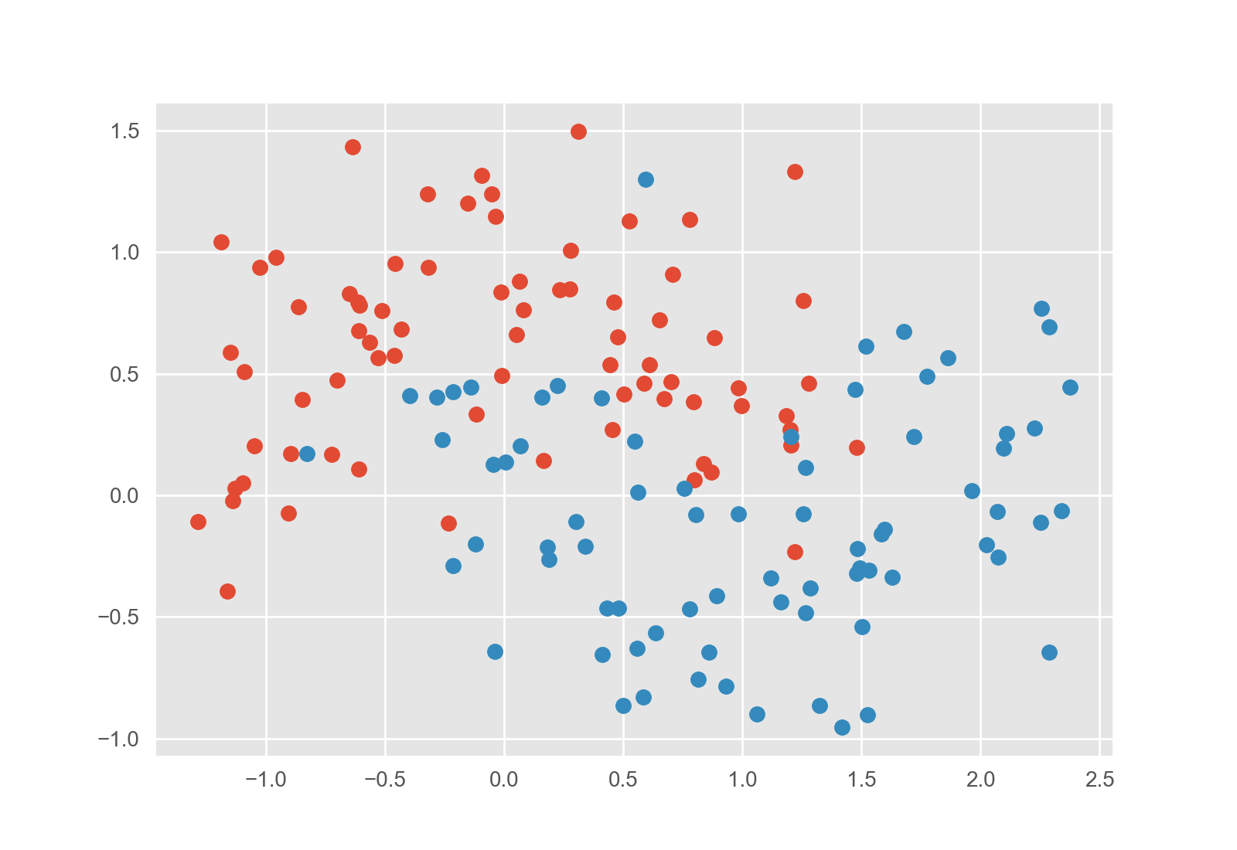
Overfitting and techniques to mitigate it why is this important?
Strategy 1:
Penalize complexity
(regularization)
We can quantify how curvy the line is and add that to the loss.
Strategy 2:
Keep checking the validation set
(early stopping)
When our boundary no longer works well on new data, we know we’ve gone too far.
Notes:
Note that really strategy 1 is explicit regularization, whereas strategy 2 is implicit regularization

Slide 13
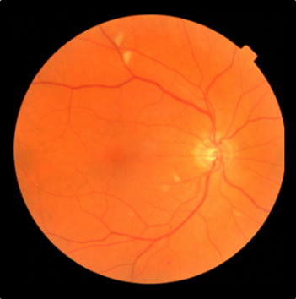
Understanding Model Predictions
Retinopathy? Yes/No

Slide 14
Course Objective
Understand of the capabilities and limitations of healthcare data science well enough to:
design and manage data science research and/or QA/QI projects
collaborate and communicate effectively with data scientists
critically evaluate data science models and methods, with an emphasis on rigorous model validation
Notes:
Note that we’re focused on collaboration, etc.
Also note that we are going to jump right in and talk about models
Then we will pull back a little

Slide 15
Thank you!
Be in touch: m.engelhard@duke.edu

