Slide 1
Envirotyping Case Study
MMCi Block 3
Matthew Engelhard

Slide 2
Smoking Environments have distinctive characteristics that can be identified using machine learning
Engelhard MM, Oliver JA, Henao R, Hallyburton M, Carin LE, Conklin CA, McClernon FJ. Identifying Smoking Environments From Images of Daily Life With Deep Learning. JAMA Netw Open. 2019;2(8):e197939.

Slide 3
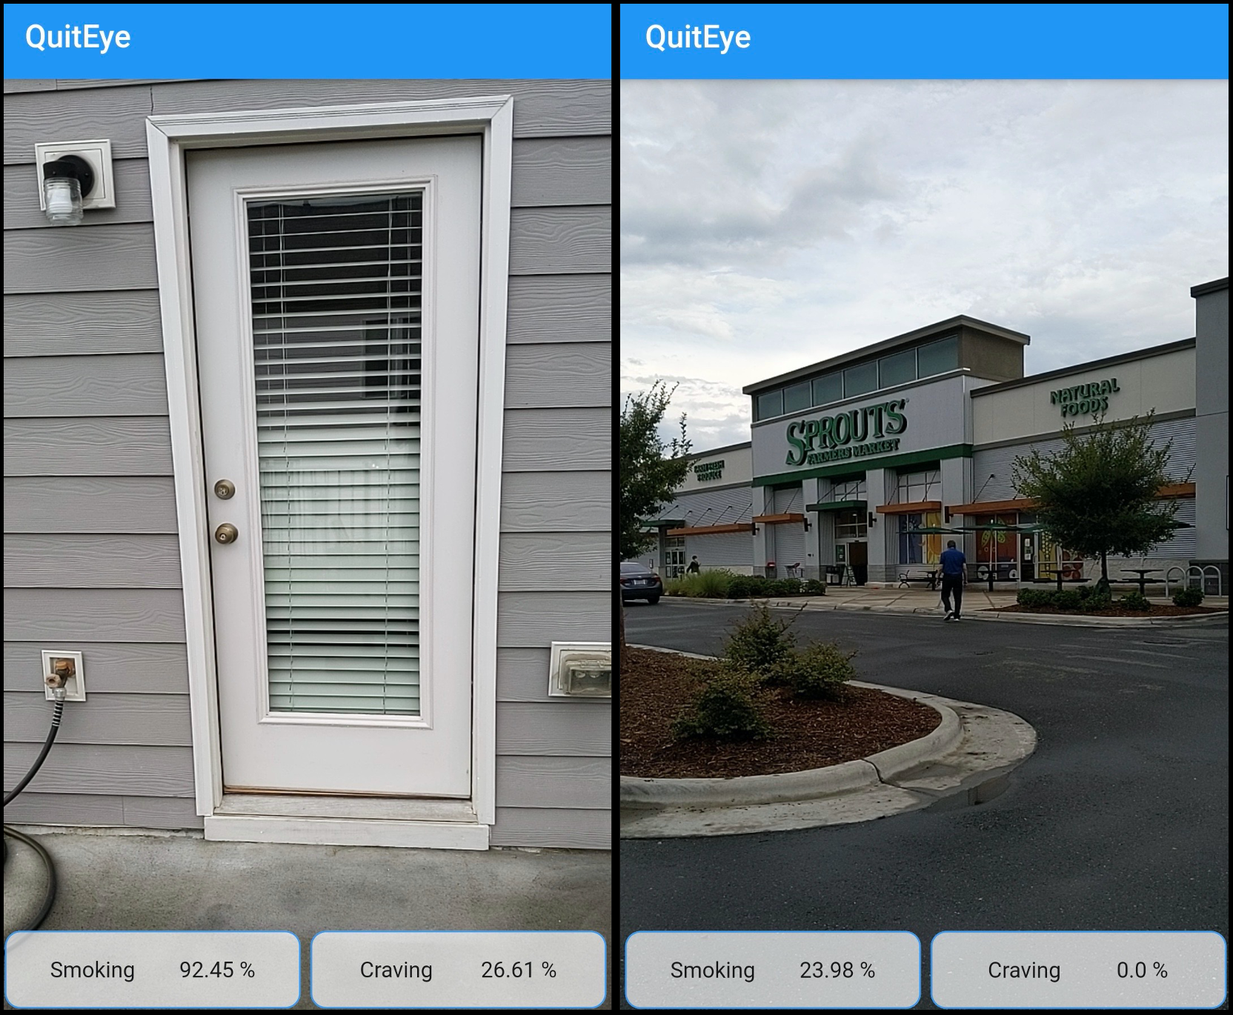
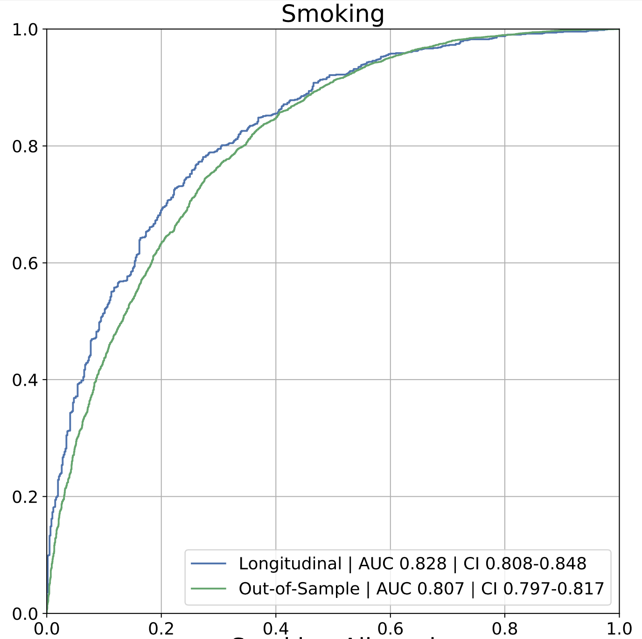
These characteristics can be used to predict environment-associated smoking risk in real time
Engelhard MM, D’Arcy J, Oliver JA, Kozink K, McClernon FJ. Machine Learning Prediction of Smoking Risk from Repeated Sampling of Environmental Images. Submitted to JMIR
NIDA 5R21DA047131

