Slide 1
Mitigating Overfitting
Matthew Engelhard

Slide 2

Recall the NDP
Complex models are capable of dramatically overfitting the data
We can think of this as “memorizing” the data
It is therefore critical to evaluate on a held-out test set
(supposing what you care about is out-of-sample performance)

Slide 3
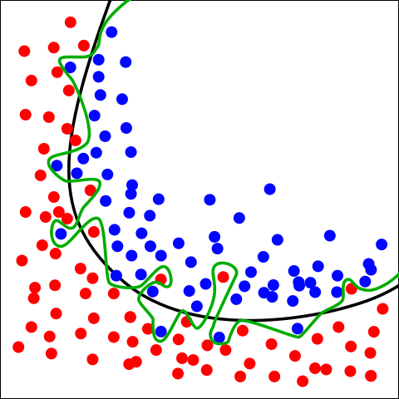
Which boundary performs better on unseen data?
Green boundary:
Correct predictions for all training data
Very likely to be overfitting
Black boundary:
Balance between fit and model complexity
By Chabacano - Own work, CC BY-SA 4.0, https://commons.wikimedia.org/w/index.php?curid=3610704
Notes:
it’s possible to have a model that’s too flexible –
In some cases, we can have a decision boundary that can bob and weave around the feature space as much as it needs to
To make perfect predictions on the training set
The green boundary is an example of this – we’d say it’s overfitted – whereas the black boundary seems like it’s probably doing a better job capturing the “real” relationship between the coordinates and the labels
Our intuition about this comes from our belief – from experience – that data in the real-world are noisy
Now, it’s possible that our intuitions are wrong – it’s possible that the green boundary is actually best
How can we know for sure?
We can evaluate both boundaries on new data – data that wasn’t used to develop the boundary
This is what we do in machine learning.
If the boundary does a good job capturing the true relationship between predictors and labels, it’ll generalize well to new data – data it hasn’t yet seen before

Slide 4
Quantifying Overfitting
Which boundary performs better when applied to new data? And by how much?
We can quantify overfitting as the difference in performance (usually the cross-entropy loss) between the training and validation sets
Greater overfitting usually (but not always) means worse out-of-sample performance
So, we almost always take steps to mitigate it
By Chabacano - Own work, CC BY-SA 4.0, https://commons.wikimedia.org/w/index.php?curid=3610704
Notes:
it’s possible to have a model that’s too flexible –
In some cases, we can have a decision boundary that can bob and weave around the feature space as much as it needs to
To make perfect predictions on the training set
The green boundary is an example of this – we’d say it’s overfitted – whereas the black boundary seems like it’s probably doing a better job capturing the “real” relationship between the coordinates and the labels
Our intuition about this comes from our belief – from experience – that data in the real-world are noisy
Now, it’s possible that our intuitions are wrong – it’s possible that the green boundary is actually best
How can we know for sure?
We can evaluate both boundaries on new data – data that wasn’t used to develop the boundary
This is what we do in machine learning.
If the boundary does a good job capturing the true relationship between predictors and labels, it’ll generalize well to new data – data it hasn’t yet seen before

Slide 5




Let’s teach our robot to identify beaches.
We show it a bunch of images and ask:
What do you see?
It starts listing features from most to least obvious.

Slide 6
Let’s teach our robot to identify beaches.
I think beaches have:
water
land
sky
sand
palm trees
clouds
ripples
foam
white sand
clear water
deep blue sky
exactly 0 or 1 seashells
Instagram color palette

Slide 7

It just doesn’t know when to stop.
I think beaches have:
water
land
sky
sand
palm trees
clouds
ripples
foam
white sand
clear water
deep blue sky
exactly 0 or 1 seashells
Instagram color palette
? ? ? ? ? ? ? ?

Slide 8
We need to give it a strategy to decide how far to go.
I think beaches have:
water
land
sky
sand
palm trees
clouds
ripples
foam
white sand
clear water
deep blue sky
exactly 0 or 1 seashells
Instagram color palette
? ? ? ? ? ? ? ?
Sure.
Maybe?
Uh… no.

Slide 9
Strategy 1: Use as few features as you can.
I think beaches have:
water
land
sky
sand
palm trees
clouds
ripples
foam
white sand
clear water
deep blue sky
exactly 0 or 1 seashells
Instagram color palette
? ? ? ? ? ? ? ?
Sure.
Maybe?
Uh… no.
Penalize: loss, but also total parameter magnitude

Slide 10


Strategy 2: Keep checking other data
Validation
set
Training set

Slide 11
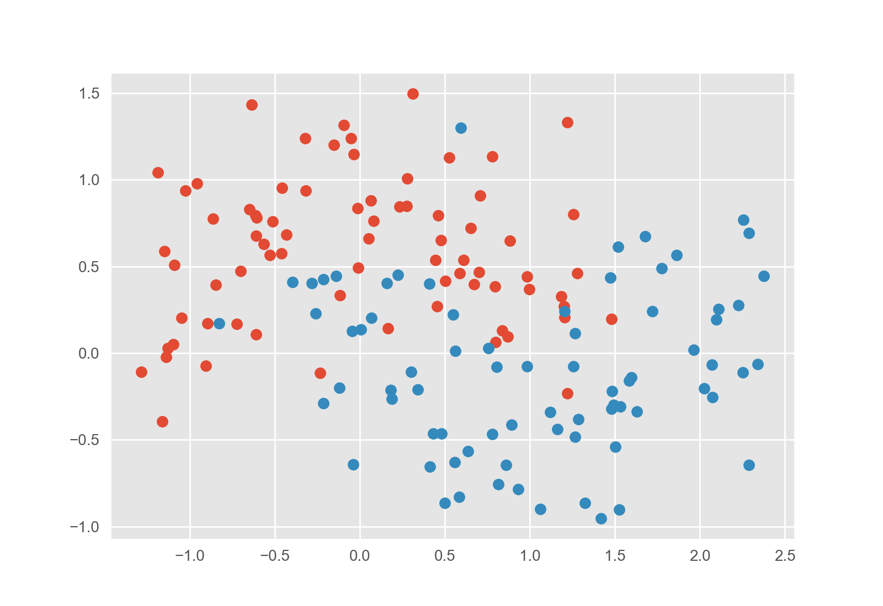
Let’s teach a neural network to identify cancer
Initial decision boundary
(epoch 0)

Slide 12
Let’s teach a neural network to identify cancer
Updated decision boundary
(epoch 1)
Sure.

Slide 13
Let’s teach a neural network to identify cancer
Updated decision boundary
(epoch 4)
Wow!

Slide 14
Let’s teach a neural network to identify cancer
Updated decision boundary
(epoch 23)
Uh… let’s dial it back.
Just like our robot, it doesn’t know when to stop.

Slide 15
We need a strategy to decide when to stop.
Strategy 1:
Penalize complexity
(regularization)
We could quantify how curvy the line is and add that value to the loss.
Notes:
Note that really strategy 1 is explicit regularization, whereas strategy 2 is implicit regularization

Slide 16
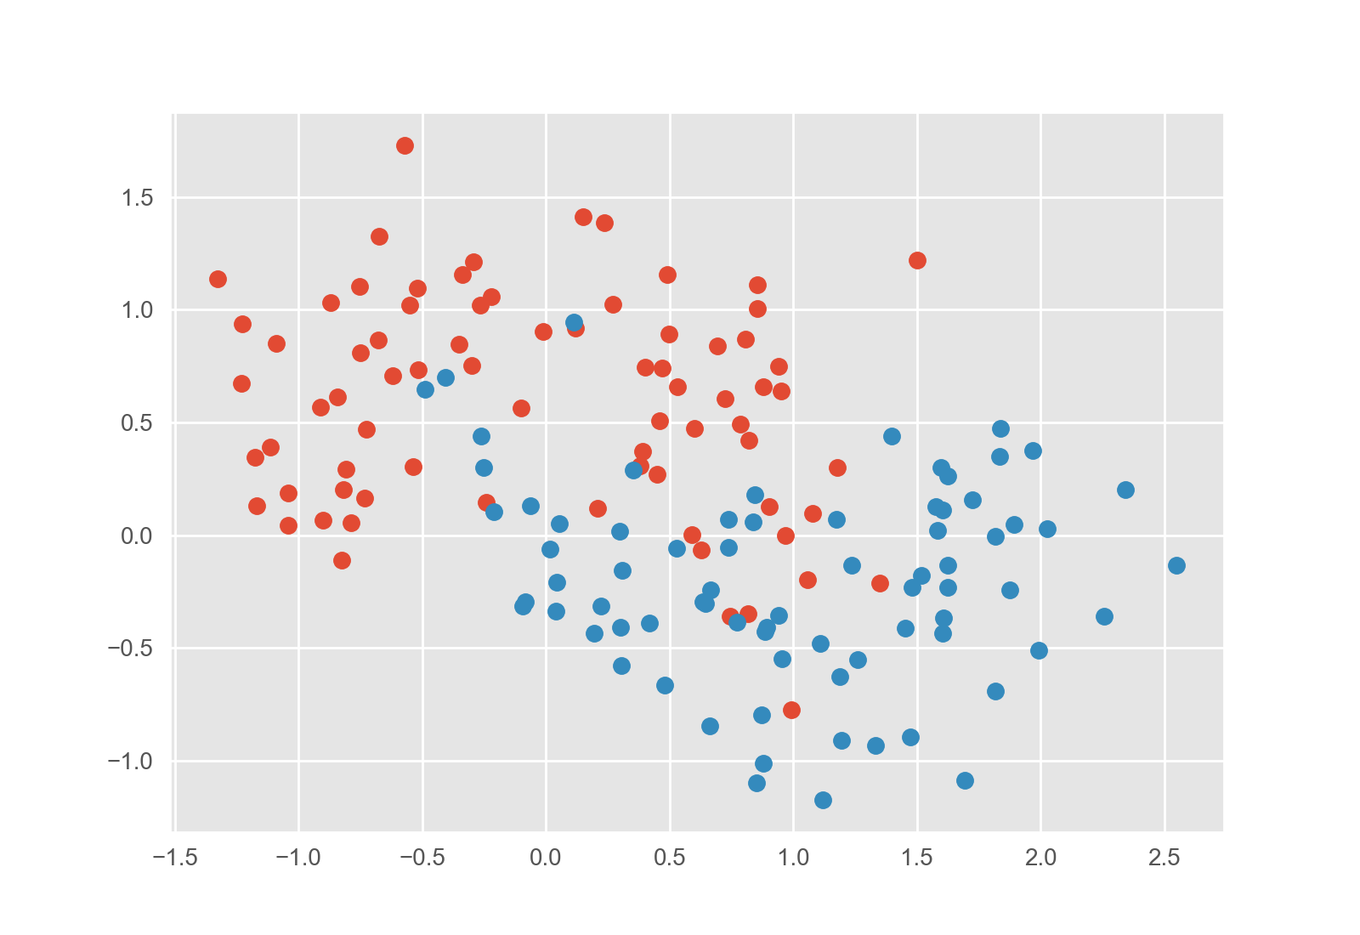
We need a strategy to decide when to stop.
Strategy 2:
Keep checking the validation set
(early stopping)
When our boundary no longer works well on new data, we know we’ve gone too far.
Notes:
Note that really strategy 1 is explicit regularization, whereas strategy 2 is implicit regularization

Slide 17

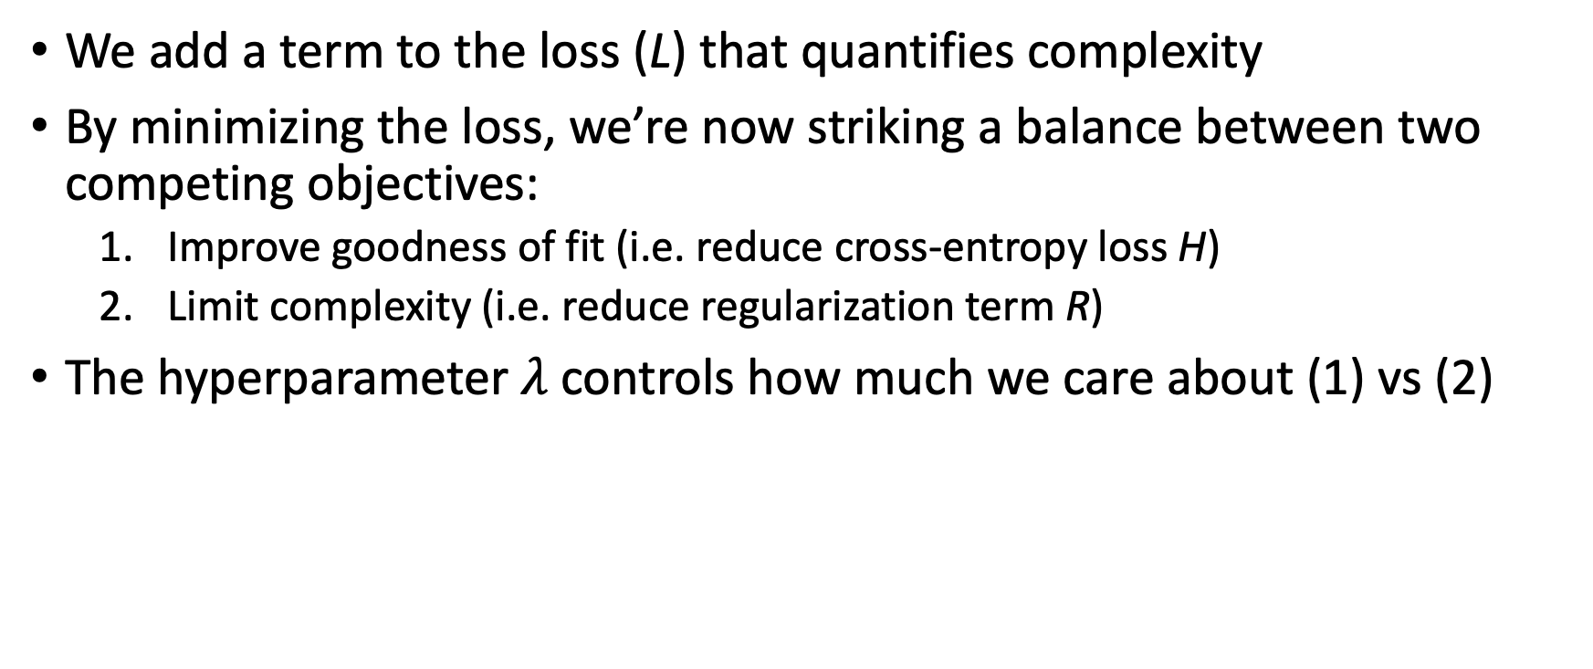
Strategy 1: Explicit Regularization
We add a term to the loss (L) that quantifies complexity
By minimizing the loss, we’re now striking a balance between two competing objectives:
Improve goodness of fit (i.e. reduce cross-entropy loss H)
Limit complexity (i.e. reduce regularization term R)
The hyperparameter $λ$controls how much we care about (1) vs (2)
$$L=H+λR$$

Slide 18
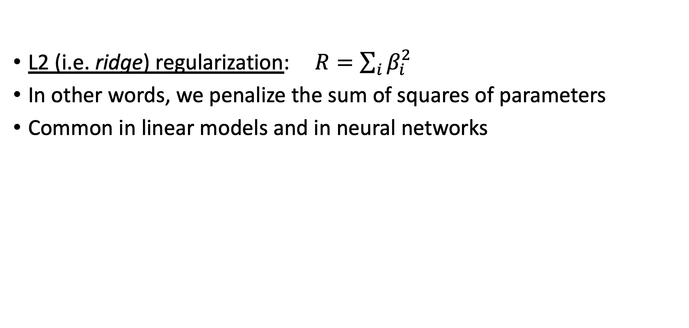
Examples of Explicit Regularization
L2 (i.e. ridge) regularization: $R=\sum_{i}{β_{i}^{2}}$
In other words, we penalize the sum of squares of parameters
Common in linear models and in neural networks
$$L=H+λR$$

Slide 19
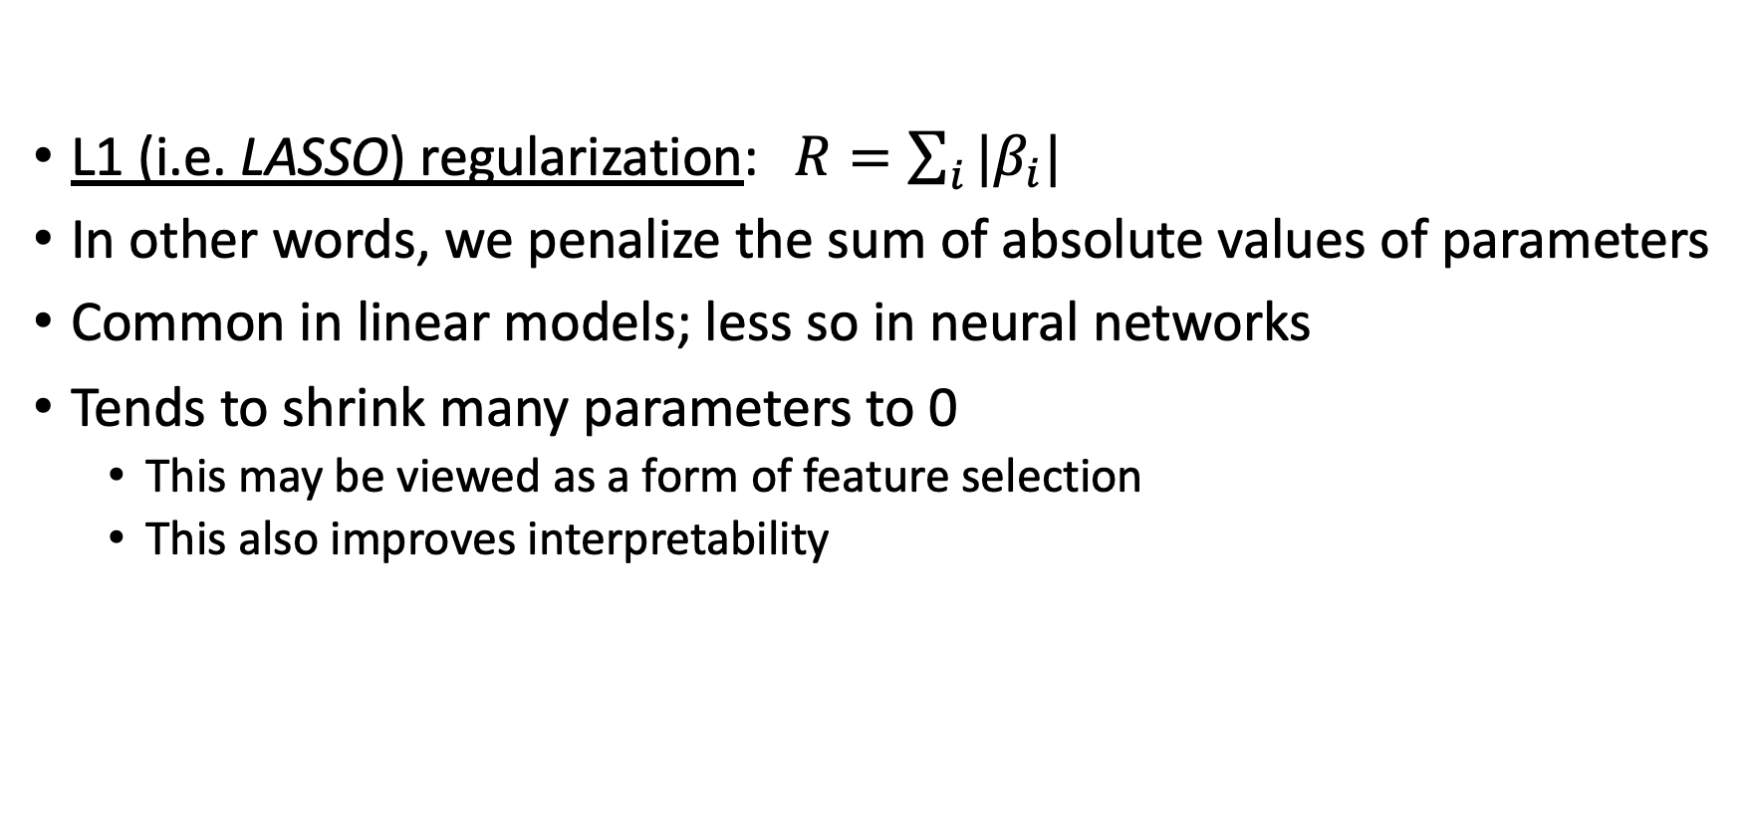
Examples of Explicit Regularization
L1 (i.e. LASSO) regularization: $R=\sum_{i}{|β_{i}|}$
In other words, we penalize the sum of absolute values of parameters
Common in linear models; less so in neural networks
Tends to shrink many parameters to 0
This may be viewed as a form of feature selection
This also improves interpretability
$$L=H+λR$$

Slide 20
Strategy 2: Early Stopping
During optimization, we can check the validation loss as we go.
Instead of optimizing to convergence, we can optimize until the validation loss stops improving
Saves computational cost
Performs better on validation (and test) sets
Widely used technique
Best Validation (and Generalization) Here
Training Loss Keeps Improving
Notes:
One important way to use the validation set, which is very common when training neural networks,
Is to monitor performance on the validation set repeatedly during training
As long as performance on the validation set is improving, we keep fine-tuning our model’s parameters by following the gradient of the loss
But when validation performance starts getting worse, we’re overfitting, so we stop training and lock in our current model parameters
Using the validation set in this way is called “early stopping”, and we’ll use it when training our neural network models both in scikit-learn and in tensorflow

Slide 21
Strategy 3: Dropout
Exclusive to neural networks
During training, we set some hidden features to zero at random (different features for each training step)
This has a dual effect:
Parameter shrinkage (similar to L2)
Encourages redundancy / redundant features; in other words, the network must model the relationship between x and y in multiple ways

Slide 22
Mitigating Overfitting in Practice
Machine learning almost always uses some form of regularization and/or early stopping
Very common to use multiple forms at once
Dropout + early stopping in neural networks
Combination of L1 and L2 regularization in linear models (i.e. elastic net)
The validation set is the key: used to choose between strategies
You will see this when working on data science projects.

Slide 23
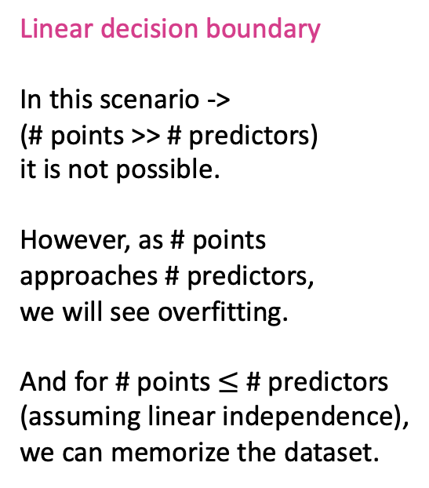
Linear models can also overfit!!! (How?)
Linear decision boundary
In this scenario ->
(# points >> # predictors)
it is not possible.
However, as # points approaches # predictors,
we will see overfitting.
And for # points $≤$ # predictors
(assuming linear independence),
we can memorize the dataset.

Slide 24
Scenarios
How to mitigate overfitting?

Slide 25
Scenario 1: Interpretable CDP
You are building a clinical decision support system using variables from structured EHR fields
You have a thousand predictors and a few thousand data points (i.e. patients) in your training set
You want it to be easy for providers to understand how the model works, and what features are important

Slide 26
Scenario 2: Pure prediction
You are building a neural network-based model that identifies nicotine withdrawal from digital health data
Your input data is a high-dimensional time series of physiologic measurements from multiple sensors
There is no need to interpret or explain the model: you care only about out-of-sample performance

Slide 27
Overfitting in linear models
(time permitting)

Slide 28
Suppose we have the following data
Patient | Predictor 1 (numeric) | Predictor 2 (numeric) | Outcome (numeric)
A | .5 | .75 | 1.5
B | 1 | .75 | 1.25
> Goal: find the linear equation that best predicts the outcome

Slide 29
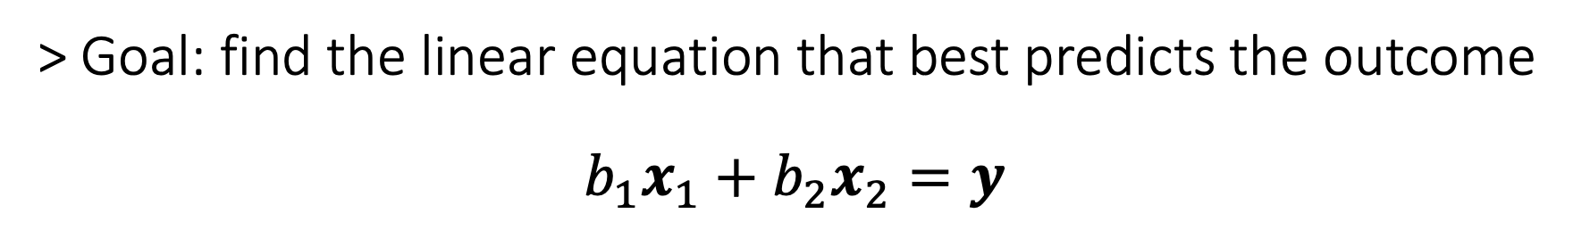
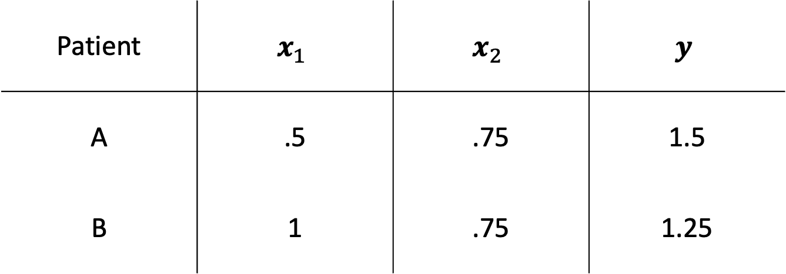
Patient | $$x_{1}$$ | $$x_{2}$$ | $$y$$
A | .5 | .75 | 1.5
B | 1 | .75 | 1.25
> Goal: find the linear equation that best predicts the outcome
$$b_{1}x_{1}+b_{2}x_{2}=y$$

Slide 30

value in patient B
$$y$$
1
1
value in patient A

Slide 31
value in patient B
$$y$$
1
1
value in patient A

Slide 32

value in patient B
$$y$$
1
$$x_{1}$$
1
value in patient A

Slide 33
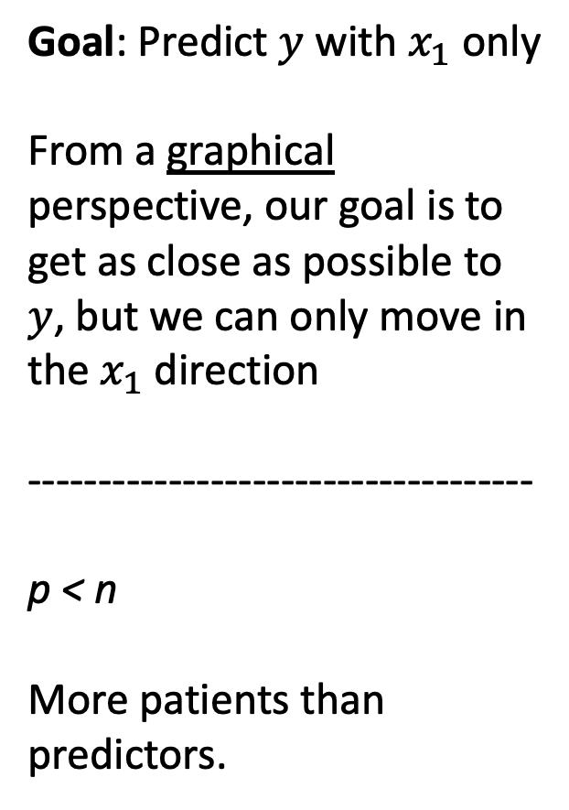
Goal: Predict $y$ with $x_{1}$ only
From a graphical perspective, our goal is to get as close as possible to $y$, but we can only move in the $x_{1}$ direction
------------------------------------
p < n
More patients than predictors.
value in patient B
$$y$$
1
$$x_{1}$$
1
value in patient A

Slide 34

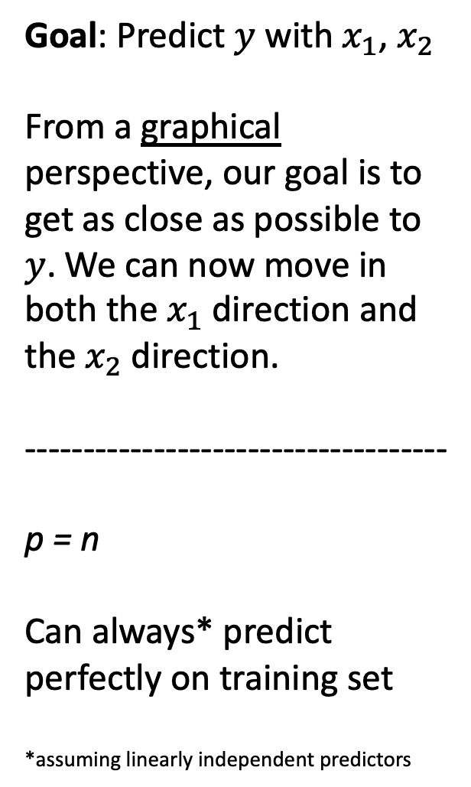
Goal: Predict $y$ with $x_{1}$, $x_{2}$
From a graphical perspective, our goal is to get as close as possible to $y$. We can now move in both the $x_{1}$ direction and the $x_{2}$ direction.
------------------------------------
p = n
Can always* predict perfectly on training set
*assuming linearly independent predictors
value in patient B
$$y$$
1
$$x_{1}$$
$$x_{2}$$
1
value in patient A

Slide 35
Goal: Predict $y$ with $x_{1}$, $x_{2}$
From a graphical perspective, our goal is to get as close as possible to $y$. We can now move in both the $x_{1}$ direction and the $x_{2}$ direction.
------------------------------------
p = n
Can always* predict perfectly on training set
*assuming linearly independent predictors
value in patient B
$$y$$
1
$$x_{1}$$
$$x_{2}$$
1
value in patient A

Slide 36
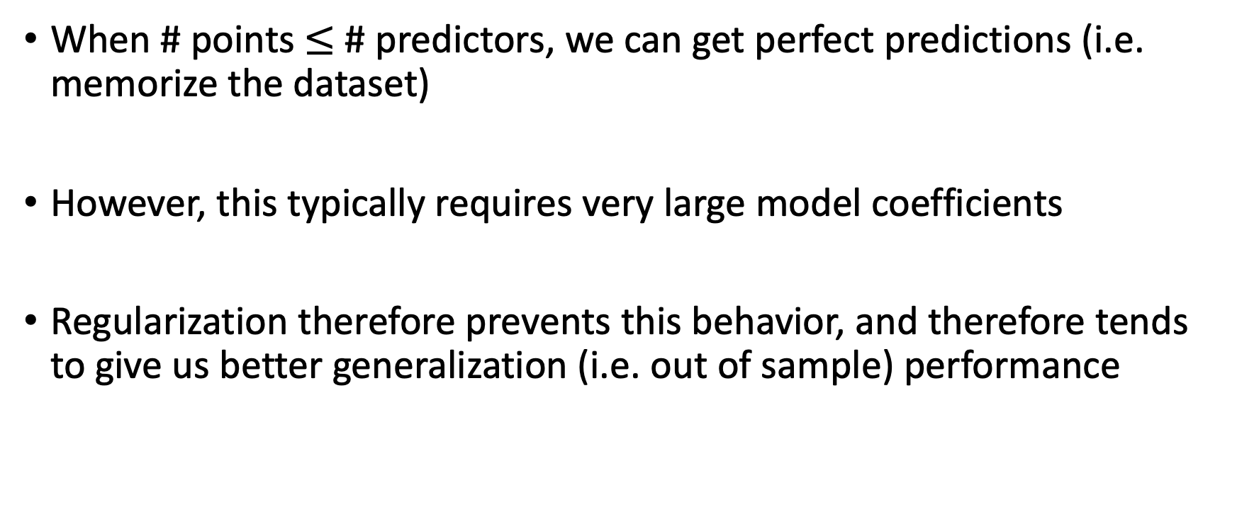
Takeaways
When # points $≤$ # predictors, we can get perfect predictions (i.e. memorize the dataset)
However, this typically requires very large model coefficients
Regularization therefore prevents this behavior, and therefore tends to give us better generalization (i.e. out of sample) performance

Slide 37
Cross-Validation
(time permitting)

Slide 38
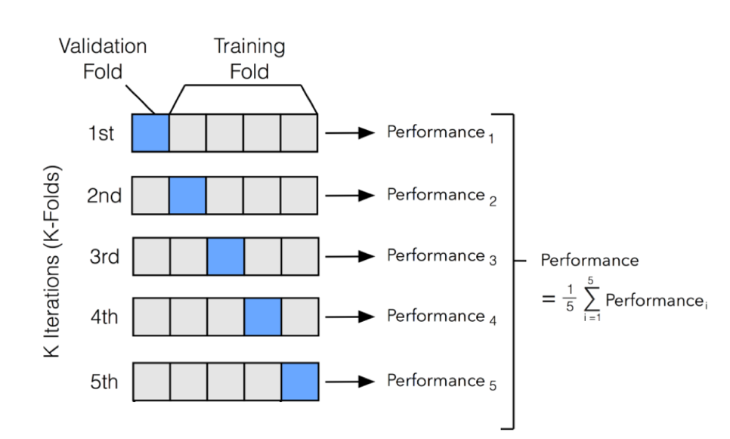
What if we don’t have enough data for this?
Very common in medicine
We use cross validation
http://ethen8181.github.io/machine-learning/model_selection/model_selection.html

