Slide 1
Activity: MLP Structure
ML for Health, Week 3

Slide 2
Part I
For each of the following, determine (a) how many logistic regression models and (b) how many parameters are contained in the model.
Logistic regression with 3 input features
An MLP with 3 input features and 1 hidden layer with 6 hidden units
An MLP with 3 input features and 2 hidden layers, each with 6 hidden units
(challenge) An MLP with 3 input features and 3 hidden layers with 6, 2, and 6 hidden units, respectively
It may be helpful to draw or create graphs for these models. For this activity, bias/intercept parameters may be ignored.

Slide 3








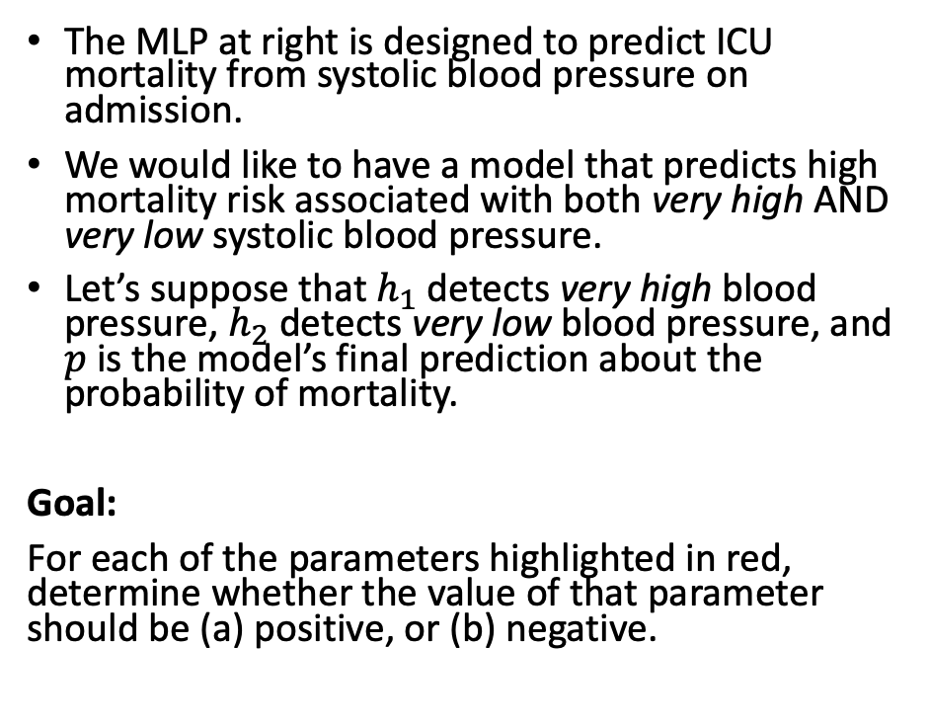



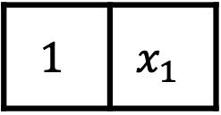


Part IIA
$$p$$
$$σ$$
The MLP at right is designed to predict ICU mortality from systolic blood pressure on admission.
We would like to have a model that predicts high mortality risk associated with both very high AND very low systolic blood pressure.
Let’s suppose that $h_{1}$ detects very high blood pressure, $h_{2}$ detects very low blood pressure, and $p$ is the model’s final prediction about the probability of mortality.
Goal:
For each of the parameters highlighted in red, determine whether the value of that parameter should be (a) positive, or (b) negative.
$$z$$
$$β_{1}$$
$$β_{2}$$
$$σ(h_{1})$$
$$σ(h_{2})$$
$$σ$$
$$σ$$
$$h_{1}$$
$$h_{2}$$
$$b_{1,1}$$
$$b_{1,2}$$
$$1$$ | $$x_{1}$$
Intercept
SBP

Slide 4



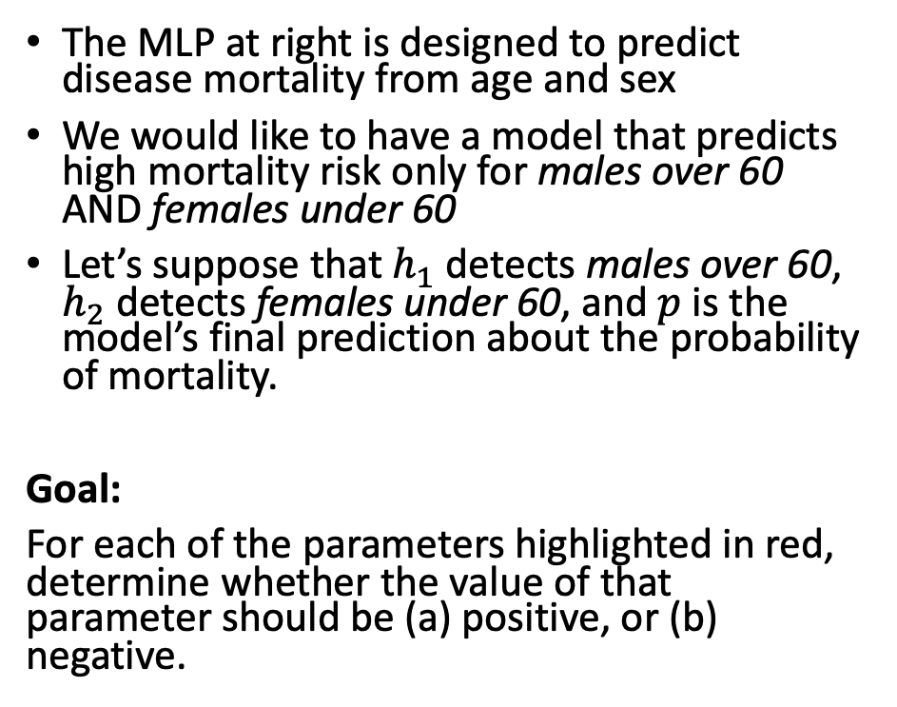
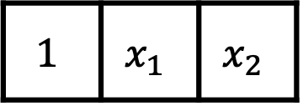

Part IIB
$$p$$
$$σ$$
The MLP at right is designed to predict disease mortality from age and sex
We would like to have a model that predicts high mortality risk only for males over 60 AND females under 60
Let’s suppose that $h_{1}$ detects males over 60, $h_{2}$ detects females under 60, and $p$ is the model’s final prediction about the probability of mortality.
Goal:
For each of the parameters highlighted in red, determine whether the value of that parameter should be (a) positive, or (b) negative.
$$z$$
$$β_{1}$$
$$β_{2}$$
$$σ(h_{1})$$
$$σ(h_{2})$$
$$σ$$
$$σ$$
$$h_{1}$$
$$h_{2}$$
$$b_{1,1}$$
$$b_{2,1}$$
$$b_{2,2}$$
$$b_{1,2}$$
$$1$$ | $$x_{1}$$ | $$x_{2}$$
Intercept
Age
Sex

