Slide 1
What
should I watch next?
Product Presentation
Notes:
Sabina

Slide 2
Product
A web application where you can look for the best movies to watch. If you don’t know what movies to watch, tell us about some of your favourite movies and we will recommend you some more.
Notes:
Sabina

Slide 3
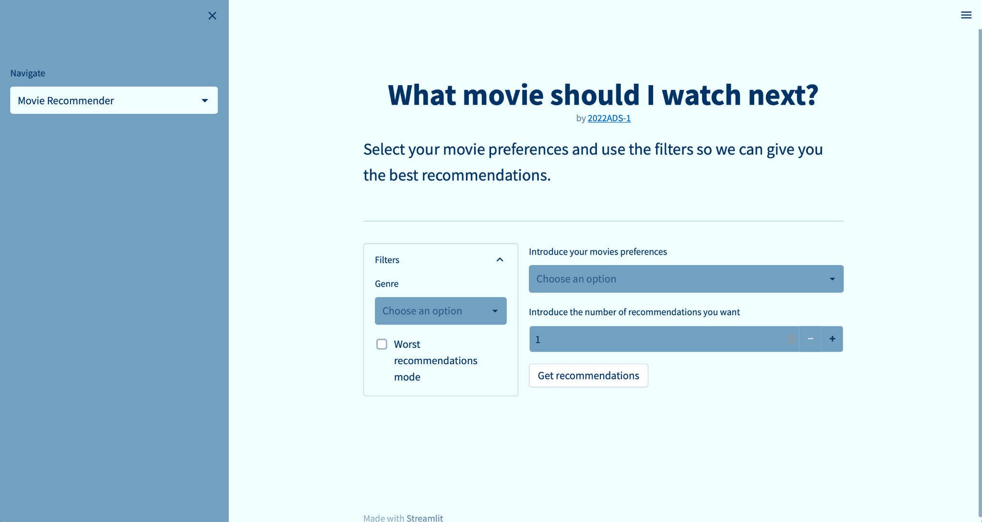
Product Demo

Slide 4





Product Evolution
Sprint 1
Sprint 2
Sprint 3
Basic recommender model
Basic frontend
Web app deployment
Register and log in
Model deployment
Database connection
Profile page
UI/UX

Slide 5
Retrospective
Lessons learnt
Functional prototype at the end of every sprint
Should have defined clearer and more specific AC
Needed more time for planning and clearly defining the product
Time consuming to define the product and break it down into stories
Communication is key
Planning is vital

Slide 6
Next steps
01
Bug fixing
03
DevOps
05
Model
Improve the recommendations given by the model
Retrain the model periodically with the new data…
Improve the recommendations
02
UI
04
Features
Add movie covers, navigation bar…
Profile image, log out, forget password…

Slide 7
Thanks!
Do you have any questions?
You can also check out our web application:
http://agile-g1.herokuapp.com
Sara Bardají
Sergi Bech
Marta Buetas
Sabina Cardell
Gerard Castillo
Jordi Segura

