Slide 1

Lecture 3: Local Descent
Optimization T2023
Màster de Fonaments de Ciència de Dades

Slide 2
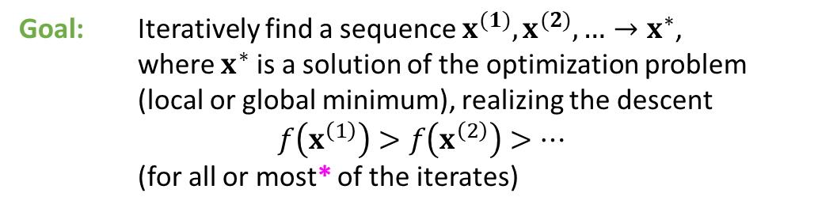


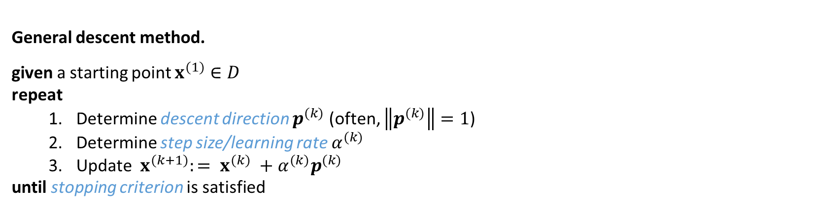
$f\left(x\right)→min, x∈D⊆ℝ^{n}, n≥1$, $f$ is smooth
Goal: Iteratively find a sequence $x^{(1)}, x^{(2)}, …→x^{∗}$,
where $x^{∗}$ is a solution of the optimization problem
(local or global minimum), realizing the descent
$f\left(x^{\left(1\right)}\right)>f\left(x^{\left(2\right)}\right)>…$
(for all or most* of the iterates)
Recall that $∇f\left(x^{∗}\right)=0$
General descent method.
given a starting point $x^{(1)}∈D$
repeat
Determine descent direction $p^{(k)}$ (often, $\left\|p^{(k)}\right\|=1$)
Determine step size/learning rate $α^{(k)}$
Update $x^{(k+1)}:= x^{(k)} +α^{(k)}p^{(k)}$
until stopping criterion is satisfied
III. Descent direction?
II. Step size?
I. Stopping criterion?

Slide 3

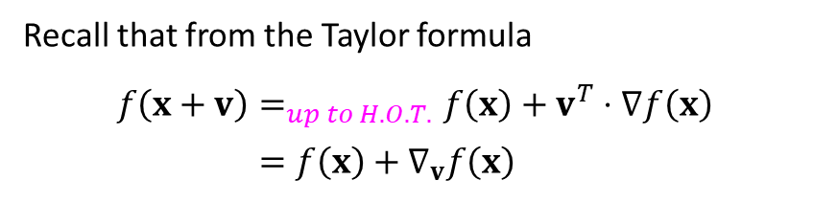


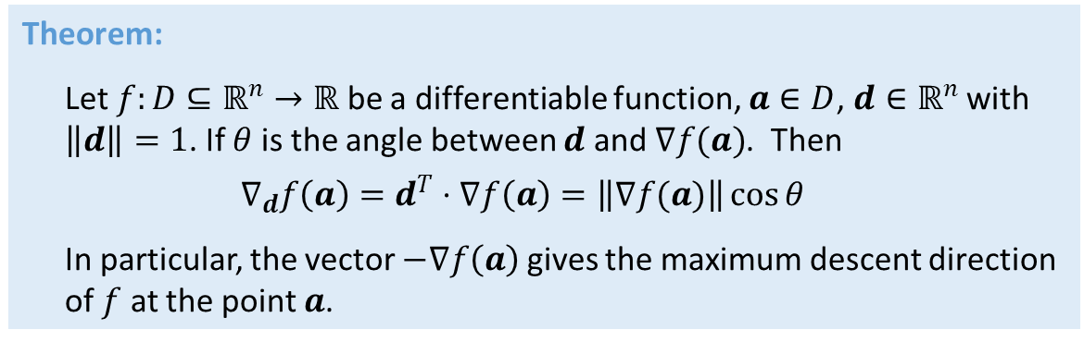






Digression: Why gradient?
Recall that from the Taylor formula
$f\left(x+v\right)=_{up to H.O.T.}f\left(x\right)+v^{T}⋅∇f\left(x\right)$
$$=f\left(x\right)+∇_{v}f\left(x\right)$$
Directional derivative
We want it to be negative
Theorem:
Let $f:D⊆ℝ^{n}→ℝ$ be a differentiable function, $a∈D$, $d∈ℝ^{n}$ with $\left\|d\right\|=1$. If $θ$ is the angle between $d$ and $∇f(a)$. Then
$$∇_{d}f\left(a\right)=d^{T}⋅∇f\left(a\right)=\left\|∇f(a)\right\|\cos{θ}$$
In particular, the vector $−∇f\left(a\right)$ gives the maximum descent direction of $f$ at the point $a$.
$$∇f(a)$$
$$θ$$
$$d$$
$$∇f(a)$$
Level sets (line, surface..) of $f$
$$a$$
$$f\left(x\right)=c=f(a)$$
$$d$$
$$−∇f(a)$$

Slide 4
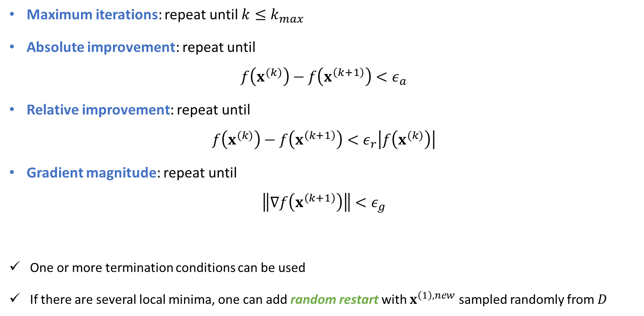
I. Stopping criteria/termination conditions
Maximum iterations: repeat until $k≤k_{max}$
Absolute improvement: repeat until
$$f\left(x^{(k)}\right)−f\left(x^{\left(k+1\right)}\right)<ε_{a}$$
Relative improvement: repeat until
$$f\left(x^{(k)}\right)−f\left(x^{\left(k+1\right)}\right)<ε_{r}\left|f\left(x^{(k)}\right)\right|$$
Gradient magnitude: repeat until
$$\left\|∇f\left(x^{\left(k+1\right)}\right)\right\|<ε_{g}$$
One or more termination conditions can be used
If there are several local minima, one can add random restart with $x^{\left(1\right),new}$ sampled randomly from $D$

Slide 5
II. Step size/learning rate
Suppose ${x=x}^{(k)}$ and $p=p^{(k)}$ is given. How to find ${α=α}^{(k)}$?
Methods:
Exact line search
Approximate line search
Trust region methods

Slide 6
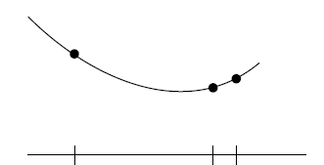

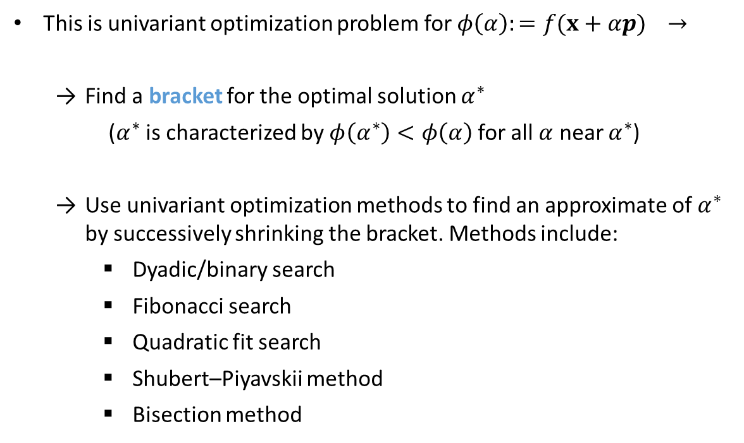



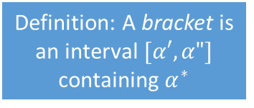
$$minimize_{α} f\left(x+αp\right)$$
Exact line search
Definition: A bracket is an interval $[α′,α"]$ containing $α^{∗}$
This is univariant optimization problem for $φ\left(α\right):=f(x+αp)$ $→$
Find a bracket for the optimal solution $α^{∗}$
($α^{∗}$ is characterized by $φ\left(α^{∗}\right)<φ\left(α\right)$ for all $α$ near $α^{∗}$)
Use univariant optimization methods to find an approximate of $α^{∗}$ by successively shrinking the bracket. Methods include:
Dyadic/binary search
Fibonacci search
Quadratic fit search
Shubert–Piyavskii method
Bisection method
$$α′$$
$$α^{∗}$$
$$α′′$$

Slide 7
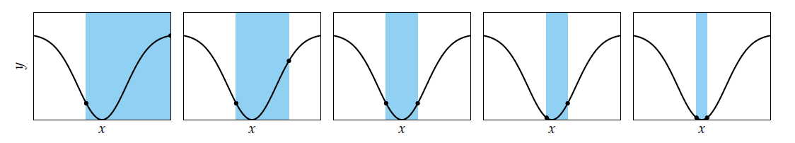
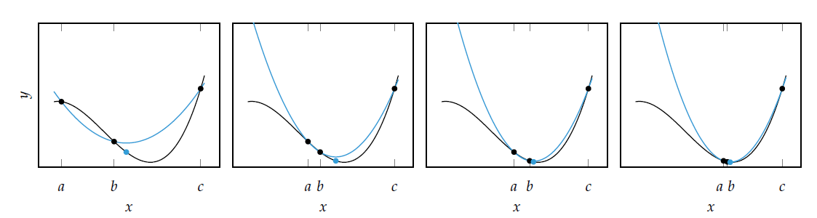
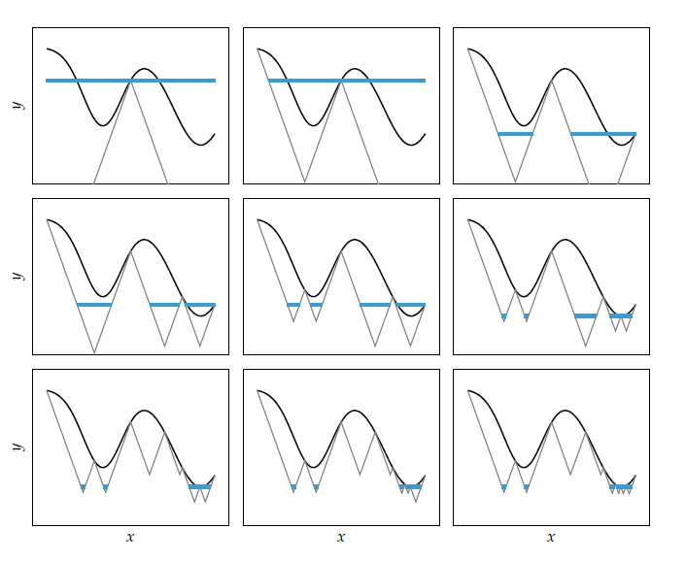
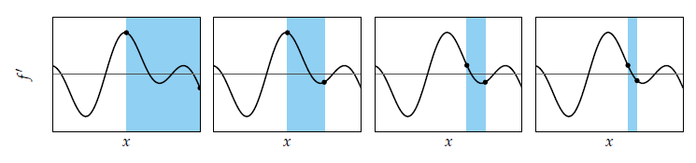

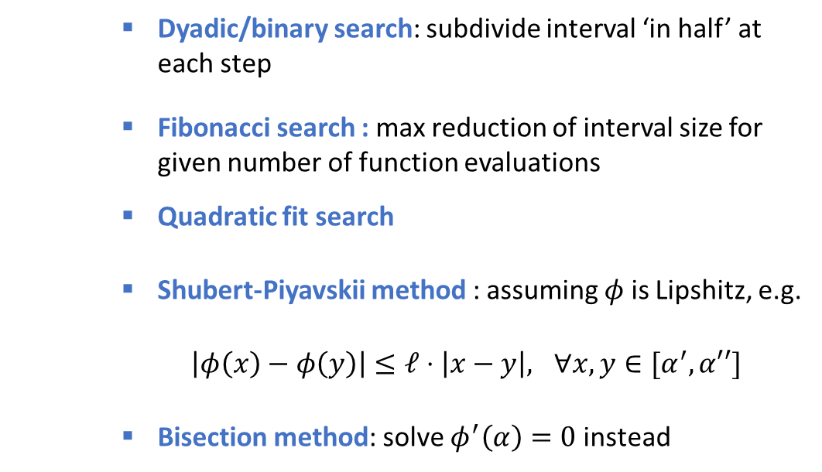
Digression: some univalent optimization methods
[KW, Ch.3]
Dyadic/binary search: subdivide interval ‘in half’ at each step
Fibonacci search : max reduction of interval size for given number of function evaluations
Quadratic fit search
Shubert-Piyavskii method : assuming $φ$ is Lipshitz, e.g.
$\left|φ\left(x\right)−φ\left(y\right)\right|≤ℓ⋅\left|x−y\right|, ∀x,y∈[α^{′},α′′]$
Bisection method: solve $φ^{′}\left(α\right)=0$ instead
$$φ′$$

Slide 8




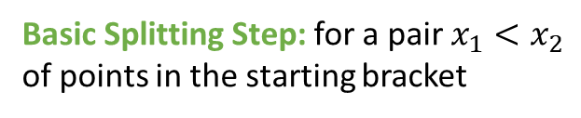


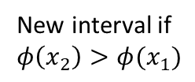

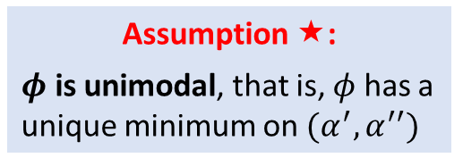
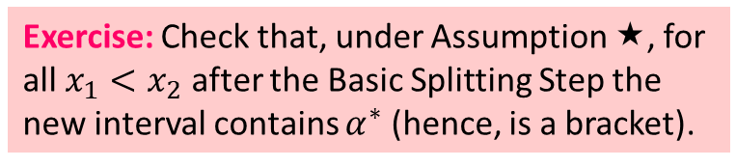




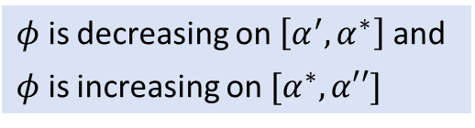
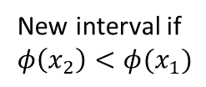



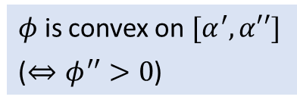


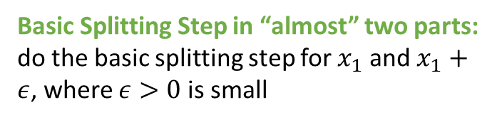
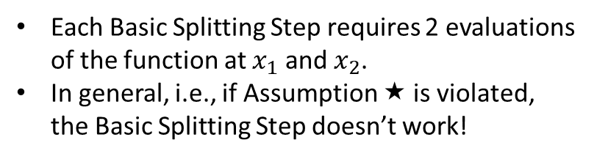
Dyadic/binary and Fibonacci search
$$φ$$
$$α′$$
$$α^{∗}$$
$$α′′$$
Assumption :
$φ$ is unimodal, that is, $φ$ has a unique minimum on $(α^{′},α^{′′})$
$φ$ is decreasing on $\left[α^{′},α^{∗}\right]$ and
$φ$ is increasing on $[α^{∗},α′′]$
$φ$ is convex on $[α^{′},α′′]$
($⇔φ^{′′}>0$)
Basic Splitting Step: for a pair $x_{1}<x_{2}$ of points in the starting bracket
Basic Splitting Step in “almost” two parts: do the basic splitting step for $x_{1}$ and $x_{1}+ε$, where $ε>0$ is small
$$α′$$
$$x_{1}$$
$$x_{2}$$
$$α′′$$
$$x_{1}+ε$$
New interval if $φ\left(x_{2}\right)>φ(x_{1})$
$$α′$$
$$x_{1}$$
$$α′′$$
$$α′$$
$$x_{2}$$
New interval if $φ\left(x_{2}\right)<φ(x_{1})$
$$x_{1}$$
$$α′′$$
Each Basic Splitting Step requires 2 evaluations of the function at $x_{1}$ and $x_{2}$.
In general, i.e., if Assumption  is violated, the Basic Splitting Step doesn’t work!
Exercise: Check that, under Assumption , for all $x_{1}<x_{2}$ after the Basic Splitting Step the new interval contains $α^{∗}$ (hence, is a bracket).
Exercise: Give an example

Slide 9
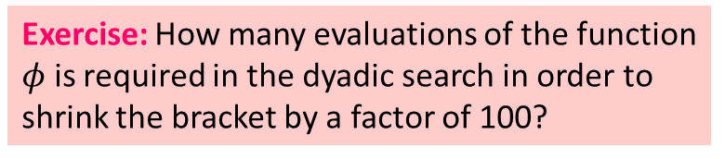
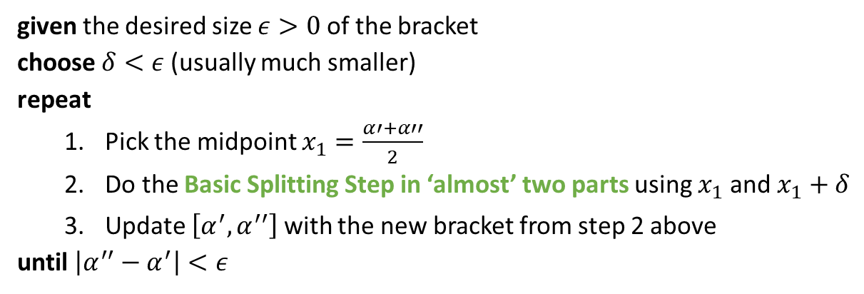
Dyadic/binary search:
under Assumption 
given the desired size $ε>0$ of the bracket
choose $δ<ε$(usually much smaller)
repeat
Pick the midpoint $x_{1}=\frac{α′+α′′}{2}$
Do the Basic Splitting Step in ‘almost’ two parts using $x_{1}$ and $x_{1}+δ$
Update $\left[α^{′},α^{′′}\right]$ with the new bracket from step 2 above
until $\left|α^{′′}−α^{′}\right|<ε$
Exercise: How many evaluations of the function $φ$ is required in the dyadic search in order to shrink the bracket by a factor of 100?

Slide 10
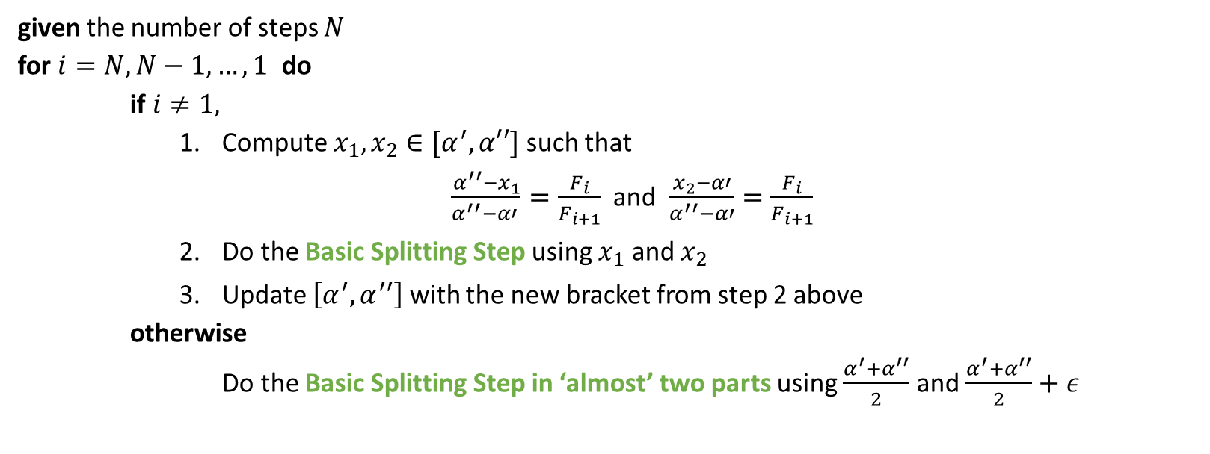
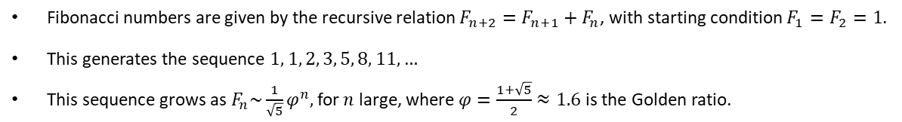
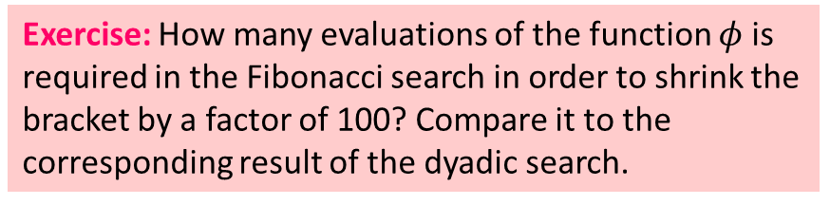
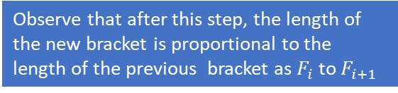
Fibonacci numbers are given by the recursive relation $F_{n+2}=F_{n+1}+F_{n}$, with starting condition $F_{1}=F_{2}=1$.
This generates the sequence $1, 1, 2, 3, 5, 8, 11, …$
This sequence grows as $F_{n}\sim \frac{1}{\sqrt{5}}φ^{n},$for $n$ large, where $φ=\frac{1+\sqrt{5}}{2}≈1.6$ is the Golden ratio.
Fibonacci search (under Assumption )
given the number of steps $N$
for $i=N,N−1, …,1$ do
if $i≠1,$
Compute $x_{1},x_{2}∈[α^{′},α′′]$ such that
$\frac{{α^{′′}−x}_{1}}{α^{′′}−α′ }=\frac{F_{i}}{F_{i+1}}$ and $\frac{x_{2}−α′}{α^{′′}−α′}=\frac{F_{i}}{F_{i+1}}$
Do the Basic Splitting Step using $x_{1}$ and $x_{2}$
Update $\left[α^{′},α^{′′}\right]$ with the new bracket from step 2 above
otherwise
Do the Basic Splitting Step in ‘almost’ two parts using $\frac{α^{′}+α^{′′}}{2}$ and $\frac{α^{′}+α^{′′}}{2}+ε$
Observe that after this step, the length of the new bracket is proportional to the length of the previous bracket as $F_{i}$ to $F_{i+1}$
Key Advantage: Fibonacci search uses significantly smaller evaluations of the function than the dyadic search because it re-uses some evaluation points!
(see example on the next slide)
Exercise: How many evaluations of the function $φ$ is required in the Fibonacci search in order to shrink the bracket by a factor of 100? Compare it to the corresponding result of the dyadic search.

Slide 11
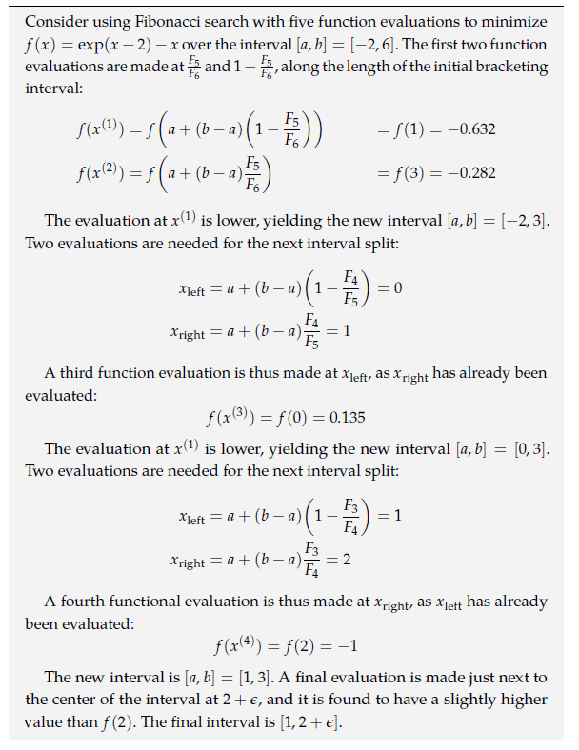
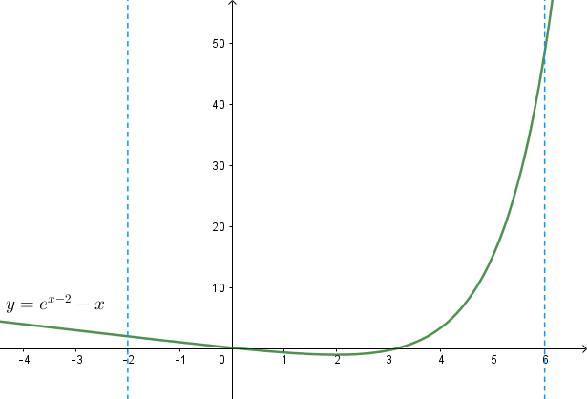
Fibonacci search (under Assumption ):
an example
minimum

Slide 12
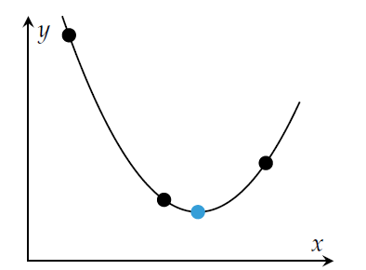

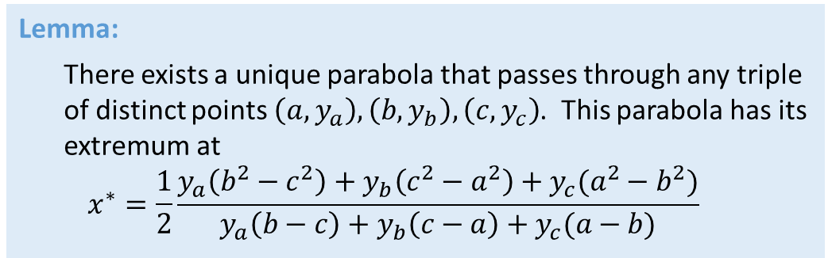



Quadratic fit search
The method is based on the following observations:
‘close’ to the minima functions look like quadratic functions
we can explicitly find minima of quadratic functions:
Lemma:
There exists a unique parabola that passes through any triple of distinct points $\left(a,y_{a}\right), \left(b, y_{b}\right), \left(c,y_{c}\right)$. This parabola has its extremum at
$$x^{∗}=\frac{1}{2}\frac{y_{a}\left(b^{2}−c^{2}\right)+y_{b}\left(c^{2}−a^{2}\right)+y_{c}(a^{2}−b^{2})}{y_{a}\left(b−c\right)+y_{b}\left(c−a\right)+y_{c}(a−b)}$$
$$(a,y_{a})$$
$$(c,y_{c})$$
$$(b,y_{b})$$
$$x^{∗}$$
Exercise*: Show that the algorithm described on the next slide converges to a local minimum (assuming the function is smooth)

Slide 13
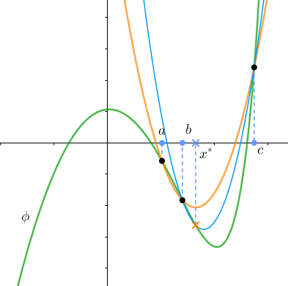
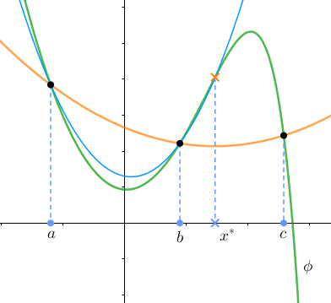
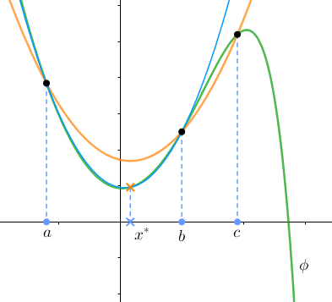
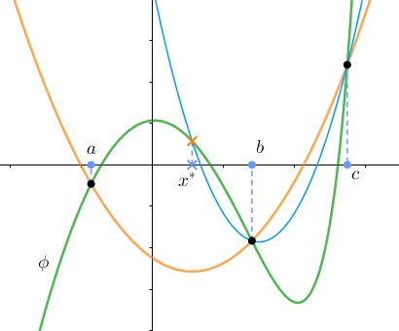

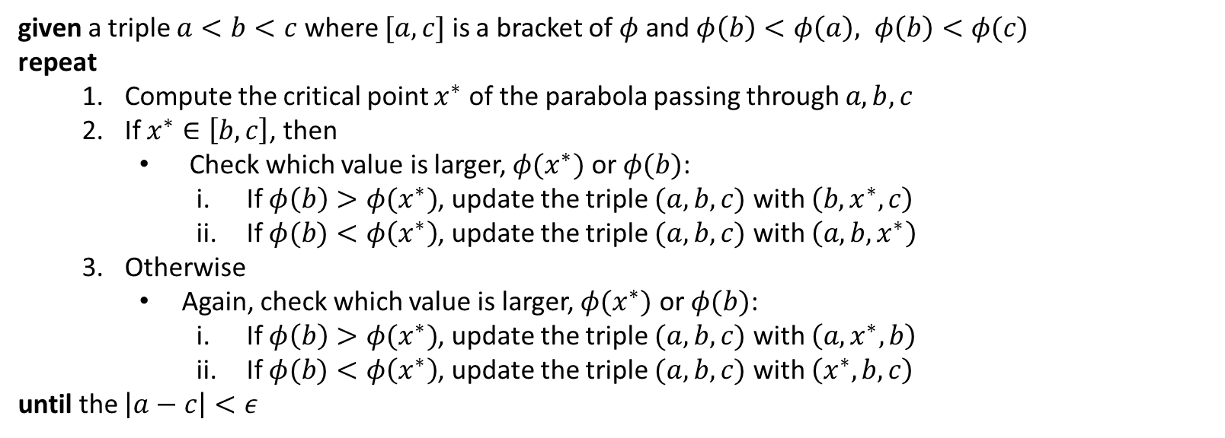
Quadratic fit search
#
given a triple $a<b<c$ where $[a,c]$ is a bracket of $φ$ and $φ\left(b\right)<φ\left(a\right), φ\left(b\right)<φ(c)$
repeat
Compute the critical point $x^{∗}$ of the parabola passing through $a,b,c$
If $x^{∗}∈\left[b,c\right]$, then
Check which value is larger, $φ(x^{∗})$ or $φ(b)$:
If $φ\left(b\right)>φ(x^{∗})$, update the triple $(a,b,c)$ with $\left(b,x^{∗},c\right)$
If $φ(b)<φ\left(x^{∗}\right)$, update the triple $(a,b,c)$ with $\left(a,b,x^{∗}\right)$
Otherwise
Again, check which value is larger, $φ(x^{∗})$ or $φ(b)$:
If $φ\left(b\right)>φ(x^{∗})$, update the triple $(a,b,c)$ with $\left(a, x^{∗},b\right)$
If $φ(b)<φ\left(x^{∗}\right)$, update the triple $(a,b,c)$ with $\left(x^{∗},b,c\right)$
until the $\left|a−c\right|<ε$
In these examples, parabola at the current step is in orange; parabola at the next step is in blue
That is, when $x^{∗}∈[a,b)$ because of condition #
Or any other stopping criterion based on variation of the function

Slide 14
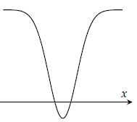

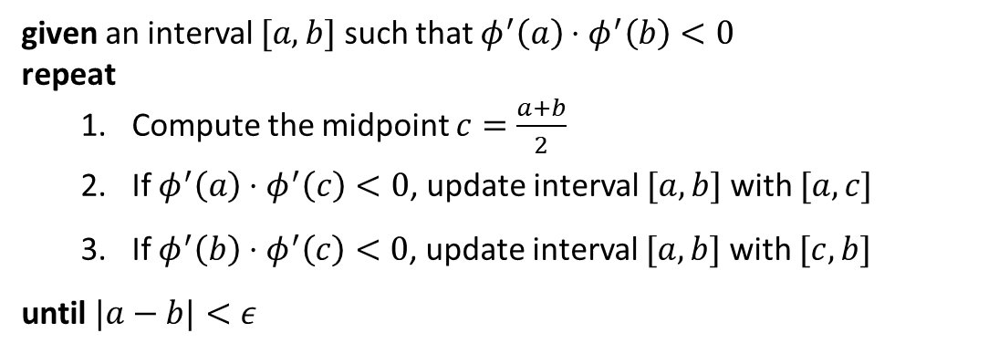
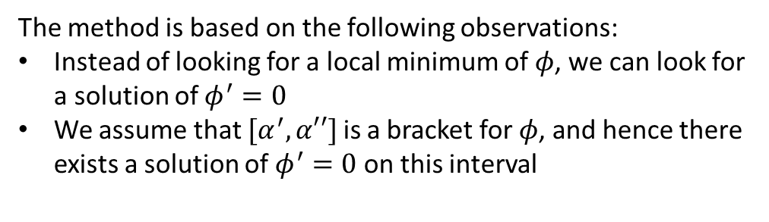
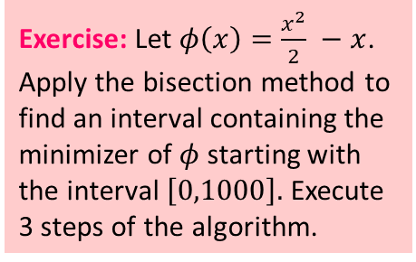
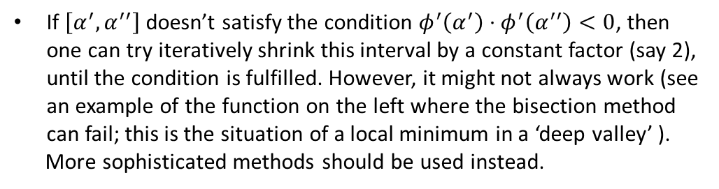
Bisection method
The method is based on the following observations:
Instead of looking for a local minimum of $φ$, we can look for a solution of $φ^{′}=0$
We assume that $[α^{′},α′′]$ is a bracket for $φ$, and hence there exists a solution of $φ^{′}=0$ on this interval
given an interval $[a,b]$ such that $φ^{′}\left(a\right)⋅φ^{′}\left(b\right)<0$
repeat
Compute the midpoint $c=\frac{a+b}{2}$
If $φ^{′}\left(a\right)⋅φ^{′}\left(c\right)<0$, update interval $[a,b]$ with $[a,c]$
If $φ^{′}\left(b\right)⋅φ^{′}\left(c\right)<0$, update interval $[a,b]$ with $[c,b]$
until $|a−b|<ε$
$$φ′$$
Exercise: Let $φ\left(x\right)=\frac{x^{2}}{2} −x$. Apply the bisection method to find an interval containing the minimizer of $φ$ starting with the interval $\left[0,1000\right].$Execute 3 steps of the algorithm.
If $\left[α^{′},α^{′′}\right]$ doesn’t satisfy the condition $φ^{′}\left(α^{′}\right)⋅φ^{′}\left(α^{′′}\right)<0$, then one can try iteratively shrink this interval by a constant factor (say 2), until the condition is fulfilled. However, it might not always work (see an example of the function on the left where the bisection method can fail; this is the situation of a local minimum in a ‘deep valley’ ).
More sophisticated methods should be used instead.
End of digression

Slide 15
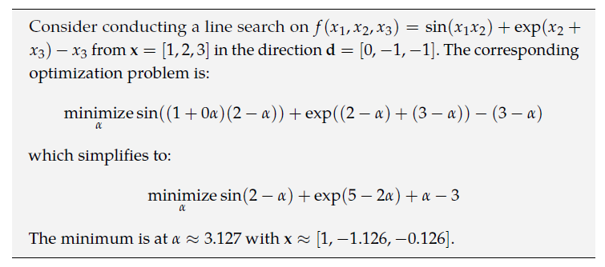
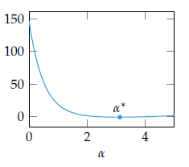
$$minimize_{α} f\left(x+αp\right)$$
Exact line search

Slide 16
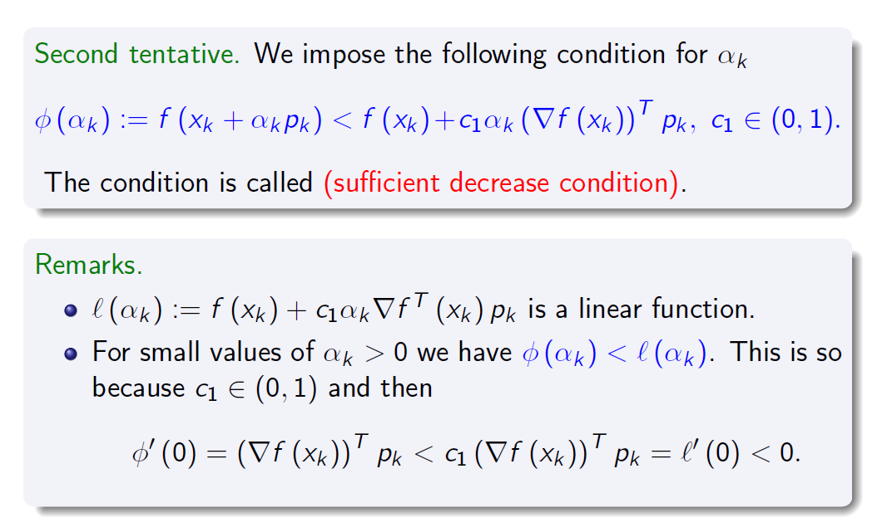


Find $α^{(k)}$ approximately and move on with the descent method
Approximate line search
For simplicity, $x_{k}=x^{(k)}, p_{k}=p^{(k)}, α_{k}=α^{(k)}$

Slide 17
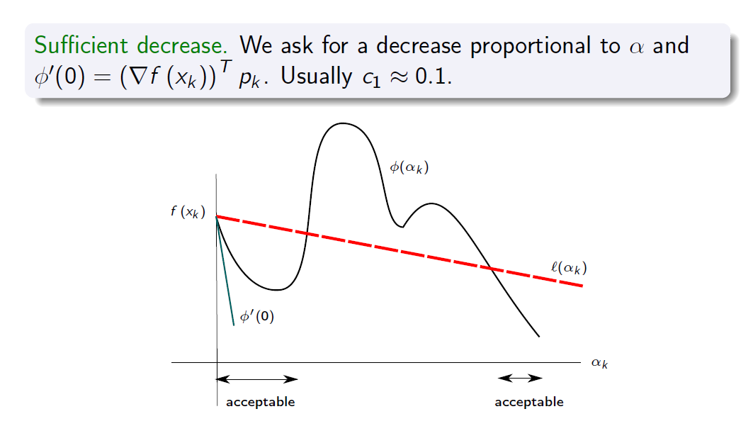
Approximate line search

Slide 18
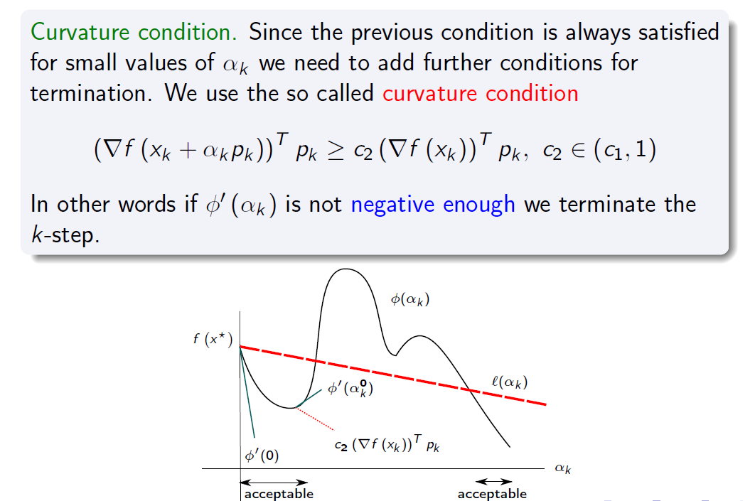
Approximate line search

Slide 19
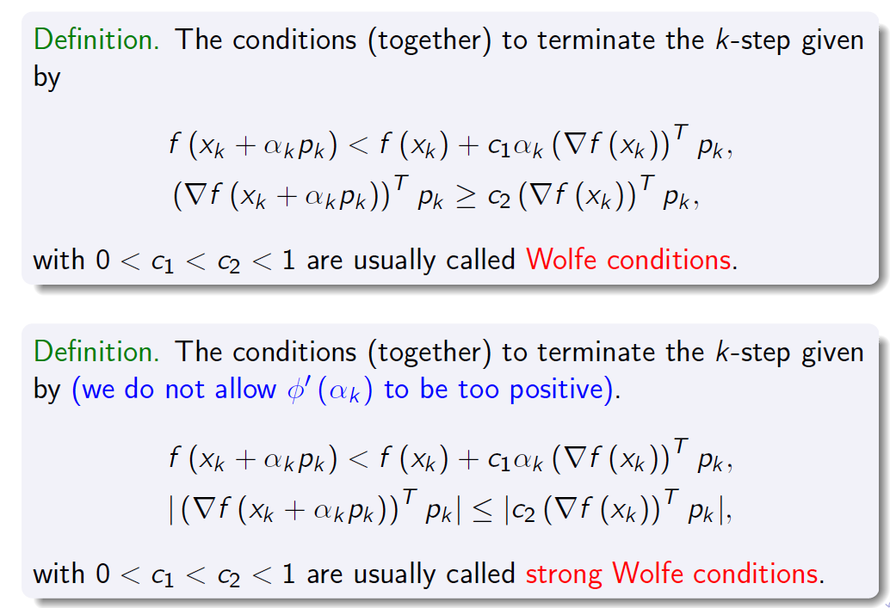
Approximate line search
Wolfe conditions

Slide 20
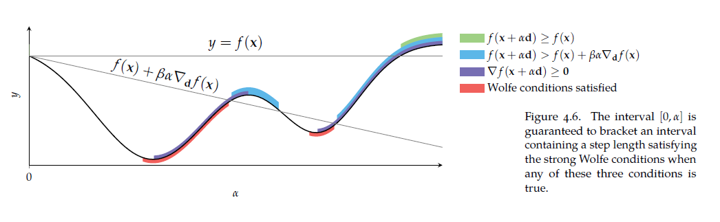
Approximate line search
Wolfe conditions

Slide 21
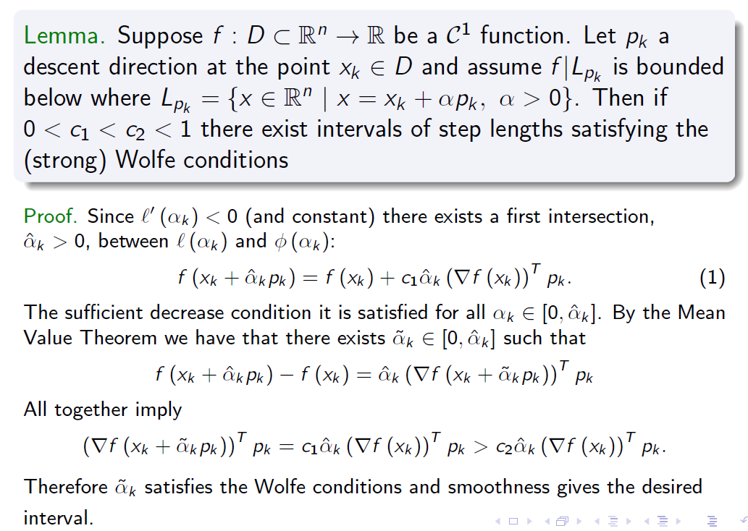
Approximate line search
Wolfe conditions: existence

Slide 22

Approximate line search
Convergence

Slide 23

Approximate line search
Convergence

