Slide 1




Don’t Optimize my Queries; Optimize my Data!
Julian Hyde DataEngConf NYC 2017/10/30

Slide 2

@julianhyde
SQL
Query planning
Query federation
OLAP
Streaming
Hadoop
ASF member
Original author of Apache Calcite
PMC Apache Arrow, Calcite, Drill, Eagle, Kylin
Architect at Hortonworks

Slide 3
Overview
How do you tune a data system? How can (or should) a data system tune itself?
What problems have we solved to bring these things to Apache Calcite?
Part 1: Strategies for organizing data. (We rely heavily on relational algebra, especially materialized views.)
Part 2: How to make systems self-organizing? (Algorithms for design materialized views, infer relationships between data sets, gathering statistics about data sets.)
Notes:
What I am going to talk about today is old knowledge
Query optimization (I prefer to call it planning) relies on relational algebra - a declarative query language, and a mathematically sound way of transforming queries to
We’ll look at what relational algebra can do for the related problem of how to organize the data for efficient query
There is talk of “self-driving database”

Slide 4
Relational algebra
SELECT d.name, COUNT(*) AS c FROM Emps AS e JOIN Depts AS d USING (deptno) WHERE e.age < 40 GROUP BY d.deptno HAVING COUNT(*) > 5 ORDER BY c DESC
Based on set theory, plus operators: Project, Filter, Aggregate, Union, Join, Sort
Requires: declarative language (SQL), query planner
Original goal: data independence
Enables: query optimization, new algorithms and data structures
Sort [c DESC]
Project [name, c]
Filter [c > 5]
Aggregate [deptno, COUNT(*) AS c]
Filter [e.age < 30]
Join [e.deptno = d.deptno]
Scan [Emps]
Scan [Depts]
Notes:
The main “very old idea” in this talk is relational algebra. As you know it enables query optimization, but it also enables data optimization
Based on set theory -- albeit sets that allow duplicates and in some cases have a defined order
Users write their queries in a declarative language - with the understanding that they will be
The original motivation was to avoid putting disk block addresses in data sets. Allowed us to move the data to a different disk without re-writing it. Data became logical. But once we have an optimizer, the optimizer can choose algorithms and can accept new data structures, without changing the query
Enables query optimization, new algorithms (e.g. hash join, merge join), new data structures (e.g. r-trees, sorted partitions), abstraction (e.g. views), security (e.g. access-controlled views)

Slide 5
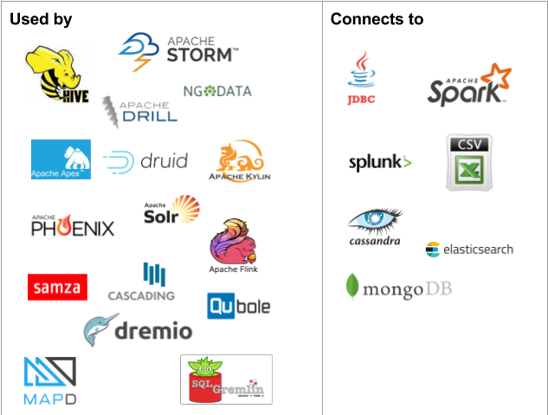
Apache Calcite
Apache top-level project since October, 2015
Query planning framework used in many projects and products
Also works standalone: embedded federated query engine with SQL / JDBC front end
Apache community development model
Notes:
Our typical contributors are members of other projects, say Hive or Flink. They contribute the extensions to the framework that they need.
MapD (database on GPUs) just went open source.

Slide 6
1. Organizing data

Slide 7
A “simple” query
Data
2010 U.S. census
100 million records
1KB per record
100 GB total
System
4x SATA 3 disks
Total read throughput 1 GB/s
Query
Goal
Compute the answer to the query in under 5 seconds
SELECT SUM(householdSize) FROM CensusHouseholds;
Notes:
To motivate, let’s look at a simple problem. Which may not be so simple.
An analytic query - figure out the number of people in the country
Impossible to meet the goal - it takes 80 seconds to read the data
One possible solution is to buy 100 GB of memory. Another is to buy another 80 disks.

Slide 8
Solutions
Sequential scan | Query takes 100 s (100 GB at 1 GB/s)
Parallelize | Spread the data over 40 disks in 10 machines Query takes 10 s
Cache | Keep the data in memory 2nd query: 10 ms 3rd query: 10 s
Materialize | Summarize the data on disk All queries: 100 ms
Materialize + cache + adapt | As above, building summaries on demand

Slide 9
Ways of organizing data
Format (CSV, JSON, binary)
Layout: row- vs. column-oriented (e.g. Parquet, ORC), cache friendly (e.g. Arrow)
Storage medium (disk, flash, RAM, NVRAM, ...)
Non-lossy copy: sorted / partitioned
Lossy copies of data: project, filter, aggregate, join
Combinations of the above
Logical optimizations >> physical optimizations
Notes:
Data format - e.g. CSV if textual, various binary formats; the more schema is known in advance, the more concise the format can be
A simple copy of data is a snapshot. Useful if it provides redundancy, but more useful if it has different sort / partitioning
If two tables are partitioned or sorted on the same key, they can be more easily joined
Choosing the right

Slide 10
Index
CREATE TABLE Emp (empno INT, name VARCHAR(20), deptno INT); CREATE INDEX I_Emp_Deptno ON Emp (deptno, name);
SELECT DISTINCT deptno FROM Emp WHERE deptno BETWEEN 20 AND 40 ORDER BY deptno;
A sorted, projected materialized view
Accelerates queries that use ranges, correlated lookups, sorting, aggregate, distinct
empno | name | deptno
100 | Fred | 20
110 | Barney | 10
120 | Wilma | 30
130 | Dino | 10
deptno | name | rowid
10 | Barney | af5634.0001
10 | Dino | af5634.0003
20 | Fred | af5634.0000
30 | Wilma | af5634.0002
Notes:
Let’s look at the oldest and still most popular data structure for optimizing data
We’re all familiar with indexes. Indexes made relational databases practical in the mid-70s
Did you know that an index is a materialized view? Technically it’s, a sorted, projected materialized view, duplicates retained

Slide 11
Covering index
CREATE INDEX I_Emp_Deptno2 ( deptno INTEGER, name VARCHAR(20)) COVER (empno);
Add the remaining columns
No longer need “rowid”
Lossless
During planning, treat indexes as tables, and index lookups as joins
empno | name | deptno
100 | Fred | 20
110 | Barney | 10
120 | Wilma | 30
130 | Dino | 10
deptno | name | empno
10 | Barney | 100
10 | Dino | 130
20 | Fred | 20
30 | Wilma | 30
Notes:
Let’s look at a slightly different kind of index. It is still sorted, which gives us the same advantages for range queries and so forth.
It doesn’t contain rowids, because in analytic databases random IOs are too expensive.
Pure relational, loss-less
MV puts it on sound algebraic footing

Slide 12
Materialized view
CREATE MATERIALIZED VIEW EmpsByDeptno AS SELECT deptno, name, deptno FROM Emp ORDER BY deptno, name;
As a materialized view, an index is now just another table
Several tables contain the information necessary to answer the query - just pick the best
Sort [deptno, name]
Scan [EmpsByDeptno]
Scan [Emps]
empno | name | deptno
100 | Fred | 20
110 | Barney | 10
120 | Wilma | 30
130 | Dino | 10
deptno | name | empno
10 | Barney | 100
10 | Dino | 130
20 | Fred | 20
30 | Wilma | 30
Notes:
Same data structure as previously, but represented generically
It doesn’t contain rowids, because in analytic databases random IOs are too expensive.
Pure relational, loss-less
MV puts it on sound algebraic footing

Slide 13
Spatial query
 |  |  |  |  |  | •
 |  |  |  | •
 |  |  |  |  |  | •
 |  | •
King Yen
Station burger
Find all restaurants within 1.5 distance units of where I am:
Filippo’s
SELECT * FROM Restaurants AS r WHERE ST_Distance( ST_MakePoint(r.x, r.y), ST_MakePoint(6, 7)) < 1.5
Zachary’s pizza
restaurant | x | y
Zachary’s pizza | 3 | 1
King Yen | 7 | 7
Filippo’s | 7 | 4
Station burger | 5 | 6
Notes:
Calcite recently added OpenGIS extensions to SQL standard

Slide 14
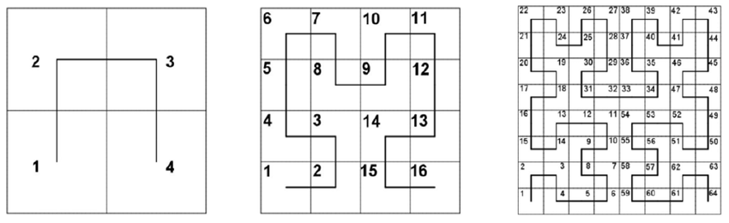
Hilbert space-filling curve
A space-filling curve invented by mathematician David Hilbert
Every (x, y) point has a unique position on the curve
Points near to each other typically have Hilbert indexes close together
Notes:
Here are 3 generations of generating the Hilbert curve. You can go on… every point has a position on the curve.
I actually prefer to think of the Hilbert index as a binary fraction between 0 and 1.
It is a permutation and interleaving of the bits of the (x, y) coordinates.
Dimension reduction from 2 to 1 dimensions means we can use b-tree indexes, range partitions etc.

Slide 15
Using Hilbert index
 |  |  |  |  |  | •
 |  |  |  | •
 |  |  |  |  |  | •
 |  | •
King Yen
Station burger
Add restriction based on h, a restaurant’s distance along the Hilbert curve
Must keep original restriction due to false positives
Filippo’s
Zachary’s pizza
SELECT * FROM Restaurants AS r WHERE (r.h BETWEEN 35 AND 42 OR r.h BETWEEN 46 AND 46) AND ST_Distance( ST_MakePoint(r.x, r.y), ST_MakePoint(6, 7)) < 1.5
restaurant | x | y | h
Zachary’s pizza | 3 | 1 | 5
King Yen | 7 | 7 | 41
Filippo’s | 7 | 4 | 52
Station burger | 5 | 6 | 36

Slide 16
Telling the optimizer
CREATE TABLE Restaurants ( restaurant VARCHAR(20), x DOUBLE, y DOUBLE, h DOUBLE GENERATED ALWAYS AS ST_Hilbert(x, y) STORED) SORT KEY (h);
Declare h as a generated column
Sort table by h
Planner can now convert spatial range queries into a range scan
Does not require specialized spatial index such as r-tree
Very efficient on a sorted table such as HBase
restaurant | x | y | h
Zachary’s pizza | 3 | 1 | 5
Station burger | 5 | 6 | 36
King Yen | 7 | 7 | 41
Filippo’s | 7 | 4 | 52

Slide 17
Streaming
Streaming query
SELECT STREAM * FROM Orders WHERE units > 1000
Much valuable data is “data in flight”
Use SQL to query streams (or streams + tables)
Historic query
SELECT AVG(unitPrice) FROM Orders WHERE units > 1000 AND orderDate BETWEEN ‘2014-06-01’ AND ‘2015-12-31’
Data center

Slide 18
Hybrid query combines a stream with its own history
Orders is used as both as stream and as “stream history” virtual table
“Average order size over last year” should be maintained by the system, i.e. a materialized view
SELECT STREAM * FROM Orders AS o WHERE units > ( SELECT AVG(units) FROM Orders AS h WHERE h.productId = o.productId AND h.rowtime > o.rowtime - INTERVAL ‘1’ YEAR)
“Orders” used as a stream
“Orders” used as a “stream history” virtual table
Notes:
This query combines both future (stream) and past. The past is useful to automatically normalize data, and figure out what is ‘exceptional’ without involving a human.
“Any useful metric is dimensionless” (in the physics sense, i.e. it has no units, because it is a ratio)
The system determines where to find the historical and streaming records. The records might be available in more than one place (in which case the system adds value by choosing the best) or nowhere (in which case the query is invalid because it is unsatisfiable).

Slide 19
Summary - data optimization via materialized views
Many forms of data optimization can be modeled as materialized views:
Blocks in cache
B-tree indexes
Summary tables
Spatial indexes
History of streams
Allows the optimizer to “understand” the optimization and use it (if beneficial)
But who designs the optimizations?

Slide 20
2. Learning

Slide 21
How do data systems learn?
Goals | Improve response time, throughput, storage cost Predictable, adaptive (short and long term), allow human intervention
How? | Humans Adaptive systems Smart algorithms
Example adaptations | Cache disk blocks in memory Cached query results Data organization, e.g. partition on a different key Secondary structures, e.g. b-tree and r-tree indexes
queries
DML
recommender
statistics
adaptations
Notes:
Over time, the data changes (usually grows), and users run queries
The main agent tuning the system is -- for now at least -- humans. Database administrators observe the data and the query load and optimize the system.
Improve understanding of the system
Gather statistics -- e.g. ANALYZE TABLE, deduce unique and foreign keys
Observe query patterns
Observe how data is loaded (e.g. is a table read-only, append-only)
Inputs the recommender are queries, the pattern of DML activity (inserts, updates, deletes), and data volumetrics; outputs are recommended adaptations (e.g. summary tables to build). Iterate, because if you build a summary table it might reduce load on another part of the system

Slide 22
Tiled, in-memory materialized views
in-memory materializations
SELECT x, SUM(n) FROM t GROUP BY x
tables on disk
A vision for an adaptive data system (we’re not there yet)
Notes:
Where we’d like to go is in-memory materializations. Adaptive and in-memory (like cache) but summarized (like summary tables) therefore more compact. Unlike cache, is known to the planner.
Some most of the data needed by the query is in memory in summarized “tiles”. Possibly created by previous queries. Where there are gaps, the query goes to disk, but it can still answer the query. Over time the useful data ends up in memory.

Slide 23
Building materialized views
Challenges:
Design Which materializations to create?
Populate Load them with data
Maintain Incrementally populate when data changes
Rewrite Transparently rewrite queries to use materializations
Adapt Design and populate new materializations, drop unused ones
Express Need a rich algebra, to model how data is derived
Initial focus: summary tables (materialized views over star schemas)

Slide 24
Designing summary tables via lattices
CREATE MATERIALIZED VIEW SalesYearZipcode AS SELECT t.year, c.state, c.zipcode, COUNT(*), SUM(units) FROM Sales AS s JOIN Time AS t USING (timeId) JOIN Customers AS c USING (customerId) GROUP BY 1, 2, 3;
sales
customers
product
time
product class
CREATE LATTICE Sales AS SELECT t.*, c.*, COUNT(*), SUM(s.units) FROM Sales AS s JOIN Time AS t USING (timeId) JOIN Customers AS c USING (customerId) JOIN Products AS p USING (productId);

Slide 25
Many possible summary tables
() 1
(z) 43k
(s) 50
(g) 2
(y) 5
(m) 12
(z, s) 43.4k
(g, y) 10
(y, m) 60
(g, y, m) 120
(s, g, y, m) 6k
Key
z zipcode (43k)
s state (50)
g gender (2)
y year (5)
m month (12)
Fewer than you would expect, because state depends on zipcode
(z, s, g, y, m) 912k
Fewer than you would expect, because 5m combinations cannot occur in 1m row table
raw 1m

Slide 26
Algorithm: Design summary tables
Given a database with 30 columns, 10M rows. Find X summary tables with under Y rows that improve query response time the most.
AdaptiveMonteCarlo algorithm [1]:
Based on research [2]
Greedy algorithm that takes a combination of summary tables and tries to find the table that yields the greatest cost/benefit improvement
Models “benefit” of the table as query time saved over simulated query load
The “cost” of a table is its size
[1] org.pentaho.aggdes.algorithm.impl.AdaptiveMonteCarloAlgorithm
[2] Harinarayan, Rajaraman, Ullman (1996). “Implementing data cubes efficiently”
Notes:
Algorithm just needs to know how many rows each summary table would contain. Compute count(distinct x, y, z) for each combination of attributes. Full scan, sort, unique, count; repeat 2³⁰ times But there are 2³⁰ possible summary tables!

Slide 27
Lattice (optimized)
() 1
(z) 43k
(s) 50
(g) 2
(y) 5
(m) 12
(z, s) 43.4k
(g, y) 10
(g, m) 24
(y, m) 60
(z, s, g) 83.6k
(g, y, m) 120
(z, s, g, y) 392k
(z, s, g, m) 644k
(z, s, y, m) 831k
(z, g, y, m) 909k
(s, g, y, m) 6k
Key
z zipcode (43k)
s state (50)
g gender (2)
y year (5)
m month (12)
(z, s, g, y, m) 912k
raw 1m

Slide 28
Data profiling
Algorithm needs count(distinct a, b, ...) for each combination of attributes:
Previous example had 2⁵ = 32 possible tables
Schema with 30 attributes has 2³⁰ (about 10⁹) possible tables
Algorithm considers a significant fraction of these
Approximations are OK
Attempts to solve the profiling problem:
Compute each combination: scan, sort, unique, count; repeat 2³⁰ times!
Sketches (HyperLogLog)
Sketches + parallelism + information theory [CALCITE-1616]

Slide 29
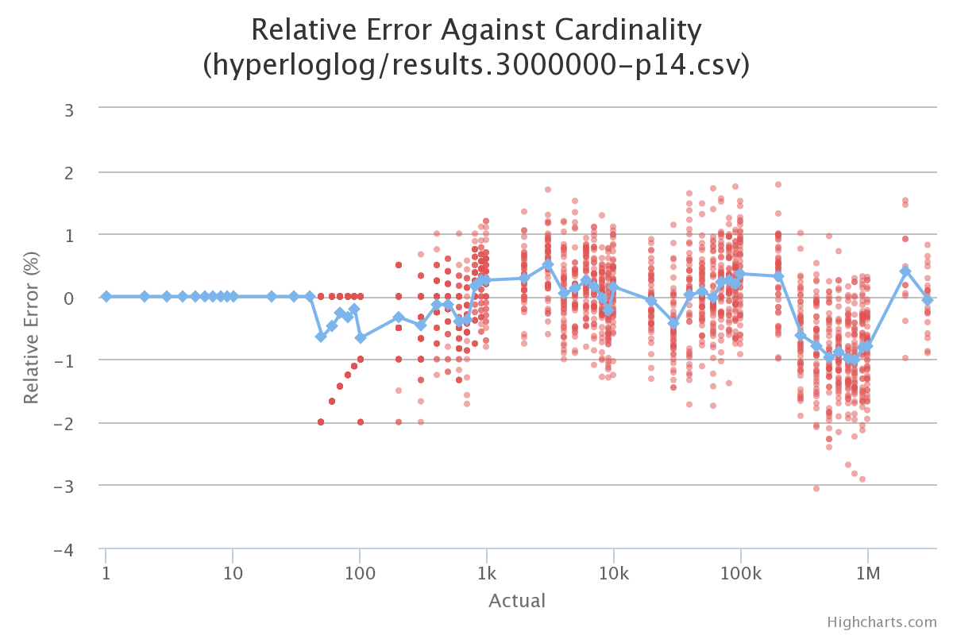
Sketches
HyperLogLog is an algorithm that computes approximate distinct count. It can estimate cardinalities of 10⁹ with a typical error rate of 2%, using 1.5 kB of memory. [3][4]
With 16 MB memory per machine we can compute 10,000 combinations of attributes each pass.
So, we’re down from 10⁹ to 10⁵ passes.
[3] Flajolet, Fusy, Gandouet, Meunier (2007). "Hyperloglog: The analysis of a near-optimal cardinality estimation algorithm" [4] https://github.com/mrjgreen/HyperLogLog

Slide 30
Combining probability & information theory
Given | Expected cardinality | Actual cardinality | Surprise
(gender): 2 (state): 50 | (gender, state): 100.0 | 100 | 0.000
(month): 12 (zipcode): 43,000 | (month, zipcode): 441,699.3 | 442,700 | 0.001
(state): 50 (zipcode): 43,000 | (state, zipcode): 799,666.7 | 43,400 | 0.897
(state, zipcode): 43,400 (gender, state): 100 (gender, zipcode): 85,995 | (gender, state, zipcode): 86,799 = min(86,799, 892,234, 892,228) | 83,567 | 0.019
Surprise = abs(actual - expected) / (actual + expected)
E(card (x, y)) = n . (1 - ((n - 1) / n) ^ p) n = card (x) * card (y), p = row count

Slide 31
Algorithm
surprise_threshold := 1 queue := {singleton combinations} // (a), (b), ... while queue is not empty { batch := remove first 10,000 entries in queue compute cardinality of each combination in batch for each actual (computed) cardinality a { e := expected cardinality of combination s := surprise(a, e) if s > surprise_threshold { store combination and its cardinality add child combinations to queue // (x, a), (x, b), ... } increase surprise_threshold } }
Three ways “surprise” can help:
If a cardinality is not surprising, we don’t need to store it -- we can derive it
If a combination’s cardinality is not surprising, it is unlikely to have surprising children
If we’re not seeing surprising results, it’s time to stop

Slide 32
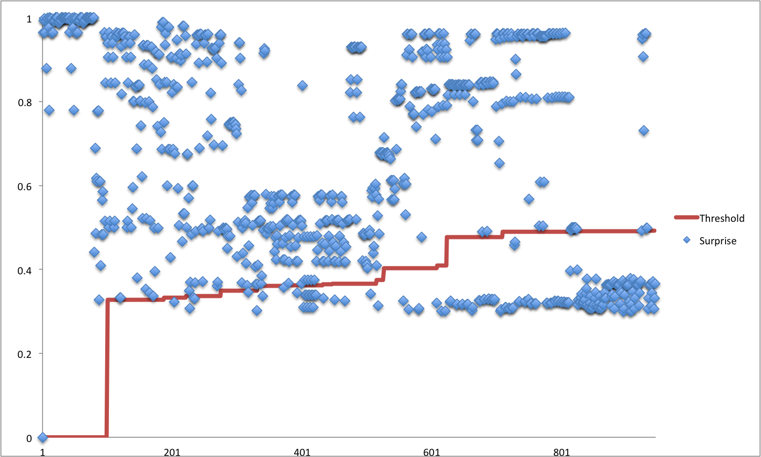
Algorithm progress and “surprise” threshold
Surprise threshold rises as algorithm progresses
Singleton combinations are have surprise = 1
Surprise threshold rises after we have completed the first batch
Rejected as not sufficiently surprising
Progress of algorithm
Notes:
We don’t store results that are not “surprising”
We don’t explore children of un-surprising combinations of attributes

Slide 33
Data profiling - summary
The algorithm defeats a combinatorial search space using sketches + information theory + parallelism
Recommending data structures is an optimization problem; profiling provides the cost & benefit function
As a by-product, the algorithm discovers unique keys, “almost” keys, and foreign keys
But which tables are actually joined together in practice?
Notes:
Recommending data structures is an optimization problem.

Slide 34
Designing summary tables via lattices (2)
CREATE MATERIALIZED VIEW SalesYearZipcode AS SELECT t.year, c.state, c.zipcode, COUNT(*), SUM(units) FROM Sales AS s JOIN Time AS t USING (timeId) JOIN Customers AS c USING (customerId) GROUP BY 1, 2, 3;
sales
customers
product
time
product class
The lattice generates the summary tables. But who writes the lattice?
CREATE LATTICE Sales AS SELECT t.*, c.*, COUNT(*), SUM(s.units) FROM Sales AS s JOIN Time AS t USING (timeId) JOIN Customers AS c USING (customerId) JOIN Products AS p USING (productId);

Slide 35
Designing summary tables via lattices (3)
CREATE MATERIALIZED VIEW SalesYearZipcode AS SELECT t.year, c.state, c.zipcode, COUNT(*), SUM(units) FROM Sales AS s JOIN Time AS t USING (timeId) JOIN Customers AS c USING (customerId) GROUP BY 1, 2, 3;
sales
customers
product
time
product class
CREATE LATTICE Sales AS SELECT t.*, c.*, COUNT(*), SUM(s.units) FROM Sales AS s JOIN Time AS t USING (timeId) JOIN Customers AS c USING (customerId) JOIN Products AS p USING (productId);
ALTER SCHEMA Sales INFER LATTICES;

Slide 36
Growing and evolving lattices based on queries
Query 2
sales
product
Query 1
sales
product class
customers
Lattice after Query 1 + 2
sales
customers
product
See: [CALCITE-1870] “Lattice suggester”
product class

Slide 37
Summary
Learning systems = manual tuning + adaptive + smart algorithms
Query history + data profiling→ lattices → summary tables
We have discussed summary tables (materialized views based on join/aggregate in a star schema) but the approach can be applied to other kinds of materialized views
Relational algebra, incorporating materialized views, is a powerful language that allows us to combine many forms of data optimization

Slide 38
Thank you! Questions?
@julianhyde · @ApacheCalcite · http://apache.calcite.org
Resources
[CALCITE-1616] Data profiler
[CALCITE-1870] Lattice suggester
[CALCITE-1861] Spatial indexes
[CALCITE-1968] OpenGIS
[CALCITE-1991] Generated columns
Talk: “Data profiling with Apache Calcite” (Hadoop Summit, 2017)
Talk: “SQL on everything, in memory” (Strata, 2014)
Zhang, Qi, Stradling, Huang (2014). “Towards a Painless Index for Spatial Objects”
Harinarayan, Rajaraman, Ullman (1996). “Implementing data cubes efficiently”
Image credit
https://www.flickr.com/photos/defenceimages/6938469933/

Slide 40
Extra slides

Slide 41
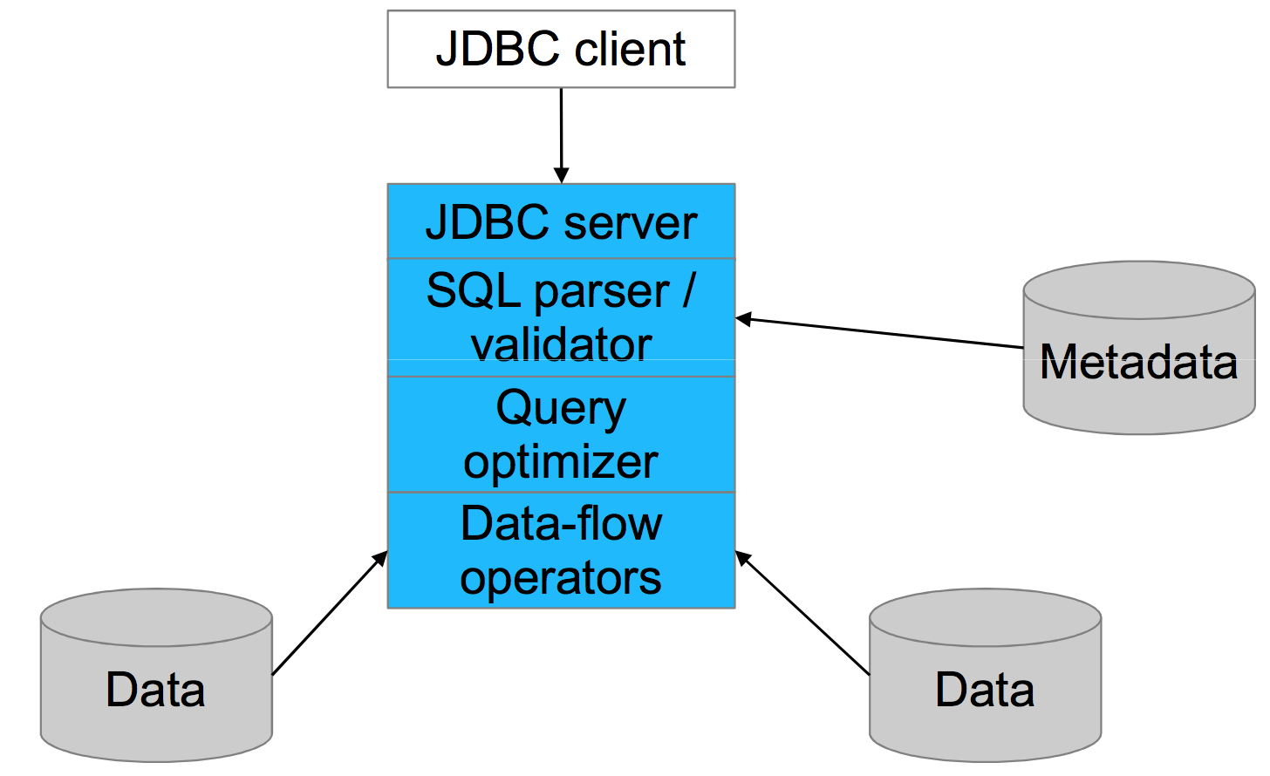
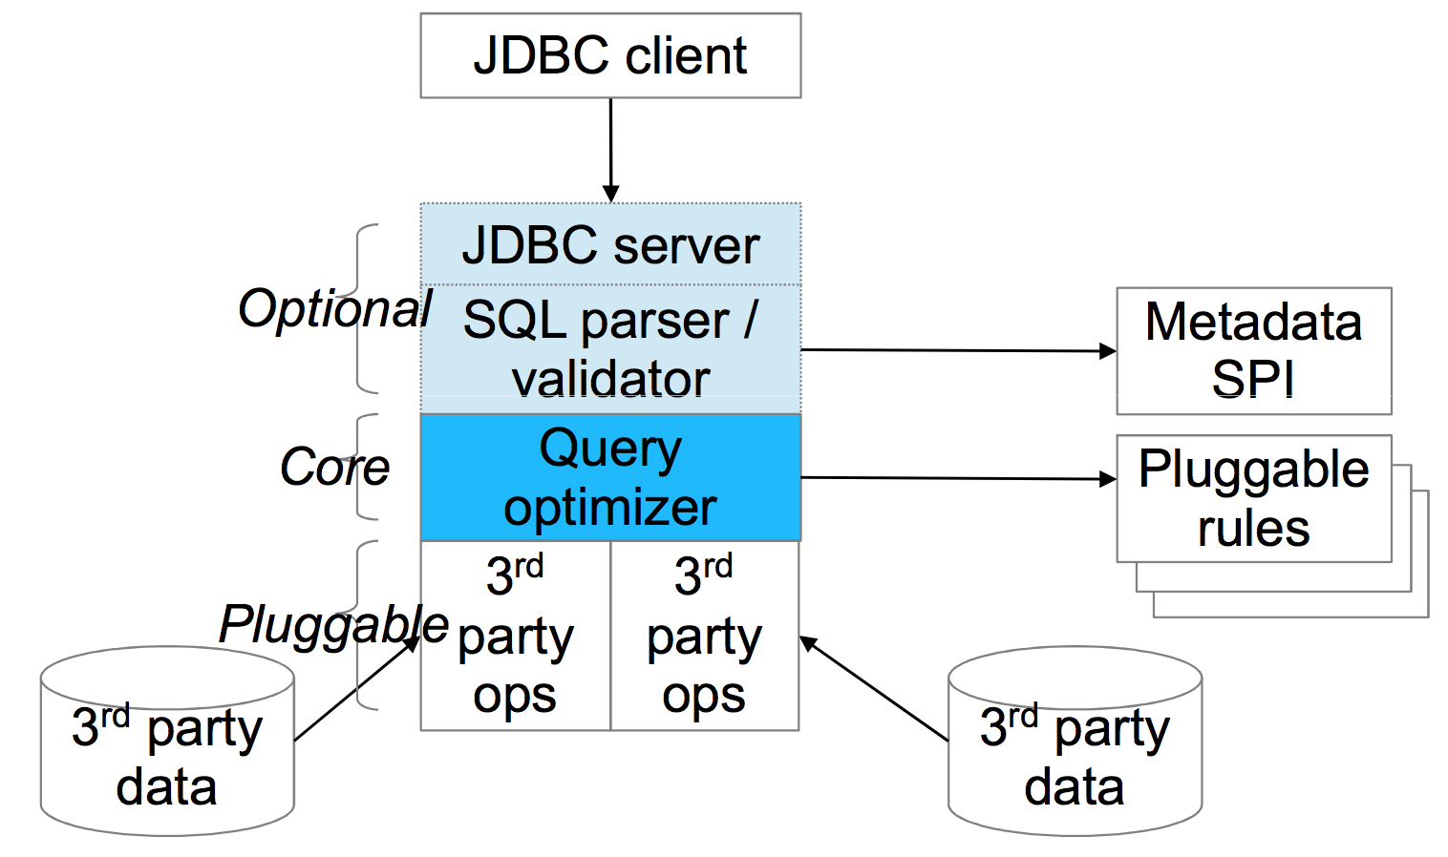
Architecture
Conventional database
Calcite

Slide 42
Planning queries
select p.productName, count(*) as c from splunk.splunk as s join mysql.products as p on s.productId = p.productId where s.action = 'purchase' group by p.productName order by c desc
Splunk
Table: splunk
Key: productId
Condition: action = 'purchase'
Key: productName Agg: count
Key: c desc
scan
join
MySQL
filter
group
sort
scan
Table: products

Slide 43
Optimized query
select p.productName, count(*) as c from splunk.splunk as s join mysql.products as p on s.productId = p.productId where s.action = 'purchase' group by p.productName order by c desc
Splunk
Table: splunk
Condition: action = 'purchase'
Key: productId
Key: productName Agg: count
Key: c desc
scan
filter
MySQL
join
group
sort
scan
Table: products
Notes:
Two rules have fired, filter-join-transpose-rule followed by splunk-filter-rule, and the query has become more efficient, because many fewer rows are coming out of Splunk. To truly optimize the query we would need to fire many more rules, and apply a cost model to choose which of the many equivalent plans is the best.

Slide 44
Calcite framework
Relational algebra
RelNode (operator) TableScan Filter Project Union Aggregate … RelDataType (type) RexNode (expression) RelTrait (physical property) RelConvention (calling-convention) RelCollation (sortedness) RelDistribution (partitioning) RelBuilder
SQL parser
SqlNode SqlParser SqlValidator
Transformation rules
RelOptRule FilterMergeRule AggregateUnionTransposeRule 100+ more Global transformations Unification (materialized view) Column trimming De-correlation
Metadata
Schema Table Function TableFunction TableMacro Lattice
Cost, statistics
RelOptCost RelOptCostFactory RelMetadataProvider RelMdColumnUniquensss RelMdDistinctRowCount RelMdSelectivity
JDBC driver

Slide 45
Materialized views, lattices, tiles
CREATE MATERIALIZED VIEW t AS SELECT * FROM emps WHERE deptno = 10;
Materialized view - A table whose contents are guaranteed to be the same as executing a given query.
Lattice - Recommends, builds, and recognizes summary materialized views (tiles) based on a star schema.
A query defines the tables and many:1 relationships in the star schema.
Tile - A summary materialized view that belongs to a lattice. A tile may or may not be materialized. Might be:
Declared in lattice, or
Generated via recommender algorithm, or
Created in response to query.
CREATE LATTICE star AS SELECT * FROM sales_fact_1997 AS s JOIN product AS p ON … JOIN product_class AS pc ON … JOIN customer AS c ON … JOIN time_by_day AS t ON …;
CREATE MATERIALIZED VIEW zg IN star SELECT gender, zipcode, COUNT(*), SUM(unit_sales) FROM star GROUP BY gender, zipcode;

Slide 46
Combining past and future
select stream * from Orders as o where units > ( select avg(units) from Orders as h where h.productId = o.productId and h.rowtime > o.rowtime - interval ‘1’ year)
Orders is used as both stream and table
System determines where to find the records
Query is invalid if records are not available
Notes:
This query combines both future (stream) and past. The past is useful to automatically normalize data, and figure out what is ‘exceptional’ without involving a human.
“Any useful metric is dimensionless” (in the physics sense, i.e. it has no units, because it is a ratio)
The system determines where to find the historical and streaming records. The records might be available in more than one place (in which case the system adds value by choosing the best) or nowhere (in which case the query is invalid because it is unsatisfiable).

Slide 47
Controlling when data is emitted
select stream productId, count(*) as c from Orders group by productId, floor(rowtime to hour) emit at watermark, early interval ‘2’ minute, late limit 1;
Early emission is the defining characteristic of a streaming query.
The emit clause is a SQL extension inspired by Apache Beam’s “trigger” notion. (Still experimental… and evolving.)
A relational (non-streaming) query is just a query with the most conservative possible emission strategy.
select * from Orders emit when complete;

Slide 48
Other applications of data profiling
Query optimization:
Planners are poor at estimating selectivity of conditions after N-way join (especially on real data)
New join-order benchmark: “Movies made by French directors tend to have French actors”
Predict number of reducers in MapReduce & Spark
“Grokking” a data set
Identifying problems in normalization, partitioning, quality
Applications in machine learning?
Notes:
Maybe that “almost hierarchy” should be a true hierarchy -- so you have a quality problem
If attributes have a lower cardinality than expected, then maybe you can use one to predict another

Slide 49
Further improvements to data profiling
Build sketches in parallel
Run algorithm in a distributed framework (Spark or MapReduce)
Compute histograms
For example, Median age for male/female customers
Seek out functional dependencies
Once you know FDs, a lot of cardinalities are no longer “surprising”
FDs occur in denormalized tables, e.g. star schemas
Smarter criteria for stopping algorithm
Skew/heavy hitters. Are some values much more frequent than others?
Conditional cardinalities and functional dependencies
Does one partition of the data behave differently from others? (e.g. year=2005, state=LA)

