Slide 1




$$∇∙E=ρ/ε_{0}$$
$$∇∙B=0$$
$$∇ × E=−\frac{∂B}{∂t}$$
$$∇ × B=μ_{0}j+μ_{0}ε_{0}\frac{∂E}{∂t}$$

Slide 2

$$iℏ\frac{∂}{∂t}\left|Ψ\right\rangle =\hat{H}\left|Ψ\right\rangle$$

Slide 3

$$G_{μν}+Λg_{μν}=8πGT_{μν}$$

Slide 4

$$\frac{d}{dt}\left(\frac{∂L}{∂\dot{q_{i}}}\right)−\frac{ ∂L}{∂q_{i}}=0$$

Slide 5
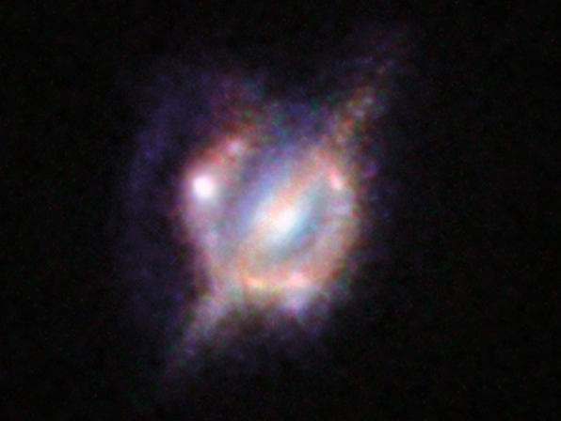
By ESO/NASA/ESA/W. M. Keck Observatory - https://www.eso.org/public/images/eso1426a/, CC BY 4.0, https://commons.wikimedia.org/w/index.php?curid=34962810

Slide 6




$$v−v_{0}=at$$
$$x−x_{0}=\frac{1}{2}\left(v_{0}+v\right)\left(t−t_{0}\right)$$
$$x−x_{0}=v_{0}\left(t−t_{0}\right)+\frac{1}{2}a{\left(t−t_{0}\right)}^{2}$$
$$v^{2}−v_{0}^{2}=2a\left(x−x_{0}\right)$$

Slide 7

$$S=k_{B}\ln{Ω}$$

Slide 8

$$ψ_{nk}\left(r\right)=e^{ik⋅r}u_{nk}(r)$$

Slide 10


