Slide 1
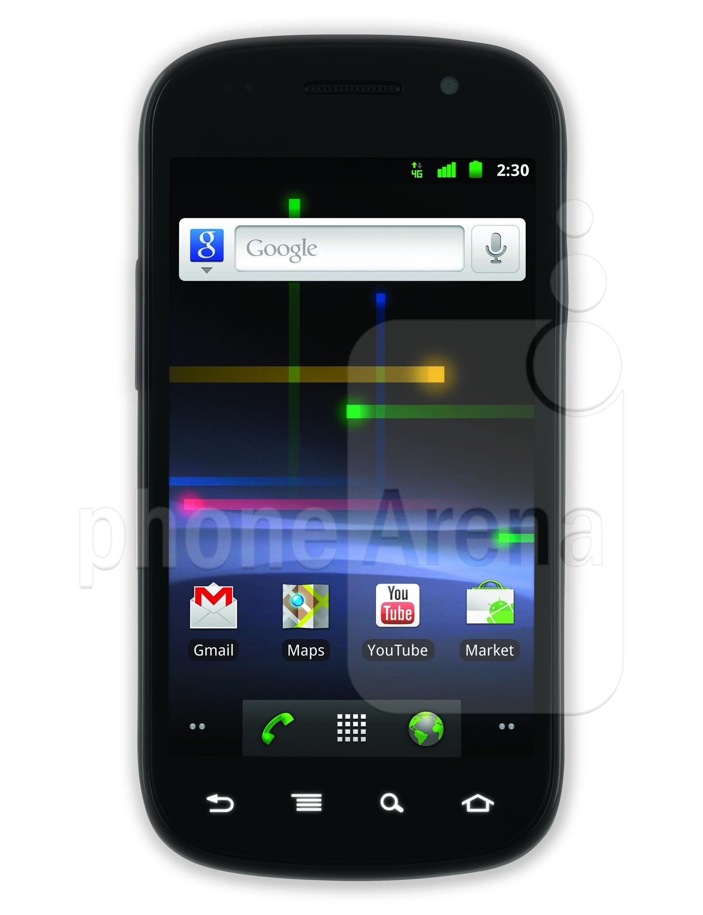
Phone
Server
Hidden Driver & Availability Estimator
Event Detector
Filter
Filter & Lot Labeler

Slide 2
Lot 1
Lot 2
A
B
C

