Slide 1
Firefly Inspired Time Synchronization
Uri Braun
Geetika Tewari
Geoffrey Werner-Allen
December, 2004

Slide 2
Motivation
Time synchronization in wireless sensor networks is crucial in many operations
  Keeps data consistent
  Communication
  Coordination
  Backbone of common services (logging, database queries, cryptography schemes)

Slide 3



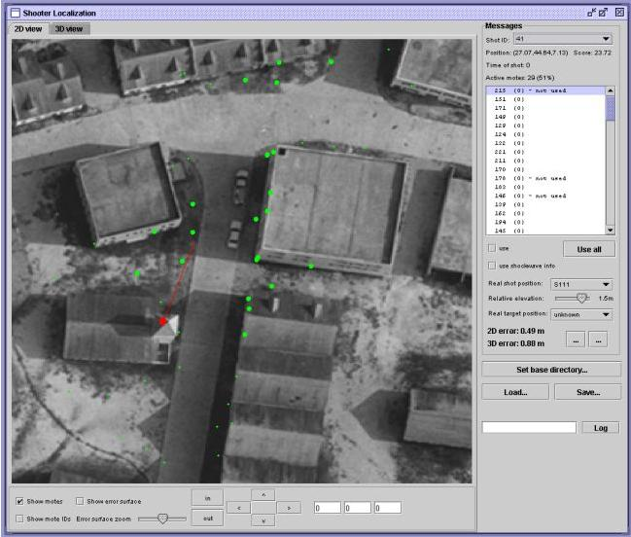
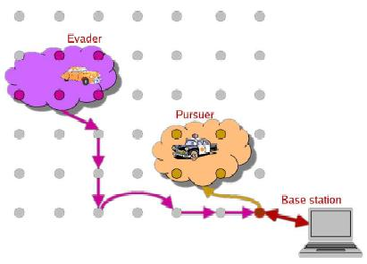
Applications
Some uses include:

Slide 4

Problem Statement
Given limited resources and bandwidth, design a firefly inspired time synchronization (FITS) protocol based on the pulse-coupled integrate and fire model embedded in biological swarms formalized by Mirollo and Strogatz, and evaluate its performance in achieving time synchronicity in a wireless sensor test bed.
Time synchronization: Establish a common time base on all motes (not just pulse-coupled) in a multi-hop context

Slide 5
Previous Work
Time synchronization protocols for WSNs:
  Flooding Time Synchronization Protocol (FTSP), Maroti, Kusy et al., SENSYS, 2004
  Decentralized Synchronization Protocols with Nearest Neighbor Communication, Lucarelli, Wang, SENSYS 2004.
  Fine-grained Network Time Synchronization Using Network Broadcast Requests (RBS), Elson, Girod and Estrin, OSDI, 2002.

Slide 6
Previous Work
Pulse-coupled oscillator based synchronization:
  Time synchronization scheme based on pulse-coupled oscillations for Ultra Wideband (UWB) networks, Hong et al, ISIT 2003.

Slide 7
Implementation Challenges
 | Strogatz | Lucarelli | FITS
Communication assumption | Perfect links ‘All-to-All’ | Perfect links Local interaction | Lossy Links Local interaction
Event Processing Time | None | None | Exists
Time Precision | Infinite | Infinite | Finite (No floating point!)
Oscillator Dynamics | None | None | Varies by node crystals. Influenced by environmental factors and over time.
Communication Delay | None | None | Always non-zero. Scales with neighborhood size.

Slide 8
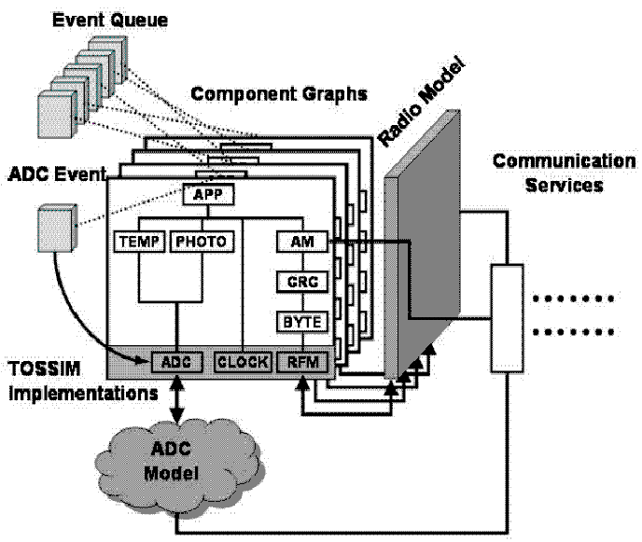
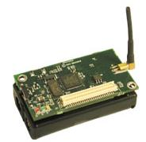
Research Methodology
Implementation of FITS algorithm
Evaluation in TOSSIM
  Parameter tweaking in simulation
  environment
Evaluation on Motelab
  Testbed of wireless sensors: MicaZs
Comparison with FTSP

Slide 9
Experiments
TOSSIM Experiments
  Choice of Firing Function
    Logarithmic – linearized function. Easy to implement on MicaZ integer only platform
  Different static topologies (ring, line, grid…)
  Different number of nodes
  Varying Firing Function Constants
  Varying “Ignore-time” (To counter additive properties)
Motelab Experiments
  Measure clock skew
  Single-hop: All nodes on MD 2nd floor

Slide 10
Integrate and Fire Implementation
e₁
e₂
e₃
e₄
r₄
Fire_{n-1}
Fire_{n}
Fire heard
e₁
e₂
e₃
e₄
Event Queue
Fire_{n}

Slide 11
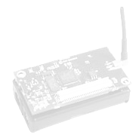
Data Collection
Receiver (logging)

Slide 12
Evaluation Strategies
Simple linear regression to detect variations in pulse frequency of individual motes.
Robust algorithm to automatically identify synchronized groups from a range of pulses of n motes over time.

Slide 13
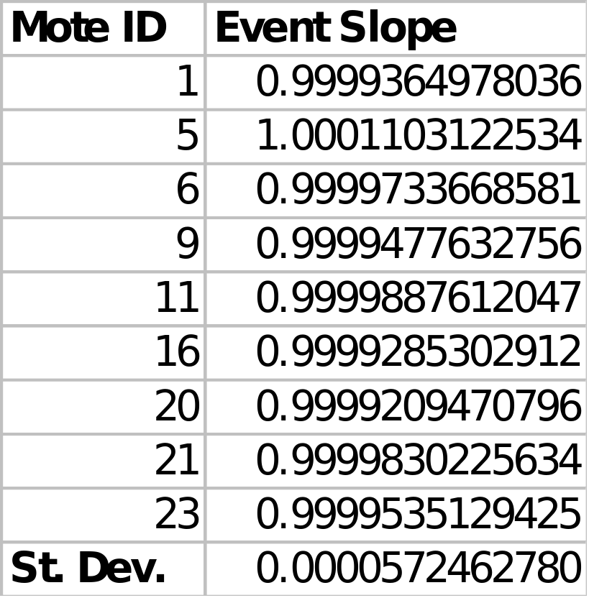
Early Motelab Results

Slide 14
Common Time base Computation
Firefly-based approach: synchronized pulses
Challenge: Establish a common time base on all motes from pulses.

Slide 15
Immediate Next Steps
Fine-tune FITS on TOSSIM to better comprehend convergence properties
Parameter tweaking to increase time synchronization accuracy
Further experiments to test robustness of FITS
  Handling of dynamic topologies/node failures
Multi-hop time synchronization protocol
Compare to FTSP
Evaluate efficiency of deployment (E.g. power consumption)

Slide 16
Ambitious Next Steps
Leverage separate synchronized groups to attain TDMA scheduling
(Prove useful properties of firefly-based model in actual test-bed environment)

