Slide 1
Firefly Inspired Time Synchronization
Uri Braun
Geetika Tewari
Geoffrey Werner-Allen

Slide 2
Motivation
Time synchronization in wireless sensor networks is crucial in many operations
  Keeps data consistent
  Communication
  Coordination
  Backbone of common services
  (logging, database queries)

Slide 3


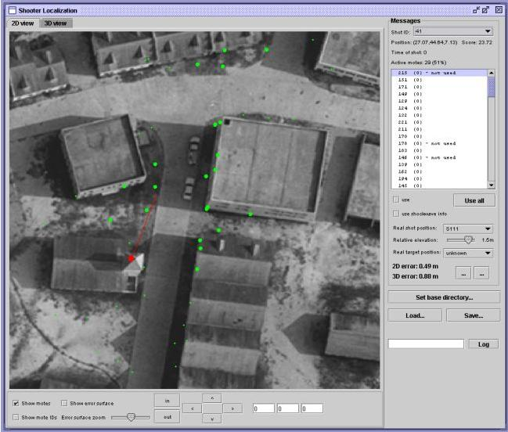
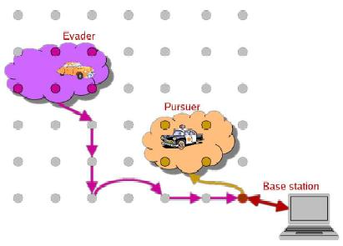
Applications
Some uses include:

Slide 4

Problem Statement
Given limited resources and bandwidth, design a firefly inspired time synchronization protocol based on the pulse-coupled integrate and fire model embedded in biological swarms and formalized by Mirollo and Strogatz, and evaluate its performance in achieving time synchronicity in a wireless sensor test bed.
Time synchronization: Establish a common time global base on all motes (not just pulse-coupled)

Slide 5
Model versus Implementation
Strogatz’s assumptions
  Oscillators have identical dynamics
  Each oscillator is coupled to all the others (all-to-all)
Wireless Sensor Network conditions
  Clock skew: Motes have varying frequencies
  Medium Access Control (MAC) layer delays

Slide 6
Previous Work
Time synchronization protocols for WSNs:
  Fast Time Synchronization Protocol, Maroti, Kusy et al. SenSys’04
  Decentralized Synchronization Protocols with Nearest Neighbor Communication, Lucarelli, Wang, SENSYS 2004.
  Fine-grained Network Time Synchronization Using Network Broadcast Requests, Elson, Girod and Estrin, OSDI, 2002.

Slide 7
Previous Work
Pulse-coupled oscillator based synchronization:
  Time synchronization scheme based on pulse-coupled oscillations for Ultra Wideband (UWB) networks, Hong et al, ISIT 2003.

Slide 8
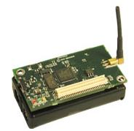
Research Methodology
Implementation of FITS algorithm
Evaluation in TOSSIM
Evaluation on Motelab
  Testbed of wireless sensors: MicaZs

