Slide 1
1—Power-Agile Computing

Slide 2
power-proportionality:
power scales proportional to the amount of work the system performs

Slide 3
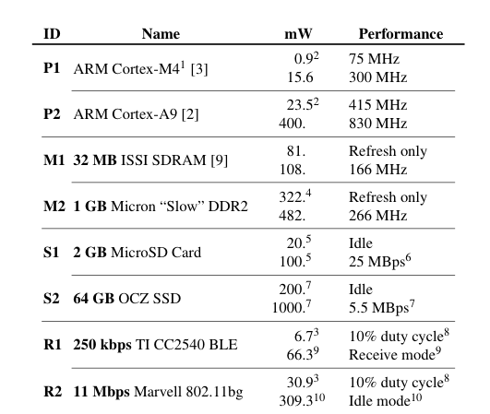

Slide 4




CPU
Memory
Disk
Radio
23.5–400 mW
322–482 mW
200-1000 mW
30.9–309.3 mW

Slide 5
CPU
Memory
Disk
Radio
23.5–400 mW
322–482 mW
200-1000 mW
30.9–309.3 mW
0.9–15.6 mW
81–108 mW
20-100 mW
6.7–66.3 mW

Slide 6
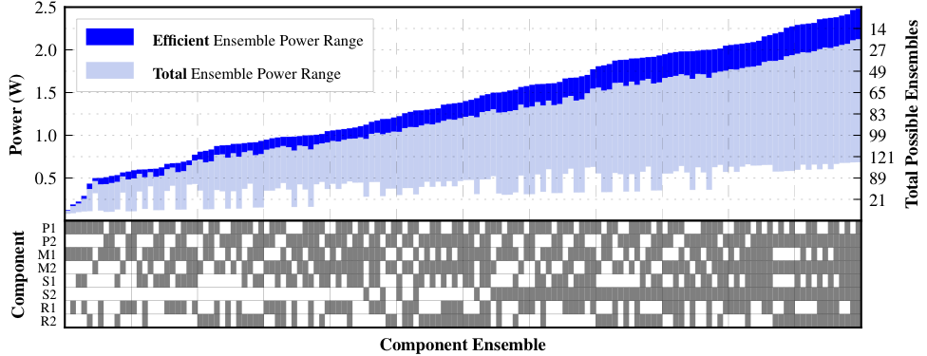

Slide 7
power-agility:
the ability of a heterogeneous power-proportional system to adjust to changes in demand (or availability)

Slide 8
component ensemble:
the set of components in use at a particular time
architectural assertions:
1) no single ensemble works well for all applications
2) dynamically adjusting the state of the system outperforms a static ensemble for a large class of applications

Slide 9
systems challenges:
1) measuring application power efficiency
2) predicting ensemble performance
3) selecting component ensembles
4) preparing ensemble transitions
5) executing ensemble transitions

Slide 10
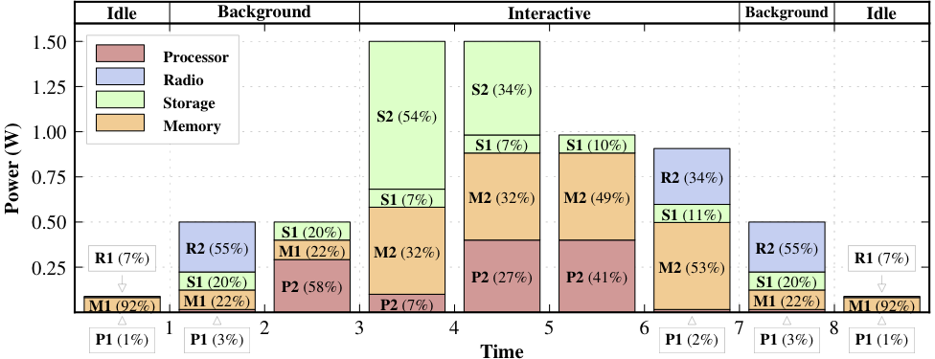
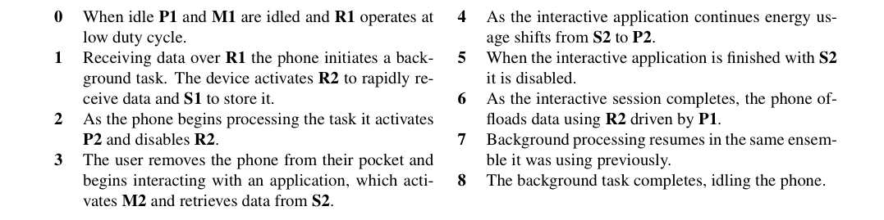

Slide 11
power-agility
—or—
the multicomputer

Slide 12
2—PhoneLab

