Slide 1
The Case for Power-Agile Computing
Geoffrey Challen (SUNY Buffalo), Mark Hempstead (Drexel University)

Slide 2


Slide 3
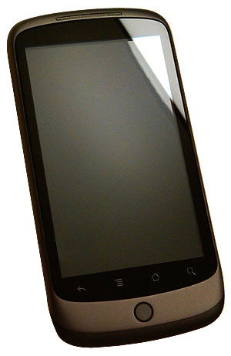

Slide 4


Slide 6


Slide 8
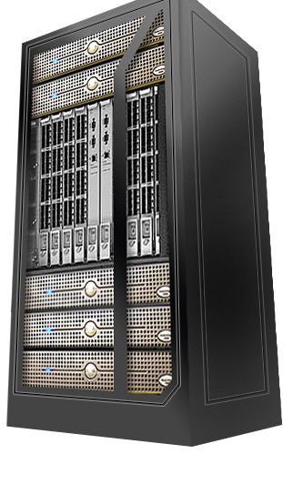

Slide 10



Slide 11





Slide 15
Computer Science Genius TODO
Selecting devices for each application

Slide 16
Computer Science Genius TODO
Selecting devices for each application
Measuring application efficiency

Slide 17
Computer Science Genius TODO
Selecting devices for each application
Measuring application efficiency
Predicting device performance for a given application

Slide 18
Computer Science Genius TODO
Selecting devices for each application
Measuring application efficiency
Predicting device performance for a given application
Executing transitions between devices

Slide 19





Shazam!
Shazam!
Shazam!
Shazam!

Slide 22
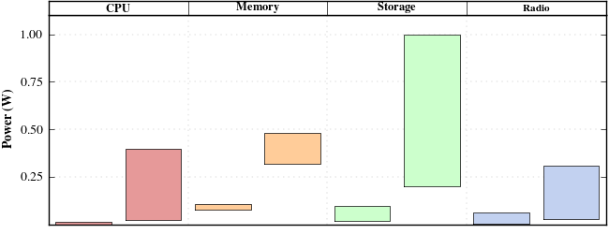
CPU
Memory
Storage
Radio
1000
Power (W)
482
400
322
200
309
108
100
66.3
15.6
23.5
30.9
81
20
6
0.9
P1
P2
M1
M2
S1
S2
R1
R2
75–300 MHz
415–830 MHz
32 MB
1 GB
2 GB
64 GB
250 kbps
11 Mbps

Slide 23
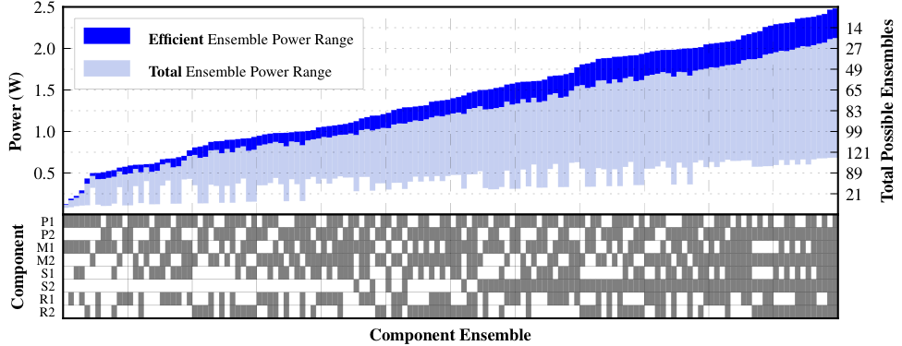

Slide 24
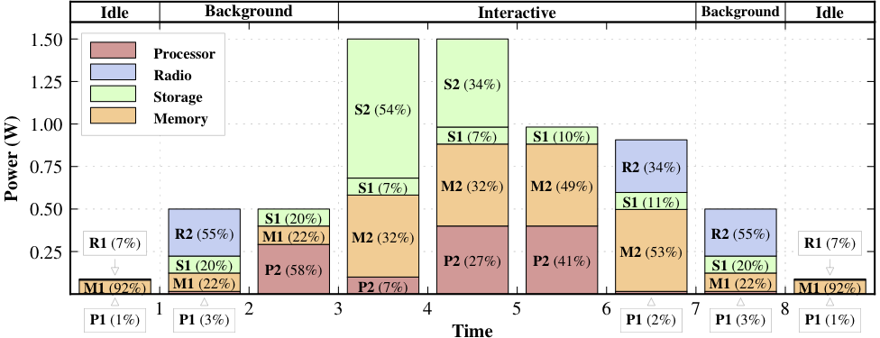

Slide 33
The Power-Agile
Multicomputer

Slide 34
Power-Agile Computing Challenges
Selecting component ensembles for each application
Measuring application efficiency
Predicting ensemble performance for a given application
Executing transitions between ensembles
Increased device complexity and cost

Slide 35
Shazam!

Slide 36


Slide 37
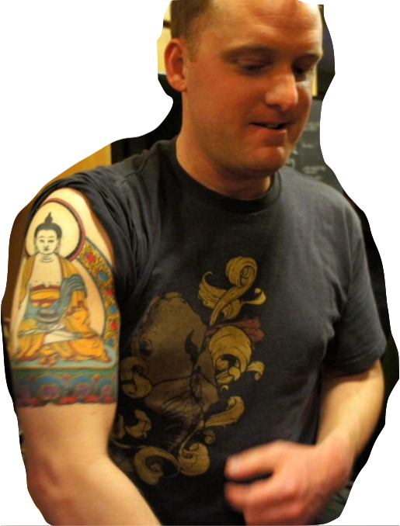
Benevolent Dictator
Peaceful Buddha

Slide 38
Power-Agile Computing
Opportunity:
A device composed of multiple heterogeneous components allows power to be flexibly allocated across subsystems in ways that improve application performance while reducing overall power usage.
Challenges:
Measuring application efficiency
Predicting ensemble performance for a given application
Selecting component ensembles for each application
Executing transitions between ensembles
Increased device complexity and cost
Geoffrey Challen (SUNY Buffalo), Mark Hempstead (Drexel University)

