Slide 1
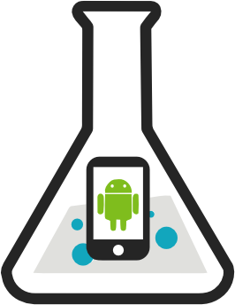
PhoneLab: A Large Programmable Smartphone Testbed
Anandatirtha Nandugudi, Anudipa Maiti, Taeyeon Ki, Fatih Bulut
Murat Demirbas, Tevfik Kosar, Chunming Qiao, Steven Y. Ko and Geoffrey Challen
University at Buffalo
http://www.phone-lab.org

Slide 2
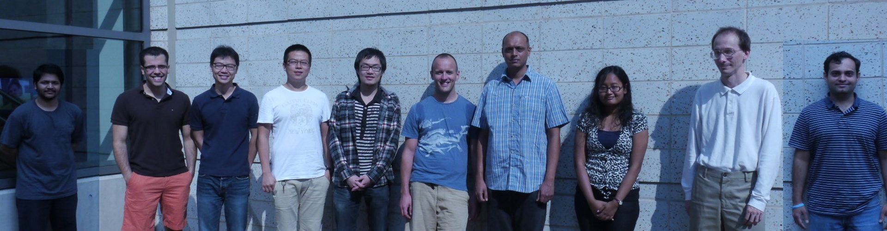
blue: A Systems Research Group
Anandatirthra
Nandugudi
Carl
Nuessle
Guru
Prasad
Taeyeon Ki
Tong Guan
Gino
Buzzelli
Jinghao
Shi
Anudipa
Maiti
Maulik
Dave
Me

Slide 3
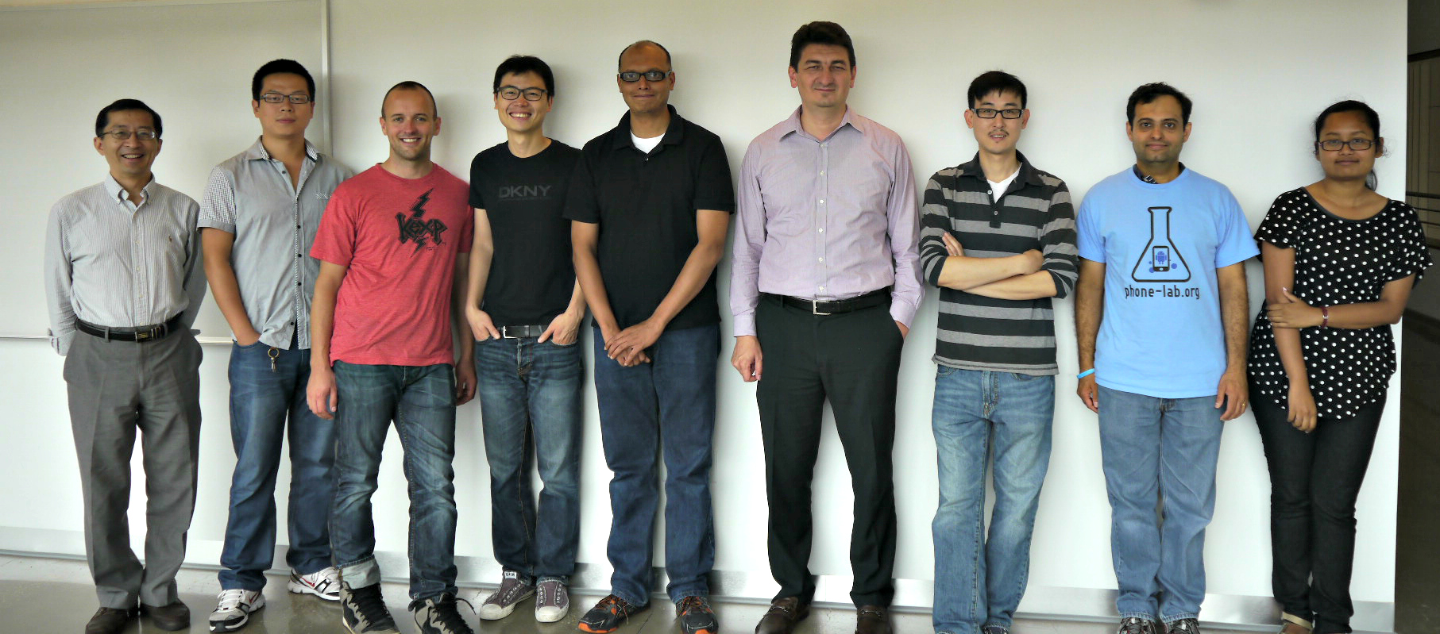
The PhoneLab Team
Anandatirthra
Nandugudi
Chunming
Qiao
Steve Ko
Me
Anudipa Maiti
Jinghao
Shi
Tevfik Kosar
Maulik
Dave
Taeyeon Ki

Slide 4

The Best Smartphone Testbed
The Google Play Store

Slide 5
Research on the Play Store
Pros
Massive scale
  700K for something useful¹
  Even 4K for just data collection²
Representative
Cons
No incentives
Can't run background experiments
Can't modify platform components
No built-in data collection
1. Carat: Collaborative Energy Diagnosis for Mobile Devices, SenSys'13.
2. Characterizing and Modeling the Impact of Wireless Signal Strength on Smartphone Battery Drain, SIGMETRICS'13.

Slide 6



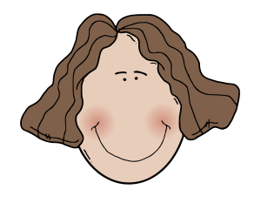

Where PhoneLab Fits In
>
>
Size: 288 users
Representativeness: good split of genders and ages, access to users' primary device
Devices: homogeneous set, currently Galaxy Nexus
Incentives: built-in through service discounts
Data collection: also built-in

Slide 7
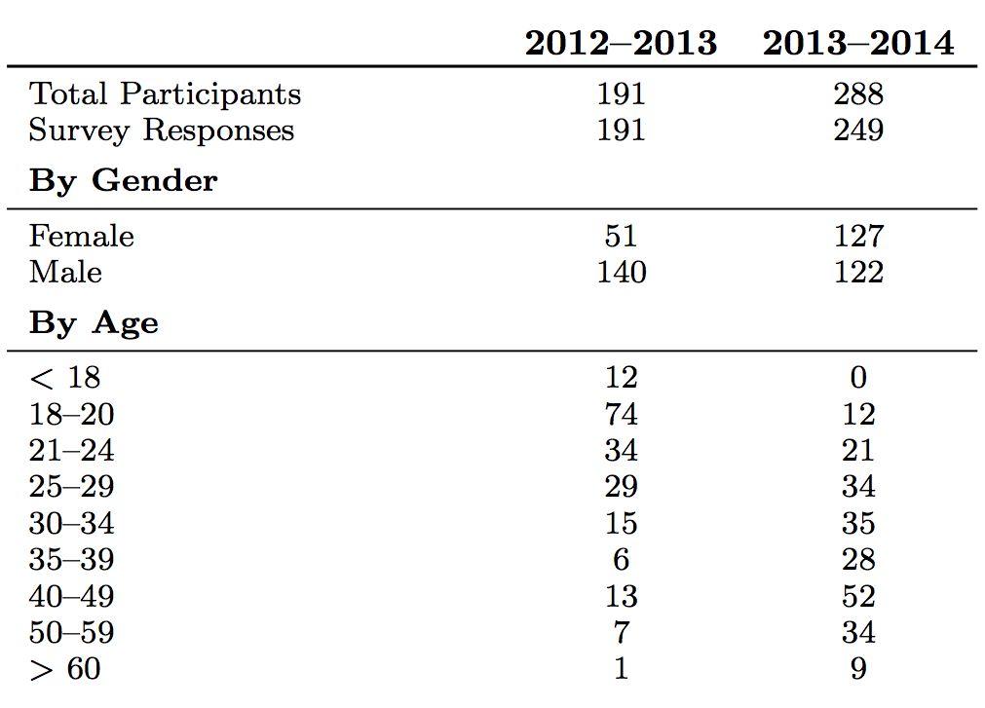
Participant Demographics

Slide 8
PhoneLab Data Collection
Log.v("MyGreatExperiment", "The user did something interesting.");

Slide 9
PhoneLab Experiments
Interactive
  What we think of as Android apps
  Potentially a better fit for the Play Store
Background
  No user interaction
  Can't normally be started on Android
Platform
  Open-source platform allows you to change anything!
  Hard to support safely—check back in a year

Slide 10
Experimental Process
Idea Submission
PhoneLab
Developer Testing
Human Subjects
Review
Experiment
Deployment
+1 year
Data Release

Slide 11
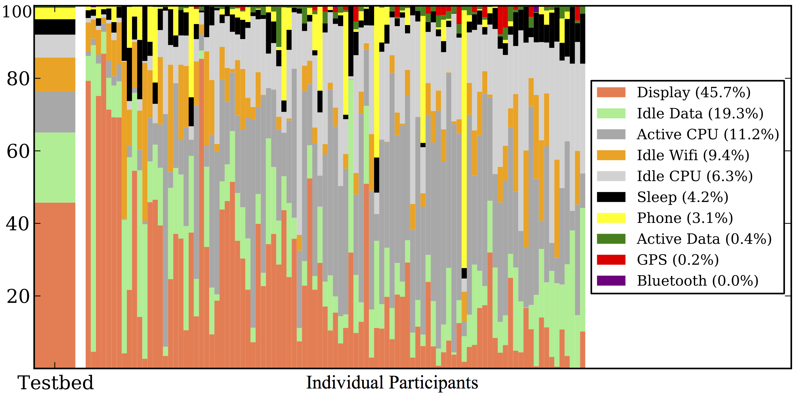
Energy Usage
Does GPS energy usage matter?

Slide 12
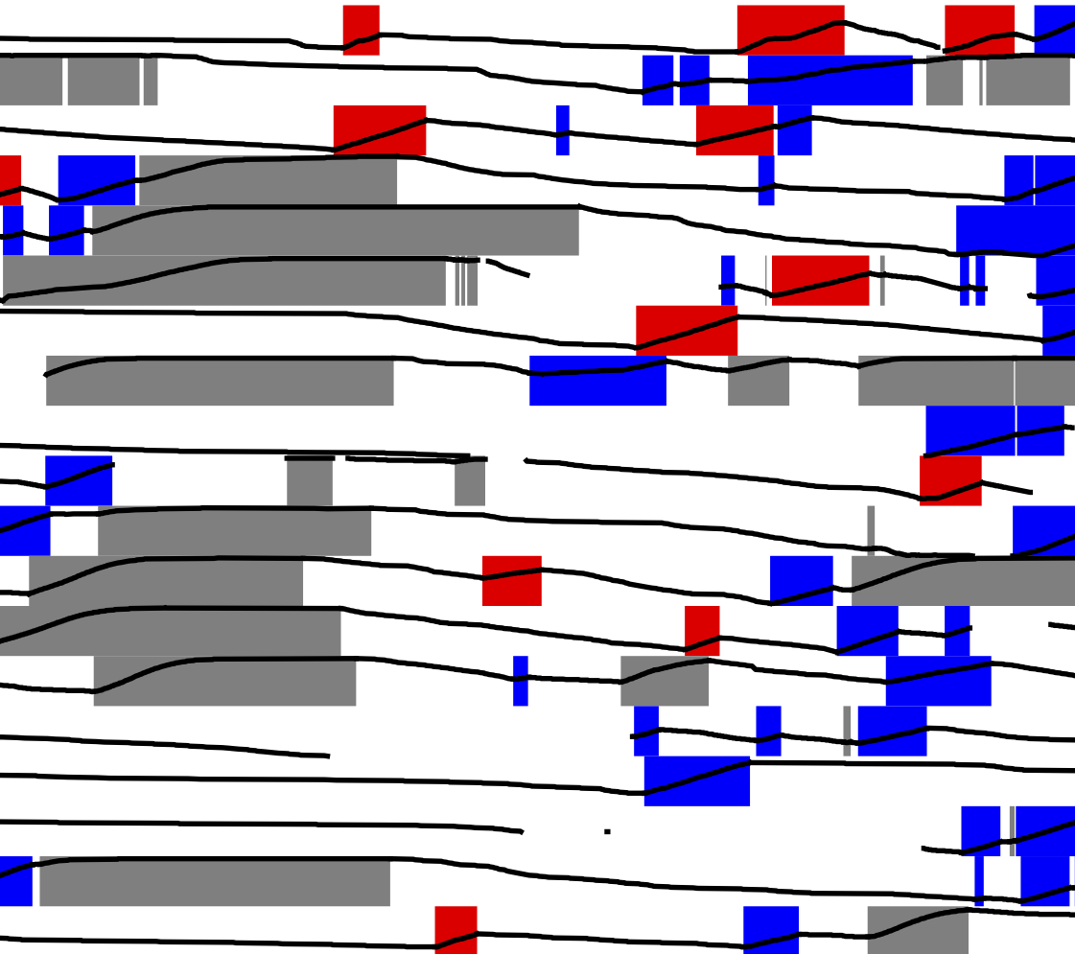

Charging Patterns
Battery Level
Opportunistic Needed
Opportunistic Unneeded
Habitual
39% of charging sessions were opportunistic
Participants
53% of users performed at least one opportunistic charge
Are users treating smartphones more like laptops?
Time

Slide 13
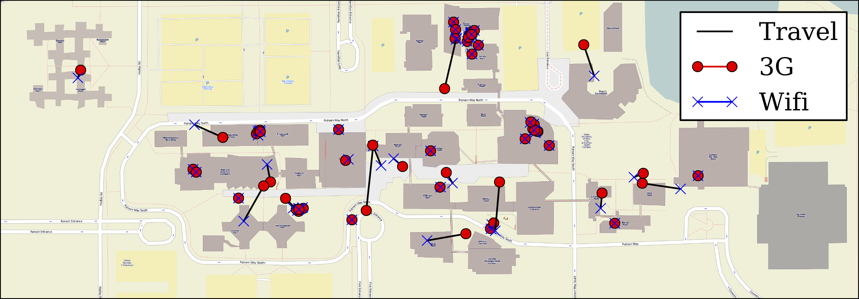
Network Handoff Locations
Are network transitions predictable?

Slide 14
Other Smartphone Testbeds
NetSense @ Notre Dame:
  Similar size
  Single-experiment study
  http://netsense.nd.edu/
LiveLabs @ Singapore Management University
  Urban lifestyle innovation platform
  Aiming for much larger scale (but not there yet)
  Not publicly available
  http://livelabs.smu.edu.sg/

Slide 15
The PhoneLab Team
Anandatirthra
Nandugudi
Chunming
Qiao
Steve Ko
Me
Anudipa Maiti
Jinghao
Shi
Tevfik Kosar
Maulik
Dave
Taeyeon Ki
Core Developers: Anandatirthra Nandugudi, Taeyeon Ki, Anudipa Maiti, Geoffrey Challen, Steve Ko
Testbed Administrator: Maulik Dave

Slide 16




PhoneLab Supporters

Slide 17
PhoneLab is Open
http://www.phone-lab.org

