Slide 1
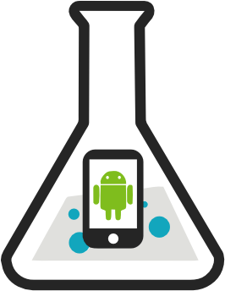
PhoneLab: A Large Programmable Smartphone Testbed
Anandatirtha Nandugudi, Anudipa Maiti, Taeyeon Ki, Fatih Bulut
Murat Demirbas, Tevfik Kosar, Chunming Qiao, Steven Y. Ko and Geoffrey Challen
University at Buffalo
http://www.phone-lab.org

Slide 2
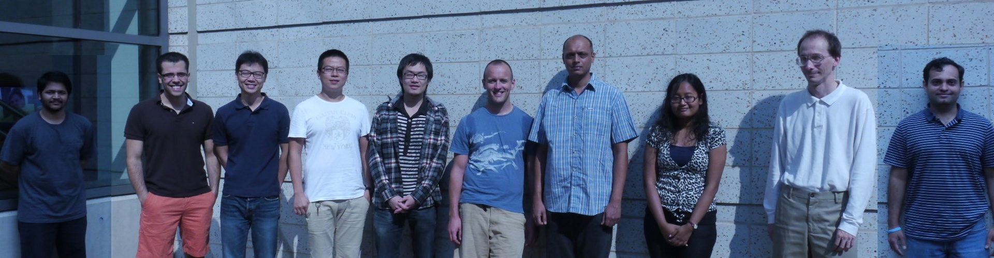
blue: A Systems Research Group
Anandatirthra
Nandugudi
Carl
Nuessle
Guru
Prasad
Taeyeon Ki
Tong Guan
Gino
Buzzelli
Jinghao
Shi
Anudipa
Maiti
Maulik
Dave
Me

Slide 3
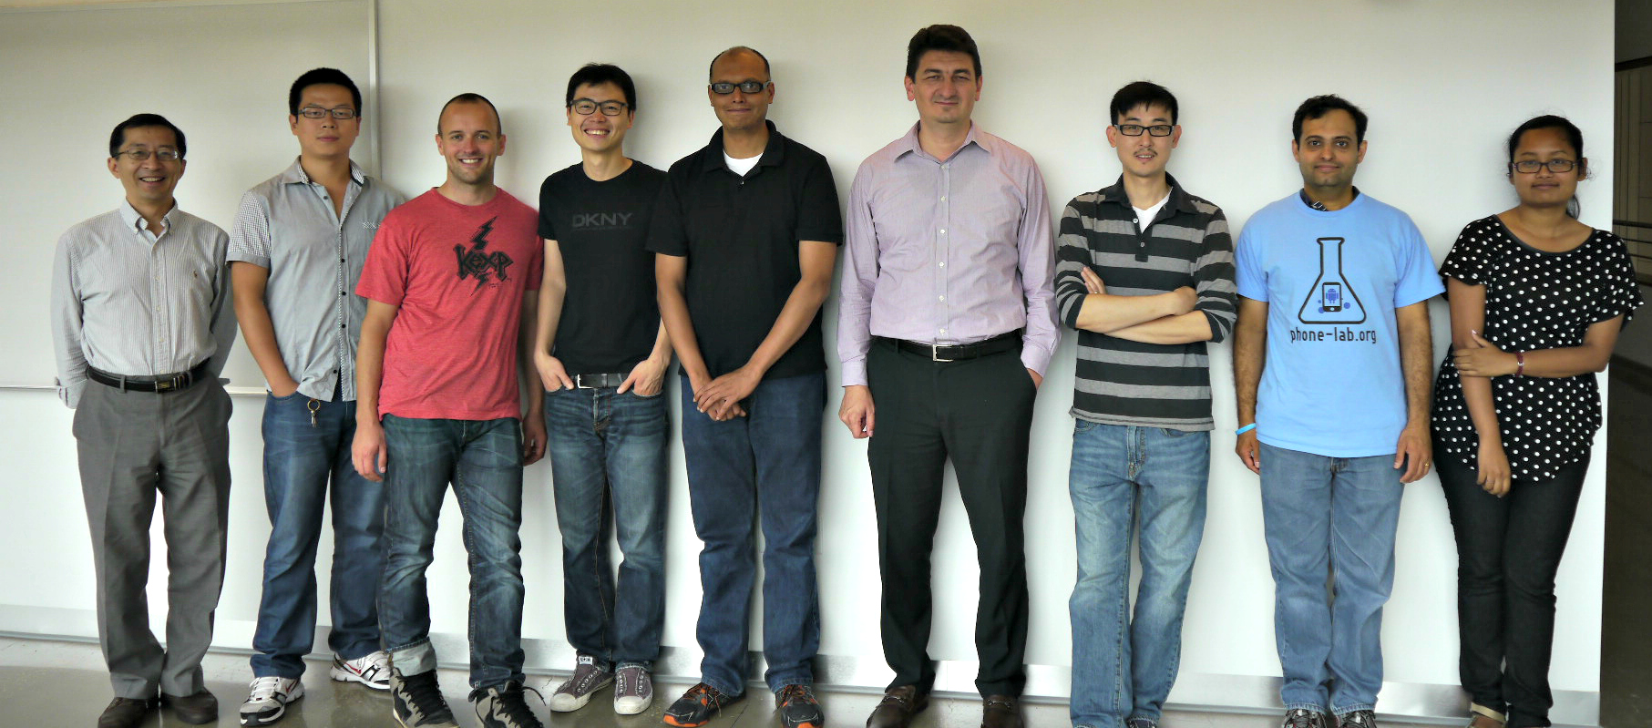
The PhoneLab Team
Anandatirthra
Nandugudi
Chunming
Qiao
Steve Ko
Me
Anudipa Maiti
Jinghao
Shi
Tevfik Kosar
Maulik
Dave
Taeyeon Ki

Slide 4

The Best Smartphone Testbed
The Google Play Store

Slide 5
Research on the Play Store
Pros
Massive scale
  700K for something useful¹
  Even 4K for just data collection²
Representative
Cons
No incentives
Can't run background experiments
Can't modify platform components
No built-in data collection
1. Carat: Collaborative Energy Diagnosis for Mobile Devices, SenSys'13.
2. Characterizing and Modeling the Impact of Wireless Signal Strength on Smartphone Battery Drain, SIGMETRICS'13.

Slide 6



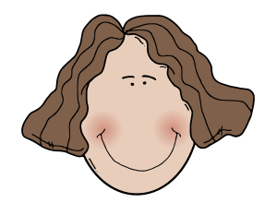

Where PhoneLab Fits In
>
>
Size: 288 users
Representativeness: good split of genders and ages, access to users' primary device
Devices: homogeneous set, currently Galaxy Nexus
Incentives: built-in through service discounts
Data collection: energy-neutral delay-tolerance comes standard

Slide 7
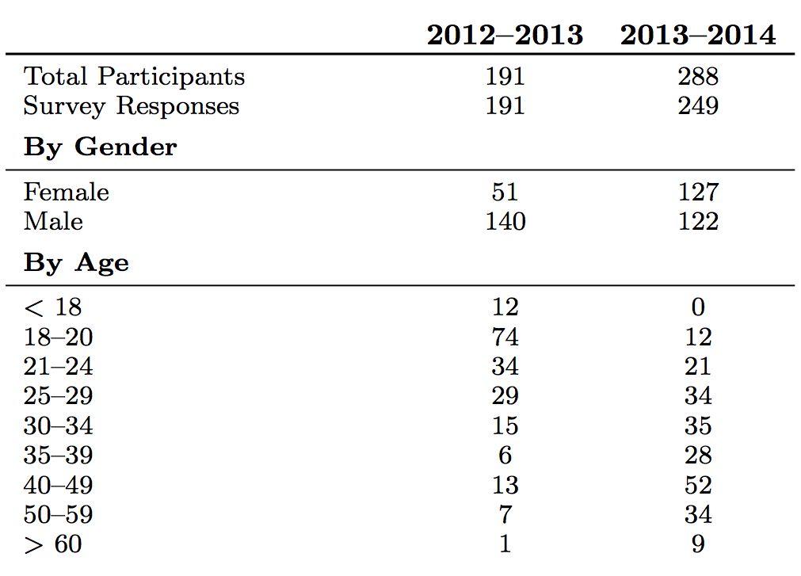
Participant Demographics

Slide 8
Where PhoneLab Fits In
Utility
Density
Density: all users spatially co-located

Slide 9
PhoneLab Data Collection
Log.v("MyGreatExperiment", "The user did something interesting.");
Also collect found logs, information generated by the Android platform and non-experimental apps
Actively working on better instrumenting the Android platform to support experimentation—may not require deploying an application at all!

Slide 10
PhoneLab Experiments
Interactive
  What we think of as Android apps
  Potentially a better fit for the Play Store
Background
  No user interaction
  Can't normally be started on Android
Platform
  Open-source platform allows you to change anything!
  Hard to support safely—check back in a year

Slide 11
Experimental Process
Idea Submission
PhoneLab
Developer Testing
Human Subjects
Review
Experiment
Deployment
+1 year
Data Release

Slide 12
Usage Experiment
115 users
6 months
Results from a small snapshot of data

Slide 13
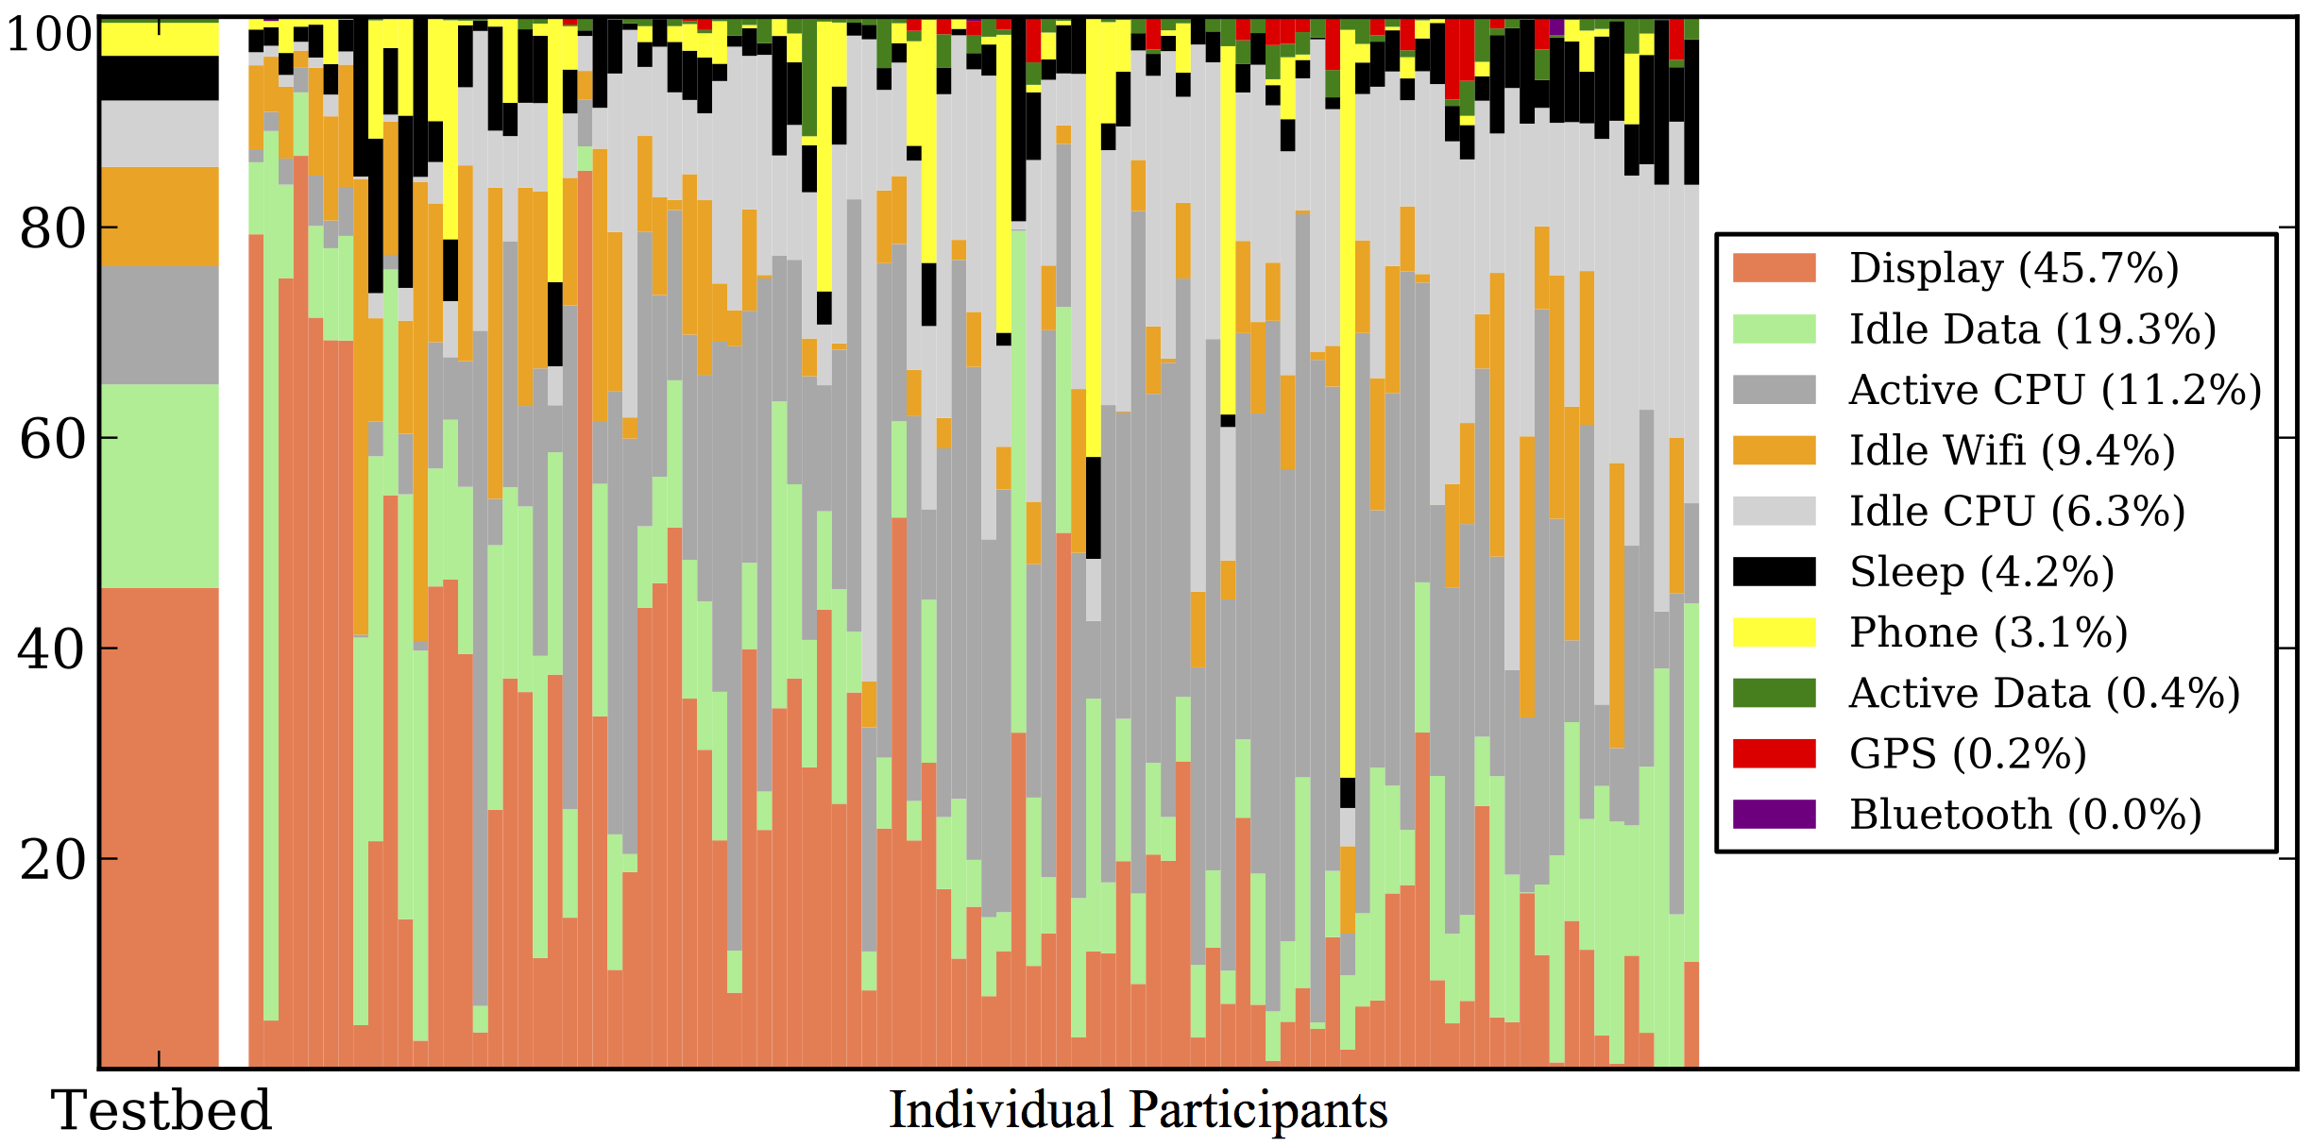
Energy Usage
Does GPS energy usage matter?

Slide 14
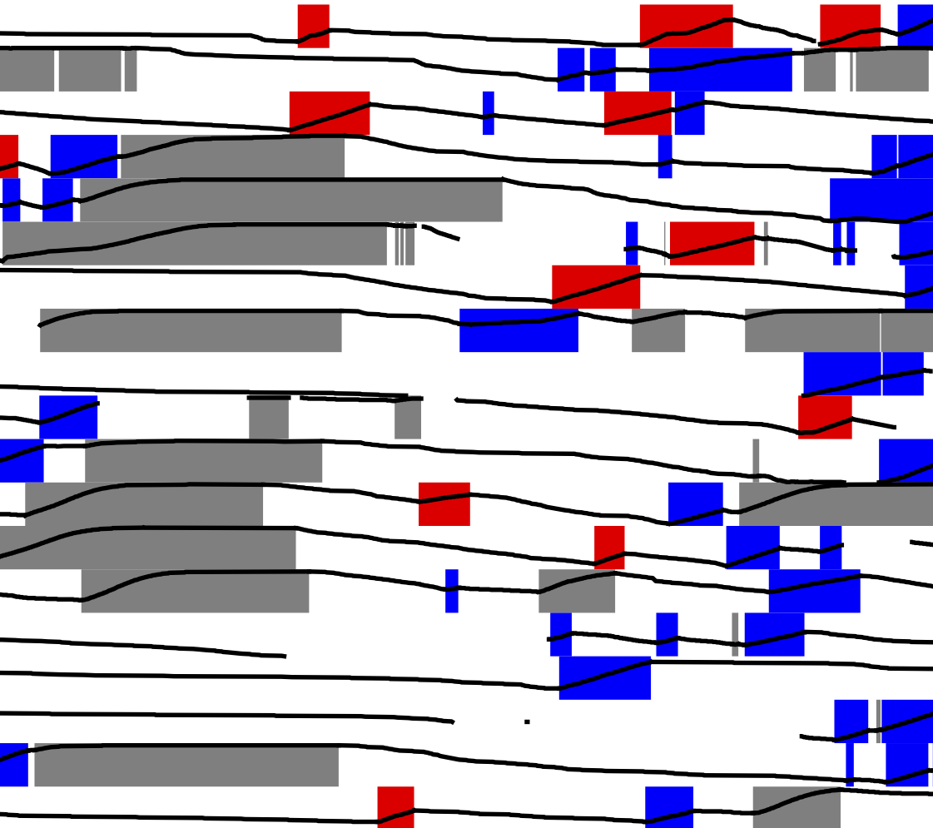

Charging Patterns
Battery Level
Opportunistic Needed
Opportunistic Unneeded
Habitual
39% of charging sessions were opportunistic
Participants
53% of users performed at least one opportunistic charge
Are users treating smartphones more like laptops?
Time

Slide 15
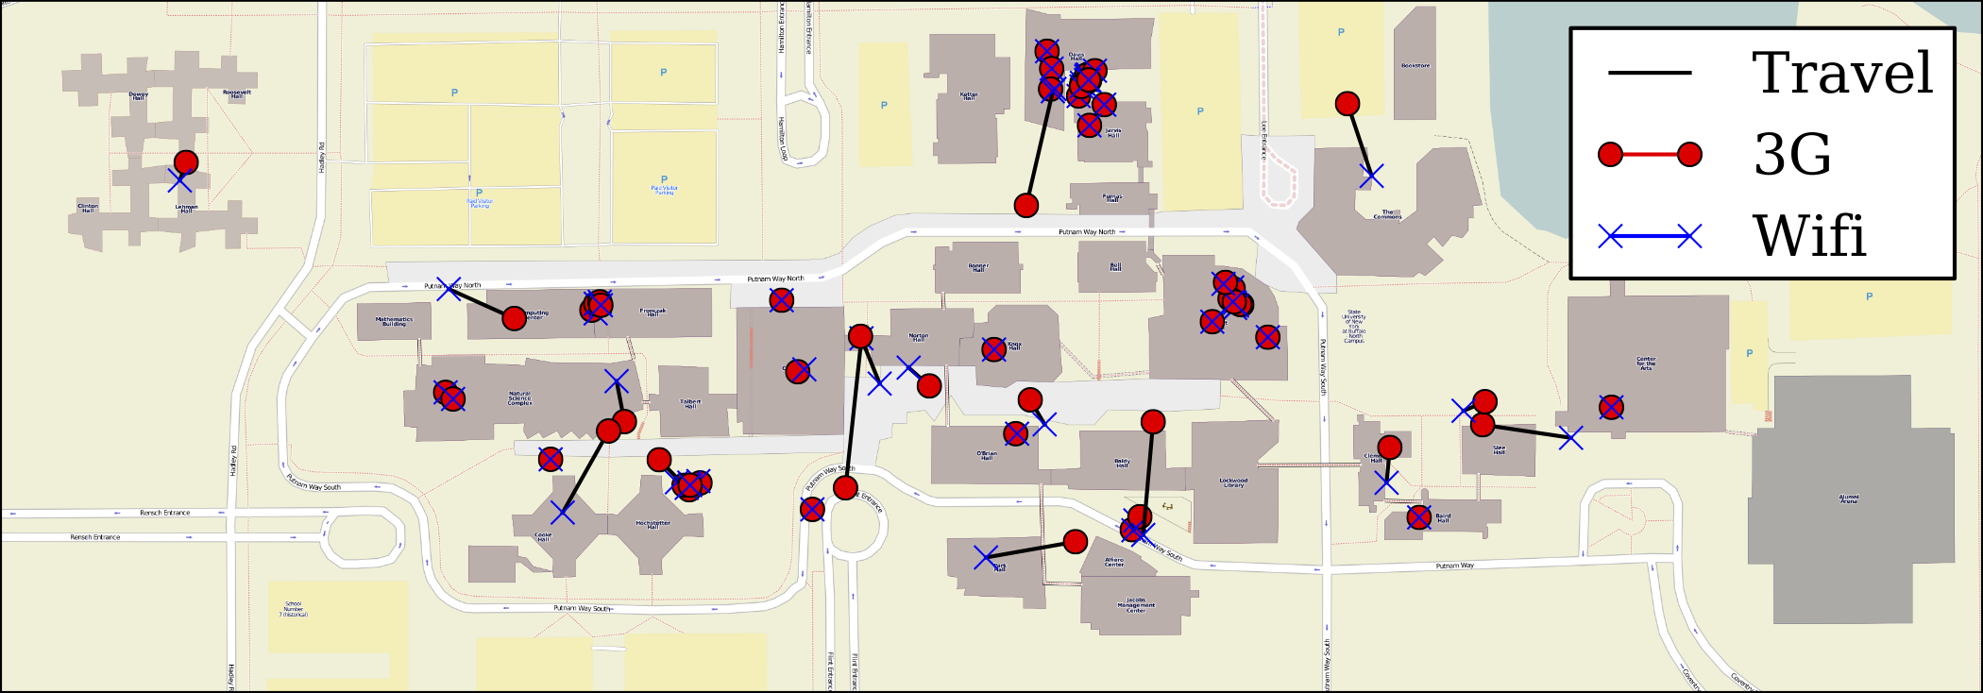
Network Handoff Locations
Are network transitions predictable?

Slide 16
Other Smartphone Testbeds
NetSense @ Notre Dame:
  Similar size
  Single-experiment study
  http://netsense.nd.edu/
LiveLabs @ Singapore Management University
  Urban lifestyle innovation platform
  Aiming for much larger scale (but not there yet)
  Not publicly available
  http://livelabs.smu.edu.sg/

Slide 17
The PhoneLab Team
Anandatirthra
Nandugudi
Chunming
Qiao
Steve Ko
Me
Anudipa Maiti
Jinghao
Shi
Tevfik Kosar
Maulik
Dave
Taeyeon Ki
Core Developers: Anandatirthra Nandugudi, Taeyeon Ki, Anudipa Maiti, Geoffrey Challen, Steve Ko
Testbed Administrator: Maulik Dave

Slide 18




PhoneLab Supporters

Slide 19
PhoneLab is Open
http://www.phone-lab.org

