Slide 1
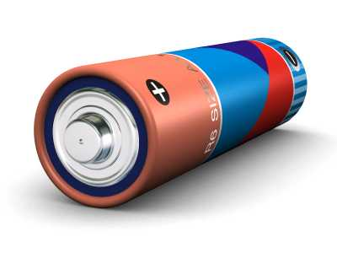
In a Perfect World...
7
6
2
4
5
1
One, Big, Battery:
Shared by all nodes
Infinite capacity
3
B

Slide 2
In a Perfect World...
7
6
2
4
5
1
One, Big, Battery:
Shared by all nodes
Infinite capacity
:: Load distribution does not matter
:: All charge captured is stored
:: No node must go offline until entire battery is exhausted
3
B

Slide 3
In Our World...
7
6
2
4
5
1
3
Many, Small, Batteries:
Local at each node
Finite capacity
:: Load distribution matters.
:: Captured charge can be wasted.
:: Nodes will go offline while energy available at other nodes.
B

Slide 4
Improving Load Distribution
Goal: Improve application fidelity by matching system load to availability
:: Capture all incident energy
:: Shift load towards underutilized nodes
:: Shift load away from threatened nodes

Slide 5
Improving Load Distribution
Goal: Improve application fidelity by matching system load to availability
:: Capture all incident energy
:: Shift load towards underutilized nodes
:: Shift load away from threatened nodes
Cannot perform all actions in the way that minimizes the total energy consumed by all involved nodes!

Slide 6
Routing Problem
Assuming Nodes 1, 2 and 3 are routing data at fixed rates to the base station Node 0:
1
0.5
0.5
3
?
0
1.0
2
1.0
represents the amount of energy (in mJ) necessary to successfully transmit a packet across the link.

Slide 7
Routing Problem
Assuming Nodes 1, 2 and 3 are routing data at fixed rates to the base station Node 0:
Assuming the application needs inputs from all three nodes, the the network lifetime is equal to the time that the first node goes offline!
1
0.5
0.5
3
?
0
1.0
2
1.0

Slide 8
Routing Problem
Assuming Nodes 1, 2 and 3 are routing data at fixed rates to the base station Node 0:
Note that the route 3,1,0 consumes the least energy for Node 3...
1
0.5
0.5
3
0
1.0
2
1.0

Slide 9
Routing Problem
Assuming Nodes 1, 2 and 3 are routing data at fixed rates to the base station Node 0:
Note that the route 3,1,0 consumes the least energy for Node 3...
Note that the route 3,1,0 consumes the least energy for Node 3... and the least energy overall!
1
0.5
0.5
3
0
1.0
2
1.0

Slide 10
Routing Problem
Assuming Nodes 1, 2 and 3 are routing data at fixed rates to the base station Node 0:
When is route 3,1,0 actually the wrong choice?
(Or when does route 3,2,0 lead to a better network outcome?)
Note that the route 3,1,0 consumes the least energy for Node 3...
Note that the route 3,1,0 consumes the least energy for Node 3... and the least energy overall!
1
0.5
0.5
3
0
1.0
2
1.0

Slide 11
Routing Problem
Assuming Nodes 1, 2 and 3 are routing data at fixed rates to the base station Node 0:
When is route 3,1,0 actually the wrong choice?
(Or when does route 3,2,0 lead to a better network outcome?)
Four Cases:
1) Differences in availability
1
0.5
0.5
3
?
0
Node | Energy
1 | 10
2 | 30
3 | 25
1.0
2
1.0
(Assume Sink 0 is powered)

Slide 12
Routing Problem
Assuming Nodes 1, 2 and 3 are routing data at fixed rates to the base station Node 0:
When is route 3,1,0 actually the wrong choice?
(Or when does route 3,2,0 lead to a better network outcome?)
Four Cases:
1) Differences in availability
:: Using Route 3,1,0:
1
0.5
0.5
3
0
Node | Energy
1 | 10
2 | 30
3 | 25
2
1.0
T=0
(Assume Sink 0 is powered)

Slide 13
Routing Problem
Assuming Nodes 1, 2 and 3 are routing data at fixed rates to the base station Node 0:
When is route 3,1,0 actually the wrong choice?
(Or when does route 3,2,0 lead to a better network outcome?)
Four Cases:
1) Differences in availability
:: Using Route 3,1,0:
Lifetime = 10, 40 units left
1
0.5
0.5
3
0
Node | Energy
1 | 0
2 | 20
3 | 20
2
1.0
T=10
(Assume Sink 0 is powered)

Slide 14
Routing Problem
Assuming Nodes 1, 2 and 3 are routing data at fixed rates to the base station Node 0:
When is route 3,1,0 actually the wrong choice?
(Or when does route 3,2,0 lead to a better network outcome?)
Four Cases:
1) Differences in availability
:: Using Route 3,1,0:
Lifetime = 10, 40 units trapped
:: Using Route 3,2,0:
1
0.5
3
0
Node | Energy
1 | 10
2 | 30
3 | 25
1.0
2
1.0
T=0
(Assume Sink 0 is powered)

Slide 15
Routing Problem
Assuming Nodes 1, 2 and 3 are routing data at fixed rates to the base station Node 0:
When is route 3,1,0 actually the wrong choice?
(Or when does route 3,2,0 lead to a better network outcome?)
Four Cases:
1) Differences in availability
:: Using Route 3,1,0:
Lifetime = 10, 40 units trapped
:: Using Route 3,2,0:
Lifetime = 15, 12.5 units trapped
1
0.5
3
0
Node | Energy
1 | 2.5
2 | 0
3 | 10
1.0
2
1.0
T=15
(Assume Sink 0 is powered)

Slide 16
Routing Problem
Assuming Nodes 1, 2 and 3 are routing data at fixed rates to the base station Node 0:
When is route 3,1,0 actually the wrong choice?
(Or when does route 3,2,0 lead to a better network outcome?)
Four Cases:
1) Differences in availability
2) Differences in non-routing load
1
0.5
0.5
3
?
0
1.0
2
1.0

Slide 17
Routing Problem
Assuming Nodes 1, 2 and 3 are routing data at fixed rates to the base station Node 0:
When is route 3,1,0 actually the wrong choice?
(Or when does route 3,2,0 lead to a better network outcome?)
Four Cases:
1) Differences in availability
2) Differences in non-routing load
3) Differences in charging rates
1
0.5
0.5
3
?
0
1.0
2
1.0

Slide 18
Routing Problem
Assuming Nodes 1, 2 and 3 are routing data at fixed rates to the base station Node 0:
When is route 3,1,0 actually the wrong choice?
(Or when does route 3,2,0 lead to a better network outcome?)
Four Cases:
1) Differences in availability
2) Differences in non-routing load
3) Differences in charging rates
4) Overcharging
1
0.5
0.5
3
?
0
1.0
2
1.0

Slide 19
Our Idea
Integrated
Distributed
Energy
Awareness

Slide 20
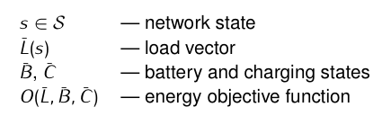
Awareness

Slide 21
Awareness
O(L, B, C) = min(Bi / Li)

Slide 22
Awareness
O(L, B, C) = min(Bi / Li)
1
0.5
0.5
s = (Null, Node 0, Node 0, Node 1)
L = (0, 1.0, 1.0, 0.5)
B = (∞, 10, 30, 25); C = (0, 0, 0, 0)
3
0
2
1.0

Slide 23
Awareness
O(L, B, C) = min(Bi / Li)
1
0.5
0.5
s = (Null, Node 0, Node 0, Node 1)
L = (0, 1.0, 1.0, 0.5)
B = (∞, 10, 30, 25); C = (0, 0, 0, 0)
O(L, B, C) = 10
3
0
2
1.0

Slide 24
Awareness
O(L, B, C) = min(Bi / Li)
1
0.5
0.5
s = (Null, Node 0, Node 0, Node 1)
L = (0, 1.0, 1.0, 0.5)
B = (∞, 10, 30, 25); C = (0, 0, 0, 0)
O(L, B, C) = 10
3
0
2
1.0
1
0.5
s = (Null, Node 0, Node 0, Node 2)
L = (0, 0.5, 2.0, 1.0)
B = (∞, 10, 30, 25); C = (0, 0, 0, 0)
3
0
1.0
2
1.0

Slide 25
Awareness
O(L, B, C) = min(Bi / Li)
1
0.5
0.5
s = (Null, Node 0, Node 0, Node 1)
L = (0, 1.0, 1.0, 0.5)
B = (∞, 10, 30, 25); C = (0, 0, 0, 0)
O(L, B, C) = 10
3
0
2
1.0
1
0.5
s = (Null, Node 0, Node 0, Node 2)
L = (0, 0.5, 2.0, 1.0)
B = (∞, 10, 30, 25); C = (0, 0, 0, 0)
O(L, B, C) = 15
3
0
1.0
2
1.0

Slide 26
Awareness: Global State
IDEA Optimizer
O(L(S), B, C)
Energy
Objective
Function
Global State
Not known at any node
Most state changes affect only local neighbors
Perform local optimization using local information
Does not guarantee global optimality!

Slide 27
Our Idea
Integrated
Distributed
Energy
Awareness

Slide 28
Distribution
What does Node 3 need to know?
1
0.5
0.5
3
?
0
1.0
2
1.0

Slide 29
Distribution
1
0.5
0.5
3
?
0
1.0
2
1.0
B = (??, ??, ???, 25)
C = (??, ??, ??, 0)
L1 = (??, 0.5, ??, 0.5)
L2 = (??, ??, 1.0, 1.0)

Slide 30
Distribution
1
0.5
0.5
3
?
0
1.0
2
1.0
B = (??, ??, ???, 25)
C = (??, ??, ??, 0)
L1 = (??, 0.5, ??, 0.5), E(L1,B,C) = 50
L2 = (??, ??, 1.0, 1.0), E(L2,B,C) = 25

Slide 31
Distribution
1
0.5
0.5
3
0
2
1.0
B = (??, ??, ???, 25)
C = (??, ??, ??, 0)
L1 = (??, 0.5, ??, 0.5), E(L1,B,C) = 50
L2 = (??, ??, 1.0, 1.0), E(L2,B,C) = 25

Slide 32
Distribution
L = 0.5
B = 10
C = 0
1
0.5
0.5
3
?
0
1.0
2
1.0
B = (??, ??, ???, 25)
C = (??, ??, ??, 0)
L1 = (??, 0.5, ??, 0.5), E(L1,B,C) = 50
L2 = (??, ??, 1.0, 1.0), E(L2,B,C) = 25

Slide 33
Distribution
L = 0.5
B = 10
C = 0
1
0.5
0.5
3
?
0
1.0
2
1.0
B = (??, 10, ???, 25)
C = (??, 0, ??, 0)
L1 = (??, 1.0, ??, 0.5), E(L1,B,C) = 10
L2 = (??, 0.5, 1.0, 1.0), E(L2,B,C) = 20

Slide 34
Distribution
1
0.5
0.5
3
?
0
1.0
2
1.0
B = (??, 10, ???, 25)
C = (??, 0, ??, 0)
L1 = (??, 1.0, ??, 0.5), E(L1,B,C) = 10
L2 = (??, 0.5, 1.0, 1.0), E(L2,B,C) = 20
L = 1.0
B = 30
C = 0

Slide 35
Distribution
1
0.5
0.5
3
?
0
1.0
2
1.0
B = (??, 10, 30, 25)
C = (??, 0, 0, 0)
L1 = (??, 1.0, 1.0, 0.5), E(L1,B,C) = 10
L2 = (??, 0.5, 2.0, 1.0), E(L2,B,C) = 15
L = 1.0
B = 30
C = 0

Slide 36
Distribution
1
0.5
3
0
1.0
2
1.0
B = (??, 10, 30, 25)
C = (??, 0, 0, 0)
L1 = (??, 1.0, 1.0, 0.5), E(L1,B,C) = 10
L2 = (??, 0.5, 2.0, 1.0), E(L2,B,C) = 15

Slide 37



Distribution: Overhead
Data
Sharing
IDEA Optimizer
O(L(S), B, C)
Shared Data
(C0, B0, L0)
. . .
Energy
Objective
Function
(Cn, Bn, Ln)
Charge
Model
Battery
Monitor
Load
Model
Charge
Monitor
Distribution Overhead:
Can be significant
Most changes affect only local neighbors
Distribute state locally or only over k hops
Load
Monitor

Slide 38
Our Idea
Integrated
Distributed
Energy
Awareness

Slide 39

Integration
App
State
State 1
(s10,s11,s12...)
App
O(L, B, C) ∙ α + u(s) ∙ (1 - α)
State 2
(s20,s21,s22...)
State 3
(s30,s31,s32...)
Example Applications:
Routing Layers
MAC Protocols
Distributed Consensus Algorithms
Distributed Computation

Slide 40
Integration
App
State
State 1
(s10,s11,s12...)
App
O(L, B, C) ∙ α + u(s) ∙ (1 - α)
State 2
(s20,s21,s22...)
State 3
(s30,s31,s32...)
Example Applications:
Routing Layers
MAC Protocols
Distributed Consensus Algorithms
Distributed Computation

Slide 41
Integration
App
State
State 1
(s10,s11,s12...)
App
O(L, B, C) ∙ α + u(s) ∙ (1 - α)
State 2
(s20,s21,s22...)
State 3
(s30,s31,s32...)
α is the energy weighting factor
α = 1 → optimize only for energy
α = 0 → optimize only for application utility
(O() and u() must be normalized to between 0 and 1)
Example Applications:
Routing Layers
MAC Protocols
Distributed Consensus Algorithms
Distributed Computation

Slide 42
IDEA Architecture
Data
Sharing
IDEA Optimizer
O(L(S), B, C)α + u(S)(1 - α)
Shared Data
Application
Utility
Client
States
(C0, B0, L0)
. . .
Energy
Objective
Function
(Cn, Bn, Ln)
(s0,s1,s2...)
Charge
Model
Battery
Monitor
Load
Model
Charge
Monitor
Load
Monitor

Slide 43
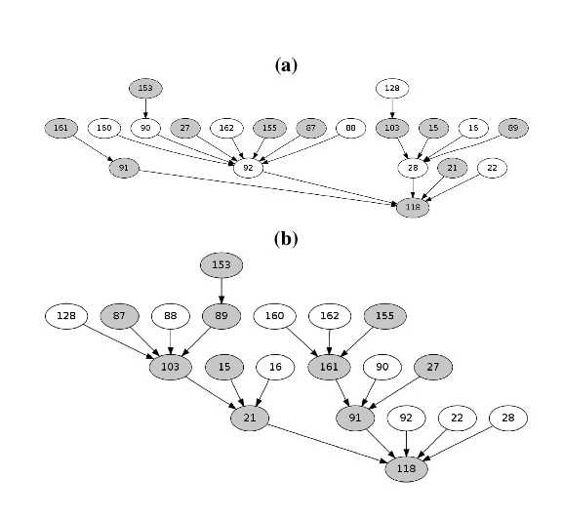
ICTP Results
Charging Nodes

Slide 44
ICTP Results
Charging Nodes

Slide 45
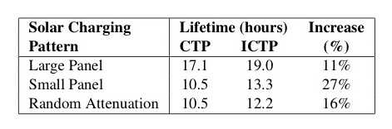
ICTP Results

Slide 46

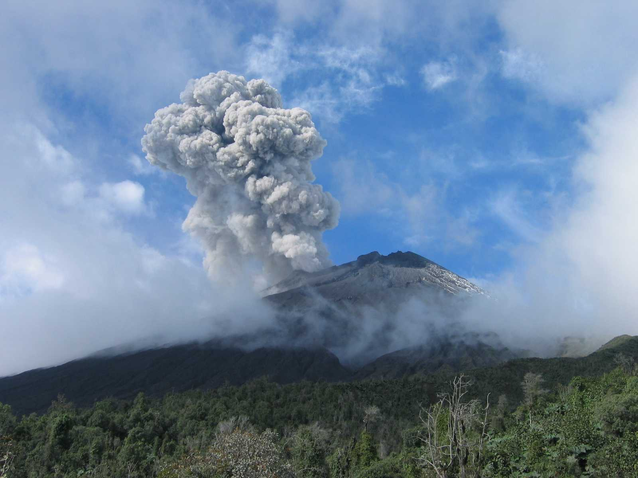
Backup Slides Follow
challen@eecs.harvard.edu
http://www.eecs.harvard.edu/~challen/

Slide 47
Effects of Load Distribution
One, Big, Battery Optimal System
Incident
Charge

Slide 48
Effects of Load Distribution
One, Big, Battery Optimal System
Incident
Charge
100% captured and devoted to maximizing application fidelity

Slide 49
Effects of Load Distribution
One, Big, Battery Optimal System
Incident
Charge
100% captured and devoted to maximizing application fidelity
All actions performed in the way that minimizes the total energy consumed by all involved nodes.

Slide 50
Effects of Load Distribution
Non-Distribution Aware System
Incident
Charge

Slide 51
Effects of Load Distribution
Non-Distribution Aware System
Wasted charging full batteries
Incident
Charge

Slide 52
Effects of Load Distribution
Non-Distribution Aware System
Wasted charging full batteries
Trapped at nodes unable to improve application fidelity
Incident
Charge

Slide 53
Effects of Load Distribution
Non-Distribution Aware System
Wasted charging full batteries
Trapped at nodes unable to improve application fidelity
Incident
Charge
Devoted to maximizing application fidelity

Slide 54
Improving Load Distribution
Distribution Aware System
Wasted charging full batteries
Trapped at nodes unable to improve application fidelity
Incident
Charge
Devoted to maximizing application fidelity

Slide 55
Improving Load Distribution
Distribution Aware System
Wasted charging full batteries
Trapped at nodes unable to improve application fidelity
Incident
Charge
Devoted to maximizing application fidelity

Slide 56
Improving Load Distribution
Distribution Aware System
Wasted charging full batteries
Trapped at nodes unable to improve application fidelity
Incident
Charge
Devoted to maximizing application fidelity

Slide 57
Improving Load Distribution
Distribution Aware System
Wasted charging full batteries
Trapped at nodes unable to improve application fidelity
Overhead of distributing energy information
Incident
Charge
Devoted to maximizing application fidelity

Slide 58
Improving Load Distribution
Distribution Aware System
Wasted charging full batteries
Trapped at nodes unable to improve application fidelity
Overhead of distributing energy information
Improvement in application fidelity
Incident
Charge
Devoted to maximizing application fidelity

