Slide 1

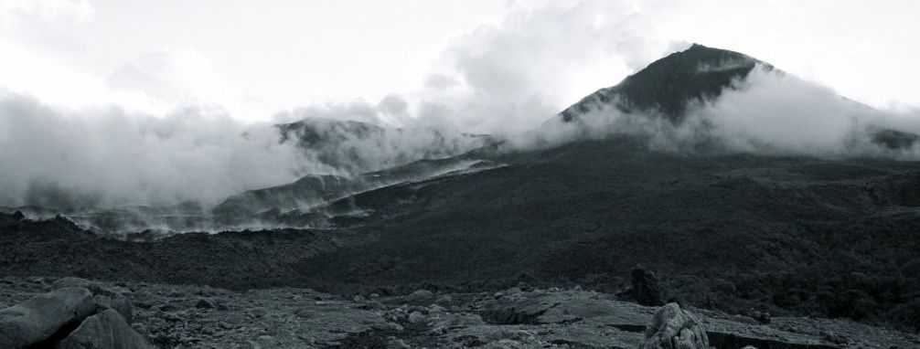
Data Fidelity and Resource Management
for Data-Rich Sensor Networks
Geoffrey Werner Challen
Harvard University School of Engineering and Applied Sciences

Slide 2
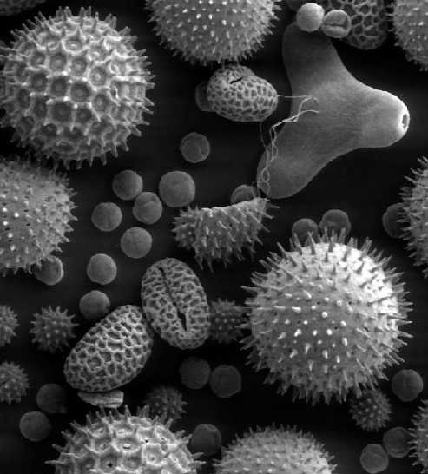
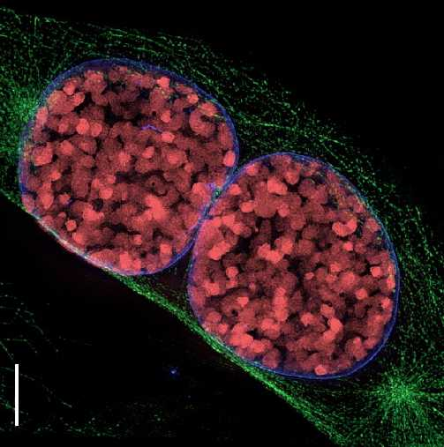
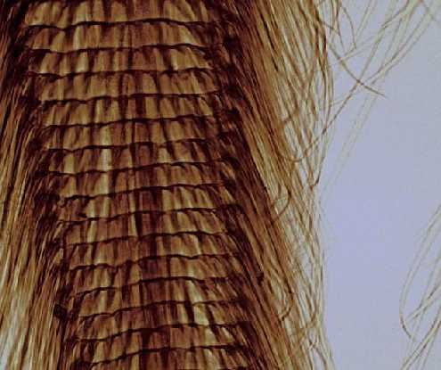
The Microscope
pollen
cells in prophase
bee's mouth
Microscope: an instrument which helps us understand very small things
i
very small things

Slide 3
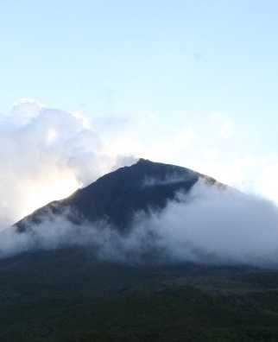
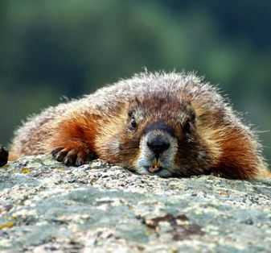
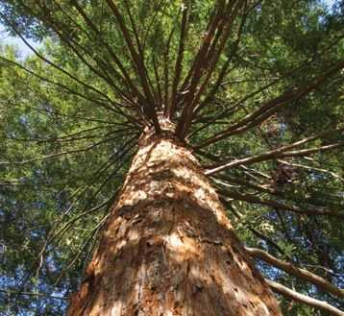
The Macroscope
volcano
marmot colony
redwood forest
Macroscope: an instrument which helps us understand very large things
a
very large things

Slide 4
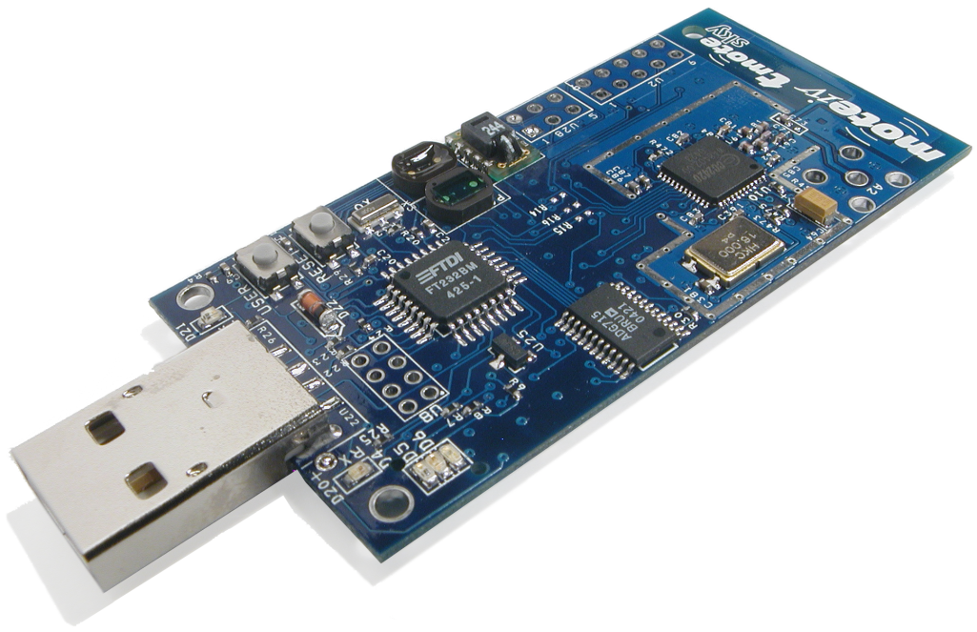
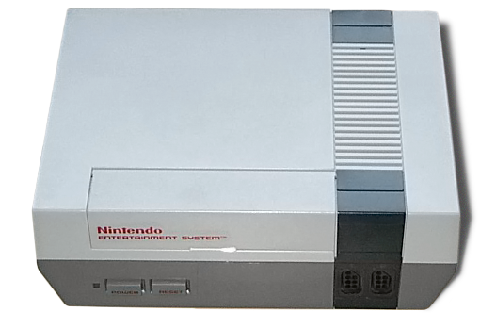
Wireless Sensor Nodes
Tmote Sky
CPU | MSP430 16 bit MCU @ 4Hz
SRAM | 10 kB
Program Flash | 40 kB
Data Flash | 1 MB
Radio | Chipcon CC2420 802.15.4, 250 kbps

Slide 5
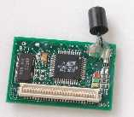
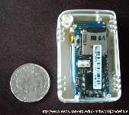
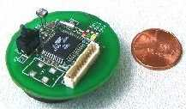
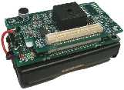
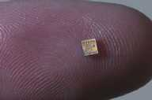
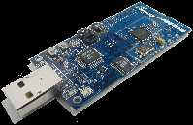
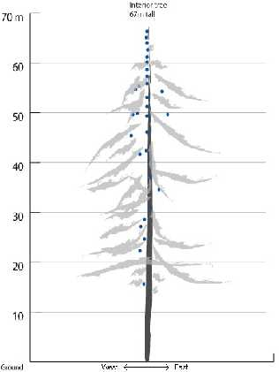
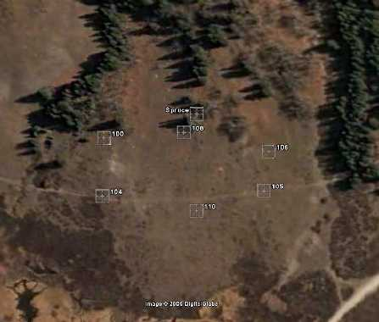
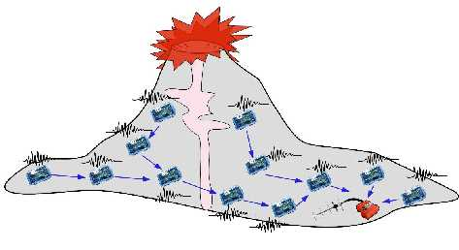
Scientific Sensor Networks
Girod et. al
IPSN'07
c
Werner-Allen et. al, OSDI'06
Tolle et. al
Sensys'05
Acoustic source
localization
Data quality
optimization
Data analysis
and visualization

Slide 6
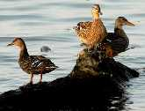
High Data-Rate Science
Bytes-per-second (bps) collected by each node
(log scale)
0.01
0.1
1
10
100
1000
10000
Great Duck
Island
0.5 bps
c
Reventador
Volcano
1600 bps
Redwood Forest
0.05 bps
Marmot Detection
20 kbps

Slide 7
High Data-Rate Science
Bytes-per-second (bps) collected by each node
(log scale)
0.01
0.1
1
10
100
1000
10000
Great Duck
Island
0.5 bps
c
Reventador
Volcano
1600 bps
Redwood Forest
0.05 bps
Marmot Detection
20 kbps

Slide 8
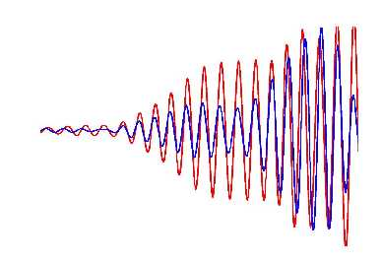
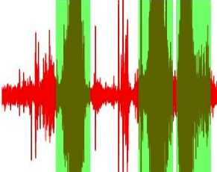
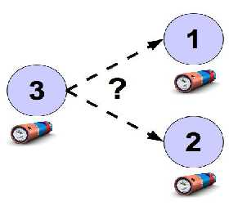
High Data-Rate Challenges
1)
Accurate Timestamping
Goal: assign timestamps accurate enough to support scientific analysis
Volcano Monitoring Case Study : 2004 – Present
(EWSN'05, OSDI'06)
2)
Optimizing Data Quality
Goal: devote system resources to only the most valuable data
Lance System Architecture : 2006 – 2009
(Sensys'08, Sensys'09)
3)
Manage Distributed Energy
Goal: control energy usage to extend the lifetime of the instrument
Distributed Energy Awareness : 2008 – Present
(MobiSys'10)

Slide 9
Thesis
By managing distributed resource
usage, we can improve the data
quality provided by sensor networks
to scientific applications.

Slide 10
Contributions
First sensor network for monitoring active volcanoes
Deployed at Tungurahua Volcano ('04, '08) and Reventador Volcano ('05)
Post-hoc time rectification technique
Successfully derived timestamps in the face of timing protocol failures
Lance system architecture
Optimization framework suitable for high data-rate applications
Lance online heuristic
Combines cost and value to achieve over 95% of offline optimal performance
IDEA architecture for controlling energy distribution
Increases system lifetime by up to 35% by better distributing energy usage

Slide 11
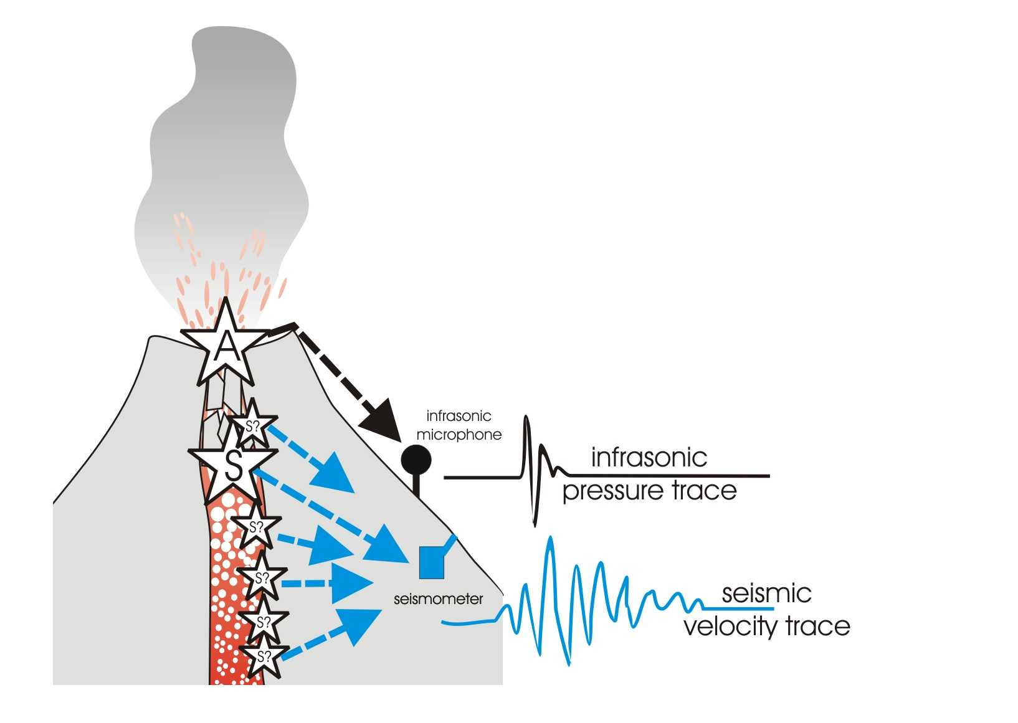
Case Study : Volcano Monitoring
Microphones:
Measure infrasonic (low-frequency acoustic)
waves produced by eruptions
Seismometers:
Measure ground motion due to
earthquakes, eruptions, tremor

Slide 12
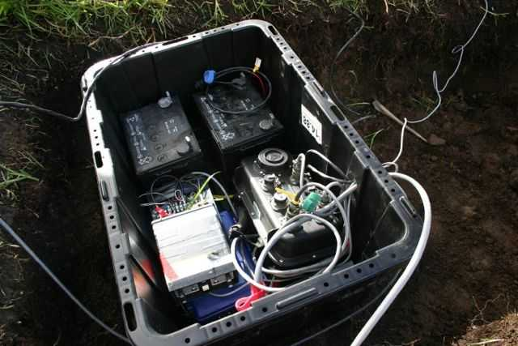
High-Resolution Sensor Station
Cables to microphones
Reftek 130-01
Size | 8500 cm³
Power | 1-2.1 W
Cost | $9,000
Weight | 2 kg
~1m
2 Car batteries
Data Logger
Mic amplifier
Power distribution
Cable to seismometer

Slide 13
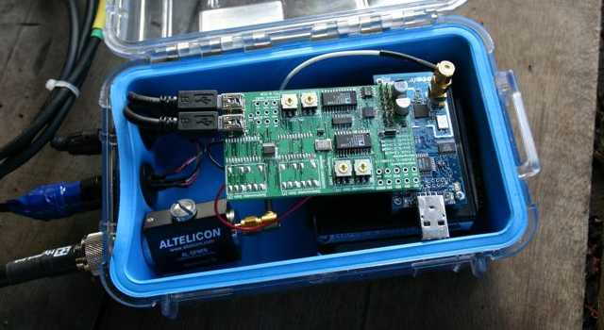
Volcano-Monitoring Sensor Node
Custom ADC board
Microphone cable
Tmote Sky
Seismometer cable
Tmote Sky
Size | 12.8 cm³
Power | 60 mW
Cost | $79
Weight | 0.015 kg
D cell batteries
Antenna cable
~20cm
Notes:
“This is a picture of our wireless sensor node, based on a mote running TinyOS. It has a low-power processor and radio, a custom sensor interface board, and connectors for a seismometer, microphone, and radio antenna.
It is powered by D-cell batteries which run for about 10 days.”

Slide 14
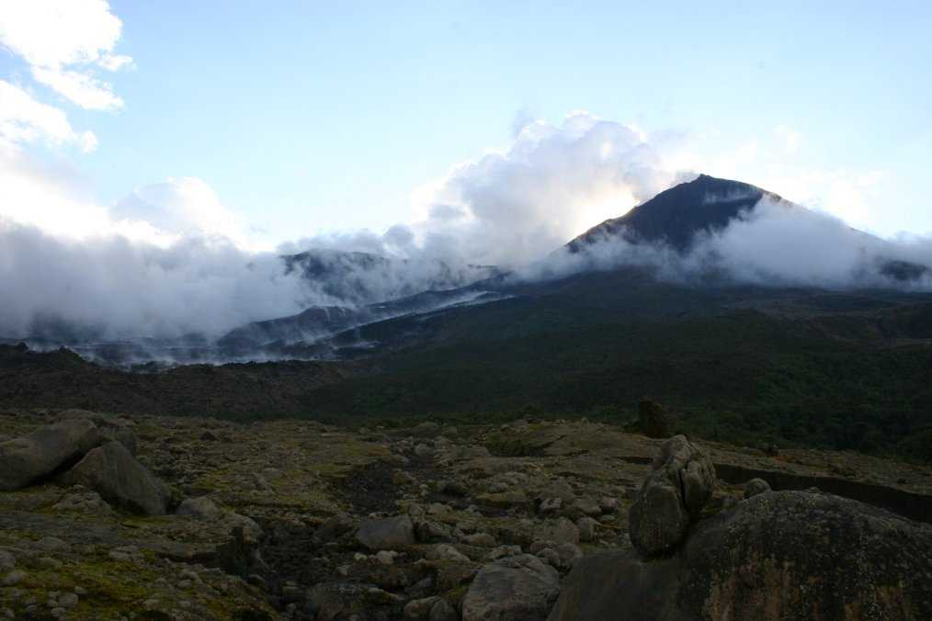
Reventador Volcano

Slide 15
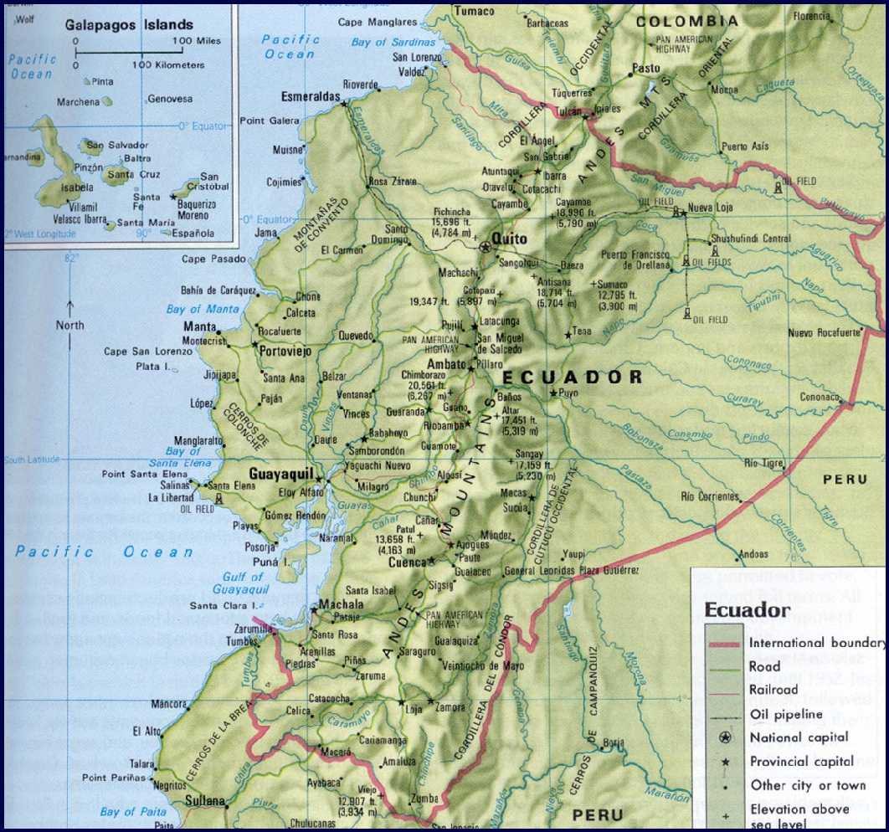
Reventador Volcano
Reventador

Slide 16
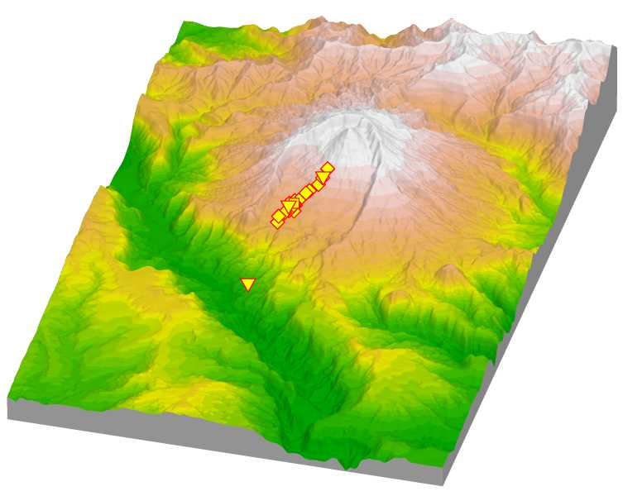
Deployment Map
Sensor network
(spans over 3km)
Observatory

Slide 17
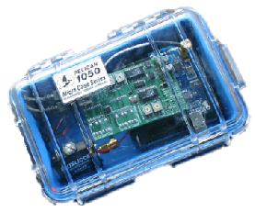



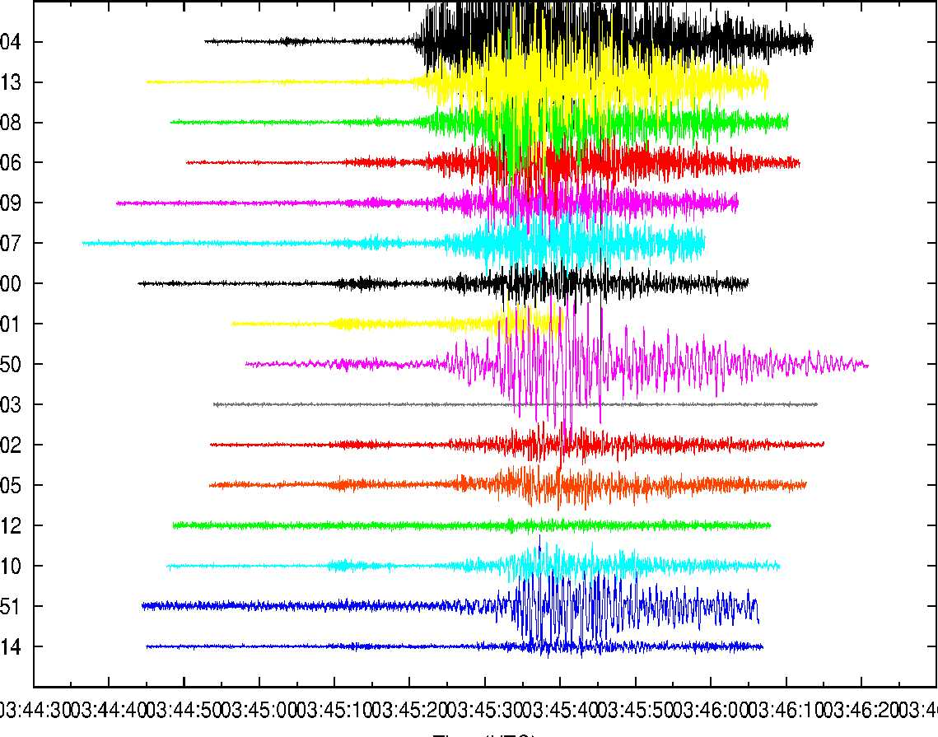
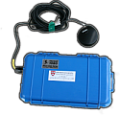
System Architecture
Sensor
Nodes
Long-distance radio link
(> 4km)
Laptop
Laptop
Freewave Modem
Goal: Download 60s worth
of data from each node
following an “interesting” event
GPS

Slide 18
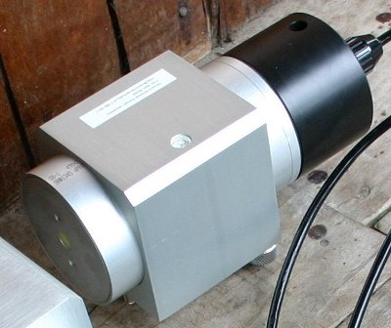
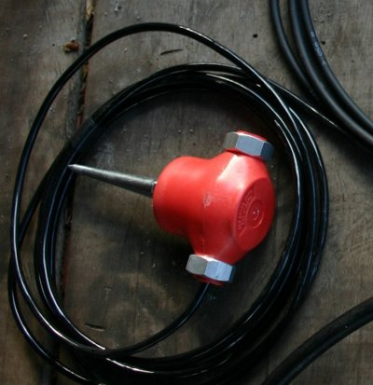
Deployed Sensors
GS-1 1Hz Seismometer
GS-11 4.5Hz “Geophone” Seismometer

Slide 19
Evaluation Methodology
flash
storage usage
fidelity
time sync overhead
System Centric
Science Centric
routing stability
yield
data transfer
rates

Slide 20
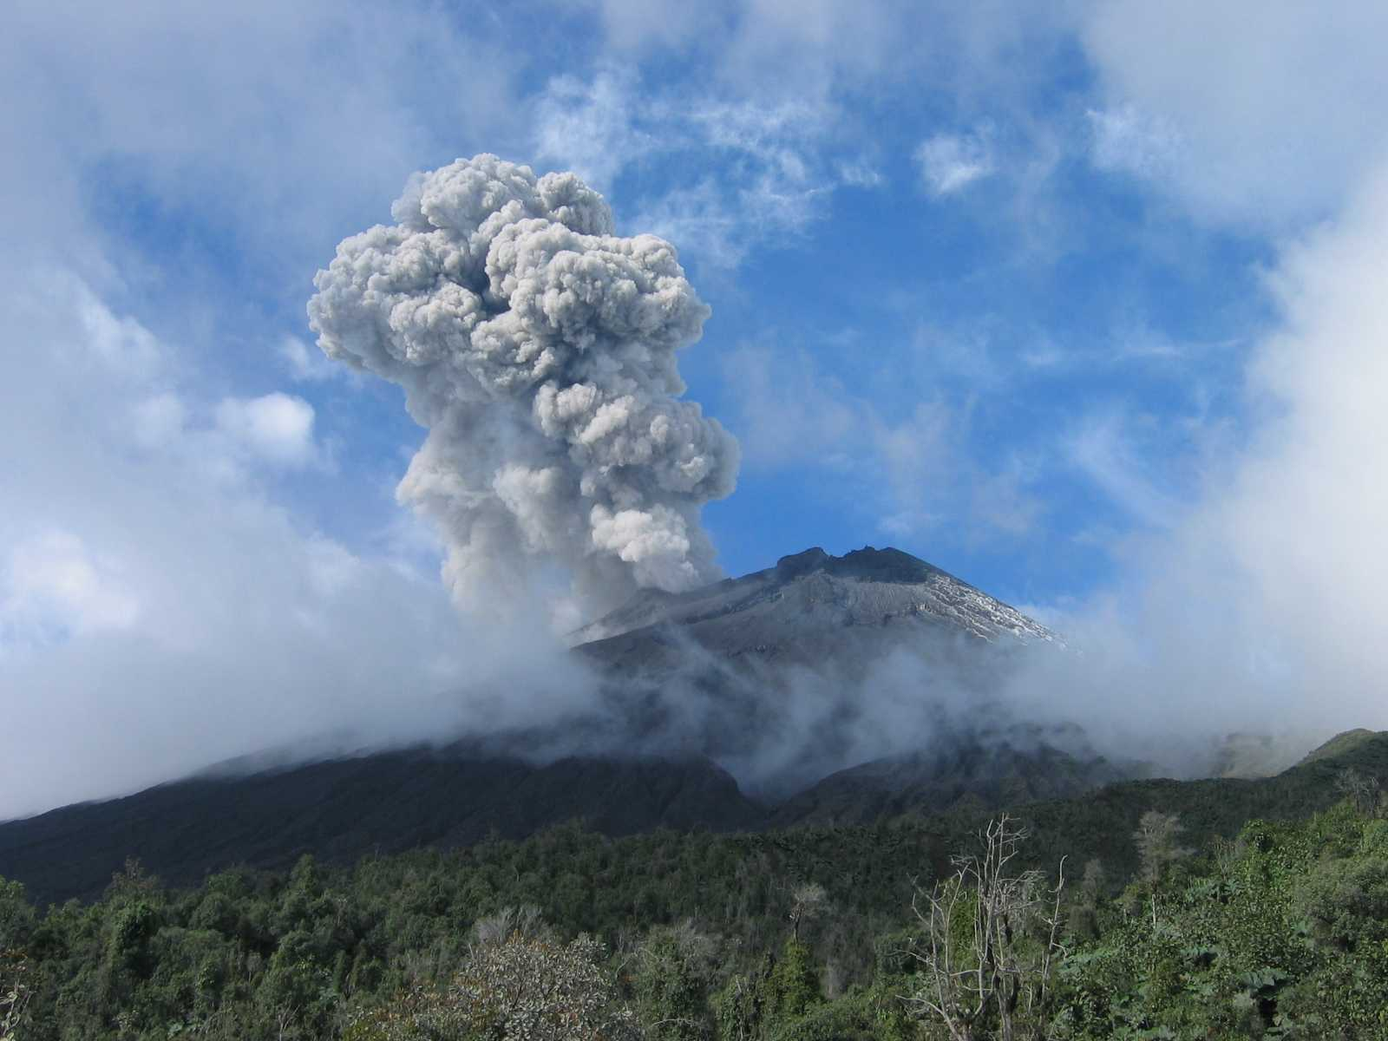
Backup Slides Follow
challen@eecs.harvard.edu
http://www.eecs.harvard.edu/~challen/

Slide 21
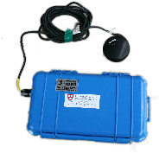
Fidelity: FTSP
GPS
FTSP (Flooding Time Synchronization Protocol)
GPS receiver acts as “root”
All other nodes attempt to synchronize their clock to the root
Each node broadcasts periodic beacon with
global time of transmission
Receivers mark time of beacon reception
Each node computes offset and skew from its local clock to global timebase
Each sample tagged with FTSP global time
Sensor
Nodes

Slide 22
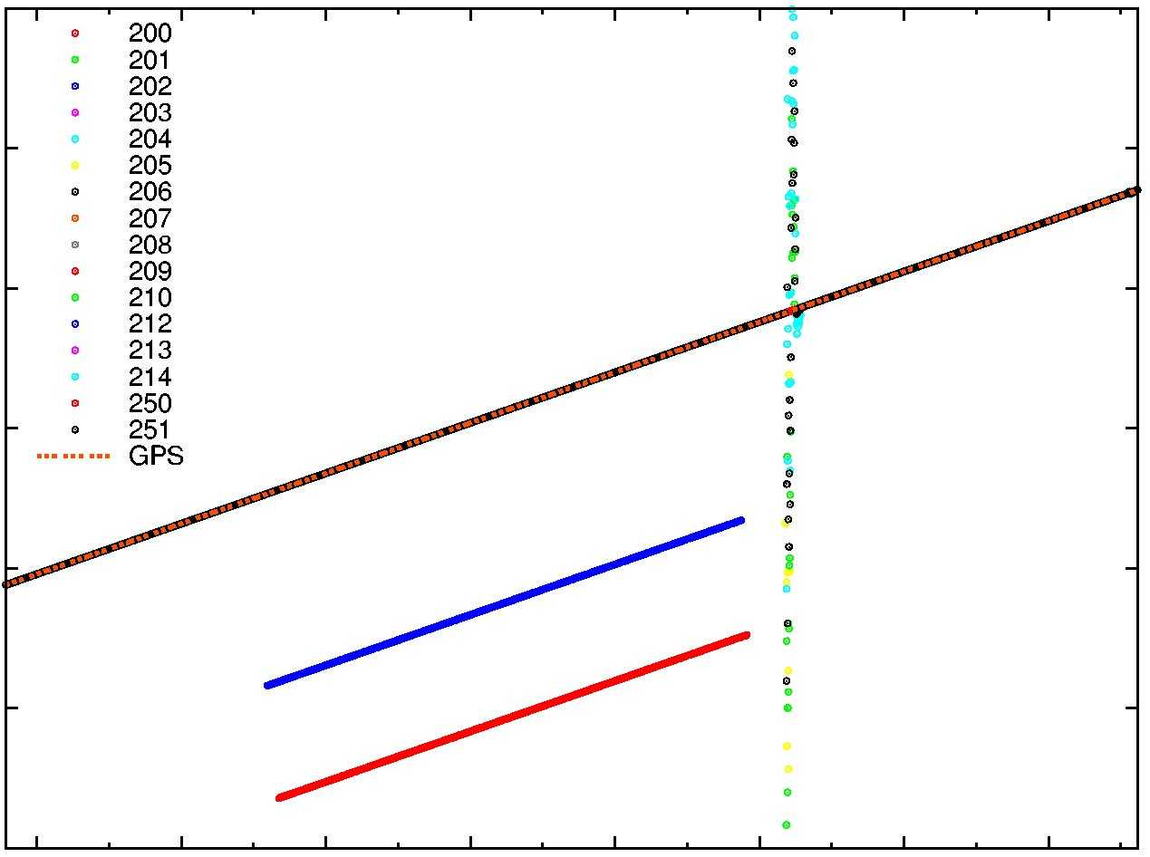
Fidelity: Timing Problems
140000
200
201
202
203
204
205
206
207
208
209
210
212
213
214
250
251
GPS
Broken nodes
rebooted
130000
Network
Global
Time
120000
110000
100000
2 nodes global times diverge
90000
90000
80000
11:00
12:00
13:00
14:00
15:00
16:00
17:00
18:00
Time (GMT)

Slide 23
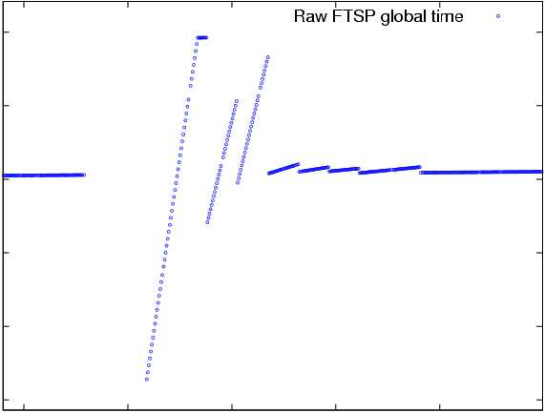
Fidelity: Time Rectification
Unrectified FTSP Global Time
100000
90000
Node
Global
Time
80000
70000
60000
50000
29500
29600
29700
29800
29900
Node Local Time

Slide 24
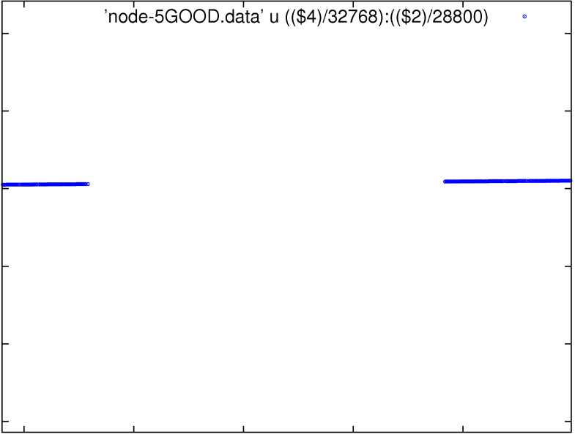
Fidelity: Time Rectification
Unrectified FTSP Global Time
Unrectified FTSP Global Time
100000
90000
Node
Global
Time
80000
70000
60000
50000
29500
29600
29700
29800
29900
Node Local Time

Slide 25
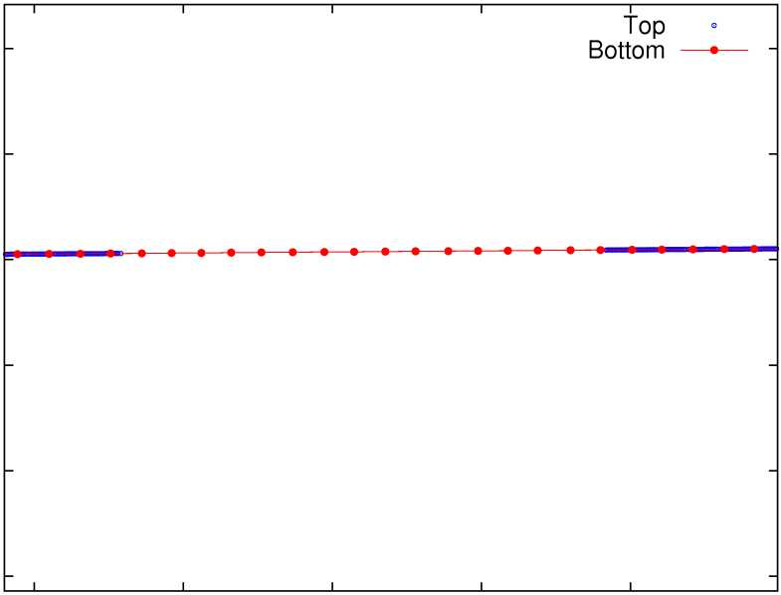
Fidelity: Time Rectification
Unrectified FTSP Global Time
Rectified Global Time
Unrectified FTSP Global Time
Unrectified FTSP Global Time
100000
90000
Node
Global
Time
80000
70000
60000
50000
29500
29600
29700
29800
29900
Node Local Time

Slide 26
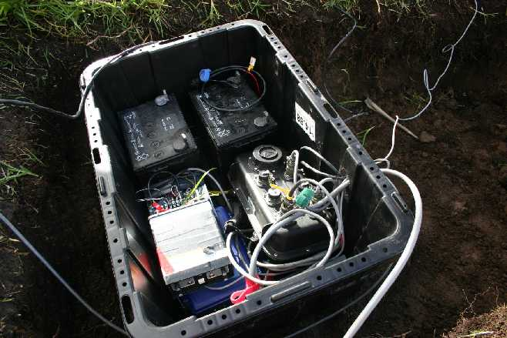
Fidelity: Timing Correctness
Compare data captured by one of our sensor nodes to a nearby standalone seismic station
Data timestamped by FTSP
Data timestamped by Internal GPS
Node 213
(3 hops from FTSP root)
56 meters
Largest expected offset: 47ms
(based on distance between stations)
RVEN
Reventador VENt
standalone seismic station

Slide 27
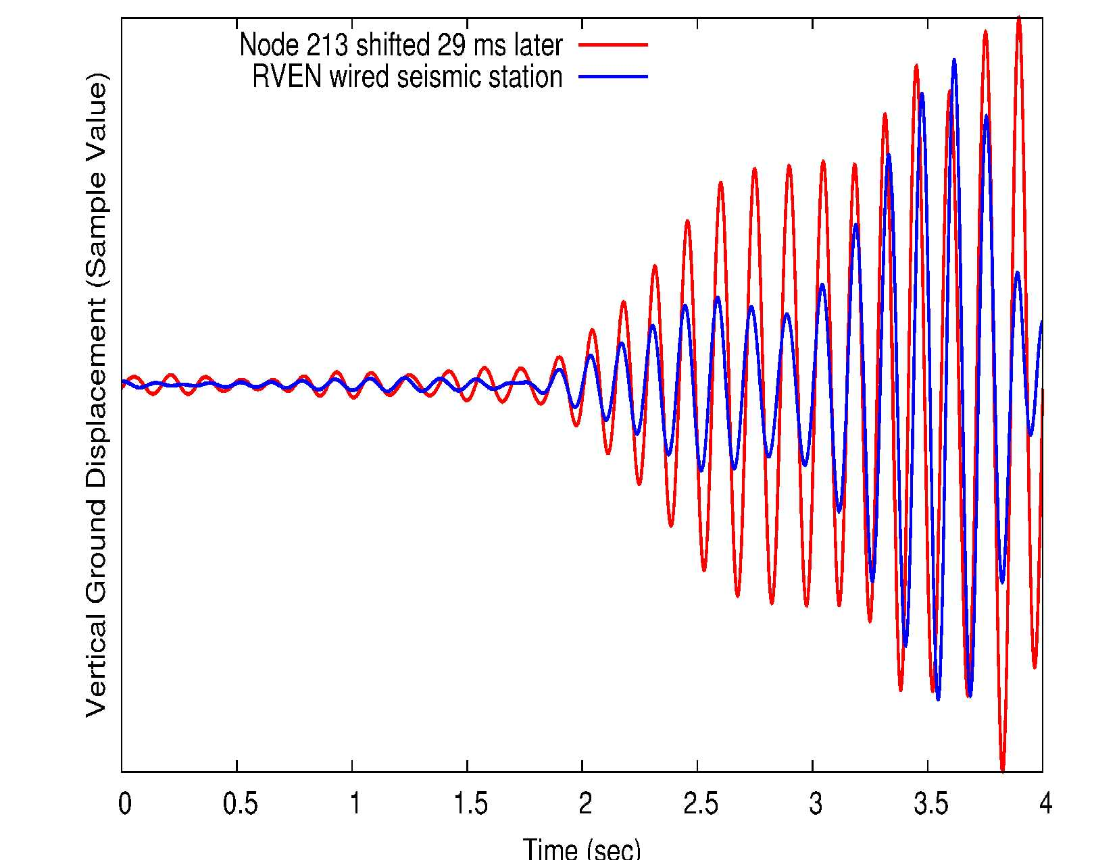
Fidelity: Timing Correctness
Node 213 shifted 29 ms later
RVEN wired station
Ground Displacement
(Sample Value)
29 ms time shift between signals
0
0.5
1
1.5
2
2.5
3.0
3.5
4
2
Time (sec)

Slide 28
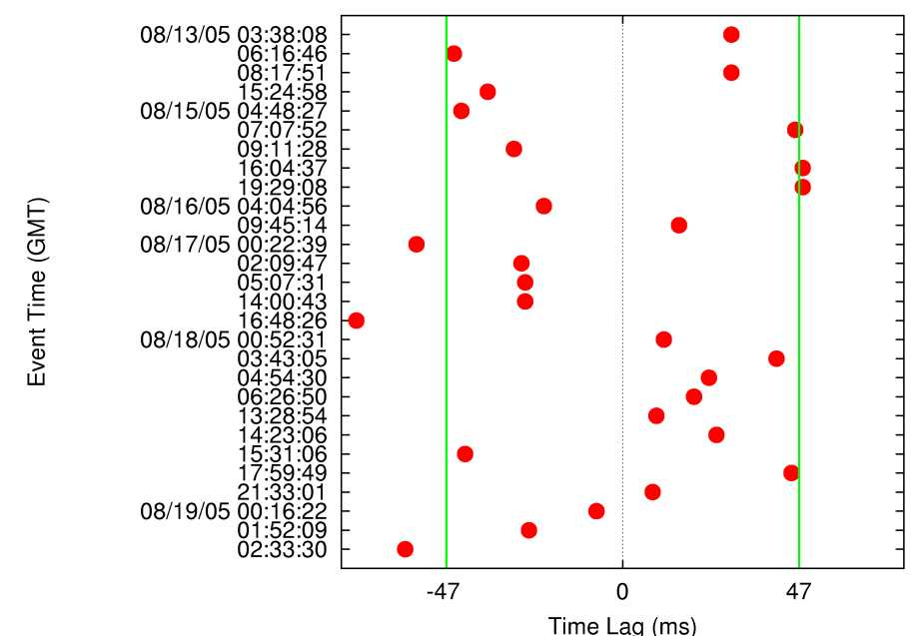
Fidelity: Timing Evaluation
Expected lag times
Event Time
(GMT)
Most events fall within expected range
Time Lag (ms)

Slide 29
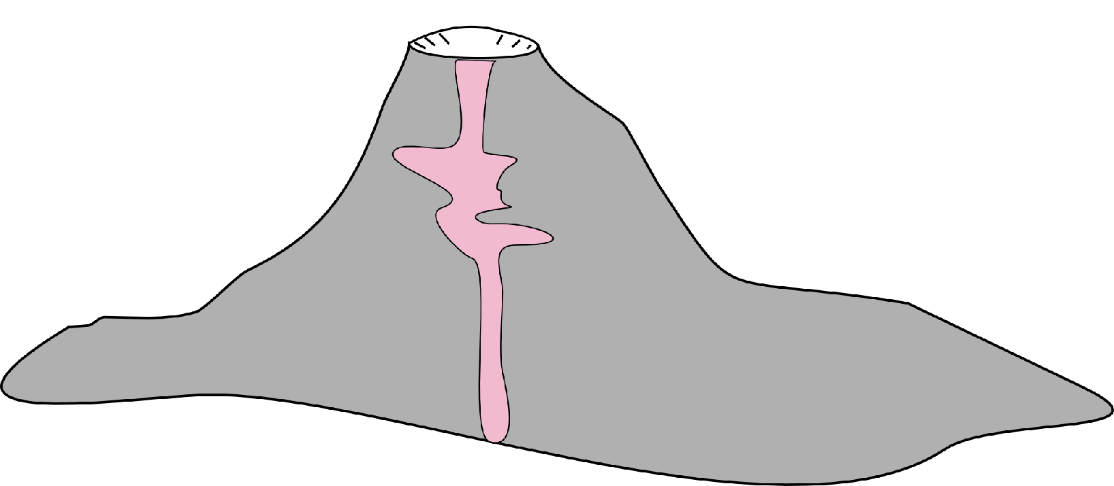
Volcano Tomography
Goal: Map density structure and understand internal processes
Notes:
“Here is an overview of our network architecture. We deployed 16 sensor nodes on the volcano, each of which has a seismometer and microphone. A single GPS receiver was used for time synchronization, which will be described later. Nodes form a multihop network and relay data, via radio, to a base station located at the volcano observatory. Radio modems were used to establish a long-distance radio link to the observatory. On the left you can see an example of a seismic signal collected at the volcano.”
Nodes very far from the observatory, need for Freewave.

Slide 30
Volcano Tomography
Goal: Map density structure and understand internal processes
Notes:
“Here is an overview of our network architecture. We deployed 16 sensor nodes on the volcano, each of which has a seismometer and microphone. A single GPS receiver was used for time synchronization, which will be described later. Nodes form a multihop network and relay data, via radio, to a base station located at the volcano observatory. Radio modems were used to establish a long-distance radio link to the observatory. On the left you can see an example of a seismic signal collected at the volcano.”
Nodes very far from the observatory, need for Freewave.

Slide 31
Volcano Tomography
Goal: Map density structure and understand internal processes
Notes:
“Here is an overview of our network architecture. We deployed 16 sensor nodes on the volcano, each of which has a seismometer and microphone. A single GPS receiver was used for time synchronization, which will be described later. Nodes form a multihop network and relay data, via radio, to a base station located at the volcano observatory. Radio modems were used to establish a long-distance radio link to the observatory. On the left you can see an example of a seismic signal collected at the volcano.”
Nodes very far from the observatory, need for Freewave.

