Slide 1
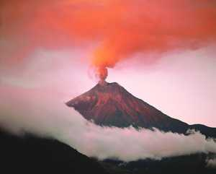

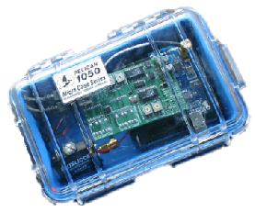


Yield: The Problem
data rate > retrieval rate
4800 b/s > 512 b/s

Slide 2
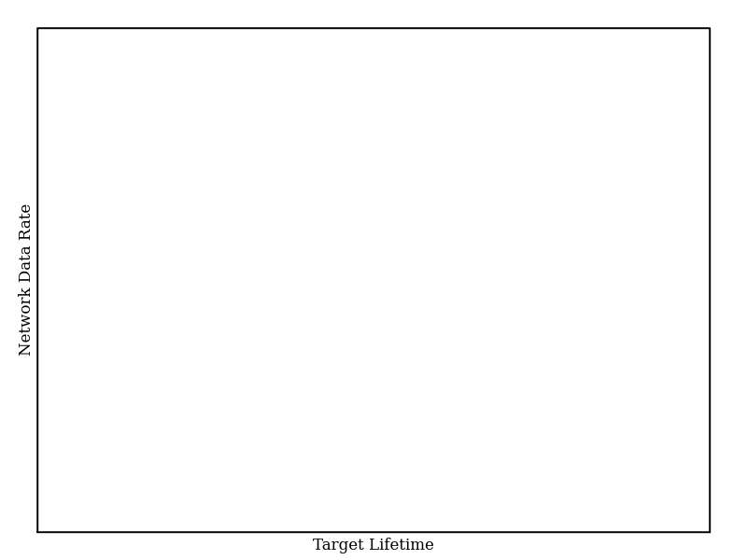
Yield: The Problem
Aggregate Network
Sampling Rate
Target Lifetime

Slide 3
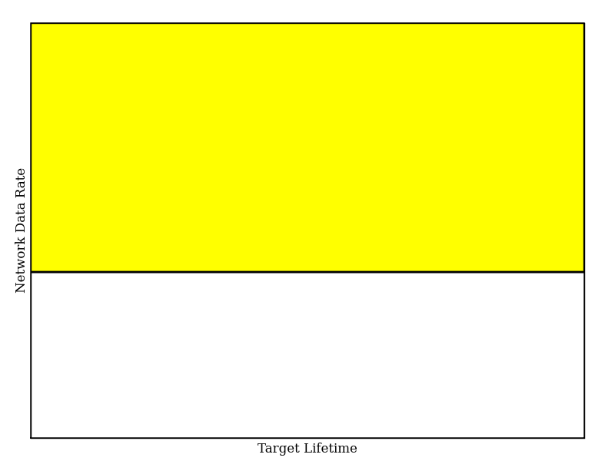
Yield: The Problem
Aggregate Network Sampling Rate =
Reliable Transfer Rate
Aggregate Network
Sampling Rate
Bandwidth
Constrained
Full Signal
Collection
Target Lifetime

Slide 4
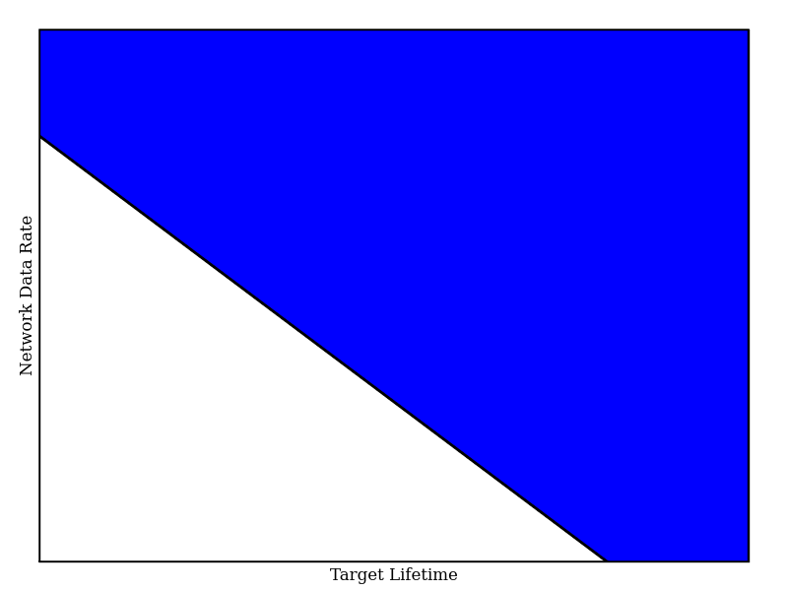
Yield: The Problem
Aggregate Network Sampling Rate *
Lifetime Target * Joules / Byte = Battery Capacity
Aggregate Network
Sampling Rate
Full Signal
Collection
Energy
Constrained
Target Lifetime

Slide 5
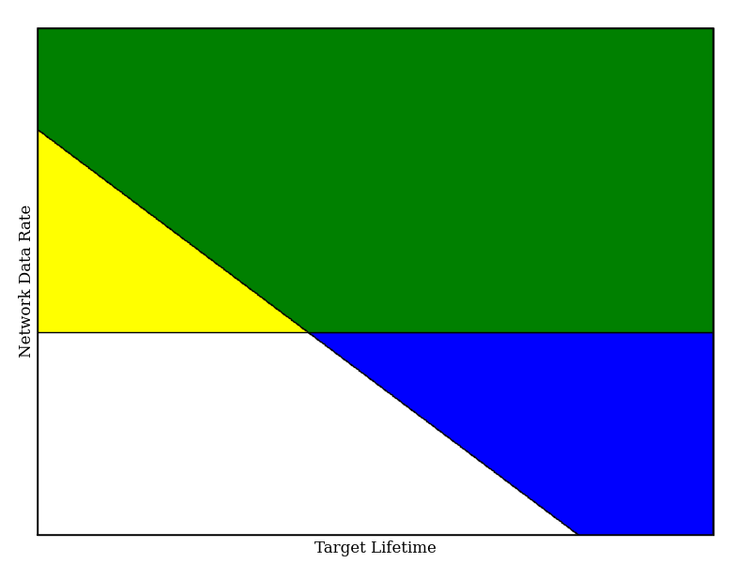
Yield: The Problem
Energy and
Bandwidth
Constrained
Aggregate Network
Sampling Rate
Bandwidth
Constrained
Full Signal
Collection
Energy
Constrained
Target Lifetime

Slide 6
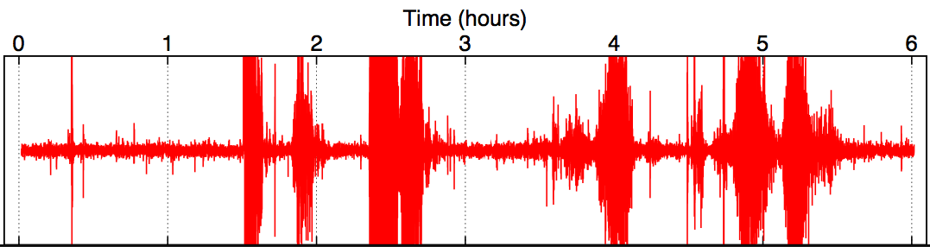
Data Has Value
100Hz Seismometer, Volcan Reventador 2005
Small
Earthquake
Noise
Large
Eruption
Large
Eruptions
Large
Eruption
Large
Eruptions
interesting data

Slide 7
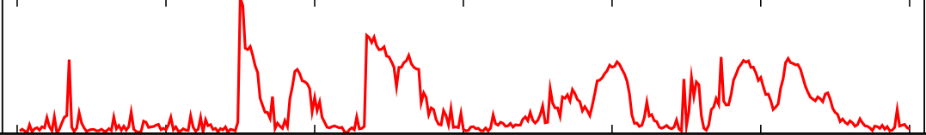
Assigning Value
Summaries should be small (relative to ADU size) and easy to compute
Signal Bandwidth: 18000 B/min
Summary Bandwidth: 4 B/min
Volcano Application Example: RSAM
Raw signal
Reduced
Seismic
Amplitude
Measurement
(RSAM)
Notes:
Used by seismic community, more interesting data, etc.

Slide 8
Data Has Cost
7
6
2
4
5
1
3
B
Bandwidth to Node 1:
1024 Bytes/sec
Bandwidth to Node 7:
512 Bytes/sec
(Bandwidth for reliable data transfer)

Slide 9
Assigning Cost
Empirically measure:
id: energy consumption during downloading
ir: energy consumption during routing
io: energy consumption during overhearing
Multiply by estimated transfer time to get power
7
6
2
4
5
1
3
B

Slide 10
Assigning Cost
Empirically measure:
id: the current draw during downloading
ir: the current draw during routing
io: the current draw during overhearing
Multiply by estimated transfer time to get power
7
7
6
6
2
2
5
4
5
4
1
1
3
3
B
B

Slide 11
Assigning Cost
Empirically measure:
id: the current draw during downloading
ir: the current draw during routing
io: the current draw during overhearing
Multiply by estimated transfer time to get power
7
7
7
c⁷ = (0, 0, ir, io, ir, io, id) * t⁷
6
6
6
2
2
2
5
5
4
5
4
4
1
1
1
3
3
3
B
B
B

Slide 12
Cost Vectors
Energy cost expressed as a vector c
ci = energy needed to download ADU on Node i
(Initial cost vector estimated based on download history and knowledge of the transfer protocol)

Slide 13

Lance
Given extraction cost and data value:
Maximize total value retrieved, subject to bandwidth and energy constraints

Slide 14
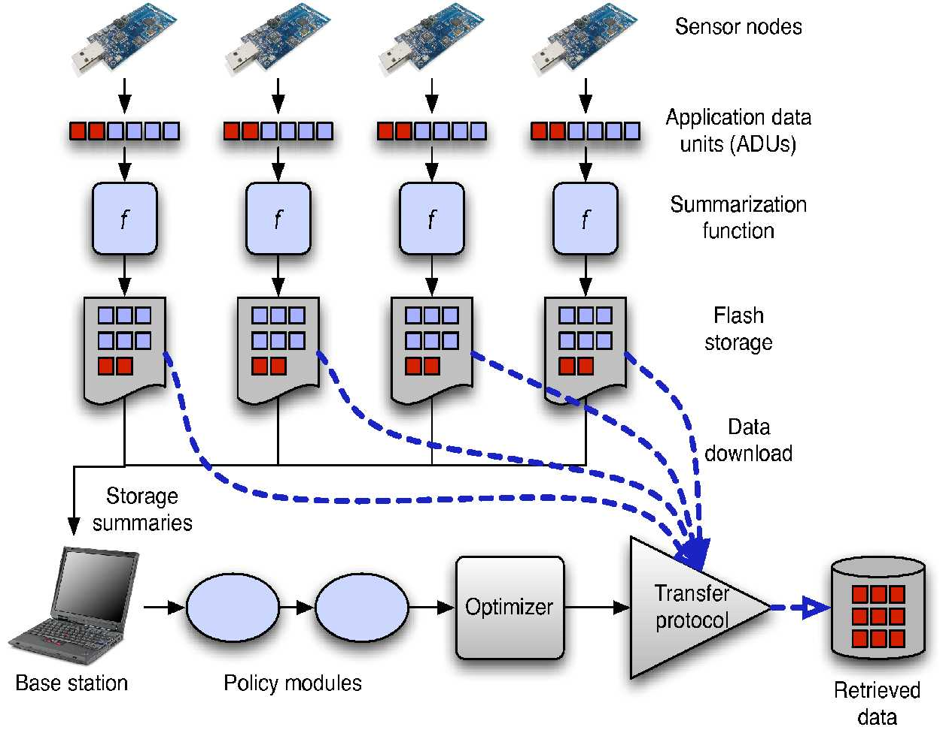
Lance Architecture

Slide 15
Lance Architecture
1) Nodes sample data to ADUs

Slide 16
Lance Architecture
2) Nodes compute summary for each ADU

Slide 17
Lance Architecture
2) Nodes compute summary for each ADU
3) Summaries sent to base station

Slide 18
Lance Architecture
4) ADUs logged to Flash

Slide 19
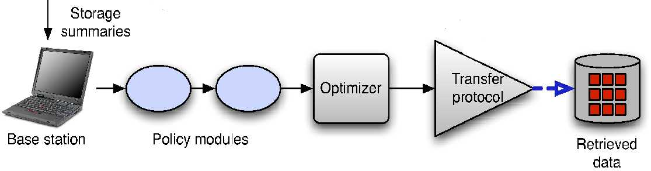
Lance Architecture
On the Base Station
(1)
Assign Value,Cost
1) Initial Value, Cost Computed
2) Value Modified by Policy Modules
3) ADUs Scored by Lance Optimizer
4) Top-Scoring ADU Downloaded
Policy Modules
Optimizer
Download
Notes:
Replace with flowchart

Slide 20
Lance Architecture
On the Base Station
(1)
(2)
Assign Value,Cost
1) Initial Utility, Cost Computed
2) Value Modified by Policy Modules
3) ADUs Scored by Lance Optimizer
4) Top-Scoring ADU Downloaded
Policy Modules
Optimizer
Download

Slide 21
Lance Architecture
On the Base Station
(1)
(2)
(3)
Assign Value,Cost
1) Initial Value, Cost Computed
2) Values Modified by Policy Modules
3) ADUs Scored by Lance Optimizer
4) Top-Scoring ADU Downloaded
Policy Modules
Optimizer
Download

Slide 22
Lance Architecture
On the Base Station
(1)
(2)
(3)
(4)
Assign Value,Cost
1) Initial Value, Cost Computed
2) Values Modified by Policy Modules
3) ADUs Scored by Lance Optimizer
4) Top-Scoring ADU Downloaded
Policy Modules
Optimizer
Download

Slide 23
Optimization Goal
U = all possible ADUs
B = initial node battery state constraint vector
c(u), v(u) are the cost, value of an ADU (or set of ADUs)
The optimal set uo is the set of ADUs maximizing
∑ v(uo) subject to ∑ c(uo) < B

Slide 24
Optimization Goal
U = all possible ADUs
B = initial node battery state constraint vector
c(u), v(u) are the cost, value of an ADU (or set of ADUs)
The optimal set uo is the set of ADUs maximizing
∑ v(uo) subject to ∑ c(uo) < B
Offline Solution: Multidimensional Knapsack Problem
c(u) are weights,
v(u) are values,
Bi's are knapsack capacities
Used to produce optimality bound

Slide 25
Optimization Strategy
Goal: Online Approximation of Offline Optimal
1) Examine all available ADUs
2) Assign each a score via scoring function
3) Download top-scoring ADU if resources available

Slide 26
Scoring Functions
Inputs: ADU with value, cost vector
Output: Score used to rank ADUs
2) Cost Total
1) Value Only
3) Cost Bottleneck
Use the most significant component of the cost to weight the value of the ADU

Slide 27
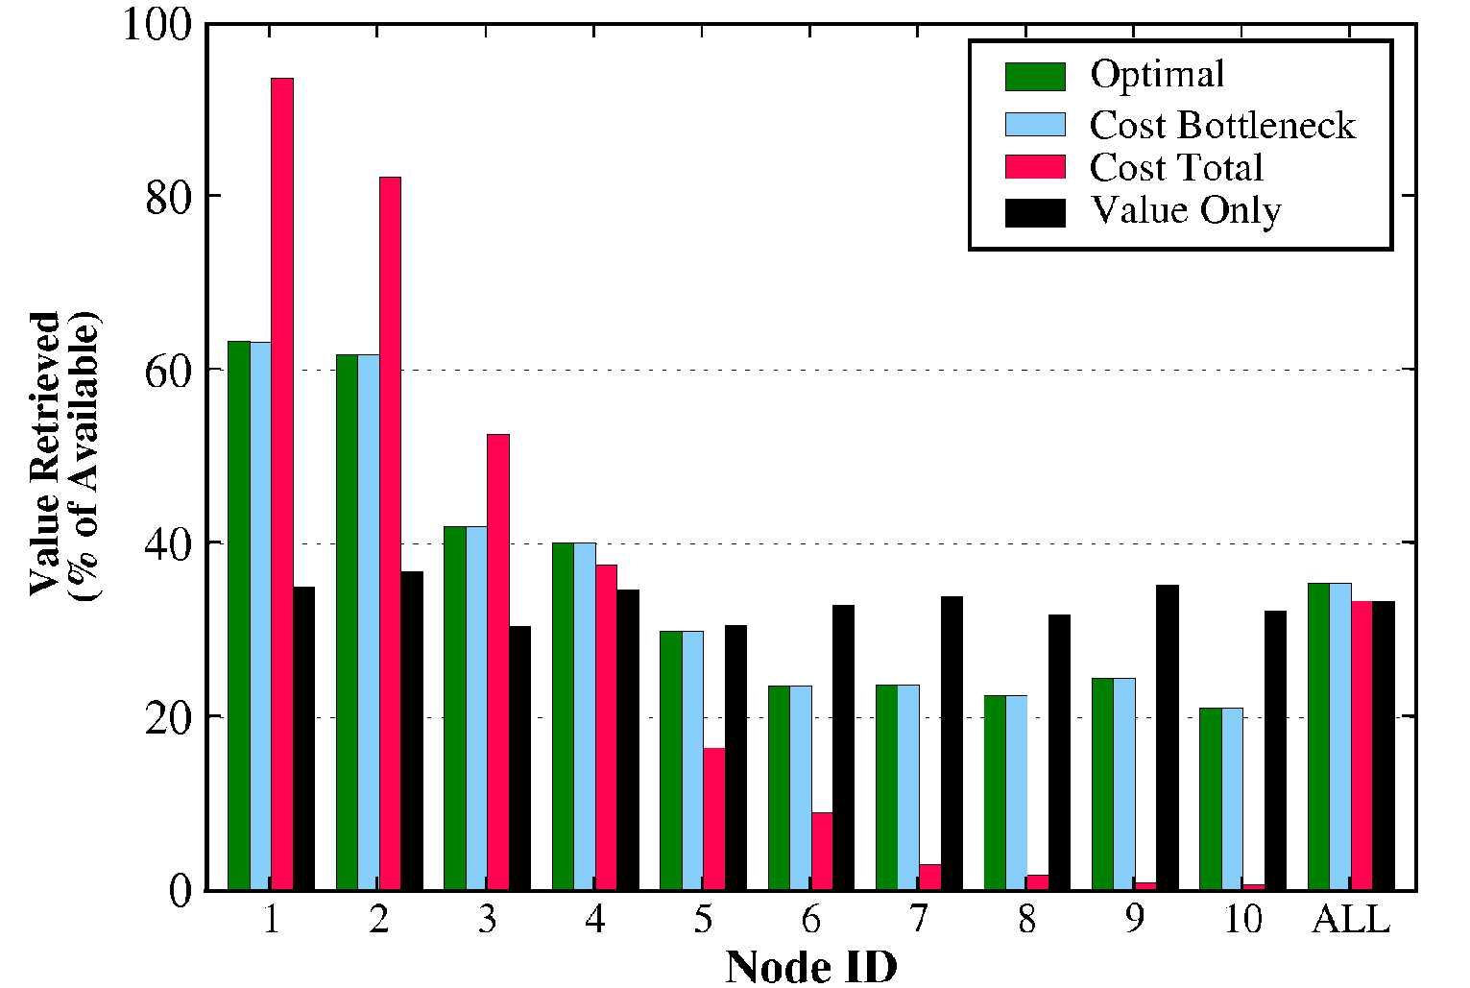
Scoring Functions
Simulation Results:
10-node linear topology
Biased towards nodes near sink
Almost matches
optimal
Same from all nodes

Slide 28
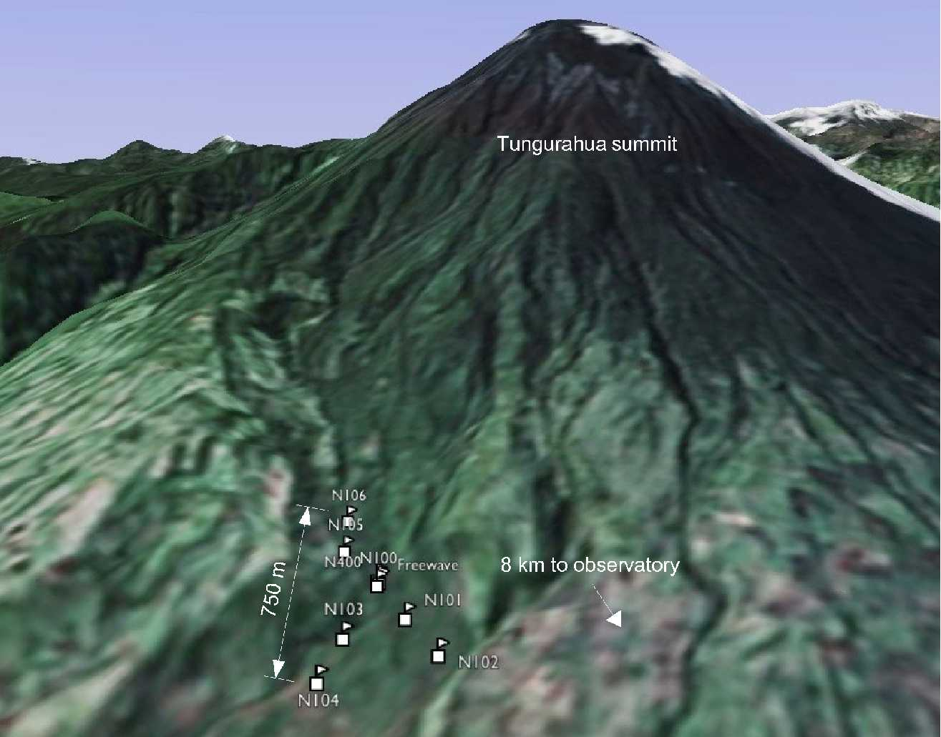
2007 Deployment
1 Week deployment
Volcan Tungarahua
August 2007
8 nodes
Seismic and acoustic sensors

Slide 29
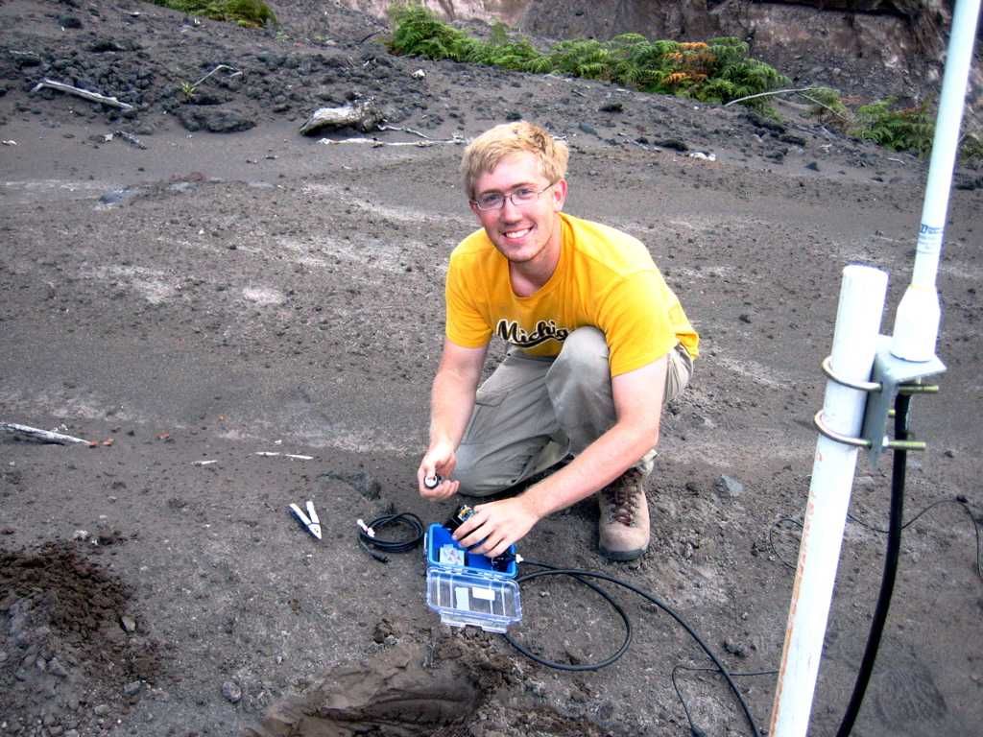
2007 Deployment

Slide 30
Deployment Evaluation
Lance extracted 99.5% of the
offline optimal value

Slide 31

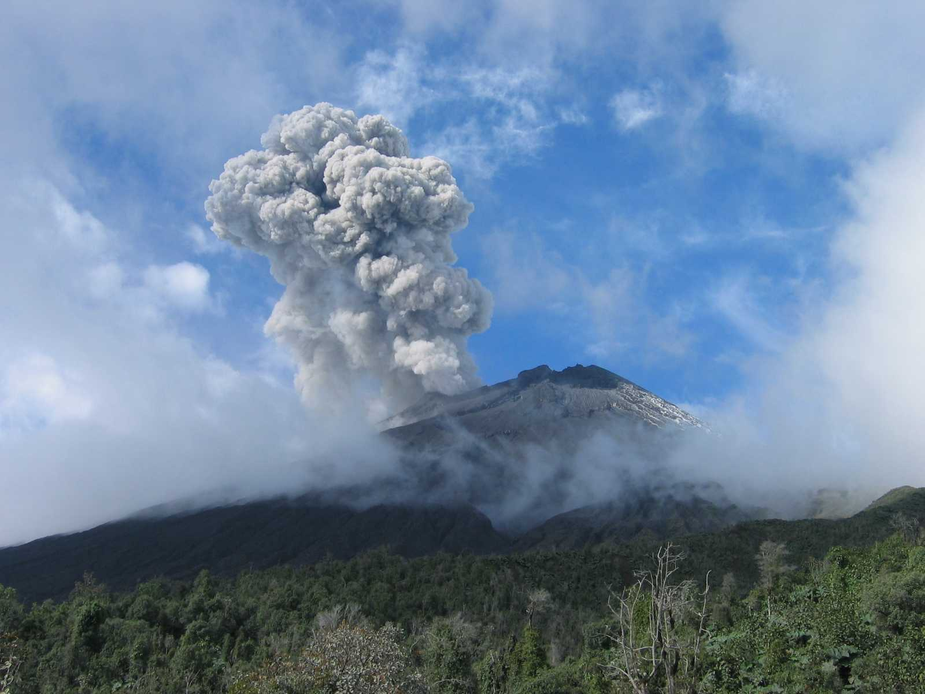
Backup Slides Follow
challen@eecs.harvard.edu
http://www.eecs.harvard.edu/~challen/

Slide 32
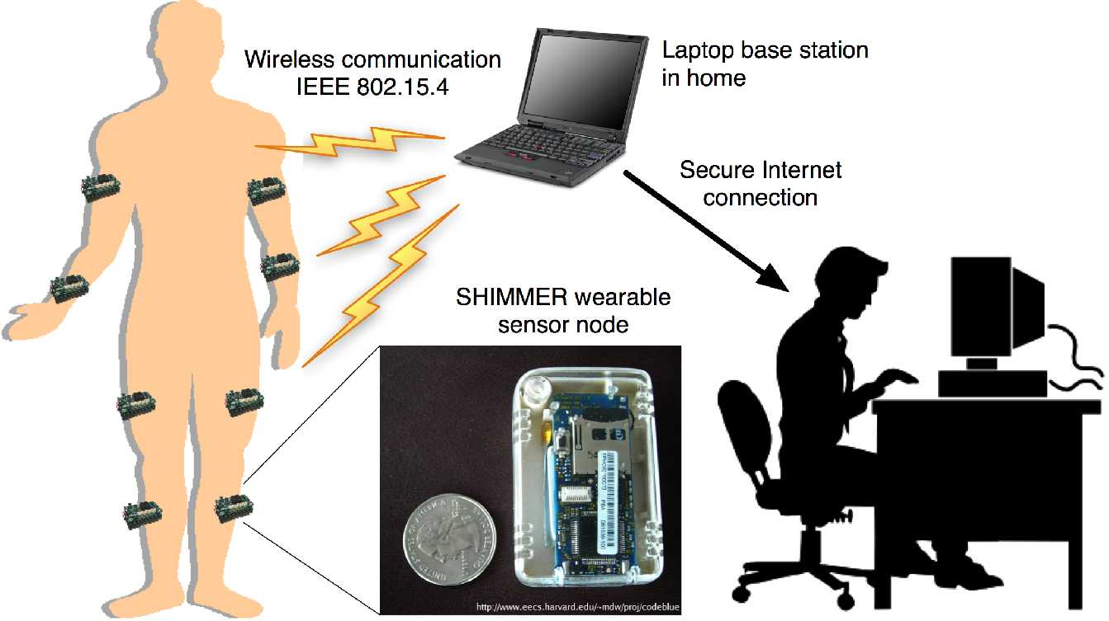
Lance: Mercury

