Slide 1
Related Work
High Data Rate Sensing
  Structural Monitoring: Golden Gate Bridge, NetSHM, WIMMS
  Marmot Monitoring: ENSBox, Wavescope, Wavescript
  Camera-Based Sensor Networks: Cyclops, M²
  Condition-based Maintenance: Intel North Sea
Scientific Applications
  Great Duck Island, Berkeley Redwoods, James Reserve
  TurtleNet: Eon
  Flood and Landslide Detection
  WSU Volcano Monitoring Project
Data Optimization Frameworks
  EnviroMic/EnviroSuite: distributing storage load
  ICEDB: query processing engine for CarTel
  VanGo: programming model for efficient signal processing
Energy Load Balancing Services
  Quanto: network-wide energy tracking
  LEACH, Vigilnet: rotate responsibilites within clusters
  Pixie: operating system for resource-aware programming
  Peloton: architecture for distributed resource management
Notes:
Add citations

Slide 2
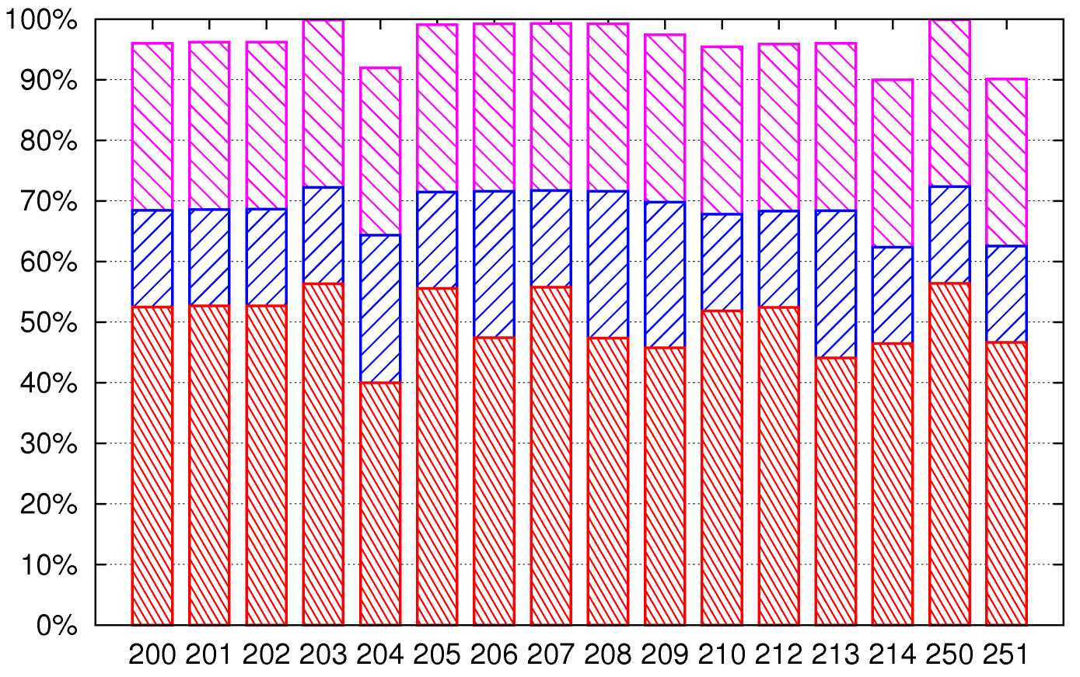
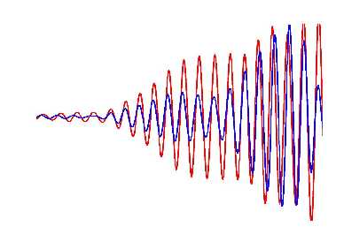
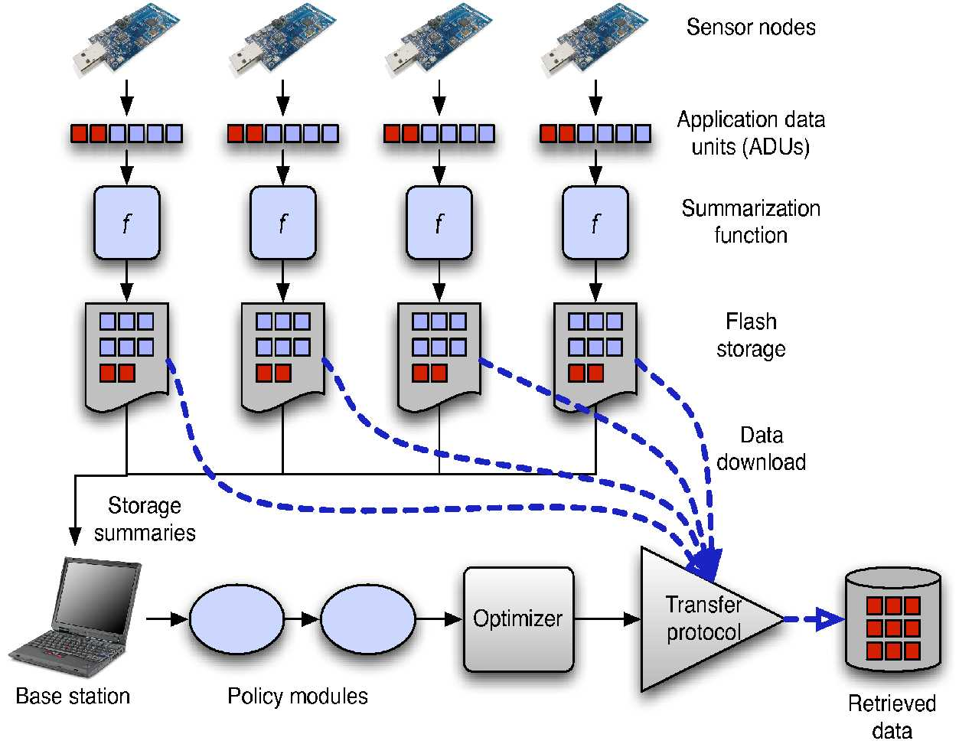
Lessons Learned
Nodes were reliable, infrastructure was not.
Accurate timing is hard.
Ground truth is critical.
Balance centralization and decentralization.
Energy has quantity, location, and impact.

Slide 3
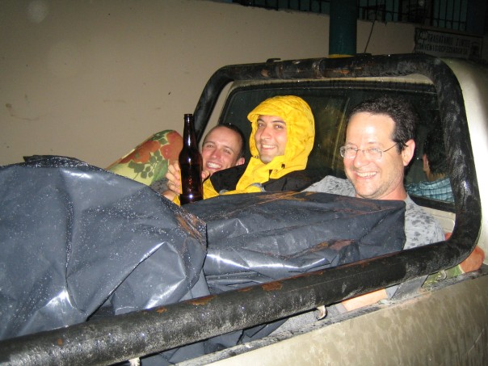
Research Collaborators
Ph.D. Adviser: Matt Welsh
CS Co-Authors:
Bor-rong Chen, Steve Dawson-Haggerty,
Thaddeus Fulfold-Jones, Konrad Lorincz, Pat Swieskowski, Jason Waterman
Seismology Co-Authors:
Jeff Johnson (NMT), Jonathan Lees (UNC), Omar Marcillo (NMT), Mario Ruiz (IGEPN)
Group Members and Friends:
Mark Hempstead, Rohan Murty,
Tao Stein

Slide 4
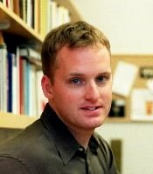
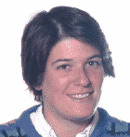
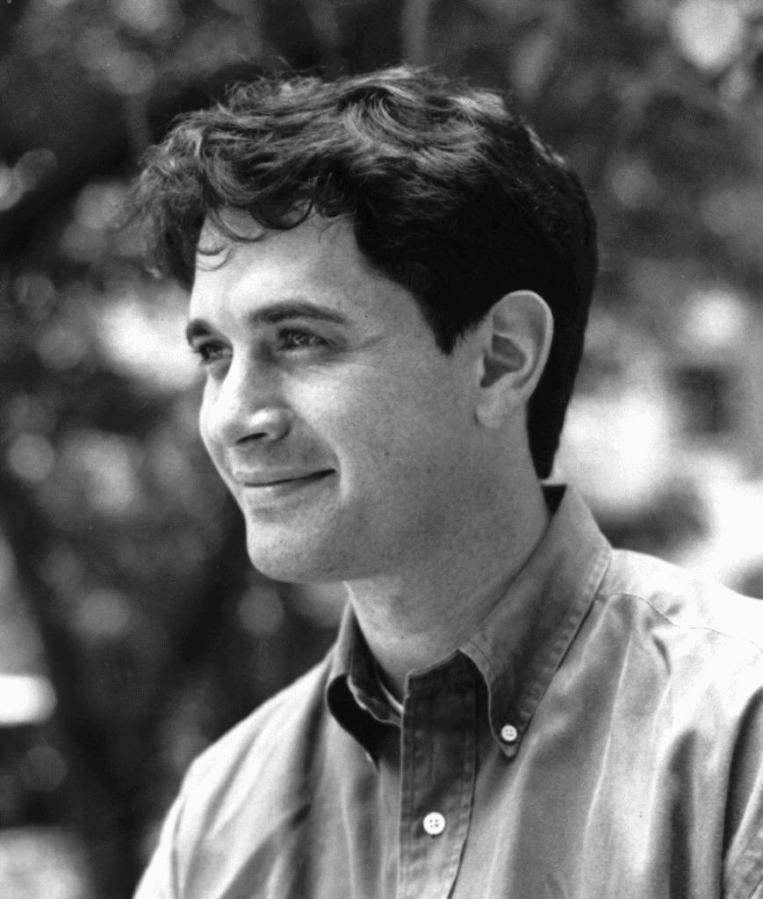
Dissertation Committee
Professor Welsh
Professor Seltzer
Professor Mitzenmacher

Slide 5

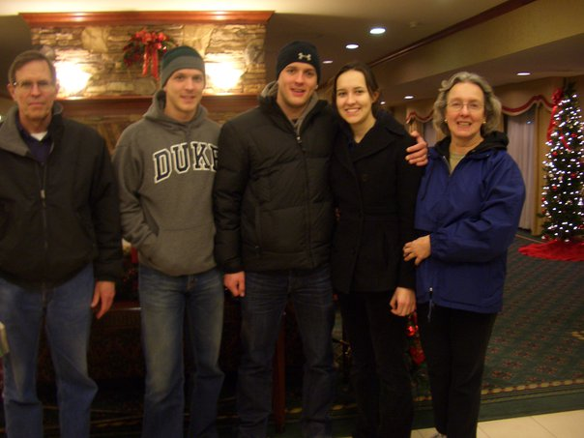
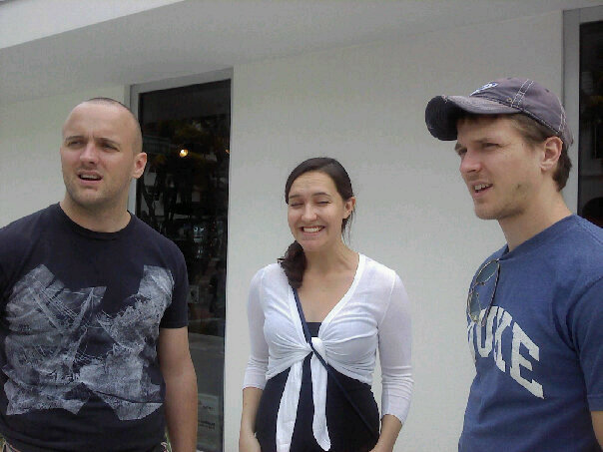
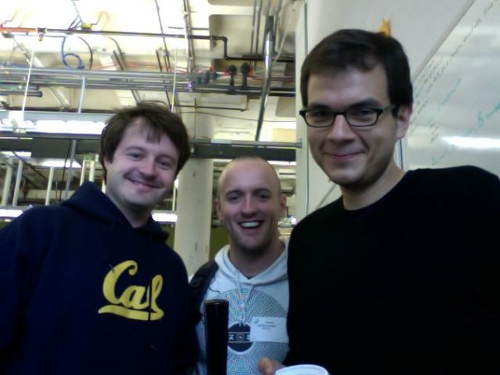

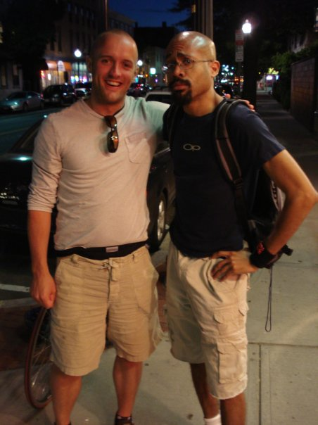
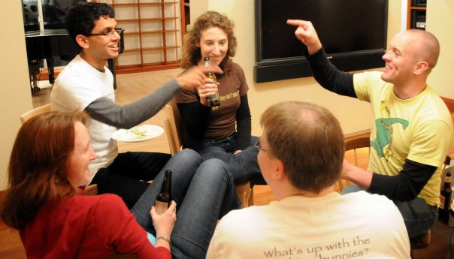
Family, Friends, Domus

Slide 6

Chuchu

Slide 7
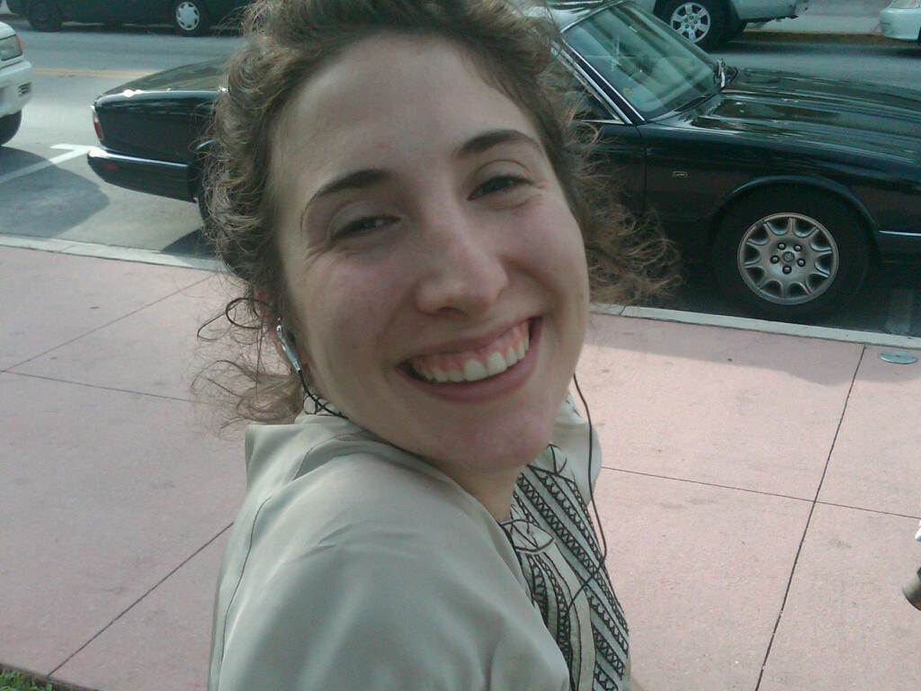
Suzanna

Slide 8

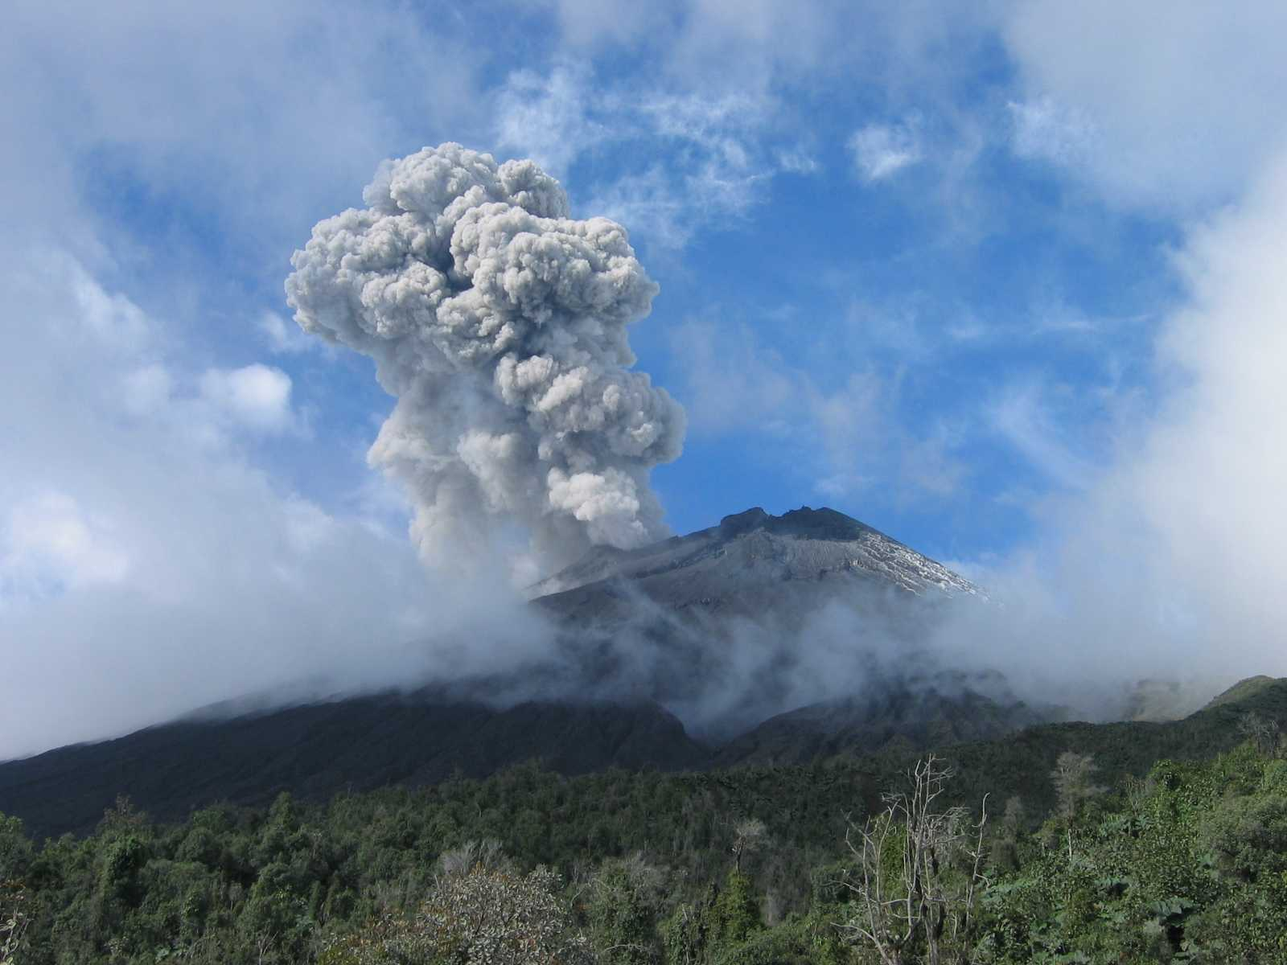
challen@eecs.harvard.edu
http://www.eecs.harvard.edu/~challen/
Questions?

Slide 9

challen@eecs.harvard.edu
http://www.eecs.harvard.edu/~challen/
Questions?
challen@cse.buffalo.edu
http://www.cse.buffalo.edu/~challen/

Slide 10
Backup Slides Follow
challen@eecs.harvard.edu
http://www.eecs.harvard.edu/~challen/

