Slide 1

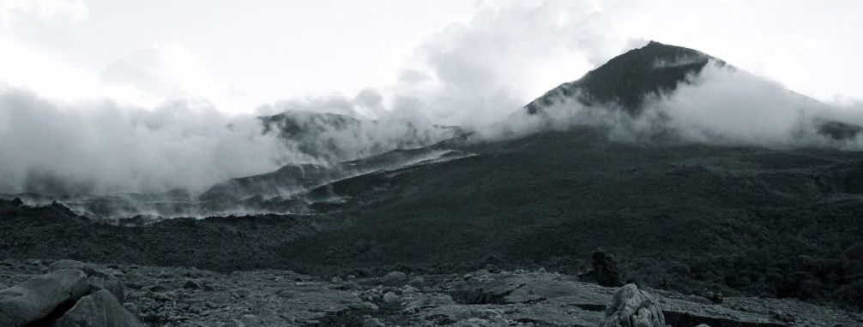
Fidelity and Yield in
Resource-Constrained Sensor Networks
Geoffrey Werner Challen
Harvard University School of Engineering and Applied Sciences

Slide 2
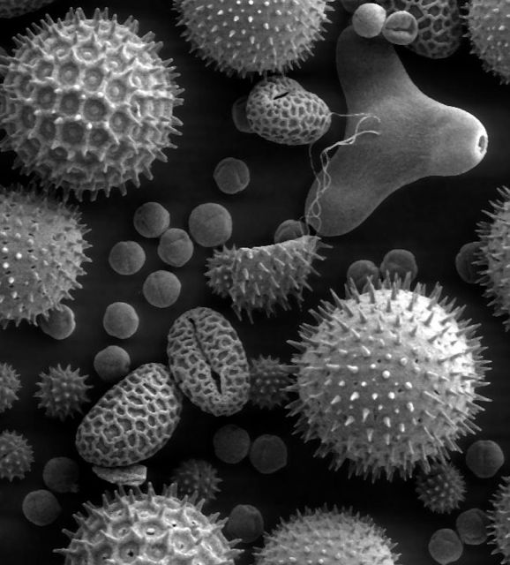
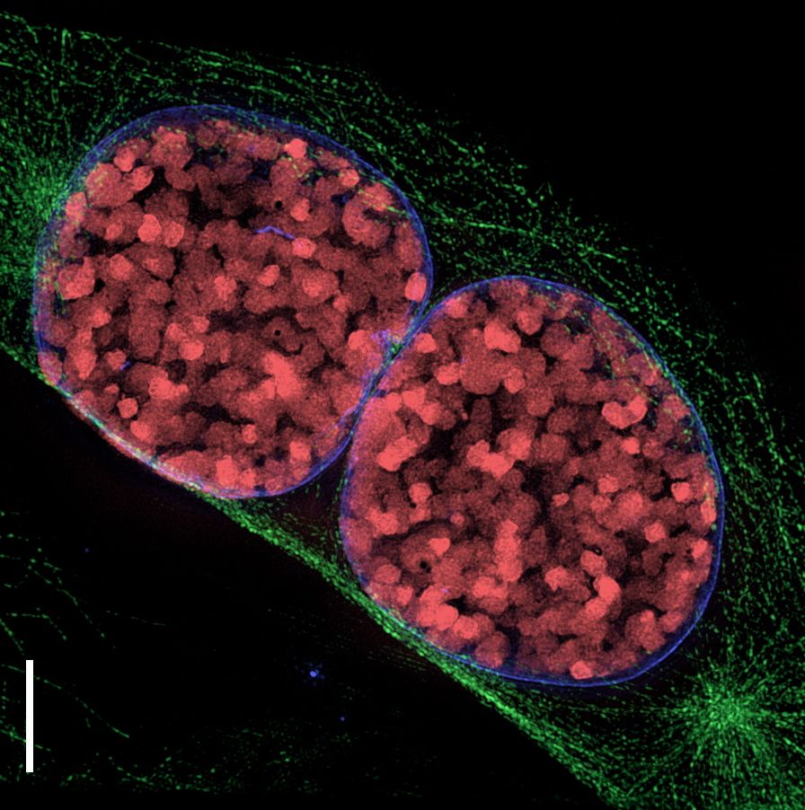

The Macroscope
pollen
cells in prophase
bee's mouth
Microscope: an instrument which helps us understand very small things
i
very small things

Slide 3
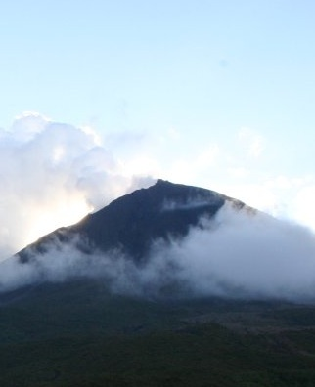

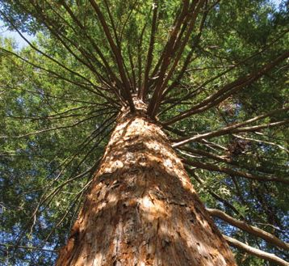
The Macroscope
volcano
marmot colony
redwood forest
Macroscope: an instrument which helps us understand very large things
a
very large things

Slide 4
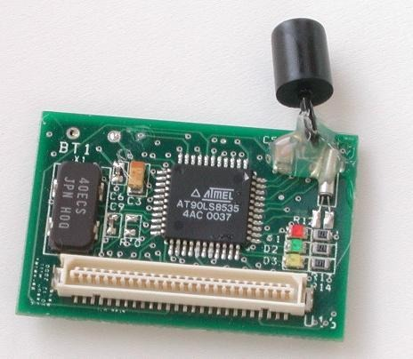
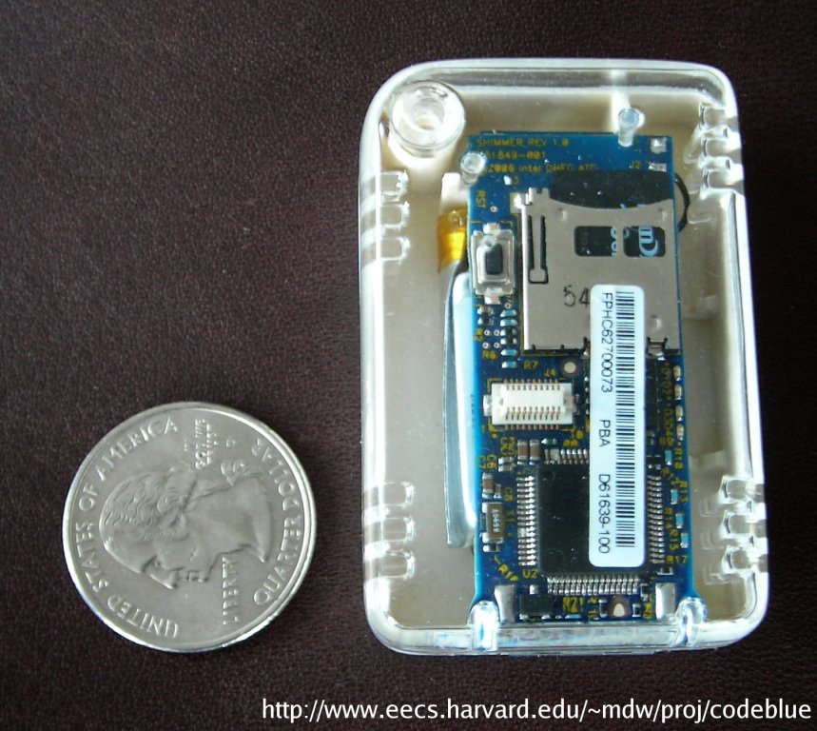
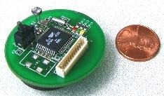
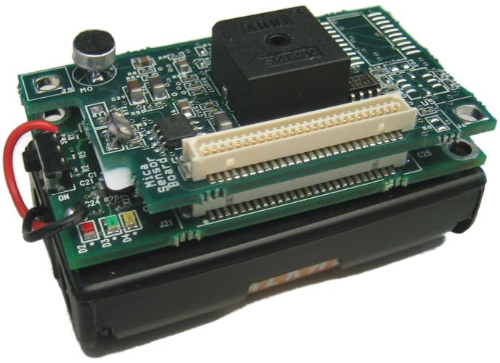
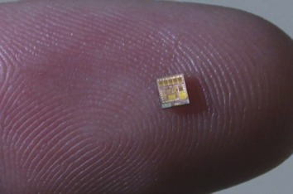
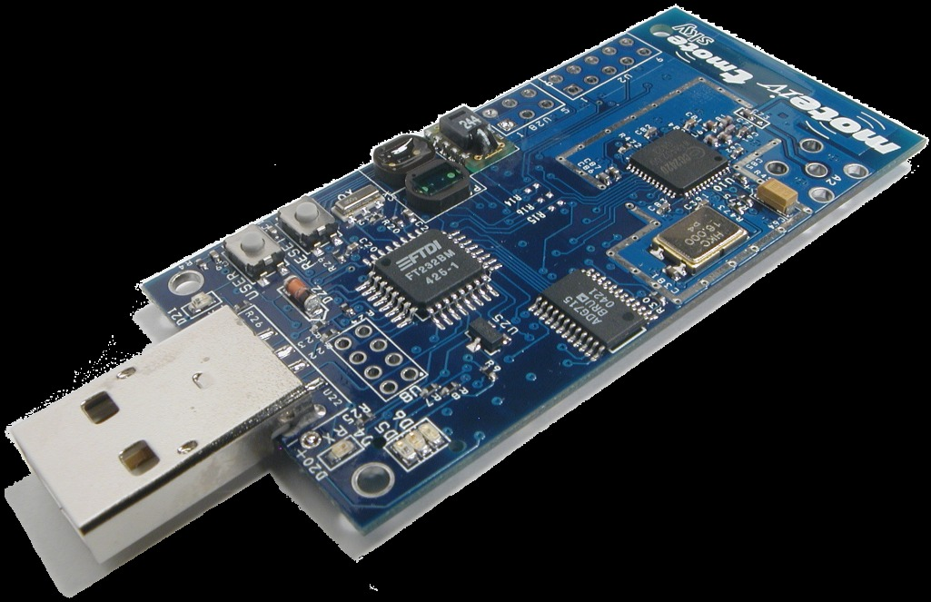
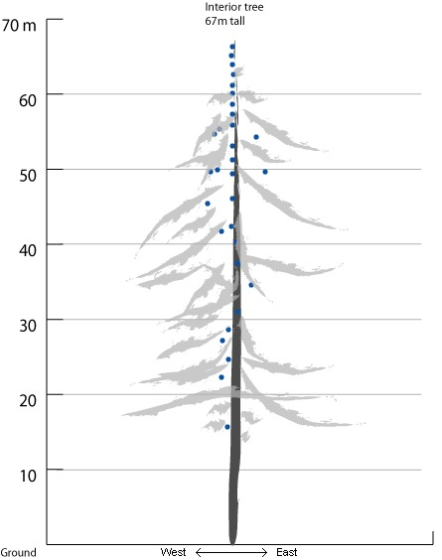
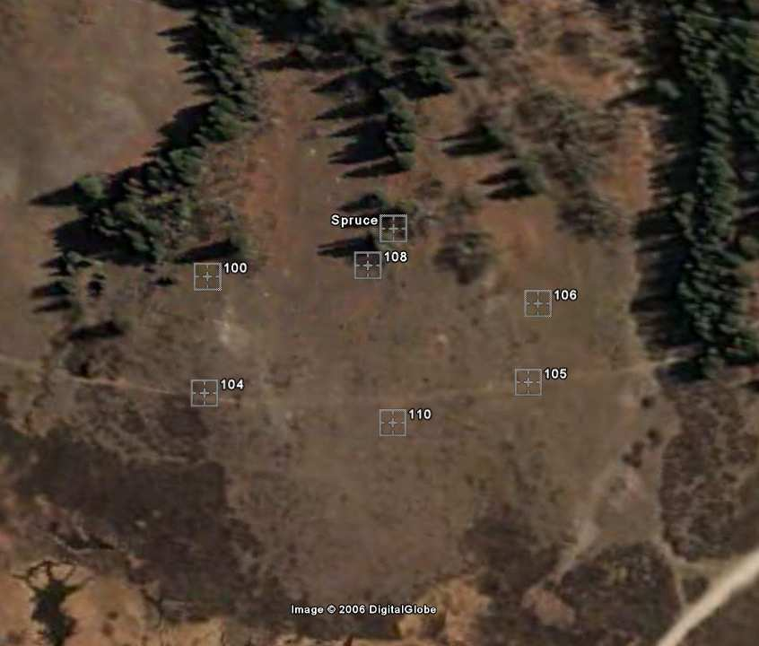
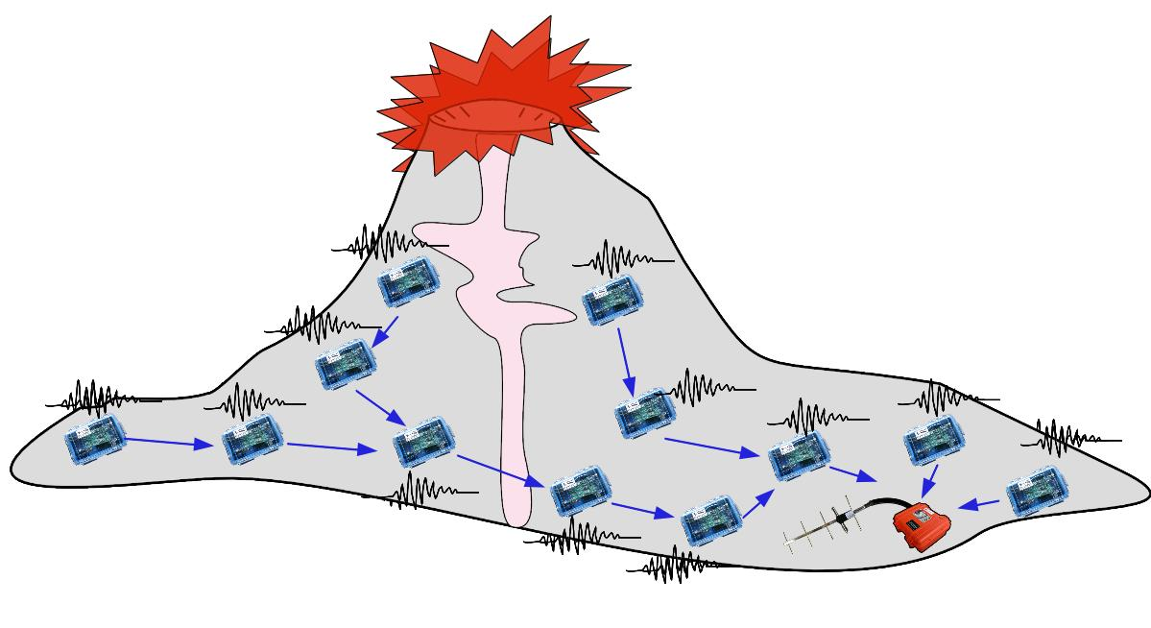
Scientific Sensor Networks
Girod et. al
IPSN'07
c
Werner-Allen et. al, OSDI'06
Tolle et. al
Sensys'05
Acoustic source
localization
Data quality
optimization
Data analysis
and visualization

Slide 5
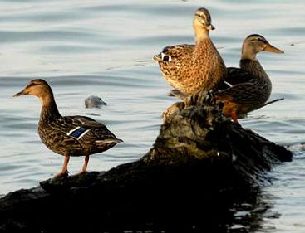
High Data-Rate Science
Bytes-per-second (bps) collected by each node
(log scale)
0.01
0.1
1
10
100
1000
10000
Great Duck
Island
0.5 bps
c
Reventador
Volcano
1600 bps
Redwood Forest
0.05 bps
Marmot Detection
20 kbps

Slide 6
High Data-Rate Science
Bytes-per-second (bps) collected by each node
(log scale)
0.01
0.1
1
10
100
1000
10000
Great Duck
Island
0.5 bps
c
Reventador
Volcano
1600 bps
Redwood Forest
0.05 bps
Marmot Detection
20 kbps

Slide 7
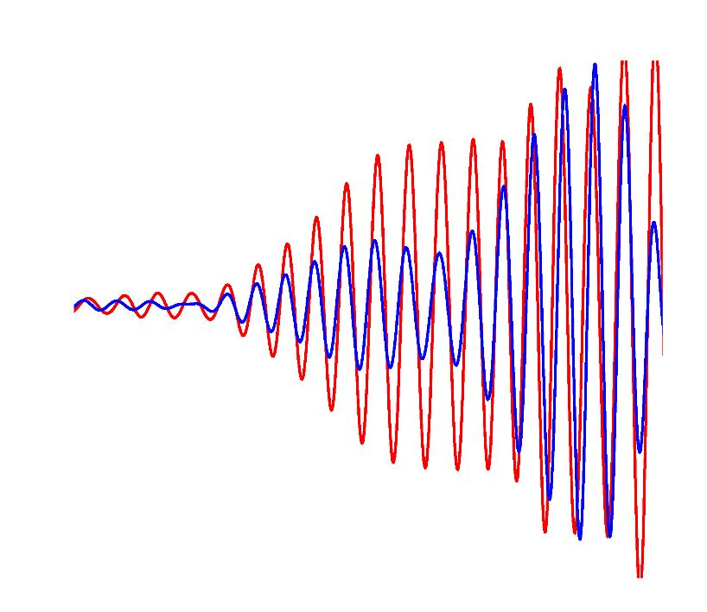
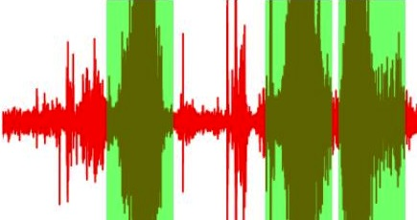
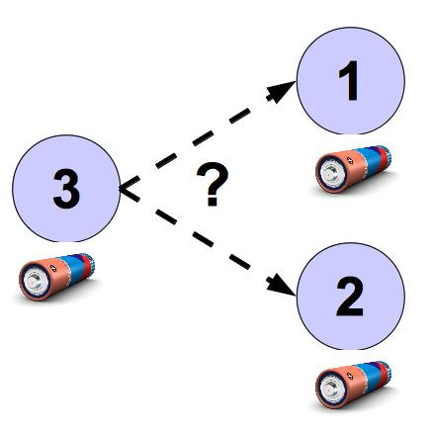
High Data-Rate Challenges
1)
Accurate Timestamping
Goal: assign timestamps accurate enough to support scientific analysis
Volcano Monitoring Case Study : 2004 – Present
(EWSN'05, OSDI'06)
2)
Optimizing Data Quality
Goal: devote system resources to only the most valuable data
Lance System Architecture : 2006 – 2009
(Sensys'08, Sensys'09)
3)
Manage Distributed Energy
Goal: control energy usage to extend the lifetime of the instrument
Distributed Energy Awareness : 2008 – Present
(MobiSys'10)

Slide 8
Contributions
First sensor network for monitoring active volcanoes
Deployed at Tungurahua Volcano ('04, '08) and Reventador Volcano ('05)
Post-hoc time rectification technique
Successfully derived timestamps in the face of timing protocol failures
Lance system architecture
Optimization framework suitable for high data-rate applications
Lance online heuristic
Combines cost and value to achieve over 95% of offline optimal performance
IDEA architecture for controlling energy distribution
Increases system lifetime by up to 35% by better distributing energy usage

Slide 9
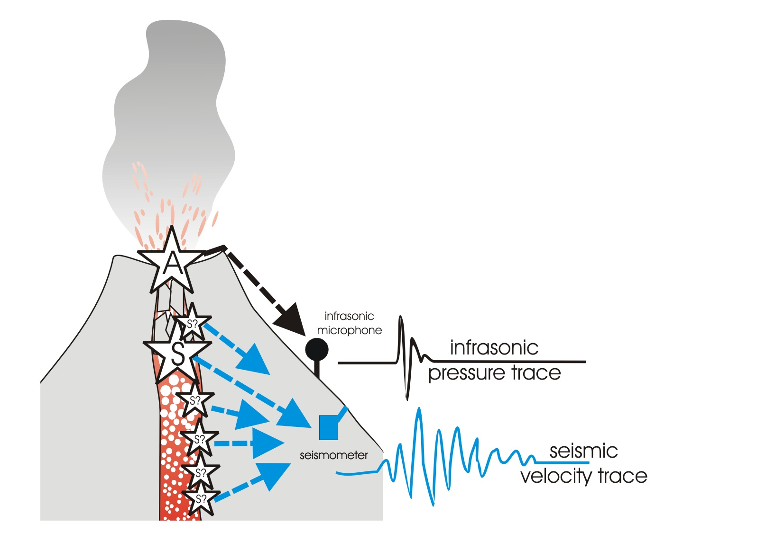
Case Study : Volcano Monitoring
Microphones:
Measure infrasonic (low-frequency acoustic)
waves produced by eruptions
Seismometers:
Measure ground motion due to
earthquakes, eruptions, tremor

Slide 10
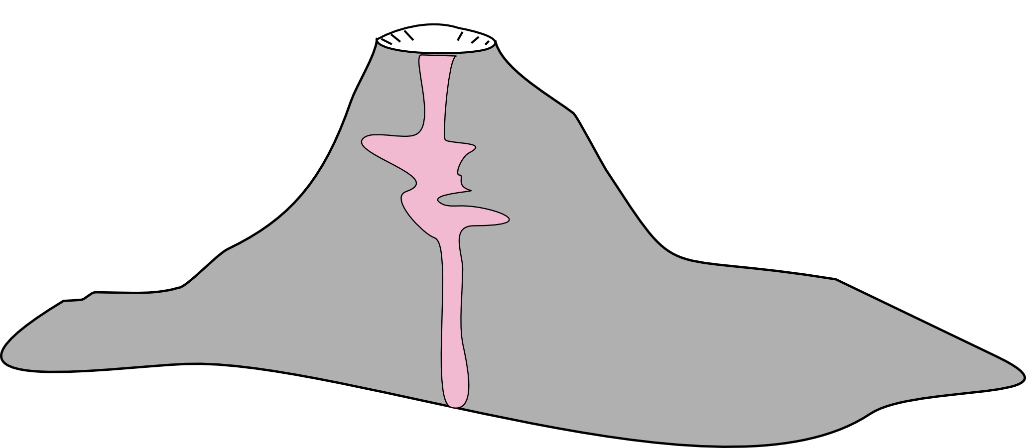
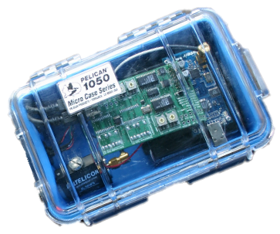
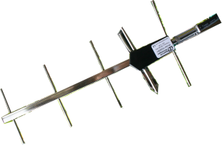
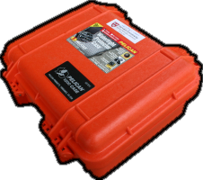

Volcano Tomography
Goal: Map density structure and understand internal processes
Notes:
“Here is an overview of our network architecture. We deployed 16 sensor nodes on the volcano, each of which has a seismometer and microphone. A single GPS receiver was used for time synchronization, which will be described later. Nodes form a multihop network and relay data, via radio, to a base station located at the volcano observatory. Radio modems were used to establish a long-distance radio link to the observatory. On the left you can see an example of a seismic signal collected at the volcano.”
Nodes very far from the observatory, need for Freewave.

Slide 11
Volcano Tomography
Goal: Map density structure and understand internal processes
Notes:
“Here is an overview of our network architecture. We deployed 16 sensor nodes on the volcano, each of which has a seismometer and microphone. A single GPS receiver was used for time synchronization, which will be described later. Nodes form a multihop network and relay data, via radio, to a base station located at the volcano observatory. Radio modems were used to establish a long-distance radio link to the observatory. On the left you can see an example of a seismic signal collected at the volcano.”
Nodes very far from the observatory, need for Freewave.

Slide 12
Volcano Tomography
Goal: Map density structure and understand internal processes
Notes:
“Here is an overview of our network architecture. We deployed 16 sensor nodes on the volcano, each of which has a seismometer and microphone. A single GPS receiver was used for time synchronization, which will be described later. Nodes form a multihop network and relay data, via radio, to a base station located at the volcano observatory. Radio modems were used to establish a long-distance radio link to the observatory. On the left you can see an example of a seismic signal collected at the volcano.”
Nodes very far from the observatory, need for Freewave.

Slide 13
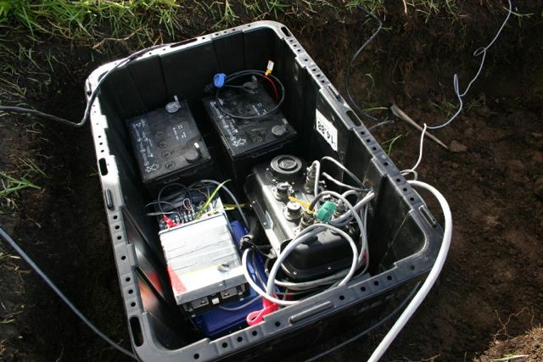
High-Resolution Sensor Station
Cables to microphones
2 Car batteries
~1m
Data Logger
Mic amplifier
Power distribution
Cable to seismometer

Slide 14
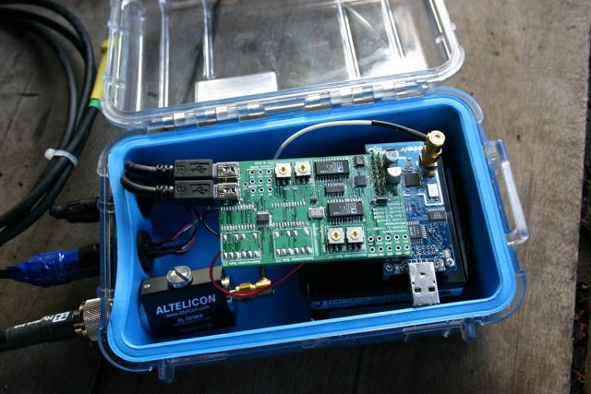
Volcano-Monitoring Sensor Node
Custom ADC board
Microphone cable
Tmote Sky
Seismometer cable
D cell batteries
Antenna cable
~20cm
Notes:
“This is a picture of our wireless sensor node, based on a mote running TinyOS. It has a low-power processor and radio, a custom sensor interface board, and connectors for a seismometer, microphone, and radio antenna.
It is powered by D-cell batteries which run for about 10 days.”

Slide 15
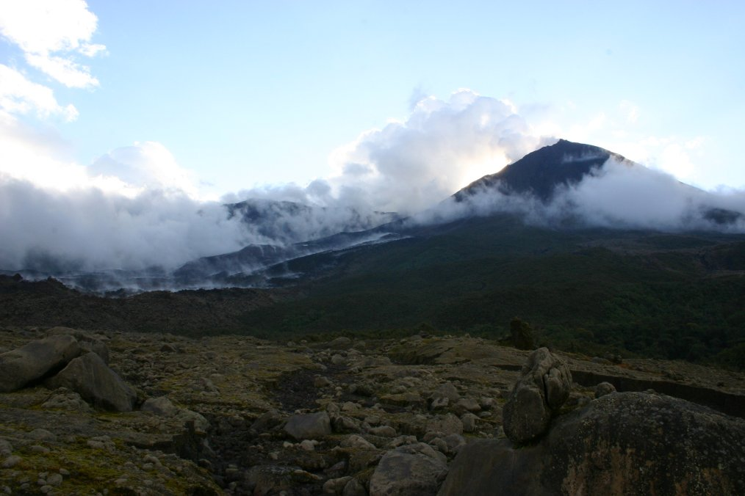
Reventador Volcano

Slide 16
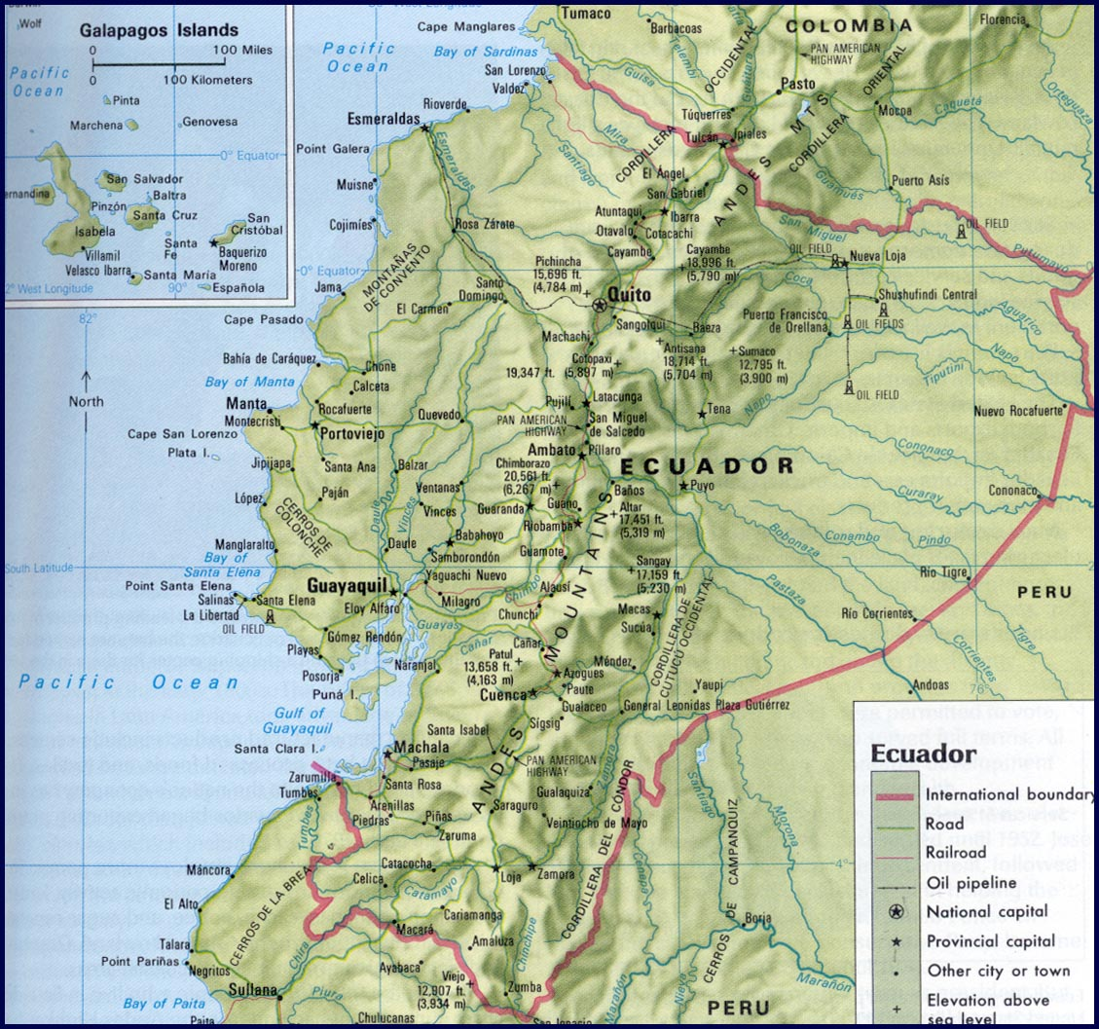
Reventador Volcano
Reventador

Slide 17
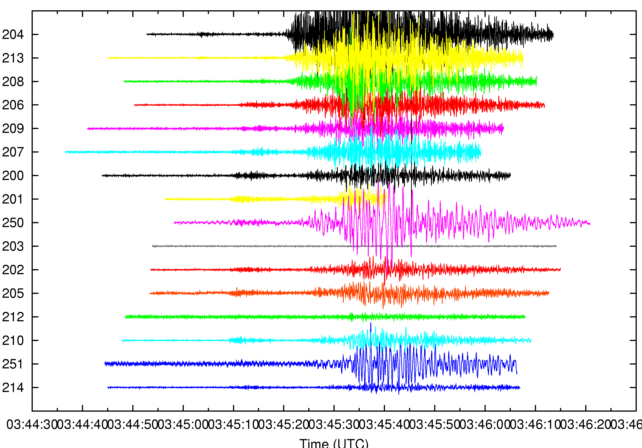
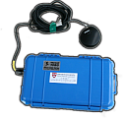
System Architecture
Sensor
Nodes
Long-distance radio link
(> 4km)
Laptop
Laptop
Freewave Modem
Goal: Download 60s worth
of data from each node
following an “interesting” event
GPS

Slide 18
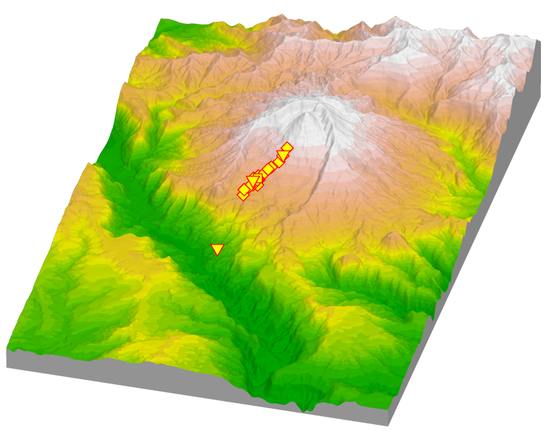
Deployment Map
Sensor network
(spans over 3km)
Observatory

Slide 19
Evaluation Methodology
flash
storage usage
fidelity
time sync overhead
System Centric
Science Centric
routing stability
yield
data transfer
rates

Slide 20
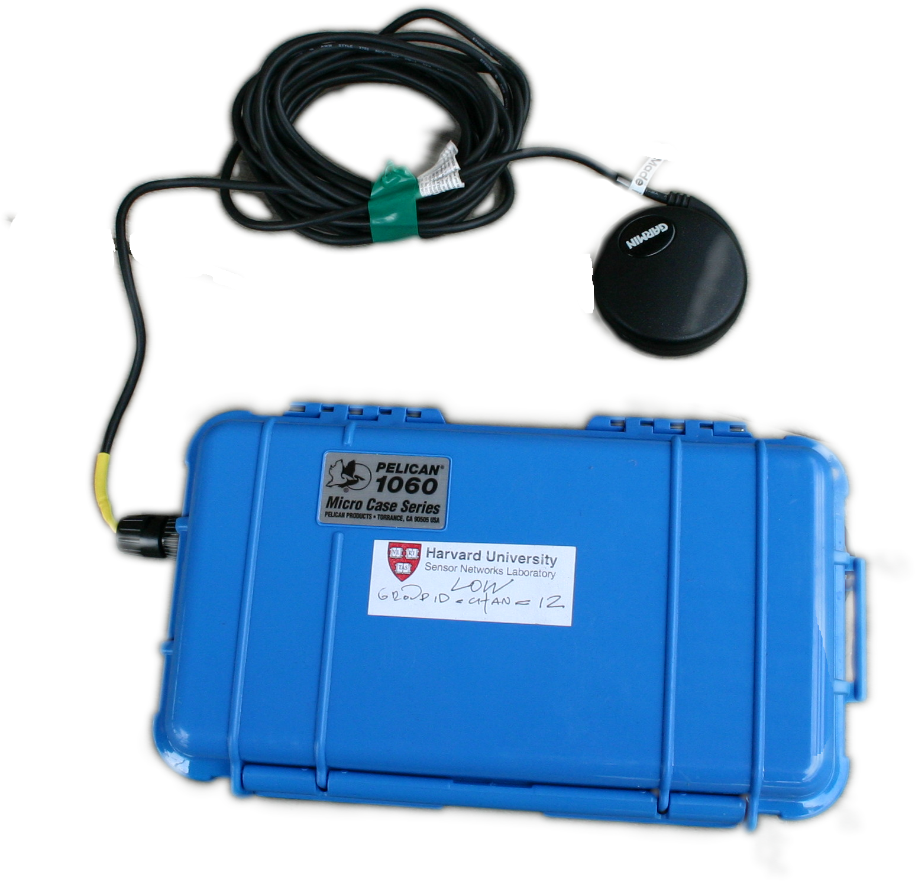
Fidelity: FTSP
GPS
FTSP (Flooding Time Synchronization Protocol)
GPS receiver acts as “root”
All other nodes attempt to synchronize their clock to the root
Each node broadcasts periodic beacon with
global time of transmission
Receivers mark time of beacon reception
Each node computes offset and skew from its local clock to global timebase
Each sample tagged with FTSP global time
Sensor
Nodes

Slide 21
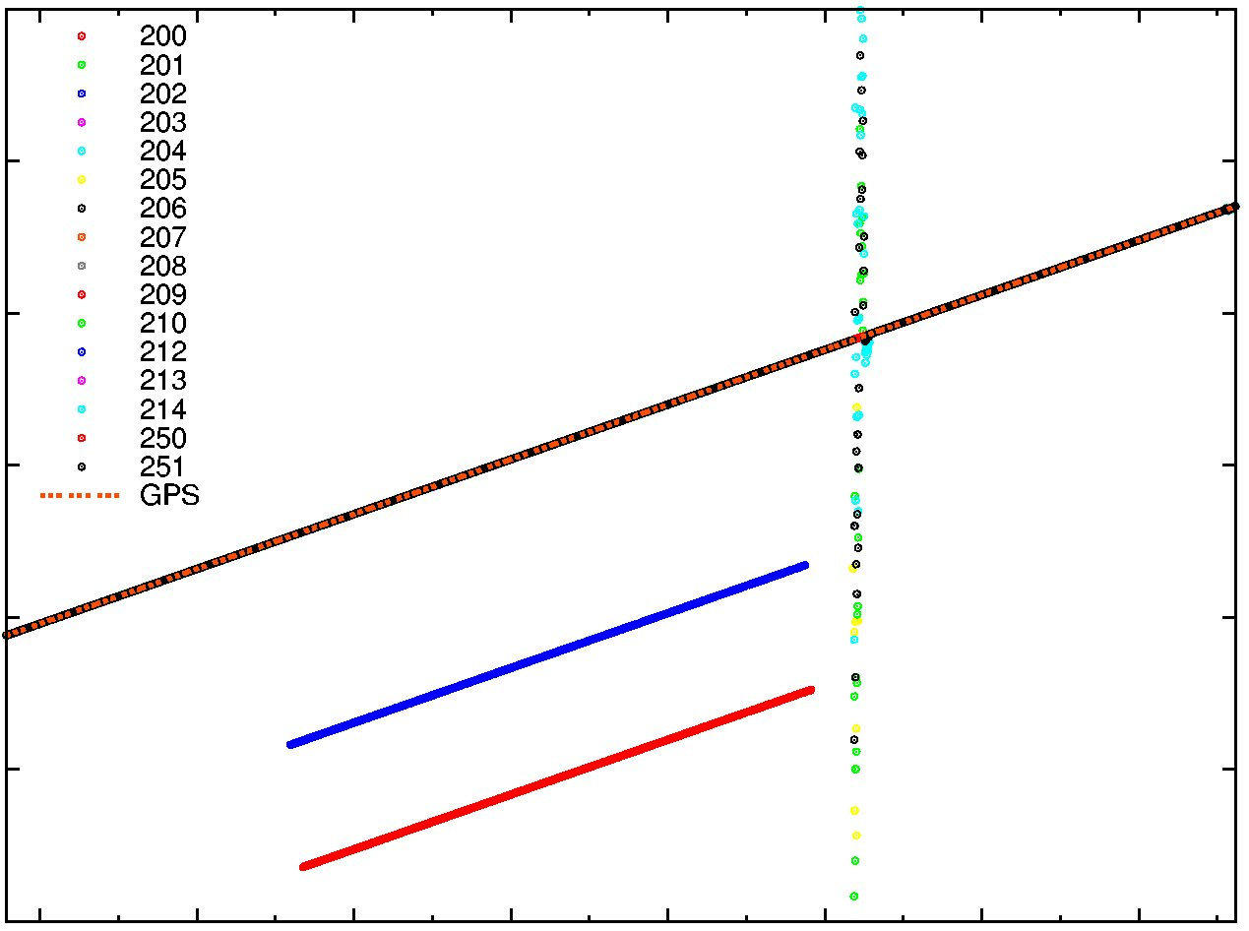
Fidelity: Timing Problems
140000
200
201
202
203
204
205
206
207
208
209
210
212
213
214
250
251
GPS
Broken nodes
rebooted
130000
Network
Global
Time
120000
110000
100000
2 nodes global times diverge
90000
90000
80000
11:00
12:00
13:00
14:00
15:00
16:00
17:00
18:00
Time (GMT)

Slide 22
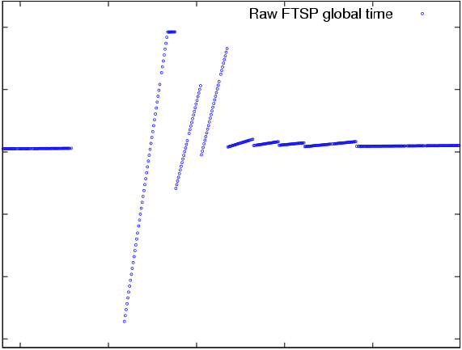
Fidelity: Time Rectification
Unrectified FTSP Global Time
100000
90000
Node
Global
Time
80000
70000
60000
50000
29500
29600
29700
29800
29900
Node Local Time

Slide 23
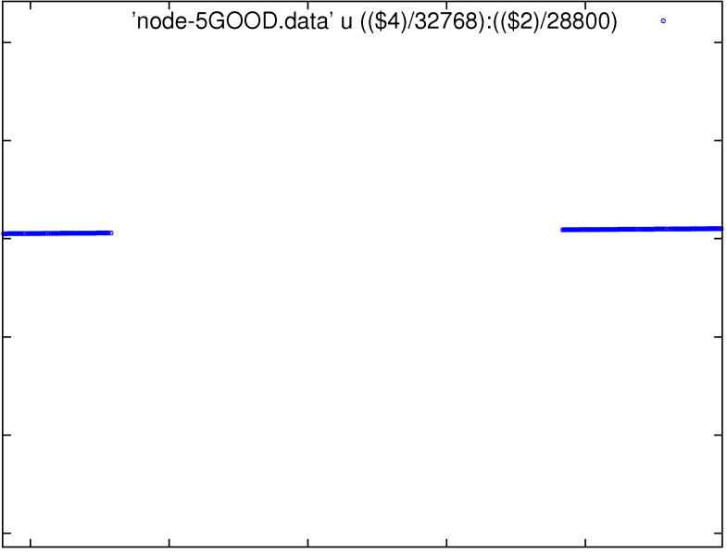
Fidelity: Time Rectification
Unrectified FTSP Global Time
Unrectified FTSP Global Time
100000
90000
Node
Global
Time
80000
70000
60000
50000
29500
29600
29700
29800
29900
Node Local Time

Slide 24
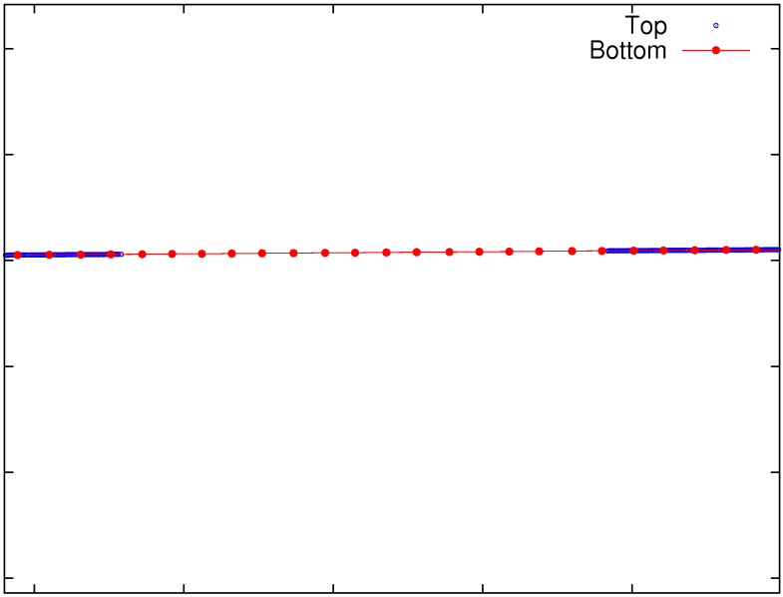
Fidelity: Time Rectification
Unrectified FTSP Global Time
Rectified Global Time
Unrectified FTSP Global Time
Unrectified FTSP Global Time
100000
90000
Node
Global
Time
80000
70000
60000
50000
29500
29600
29700
29800
29900
Node Local Time

Slide 25
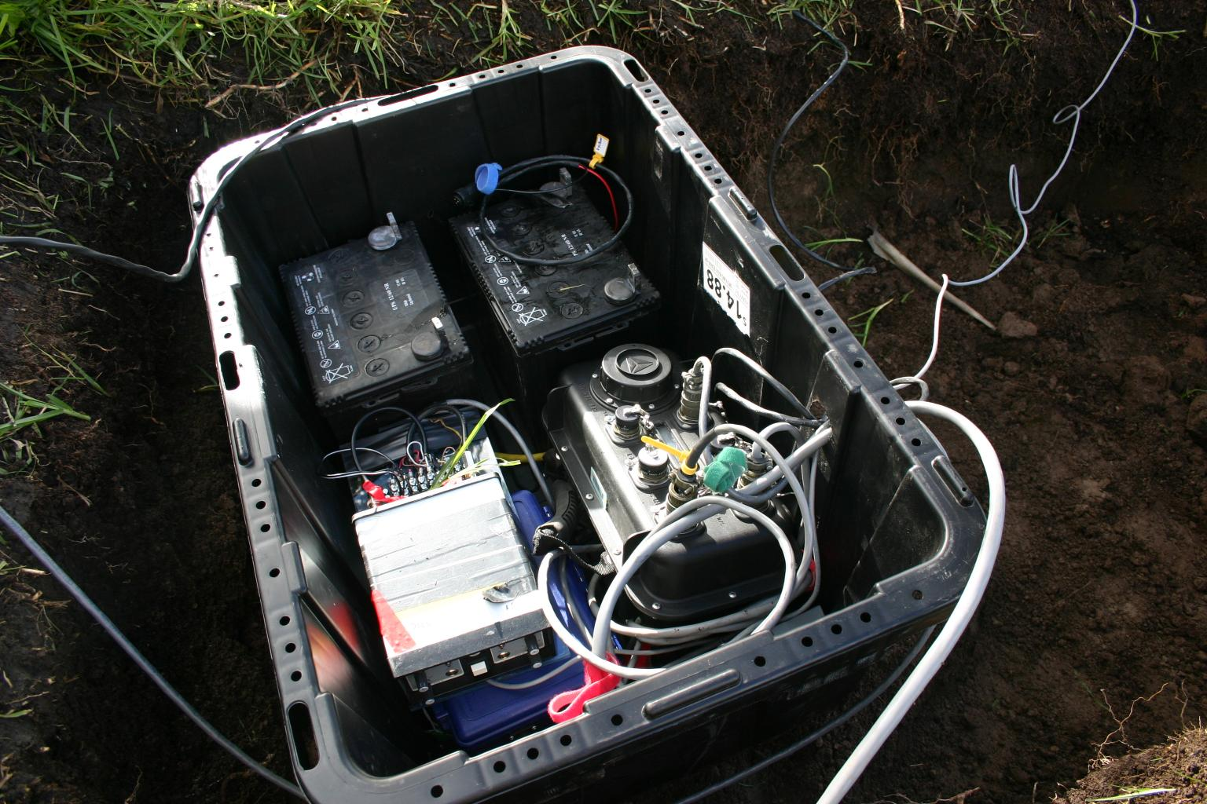
Fidelity: Timing Correctness
Compare data captured by one of our sensor nodes to a nearby standalone seismic station
Data timestamped by FTSP
Data timestamped by Internal GPS
Node 213
(3 hops from FTSP root)
56 meters
Largest expected offset: 47ms
(based on distance between stations)
RVEN
Reventador VENt
standalone seismic station

Slide 26
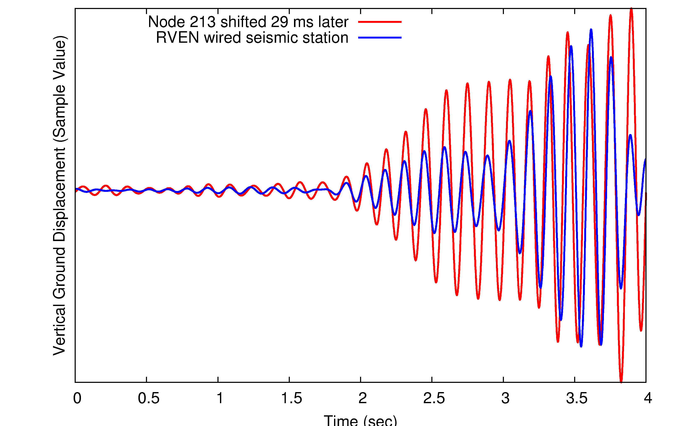
Fidelity: Timing Correctness
Node 213 shifted 29 ms later
RVEN wired station
Ground Displacement
(Sample Value)
29 ms time shift between signals
0
0.5
1
1.5
2
2.5
3.0
3.5
4
2
Time (sec)

Slide 27
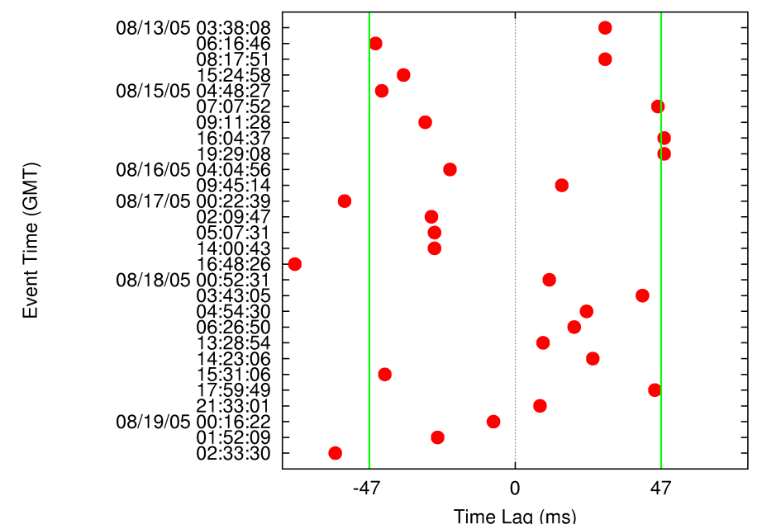
Fidelity: Timing Evaluation
Expected lag times
Event Time
(GMT)
Most events fall within expected range
Time Lag (ms)

Slide 28
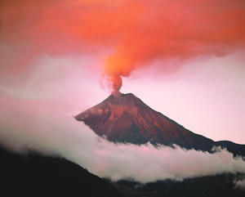

Yield: The Problem
data rate > retrieval rate
4800 b/s > 512 b/s

Slide 29

Yield: The Problem
Aggregate Network
Sampling Rate
Target Lifetime

Slide 30
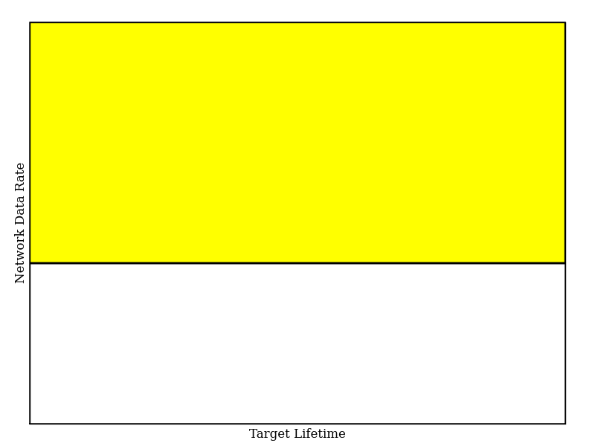
Yield: The Problem
Aggregate Network Sampling Rate =
Reliable Transfer Rate
Aggregate Network
Sampling Rate
Bandwidth
Constrained
Full Signal
Collection
Target Lifetime

Slide 31
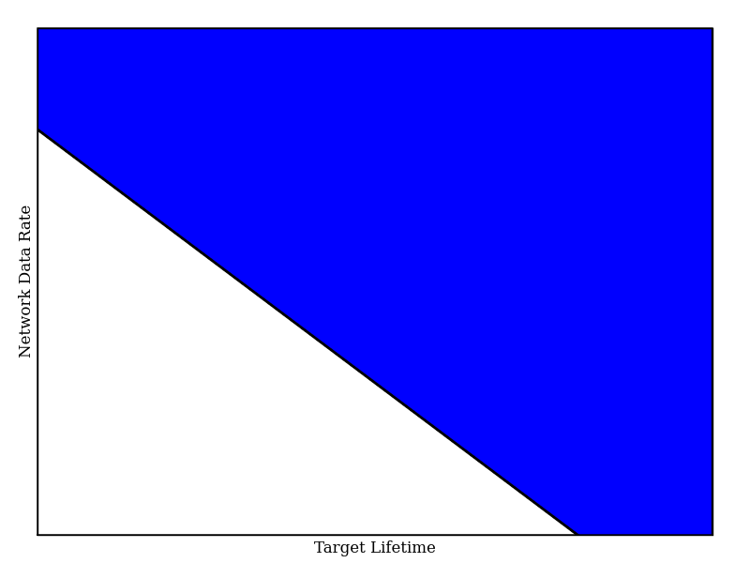
Yield: The Problem
Aggregate Network Sampling Rate *
Lifetime Target * Joules / Byte = Battery Capacity
Aggregate Network
Sampling Rate
Full Signal
Collection
Energy
Constrained
Target Lifetime

Slide 32
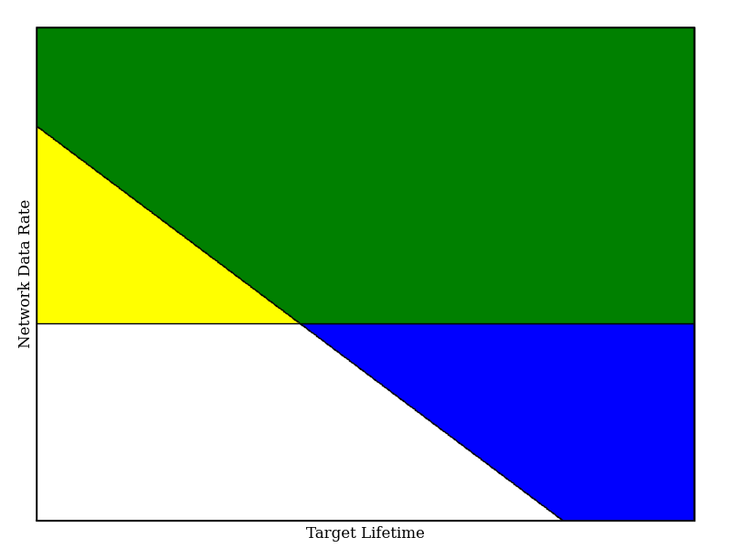
Yield: The Problem
Energy and
Bandwidth
Constrained
Aggregate Network
Sampling Rate
Bandwidth
Constrained
Full Signal
Collection
Energy
Constrained
Target Lifetime

Slide 33
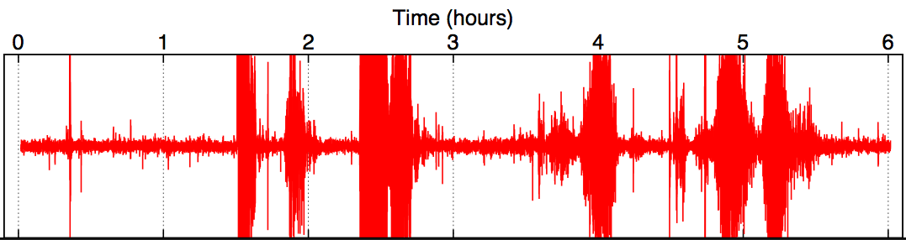
Data Has Value
100Hz Seismometer, Volcan Reventador 2005
Small
Earthquake
Noise
Large
Eruption
Large
Eruptions
Large
Eruption
Large
Eruptions
interesting data

Slide 34
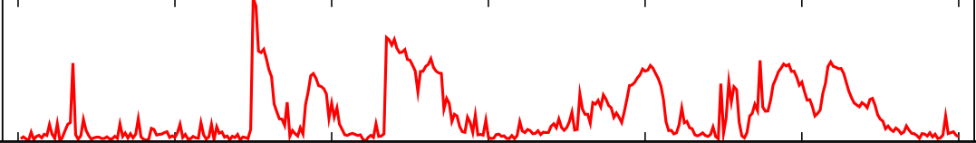
Assigning Value
Summaries should be small (relative to ADU size) and easy to compute
Signal Bandwidth: 18000 B/min
Summary Bandwidth: 4 B/min
Volcano Application Example: RSAM
Raw signal
Reduced
Seismic
Amplitude
Measurement
(RSAM)
Notes:
Used by seismic community, more interesting data, etc.

Slide 35
Data Has Cost
7
6
2
4
5
1
3
B
Bandwidth to Node 1:
1024 Bytes/sec
Bandwidth to Node 7:
512 Bytes/sec
(Bandwidth for reliable data transfer)

Slide 36
Assigning Cost
Empirically measure:
id: energy consumption during downloading
ir: energy consumption during routing
io: energy consumption during overhearing
Multiply by estimated transfer time to get power
7
6
2
4
5
1
3
B

Slide 37
Assigning Cost
Empirically measure:
id: the current draw during downloading
ir: the current draw during routing
io: the current draw during overhearing
Multiply by estimated transfer time to get power
7
7
6
6
2
2
5
4
5
4
1
1
3
3
B
B

Slide 38
Assigning Cost
Empirically measure:
id: the current draw during downloading
ir: the current draw during routing
io: the current draw during overhearing
Multiply by estimated transfer time to get power
7
7
7
c⁷ = (0, 0, ir, io, ir, io, id) * t⁷
6
6
6
2
2
2
5
5
4
5
4
4
1
1
1
3
3
3
B
B
B

Slide 39
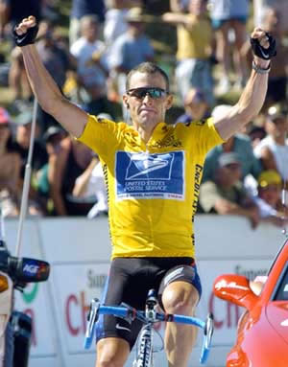
Lance
Given extraction cost and data value:
Maximize total value retrieved, subject to bandwidth and energy constraints

Slide 40
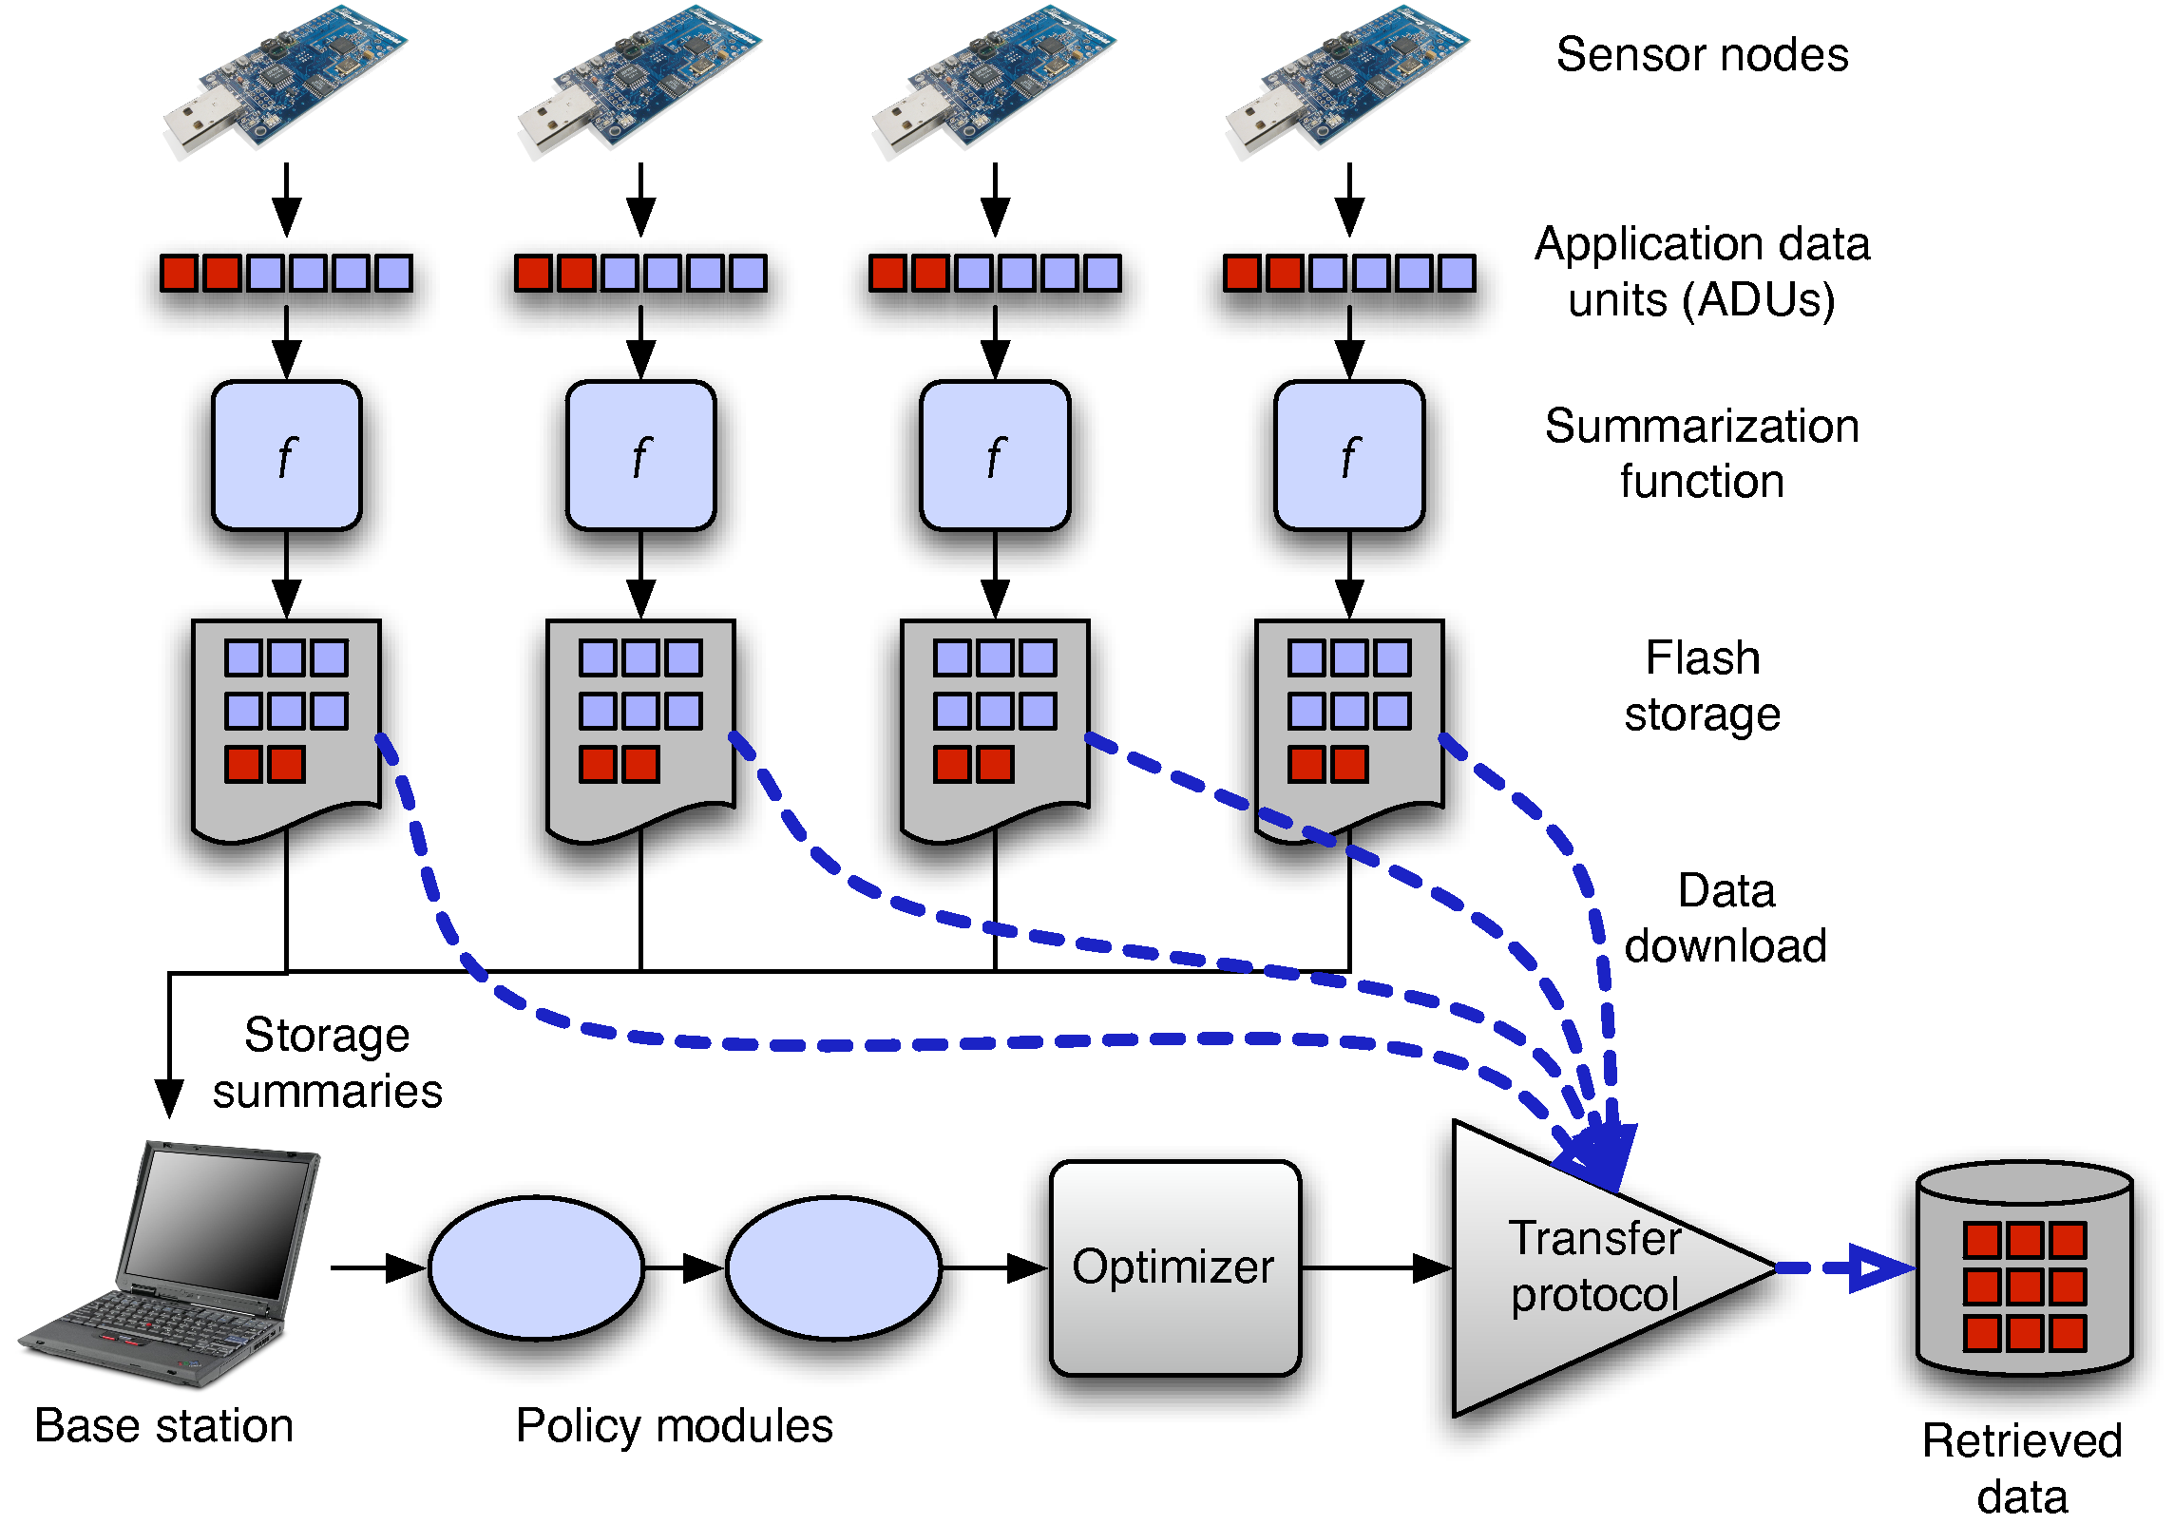
Lance Architecture

Slide 41
Lance Architecture
1) Nodes sample data to ADUs

Slide 42
Lance Architecture
2) Nodes compute summary for each ADU

Slide 43
Lance Architecture
2) Nodes compute summary for each ADU
3) Summaries sent to base station

Slide 44
Lance Architecture
4) ADUs logged to Flash

Slide 45
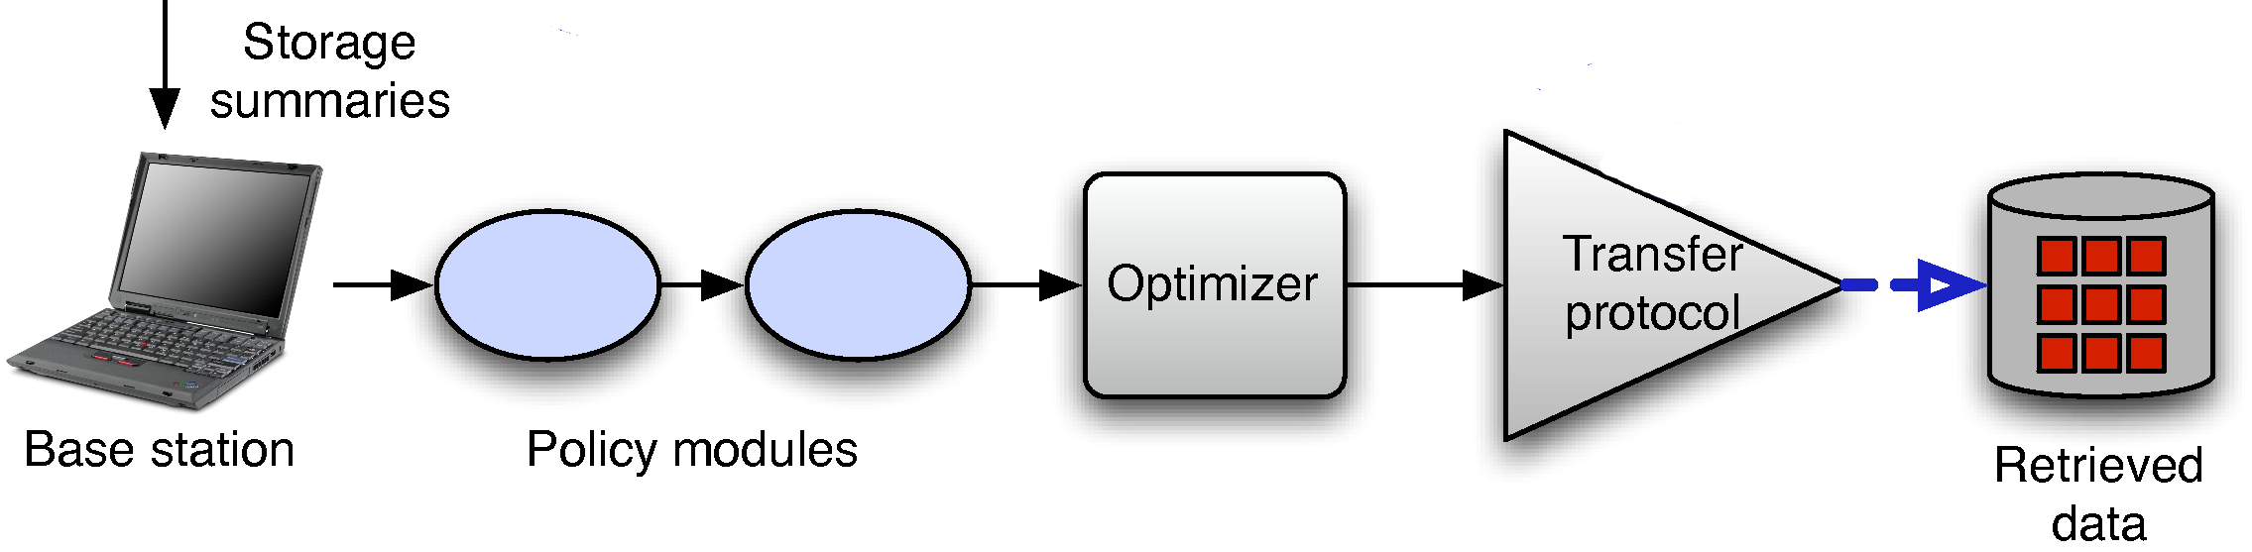
Lance Architecture
On the Base Station
(1)
Assign Value,Cost
1) Initial Value, Cost Computed
2) Value Modified by Policy Modules
3) ADUs Scored by Lance Optimizer
4) Top-Scoring ADU Downloaded
Policy Modules
Optimizer
Download
Notes:
Replace with flowchart

Slide 46
Lance Architecture
On the Base Station
(1)
(2)
Assign Value,Cost
1) Initial Utility, Cost Computed
2) Value Modified by Policy Modules
3) ADUs Scored by Lance Optimizer
4) Top-Scoring ADU Downloaded
Policy Modules
Optimizer
Download

Slide 47
Lance Architecture
On the Base Station
(1)
(2)
(3)
Assign Value,Cost
1) Initial Value, Cost Computed
2) Values Modified by Policy Modules
3) ADUs Scored by Lance Optimizer
4) Top-Scoring ADU Downloaded
Policy Modules
Optimizer
Download

Slide 48
Lance Architecture
On the Base Station
(1)
(2)
(3)
(4)
Assign Value,Cost
1) Initial Value, Cost Computed
2) Values Modified by Policy Modules
3) ADUs Scored by Lance Optimizer
4) Top-Scoring ADU Downloaded
Policy Modules
Optimizer
Download

Slide 49
Cost Vectors
Energy cost expressed as a vector c
ci = energy needed to download ADU on Node i
(Initial cost vector estimated based on download history and knowledge of the transfer protocol)

Slide 50
Optimization Goal
U = all possible ADUs
B = initial node battery state constraint vector
c(u), v(u) are the cost, value of an ADU (or set of ADUs)
The optimal set uo is the set of ADUs maximizing
∑ v(uo) subject to ∑ c(uo) < B

Slide 51
Optimization Goal
U = all possible ADUs
B = initial node battery state constraint vector
c(u), v(u) are the cost, value of an ADU (or set of ADUs)
The optimal set uo is the set of ADUs maximizing
∑ v(uo) subject to ∑ c(uo) < B
Offline Solution: Multidimensional Knapsack Problem
c(u) are weights,
v(u) are values,
Bi's are knapsack capacities
Used to produce optimality bound

Slide 52
Optimization Strategy
Goal: Online Approximation of Offline Optimal
1) Examine all available ADUs
2) Assign each a score via scoring function
3) Download top-scoring ADU if resources available

Slide 53
Scoring Functions
Inputs: ADU with value, cost vector
Output: Score used to rank ADUs
2) Cost Total
1) Value Only
3) Cost Bottleneck
Use the most significant component of the cost to weight the value of the ADU

Slide 54
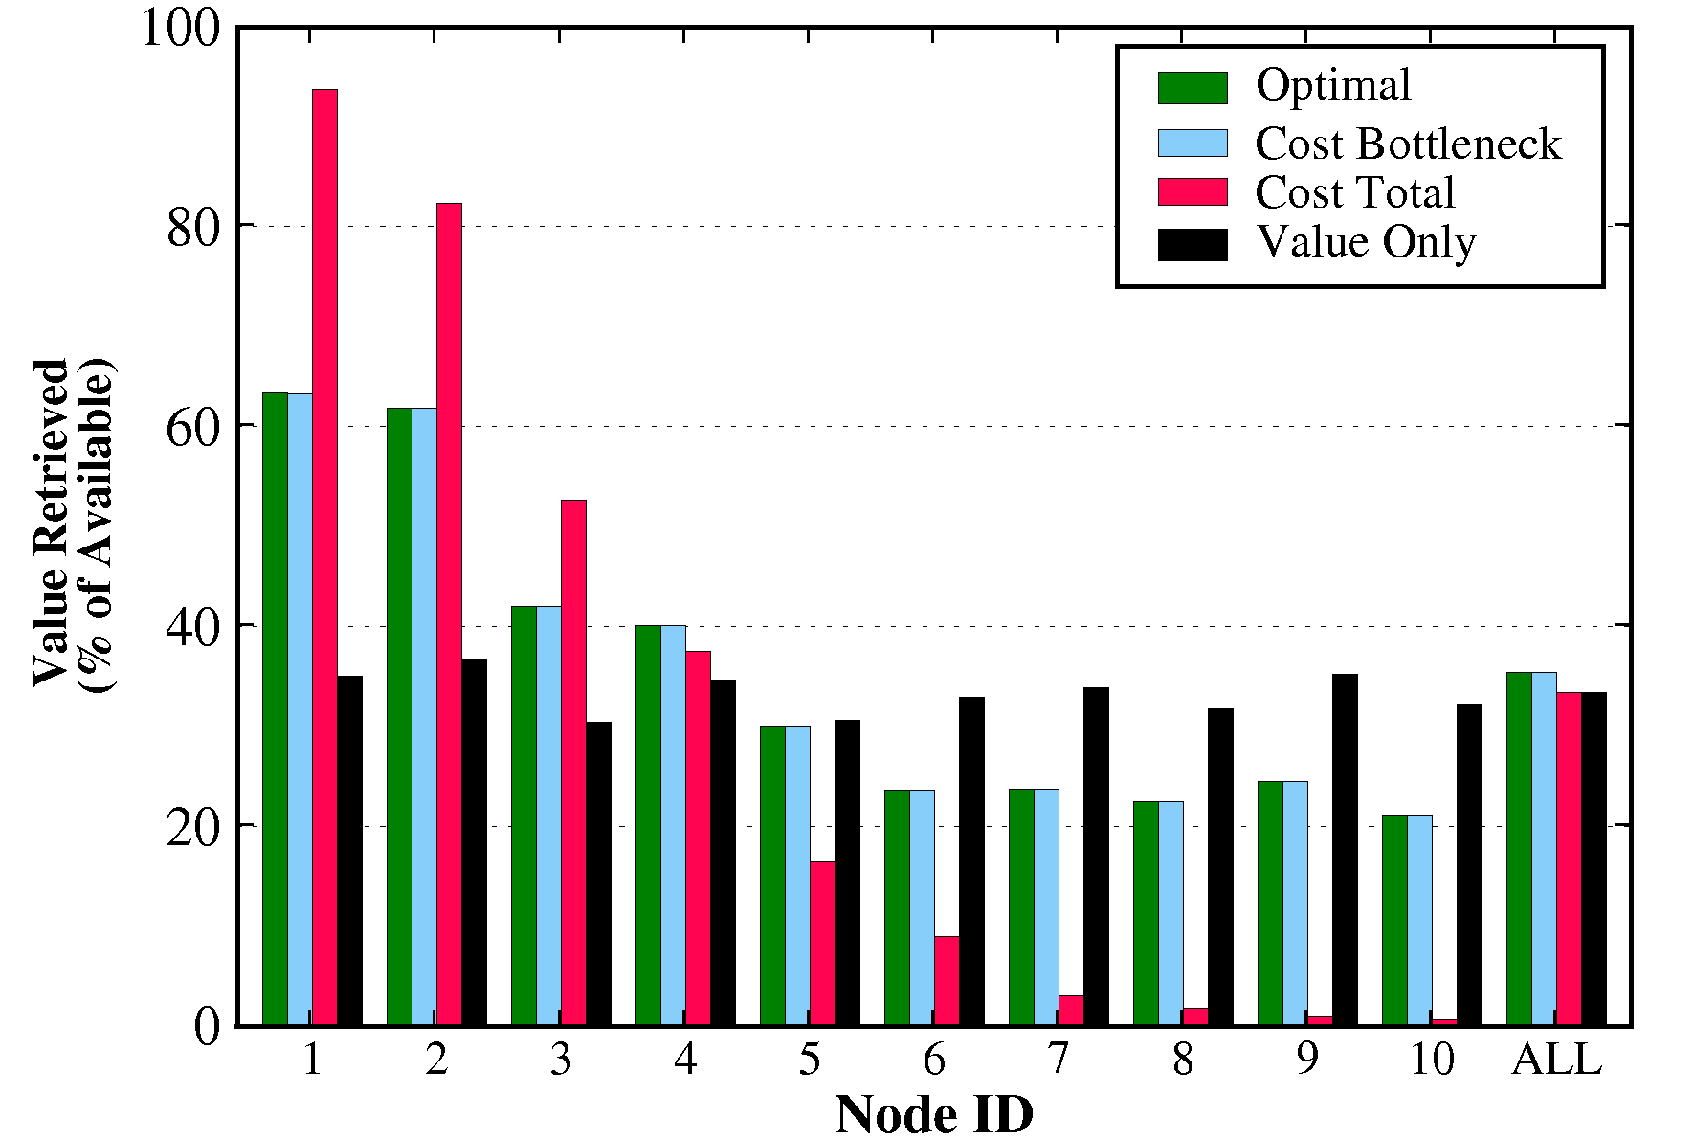
Scoring Functions
Simulation Results:
10-node linear topology
Biased towards nodes near sink
Almost matches
optimal
Same from all nodes

Slide 55
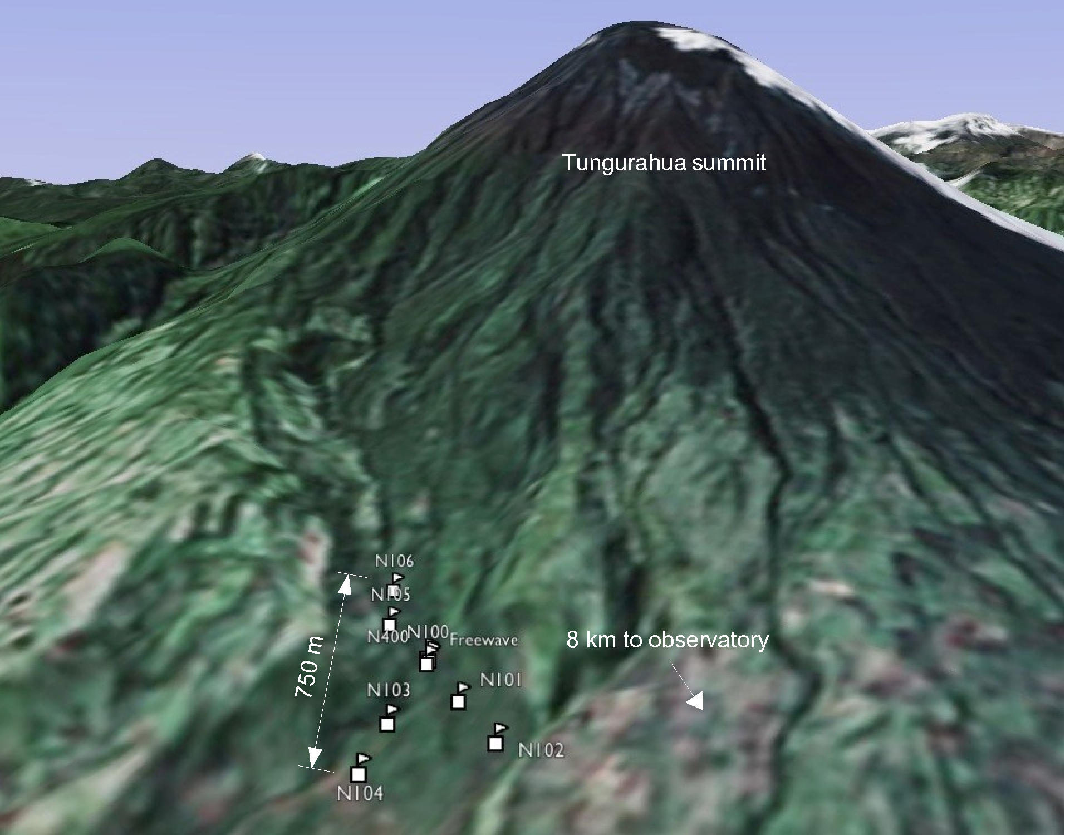
2007 Deployment
1 Week deployment
Volcan Tungarahua
August 2007
8 nodes
Seismic and acoustic sensors

Slide 56
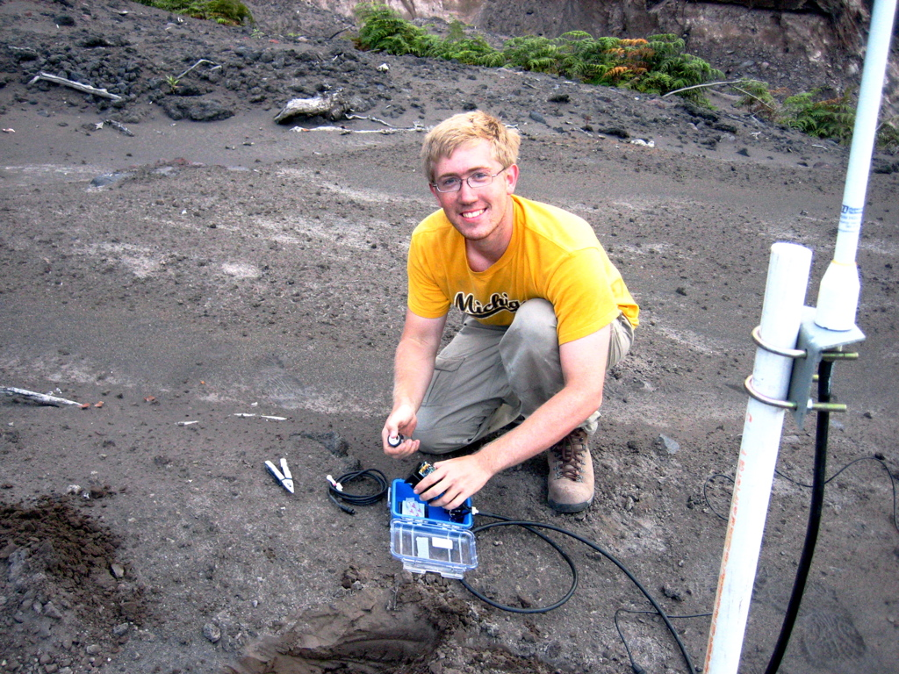
2007 Deployment

Slide 57
Deployment Evaluation
Lance extracted 99.5% of the
offline optimal value

Slide 58

Lance: Mercury

Slide 59
Related Work
EnviroMic [L. Luo 2007]:
  Focuses on storage management and load balancing
  Not yet targetting real-time data download
ICEDB [Y. Zhang 2007]:
  Delay-tolerant priority-driven query processor for CarTel
  Does not consider energy as a constraint
VanGo [B. Greenstein 2006]:
  Architecture for collecting and processing high-resolution sensor data
  Focuses on programming model, but possibly complementary to our approach
MUDS [M. Li 2007]:
  Identifies multiple users as primary challenge
  Similar utility-driven architecture
ADAE [M. Chang]:
  Also employs utility-based controller
  Focuses on retasking network to respond to scientific objectives
Notes:
Add citations

Slide 60

Lessons Learned
Nodes were reliable, infrastructure was not.
Accurate timing is hard.
Ground truth is critical.
Balance centralization and decentralization.
Energy has quantity, location, and impact.

Slide 61
The Value of Deployment
Deploying real systems:
Builds rapport with end users
Helps identify real problems
Provides valuable data for evaluation
Can be slow, expensive, and a lot of fun

Slide 62
Future Work: Hourglass Model
Low-Power Sensor Network

Slide 63




Future Work: Hourglass Model
High-Power Network
Sink/Gateway
Low-Power Sensor Network

Slide 64

Shattering the Hourglass
High-Power Network
Sink/Gateway
Low-Power Sensor Network

Slide 65
Shattering the Hourglass
Cooperative Sensing
Infrastructure

Slide 66
Shattered Network Architecture
multi-hop
last hop

Slide 67
Shattered Low-Power Hardware
802.15.4
protocols enabling interoperation

Slide 68
Shattered Programming Model
the application is the network
shared infrastructure

Slide 69
Acknowledgments
Ph.D. Adviser: Matt Welsh
CS Collaborators:
Steve Dawson-Haggerty, Konrad Lorincz, Pat Swieskowski, Jason Waterman
Seismology Collaborators:
Jeff Johnson (NMT), Jonathan Lees (UNC), Mario Ruiz (IGEPN), Omar Marcillo (IGEPN)

Slide 70


Macroscopic Thoughts

Slide 71

Questions?
challen@eecs.harvard.edu
http://www.eecs.harvard.edu/~challen/

Slide 72
Backup Slides Follow
challen@eecs.harvard.edu
http://www.eecs.harvard.edu/~challen/

Slide 73

Network Robustness
16
Number of Active Nodes
12
8
4
0
1
2
3
4
5
6
7
8
9
10
11
12
13
14
15
16
17
18
4
19
20
Date (August 2005)

Slide 74
Network Robustness
Entire network operational
16
Number of Active Nodes
12
8
4
0
1
2
3
4
5
6
7
8
9
10
11
12
13
14
15
16
17
18
4
19
20
Date (August 2005)

Slide 75
Network Robustness
Entire network operational
16
Number of Active Nodes
12
8
4
Deluge software failure
0
1
2
3
4
5
6
7
8
9
10
11
12
13
14
15
16
17
18
4
19
20
Date (August 2005)

Slide 76
Network Robustness
Entire network operational
16
Number of Active Nodes
12
Manual reprogram
8
4
Deluge software failure
0
1
2
3
4
5
6
7
8
9
10
11
12
13
14
15
16
17
18
4
19
20
Date (August 2005)

Slide 77
Network Robustness
Entire network operational
16
Number of Active Nodes
12
Manual reprogram
8
4
Deluge software failure
Base station power failures
0
1
2
3
4
5
6
7
8
9
10
11
12
13
14
15
16
17
18
4
19
20
Date (August 2005)

Slide 78
Network Robustness
Entire network operational
Node 204
goes offline...?
16
Number of Active Nodes
12
Manual reprogram
8
4
Deluge software failure
Base station power failures
0
1
2
3
4
5
6
7
8
9
10
11
12
13
14
15
16
17
18
4
19
20
Date (August 2005)

Slide 79

Another First
Node 204
Antenna mast
(truncated)
Mote
(OK)
Broken antenna mount
Notes:
I like to spring this slide on folks at the end of the previous slide, surprise them a bit with what happened to this node. Do this quickly though and simply say that the volcano ejected a “bomb” that clearly sheared off the top of the antenna mast ... although the mote itself was fine. Do mention that this was the node highest up on the volcano, closest to the vent.

Slide 80

Optimality Results
Simulation Results:
25-node tree topology
Above 95% in all cases
Notes:
Callouts here

Slide 81

Optimality Results
Simulation Results:
25-node tree topology
Above 96 in all cases
Notes:
Callouts

Slide 82

Testbed Experiments
http://motelab.eecs.harvard.edu

Slide 83

Testbed Experiments
Testbed Results:
50-node tree topology
Matches
optimal behavior
Per Node

Slide 84
Lance Scoring Functions
Inputs: ADU with value, cost vector
Output: Score used to rank ADUs
ADU1: [v=10, c = (10, 0, 0)]
3
ADU2: [v=20, c = (15, 15, 0)]
ADU3: [v=40, c = (100, 100, 100)]
v=40
2
v=20
1
v=10
B

Slide 85
Lance Scoring Functions
Inputs: ADU with value, cost vector
Output: Score used to rank ADUs
1) Value Only
ADU1: [v=10, c = (10, 0, 0)]
ADU2: [v=20, c = (15, 15, 0)]
ADU3: [v=40, c = (100, 100, 100)]

Slide 86
Lance Scoring Functions
Inputs: ADU with value, cost vector
Output: Score used to rank ADUs
1) Value Only
ADU1: [v=10, c = (10, 0, 0), s=10]
ADU2: [v=20, c = (15, 15, 0), s=20]
ADU3: [v=40, c = (100, 100, 100), s=40]

Slide 87
Lance Scoring Functions
Inputs: ADU with value, cost vector
Output: Score used to rank ADUs
1) Value Only
ADU3: [v=40, c = (100, 100, 100)]
2) Cost Total
ADU1: [v=10, c = (10, 0, 0)]
ADU2: [v=20, c = (15, 15, 0)]
ADU3: [v=40, c = (100, 100, 100)]

Slide 88
Lance Scoring Functions
Inputs: ADU with value, cost vector
Output: Score used to rank ADUs
1) Value Only
ADU3: [v=40, c = (100, 100, 100)]
2) Cost Total
ADU1: [v=10, c = (10, 0, 0), s=1]
ADU2: [v=20, c = (15, 15, 0), s=0.66]
ADU3: [v=40, c = (100, 100, 100), s=0.13]

Slide 89
Lance Scoring Functions
Inputs: ADU with value, cost vector
Output: Score used to rank ADUs
Use the most significant component of the cost to weight the value of the ADU
3) Cost Bottleneck
ADU1: [v=10, c = (10, 0, 0)]
ADU2: [v=20, c = (15, 15, 0)]
ADU3: [v=40, c = (100, 100, 100)]

Slide 90
Lance Scoring Functions
Inputs: ADU with value, cost vector
Output: Score used to rank ADUs
Use the most significant component of the cost to weight the value of the ADU
3) Cost Bottleneck
ADU1: [v=10, c = (10, 0, 0)]
ADU2: [v=20, c = (15, 15, 0)]
ADU3: [v=40, c = (100, 100, 100)]
B = (30, 60, 200)

Slide 91
Lance Scoring Functions
Inputs: ADU with value, cost vector
Output: Score used to rank ADUs
Use the most significant component of the cost to weight the value of the ADU
3) Cost Bottleneck
ADU1: [v=10, c = (10, 0, 0)]
ADU2: [v=20, c = (15, 15, 0)]
ADU3: [v=40, c = (100, 100, 100)]
B = (30, 60, 200)

Slide 92
Lance Scoring Functions
Inputs: ADU with value, cost vector
Output: Score used to rank ADUs
Use the most significant component of the cost to weight the value of the ADU
3) Cost Bottleneck
ADU1: [v=10, c = (10, 0, 0), s=1]
ADU2: [v=20, c = (15, 15, 0), s=1.3]
ADU3: [v=40, c = (100, 100, 100), s=0.4]
B = (30, 60, 200)
Notes:
Add english description on slide

Slide 93
Lance Scoring Functions
Inputs: ADU with value, cost vector
Output: Score used to rank ADUs
Use the most significant component of the cost to weight the value of the ADU
3) Cost Bottleneck
ADU1: [v=10, c = (10, 0, 0), s=1]
ADU2: [v=20, c = (15, 15, 0), s=1.3]
ADU3: [v=40, c = (100, 100, 100), s=0.4]
Notes:
Add english description on slide

Slide 94
Policy Modules
User-supplied functions that can
inspect, modify, or filter
ADU values at the base station

Slide 95
Policy Modules
User-supplied functions that can
inspect, modify, or filter
ADU values at the base station
Examples: 1) Thresholding
t3,v3=9
t3,v3=9
t2,v2=12
If vt < 10 set vt = 0
t2,v2=12
(Output)
t1,v1=4
t1,v1=4
t1,v1=0
t2,v2=12
t3,v3=0
(Input)
(Lance will not download an
ADU with value = 0)

Slide 96
Policy Modules
User-supplied functions that can
inspect, modify, or filter
ADU values at the base station
Examples: 2) Timespread
t3,v3=9
t3,v3=9
t2,v2=12
If vt > 10
set vt-1,vt+1= vt
t2,v2=12
(Output)
t1,v1=4
t1,v1=4
t2,v2=12
t3,v3=12
t1,v1=12
(Input)

Slide 97
Policy Modules
User-supplied functions that can
inspect, modify, or filter
ADU values at the base station
Examples: 3) Correlation
If > 2
set =
(Input)
(Output)
Notes:
Show volcano talk, use animations in volcano talk
Ramp up priority of all signals
Maybe only want nodes around signal
Temporal or spatial

Slide 98
Policy Modules
Can be assembled into linear chain to implement more
complicated actions
Run at base station, so easy to swap in, swap out
Reusable between applications
Thresholding
Correlation
Timespread
Simple event detector from Reventador system implemented with policy modules

Slide 99
Questions to Drive Future Work
How do you program a 10,000 node sensor network?

Slide 100
Questions to Drive Future Work
How do you program a 10,000 node sensor network?
How do scientists program a 10,000 node sensor network?

Slide 101
Questions to Drive Future Work
What happens when deployed sensor nodes last forever?

Slide 102
Questions to Drive Future Work
What happens when deployed sensor nodes last forever?
Will we ever want them back?

Slide 103
Questions to Drive Future Work
How do we use the largest macroscope on earth?

Slide 104
Questions to Drive Future Work
How do we use the largest macroscope on earth?
(That would be the global cell phone network!)

Slide 105
Fidelity and Yield in a
Volcano Monitoring Sensor Network
Geoffrey Werner-Allen, Konrad Lorincz, and Matt Welsh
Harvard University
Jeff Johnson
University of New Hampshire
Jonathan Lees
University of North Carolina
Notes:
My notes here are meant as suggestions for wording, and also how much time/detail you need to get into on each slide.
You need to say all of our names here and thank the session chair: Derek McAuley
“Thank you for the introduction.
This is joint work with Konrad Lorincz, another graduate student at Harvard, and my advisor, Matt Welsh.
We are also working with Jeff Johnson and Jonathan Lees, who are seismologists at UNH and UNC.”

Slide 106
One-Slide Summary
We deployed a wireless sensor network at Reventador, an active volcano in Ecuador
  16 nodes monitoring seismic and acoustic signals over 19 days (August, 2005)
  Collected data for hundreds of eruptions, earthquakes, and tremor events
Very stringent domain science requirements:
  High data rates (100 Hz per channel, 2-4 channels per node)
  Reliable data collection over multihop wireless topology
  Accurate timestamping requiring 10ms accuracy
We evaluate our sensor network as a scientific instrument
  Robustness
  Event-detection accuracy
  Data yield
  Data fidelity
Notes:
Here is an overview of this talk...

Slide 107
Sensors for Volcanic Monitoring
Microphones:
Measure infrasonic (low-frequency acoustic)
waves produced by eruptions
Seismometers:
Measure ground motion due to
earthquakes, eruptions, tremor
Notes:
Do this quickly: mainly introduce seismometers and microphones.
“Two kinds of instruments are commonly used to monitor volcanoes: seismometers and microphones....”

Slide 108

Conventional Volcano Sensor Station
Cables to microphones
2 Car batteries
~1m
Data Logger
Mic amplifier
Power distribution
Cable to seismometer
Notes:
“Here is a an example sensor station used in volcano studies....”
Main point:
Large and heavy
No networking: only logs data locally
Therefore, hard to deploy many.
No real-time data.

Slide 109

Our Volcano Sensor Mote
Custom ADC board
Microphone cable
Tmote Sky
Seismometer cable
D cell batteries
Antenna cable
~20cm
Notes:
“This is a picture of our wireless sensor node, based on a mote running TinyOS. It has a low-power processor and radio, a custom sensor interface board, and connectors for a seismometer, microphone, and radio antenna.
It is powered by D-cell batteries which run for about 10 days.”

Slide 110
Benefits of wireless sensor networks
Ease of deployment
  Can rapidly install sensors in remote and hazardous areas
  Often no road access: must carry equipment in by hand
  Reventador required a multi-hour hike through dense jungle to reach
Increased spatial resolution:
  Can deploy many more sensors than conventional monitoring stations
  More vantage points on volcano's activity can enhance scientific understanding
  e.g., Studying propagation of seismic waves through volcanic edifice,
  localizing earthquake sources, tomography
Real-time data acquisition
  Hazard monitoring requires real-time data
  Also useful for calibrating sensor location, gain, and other parameters

Slide 111
Science Requirements and CS Challenges
High data rate sampling
  Seismometers and microphones typically sampled at 100 Hz, 24 bits per channel
  Total data rate exceeds radio bandwidth!
Notes:
This slide serves two purposes:
1) Point out the CS challenges
2) Give an overview of our approach to addressing those challenges
Practice talking over this slide several times. You can tie each contept into the next by telling the story of how the network worked, and why we designed it the way we did, by explaining the related CS challenge.
Why not use 802.11? Start up cost, etc. Look up power-bit. No duty cycling. Only a day or two of lifetime.
Find sweet spot between high power consumption, heavy, low spatial resolution and low power consumption, light, easy to deploy, high spatial resolution.
Point out that bandwidth exceeds capacity.
“Designing sensor networks for volcano monitoring raises some unique challenges. First, the data rates involved are relatively high, since each channel is sampled at 100 Hz. As a result it is impossible to transmit all of the data collected by the network. Instead, we automatically detect seismic events of interest, such as earthquakes, and transfer 60 sec. of data to the base station following each event. This requires an event detection algorithm, which we describe in the paper. Following an event, we need to reliably download the signal, for which we designed a reliable data transfer protocol, called Fetch. Finally, it is essential that signals are accurately timestamped to facilitate further analysis. In our case, a timing accuracy of at least 10 ms is required. We use the Vanderbilt FTSP time sync protocol for this purpose, although as I will explain later, we ran into some problems with this protocol in the field.”

Slide 112
Science Requirements and CS Challenges
High data rate sampling
  Seismometers and microphones typically sampled at 100 Hz, 24 bits per channel
  Total data rate exceeds radio bandwidth!
Automatic seismic event detection
  Detect signals of interest – earthquakes, eruptions, etc.
  Our detector uses a ratio of two EWMA filters (described in paper)
Notes:
This slide serves two purposes:
1) Point out the CS challenges
2) Give an overview of our approach to addressing those challenges
Practice talking over this slide several times. You can tie each contept into the next by telling the story of how the network worked, and why we designed it the way we did, by explaining the related CS challenge.
Why not use 802.11? Start up cost, etc. Look up power-bit. No duty cycling. Only a day or two of lifetime.
Find sweet spot between high power consumption, heavy, low spatial resolution and low power consumption, light, easy to deploy, high spatial resolution.
Point out that bandwidth exceeds capacity.
“Designing sensor networks for volcano monitoring raises some unique challenges. First, the data rates involved are relatively high, since each channel is sampled at 100 Hz. As a result it is impossible to transmit all of the data collected by the network. Instead, we automatically detect seismic events of interest, such as earthquakes, and transfer 60 sec. of data to the base station following each event. This requires an event detection algorithm, which we describe in the paper. Following an event, we need to reliably download the signal, for which we designed a reliable data transfer protocol, called Fetch. Finally, it is essential that signals are accurately timestamped to facilitate further analysis. In our case, a timing accuracy of at least 10 ms is required. We use the Vanderbilt FTSP time sync protocol for this purpose, although as I will explain later, we ran into some problems with this protocol in the field.”

Slide 113
Science Requirements and CS Challenges
High data rate sampling
  Seismometers and microphones typically sampled at 100 Hz, 24 bits per channel
  Total data rate exceeds radio bandwidth!
Automatic seismic event detection
  Detect signals of interest – earthquakes, eruptions, etc.
  Our detector uses a ratio of two EWMA filters (described in paper)
Reliable data collection
  Download 60 sec. of data from each node following a detected event
  We developed a reliable multihop data transfer protocol, called Fetch
Notes:
This slide serves two purposes:
1) Point out the CS challenges
2) Give an overview of our approach to addressing those challenges
Practice talking over this slide several times. You can tie each contept into the next by telling the story of how the network worked, and why we designed it the way we did, by explaining the related CS challenge.
Why not use 802.11? Start up cost, etc. Look up power-bit. No duty cycling. Only a day or two of lifetime.
Find sweet spot between high power consumption, heavy, low spatial resolution and low power consumption, light, easy to deploy, high spatial resolution.
Point out that bandwidth exceeds capacity.
“Designing sensor networks for volcano monitoring raises some unique challenges. First, the data rates involved are relatively high, since each channel is sampled at 100 Hz. As a result it is impossible to transmit all of the data collected by the network. Instead, we automatically detect seismic events of interest, such as earthquakes, and transfer 60 sec. of data to the base station following each event. This requires an event detection algorithm, which we describe in the paper. Following an event, we need to reliably download the signal, for which we designed a reliable data transfer protocol, called Fetch. Finally, it is essential that signals are accurately timestamped to facilitate further analysis. In our case, a timing accuracy of at least 10 ms is required. We use the Vanderbilt FTSP time sync protocol for this purpose, although as I will explain later, we ran into some problems with this protocol in the field.”

Slide 114
Science Requirements and CS Challenges
High data rate sampling
  Seismometers and microphones typically sampled at 100 Hz, 24 bits per channel
  Total data rate exceeds radio bandwidth!
Automatic seismic event detection
  Detect signals of interest – earthquakes, eruptions, etc.
  Our detector uses a ratio of two EWMA filters (described in paper)
Reliable data collection
  Download 60 sec. of data from each node following a detected event
  We developed a reliable multihop data transfer protocol, called Fetch
Fine grained time synchronization
  Must correlate signals across the network (e.g., for computing wave arrival times)
  Requires accuracy of one sample time (10 ms)
  We use Vanderbilt FTSP¹ protocol and single GPS receiver
1. Maroti et. al, Sensys'06
Notes:
This slide serves two purposes:
1) Point out the CS challenges
2) Give an overview of our approach to addressing those challenges
Practice talking over this slide several times. You can tie each contept into the next by telling the story of how the network worked, and why we designed it the way we did, by explaining the related CS challenge.
Why not use 802.11? Start up cost, etc. Look up power-bit. No duty cycling. Only a day or two of lifetime.
Find sweet spot between high power consumption, heavy, low spatial resolution and low power consumption, light, easy to deploy, high spatial resolution.
Point out that bandwidth exceeds capacity.
“Designing sensor networks for volcano monitoring raises some unique challenges. First, the data rates involved are relatively high, since each channel is sampled at 100 Hz. As a result it is impossible to transmit all of the data collected by the network. Instead, we automatically detect seismic events of interest, such as earthquakes, and transfer 60 sec. of data to the base station following each event. This requires an event detection algorithm, which we describe in the paper. Following an event, we need to reliably download the signal, for which we designed a reliable data transfer protocol, called Fetch. Finally, it is essential that signals are accurately timestamped to facilitate further analysis. In our case, a timing accuracy of at least 10 ms is required. We use the Vanderbilt FTSP time sync protocol for this purpose, although as I will explain later, we ran into some problems with this protocol in the field.”

Slide 115
Our contributions
Validation of sensor network as a scientific instrument
Robustness
  How available was the system during the deployment?
Event detection accuracy
  How effective was our event detector in identifying interesting volcanic events?
Data transfer performance
  How quickly and reliably did we extract data from the network?
Timing accuracy
  How accurate were the timestamps assigned to each sample?
Data fidelity
  Was our data consistent with ground truth?
  Was the data produced by the network internally consistent?
Notes:
“The main contributions of this work is a detailed analysis of the sensor network as a scientific instrument. We looked at the following metrics in the paper:...”

Slide 116
Focus of this talk
Validation of sensor network as a scientific instrument
Robustness
  How available was the system during the deployment?
Event detection accuracy
  How effective was our event detector in identifying interesting volcanic events?
Data transfer performance
  How quickly and reliably did we extract data from the network?
Timing accuracy
  How accurate were the timestamps assigned to each sample?
Data fidelity
  Was our data consistent with ground truth?
  Was the data produced by the network internally consistent?
Notes:
“The main contributions of this work is a detailed analysis of the sensor network as a scientific instrument. We looked at the following metrics in the paper:...”
The others are discussed in the paper

Slide 117

System Design
GPS receiver
for time sync
FreeWave
radio modem
Long-distance
radio link (4km)
Base station
at observatory
Notes:
“Here is an overview of our network architecture. We deployed 16 sensor nodes on the volcano, each of which has a seismometer and microphone. A single GPS receiver was used for time synchronization, which will be described later. Nodes form a multihop network and relay data, via radio, to a base station located at the volcano observatory. Radio modems were used to establish a long-distance radio link to the observatory. On the left you can see an example of a seismic signal collected at the volcano.”
Nodes very far from the observatory, need for Freewave.

Slide 118
System Design
1) Earthquake or eruption occurs
2) Nodes detect seismic event
3) Each node sends event report
to base station
GPS receiver
for time sync
FreeWave
radio modem
Base station
at observatory
Notes:
“Here is an overview of our network architecture. We deployed 16 sensor nodes on the volcano, each of which has a seismometer and microphone. A single GPS receiver was used for time synchronization, which will be described later. Nodes form a multihop network and relay data, via radio, to a base station located at the volcano observatory. Radio modems were used to establish a long-distance radio link to the observatory. On the left you can see an example of a seismic signal collected at the volcano.”

Slide 119
System Design
4) Download 60 sec of data from
each node in turn
GPS receiver
for time sync
FreeWave
radio modem
Base station
at observatory
Notes:
“Here is an overview of our network architecture. We deployed 16 sensor nodes on the volcano, each of which has a seismometer and microphone. A single GPS receiver was used for time synchronization, which will be described later. Nodes form a multihop network and relay data, via radio, to a base station located at the volcano observatory. Radio modems were used to establish a long-distance radio link to the observatory. On the left you can see an example of a seismic signal collected at the volcano.”

Slide 120
System Design
4) Download 60 sec of data from
each node in turn
GPS receiver
for time sync
FreeWave
radio modem
Base station
at observatory
Notes:
“Here is an overview of our network architecture. We deployed 16 sensor nodes on the volcano, each of which has a seismometer and microphone. A single GPS receiver was used for time synchronization, which will be described later. Nodes form a multihop network and relay data, via radio, to a base station located at the volcano observatory. Radio modems were used to establish a long-distance radio link to the observatory. On the left you can see an example of a seismic signal collected at the volcano.”

Slide 121
System Design
4) Download 60 sec of data from
each node in turn
GPS receiver
for time sync
FreeWave
radio modem
Base station
at observatory
Notes:
“Here is an overview of our network architecture. We deployed 16 sensor nodes on the volcano, each of which has a seismometer and microphone. A single GPS receiver was used for time synchronization, which will be described later. Nodes form a multihop network and relay data, via radio, to a base station located at the volcano observatory. Radio modems were used to establish a long-distance radio link to the observatory. On the left you can see an example of a seismic signal collected at the volcano.”

Slide 122
System Design
4) Download 60 sec of data from
each node in turn
GPS receiver
for time sync
FreeWave
radio modem
Base station
at observatory
Notes:
“Here is an overview of our network architecture. We deployed 16 sensor nodes on the volcano, each of which has a seismometer and microphone. A single GPS receiver was used for time synchronization, which will be described later. Nodes form a multihop network and relay data, via radio, to a base station located at the volcano observatory. Radio modems were used to establish a long-distance radio link to the observatory. On the left you can see an example of a seismic signal collected at the volcano.”

Slide 123

Deployment Site: Reventador Volcano, Ecuador
Notes:
“Our deployment site was Reventador volcano, in Ecuador. This is a very active volcano and during our time there was erupting several times a day, as well as generating a large number of earthquakes and tremor events that we detected with our network.”

Slide 124


Notes:
“Here are some pictures of us deploying the network. On the right we have several nodes set up and ready to install. The volcano was a strenuous three-hour hike from the observatory, and we had to carry all of the equipment in by hand. On the right, Jonathan Lees (one of the seismologists) is setting up a seismometer. I could tell you many interesting stories about the deployment itself, but you'll have to check out the paper for details.”
Don't refer to JL as “collaborator”

Slide 125
Sensor Deployment Map
Sensor network
(spans over 3km)
Observatory
Notes:
Here is a view of the sensor deployment. We ran the sensors roughly in a vertical line away from the vent, and the total extent of the network was over 3km. Nodes were spaced about 200-400 meters apart. The data was transmitted, via a repeater, to a base station at the observatory shown here.
Observatory is quite far from the deployment site, several hours of hiking from the observatory.

Slide 126

Some Representative Events
Volcano-Tectonic Earthquake
204
213
208
206
209
207
Node
ID
200
201
250
203
202
205
212
210
251
214
16:06:00
16:06:30
16:07:00
16:07:30
16:08:00
Time (GMT)
Notes:
“... And this is a much larger event, as you can tell from the amplitude of the signal.
We recorded data on about 230 earthquakes and eruptions during the deployment.” (be sure to say this here)

Slide 127

Some Representative Events
Explosion
204
213
208
206
209
207
Node
ID
200
201
250
203
202
205
212
210
251
214
19:28:30
19:29:00
19:29:30
19:30:00
Time (GMT)
Notes:
“... And this is a much larger event, as you can tell from the amplitude of the signal.
We recorded data on about 230 earthquakes and eruptions during the deployment.” (be sure to say this here)

Slide 128
Focus of this talk
Validation of sensor network as a scientific instrument
Robustness
  How available was the system during the deployment?
Event detection accuracy
  How effective was our event detector in identifying interesting volcanic events?
Data transfer performance
  How quickly and reliably did we extract data from the network?
Timing accuracy
  How accurate were the timestamps assigned to each sample?
Data fidelity
  Was our data consistent with data recorded by wired data loggers?
Notes:
“The main contributions of this work is a detailed analysis of the sensor network as a scientific instrument. We looked at the following metrics in the paper:...”

Slide 129
Network Robustness
16
Number of Active Nodes
12
8
4
0
1
2
3
4
5
6
7
8
9
10
11
12
13
14
15
16
17
18
4
19
20
Date (August 2005)

Slide 130
Network Robustness
Entire network operational
16
Number of Active Nodes
12
8
4
0
1
2
3
4
5
6
7
8
9
10
11
12
13
14
15
16
17
18
4
19
20
Date (August 2005)

Slide 131
Network Robustness
Entire network operational
16
Number of Active Nodes
12
8
4
Deluge software failure
0
1
2
3
4
5
6
7
8
9
10
11
12
13
14
15
16
17
18
4
19
20
Date (August 2005)

Slide 132
Network Robustness
Entire network operational
16
Number of Active Nodes
12
Manual reprogram
8
4
Deluge software failure
0
1
2
3
4
5
6
7
8
9
10
11
12
13
14
15
16
17
18
4
19
20
Date (August 2005)

Slide 133
Network Robustness
Entire network operational
16
Number of Active Nodes
12
Manual reprogram
8
4
Deluge software failure
Base station power failures
0
1
2
3
4
5
6
7
8
9
10
11
12
13
14
15
16
17
18
4
19
20
Date (August 2005)

Slide 134
Network Robustness
Entire network operational
Node 204
goes offline...?
16
Number of Active Nodes
12
Manual reprogram
8
4
Deluge software failure
Base station power failures
0
1
2
3
4
5
6
7
8
9
10
11
12
13
14
15
16
17
18
4
19
20
Date (August 2005)

Slide 135
Node 204
Antenna mast
(truncated)
Mote
(OK)
Broken antenna mount
Notes:
I like to spring this slide on folks at the end of the previous slide, surprise them a bit with what happened to this node. Do this quickly though and simply say that the volcano ejected a “bomb” that clearly sheared off the top of the antenna mast ... although the mote itself was fine. Do mention that this was the node highest up on the volcano, closest to the vent.

Slide 136

Node Uptime
100
90
Node
Uptime
(%)
80
70
60
51%
50
40
30
20
10
0
Node ID
With base and Deluge failures
Notes:
Over the 19-day deployment, then, the overall uptime was not very impressive: below 60% on average.
Actual numbers...

Slide 137

Node Uptime
100
90
Node
Uptime
(%)
80
70
69%
60
50
40
30
20
10
0
Node ID
With base and Deluge failures
Without base failures
Notes:
Over the 19-day deployment, then, the overall uptime was not very impressive: below 60% on average.
Actual numbers...

Slide 138
Node Uptime
100
96%
90
Node
Uptime
(%)
80
70
60
50
40
Overall sensor nodes very reliable!
30
20
10
0
Node ID
With base and Deluge failures
Without base failures
Without base and Deluge failures
Notes:
Over the 19-day deployment, then, the overall uptime was not very impressive: below 60% on average.
Actual numbers...

Slide 139
Focus of this talk
Validation of sensor network as a scientific instrument
Robustness
  How available was the system during the deployment?
Event detection accuracy
  How effective was our event detector in identifying interesting volcanic events?
Data transfer performance
  How quickly and reliably did we extract data from the network?
Timing accuracy
  How accurate were the timestamps assigned to each sample?
Data fidelity
  Was our data consistent with ground truth?
  Was the data produced by the network internally consistent?
Notes:
“The main contributions of this work is a detailed analysis of the sensor network as a scientific instrument. We looked at the following metrics in the paper:...”
The others are discussed in the paper

Slide 140
FTSP: Flooding Time Synchronization Protocol
In FTSP, nodes periodically exchange information on global time
  Each node sends heartbeat messages with MAC-delay corrected global timestamp
  Nodes use this information to calculate local clock skew w.r.t. global clock
Very good pre-deployment test results:
  90th percentile error of 2.1 ms on a 5-hop linear testbed
Notes:
Explain why FTSP broke.

Slide 141
FTSP stability issues
140000
200
201
202
203
204
205
206
207
208
209
210
212
213
214
250
251
GPS
Network
Global
Time
130000
120000
110000
100000
90000
90000
80000
11:00
12:00
13:00
14:00
15:00
16:00
17:00
18:00
Time (GMT)
Notes:
The next major problem we encounted had to do with FTSP, the time sync protocol we used. In the field, we noticed very odd behavior: nodes would sometimes start reporting bogus timestamps. Here is an example of this. On the X axis is the wall clock time, while the Y axis is the global time reported by each node. Prior to this point all of the nodes are synchronized. Suddenly, two nodes jump several hours out of sync, until they were rebooted some time later. This causes the time sync protocol to destablize a bit while the nodes rejoin the rest of the network.
FIX THIS SLIDE

Slide 142
FTSP stability issues
140000
200
201
202
203
204
205
206
207
208
209
210
212
213
214
250
251
GPS
Network
Global
Time
130000
120000
110000
100000
2 nodes global times go bezerk
90000
90000
80000
11:00
12:00
13:00
14:00
15:00
16:00
17:00
18:00
Time (GMT)
Notes:
The next major problem we encounted had to do with FTSP, the time sync protocol we used. In the field, we noticed very odd behavior: nodes would sometimes start reporting bogus timestamps. Here is an example of this. On the X axis is the wall clock time, while the Y axis is the global time reported by each node. Prior to this point all of the nodes are synchronized. Suddenly, two nodes jump several hours out of sync, until they were rebooted some time later. This causes the time sync protocol to destablize a bit while the nodes rejoin the rest of the network.
FIX THIS SLIDE

Slide 143
FTSP stability issues
140000
200
201
202
203
204
205
206
207
208
209
210
212
213
214
250
251
GPS
Network
Global
Time
Broken nodes
rebooted
130000
120000
110000
100000
2 nodes global times go bezerk
90000
90000
80000
11:00
12:00
13:00
14:00
15:00
16:00
17:00
18:00
Time (GMT)
Notes:
The next major problem we encounted had to do with FTSP, the time sync protocol we used. In the field, we noticed very odd behavior: nodes would sometimes start reporting bogus timestamps. Here is an example of this. On the X axis is the wall clock time, while the Y axis is the global time reported by each node. Prior to this point all of the nodes are synchronized. Suddenly, two nodes jump several hours out of sync, until they were rebooted some time later. This causes the time sync protocol to destablize a bit while the nodes rejoin the rest of the network.
FIX THIS SLIDE

Slide 144
FTSP stability issues
In FTSP, nodes periodically exchange information on global time
  Each node sends heartbeat messages with MAC-delay corrected global timestamp
  Nodes use this information to calculate local clock skew w.r.t. global clock
Problem: Nodes can produce corrupted FTSP messages
  Bug in MSP430 clock driver caused nodes to sometimes read wrong time.
  FTSP trusts this information and includes it in local skew/offset calculations
    Also, bad information can propagate throughout the network.
Lesson: FTSP should perform internal consistency checks
  e.g., Avoid radically updating local phase/skew if well-synchronized already
Notes:
Explain why FTSP broke.

Slide 145
Post hoc time rectification technique
Must correct global timestamps in recorded data set
1) Filter out obviously wrong global timestamps
  e.g., Those that differ significantly from global time recorded by FTSP root
  Threshold used: 1 sec.
2) Perform piecewise linear regression on remaining data set
  Produce a mapping from node's local time to “correct” global time
  Linear regression extends for no more than 30 minutes
  Check that clock skew produced by model is sane (within error tolerance of crystal frequency)
3) Apply this mapping to the recorded data for all events
Notes:
Idea is to do this quickly. Whenever I gave the talk I managed to explain the time rectification in just a few sentences: the high-level idea is simple enough although the details are, of course, more involved. You don't need to get into the details here.

Slide 146
Time rectification example
Unrectified FTSP Global Time
100000
90000
Node
Global
Time
80000
70000
60000
50000
29500
29600
29700
29800
29900
Node Local Time
Notes:
“Here is an example of the time rectification at work. As you can see, during this time the node's global time was out of sync. Our technique throws out all of the bogus timestamps and builds a linear regression “bridge” across the gap to recover the timing despite this failure.”

Slide 147
Time rectification example
Unrectified FTSP Global Time
100000
90000
Node
Global
Time
80000
70000
60000
50000
29500
29600
29700
29800
29900
Node Local Time
Notes:
“Here is an example of the time rectification at work. As you can see, during this time the node's global time was out of sync. Our technique throws out all of the bogus timestamps and builds a linear regression “bridge” across the gap to recover the timing despite this failure.”

Slide 148
Time rectification example
Unrectified FTSP Global Time
Rectified Global Time
100000
90000
Node
Global
Time
80000
70000
60000
50000
29500
29600
29700
29800
29900
Node Local Time
Notes:
“Here is an example of the time rectification at work. As you can see, during this time the node's global time was out of sync. Our technique throws out all of the bogus timestamps and builds a linear regression “bridge” across the gap to recover the timing despite this failure.”

Slide 149
How do we know we got the timing right?
Compare data captured by one of our sensor nodes to a nearby standalone seismic station
Data timestamped by FTSP
Data timestamped by Internal GPS
Node 213
(3 hops from FTSP root)
56 meters
Largest expected offset: 47ms
(based on distance between stations)
RVEN
Reventador VENt
standalone seismic station
Notes:
“The essential question is: How did we know we got the timing right?
Fortunately, one of our sensor nodes was located 50 meters from a datalogger used by the seismologists. The datalogger has its own GPS receiver, so its timing is assumed to be perfect. So, we can compare the signals between these two nodes to determine if our timing was accurate.
However, because of the 50 meter distance between the nodes, there will still be some time offset between the two signals. In this case the maximum lag time could be 47 milliseconds, based on the speed of the SLOWEST seismic wave traveling between the two stations.
55 meters (distance between stations)
/ 1500 m/s (speed of slowest seismic wave)
+ 10 ms (acceptable time error)
= 47 ms

Slide 150
Comparison with Reftek wired station
Node 213 shifted 29 ms later
RVEN wired station
Ground Displacement
(Sample Value)
29 ms time shift between signals
0
0.5
1
1.5
2
2.5
3.0
3.5
4
2
Time (sec)
Notes:
“What we did was take signals recorded on our mote and the datalogger and use a cross-correlation to compute the timing offset between the two signals. Here is an example of two signals with a time shift of 29 ms between them. As you can see, the two signals match up very well.”

Slide 151
Time lags across multiple events
Most events fall within expected range
Expected lag times
Event Time
(GMT)
Time Lag (ms)
Notes:
“Looking across multiple events recorded at both stations, we see that the time lag between the two almost always falls within the 47 millisecond envelope. It is worth noting that none of the offsets is extremely large: this is very encouraging and gives us confidence that our time rectification works.”

Slide 152

Data validation: Acoustic wave traversal
Check the speed of acoustic waves propagating across the array
Notes:
(This slide and the next can be skipped if you end up being short on time, ie., if the session chair is giving you a 2 minute warning to wrap up)
“Another way to validate our timing is to look at the speed of acoustic waves as they travel across the sensor array. Assuming an infrasonic wave originates at the volcano's vent, we can calculate its apparent velocity as the wave hits each sensor. Of course, we would expect the wave traverse the array at the speed of sound.”
During an eruption the volcano produces a loud acoustic pulse that originates from the vent.

Slide 153

Data validation: Acoustic wave traversal
Measured acoustic velocity
within expected range:
(331-349 m/s @ 0-30ºC)
8/16/05 09:45:14
Velocity: 331 m/s
R²: 0.9988
6
4
2
0
8/15/05 19:29:08
Velocity: 339 m/s
R²: 0.9998
Arrival
Time
(sec)
6
4
2
0
8/13/05 01:27:46
Velocity: 346 m/s
R²: 0.9995
6
4
2
0
8/12/05 02:15:18
Velocity: 342 m/s
R²: 0.9999
6
4
2
0
1.5
2
2.5
3
3.5
4
Distance from Vent (km)
Notes:
“What we have done here is taken four different acoustic signals generated by the volcano. On the X axis is the distance of each sensor from the vent, and on the Y axis is the arrival time of the acoustic wave at each station. Fitting a line to each data set results in an apparent velocity between 331 and 346 m/s, which is within the range we would expect, since the speed of sound varies with temperature and humidity.
Also note that the R-squared values are very high: over 0.99 in all cases; and there are no visible outliers to the fit.”
Explain what this is!

Slide 154
Summary
Validation of sensor network as a scientific instrument
Robustness
  How available was the system during the deployment?
  Surprisingly, the sensor nodes themselves were far more reliable than the infrastructure
Timing accuracy and data fidelity
  How accurate were the timestamps assigned to each sample?
  After a great deal of work we achieved accuracy within the scientific tolerances in most cases
  Was our data consistent with ground truth and internally consistent?
  Although ground truth was difficult to ascertain, we believe so
Also in the paper
  Event detection accuracy
  Data transfer performance
Notes:
“The main contributions of this work is a detailed analysis of the sensor network as a scientific instrument. We looked at the following metrics in the paper:...”

Slide 155
Lessons Learned
Need for ground truth and validation in the field
  We should have tied one of our sensors into a standalone data logger
  Extensive logging of node metadata was essential to our study
Network infrastructure more brittle than sensor nodes
  Numerous power outages and single Deluge-related software failure
  Sensor nodes themselves seemed to be very reliable (96% uptime)
Need to build confidence with domain scientists
  Tension between bleeding-edge Computer Science and solid domain science work
  Plenty of interest in scientific community for wireless sensors!
Notes:
“To wrap up, we feel that sensor nets are clearly beneficial for scientific instrumentation, although there is a lot of work do make them more robust and to validate the data that they produce in the field....”
End talk on a POSITIVE tone – the last sentence should be something like,
“Despite these challenges, there is a clear demand for wireless sensors in a range of scientific domains, and we have learned a lot working with the seismologists on this project.”
Think about how to talk through this slide...

Slide 156
Thank you!
Source Code, Volcano Data Sets and Hardware Designs:
http://www.eecs.harvard.edu/~mdw/proj/volcano
werner@eecs.harvard.edu
Notes:
“Thank you for sticking it out until the final talk and I'll be happy to take any questions.”

Slide 157

Network Topology
Typical node separation
200-400 m
Over 1 km radio
range achieved!
Gateway

Slide 158

Eruption Detection Algorithm
Each node samples continuously and stores data to flash
  1 Mbyte flash can store ~ 20 minutes of data
Nodes locally detect “interesting” events and report them to the base
  If 5 or more reports in a 10 sec window, initiate a download cycle

Slide 159
Time Synchronization Protocol
Used FTSP time-sync protocol from Vanderbilt
  GPS receiver acts as “root”
  All other nodes attempt to synchronize their
  clock to the root
Each node broadcasts periodic beacon with
global time of transmission
    Must account for MAC delays on sender!
Receivers mark time of beacon reception
Each node computes offset and skew
from its local clock to global timebase
  Each sample tagged with FTSP global time
GPS receiver
Sensor nodes

Slide 160

FTSP Stability
08/12/05 to 08/19/05

Slide 161

Event Triggers Per Node

Slide 162

Event Triggers Over Time

Slide 163

Event Yield

Slide 164

Event Yield Per Node

Slide 165

Fetch Latency for Two Nodes

Slide 166

Fetch Protocol Operation
Base station wants Blocks 0 – 10 from Node 202
1) Request Block 0
202
200
201
Node 202
Block 0
203
SINK

Slide 167
Fetch Protocol Operation
Base station wants Blocks 0 – 10 from Node 202
1) Request Block 0
202
200
201
Node 202
Block 0
203
SINK

Slide 168
Fetch Protocol Operation
Base station wants Blocks 0 – 10 from Node 202
1) Request Block 0
202
200
201
Node 202
Block 0
Node 202
Block 0
Node 202
Block 0
203
SINK

Slide 169
Fetch Protocol Operation
Base station wants Blocks 0 – 10 from Node 202
1) Request Block 0
2) Return Block 0, Segment 0
(Block is fragmented across multiple messages)
202
200
201
Block 0
Segment 0
203
SINK

Slide 170
Fetch Protocol Operation
Base station wants Blocks 0 – 10 from Node 202
1) Request Block 0
2) Return Block 0, Segment 0
(Block is fragmented across multiple messages)
202
200
201
Block 0
Segment 0
203
SINK

Slide 171
Fetch Protocol Operation
Base station wants Blocks 0 – 10 from Node 202
1) Request Block 0
2) Return Block 0, Segment 0
(Block is fragmented across multiple messages)
202
200
201
Block 0
Segment 0
203
SINK

Slide 172
Fetch Protocol Operation
Base station wants Blocks 0 – 10 from Node 202
1) Request Block 0
2) Return Block 0, Segment 1
(Block is fragmented across multiple messages)
3) Repeat for each Segment
202
200
201
Block 0
Segment 1
Block 0
Segment 1
Block 0
Segment 1
203
SINK

Slide 173
Fetch Protocol Operation
Base station wants Blocks 0 – 10 from Node 202
1) Request Block 0
2) Return Block 0, Segment 2
(Block is fragmented across multiple messages)
3) Repeat for each Segment
202
200
201
Block 0
Segment 2
Block 0
Segment 2
Block 0
Segment 2
203
SINK

Slide 174
Fetch Protocol Operation
Base station wants Blocks 0 – 10 from Node 202
1) Request Block 0
2) Return Block 0, Segment 1
(Block is fragmented across multiple messages)
3) Repeat for each Segment
4) Request Block 1
...etc...
202
200
201
Node 202
Block 1
203
SINK

Slide 175

Lance:
Optimizing High-Resolution Signal Collection in Wireless Sensor Networks
Geoffrey Werner Challen and Matt Welsh
Harvard University
Stephen Dawson-Haggerty
UC Berkeley

Slide 176
The Problem
data rate > retrieval rate
4800 b/s > 512 b/s

Slide 177
The Problem
Aggregate Network
Sampling Rate
Target Lifetime

Slide 178
The Problem
Aggregate Network Sampling Rate =
Reliable Transfer Rate
Aggregate Network
Sampling Rate
Bandwidth
Constrained
Full Signal
Collection
Target Lifetime

Slide 179
The Problem
Aggregate Network Sampling Rate *
Lifetime Target * Joules / Byte = Battery Capacity
Aggregate Network
Sampling Rate
Full Signal
Collection
Energy
Constrained
Target Lifetime

Slide 180
The Problem
Energy and
Bandwidth
Constrained
Aggregate Network
Sampling Rate
Bandwidth
Constrained
Full Signal
Collection
Energy
Constrained
Target Lifetime

Slide 181
Observation: Data Differs in Value
100Hz Seismometer, Volcan Reventador 2005
Small
Earthquake
Noise
Large
Eruption
Large
Eruptions
Large
Eruption
Large
Eruptions
interesting data

Slide 182
Observation: Data Differs in Cost
7
6
2
4
5
1
3
B
Bandwidth to Node 1:
1024 Bytes/sec
Bandwidth to Node 7:
512 Bytes/sec
(Bandwidth for reliable data transfer)

Slide 183
Lance Goal
Given extraction cost and data value:
Maximize total value retrieved, subject to bandwidth and energy constraints

Slide 184

Lance Goal
Direct limited system resources at the most interesting data at the expense of everything else

Slide 185
Summary of Results
Lance achieves near optimal allocation of bandwidth and energy across a range of lifetime targets, bandwidths, and data distributions
Lance was used to drive a field deployment at Volcan Tungaruhua in July, 2007, where 8 nodes collected seismic and low-frequency acoustic signals from the active volcano
Lance can easily be adapted to suit the needs of other high-bandwidth applications
Notes:
Improve transition

Slide 186
Lance System Architecture

Slide 187
Lance System Architecture
Assumptions:
High data-rate sampling
Reliable download protocol
Ample Flash storage
No data aggregation
Notes:
100-1000s of Hz

Slide 188
Lance Node Architecture
On Each Node
1) Nodes sample data to ADUs
Application Data Unit:
Chunk of data sampled from single node
Example:
60 seconds of 100Hz seismometer data = 18kB

Slide 189
Lance Node Architecture
On Each Node
2) Nodes compute summary for each ADU

Slide 190
Lance Node Architecture
On Each Node
2) Nodes compute summary for each ADU
3) Summaries sent to base station

Slide 191
Lance Node Architecture
On Each Node
4) ADUs logged to Flash

Slide 192
Lance System Architecture
On the Base Station

Slide 193
Lance Base Station Architecture
On the Base Station
(1)
Assign Value,Cost
1) Initial Value, Cost Computed
2) Value Modified by Policy Modules
3) ADUs Scored by Lance Optimizer
4) Top-Scoring ADU Downloaded
Policy Modules
Optimizer
Download
Notes:
Replace with flowchart

Slide 194
Lance Base Station Architecture
On the Base Station
(1)
(2)
Assign Value,Cost
1) Initial Utility, Cost Computed
2) Value Modified by Policy Modules
3) ADUs Scored by Lance Optimizer
4) Top-Scoring ADU Downloaded
Policy Modules
Optimizer
Download

Slide 195
Lance Base Station Architecture
On the Base Station
(1)
(2)
(3)
Assign Value,Cost
1) Initial Value, Cost Computed
2) Values Modified by Policy Modules
3) ADUs Scored by Lance Optimizer
4) Top-Scoring ADU Downloaded
Policy Modules
Optimizer
Download

Slide 196
Lance Base Station Architecture
On the Base Station
(1)
(2)
(3)
(4)
Assign Value,Cost
1) Initial Value, Cost Computed
2) Values Modified by Policy Modules
3) ADUs Scored by Lance Optimizer
4) Top-Scoring ADU Downloaded
Policy Modules
Optimizer
Download

Slide 197



Value Assignment: Summarization
FLASH
t1
t2
t3
Data sampled into fixed-size application data units (ADUs)

Slide 198
Value Assignment: Summarization
BASE
STATION
t1
FLASH
FLASH
t1,s1
Summarization
Function
ADU summaries computed and sent to base station

Slide 199
ADU Summarization
Summaries should be small (relative to ADU size) and easy to compute
Signal Bandwidth: 18000 B/min
Summary Bandwidth: 4 B/min
Volcano Application Example: RSAM
Raw signal
Reduced
Seismic
Amplitude
Measurement
(RSAM)
Notes:
Used by seismic community, more interesting data, etc.

Slide 200
Policy Modules
User-supplied functions that can
inspect, modify, or filter
ADU values at the base station

Slide 201
Policy Modules
User-supplied functions that can
inspect, modify, or filter
ADU values at the base station
Examples: 1) Thresholding
t3,v3=9
t3,v3=9
t2,v2=12
If vt < 10 set vt = 0
t2,v2=12
(Output)
t1,v1=4
t1,v1=4
t1,v1=0
t2,v2=12
t3,v3=0
(Input)
(Lance will not download an
ADU with value = 0)

Slide 202
Policy Modules
User-supplied functions that can
inspect, modify, or filter
ADU values at the base station
Examples: 2) Timespread
t3,v3=9
t3,v3=9
t2,v2=12
If vt > 10
set vt-1,vt+1= vt
t2,v2=12
(Output)
t1,v1=4
t1,v1=4
t2,v2=12
t3,v3=12
t1,v1=12
(Input)

Slide 203
Policy Modules
User-supplied functions that can
inspect, modify, or filter
ADU values at the base station
Examples: 3) Correlation
If > 2
set =
(Input)
(Output)
Notes:
Show volcano talk, use animations in volcano talk
Ramp up priority of all signals
Maybe only want nodes around signal
Temporal or spatial

Slide 204
Policy Modules
Can be assembled into linear chain to implement more
complicated actions
Run at base station, so easy to swap in, swap out
Reusable between applications
Thresholding
Correlation
Timespread
Simple event detector from Reventador system implemented with policy modules

Slide 205
Cost Vectors
Energy cost expressed as a vector c
ci = energy needed to download ADU on Node i
(Initial cost vector estimated based on download history and knowledge of the transfer protocol)

Slide 206
Estimating Cost
Empirically measure:
id: energy consumption during downloading
ir: energy consumption during routing
io: energy consumption during overhearing
Multiply by estimated transfer time to get power
7
6
2
4
5
1
3
B

Slide 207
Estimating Cost
Empirically measure:
id: the current draw during downloading
ir: the current draw during routing
io: the current draw during overhearing
Multiply by estimated transfer time to get power
7
6
2
4
5
1
3
B

Slide 208
Estimating Cost
Empirically measure:
id: the current draw during downloading
ir: the current draw during routing
io: the current draw during overhearing
Multiply by estimated transfer time to get power
7
c⁷ = (0, 0, ir, io, ir, io, id) * t⁷
6
2
4
5
1
3
B

Slide 209
Optimization Goal
U = all possible ADUs
B = initial node battery state constraint vector
c(u), v(u) are the cost, value of an ADU (or set of ADUs)
The optimal set uo is the set of ADUs maximizing
∑ v(uo) subject to ∑ c(uo) < B

Slide 210
Optimization Goal
U = all possible ADUs
B = initial node battery state constraint vector
c(u), v(u) are the cost, value of an ADU (or set of ADUs)
The optimal set uo is the set of ADUs maximizing
∑ v(uo) subject to ∑ c(uo) < B
Offline Solution: Multidimensional Knapsack Problem
c(u) are weights,
v(u) are values,
Bi's are knapsack capacities
Used to produce optimality bound

Slide 211
Optimization Strategy
Goal: Online Approximation of Offline Optimal
1) Examine all available ADUs
2) Assign each a score via scoring function
3) Download top-scoring ADU if resources available

Slide 212
Lance Scoring Functions
Inputs: ADU with value, cost vector
Output: Score used to rank ADUs
ADU1: [v=10, c = (10, 0, 0)]
3
ADU2: [v=20, c = (15, 15, 0)]
ADU3: [v=40, c = (100, 100, 100)]
v=40
2
v=20
1
v=10
B

Slide 213
Lance Scoring Functions
Inputs: ADU with value, cost vector
Output: Score used to rank ADUs
1) Value Only
ADU1: [v=10, c = (10, 0, 0)]
ADU2: [v=20, c = (15, 15, 0)]
ADU3: [v=40, c = (100, 100, 100)]

Slide 214
Lance Scoring Functions
Inputs: ADU with value, cost vector
Output: Score used to rank ADUs
1) Value Only
ADU1: [v=10, c = (10, 0, 0), s=10]
ADU2: [v=20, c = (15, 15, 0), s=20]
ADU3: [v=40, c = (100, 100, 100), s=40]

Slide 215
Lance Scoring Functions
Inputs: ADU with value, cost vector
Output: Score used to rank ADUs
1) Value Only
ADU3: [v=40, c = (100, 100, 100)]
2) Cost Total
ADU1: [v=10, c = (10, 0, 0)]
ADU2: [v=20, c = (15, 15, 0)]
ADU3: [v=40, c = (100, 100, 100)]

Slide 216
Lance Scoring Functions
Inputs: ADU with value, cost vector
Output: Score used to rank ADUs
1) Value Only
ADU3: [v=40, c = (100, 100, 100)]
2) Cost Total
ADU1: [v=10, c = (10, 0, 0), s=1]
ADU2: [v=20, c = (15, 15, 0), s=0.66]
ADU3: [v=40, c = (100, 100, 100), s=0.13]

Slide 217
Lance Scoring Functions
Inputs: ADU with value, cost vector
Output: Score used to rank ADUs
Use the most significant component of the cost to weight the value of the ADU
3) Cost Bottleneck
ADU1: [v=10, c = (10, 0, 0)]
ADU2: [v=20, c = (15, 15, 0)]
ADU3: [v=40, c = (100, 100, 100)]

Slide 218
Lance Scoring Functions
Inputs: ADU with value, cost vector
Output: Score used to rank ADUs
Use the most significant component of the cost to weight the value of the ADU
3) Cost Bottleneck
ADU1: [v=10, c = (10, 0, 0)]
ADU2: [v=20, c = (15, 15, 0)]
ADU3: [v=40, c = (100, 100, 100)]
B = (30, 60, 200)

Slide 219
Lance Scoring Functions
Inputs: ADU with value, cost vector
Output: Score used to rank ADUs
Use the most significant component of the cost to weight the value of the ADU
3) Cost Bottleneck
ADU1: [v=10, c = (10, 0, 0)]
ADU2: [v=20, c = (15, 15, 0)]
ADU3: [v=40, c = (100, 100, 100)]
B = (30, 60, 200)

Slide 220
Lance Scoring Functions
Inputs: ADU with value, cost vector
Output: Score used to rank ADUs
Use the most significant component of the cost to weight the value of the ADU
3) Cost Bottleneck
ADU1: [v=10, c = (10, 0, 0), s=1]
ADU2: [v=20, c = (15, 15, 0), s=1.3]
ADU3: [v=40, c = (100, 100, 100), s=0.4]
B = (30, 60, 200)
Notes:
Add english description on slide

Slide 221
Lance Scoring Functions
Inputs: ADU with value, cost vector
Output: Score used to rank ADUs
Use the most significant component of the cost to weight the value of the ADU
3) Cost Bottleneck
ADU1: [v=10, c = (10, 0, 0), s=1]
ADU2: [v=20, c = (15, 15, 0), s=1.3]
ADU3: [v=40, c = (100, 100, 100), s=0.4]
Notes:
Add english description on slide

Slide 222
Evaluation Methodology
Simulations to vary network topology, bandwidths, energy constraints, and value distribution
Indoor Testbed Runs (MoteLab) to evaluate operation on actual nodes, emulating energy constraints and value distributions
Field Deployment at Tungurahua Volcano in July 2007

Slide 223

Scoring Functions
Simulation Results:
10-node linear topology
Biased towards nodes near sink
Almost matches
optimal
Same from all nodes

Slide 224
Optimality Results
Simulation Results:
25-node tree topology
Above 95% in all cases
Notes:
Callouts here

Slide 225
Optimality Results
Simulation Results:
25-node tree topology
Above 96 in all cases
Notes:
Callouts

Slide 226
Testbed Experiments
http://motelab.eecs.harvard.edu

Slide 227
Testbed Experiments
Testbed Results:
50-node tree topology
Matches
optimal behavior
Per Node

Slide 228

Policy Modules
Testbed Results:
25-node tree topology
ADU
Value
More distinct events
Fewer ADUs per event
Node ID
Fewer distinct events
More ADUs per event
Node ID
Time (hours)

Slide 229
Field Deployment
1 Week deployment
Volcan Tungarahua
August 2007
8 nodes
Seismic and acoustic sensors

Slide 231


Slide 232

Effect of DC Bias
Deployment Results:
8-node network
Node 106
ADU
Value
Node 100
Time (hours)
Notes:
Callouts
Value of each ADU, etc.
Redo axes

Slide 233

Effect of DC Bias
Deployment Results:
8-node network
ADU
Value
Time (hours)

Slide 234
Deployment Optimality
Lance extracted 99.5% of the offline optimal value
25 hours
Total ADUs: 11012
Lance downloads: 518
Optimal downloads: 554
Lance total value: 539115
Optimal total value: 577377

Slide 235
Related Work
EnviroMic [L. Luo 2007]:
  Focuses on storage management and load balancing
  Not yet targetting real-time data download
ICEDB [Y. Zhang 2007]:
  Delay-tolerant priority-driven query processor for CarTel
  Does not consider energy as a constraint
VanGo [B. Greenstein 2006]:
  Architecture for collecting and processing high-resolution sensor data
  Focuses on programming model, but possibly complementary to our approach
Notes:
Add citations

Slide 236
Future Work
Extend Lance architecture to employ more flexible notions of cost, value
Treat latency explicitly through ADU expiration or value decay
Explore optimizing operations other than data download:
deciding when to perform on-node computation
downloading data products
Integrate with Pixie project
Notes:
Add Pixie crossref

Slide 237
Questions?
Source code, hardware designs, and data sets available:
http://fiji.eecs.harvard.edu/Lance

Slide 238

Summarization Overhead
Deployment Results:
8-node network
5% overhead
Notes:
Practice this graph

Slide 239

Defining Priority
Core assumption: some data is “better” than others.
  Application's goal is to extract the “best” data given resource limitations
Raw signal
Short-term
average
divided by
long-term
average

Slide 240
Defining Priority
Core assumption: some data is “better” than others.
  Application's goal is to extract the “best” data given resource limitations
Raw signal
Reduced
Seismic
Amplitude
Measurement
(RSAM)

Slide 241
Problem Definition
Each sensor node samples ADUs Ai = {di, pi, ci} where
  di is the data, pi is the application assigned priority, and ci is the cost
  Cost captures bandwidth and/or energy to reliably download ADU from the network
  Priorities define partial order on all ADUs: A_{i} ⪰ A_{j} iff pi ⩾ pj
High-level goal: Download highest-priority ADUs such that the total cost for data retrieval is less than capacity C
  Where capacity expressed in terms of bandwidth or energy availability
We define the optimal set of ADUs Ω:
  Set of ADUs, rank-ordered by decreasing priority { A₁⪰ A₂⪰ ... ⪰ A_{k} } s.t. total cost
  is less than capacity C
The overall system goal is to download the ADUs in the optimal set Ω.

Slide 242
Problem Definition
Determining Ω requires complete knowledge of all ADUs over all time.
  When determining whether to download a given ADU, must know whether it is in Ω.
  No way of knowing this without knowledge of the future ADUs that will be sampled.
Also, retrieving Ω may require infinite per-node storage.
So, we must come up with an online algorithm that can operate
with limited per-node storage capacity.
Efficiency metric: Coverage of downloaded set S with Ω
  Coverage = | S ⋂ Ω | / | Ω |
  Note that this metric gives no credit to ADUs downloaded not in the optimal set Ω
  Other metrics possible too ... more later.

Slide 243

Lance Architecture
sensor nodes
ADUs
prioritization
function
f
f
f
f
f
f
f
f
storage
manager
storage
summaries
data
download
policy modules
download
manager
reliable
transfer
protocol
retrieved
data
base station

Slide 244
Lance Storage Manager
Nodes compute priority for each sampled ADU
  Prioritization function is app-specific
  Must not consume inordinate resources
Nodes treat local flash as bounded-size priority queue
  When storing new ADU, evict lowest-priority ADU first
Flash technology imposes some limitations:
  Must erase entire sector (e.g., 64 KB) before new data can be written
    We match size of ADU to one sector: About 109 sec. of data at 100 Hz
  Sector erase is slow – 0.6 sec typical for ST M25P80
  Therefore, we perform sector erase concurrently with storing previous ADU
    Must evict a sector before we know what will be stored in it!

Slide 245
Lance Download Manager
Design goal: Perform bandwidth allocation centrally,
at the base station
  Simpler, and far more robust, than a complex decentralized algorithm.
  Allows network's behavior to be radically changed by tweaking policies at base,
  without reprogramming nodes.
Nodes send periodic storage summaries to the base station
  List of ADUs stored on each node with corresponding priority and timestamp
Storage summaries used by download manager to assign
download priority for each ADU
  Recall: We perform one ADU download at a time to avoid network congestion

Slide 246
Download Manager Policy
Simplest policy: Download priority == node assigned storage priority
  Simply rank-order all ADUs stored in the network by priority
  Download the highest-priority ADU
Problem: Download priority for an ADU may depend on
global network state
  Example: Achieving fairness across nodes, or normalizing ADU priorities across nodes
  Correlated event detection: Detect spike in priority across several nodes and download
  same time window from all nodes
Individual nodes may not be aware of the network-wide priority
for a given ADU
  Want to allow application to modify the “raw” ADU priorities to
  implement a wide range of download policies.

Slide 247
Evaluation Metrics
Recall: Definition of optimal set Ω
  Set of ADUs that a perfect system with full knowledge of future data arrival
  would have downloaded, given the same constraints on bandwidth and storage.
Coverage metric: | S ⋂ Ω | / | Ω |
  Given downloaded set S and optimal set Ω
  Problem: doesn't matter which ADUs in Ω we manage to download.
We define weighted coverage K(S,Ω) as follows:
  Assign a score σ to each ADU as: | Ω | - rank of ADU in Ω
(Top ranked ADU gets score N, second-ranked N-1, etc.)
Σx ∊ S ⋂ Ω σ(x)
K(S,Ω) =
Σy ∊ Ω σ(y)

Slide 248
Methodology
Simulated 16 sensor nodes in a radial or linear topology
  ADU size of 64 KB and data generation rate of one ADU per node per minute
ADU priorities drawn from three distributions:
  Uniformly random
  Zipf (α = 1)
  “Bursty Zipf”: With probability P, select a new value from a Zipf distribution;
  with probability 1-P use previous value.
    P controls “burstiness”: P=1 is equivalent to Zipf. P=0 all values are the same.
Also make use of real data sets from Reventador and Mt. St. Helens seismic sensors.

Slide 249


FIFO storage management
Poor coverage under constrained bandwidth and storage capacity
Weighted coverage

Slide 250

Performance using Lance
Near-optimal coverage under range of resource constraints
  Exceeds 95% in all cases
Weighted coverage

Slide 251

Effect of priority burstiness
Zipfian
Uniform
Nearly all loss
due to storage limits
Uniform
Zipfian

Slide 252

Effect of varying ADU size
Larger size = coarser-grained control over downloads
Smaller ADU size =
higher overhead for
communicating storage summaries

Slide 253

Correlated event detection

Slide 254

Default download policy
Acquired data is scattered across nodes

Slide 255

Correlated event detection policy
Nearly every event acquired from all nodes

Slide 256

Tungurahua Volcano Deployment
Tungurahua field deployment,
August 2007
Tungurahua summit
8 km to observatory

Slide 259
Deployment Statistics
Ran 8 sensor nodes for a total of 71 hours
  Lance used to manage storage and bandwidth
  Experimented with different prioritization functions and policy modules
Successfully downloaded 1232 ADUs (77 MB of data)
  308 downloads failed due to timeouts: success rate 80%
Total storage summaries span 11012 ADUs (688 MB of data)
  Lance downloaded 11% of the data acquired by the network
No significant node outages observed

Slide 260
Bandwidth Breakdown
Management traffic consumes less than 5% of overall bandwidth

Slide 261

RSAM prioritization: DC bias
RSAM values exhibited large DC bias across nodes.
Lance only downloaded data from 1 or 2 nodes!

Slide 262
The fix: Debiasing policy module
Median debiasing filter run at base station normalizes RSAM values

Slide 263



We fixed the volcano...

Slide 264
How did RSAM perform?
Volcanic activity was unusually low during the deployment
  Only about 20 small earthquakes, no explosions
  Week before, activity was much higher, with numerous explosions and dozens of earthquakes a day
Took 8483 ADU summaries received after applying RSAM filter
  Covering about 16 hours of the deployment
  Computed optimal set Ω and weighted coverage K(S,Ω) for the downloaded data
Results: Optimal set Ω included 393 ADUs. Lance downloaded 418.
  Why more? Lance may have downloaded from nodes with faster transfer bitrates than optimal set may have chosen
  Weighted coverage of 73%
    (FIFO would have achieved only 51%)
  Lower than simulations, probably due to lack of variation in ADU priorities

Slide 265
EWMA prioritization function
Reprogrammed nodes after 25 hours to try to trigger on earthquakes
  Still, we observed only 9 discernible events after the reprogram.
11012 ADU summaries received during this time
  Optimal system would have downloaded 554 of them.
  Lance downloaded 518. Weighted coverage of 80%.
    Fifo system would have achieved 50%

Slide 266

EWMA prioritization behavior
Seismic activity corresponds to increased number of downloads

Slide 267
Future Directions
Exploring more powerful sensor node platforms
  Xscale based platforms (e.g., iMote2) offer significant horsepower
  for modest energy cost
Extend to multitier networks
  Microservers in the field for local data collection and processing
Move beyond data collection to in-network computation
  Explore cost/fidelity tradeoff between raw data and extracting higher-level features
New application domains
  e.g., Biomedical monitoring, structural/bridge monitoring, acoustic applications
  Limb motion analysis of patients with Parkinson's Disease (with Spaulding Rehabilitation Hospital, Boston)

Slide 268
Conclusions
Wireless sensor networks can be used for data-intensive applications
  But, radio bandwidth and storage are precious and must be managed carefully!
Lance provides a flexible framework for maximizing network efficiency
  Driven by application-defined prioritization of data
  Node-local prioritized storage management
  Network-wide download management
  Policy modules enable
Lance achieves highly efficient management of limited resources
  Simulations: > 95% efficiency for wide range of storage capacities, bandwidths, and
  data distributions
  Real deployment: efficiency of 73-80%, possibly hampered by low level of volcanic activity

Slide 269
Future Work and New Challenges
Thank you!
Smart signal processing within the sensor network
Source code, hardware designs, and data sets available:
http://www.eecs.harvard.edu/~mdw/proj/volcano

Slide 270

Tungurahua

Slide 271
Fetch Reliable Transfer Protocol
Base station generates request containing:
  node ID, block ID, bitmap of needed chunks
Intermediate nodes flood request to network
  Eliminates need for forward routing path from base
Base station
radio modem
node 201
block A
bitmap 0xff
node 200
A
B
C
D
node 201
flash

Slide 272
Fetch Reliable Transfer Protocol
Base station generates request containing:
  node ID, block ID, bitmap of needed chunks
Intermediate nodes flood request to network
  Eliminates need for forward routing path from base
Target node reads data from flash, breaks into chunks
  One chunk per radio message (32 bytes of payload)
Base station
radio modem
node 200
A
B
C
D
node 201
flash

Slide 273
Fetch Reliable Transfer Protocol
Base station generates request containing:
  node ID, block ID, bitmap of needed chunks
Intermediate nodes flood request to network
  Eliminates need for forward routing path from base
Target node reads data from flash, breaks into chunks
  One chunk per radio message (32 bytes of payload)
  Route each chunk to base over multihop path
Base station
radio modem
node 200
A
B
C
D
node 201
flash

Slide 274
Fetch Reliable Transfer Protocol
Base station generates request containing:
  node ID, block ID, bitmap of needed chunks
Intermediate nodes flood request to network
  Eliminates need for forward routing path from base
Target node reads data from flash, breaks into chunks
  One chunk per radio message (32 bytes of payload)
  Route each chunk to base over multihop path
Base station
radio modem
node 200
A
B
C
D
node 201
flash

Slide 275
Fetch Reliable Transfer Protocol
Base station generates request containing:
  node ID, block ID, bitmap of needed chunks
Intermediate nodes flood request to network
  Eliminates need for forward routing path from base
Target node reads data from flash, breaks into chunks
  One chunk per radio message (32 bytes of payload)
  Route each chunk to base over multihop path
Base station
radio modem
node 200
A
B
C
D
node 201
flash

Slide 276
Fetch Reliable Transfer Protocol
Base station generates request containing:
  node ID, block ID, bitmap of needed chunks
Intermediate nodes flood request to network
  Eliminates need for forward routing path from base
Target node reads data from flash, breaks into chunks
  One chunk per radio message (32 bytes of payload)
  Route each chunk to base over multihop path
Base requests missing chunks after timeout
Base station
radio modem
node 201
block A
bitmap 0x24
node 200
A
B
C
D
node 201
flash

Slide 277
Value Assignment
t1,s1
t1,v1
Value
Assignment
t1,v1'
Policy Modules
t1,v1''
Lance Optimizer

Slide 278
Fetch Reliable Transfer Protocol
Base station generates request containing:
  node ID, block ID, bitmap of needed chunks
Intermediate nodes flood request to network
  Eliminates need for forward routing path from base
Target node reads data from flash, breaks into chunks
  One chunk per radio message (32 bytes of payload)
  Route each chunk to base over multihop path
Base requests missing chunks after timeout
Node responds with missing data
Base station
radio modem
node 200
A
B
C
D
node 201
flash

