Slide 1
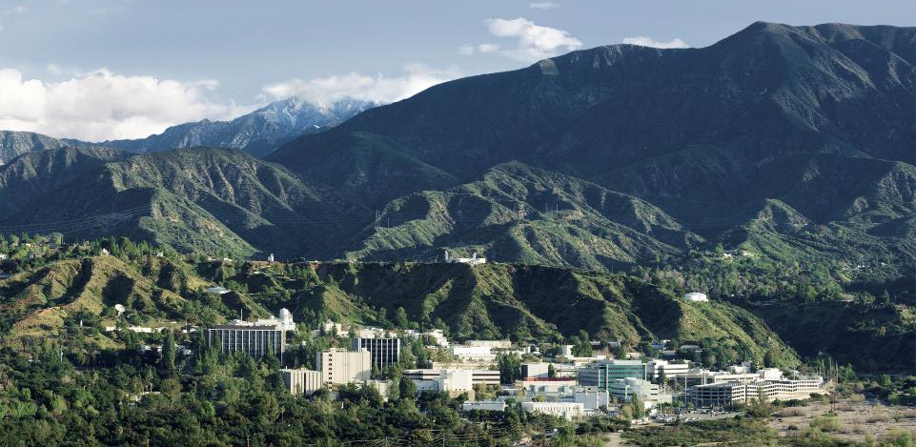
PolSARproSim+
A summary
Razi Ahmed
Jet Propulsion Laboratory, California Institute of Technology,

Slide 2
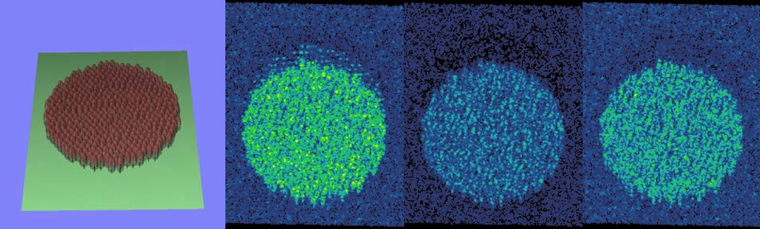
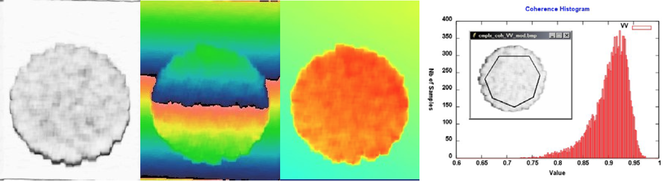
Background
Based on PolSARproSim, which is a, coherent, fully polarimetric and interferometric SAR simulation of forest
Distributed by ESA, written in ANSI C.
HH
HV
VV
Coherence
Phase
Flattened Phase

Slide 3
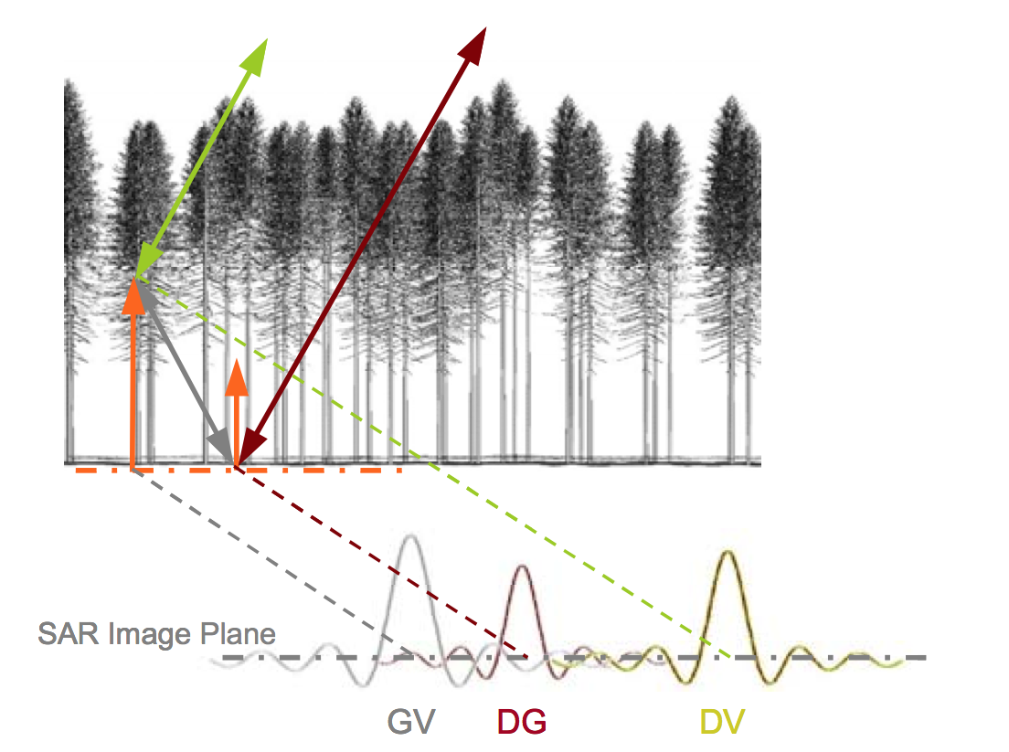
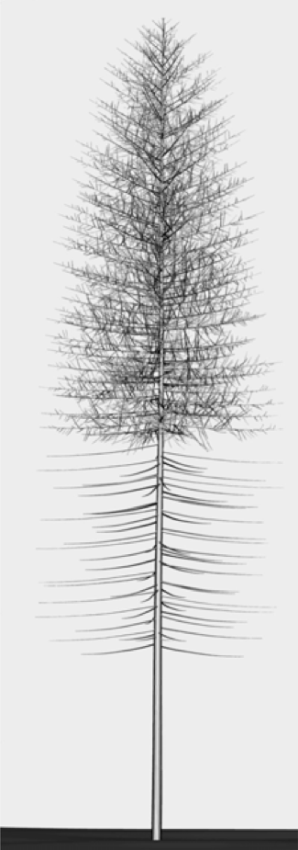
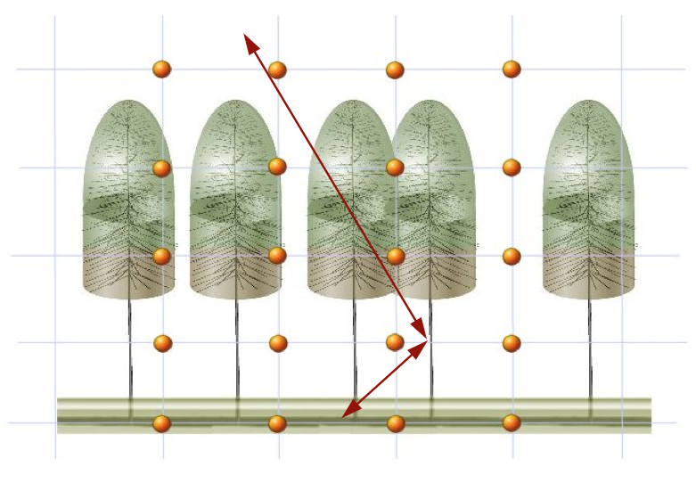
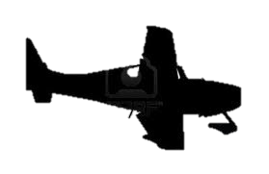
PolSARproSim+ SAR image
The SAR image is evaluated as a coherent sum of scattering events from small elements of the scene
Given the map of tree locations and dimensions a grid of points is used to sample the attenuation of the coherent wave in 3D

Slide 4
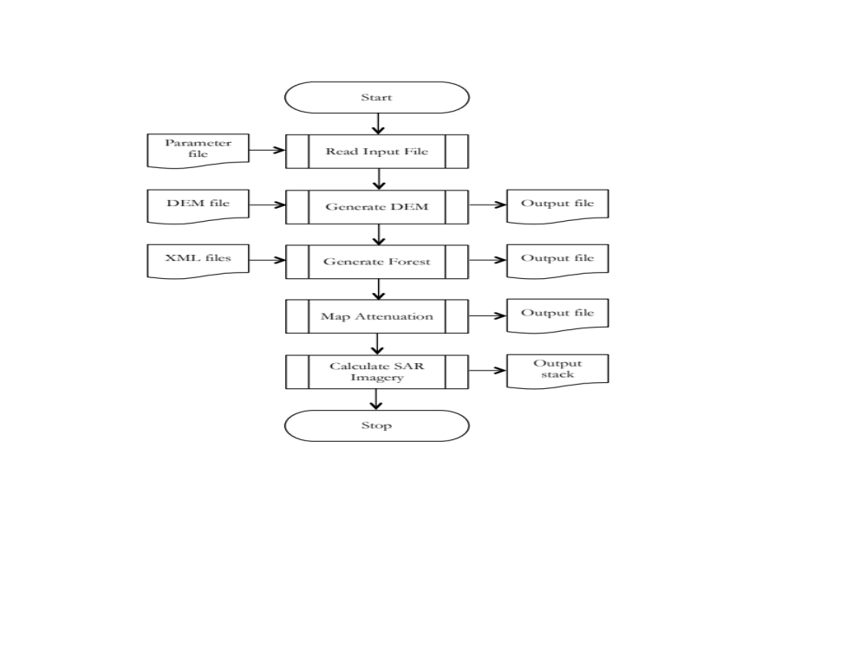
Process flow

Slide 5
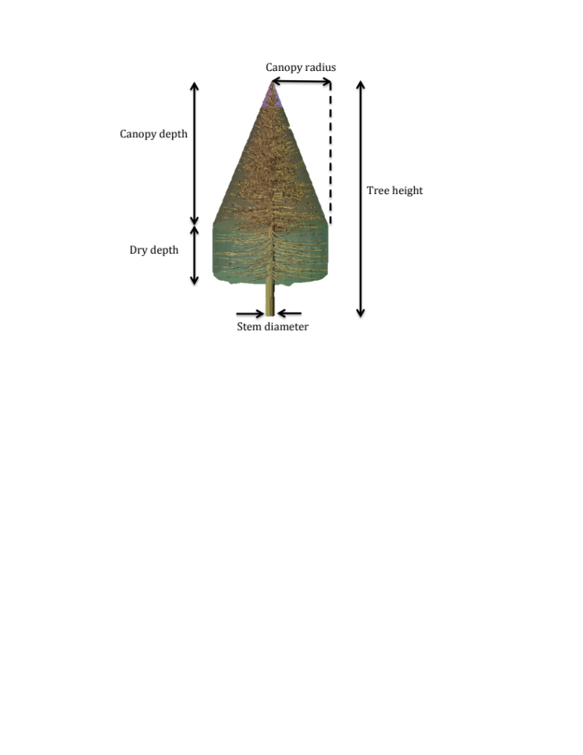
Forest and Tree Description
A tree is realized in PolSARproSim+ based on primitives that include
  Location
  Height
  Canopy shape
  Canopy depth
  Canopy radius
  Stem Diameter
The fine structure of a tree is defined by species specific parameters for
  Stems
  Primary branches
  Secondary branches
  Tertiary branches
  Foliage

Slide 6
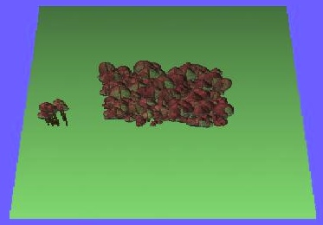
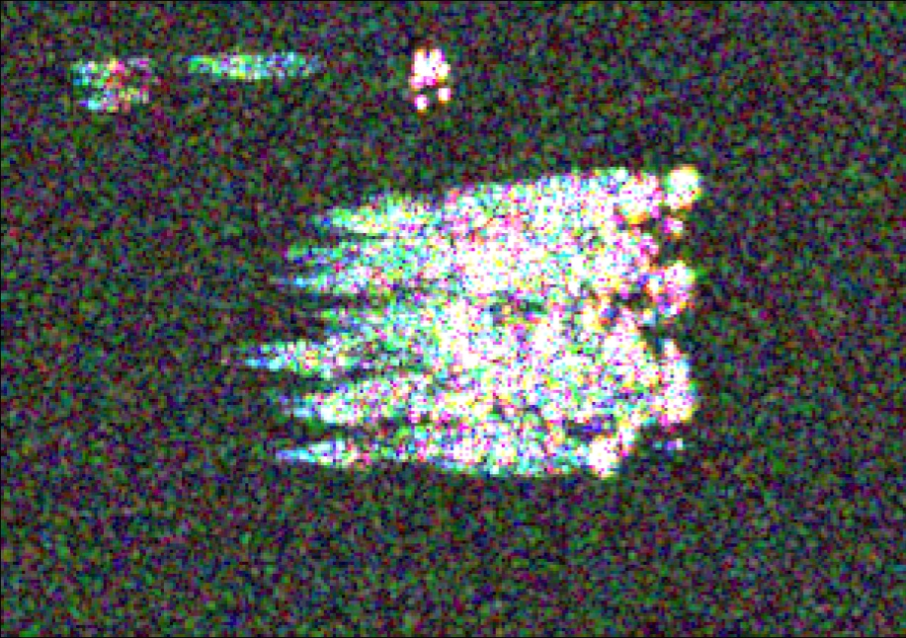
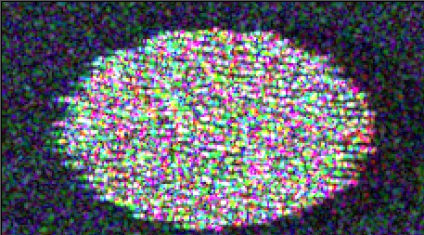
Input forest description
Added the ability to read in forest primitives in the form of XML files
<?xml version="1.0" encoding="ISO-8859-15"?>
<?xml-stylesheet type="text/xsl" href="forest.xsl"?>
<forest>
<meta>
<num_trees units="none"> 470 </num_trees> <!-- The total number of trees in this file -->
<biome units="none"> temperate </biome> <!-- The biome this forest belongs to -->
<area units="ha"> 0.4604 </area> <!-- The total area of the forest -->
</meta>
<tree>
<species units="none"> ACRU </species> <!-- Pinus Resinosa, Red Pine (see allometry file) -->
<x_location units="meters"> -38.2800 </x_location> <!-- X-axis location of tree, scene center is 0.00 -->
<y_location units="meters"> -15.3100 </y_location> <!-- Y-axis location of tree, scene center is 0.00 -->
<tree_height units="meters"> 20.0000 </tree_height> <!-- Vertical extent from tree base to canopy top -->
<canopy_radius units="meters"> 2.0000 </canopy_radius> <!-- The largest horizontal radius of the canopy -->
<canopy_depth units="meters"> 3.1980 </canopy_depth> <!-- The depth of the live part of the canopy -->
<dry_depth units="meters"> 0.3107 </dry_depth> <!-- The depth of the dry part of the canopy -->
<stem_diameter units="meters"> 0.6840 </stem_diameter> <!-- Diameter of trunk at breast height (dbh) -->
</tree>
<tree>
<species units="none"> PIRE </species> <!-- Pinus Resinosa, Red Pine (see allometry file) -->
<x_location units="meters"> -37.7800 </x_location> <!-- X-axis location of tree, scene center is 0.00 -->
<y_location units="meters"> -16.9100 </y_location> <!-- Y-axis location of tree, scene center is 0.00 -->
<tree_height units="meters"> 25.5700 </tree_height> <!-- Vertical extent from tree base to canopy top -->
<canopy_radius units="meters"> 1.1100 </canopy_radius> <!-- The largest horizontal radius of the canopy -->
<canopy_depth units="meters"> 1.7820 </canopy_depth> <!-- The depth of the live part of the canopy -->
<dry_depth units="meters"> 0.3960 </dry_depth> <!-- The depth of the dry part of the canopy -->
<stem_diameter units="meters"> 0.8745 </stem_diameter> <!-- Diameter of trunk at breast height (dbh) -->
</tree>
.
.
.
.
</forest>
Range
Range
Azimuth
Azimuth

Slide 7
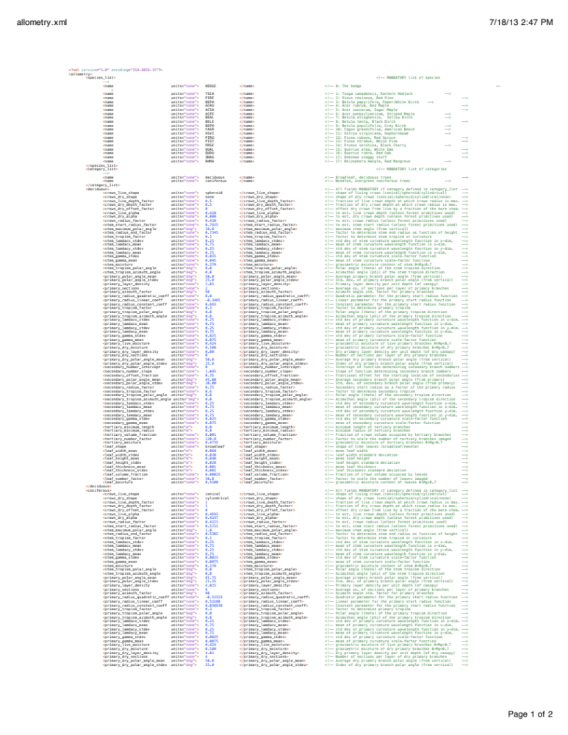
Species description

Slide 8
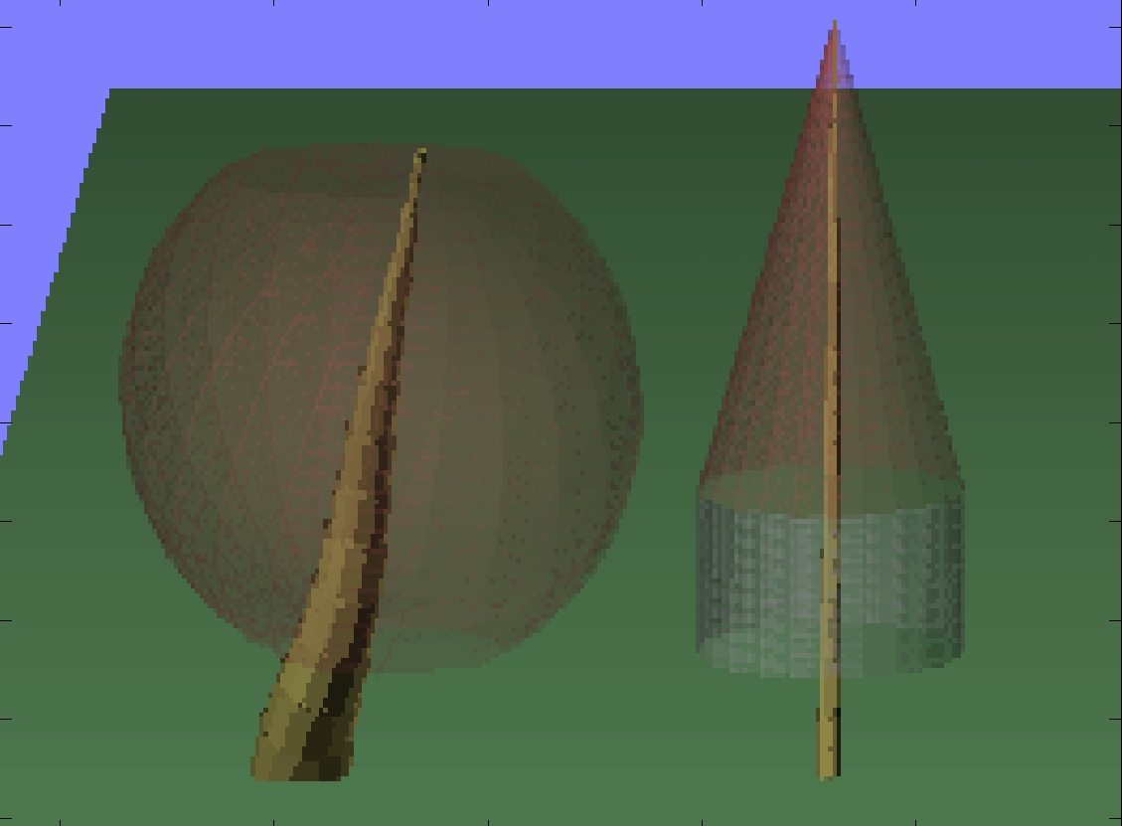
Stem angle
 | max polar angle
Left Tree | 30 degrees
Right Tree | 1 degree

Slide 9
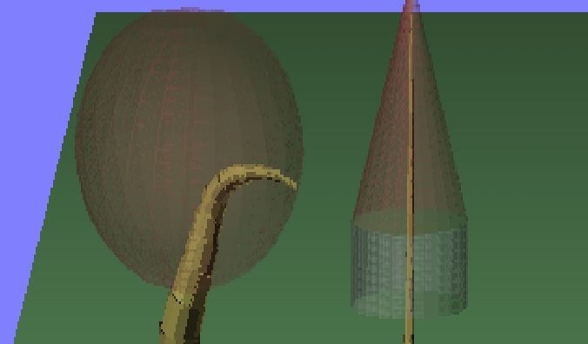
Stem tropism
 | Tropism theta | Tropism phi | Tropism factor
Left Tree | 180 | 0 | 0.8
Right Tree | 0 | 0 | 0.1

Slide 10
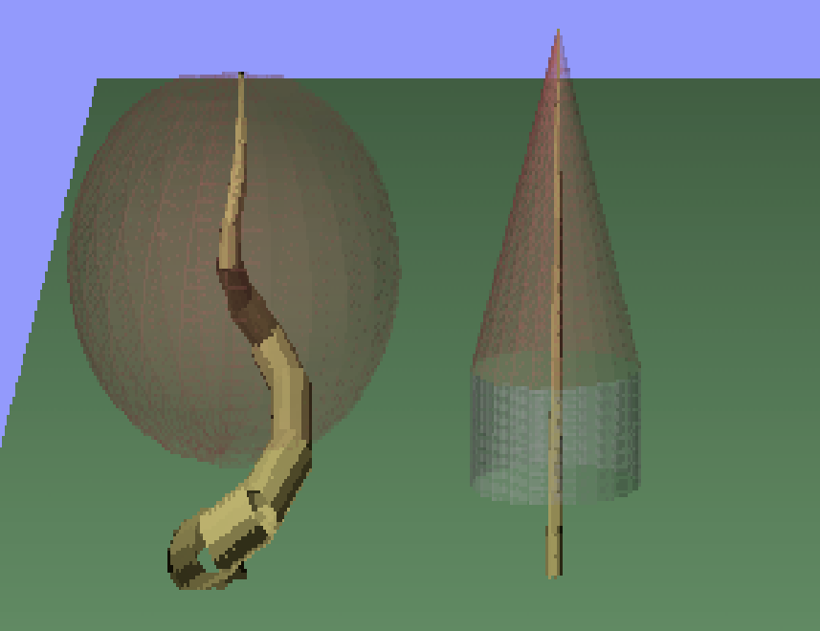
Stem curvature
 | Gamma
Left Tree | 0.75
Right Tree | 0.0075

Slide 11
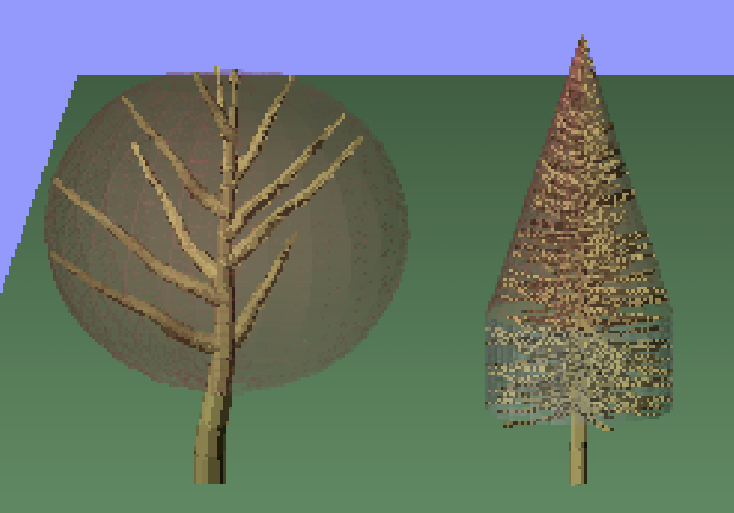
Primary branch numbers
 | Layer density | Sections
Left Tree | 1.0 | 1
Right Tree | 4.01 | 6

Slide 12
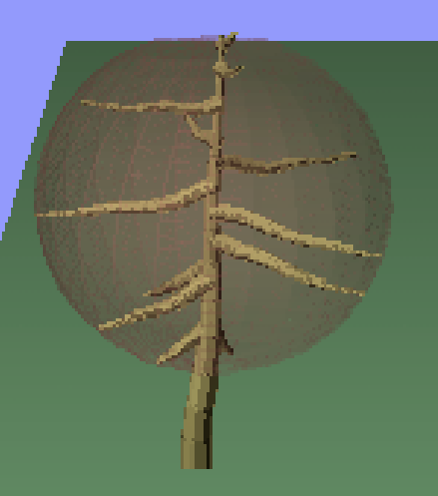
Primary branch angles
 | Polar angle
Left Tree | 50
Right Tree | 110

Slide 13
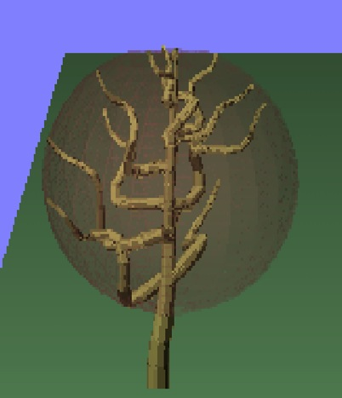
Primary branch curvature
 | Gamma
Left Tree | 0.075
Right Tree | 0.75

Slide 14
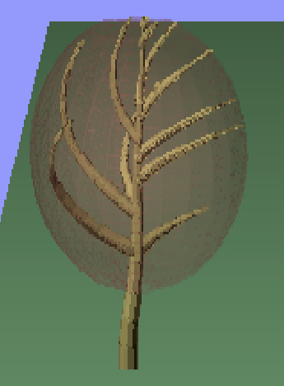
Primary branch tropism
 | Tropism theta | Tropism phi | Tropism factor
Left Tree | 0 | 0 | 0.3
Right Tree | 90 | 0 | 0.8

Slide 15
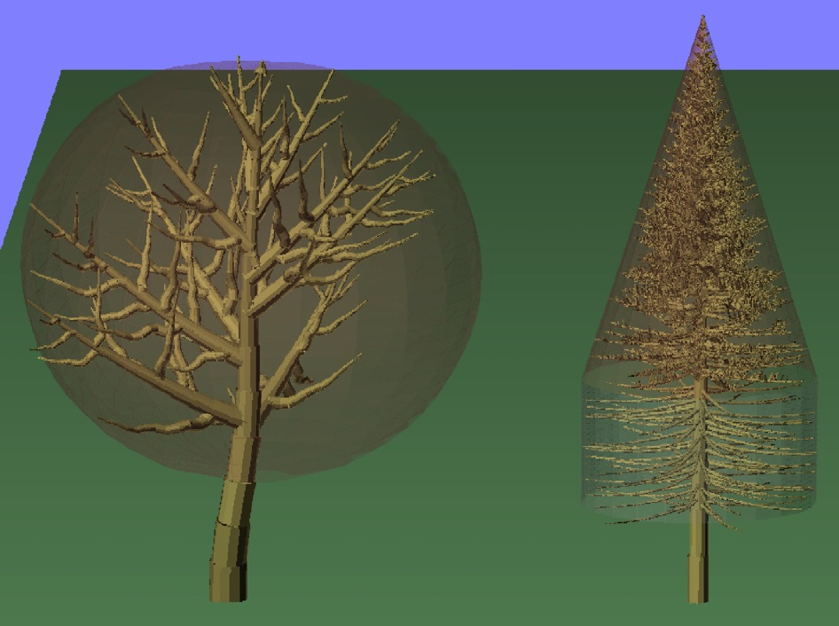
Secondary branch numbers
 | Slope | Intercept
Left Tree | 1.045 | 0
Right Tree | 18.95864 | -4.26094

Slide 16
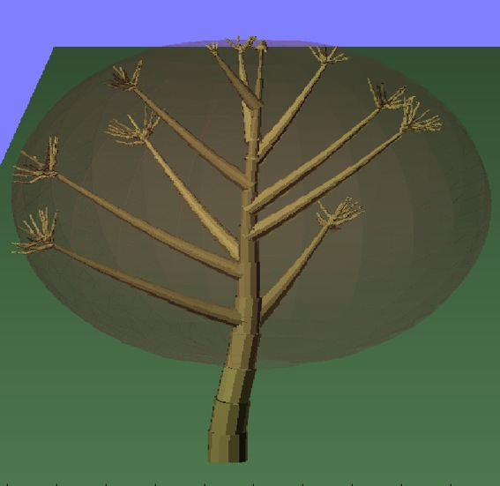
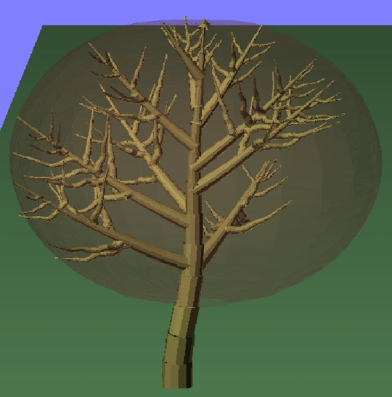
Secondary start offset
 | Fractional offset [0-1]
Left Tree | 0.8
Right Tree | 0.3

Slide 17
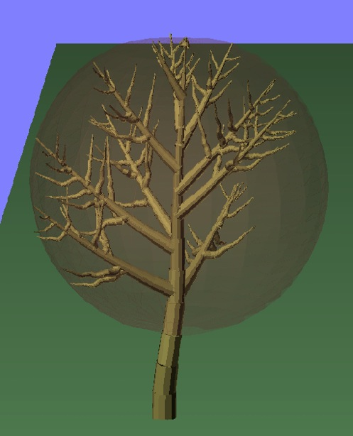
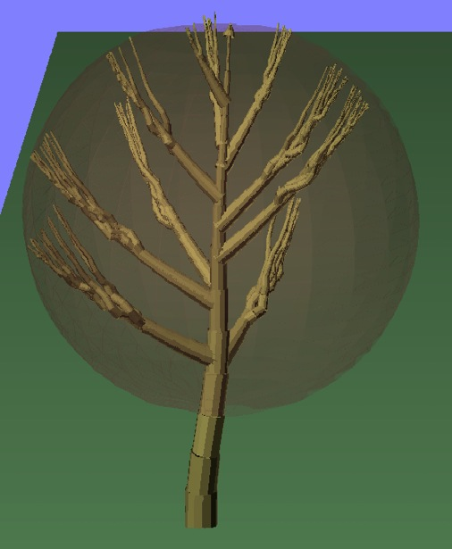
Secondary polar angles
 | Mean | Std dev.
Left Tree | 45 | 20.0
Right Tree | 7 | 0.65

Slide 18
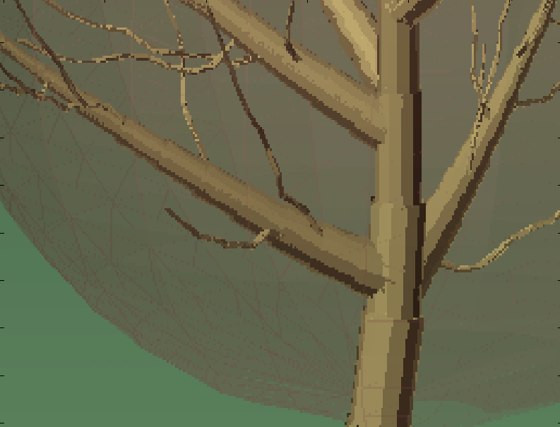
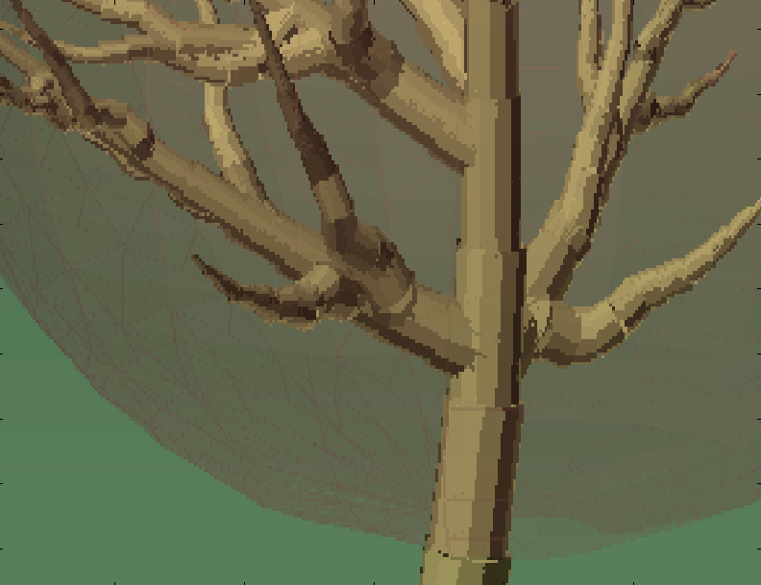
Secondary start radius factor
 | Radius Factor [0-1]
Left Tree | 0.1
Right Tree | 1.0

Slide 19
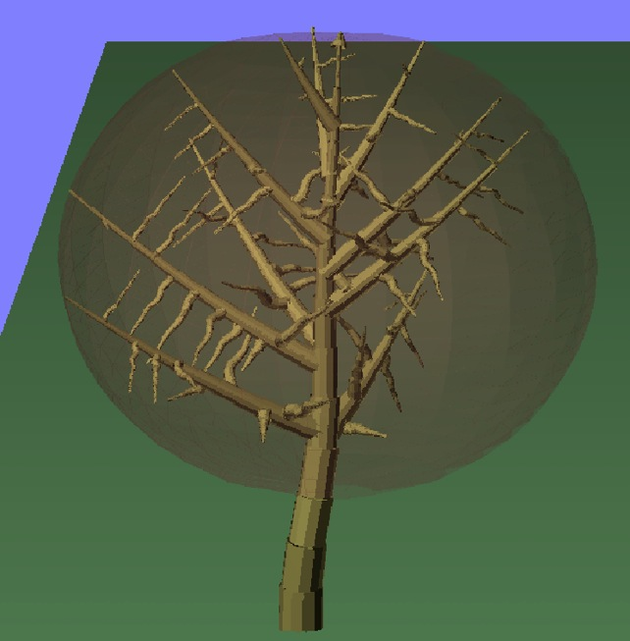
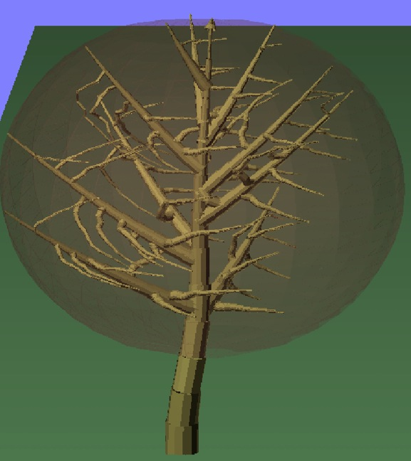
Secondary branch tropism
 | Tropism theta | Tropism phi | Tropism factor
Left Tree | 0 | 0 | 0.0
Right Tree | 90 | 0 | 0.9

Slide 20
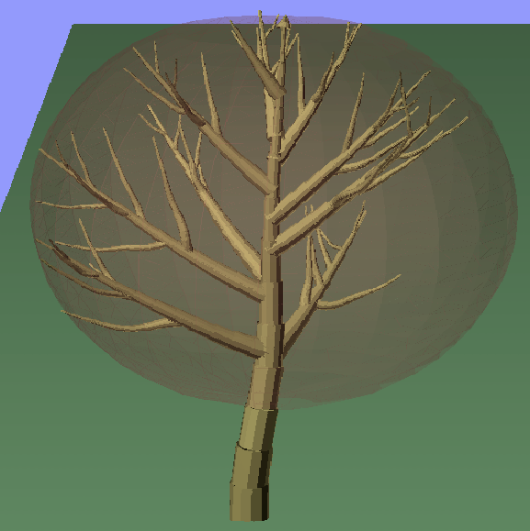
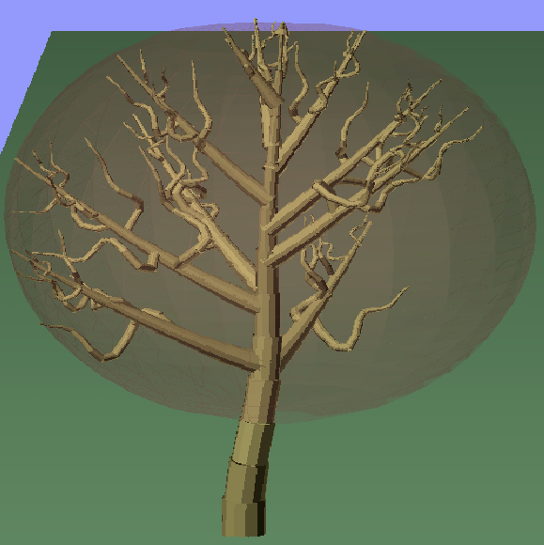
Secondary branch curvature
 | Gamma
Left Tree | 0.075
Right Tree | 0.75

Slide 21
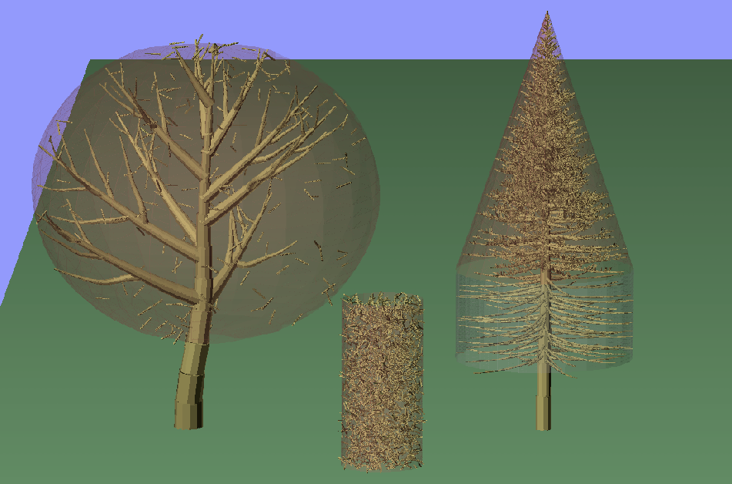
Tertiary branch controls
Size (radius, length) are calculated based on primary and secondary branch dimensions. Although minimum dimensions can now be specified.
Tertiary volume fraction, canopy size, branch volume, and Maximum Number of realizations (for Monte Carlo purposes) decide the actual number of branches.

Slide 22
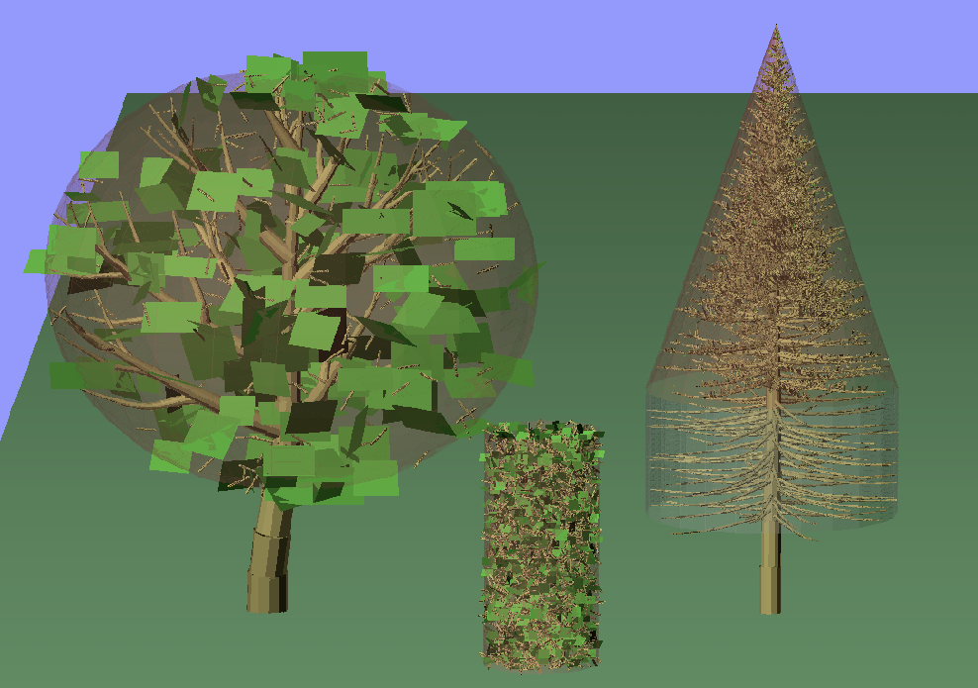
Foliage controls
Can now specify mean/stdev of leaf dimensions

Slide 23
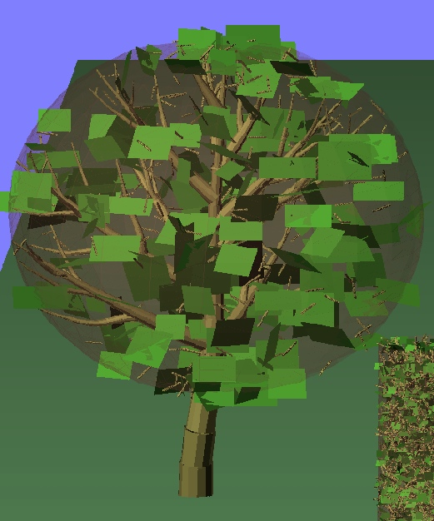
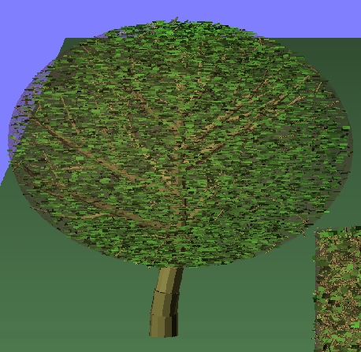
Foliage controls
Leaf volume fraction, canopy size, leaf volume, and Maximum Number of realizations (for Monte Carlo purposes) decide the actual number of leaves.

Slide 24


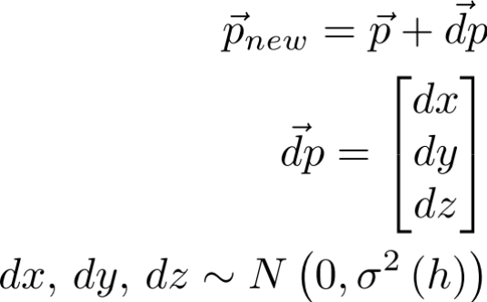
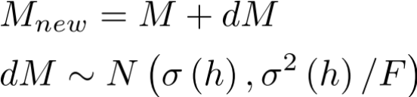
Modeling temporal decorrelation
PolSARproSim+ includes the option of modeling temporal decorrelation as change of scatterer position and moisture as a function of height, for each track
Moisture and Motion profiles are defined by programmable coefficients:
  No change
  Polynomial change profile:
  Exponential change profile:

Slide 25
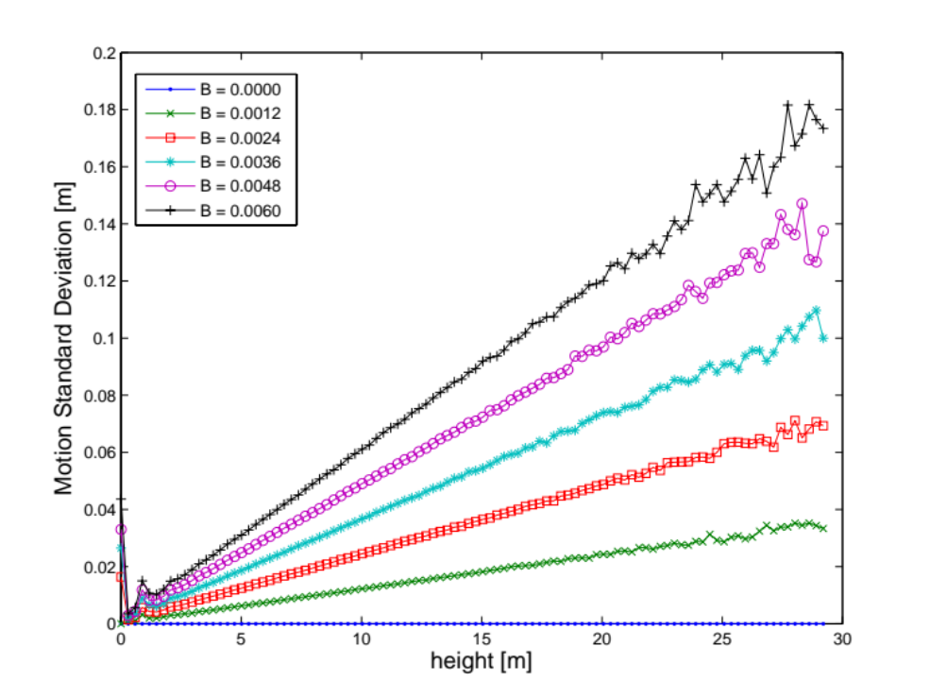
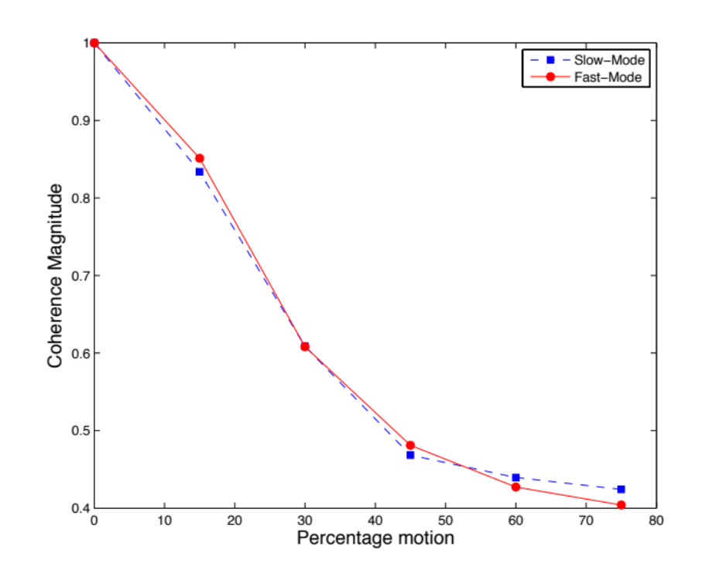
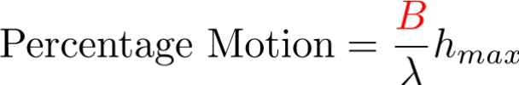
Estimated statistics of applied motion – for all trees

Slide 26
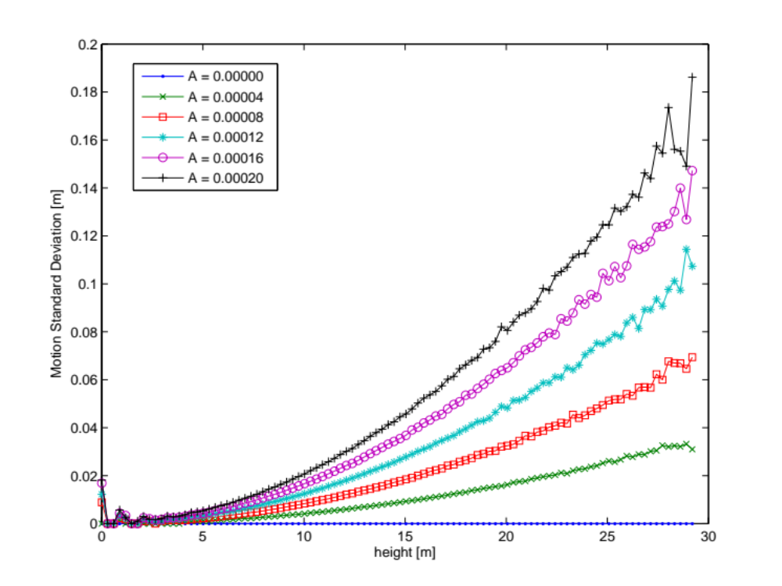
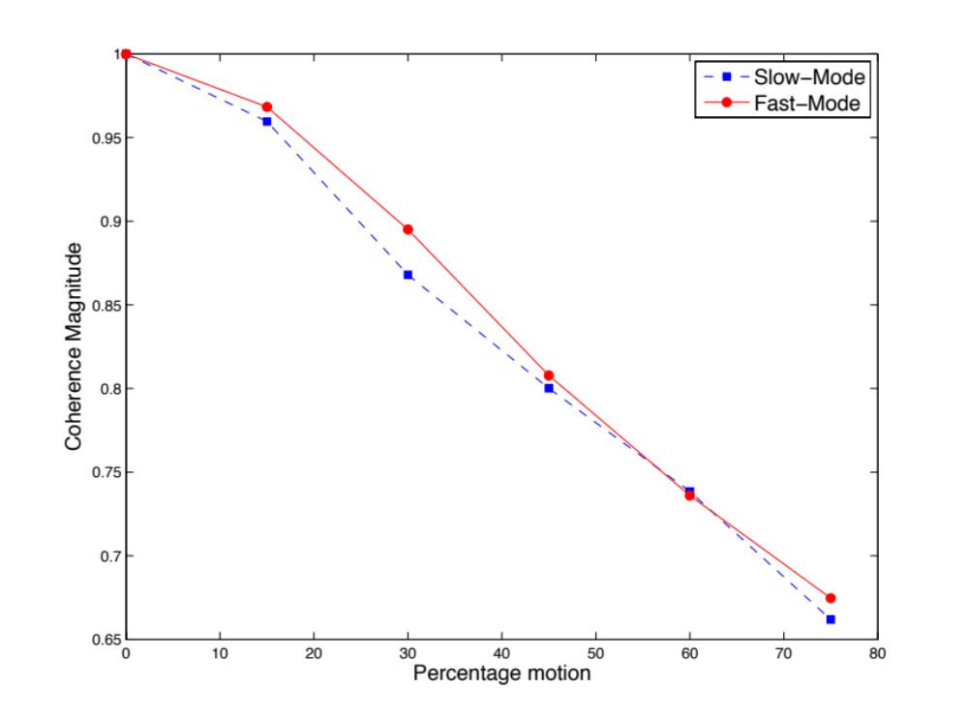
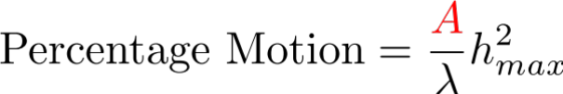
Estimated statistics of applied motion – for all trees

Slide 27
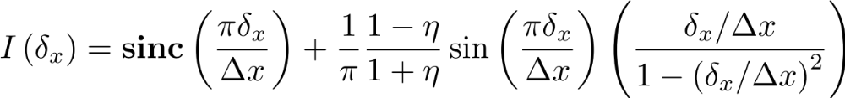
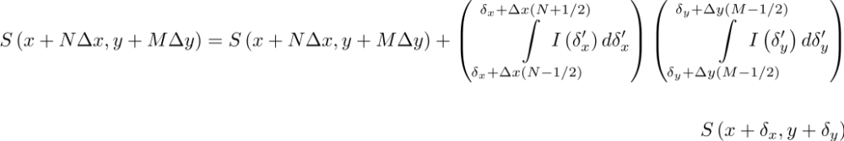
Point Spread Function

Slide 28
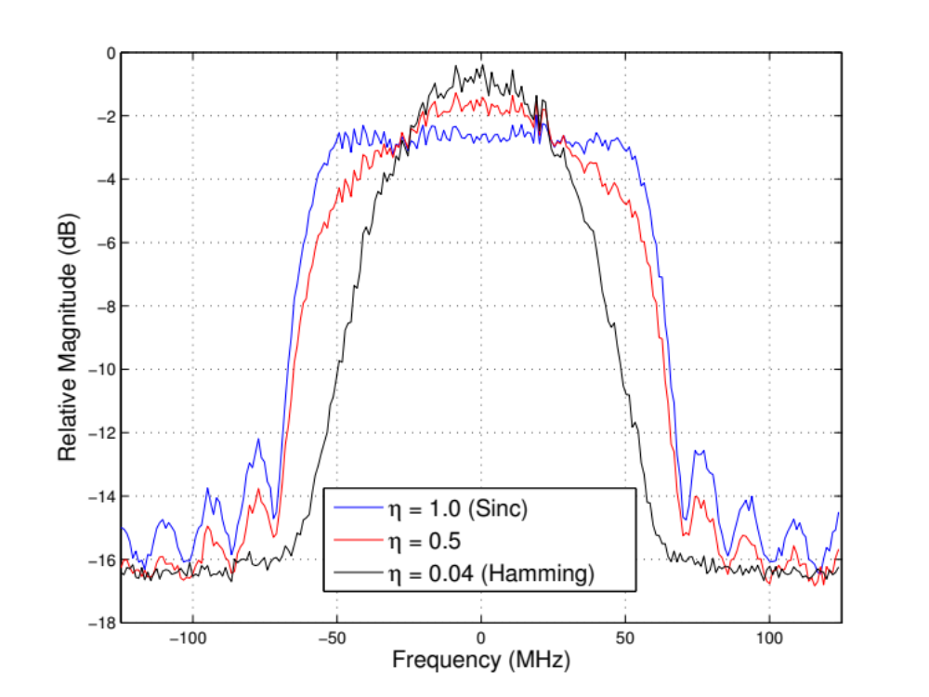
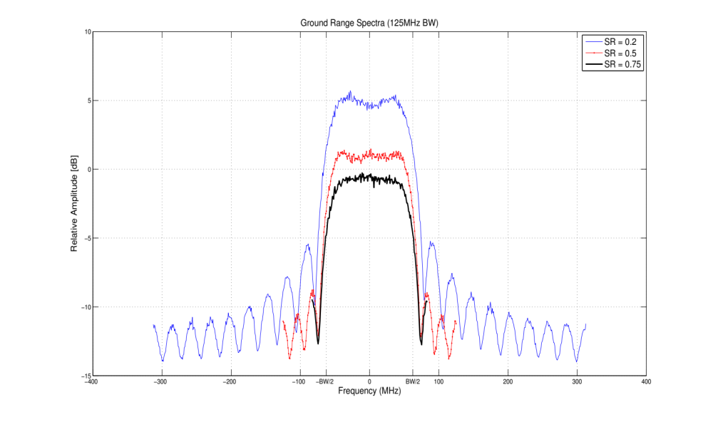
Range Spectra

Slide 29
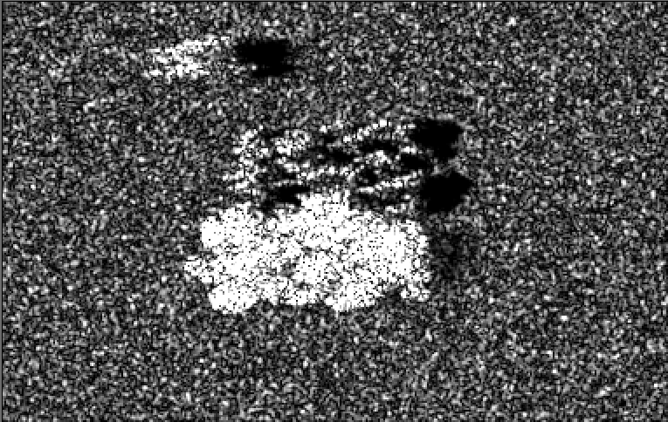
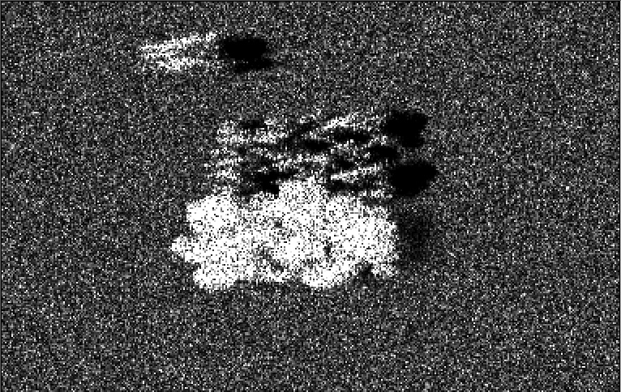
Qualitative change in images
Gaussian
Sinc, eta = 1.0

Slide 30
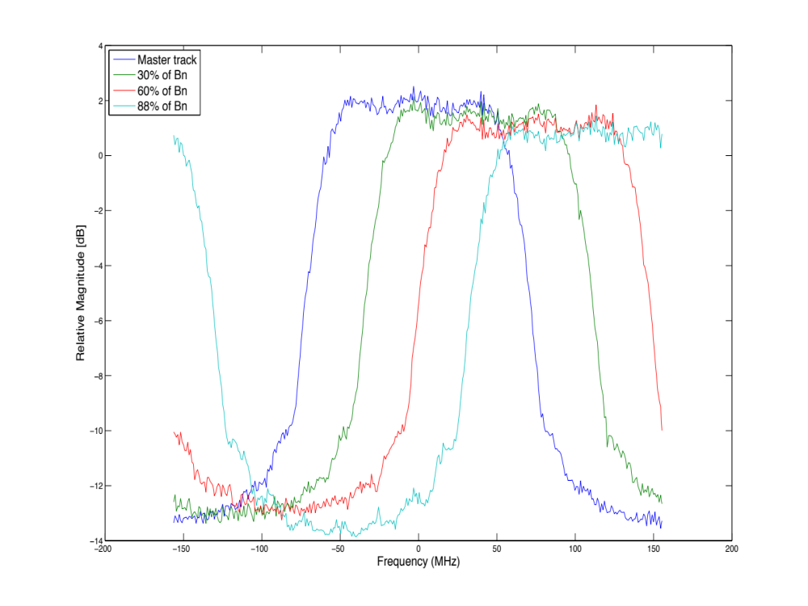
Range Spectra for different baselines

Slide 31

Adding a DEM
Read in and error checking of external DEM file
Resize/Resample to simulation coordinates
Create Shadow Map for direct scattering

Slide 32






Example (Direct scattering only)
HH backscatter
0.17m wrap
0m wrap
No DEM
HH backscatter
40m wrap
20m wrap
With DEM
Backscatter
DEM
Shadow Map

Slide 33

Adding thermal noise
Add a random number to each pixel of every stack, such that

Slide 34





Backscatter Intensity
-25dB NESZ
-30dB NESZ
-35dB NESZ
-40dB NESZ
-45dB NESZ

Slide 35










Direct Ground Scattering, the math
Facet surface normal and unit look vector

Slide 36




Scattering from a cylinder
Each branch is simulated as either an infinite or a finite cylinder based on a flag (by default set to simulate an infinite cylinder)
In case the cylinder is finite
  Karam, Fung and Antar, “Electromagnetic Wave Scattering from Some Vegetation Samples”, TGRS 1988
  Uses generalized Rayleigh-Gans (GRG) Approximation:

Slide 37

Vegetation Permittivity from Moisture, [Ulaby, El-Reyes, 1987]

