Slide 1
PolSARproSim+: The enhanced coherent, polarimetric simulator for studying forest polarimetry and interferometry
Razi Ahmed,
Scott Hensley, Maxim Neumann, Macro Lavalle
Jet Propulsion Laboratory,
California Institute of Technology
© 2015 California Institute of Technology. Government sponsorship acknowledged.

Slide 2
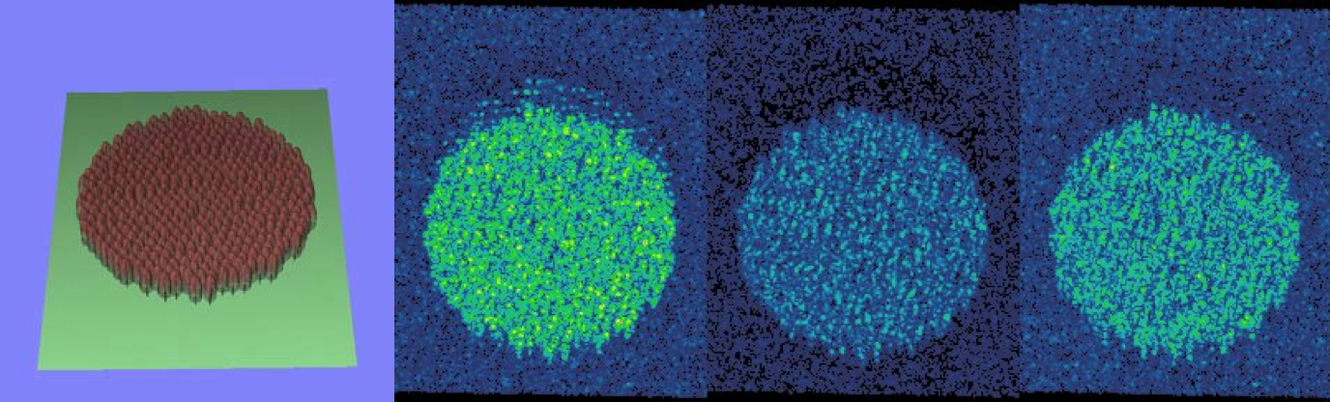
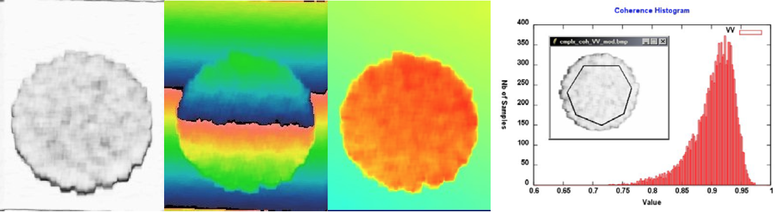
PolSARproSIM+
Based on PolSARproSim, a coherent, fully polarimetric and interferometric SAR simulation of forests
Developed by Mark L. Williams and is distributed by ESA with the PolSARpro software suite
HH
HV
VV
Coherence
Phase
Flattened Phase

Slide 3
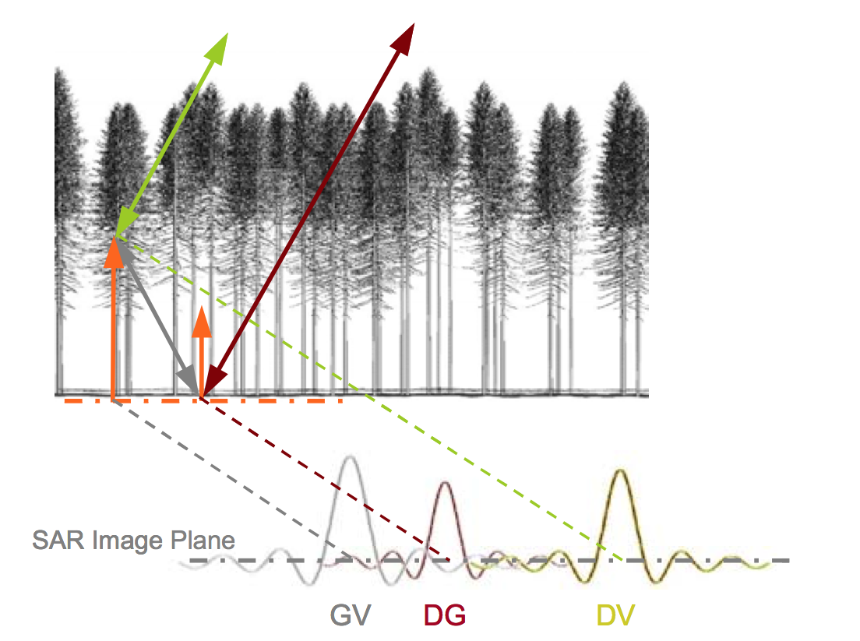
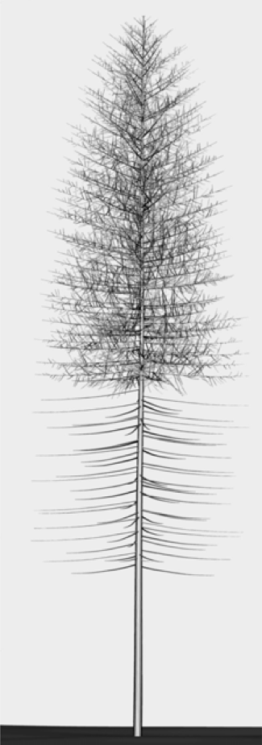
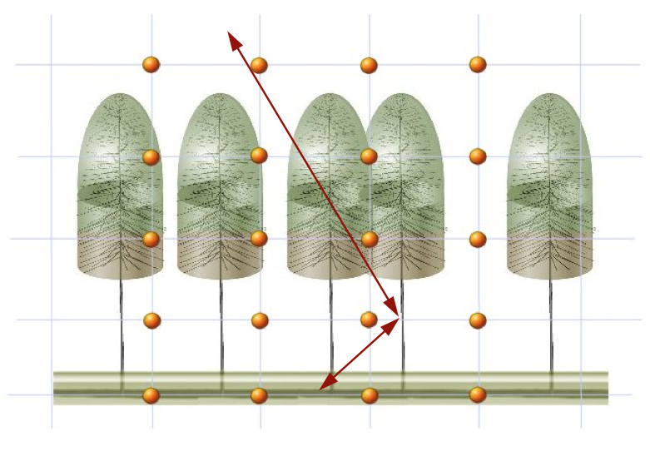
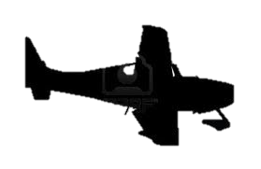
How PolSARproSim Works
The SAR image is evaluated as a coherent sum of scattering events from small elements of the scene
Given the map of tree locations and dimensions a grid of points is used to sample the attenuation of the coherent wave in 3D

Slide 4
Shortcomings of PolSARproSim
Only forest parameters under control of the user are tree height and stand density.
Tree locations and number are based on some predefined variables
Allometric calculations for all other tree parameters such as stem diameter are hardcoded, making it inflexible.
All trees belong to one species (limited to three total species)
Only simulates two tracks
Is not capable of simulating temporal decorrelation
Implements a Gaussian Point Spread function
Cannot simulate a scene with topography
Doesn’t include thermal noise effects
Runs as a single process

Slide 5
Modifications: PolSARproSim+
PolSARproSim+ has increased flexibility in describing the simulated forest by:
  Having control over detailed structural parameters for any number of species defined via an XML database
  Having any number of species in a simulated forest at once (mixtures)
  Having control over properties of each tree such as location, height, dbh etc. via a separate XML database.
Is able to simulate stacks of multi-baseline interferograms in high fidelity (slow) and approximate (fast) modes
Is able to introduce temporal decorrelation through physical change such as movement of canopy elements (branches and leaves) and moisture change
Include realistic band-limited Point Spread Functions (raised-cosine weighted) and thermal noise effects
Is able to simulate returns from arbitrary topography
The simulator runs faster (i.e. multi-threaded implementation)
  An approximate 5-fold decrease in simulation time for a single baseline configuration

Slide 6
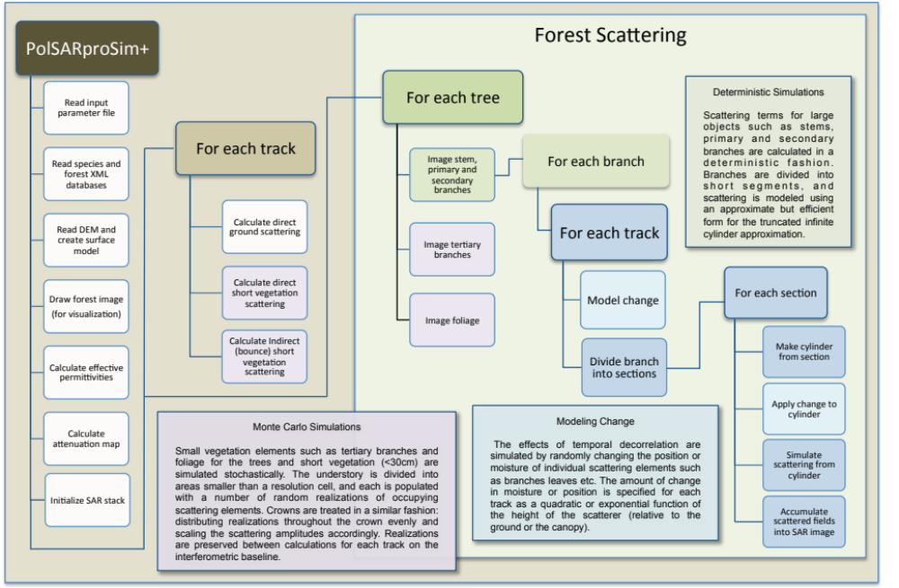
Modified Software Architecture
Notes:
Reorganized Loop Structure that allows us to introduce modeling scatterer motion or moisture change between tracks

Slide 7
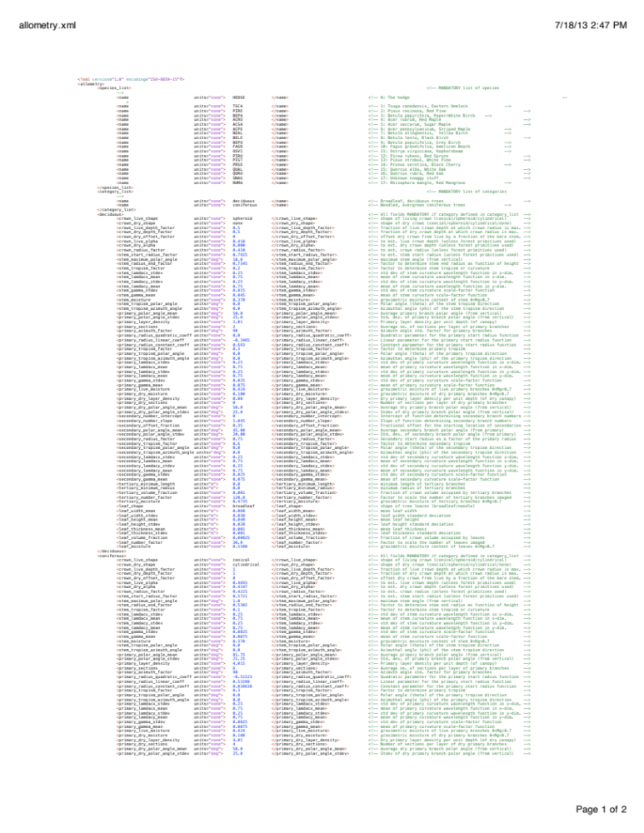
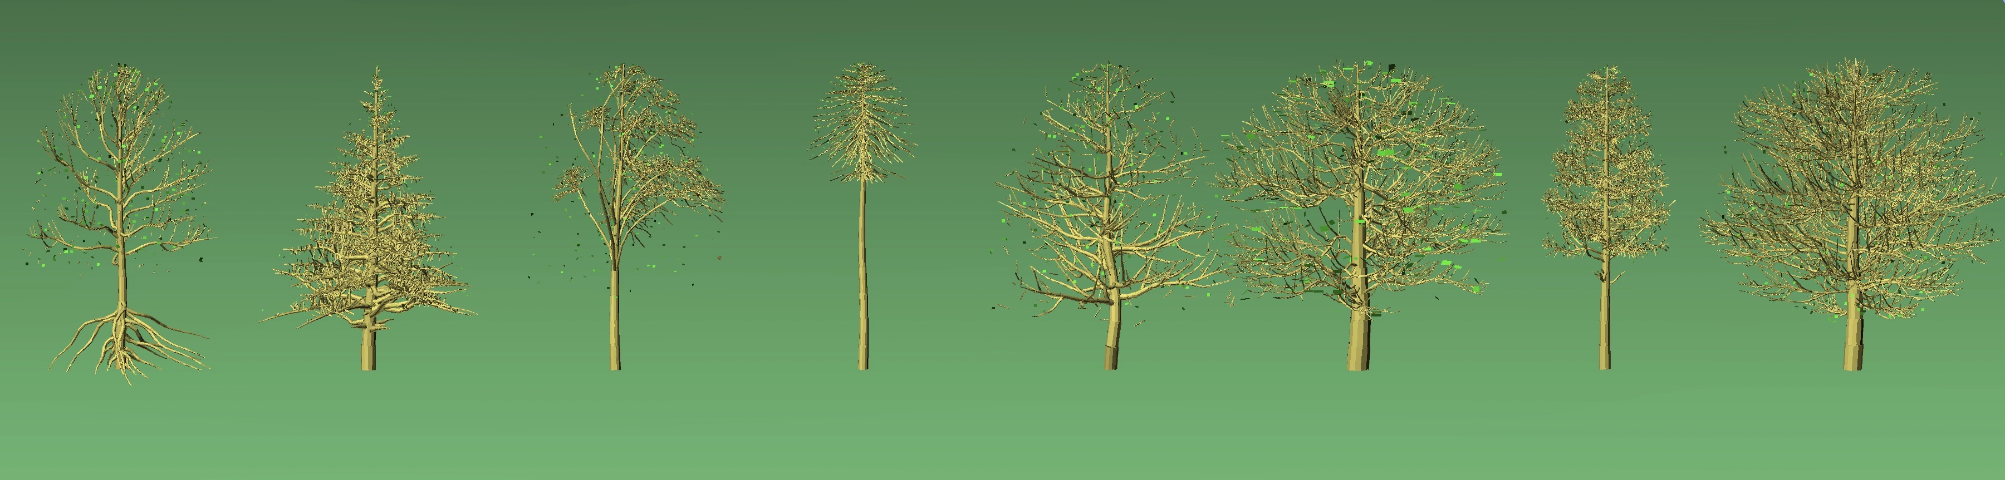
Added control of species definition
Tree species are defined in PolSARproSim+ via an XML-database file
This database contains an extensive set of parameters giving the user unprecedented control and ability to define any number of species with parameters describing the structure of
  Crown
  Stems
  Primary, secondary and tertiary branches
  Foliage
Mangrove
Hemlock
Eucalyptus
Palm
Birch
Red Maple
Red Pine
Sugar Maple
Notes:
Short snippet of a species XML database (for primary branch definition)

Slide 8
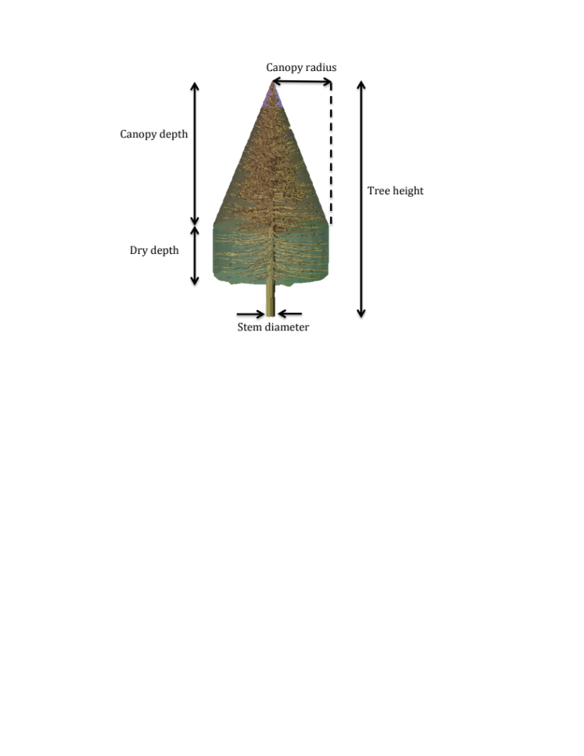
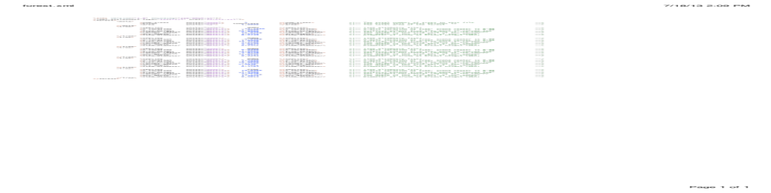
Added control of Stand Description
A forest stand simulated by PolSARproSim+ is defined via a second XML database file
Each tree in a stand is defined in this XML file with primitives that specify
  Species (as defined in the species XML file)
  Location
  Height
  Canopy shape
  Canopy depth
  Canopy radius
  Stem Diameter

Slide 9


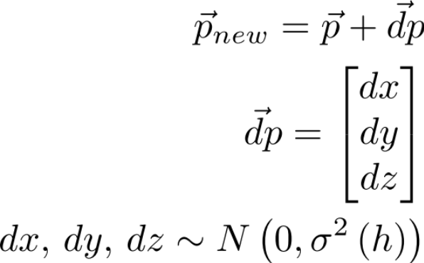
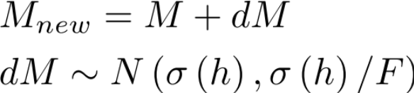
Modeling temporal decorrelation
PolSARproSim+ includes the option of modeling temporal decorrelation as change of scatterer position and moisture as a function of height, for each track
Moisture and Motion profiles are defined by programmable coefficients:
  No change
  Polynomial change profile:
  Exponential change profile:
Equations implementing Scatterer Motion
Equations implementing Moisture change

Slide 10
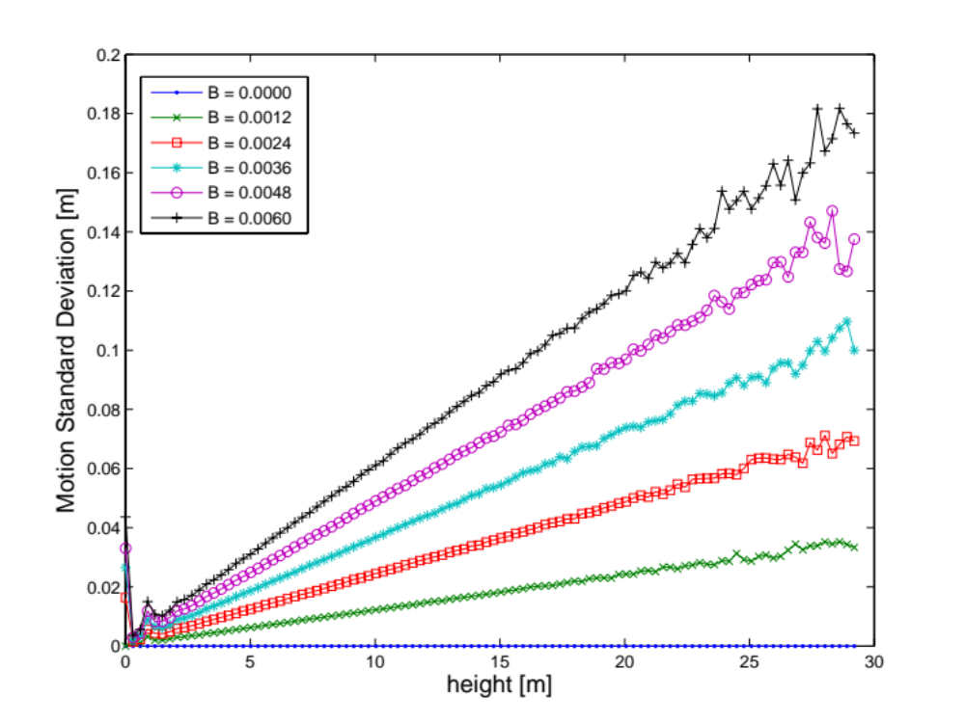
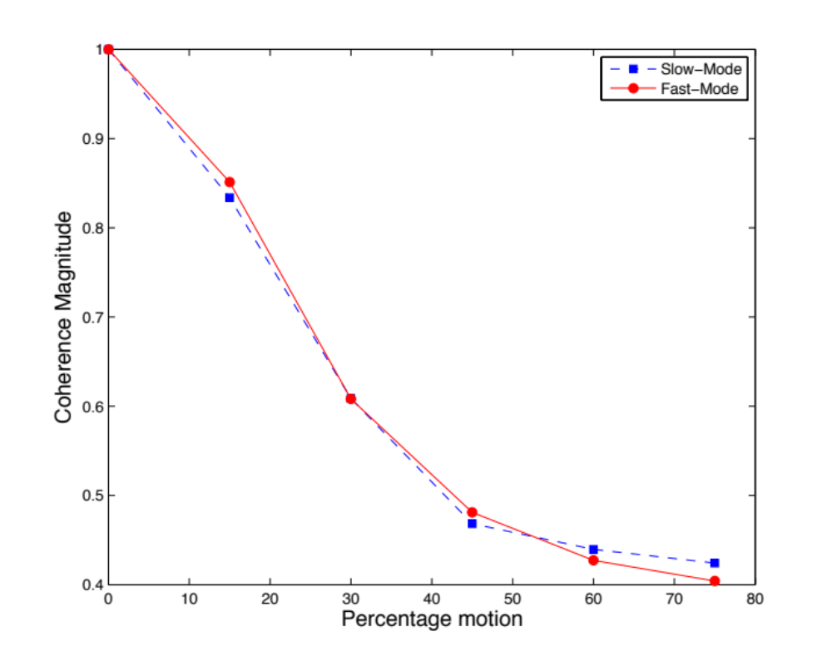
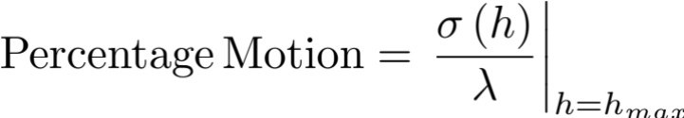
Simulated effects of scatterer motion
Scatterer motion is defined as the standard deviation of the change in scatterer position as a function of height
As an example, increasing scatterer motion (larger slopes) correspond to higher overall decorrelation seen in the simulated interferograms
Notes:
The parameter B in the plot on the left corresponds to the parameter in equation below the plot – not the baseline

Slide 11
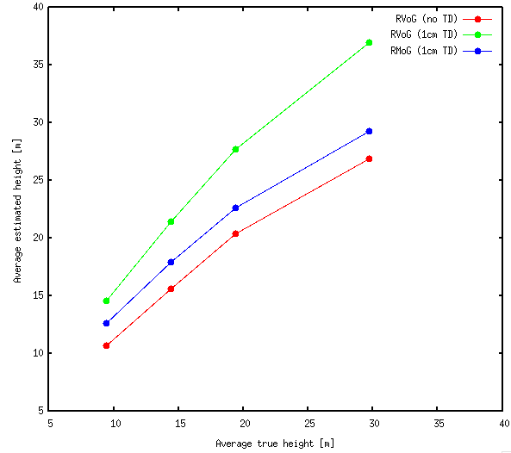
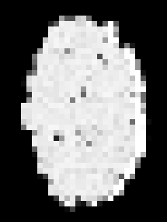
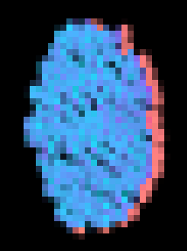
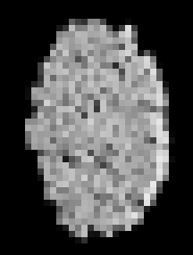
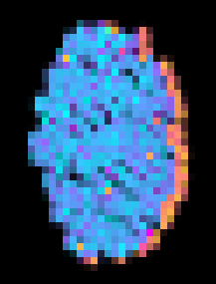


Effects on PolInSAR signatures and Inversions
PolSARproSim+ also allows for an analysis of the effects of temporal decorrelation on PolInSAR signatures and inversion algorithms.
As shown here, results of PolInSAR inversions using the three stage RVoG and RMoG algorithms on stands with an average tree height varying from 10 to 30m with a linear temporal decorrelation profile (such that there is 1cm rms motion at 20m height for L-band simulations)
Coherencee
Phase
No TD
TD (1cm)
Notes:
RMoG inversion is the blue line
RVoG inversion results without any added motion is the red line
RVoG inversion results with temporal decorrelation is the green line

Slide 12

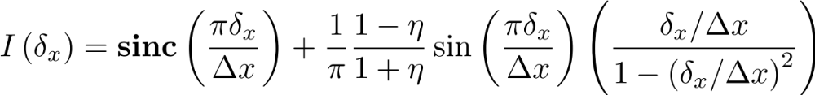
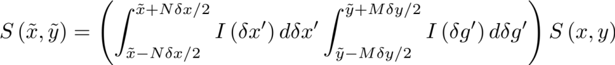
Modifying the Point Spread Function
Originally, the point spread function was modeled as Gaussian,
where the backscattered value was given by
This was replaced by
Where the backscattered value is now given by

Slide 13
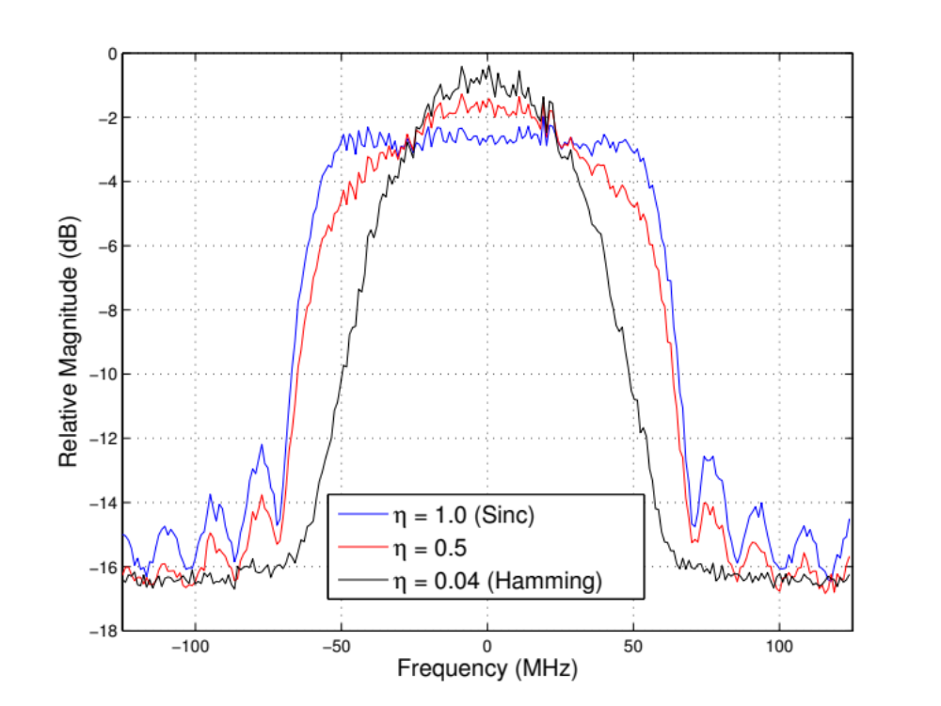
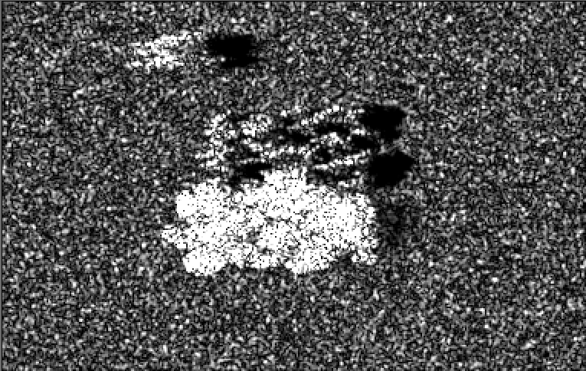
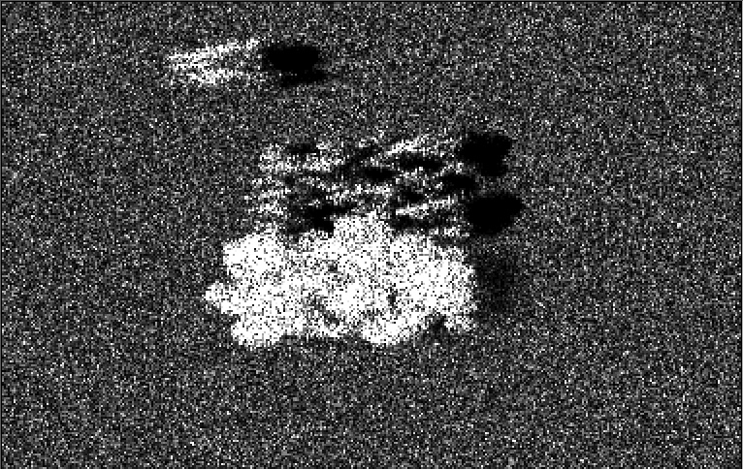
Spectra for different weighting functions
The shape of the point system point spread function can be modified in PolSARproSim+ using the broadening factor (η) as an input
The qualitative difference between two simulated images is noticeable, with a broadening factor of 0.04 (Hamming) and 1.0 (Sinc)
η=0.04
η=1.0

Slide 14
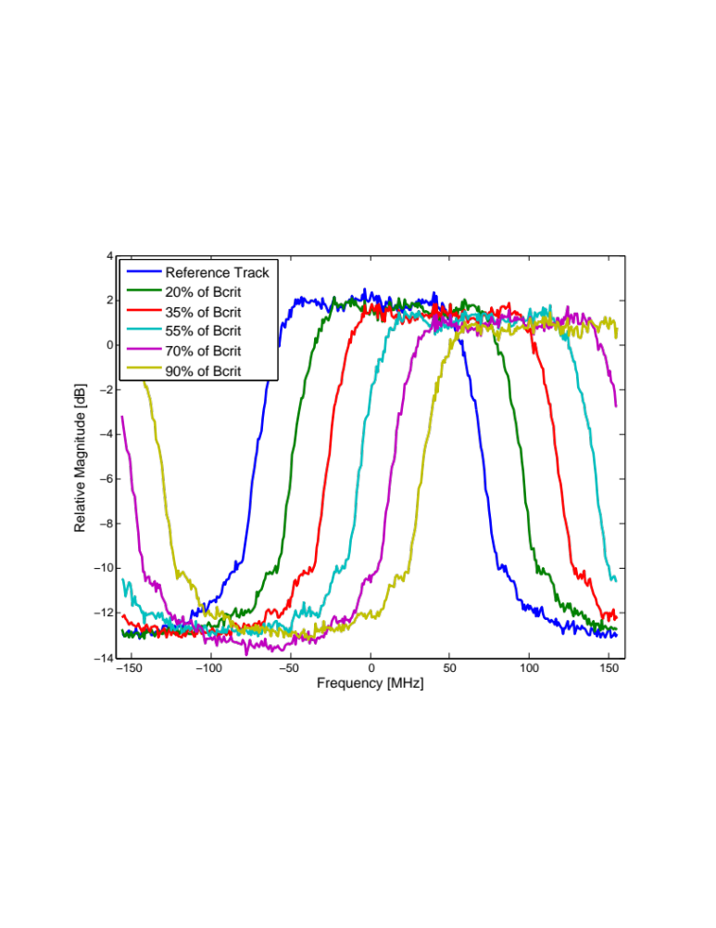
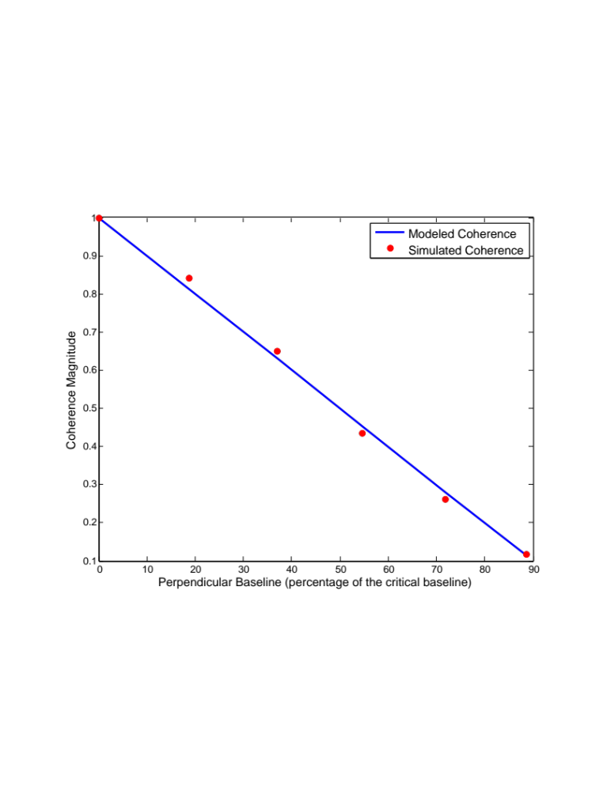
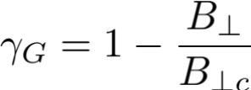
Multibaseline Simulations
PolSARproSim+ allows simulation of multibaseline data.
Track geometry is defined in the parameter file as cross-track and vertical baseline offsets from the master track.
The range spectra for scenes simulated with varying baselines chosen as a function of the critical baseline display the expected Prati Shift.
The simulated coherence for interferograms formed using these scenes follows the geometric decorrelation model given by

Slide 15
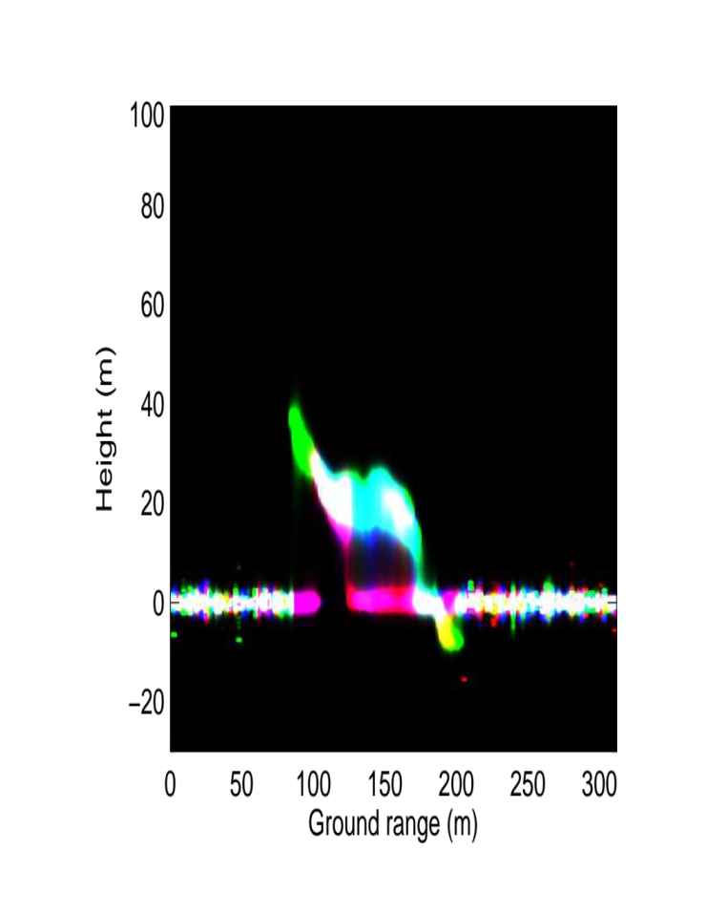
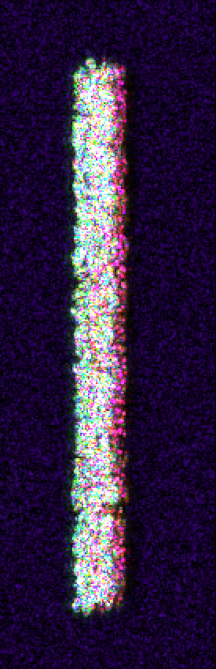
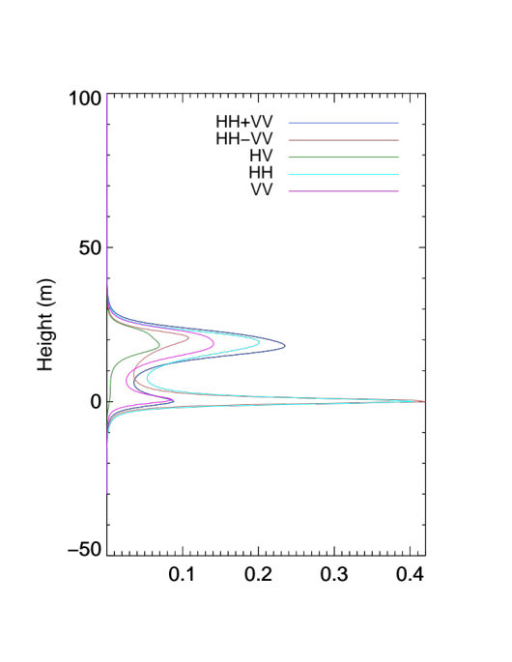
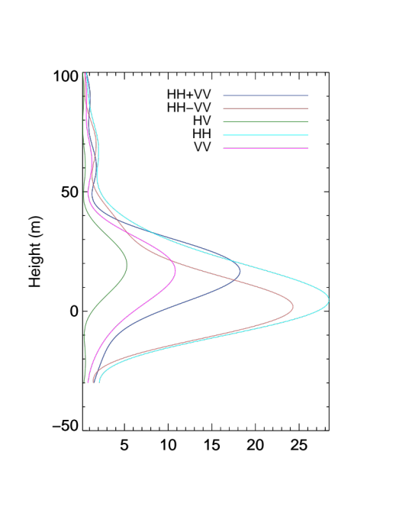
Analysis of multibaseline tomography
tomogram
Transects of a tomogram from a 7-track simulation of an exact stem map shows the ability of PolSARproSim+ to simulate realistic multibaseline data from conditions very similar to those seen in reality
The scene simulated contains roughly 1200 trees along a 200m by 50 transect in the Harvard Forest from a stem-map created by the University of Massachusetts, Amherst.
Backscatter image

Slide 16
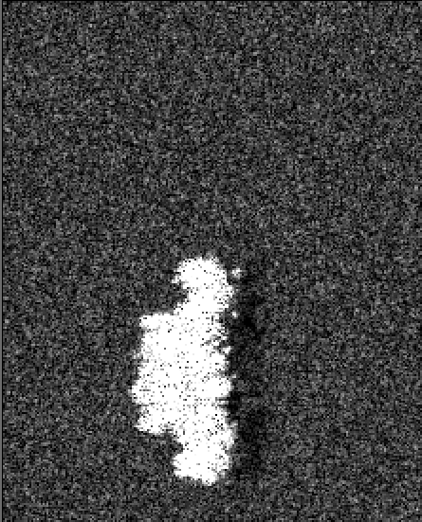
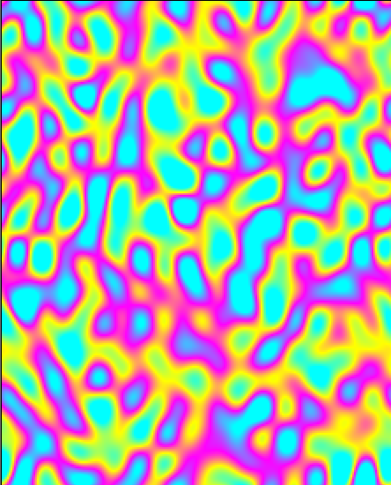

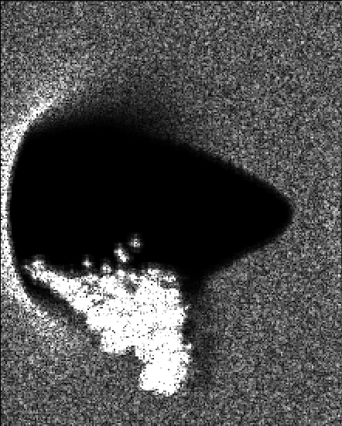
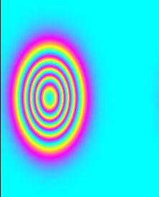
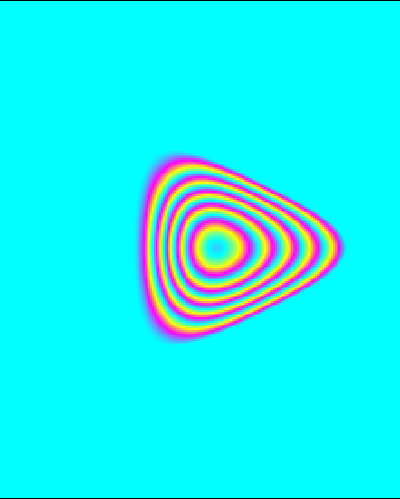
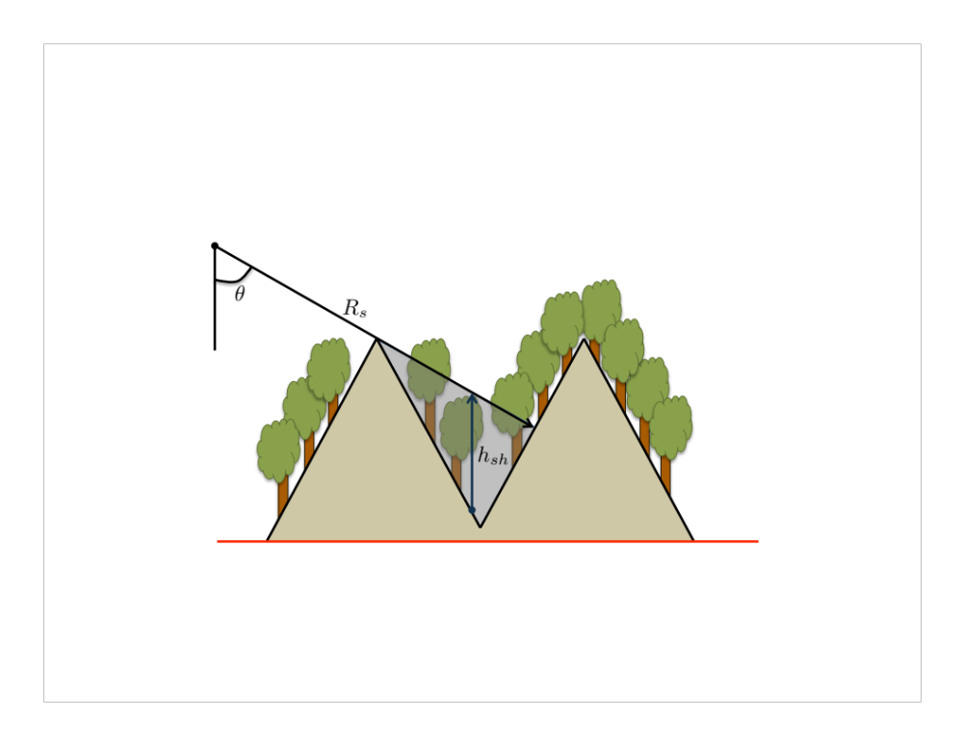
Simulations using an Arbitrary DEM
HH backscatter
0.17m wrap
0m wrap
PolSARproSIM+ allows simulation of a forest over any arbitrary terrain supplied through an external DEM.
Once read, the DEM is resampled to the simulation coordinates using a simple bilinear interpolation.
HH backscatter
40m wrap
20m wrap
Backscatter
DEM
Shadow Map
In order to account for scatterers occluded from the radar because of large slopes, a map of the shadow heights is then generated using geometry from the master track. This 2-D map contains the height up to which an object in that
Notes:
Graphic is attempting to illustrate how a shadow map is created, by walking along a range line and

Slide 17
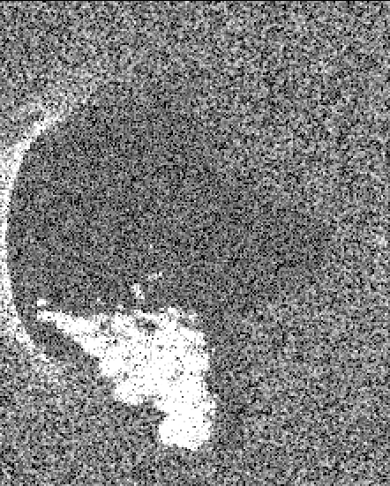
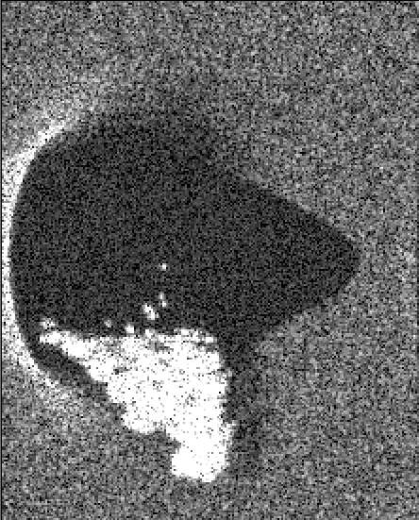
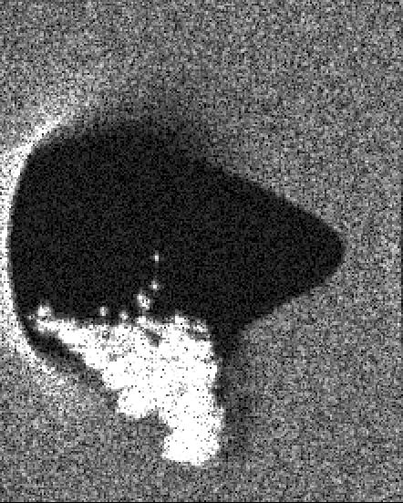
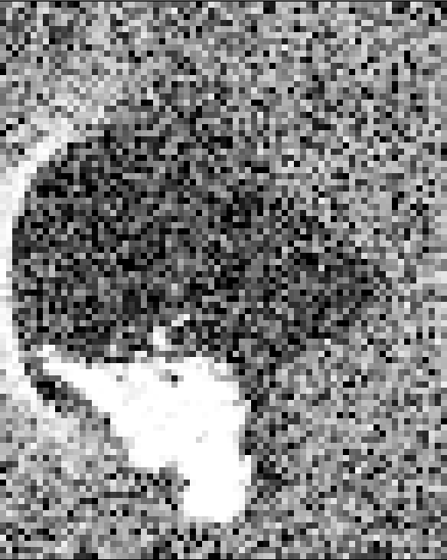
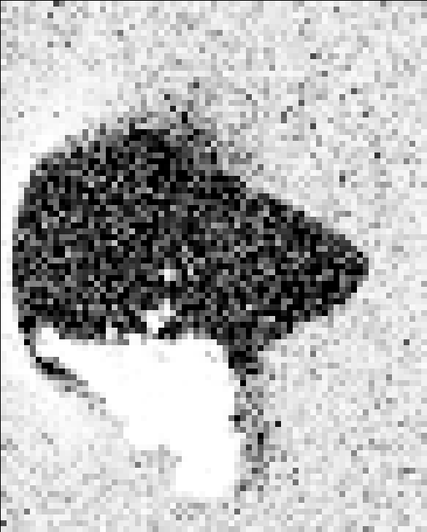
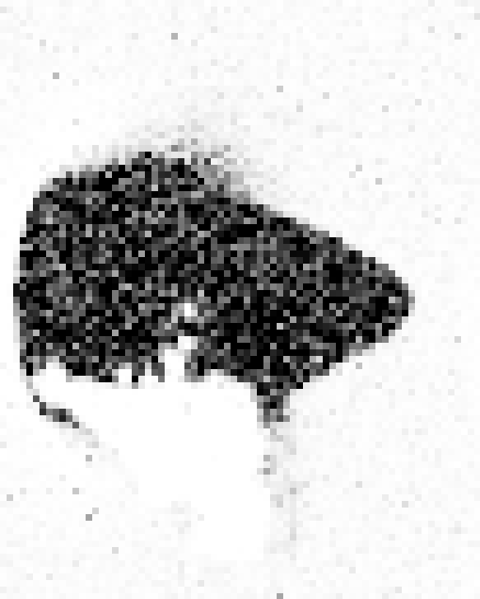
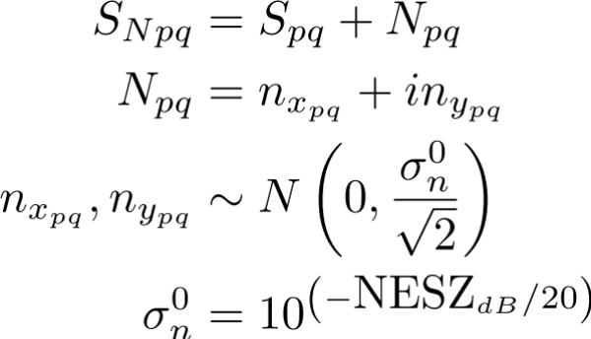
Adding thermal noise
PolSARproSim+ allows the simulation of thermal noise through the parameter ‘NESZ’, the noise equivalent sigma naught, supplied in dB for each polarization channel
The noise is uncorrelated between different tracks, which causes decorrelation in interferometric coherence as seen here
Backscatter Intensity
-25dB NESZ
-35dB NESZ
-45dB NESZ
Interferometric Coherence
-25dB NESZ
-35dB NESZ
-45dB NESZ

Slide 18
Summary
PolSARproSim+ is intended to be run as a command line tool
Simulation parameters such as scene geometry, radar parameters, forest and surface properties, moisture/motion profiles etc. can be set in a keyword-driven text-based parameter file
Primitives (such as species, location, height, crown parameters, dbh etc) of each tree in a forest stand can be specified using an XML file.
Species properties are controlled via a separate XML file using an extensive set of parameters
Any arbitrary DEM can be supplied using an external binary flat file. The DEM is resampled to simulation coordinates automatically. A shadow map is created based on the supplied DEM.
An optical image of the forest can be generated for visualization.
Stacks of multi-baseline interferograms in high fidelity (slow) and approximate (fast) modes can now be simulated
Effects of temporal decorrelation through physical change such as movement of canopy elements (branches and leaves) and moisture change can be simulated
A realistic band-limited Point Spread Functions (raised-cosine weighted) and thermal noise effects have been implemented
The simulator runs faster (i.e. multi-threaded implementation)
  An approximate 5-fold decrease in simulation time for a single baseline configuration

