Slide 1
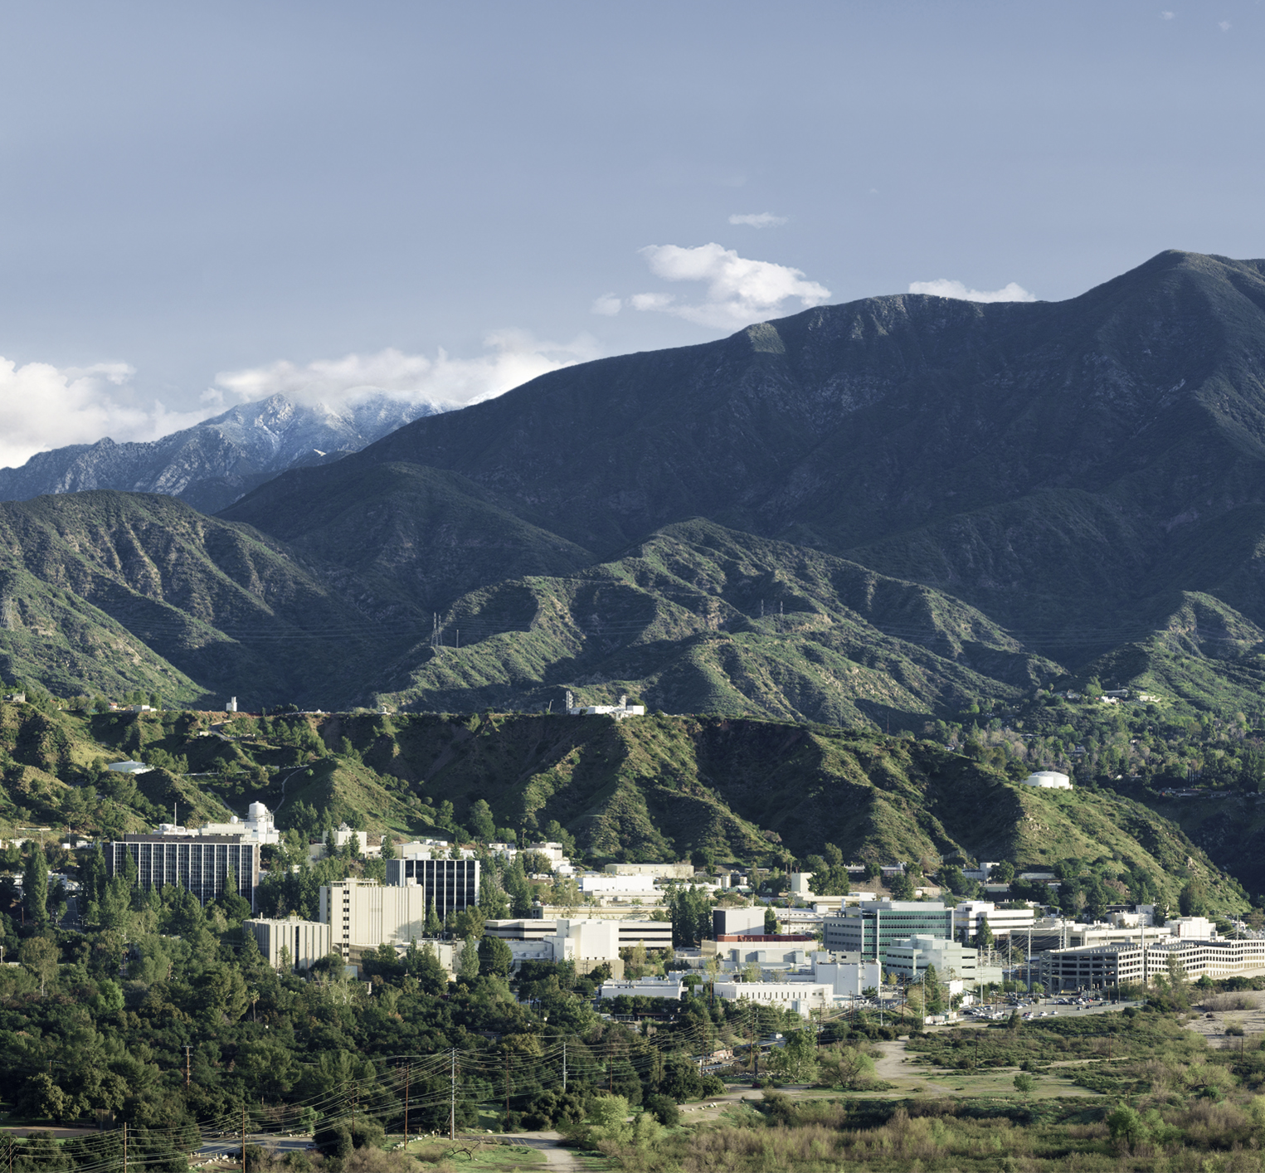
PolSARproSim+
Simulated Temporal Decorrelation in PolInSAR Signatures
Razi Ahmed
Jet Propulsion Laboratory, California Institute of Technology

Slide 2
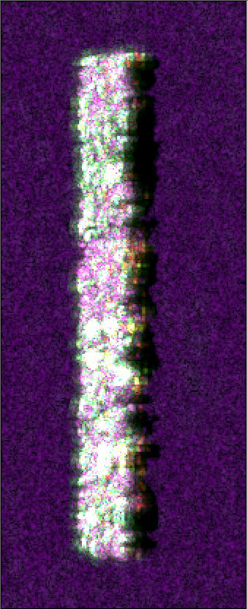
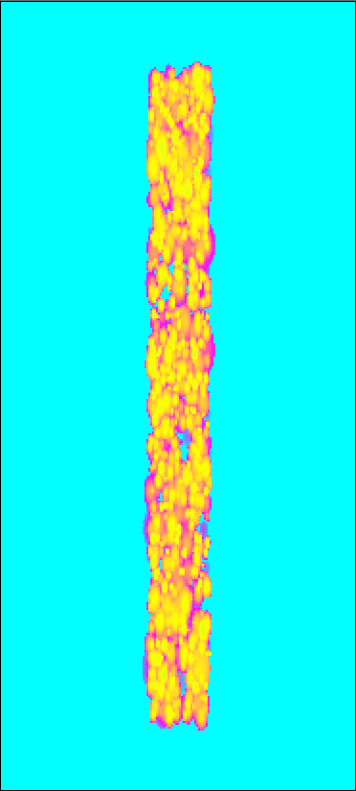
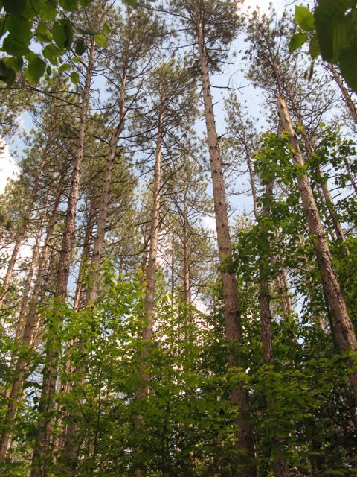
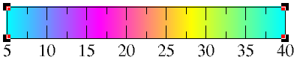
Simulating a 1-ha stand at the Harvard forest
1-ha stand (200mx50m
1200 trees, mostly coniferous (red pines)
Maximum heights of about 30m
Stem map, with location and dbh, species of every tree in this hectare surveyed by Univ. of Mass.
50m
200m
Parameter | Value
Frequency | L-Band 1217.5 to 1297.5 MHz
Bandwidth | 80 MHz
Resolution | 1.67 m Range, 0.8 m Azimuth
Polarization | Full Quad-Polarization
Simulated image
heights

Slide 3
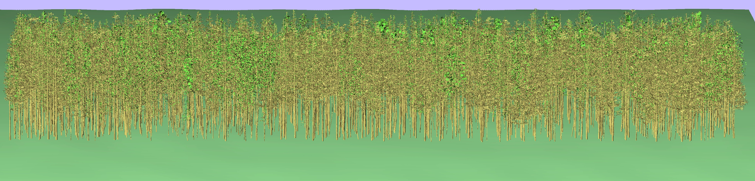
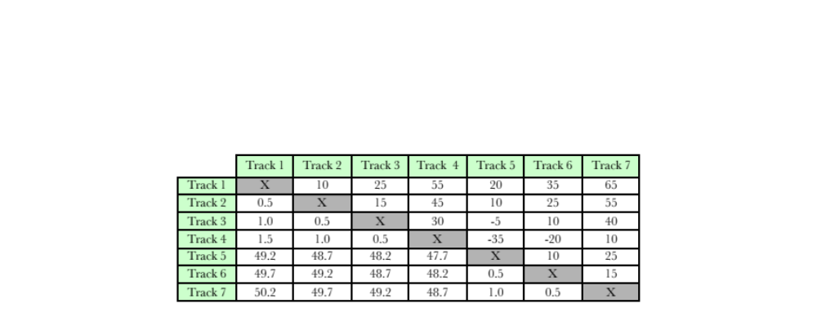
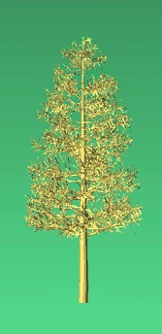
Simulated trees, stack
200m
Spatial baselines (upper half) in meters and temporal separation (lower half) in hours, for the stack of UAVSAR images. These geometries are duplicated for the simulations
Red pine

Slide 4
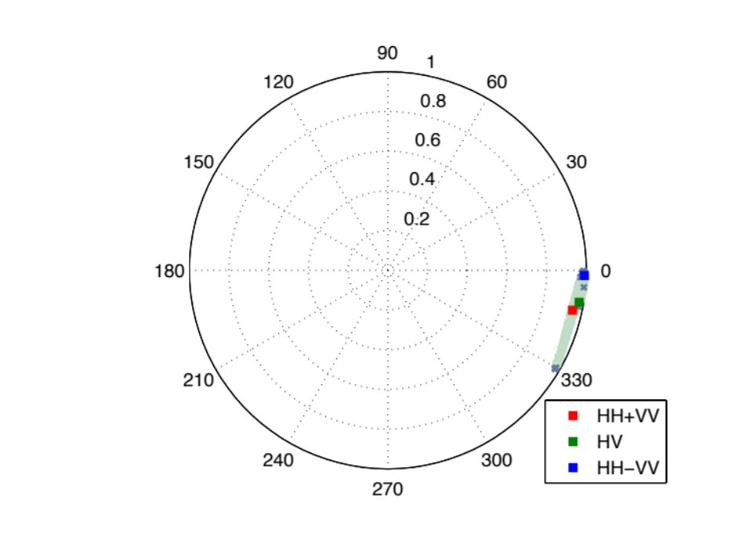
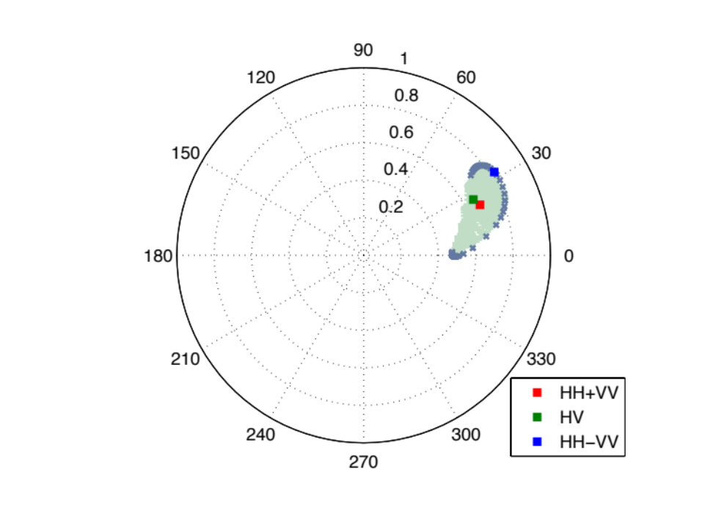
10m baseline (kz = 0.0176, unamb. Hgt = 356m)
No decorrelation
2.5cm rms motion at 30m

Slide 5
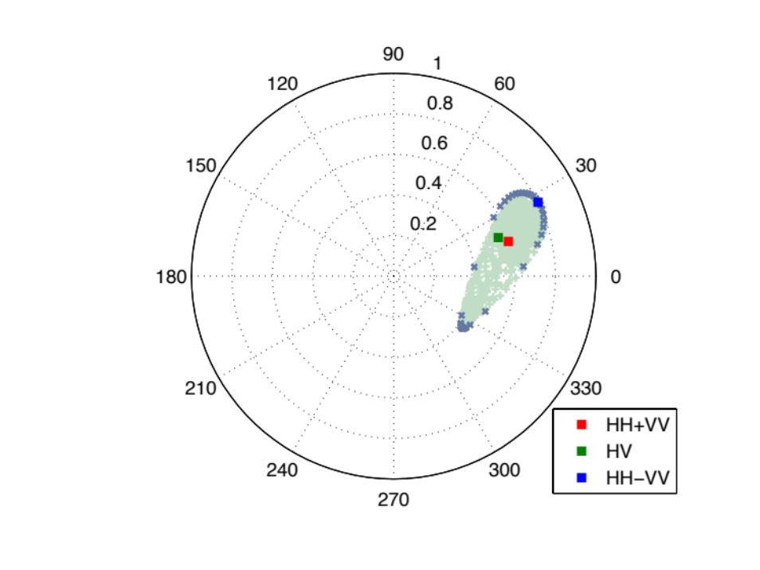
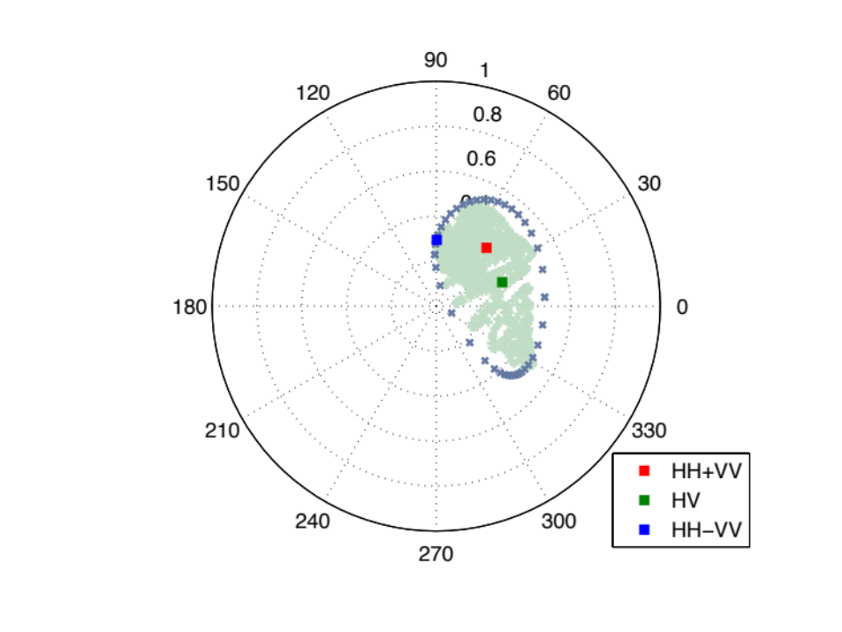
25m baseline (kz = 0.0176, unamb. Hgt = 142m)
No decorrelation
2.5cm rms motion at 30m

Slide 6
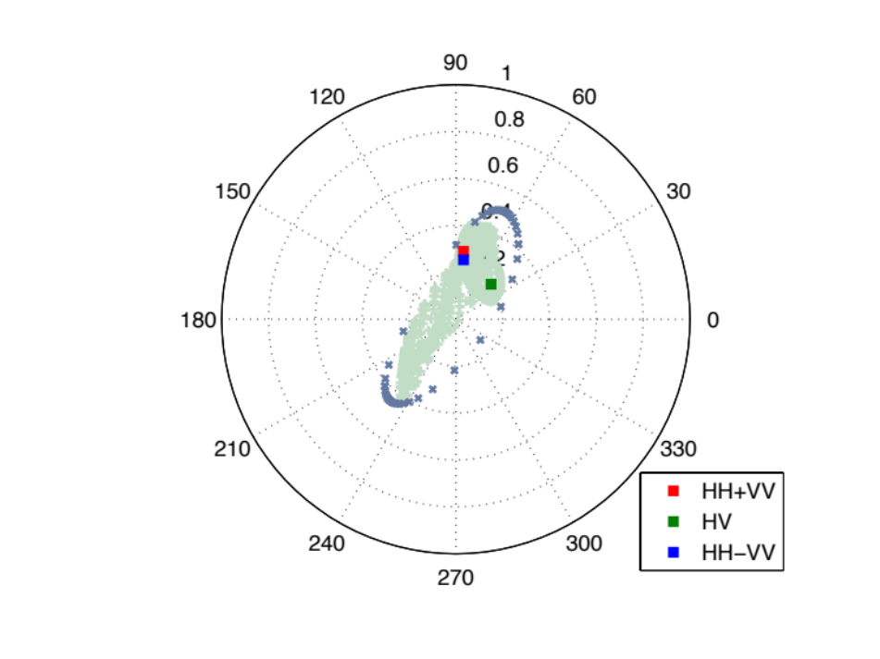
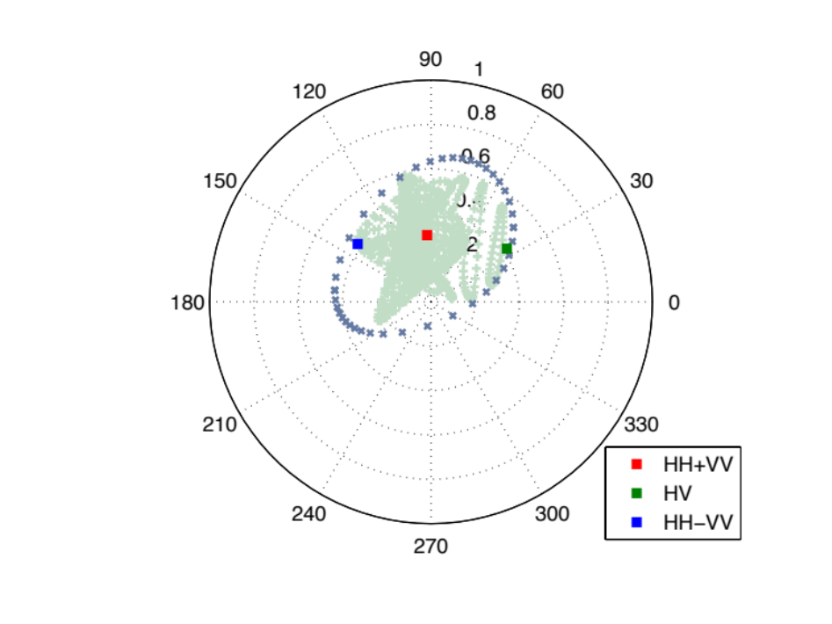
55m baseline (kz = 0.0970, unamb. Hgt = 65m)
No decorrelation
2.5cm rms motion at 30m

Slide 7
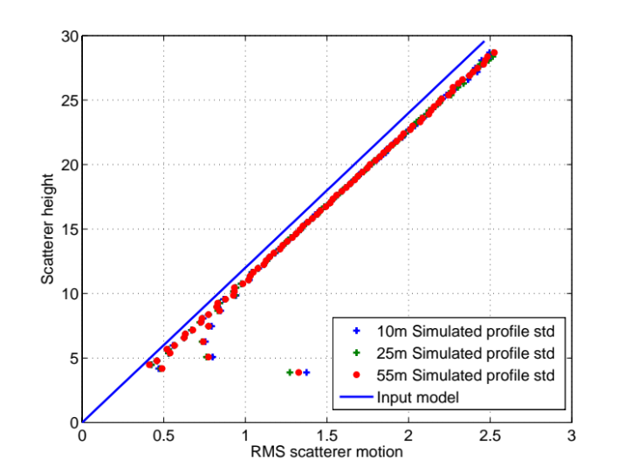
Simulated motion profile
For reference:
This plot shows the estimated standard deviation of the motion applied to scatterers (estimated for every 30cm height bin).
It likely differs from the input model (the solid blue line) due to my imperfect running std estimator

Slide 8
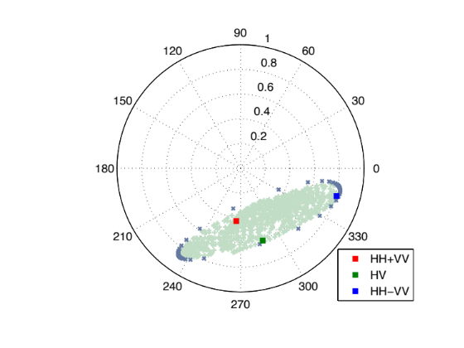
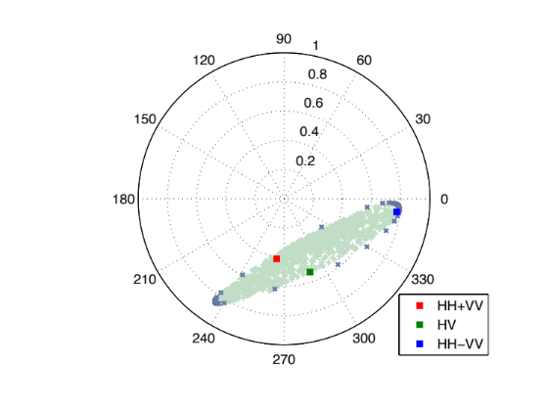
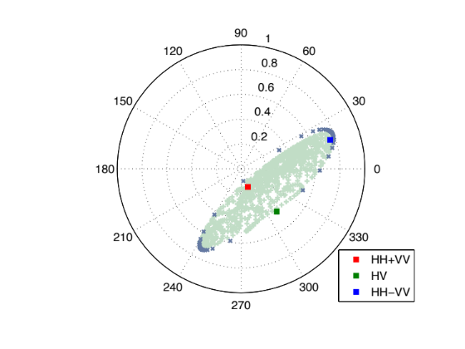
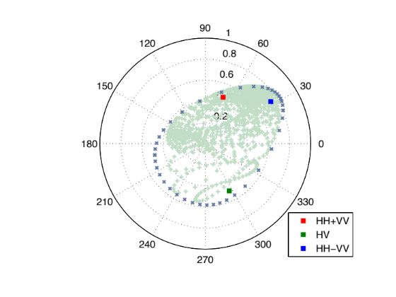
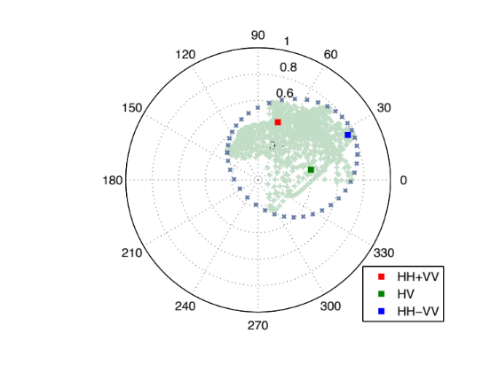
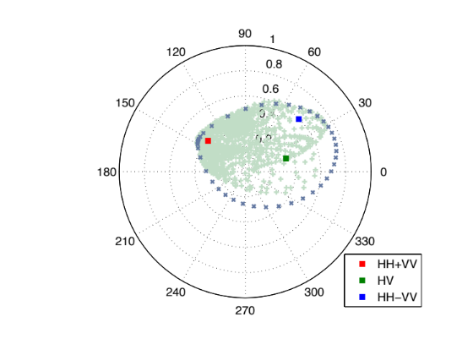
Increasing scatterer motion at 25m baseline (kz = 0.0176, unamb. Hgt = 142m)
No scatterer motion
0.6cm rms motion at 30m
1.2cm rms motion at 30m
1.8cm rms motion at 30m
2.4cm rms motion at 30m
3.0cm rms motion at 30m

Slide 9
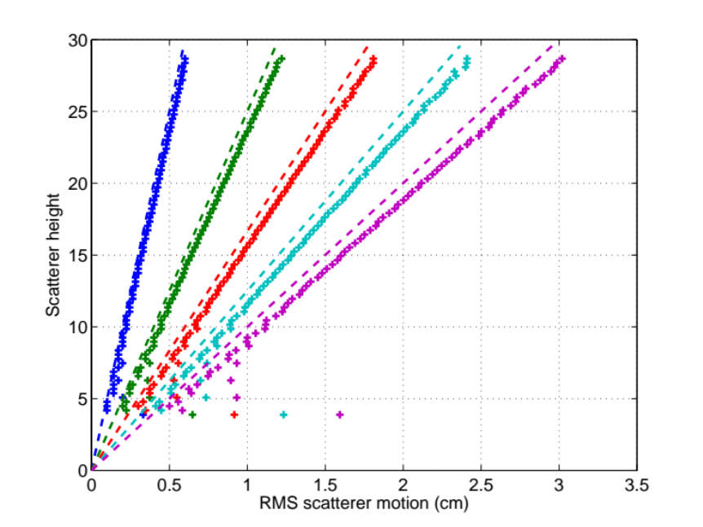
25m baseline (kz = 0.0176, unamb. Hgt = 142m)
Standard deviation of the scatterer motion as a function of height for previous slide

Slide 10
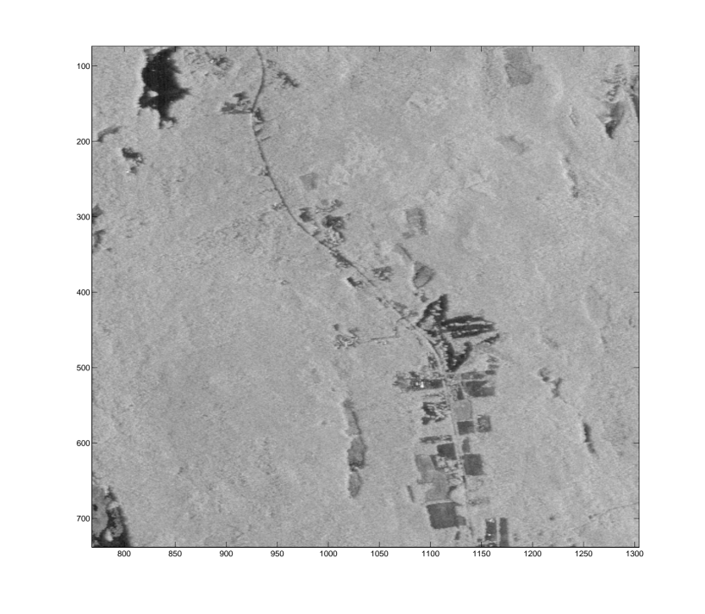
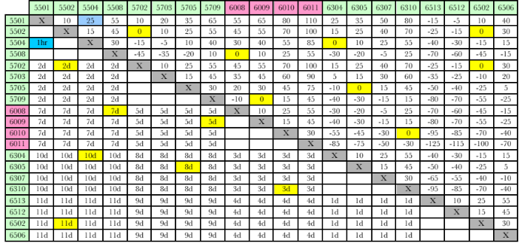
UAVSAR data over the Harvard forest
UAVSAR collected data between August 6th and and August 17th, 2009 over the Harvard Forest region
13-tracks with varying spatial and temporal baselines (shown in Table) are processed as a stack
15 1-hectare plots, divided into 16 25x25m subplots were surveyed in 2009. Stem map (tree location, dbh and species of every tree) of a 1ha plot was surveyed in 2012
Surveyed stem map 1ha plot
Harvard Forest, Prospect Hill tract

Slide 11
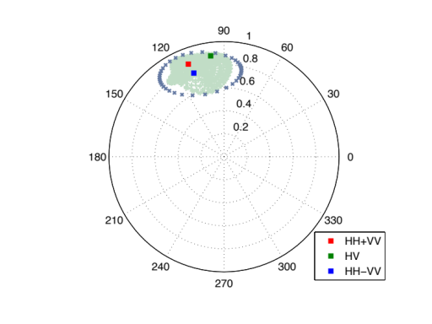
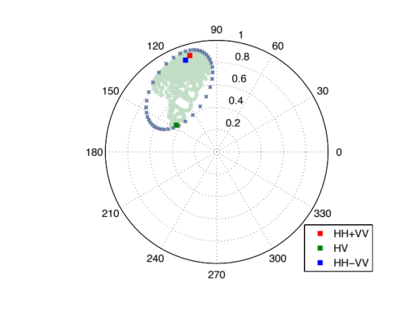
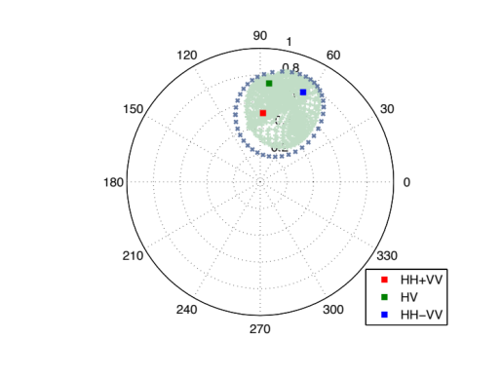
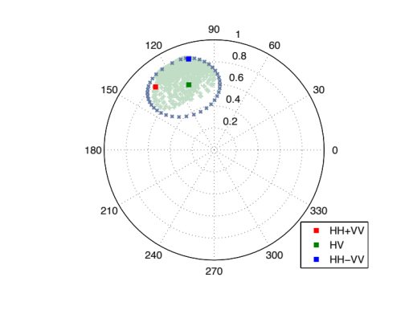
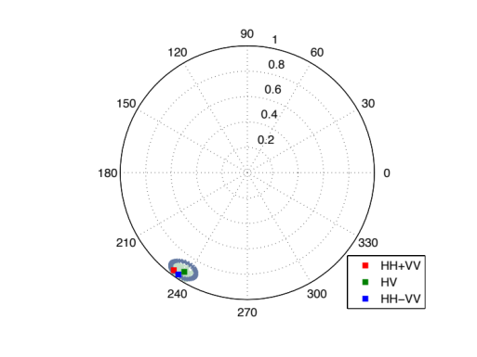
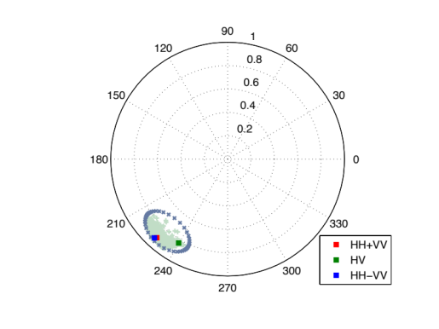
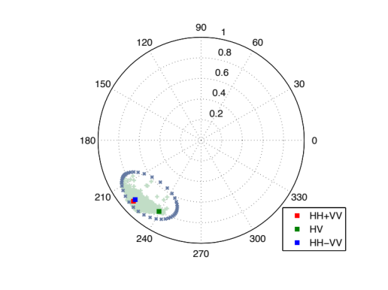
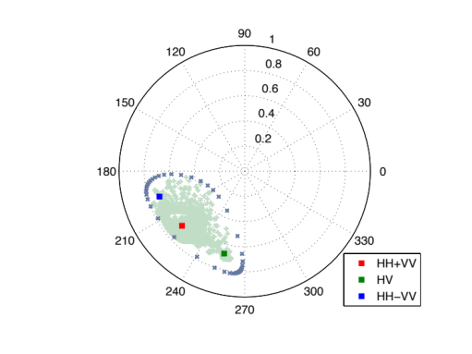
Preliminary Comparison of PolSARproSim+ simulations with UAVSAR data
Coherence regions for four pixels in the UAVSAR data that overlap the simulated pixel. The two UAVSAR tracks were spaced 1hr apart with a 25m horizontal baseline (kz = 0.0176, and unambiguous height = 142m)
Simulated image no motion
Simulated image 0.6cm RMS motion at 30m
Simulated image 1.2cm RMS motion at 30m
Simulated image 1.8cm RMS motion at 30m

