Slide 1

PolSARproSim+
Changing PolSARproSim
Razi Ahmed
Jet Propulsion Laboratory, California Institute of Technology

Slide 2
Current distribution of the software
All trees belong to one species (specified as a code in the parameter file)
Tree locations and the total number are calculated based on some predefined variables
Only one tree height is specified (input from the parameter file)
All other tree parameters such as stem diameter, canopy parameters are all allometrically calculated based on height.
Only simulates two tracks
Does not simulate temporal decorrelation
Implements a Gaussian Point Spread function
Is missing output layers such as Max tree height, look vectors etc.
Runs as a single process.
Cannot simulate a scene with arbitrary topography
Doesn’t include thermal noise effects

Slide 3
Proposed Changes
Be able to specify a forest for PolSARproSim to simulate
Be able to tell PolSARproSim to simulate different kind of tree species at the same time (i.e. mixed forests) not limited to four or five simple ones
Be able to simulate stacks of interferograms
Be able to introduce temporal decorrelation through physical change such as movement of canopy elements (branches and leaves) simulating wind, moisture change simulating rain and removal simulating death or anthropogenic change.
Implement more realistic Point Spread Functions (such as Sinc or Hamming weighted)
Make the code run faster (i.e. multi-threaded implementation)

Slide 4
PolSARproSim+ Structure
Forest Scattering
PolSARproSim+
For each track
Read input parameter file
Read DEM and create surface model
Draw forest image
(for visualization)
Calculate effective permittivities
Calculate attenuation map
Read species and forest XML databases
Calculate direct ground scattering
Calculate direct short vegetation scattering
For each tree
For each branch
Calculate Indirect (bounce) short vegetation scattering
Image tertiary branches
Image foliage
Image stem, primary and secondary branches
Initialize SAR stack
For each track
Deterministic Simulations
Scattering terms for large objects such as stems, primary and secondary branches are calculated in a deterministic fashion. Branches are divided into short segments, and scattering is modeled using an approximate but efficient form for the truncated infinite cylinder approximation.
For each track
Divide branch into sections
Model change
Monte Carlo Simulations
Small vegetation elements such as tertiary branches and foliage for the trees and short vegetation (<30cm) are simulated stochastically. The understory is divided into areas smaller than a resolution cell, and each is populated with a number of random realizations of occupying scattering elements. Crowns are treated in a similar fashion: distributing realizations throughout the crown evenly and scaling the scattering amplitudes accordingly. Realizations are preserved between calculations for each track on the interferometric baseline.
Modeling Change
The effects of temporal decorrelation are simulated by randomly changing the position or moisture of individual scattering elements such as branches leaves etc. The amount of change in moisture or position is specified for each track as a quadratic or exponential function of the height of the scatterer (relative to the ground or the canopy).

Slide 5
Reading Keyword Parameter File
Originally $prefix.sar is organized in so that parameters are input in a sequential (line by line) manner.
Added module read_parfile.c to allow reading of parameter file with keywords
Functions:
  read_cflag(FILE *pFin, str *keyword, char *data)
    reads a character from file stream pFin in line with keyword and store in data
  read_float(FILE *pFin, str *keyword, float *data)
  read_integer(FILE *pFin, str *keyword, int *data)
  read_string(FILE *pFin, str *keyword, char *data)
  read_double(FILE *pFin, str *keyword, double *data)
  read_fvector(File *pFin, str *keyword, float *data, int n)
    Reads a vector of floats of length n from stream pFin from line with keyword
  read_dvector(FILE *pFin, str *keyword, double *data, int n)
If #define READ_KEYWORD_PARFILE then use keyword parfile otherwise use the older style version. Forest parameters are generated inside the program in this case.
#PolSARproSim Configuration File
#PARAMETER NAME VALUE DESCRIPTION
tracks 1 /* The number of requested tracks */
center_slant_range_1 1443.37567 /* Slant range (broadside platform to scene centre) in metres */
incidence_angle_1 30.0000 /* Incidence angle in degrees */
center_slant_range_2 1448.40156 /* Slant range (broadside platform to scene centre) in metres */
incidence_angle_2 30.3426 /* Incidence angle in degrees */
radar_frequency 1.25 /* Centre frequency in GHz */
azimuth_resolution 0.6666 /* Azimuth resolution (width at half-height power) in metres */
slant_range_resolution 0.3333 /* Slant range resolution (width at half-height power) in metres */
DEM_model 5 /* DEM model: 0 = perfectly smooth, 10 = very rough */
ground_slope_azimuth 0.0000 /* Ground slope in azimuth direction (dimensionless) */
ground_slope_range 0.0000 /* Ground slope in ground range direction (dimensionless) */
randn_seed 45233 /* Random number generator seed */
global_tree_species 4 /* Tree species: 0 = HEDGE, 1,2,3 = PINE, 4 = DECIDUOUS */
global_tree_height 20.0000 /* Mean tree height in metres */
forest_stand_area 10000.0000 /* Area of the forest stand in square metres */
stem_density 50.0000 /* Desired stand density in stems per hectare */
ground_moisture 10 /* Ground moisture content model: 0 = driest ... 10 = wettest */
input_forest 1 /* 1: Input forest from $(prefix_canopy.txt), 0: generate forest of global_tree_species */

Slide 6
Input forest description
Added the ability to read in forest primitives in the form of XML files
<?xml version="1.0" encoding="ISO-8859-15"?>
<?xml-stylesheet type="text/xsl" href="forest.xsl"?>
<forest>
<meta>
<num_trees units="none"> 470 </num_trees> <!-- The total number of trees in this file -->
<biome units="none"> temperate </biome> <!-- The biome this forest belongs to -->
<area units="ha"> 0.4604 </area> <!-- The total area of the forest -->
</meta>
<tree>
<species units="none"> ACRU </species> <!-- Pinus Resinosa, Red Pine (see allometry file) -->
<x_location units="meters"> -38.2800 </x_location> <!-- X-axis location of tree, scene center is 0.00 -->
<y_location units="meters"> -15.3100 </y_location> <!-- Y-axis location of tree, scene center is 0.00 -->
<tree_height units="meters"> 20.0000 </tree_height> <!-- Vertical extent from tree base to canopy top -->
<canopy_radius units="meters"> 2.0000 </canopy_radius> <!-- The largest horizontal radius of the canopy -->
<canopy_depth units="meters"> 3.1980 </canopy_depth> <!-- The depth of the live part of the canopy -->
<dry_depth units="meters"> 0.3107 </dry_depth> <!-- The depth of the dry part of the canopy -->
<stem_diameter units="meters"> 0.6840 </stem_diameter> <!-- Diameter of trunk at breast height (dbh) -->
</tree>
<tree>
<species units="none"> PIRE </species> <!-- Pinus Resinosa, Red Pine (see allometry file) -->
<x_location units="meters"> -37.7800 </x_location> <!-- X-axis location of tree, scene center is 0.00 -->
<y_location units="meters"> -16.9100 </y_location> <!-- Y-axis location of tree, scene center is 0.00 -->
<tree_height units="meters"> 25.5700 </tree_height> <!-- Vertical extent from tree base to canopy top -->
<canopy_radius units="meters"> 1.1100 </canopy_radius> <!-- The largest horizontal radius of the canopy -->
<canopy_depth units="meters"> 1.7820 </canopy_depth> <!-- The depth of the live part of the canopy -->
<dry_depth units="meters"> 0.3960 </dry_depth> <!-- The depth of the dry part of the canopy -->
<stem_diameter units="meters"> 0.8745 </stem_diameter> <!-- Diameter of trunk at breast height (dbh) -->
</tree>
.
.
.
.
</forest>

Slide 7
Reading in forest primitives (XML)
Added module read_forest.c (with read_forest.h), which now also includes
  InputPolSARproSim_Forest_XML(*pPR)
    to read forest primitives file and compute some parameters for the Master Record
      pPR->mean_crown_radius, pPR->Layover_distance, pPR->Shadow_distance, pPR->Gap_distance, pPR->Stand_radius, pPR->Lx, pPR->Ly, pPR->Area, pPR->Hectares, pPR->nx, pPR->ny, pPR->deltax, pPR->deltay, pPR->Trees
      Added field pPR->max_tree_height
    Calls
      parse_XML_tree_tag() and parse_XML_meta_tag() to read the <tree> tags and the <meta> tag.
        Only parses the first N trees where N is read in from <num_trees> in <meta>
      trimwhitespaces() is a little function to strip out white spaces before and after the first and last non-space characters in a string. So that I can have good formatting in the XML file.
  CheckPolSARprSim_Forest(*pPR) (to check forest primitives)
    to check forest primitives read in from $prefix_forest.xml
Added field *ForestData of type (char) to Master_Record to store name of file that contains forest primitives. This name is computed in main() as $prefix_forest.xml
Added field ForestInput_Flag [int] in Master_Record. When it is set (to global flag EXTERNAL_FOREST_DEFINITION)
  InputPolSARproSim_Forest_XML() is invoked from InputPolSARproSim_Record() in PolSARproSim_Procedures.c
  ChecPolSARproSim_Forest() is invoked from InputPolSARproSim_Record() in PolSARproSim_Procedures.c
  Tree_Location_Generation() is not called in main() in PolSARproSim.c
Added fields to TreeLoc structure
  TreeLoc.species, TreeLoc.canopy_depth, TreeLoc.canopy_dry_depth, TreeLoc.dbh
  These fields are filled in InputPolSARproSim_Forest_XML for each tree, e.g. pPR->Tree_Location[itree].species = <name>; etc (see later slides)
  These fields are checked by ChecPolSARproSim_Forest() (see later slides)
InputPolSARproSim_Forest_XML() reads primitives from pPR->ForestData which is supposed to be an XML file with the necessary tags (without which the program will exit)
  <species> Name string <ASCII> e.g. ACRU. This is then related to the SpeciesDataBase (see later slides)
  <x_location> Tree X location: <double> [meters]
  <y_location> Tree Y location: <double> [meters]
  <tree_height> Tree height: <double> [meters]
  <canopy_radius> Canopy Radius: <double> [meters]
  <canopy_depth> Canopy depth: <double> [meters]
  <dry_depth> Canopy dry depth: <double> [meters]
  <stem_diameter> Dbh: <double> [meters] stem start diameter

Slide 8
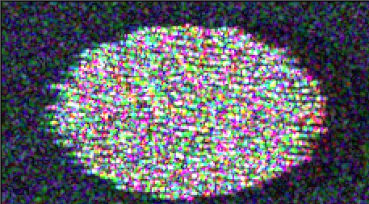
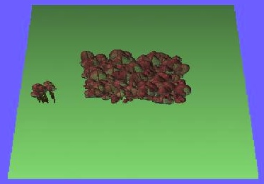
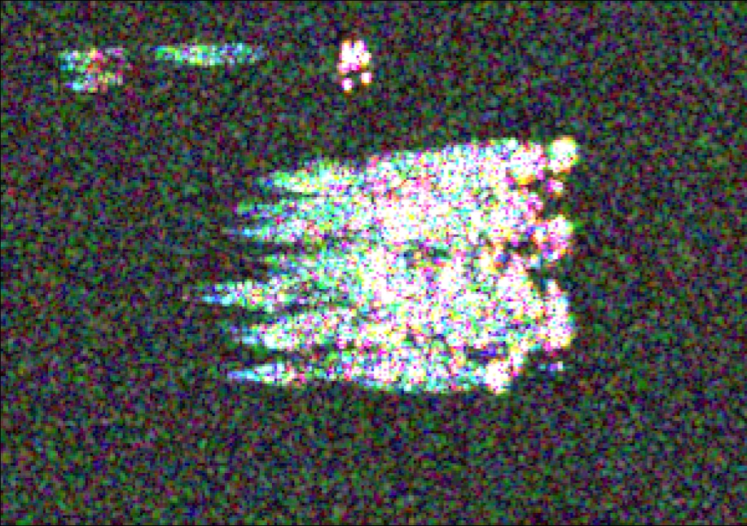
Arbitrary tree locations
Currently tree locations are generated by a randomizing a grid and avoiding collisions.
Edited PolSARproSim to include arbitrary tree locations
original
Range
Range
Azimuth
Azimuth

Slide 9
Tree Locations
TreeLoc.x and TreeLoc.y already exist
Originally tree locations are generated by Tree_Location_Generation() in PolSARproSim.c, called by main().
  Uses a randomizing algorithm in Shuffling.c
  These are stored for each Tree by setting
    pPR->Tree_Location[itree].x= generated x location;
    pPR->Tree_Location[itree].y= generated y location;
TreeLoc.x and TreeLoc.y were edited to be read in from the canopy file pPR->ForestData
  In InputPolSARproSim_Forest_XML()
    pPR->Tree_Location[itree].x = XMLDB.<x_location>
    pPR->Tree_Location[itree].y = XMLDB.<y_location>
  In CheckPolSARproSim_Forest() exit if |pPR->Tree_Location[itree].x| or |pPR->Tree_Location[itree].y| are > pPR->Lx or pPR->Ly respectively. Will not happen since pPR->Lx and pPR->Ly are decided from the input locations.
In main(), don’t call Tree_Location_Generation() if pPR->ForestInput_Flag is set to EXTERNAL_FOREST_DEFINITION.

Slide 10
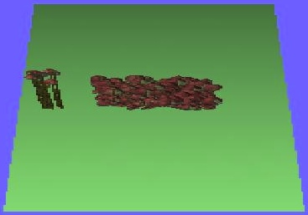
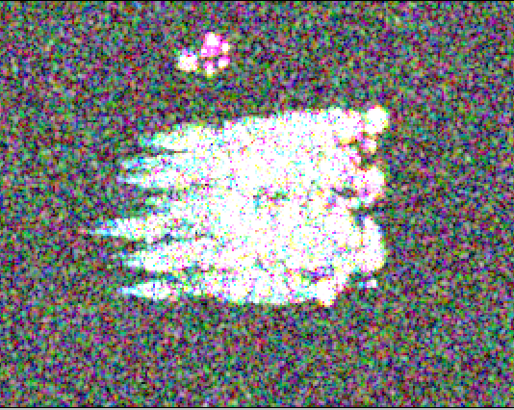
Arbitrary tree heights
Currently the height of each tree is the input global tree height +- a predefined standard deviation.
Edited PolSARproSim to allow specification of the height of each tree.
original
80m tall trees!

Slide 11
Tree Heights
TreeLoc.height already exists
It is originally filled in by InputPolSARproSim_Record() in PolSARproSim_Procedures.c as
  pPR->Tree_Location[itree].height = Realise_Tree_Height(pPR->mean_tree_height)
  Realise_Tree_Height() defined in Allometrics.c, determines the height of each tree by adding a random number of standard deviation defined by TREE_STDDEV_FACTOR, to pPR->mean_tree_height.
I edited out InputPolSARproSim_Record() to not use that part of the code when pPR->ForestInput_Flag is set to EXTERNAL_FOREST_DEFINTION, rather use Input_PolSARproSim_Forest().
Input_PolSARproSim_Forest_XML() reads pPR->ForestData where height is in the 4th column
  pPR->Tree.Location[itree].height = XMLDB.<tree_height>
Check_PolSARproSim_Forest() exits program if pPR->Tree_Location[itree].height < 0.

Slide 12
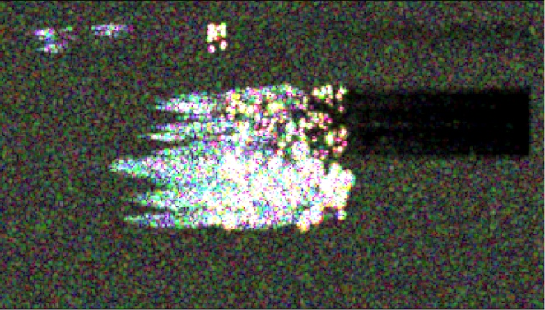
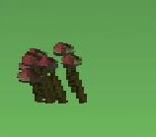
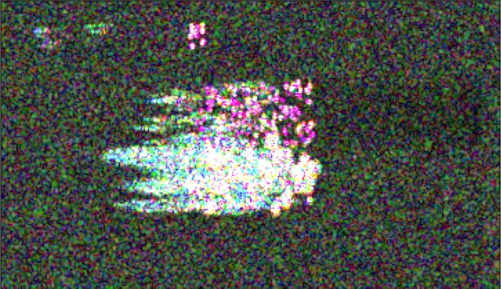
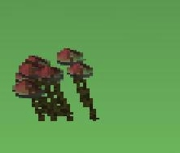
Arbitrary stem diameters
Currently the stem diameter of each tree is derived allometrically from its height.
Edited PolSARproSim to allow specification of the stem diameter of each tree as dbh.
original
Thicker stems!

Slide 13
Tree Diameters
Originally stem radius is computed by Realise_Stem() in Realisation.c through a call to Stem_Start_Radius() in Allometrics.c that returns a radius equal to STEM_RADIUS_FACTOR*height/100.
Added TreeLoc.dbh and Tree.dbh to allow dbh inputs for each tree from pPR->ForestData
  In InputPolSARproSim_Forest_XML()
    pPR->Tree_Location[itree].dbh = XMLDB.<stem_diameter>
  In CheckPolsARproSim_Forest(), exit program if pPR->Tree_Location[itree].dbh < 0
In Realise_Tree(pPR,i) set pT->dbh = pPR->Tree_Location[i].dbh to associate input dbh with a particular Tree’s dbh.
In Realise_Stem() set start_radius = pT->dbh/2 instead of start_radius = Stem_Start_Radius() to realise stem diameter from input if pPR->ForestInput_Flag is set to EXTERNAL_FOREST_DEFINITION.
Change function Primary_Radius(int species, double height) to Primary_Radius(Tree *pT, PolSARproSim_Record *pPR) so that sr0=pT->dbh/2 if pPR->ForestInput_Flag is set to EXTERNAL_FOREST_DEFINITION, otherwise sr0=Stem_Start_Radius(species, height).

Slide 14
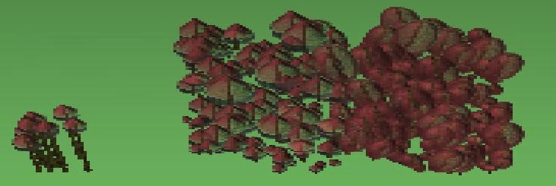
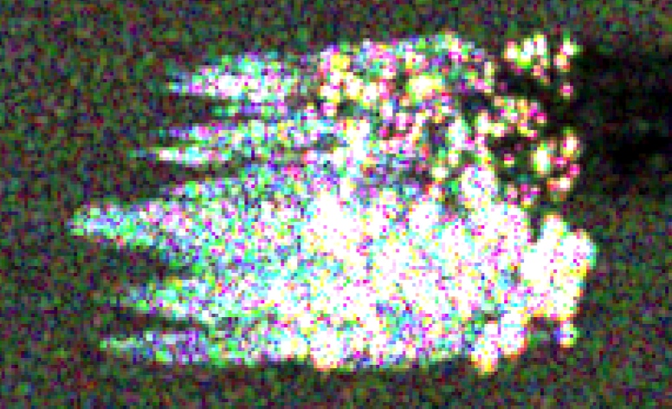
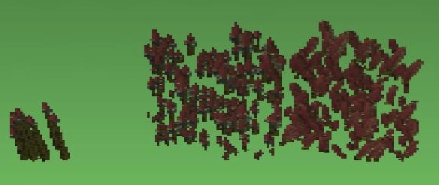

Arbitrary crown radii
Currently crown radius is allometrically derived from tree height.
Edited PolSARproSim to allow specification of the crown radius of each tree

Slide 15
Crown Radius
TreeLoc.radius already exists
Originally crown radius is computed for each tree by a call to Realise_Tree_Crown_Radius(species, height) in Allometrics.c called by InputPolSARproSim_Record() in PolSARproSim_Procedures.c
  pPR->Tree_Location[itree].radius = Realise_Tree_Crown_Radius(pPR->species, pPR->Tree_Location[itree].height
Edited to read crown radius from pPR->ForestData
  InptPolSARproSim_Forest_XML() reads in radius
    pPR->Tree_Location[itree].radius = XMLDB.<canopy_radius>
  CheckPolSARproSim_Forest exits of pPR->Tree_Location[itree].radius < 0
Mean crown radius pPR->mean_crown_radius is computed as an average of the crown radii in pPR->ForestData
Not sure why Surface_Parameters() is using Mean_Tree_Crown_Radius instead of pPR->mean_crown_radius. It sets pPR->large_scale_length, that is used in generation of ground heights.

Slide 16
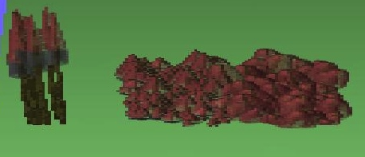
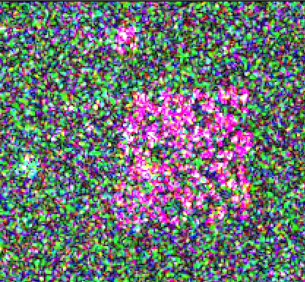

Arbitrary crown depths
Currently crown depth is allometrically derived from tree height.
Edited PolSARproSim to allow specification of the crown depth and crown dry depth of each tree
Crown depths set to zero

Slide 17
Crown Depth
Originally crown depth and crown dry depth are estimated allometrically by Mean_Living_Crown_Depth(species, height) and Crown_Fractional_Dry_Depth(species, height).
Added TreeLoc.crown_depth and TreeLoc.crown_dry_depth to read in canopy depth and canopy_dry_depth from pPR->ForestData
  Read in InputPolSARproSim_Forest_XML()
    pPR->Tree_Location[itree].canopy_depth = XMLDB.<canopy_depth>
    pPR->Tree_Locaiton[itree].canopy_dry_depth = XMLDB.<dry_depth>
  In CheckPolSARproSim_Forest()
    Exit if pPR->Tree_Location[itree].canopy_depth < 0
    Exit if pPR->Tree_Location[itree].canopy_dry_depth + pPR->Tree_Location[itree].canopy_depth > pPR->Tree_Location[itree].height
Added Tree.canopy_depth and Tree.canopy_dry_depth.
In Realise_Tree() and Realise_Tree_Crown() if pPR->InputForest_Flag is set to EXTERNAL_FOREST_DEFINITION
  pT->canopy_depth = pPR->Tree_Location[itree].canopy_depth
  pT->canopy_dry_depth = pPR->Tree_Location[itree].canopy_dry_depth
Changed Create_PINE00n_Global_Crown() and Create_DECIDUOUS001_Globa_Crown() to use pT->canopy_depth and pT->canopy_dry_depth instead of using Realise_Living_Crown_Depth() and Fractional_Dry_Depth() if pPR->InputForest_Flag is set to EXTERNAL_FOREST_DEFINITION
These parameters are used to constrain primary/secondary branch sizes and tertiary/foliage numbers.

Slide 18
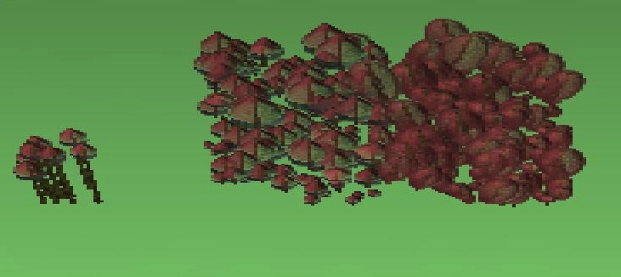

Arbitrary tree species
Currently every tree belongs to one global tree species, specified in the parameter file by code:
  0 : Hedge
  1 : Pine with spherical Crown
  2 : Pine with conical crown
  3 : Pine with randomly chosen crown
  4 : Deciduous with spherical crown
Edited PolSARproSim to allow specification of arbitrary species for each tree, with a species defined in a separate species database (XML) file.
original
Pine
Decid
Pine
Deciduous

Slide 19
XML Species Database
<?xml version="1.0" encoding="ISO-8859-15"?>
<?xml-stylesheet type="text/xsl" href="forest.xsl"?>
<allometry>
<species_list> <!-- MANDATORY list of species -->
<name units="none"> HEDGE </name> <!-- 0: The hedge -->
<name units="none"> TSCA </name> <!-- 1: Tsuga Canadensis, Eastern Hemlock -->
<name units="none"> PIRE </name> <!-- 2: Pinus Resinosa, Red Pine -->
<name units="none"> BEPA </name> <!-- 3: Betula Papyrifera, Paper/White Birch -->
<name units="none"> ACRU </name> <!-- 4: Acer Rubrum, Red Maple -->
</species_list>
<category_list> <!-- MANDATORY list of categories -->
<name units="none"> deciduous </name> <!-- Broadleaf, deciduous trees -->
<name units="none"> coniferous </name> <!-- Needlesd, evergreen coniferous trees -->
</category_list>
<deciduous> <!-- All fields MANDATORY if category defined in category_list -->
<livecrownshp units="none"> spheroid </livecrownshp> <!-- spheroidal crown by default -->
<drycrownshp units="none"> none </drycrownshp> <!-- no dry crown -->
.
.
.
</deciduous>
<coniferous> <!-- All fields MANDATORY if category defined in category_list -->
<livecrownshp units="none"> conical </livecrownshp> <!-- conical crown by default -->
<drycrownshp units="none"> cylindrical </drycrownshp> <!-- cylindrical crown by default -->
.
.
.
</coniferous>
<ACRU>
<category units="none"> deciduous </category> <!-- MANDATORY category of trees (unused if all fields defined) -->
<livecrownshp units="none"> spheroid </livecrownshp> <!-- shape of living crown (spheroid or conical) -->
<drycrownshp units="none"> none </drycrownshp> <!-- shape of dry crown (none or cylindrical) -->
</ACRU>
<PIRE>
<category units="none"> coniferous </category> <!-- MANDATORY category of trees (unused if all fields defined) -->
<livecrownshp units="none"> conical </livecrownshp> <!-- shape of living crown (spheroid or conical) -->
<drycrownshp units="none"> cylindrical </drycrownshp> <!-- shape of dry crown (none or cylindrical) -->
</PIRE>
<TSCA>
<category units="none"> coniferous </category> <!-- MANDATORY category of trees (unused if all fields defined) -->
<livecrownshp units="none"> spheroid </livecrownshp> <!-- shape of living crown (spheroid or conical) -->
<drycrownshp units="none"> cylindrical </drycrownshp> <!-- shape of dry crown (none or cylindrical) -->
</TSCA>
<BEPA>
<category units="none"> deciduous </category> <!-- MANDATORY category of trees (unused if all fields defined) -->
</BEPA>
<ACSA>
<category units="none"> deciduous </category> <!-- MANDATORY category of trees (unused if all fields defined) -->
</ACSA>
<HEDGE>
<category units="none"> deciduous </category> <!-- MANDATORY category of trees (unused if all fields defined) -->
<livecrownshp units="none"> cylindrical </livecrownshp> <!-- shape of living crown (spheroid or conical) -->
<drycrownshp units="none"> none </drycrownshp> <!-- shape of dry crown (none or cylindrical) -->
</HEDGE>
</allometry>

Slide 20
Allometry Input
Originally five species are hardcoded into PolSARproSim. Their properties are all either listed in Allometrics.h or derived by functions in Allometrics.c and are used throughout the software
      Deciduous1
      Hedge
      Pine1,Pine2,Pine3
Added module read_allometry.c that includes functions
      Input_PolSARproSim_Allometry(); To import species parameter XML database
      getSpeciesData(); getSpeciesList(); To get species attributes from XML database
      getCategoryData(); getCategoryList(); To get category attributes from XML database
Added structure Allometry with fields that will include species specific attributes, e.g. Crown Shapes, Branch/Leaf Parameters etc.
Added two pointers in MasterRecord to Allometry structures
      SpeciesDataBase
      CategoryDataBase
    The CategoryDataBase (of size, pPR->Ncategories which is based on the number of categories listed in <category_list> tag in XML database), is based on the idea that this will be general parameters for broad categories of trees such as deciduous, coniferous etc.
    The SpeciesDataBase (of size pPR->Nspecies which is based on the number of species names listed in <species_list> tag in XML database), is the parameters specific to each species.
The full path and name of the species XML file are specified in the input parameter file.
Every parameter needs to be specified for each category listed under tag <category_list>. The program will exit if either the category tag isn’t found or it doesn’t have any one of the parameters.
Each species listed in the <species_list> tag needs to at least have the <category> it belongs to. The software will exit if this field is not found or not recognized.
If any of the parameters are not found for a particular species, then the parameter from its <category> is used instead.
This method puts no limits on the number of categories or species, or the format of their names (though name must not be longer than SPECNAME_MAX_STRSIZE).

Slide 21
Tree Species –rev 1.
Originally all tree species were based on pPR->species
  0 HEDGE
  1 PINE001 Pine with spherical live crown
  2 PINE002 Pine with conical live crown
  3 PINE003 Pine with either spherical or conical live crown
  4 DECIDUOUS001 Deciduous with spherical crown
Added TreeLoc.species to allow input of tree species to each tree.
  InputPolSARproSim_Forest() reads the first column of pPR->ForestData and fills in TreeLoc.species
    pPR->Tree_Location[itree].species = <column 1>
  CheckPolSARproSim_Forest() exits program if species < 1 and > 4
In Realise_Tree(pPR, i) and Realise_Tree_Crown_Only(pPR,i) changed code to use pPR->Tree_Location[i].species if pPR->ForestInput_Flag is set to EXTERNAL_FOREST_DEFINITION
Changed the pPR->species pT->species everywhere (see notes) except
  When it is if(pPR->species == HEDGE). Did NOT include definition of HEDGE in $prefix_canopy.txt.
  In Effective_Permittivities() when choosing leaf species. Not sure what to do here!
  In Effective_Permittivities() when choosing Tertiary Branch Moisture because all species have the same tertiary branch moisture.
  In Effective_Permittivities() when choosing Tertiary Leaf Volume Fraction because all species have the same leaf volume fraction.
  In Effective_Permittivities() when computing leaf moisture, because all species have the same leaf moisture.
  In PolSARproSim_Short_Vegi.c, assuming that short vegetation species is defined by pPR->species.
This changed drastically when I added read_allometry.c/h --rev 2

Slide 22
Tree Species –rev 2
Originally all tree species were based on pPR->species
  0 HEDGE
  1 PINE001 Pine with spherical live crown
  2 PINE002 Pine with conical live crown
  3 PINE003 Pine with either spherical or conical live crown
  4 DECIDUOUS001 Deciduous with spherical crown
Rev 1. Added TreeLoc.species to allow input of tree species to each tree, and changed all pPR->species codes to pT->species codes (see previous slide)
In this revision, the TreeLoc.species code is now filled in with the index (ispecies) to SpeciesDataBase where the SpeciesDataBase[ispecies].species_name and species name specified in the forest XML file match.
This allows expansion of species beyond the hard-coded 5.

Slide 23
Realizations
Have to edit all Realization functions to eliminate all switch/if statements on pT->species.
Instead have them use species database
  pT->SpeciesDatabase[pT->species].property
Also change all functions in Allometry.c and constants in Allometry.h to be input from the species database file

Slide 24
Crown Realization
Originally, Realise_Global_Crown() either calls Realise_HEDGE/PINE00n/DECIDUOUS001_Global_Crown() based on pPR->species to create the five different canopy types.
Wrote Realise_Crown() function that creates a crown based on species specific properties (read from the species database file)
  <livecrownshp>: shape of live crown (so far only have cylinder, cone, spheroid)
  <drycrownshp>: shape of dry crown (limited to cylinder originally, can be any of the three now)
  <lcdepthfactor>: Live crown depth factor, fraction of pT->canopy_depth at which the live crown radius is specified
  <dcdepthfactor>: Dry crown depth factor, fraction of pT->dry_depth at which the crown radius is specified (maybe this will include dry crown radius as well)
  <stem_maxangle>: Stem angle: the maximum angle for the stem axis (as measured from nadir)
The dry or live crown is added to pT->crown_list only if the shape is not CROWN_NULL_SHAPE.

Slide 25
Stem Realization
Originally Realise_Stem() called by Realise_Tree() used functions such as Stem_Start_Radius(); Stem_Moisture(); using pT->species as an argument. In those functions the five species were hardcoded via definitions or switch statements.
Added these fields to the XML database file and added their reading to the SpeciesDatabase and CategoryDataBase structures, to make the stem description generic
  stem_max_angle; /* maximum stem angle (from vertical) in degrees */
  stem_end_radius_factor; /* determines end radius of tree stem as a function of height */
  stem_tropism_factor; /* determines the stem tropism */
  stem_lamdacx_stdev; /* stdev of curvature wavelength in x-direction */
  stem_lamdacx_mean; /* mean of curvature wavelength in x-direction */
  stem_lamdacy_stdev; /* stdev of curvature wavelength in y-direction */
  stem_lamdacy_mean; /* mean of curvature wavelength in y-direction */
  stem_gamma_stdev; /* stdev of curvature scale-factor */
  stem_gamma_mean; /* mean of curvature scale-factor */
  stem_moisture; /* fractional moisture of stem */
  stem_tropism_theta; /* polar angle (theta) of the stem tropism direction */
  stem_tropism_phi; /* azimuthal angle (phi) of the stem tropism direction */

Slide 26
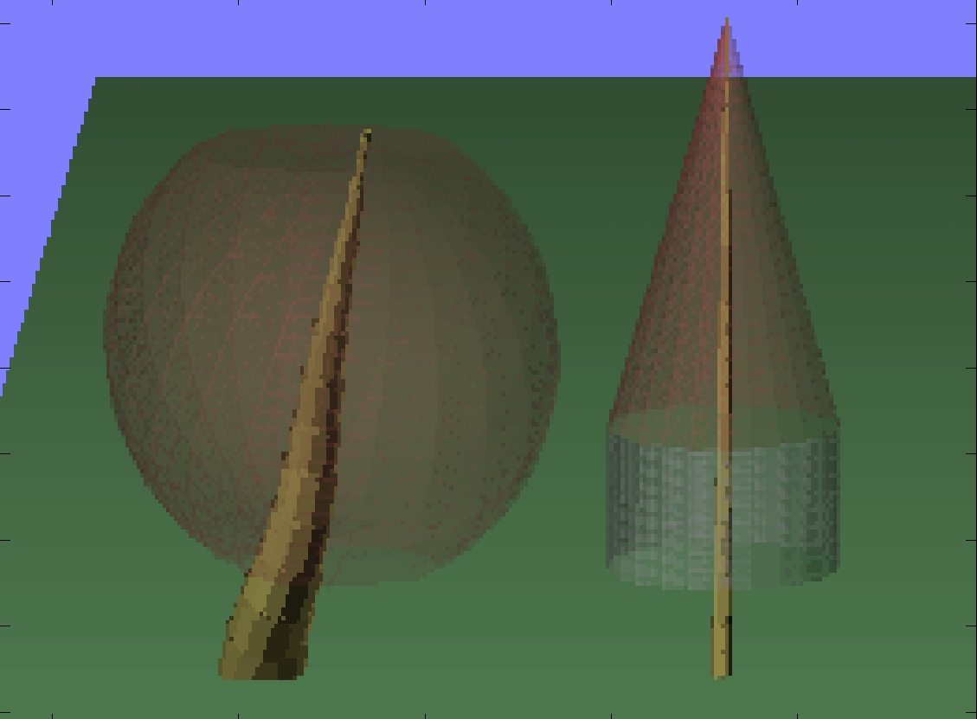
Stem angle
 | max polar angle
Left Tree | 30 degrees
Right Tree | 1 degree

Slide 27
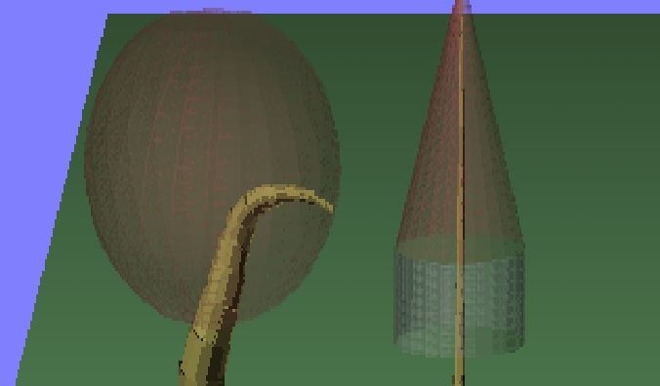
Stem tropism
 | Tropism theta | Tropism phi | Tropism factor
Left Tree | 180 | 0 | 0.8
Right Tree | 0 | 0 | 0.1

Slide 28
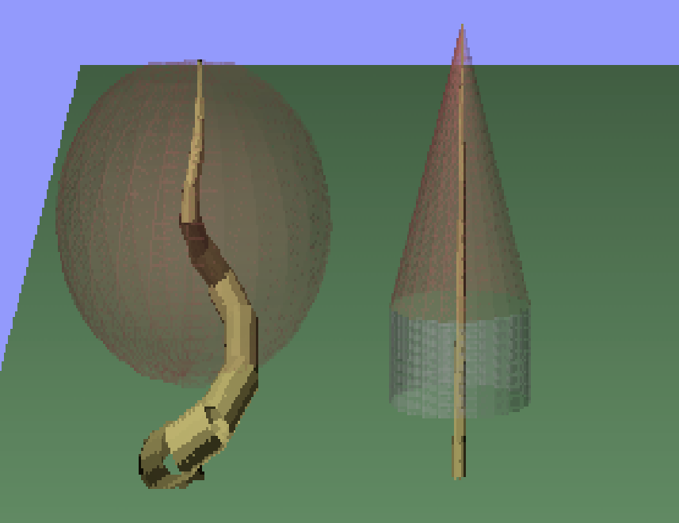
Stem curvature
 | Gamma
Left Tree | 0.75
Right Tree | 0.0075

Slide 29
Primary branch Realization
Originally Realise_Primaries() called Realise_PINE001_Primaries() or Realise_DECIDUOUS001_Primaries() based on a switch on tree species.
I rewrote Realise_Primaries() so that it realizes primary branches without the switch on species. Previous version of Realise_Primaries() and Realise_PINE/DECID_Primaries() were commented out.
Functions, Primary_Tropism_Factor(), Primary_Tropism_Direction(), Primary_Lamdacx, Primary_Lamdacy, Primary_Gamma, Primary_Moisture, Primary_Dry_Moisture() were all changed to allow reading of their respective fields from the species database.
Added these fields to the XML database file and added their reading to the SpeciesDatabase and CategoryDataBase structures, to make the primary description generic
  primary_avg_polar_angle;/* mean polar angle (theta) of the primary branches */
  primary_std_polar_angle;/* standard deviation of primary polar angle */
  primary_layer_density; /* number of primary layers per unit canopy depth */
  primary_avg_sections; /* average number of sections per layer of primary branches */
  primary_azimuth_factor; /* azimuth angle std factor for primary braches */
  primary_radius_A; /* quadratic coefficient of primary radius function */
  primary_radius_B; /* linear coefficient of the primary radius function */
  primary_radius_C; /* constant coefficient of the primary radius function */
  primary_tropism_factor; /* determines the primary tropism */
  primary_tropism_theta; /* polar angle (theta) of the primary tropism direction */
  primary_tropism_phi; /* azimuthal angle (phi) of the primary tropism direction */
  primary_lamdacx_stdev; /* stdev of curvature wavelength in x-direction */
  primary_lamdacx_mean; /* mean of curvature wavelength in x-direction */
  primary_lamdacy_stdev; /* stdev of curvature wavelength in y-direction */
  primary_lamdacy_mean; /* mean of curvature wavelength in y-direction */
  primary_gamma_stdev; /* stdev of primary branch curvature scale-factor */
  primary_gamma_mean; /* mean of primary branch curvature scale-factor */
  primary_live_moisture; /* fractional moisture of living primary branches */
  primary_dry_moisture; /* fractional moisture of dry primary branches */
  primary_dry_density; /* number of dry primary layers per unit dry canopy depth */
  primary_dry_sections; /* number of sections per layer of dry primary branches */

Slide 30
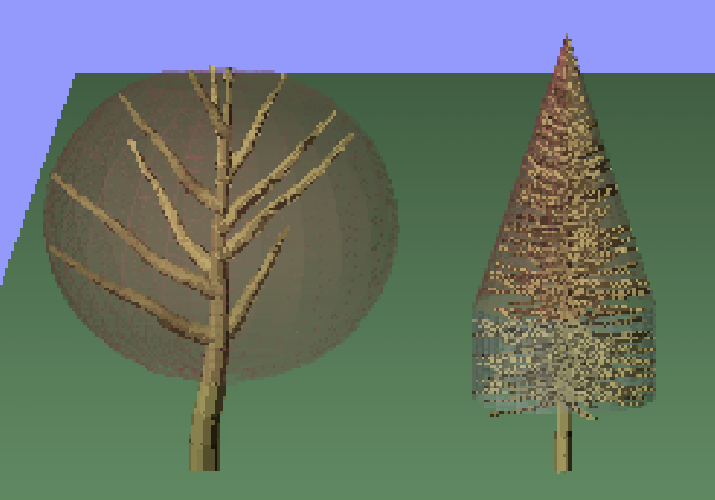
Primary branch numbers
 | Layer density | Sections
Left Tree | 1.0 | 1
Right Tree | 4.01 | 6

Slide 31
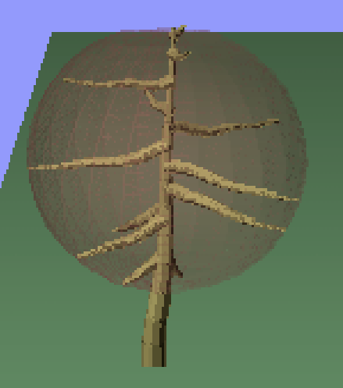
Primary branch angles
 | Polar angle
Left Tree | 50
Right Tree | 110

Slide 32
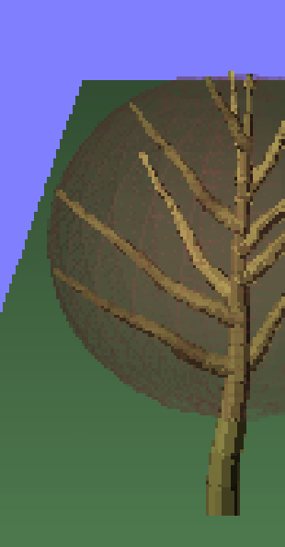
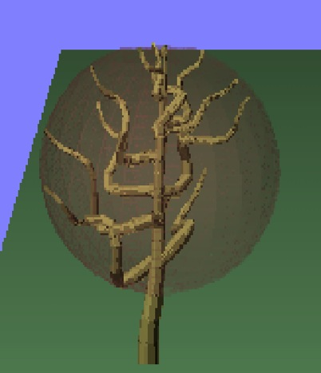
Primary branch curvature
 | Gamma
Left Tree | 0.075
Right Tree | 0.75

Slide 33
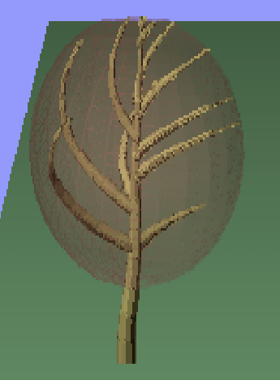
Primary branch tropism
 | Tropism theta | Tropism phi | Tropism factor
Left Tree | 0 | 0 | 0.3
Right Tree | 90 | 0 | 0.8

Slide 34
Secondary branch Realization
Originally Realise_Secondaries() called Realise_PINE001_Secondaries() or Realise_DECIDUOUS001_Secondaries() based on a switch on tree species.
I rewrote Realise_Secondaries() so that it realizes secondary branches without the switch on species. Previous version of Realise_Secondaries() and Realise_PINE/DECID_Secondaries() were commented out.
Functions, Secondary_Tropism_Factor(), Secondary_Tropism_Direction(), Secondary_Lamdacx, Secondary_Lamdacy, Secondary_Gamma were all changed to allow reading of their respective fields from the species database.
Added these fields to the XML database file and added their reading to the SpeciesDatabase and CategoryDataBase structures, to make the primary description generic
secondary_number_slope; /* slope of linear fn. determining no. of secondary branch */
secondary_number_intercept;/* intercept of linear fn. determining no. of secondary branch */
secondary_offset_fraction; /* fractional offset of secondary start location (tmin) */
secondary_avg_polar_angle; /* average polar angle of secondary branches */
secondary_std_polar_angle; /* std dev of the polar angle of secondary branches */
secondary_radius_factor; /* Start radius of secondaries as a factor of secondary radius */
secondary_tropism_factor; /* determines the secondary tropism */
secondary_tropism_theta; /* polar angle (theta) of the secondary tropism direction */
secondary_tropism_phi; /* azimuthal angle (phi) of the secondary tropism direction */
secondary_lamdacx_stdev; /* stdev of curvature wavelength in x-direction */
secondary_lamdacx_mean; /* mean of curvature wavelength in x-direction */
secondary_lamdacy_stdev; /* stdev of curvature wavelength in y-direction */
secondary_lamdacy_mean; /* mean of curvature wavelength in y-direction */
secondary_gamma_stdev; /* stdev of secondary branch curvature scale-factor */
secondary_gamma_mean; /* mean of secondary branch curvature scale-factor */

Slide 35
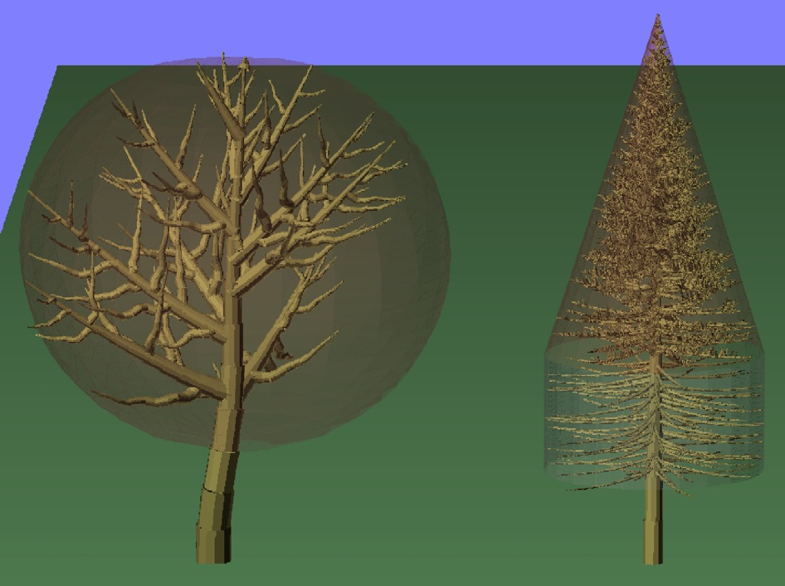
Secondary branch numbers
 | Slope | Intercept
Left Tree | 1.045 | 0
Right Tree | 18.95864 | -4.26094

Slide 36
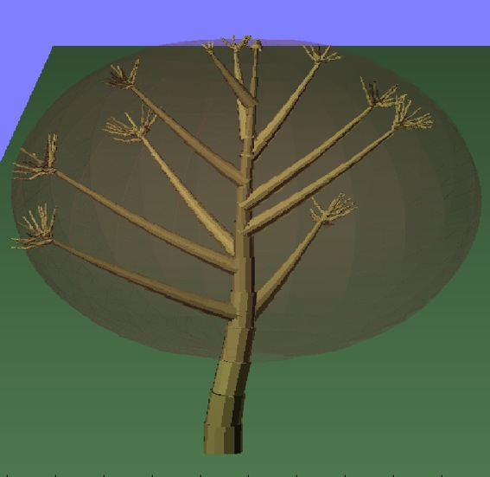
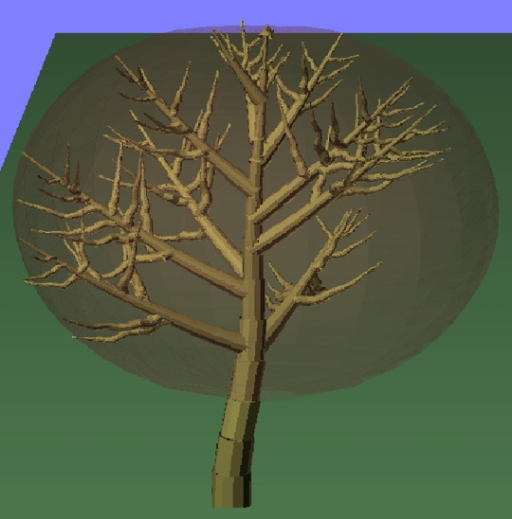
Secondary start offset
 | Fractional offset [0-1]
Left Tree | 0.8
Right Tree | 0.3

Slide 37
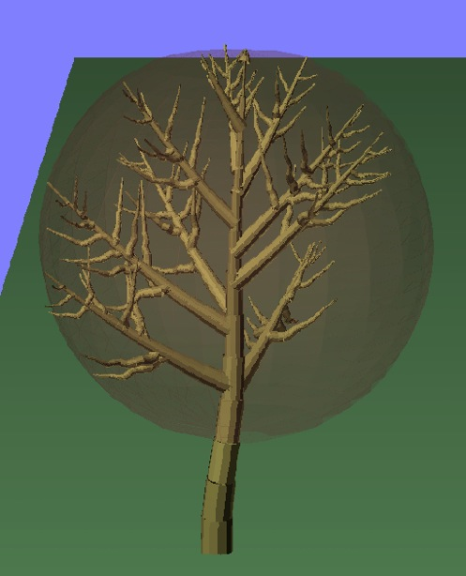
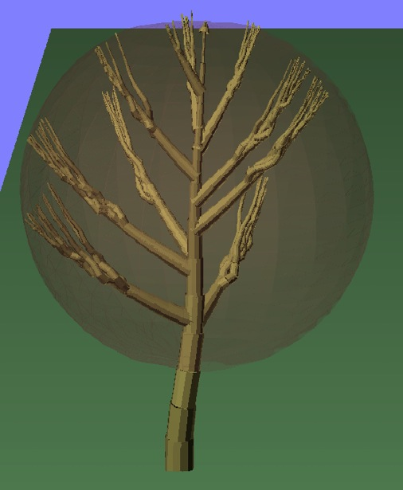
Secondary polar angles
 | Mean | Std dev.
Left Tree | 45 | 20.0
Right Tree | 7 | 0.65

Slide 38
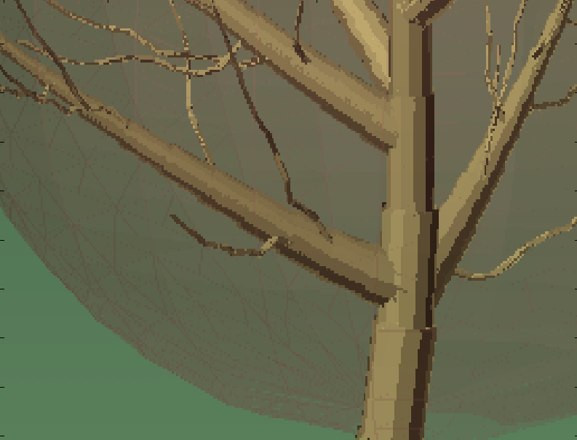
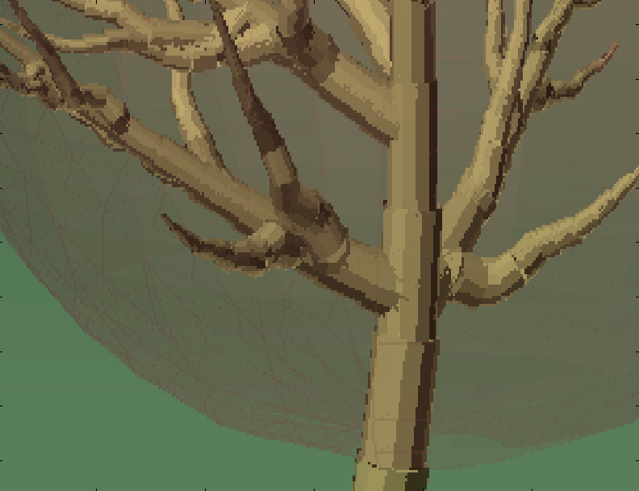
Secondary start radius factor
 | Radius Factor [0-1]
Left Tree | 0.1
Right Tree | 1.0

Slide 39
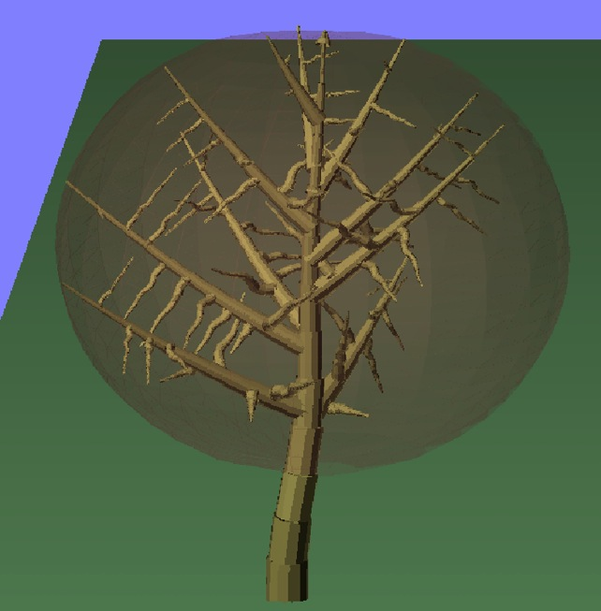
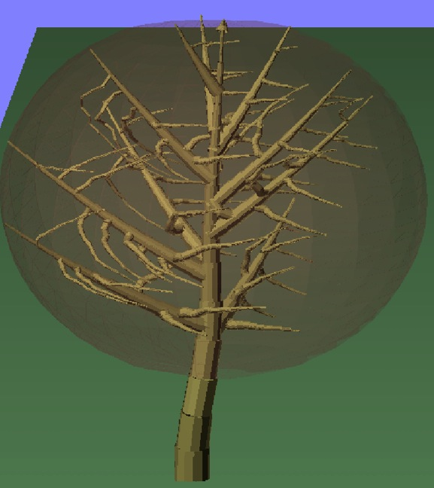
Secondary branch tropism
 | Tropism theta | Tropism phi | Tropism factor
Left Tree | 0 | 0 | 0.0
Right Tree | 90 | 0 | 0.9

Slide 40
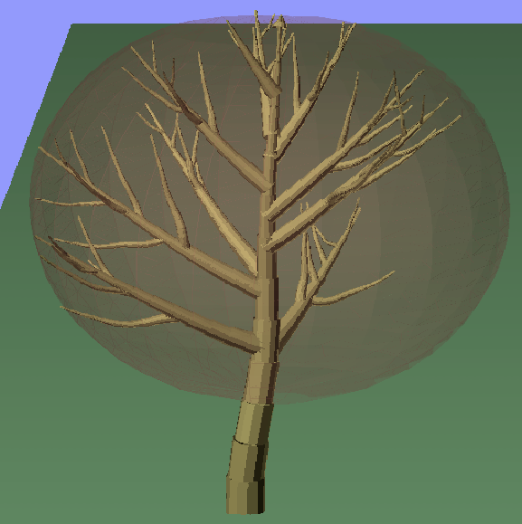
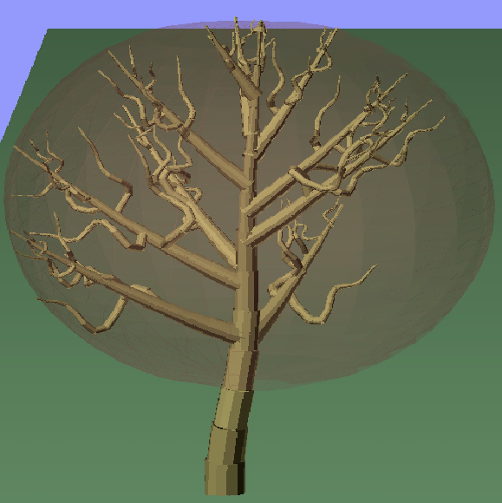
Secondary branch curvature
 | Gamma
Left Tree | 0.075
Right Tree | 0.75

Slide 41
Tertiary branch Realizations
Rewrote Realise_Tertiaries() so that it realizes tertiary branches without switches on species. Previous version of Realise_Tertiaries() was commented out.
Functions, Tertiary_Branch_Volume_Fraction() and Tertiary_Branch_Moisture() were changed to allow reading of their respective fields from the species database.
Changed Estimate_SAR_Tertiaries() to use the correct tertiary branch parameters.
Added these fields to the XML database file and added their reading to the SpeciesDatabase and CategoryDataBase structures, to make the primary description generic
tertiary_min_radius; /* minimum radius of tertiary branches */
tertiary_min_length; /* minimum length of tertiary branches */
tertiary_volume_fraction; /* fraction of the crown volume occupied by tertiary branches */
tertiary_number_factor; /* scale factor to determine maximum tertiary number */
tertiary_moisture; /* fractional moisture in tertiary branches */

Slide 42
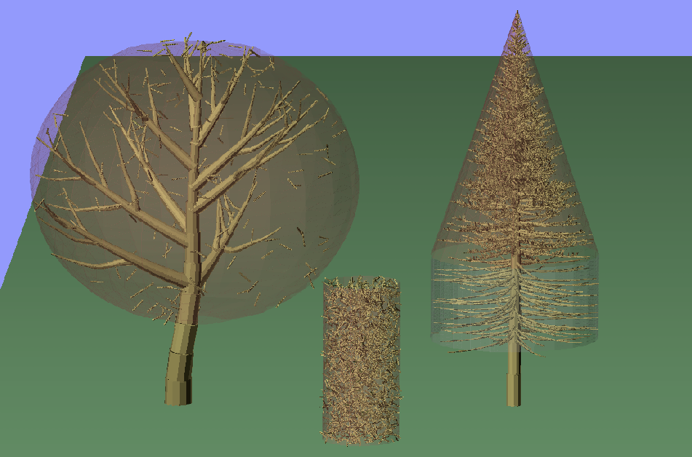
Tertiary branch controls
Size (radius, length) are calculated based on primary and secondary branch dimensions. Although minimum dimensions can now be specified.
Tertiary volume fraction, canopy size, branch volume, and Maximum Number of realizations (for Monte Carlo purposes) decide the actual number of branches.

Slide 43
Foliage Realizations
Rewrote Realise_Foliage() so that it realizes leaves without switches on species. Previous version of Realise_Foliage() was commented out.
Functions, Foliage_Volume_Fraction() and Foliage_Moisture() were changed to allow reading of their respective fields from the species database.
Added function Leaf_Size() instead of having Leaf_Dimension_1/2/3() that reads in correct parameters with randomized leaf sizes
Changed Estimate_SAR_Foliage() to use the correct tertiary branch parameters.
Added these fields to the XML database file and added their reading to the SpeciesDatabase and CategoryDataBase structures, to make the primary description generic
leaf_shape; /* leaf shape code, either needle or broadleaf */
leaf_width_mean; /* mean leaf width */
leaf_width_stdev; /* standard deviation of leaf width */
leaf_height_mean; /* mean leaf height */
leaf_height_stdev; /* standard deviation of leaf height */
leaf_thickness_mean; /* mean leaf thickness */
leaf_thickness_stdev; /* standard deviation of leaf thickness */
leaf_volume_fraction; /* fraction of the crown volume occupied by leaves */
leaf_number_factor; /* scale factor to determine maximum number of leaves */
leaf_moisture; /* fractional moisture in leaves */

Slide 44
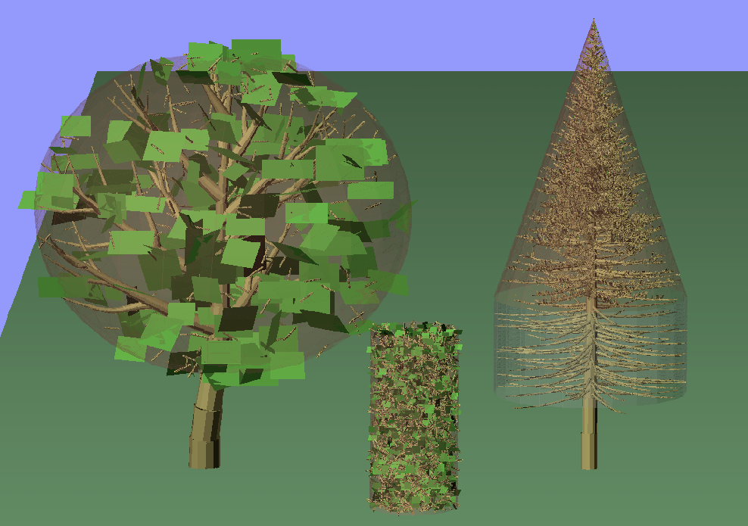
Foliage controls
Can now specify mean/stdev of leaf dimensions

Slide 45
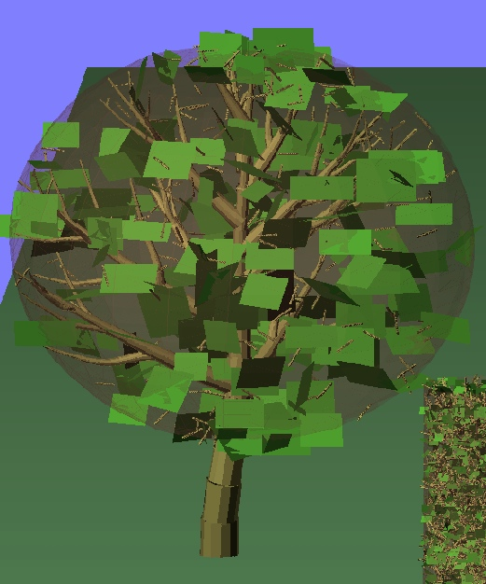
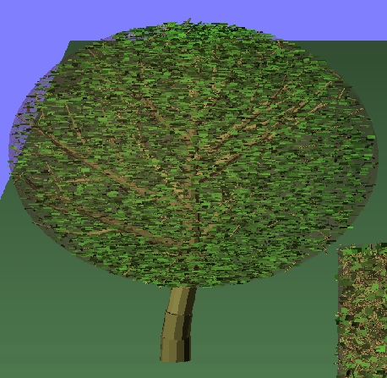
Foliage controls
Leaf volume fraction, canopy size, leaf volume, and Maximum Number of realizations (for Monte Carlo purposes) decide the actual number of leaves.

Slide 46
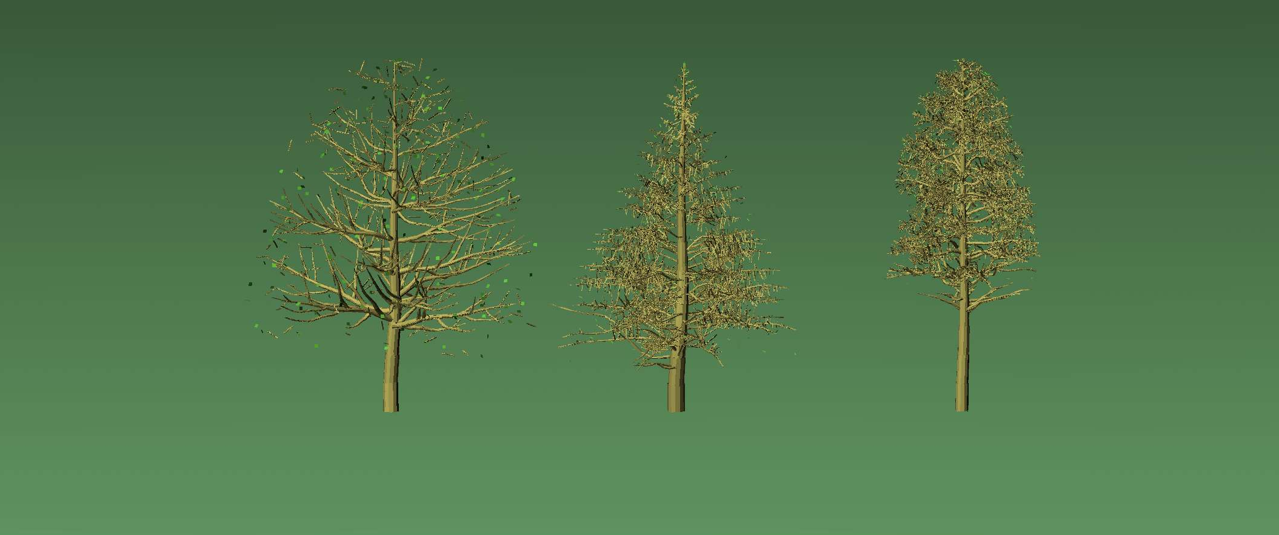
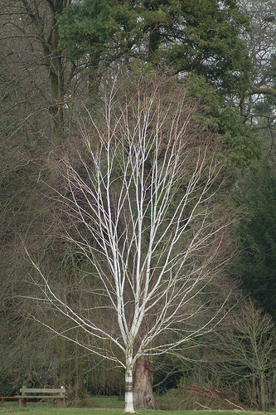
Birch
Hemlock
Pine

Slide 47
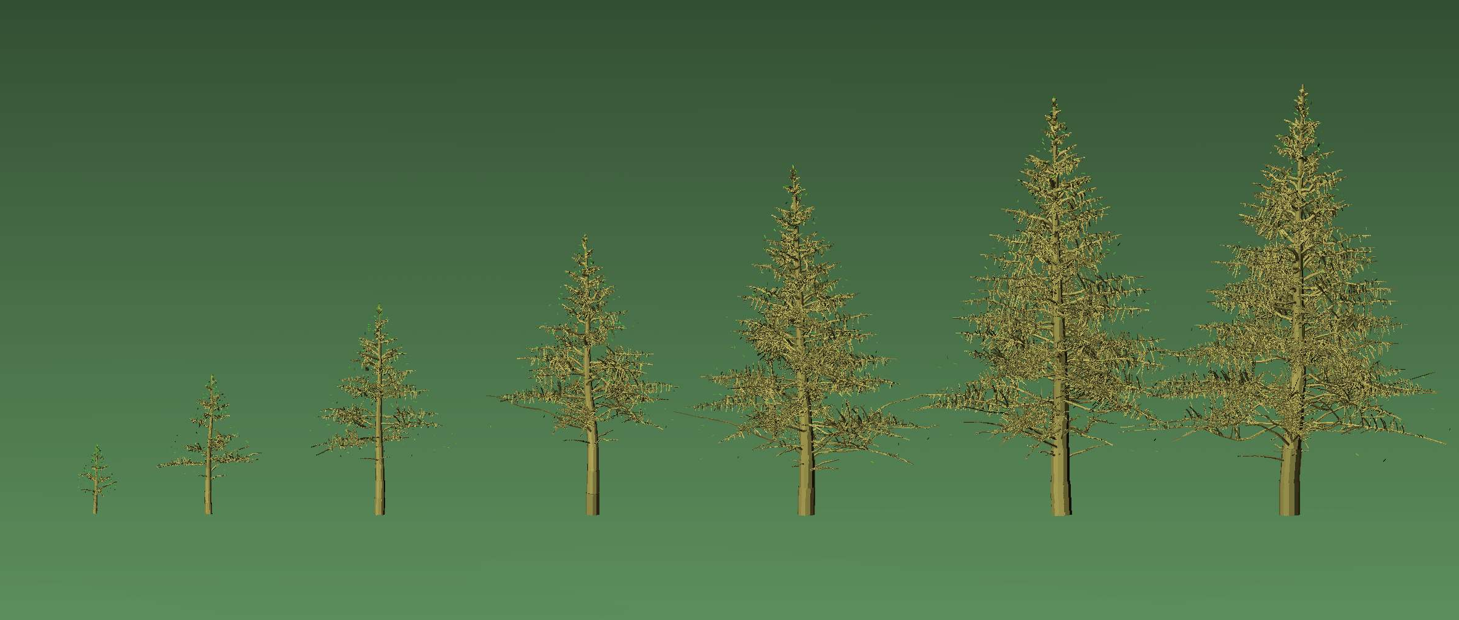
Eastern Hemlock
5m
10m
15m
20m
25m
30m
35m

Slide 48
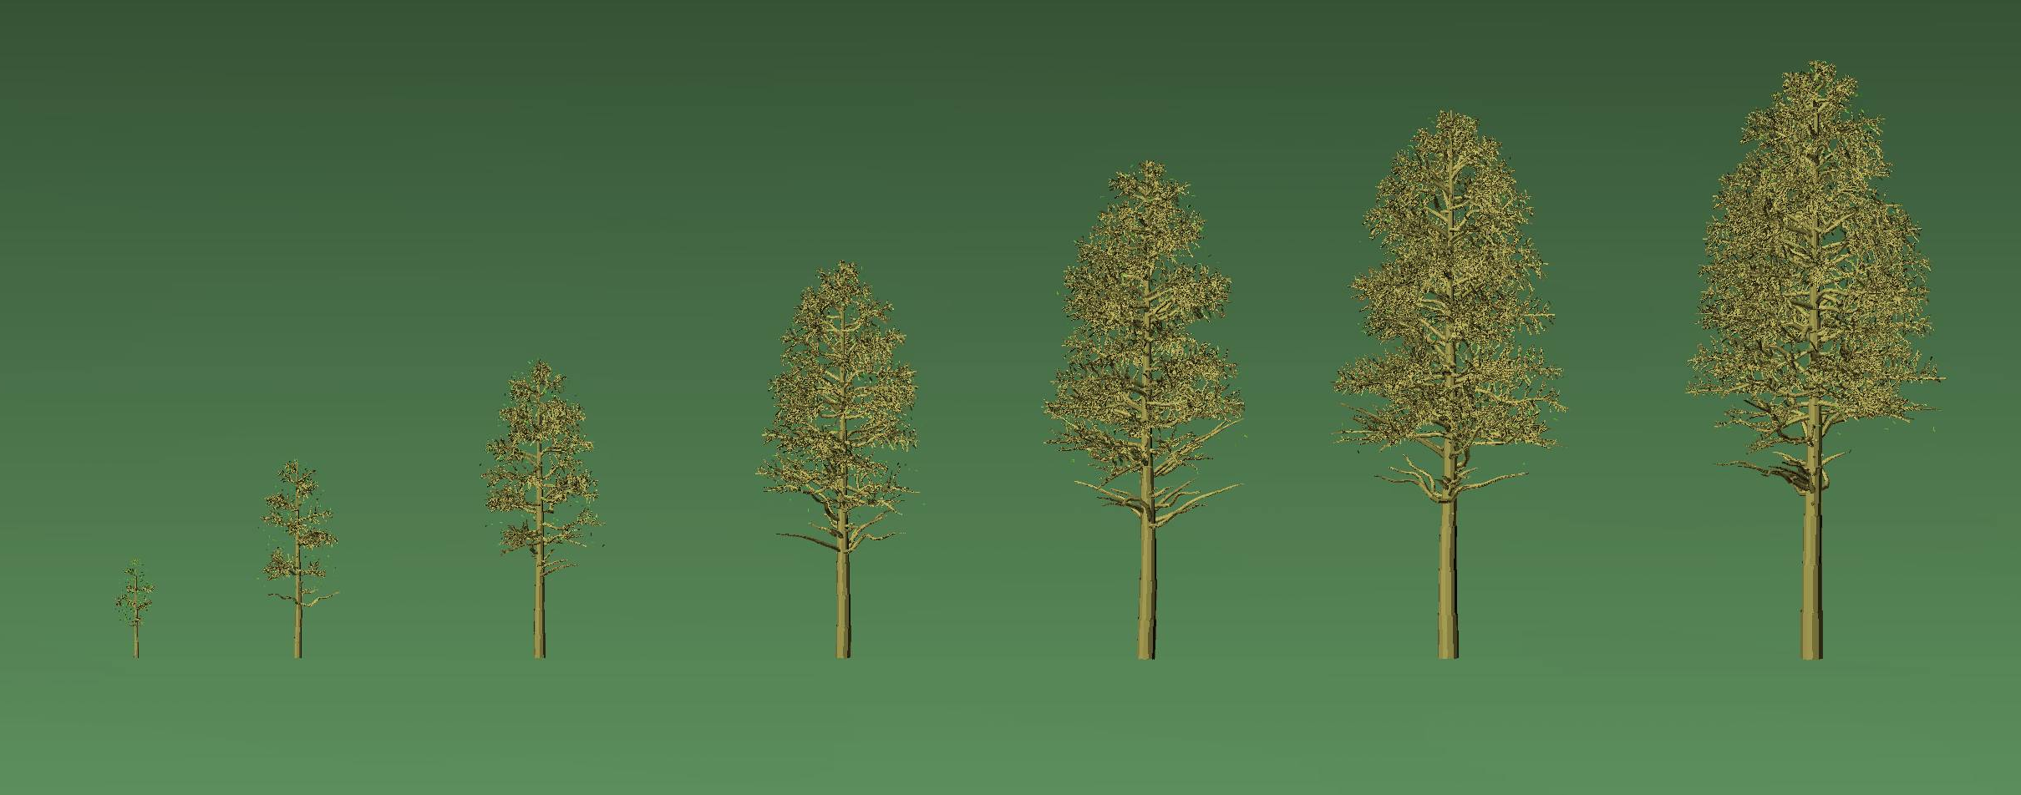
Red Pine
5m
10m
15m
20m
25m
30m
35m

Slide 49
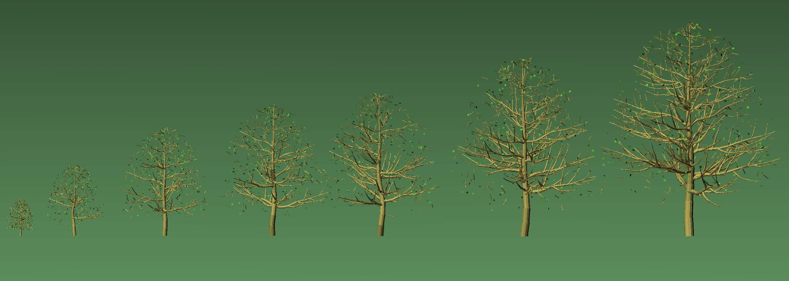
Paper Birch
5m
10m
15m
20m
25m
30m
35m

Slide 50
Effective Permittivities
Originally, the function Effective_Permittivity() computed the effective wave vectors by averaging the polarizabilities of stems, branches and leaves of the first five trees. Because all trees belonged to the same species, this was ok.
Changed Effective_Permittivity() to loop over the first N trees of each species and compute species specific effective wave vectors.
To do that, pPR->koz_(living/dry), pPR->kez_(living/dry) were defined as complex arrays of length M (for M species). The loop over trees was nested inside a loop over species.
The computation of effective permittivity of leaves and tertiary branches was changed to use already realized tertiaries and leaves instead of re-realizing them as was the case.
  I’m not perfectly confident that I did that part right. The polarizabilities of stems and branches are summed up and normalized by total crown volume (of all N trees). In case of tertiaries and leaves, this is different because only a small sample of leaves and tertiaries are actually realized. The polarizabilities are therefore averaged over a fraction of the crown volume. I’m not perfectly confident what the normalization in this case ought to be.
    Alternately I can just use the same code as original and re-realize the leaves and tertiaries for each species. I haven’t done that yet.

Slide 51
Attenuation Map
Originally, Attenuation_Map() computed the 3-D attenuation lookup table by computing path lengths of rays through canopies
  For Bounce attenuation map the rays originate at the voxel of the 3-D map and point to the radar opposite the radar line of sight.
  For Direct attenuation map the rays originate at the voxel of the 3D map and point to the ground along the radar line of sight.
There was no attenuation through stems (i.e. stems appeared transparent).
Added code that accounts for stems in the attenuation map by treating them as perfectly opaque cylinders.
However, that takes way too long, so this piece of code is only activated if the variable ENABLE_ATTENUATION_FROM_STEMS is defined.

Slide 52
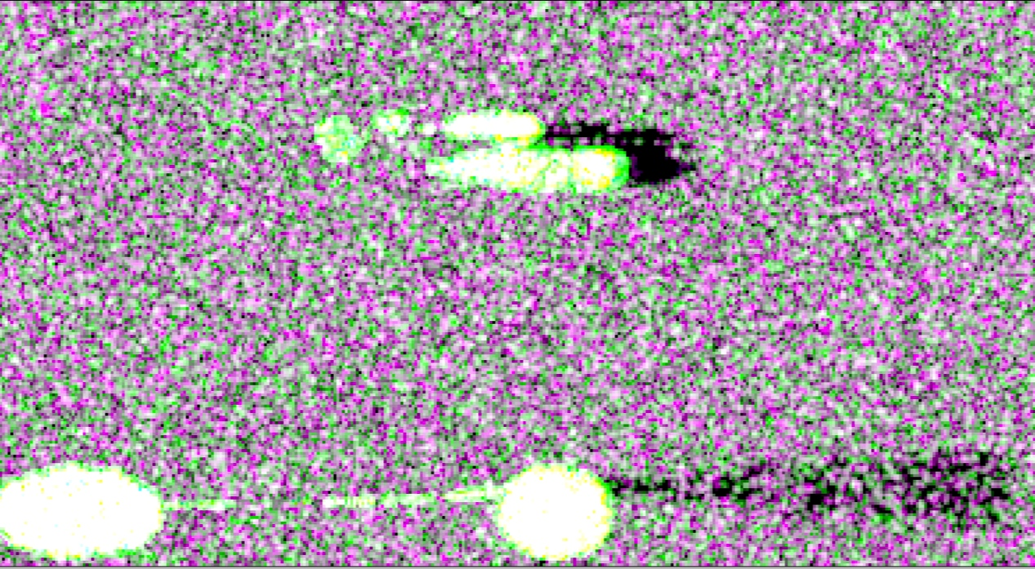
Attenuation from stems
before
after
80m tree

Slide 53
Multithreaded code
Wrote threaded versions of each module to allow faster computation
  Effective_Permittivities_SMP()
    Added function Compute_Alpha() to run as a separate thread for each tree
  Attenuation_MAP_SMP()
    Added functions Compute_Bounce/Direct_Gamma() to run as a separate thread for each vertical bin
  PolSARproSIM_Direct_Ground_SMP()
    Added function Direct_Ground_Rangeline() to run as a separate thread for each range line
  PolSARproSIM_ShortVegetation_Direct/Bounce_SMP()
    Added functions Image_ShortVeg_Direct/Bounce_Stem/Leaves() to run as separate threads for each range line
  PolSARproSIM_Forest_SMP()
    Combines Direct and Bounce scattering codes at the Image_Cylinder() level.
    Added function Image_Tree_SMP() to run as a separate thread for each tree.
This code can be activated by either
  Uncommenting line #define ENABLE_THREADS in PolSARproSIM_definitions.h
  Or including -DENABLE_THREADS are an argument for the gcc command (see Makefile)

Slide 54
Stack Processing
Original code overwrites the repeat track by overwriting the slave files
Changed the naming convention of files and locations. The new files are stored in the directory specified as input,
  $argv[1]/$(sceneid)_track($nnn)_$(Pol).bin
  With $nnn = 000 for master track and so on
  Running for multiple baselines seemed to work
Changed the code so that the memory is allocated for each polarization image and track rather than the same memory location overwritten for every track. This allows for moving the loop over tracks inside each module.

Slide 55
Changing Loop Order
Trees
Realise Tree
Branch
Tracks
Tracks
Ground/Short vegetation Imaging
sections
Tree
Tracks
Make cylinder from section
Realise Tree
Ground/Short vegetation Imaging
Image cylinder
Image Tree
Last Track
Last Section
Last Tree
(a)
Move To Trees
Last Track
Write Images
Last Branch
Last Track
Move to Other type of Branch or leaf
Exit
Last Tree
(b)
Exit

Slide 56
Temporal decorrelation
Change model must include
  Physical movement of scatterers
    Volume based: motion linked to height of volume
    Vegetation based: motion is tied to canopy dimension and tree species, damped by branch radius
  Dielectric change of scatterers
    Calculated by moisture change
  Orientation of leaves
  Removal of objects
    Turn on and off based on size and track

Slide 57
Adding module for temporal decorrelation model and implementation
Branch
Branch
Tracks
Tracks
Model Change
sections
sections
Make cylinder from section
Make cylinder from section
Image cylinder
Model Change again or simply Apply Change to cylinder
Last Section
Image cylinder
Last Section
Last Track
Last Track
Last Branch
Last Branch
Move to Other type of Branch or leaf
Move to Other type of Branch or leaf

Slide 58


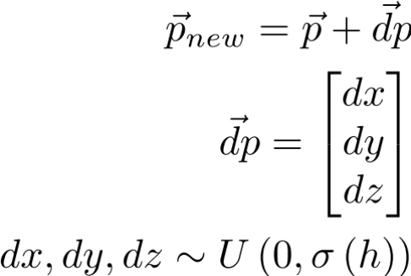
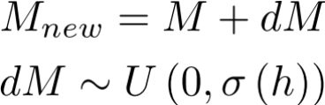
Modeling change
Moisture and Motion profiles currently include:
  No change
  Polynomial change profile:
  Exponential change profile:
  With a set of coefficients (A, B and C) each for motion and moisture that can be specified for every track separately in the input file
Option to compute the statistics of applied change is included

Slide 59
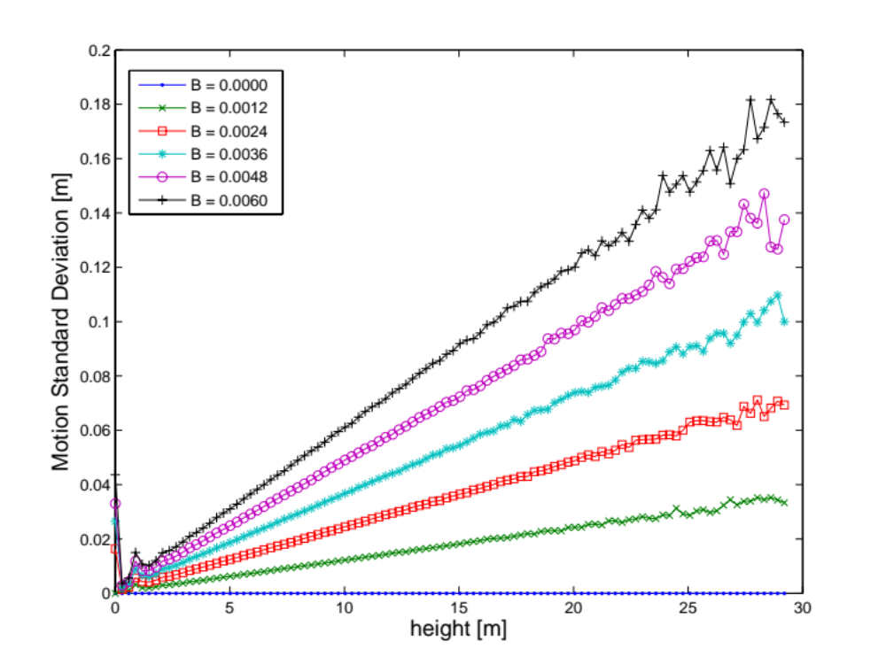
Estimated statistics of applied motion – for all trees

Slide 60
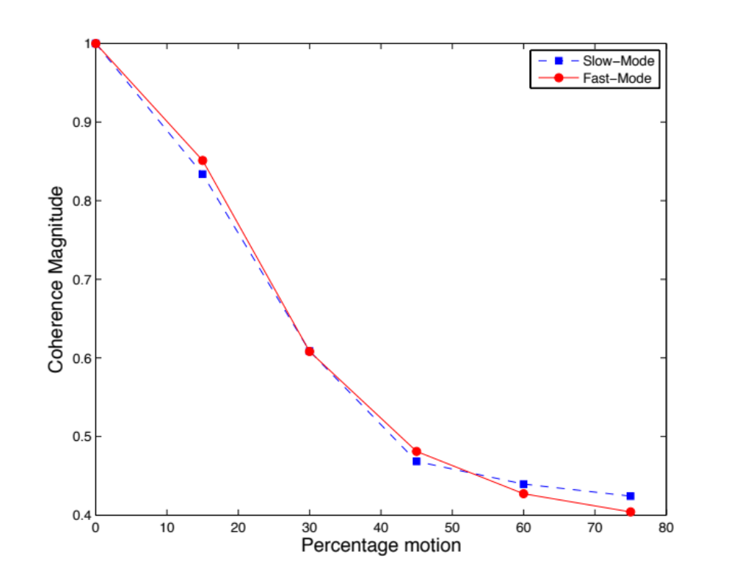

Simulated Temporal Decorrelation (HH)

Slide 61
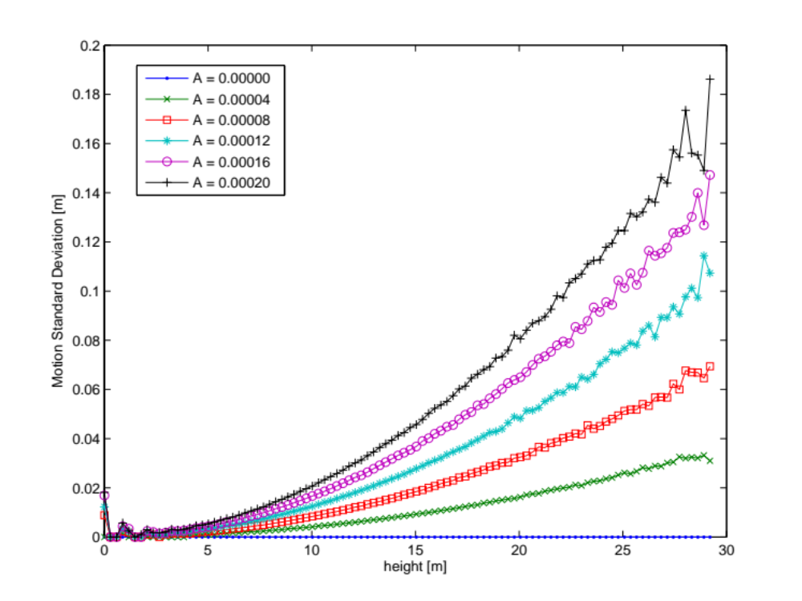
Estimated statistics of applied motion – for all trees

Slide 62
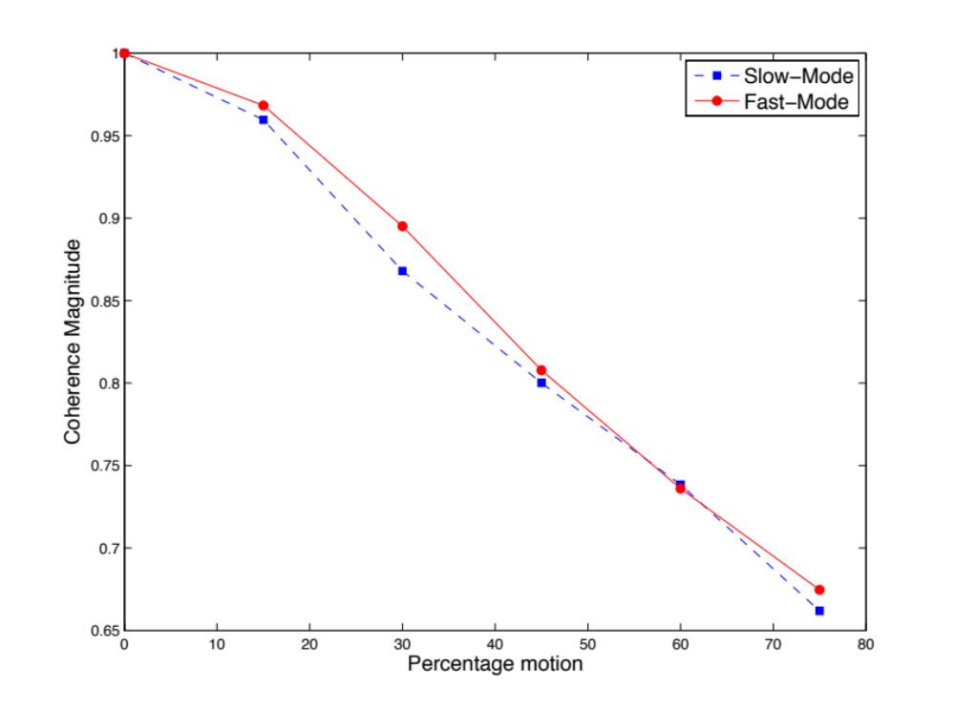

Simulated Temporal Decorrelation (HH)

Slide 63


etc

Slide 64



Point Spread Function
Originally, the point spread function was modeled as Gaussian,
where the backscattered value was given by
This was replaced by
Where the backscattered value is now given by

Slide 65

PSF Implementation
Since the images are in ground range, instead of slant range, the PSF had to be distorted, such that
The point spread function was implemented by generating lookup tables of the integrated PSF functions in azimuth and ground range. The dimensions of the Lookup tables were
  Azimuth: where Nx is the extent of the point spread function in azimuth pixels (e.g. three or four pixels on either side of the scatterer), and is the oversampling resolution of the point spread function in azimuth
  Ground Range: where Ng is the extent of the point spread function in ground range pixels, is the oversampling resolution of the PSF in ground range, while is extent of (non local)incidence angles, and is the pre-defined angular resolution, set at 1 degree.

Slide 66

Spectra for different weighting functions

Slide 67


Qualitative change in images
Gaussian
Sinc, eta = 1.0

Slide 68

Spectra for different sampling frequencies
Sampling ratios (for azimuth and range) added as inputs. It is defined as the ratio between the pixel dimension and the resolution.

Slide 69

Azimuth spectra for different sampling ratios

Slide 70

Range Spectra for different baselines

Slide 71


Estimated ground-only coherence

Slide 72

Coherence for ground-only scattering with Prati-Filtering

Slide 73


Testing Orientation Angle shift for different azimuth slopes
Ran 10 simulations, with ground only scattering.
The azimuth slope in each simulation was different, between 0 and 0.9.
Estimated the orientation angle shift and ellipticity of co-polarization signature maxima using Schuler’s algorithm [Schuler et al. TGRS 1996], for a set (approx. 100) of 4x4 pixel windows.
Slope was estimated by assuming perfect surface polarization signature has a max at an orientation of 90degrees, and is related to surface slopes (tan w) using (Lee et al. TGRS 2000)
PolSARproSim seems to simulate polarimetric scattering from titled surfaces well.

Slide 74

Corner Reflector Scattering
Added module Image_Corner_Reflectors_Direct().
It populates the gap region closest to the radar with an along-azimuth array of corner reflectors.

Slide 75
Adding a DEM
Read in External DEM
Error checking
Resize/Resample to SIM coordinates
Add bump map, set slopes to zero
Create Shadow Map for direct scattering
Modify Attenuation Map to include attenuation because of large slopes

Slide 76






Example (Direct scattering only)
HH backscatter
0.17m wrap
0m wrap
No DEM
HH backscatter
40m wrap
20m wrap
With DEM
Backscatter
DEM
Shadow Map

Slide 77

Adding thermal noise
Add a random number to each pixel of every stack, such that

Slide 78





Backscatter Intensity
-25dB NESZ
-30dB NESZ
-35dB NESZ
-40dB NESZ
-45dB NESZ

Slide 79





Coherence
-25dB NESZ
-30dB NESZ
-35dB NESZ
-40dB NESZ
-45dB NESZ

Slide 80



Coherence

Slide 81
Backups
etc

Slide 82

Contributions to backscatter by different sections of the forest
Double bounce only – all sections

Slide 83

Contributions to backscatter by different sections of the forest
Single bounce – stems only

Slide 84

Contributions to backscatter by different sections of the forest
Single bounce – primaries only

Slide 85

Contributions to backscatter by different sections of the forest
Single bounce – secondaries only

Slide 86


Contributions to backscatter by different sections of the forest
Single bounce – tertiaries only
Single bounce tertiaries only
ForestInput_Flag is unset

Slide 87

Contributions to backscatter by different sections of the forest
Single bounce – foliage only

Slide 88
Simulated forest scatterer count

Slide 89



Varied the statistical mixture of coniferous and deciduous trees from 100% pine at one extreme to 100% red maple on the other.
~500 trees with varying heights and canopy properties
Simulated for eight tracks with different baselines

Slide 90









100% pine
20% pine

Slide 91




Metrics to Analyze PolInSAR line-fit
Maximum of the line-fit residuals
Isoparametric Ratio
Dual-pol eccentricity
Psuedo-ellipticity
Coherence/phase SDEV relationship
Outward tendency

Slide 92






Baseline
Mixture percentage

Slide 93


Slide 94


Slide 95


Slide 96


Slide 97


Slide 98


Slide 99


Slide 100


